Slide 1
Bluetooth 5.1 direction finding
陆雨萌

Slide 2
Contents
Background
Bluetooth 5.1 direction finding
Related work
Our implementation
Future work
Notes:
课程说明应简短。

Slide 3


Background: location-based service
Proximity solutions
Museum
Shopping mall
Item finding
Positioning systems
Asset tracking
Navigation
Notes:
示例目标
本课程结束时，学到的内容：
将文件保存到团队 Web 服务器。
将文件移动到团队 Web 服务器上的其他位置。
在团队 Web 服务器上共享文件。

Slide 4
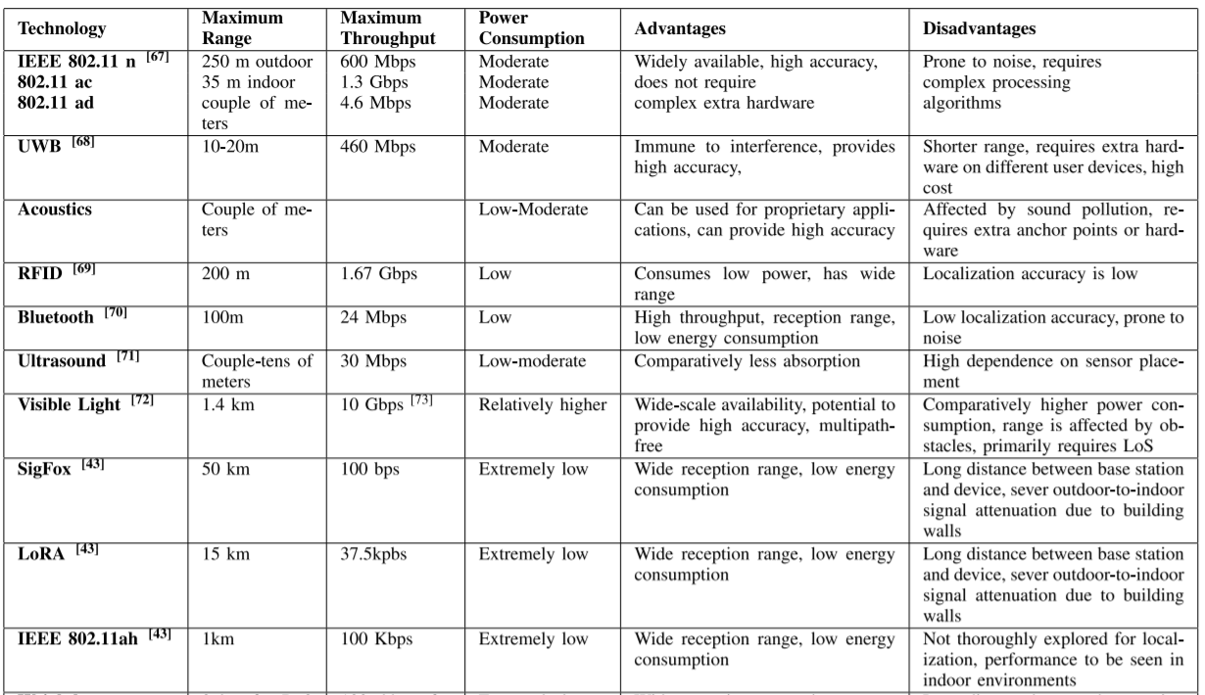
Background: different wireless technology
Low energy consumption
High accessibility
Notes:
示例目标
本课程结束时，学到的内容：
将文件保存到团队 Web 服务器。
将文件移动到团队 Web 服务器上的其他位置。
在团队 Web 服务器上共享文件。

Slide 5
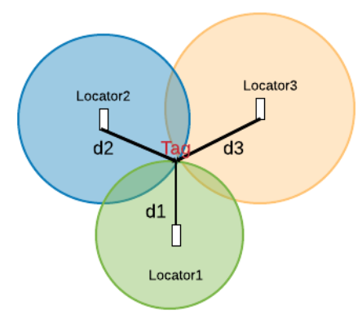
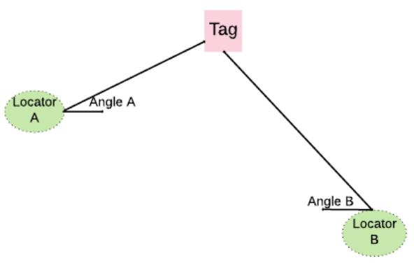
Background: current beacon technology
Distance based
Direction based
RSSI
Trilateration
AoA/AoD
Triangulation
RSSI variations
Low accuracy

Slide 6
Background: the need for direction finding
High-accuracy indoor positioning
more dependable and user-friendly indoor navigation systems
more precisely targeted proximity solutions
High-accuracy asset tracking
monitor the progress of product components as they pass through the various stages of a manufacturing process
Continuous direction finding
guide the user directly towards the lost item, with no experimentation required.
Directional discovery
find an object in a given direction with a particular capability

Slide 7
Bluetooth 5.1 direction finding
Bluetooth Core Specification v5.1 introduces new capabilities that support high-accuracy direction finding.
The controller specification has been enhanced so that specialized hardware that incorporates an antenna array can be used to support the calculation of the direction of a received radio signal.
The Host Controller Interface (HCI) has also been modified so that data acquired by the controller can be made available to higher layers of the stack where direction calculations can take place.

Slide 8
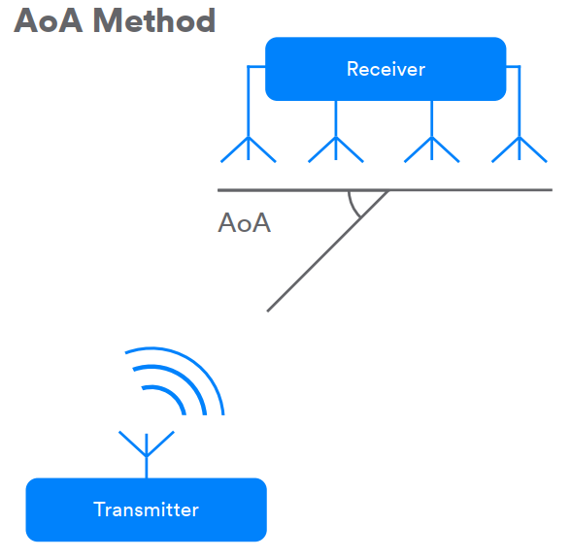
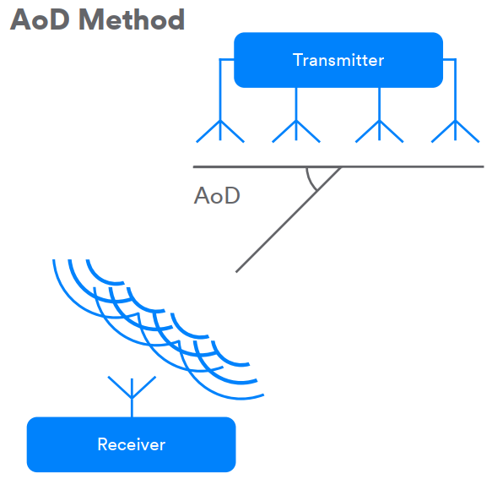
Bluetooth 5.1 direction finding
Two Direction Finding Methods

Slide 9
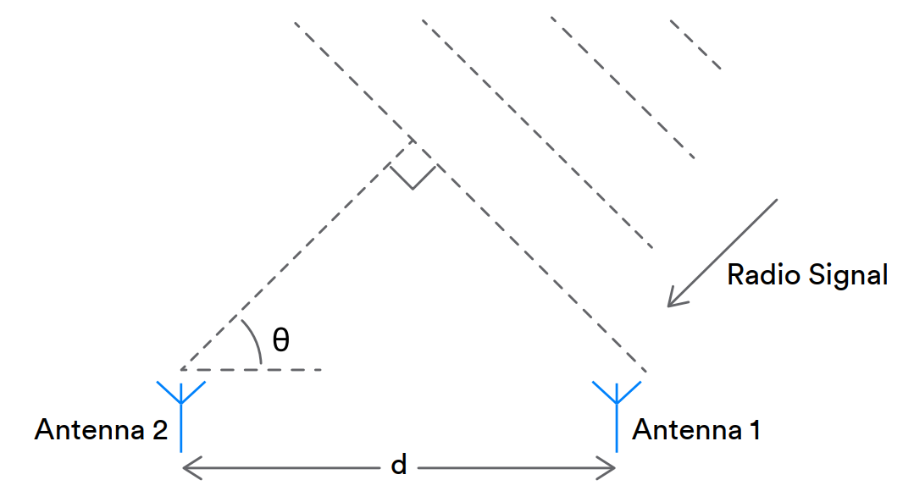
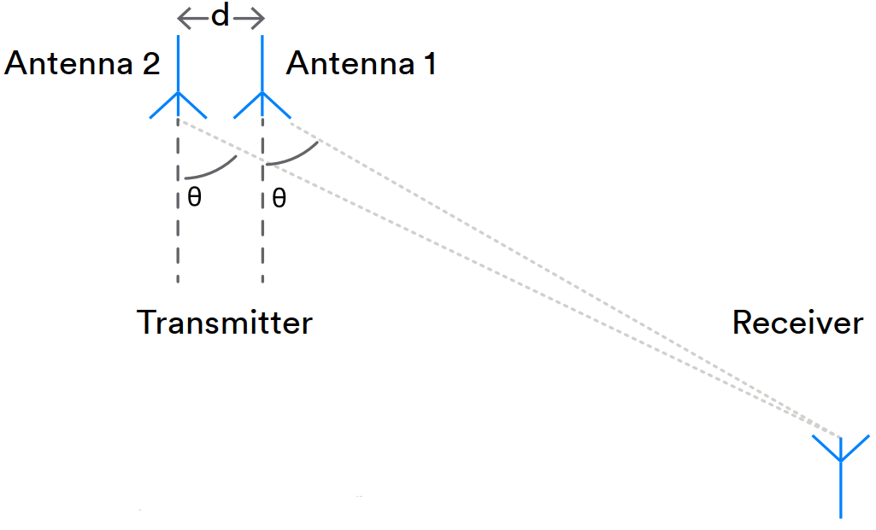


Bluetooth 5.1 direction finding theory
AoA
AoD

Slide 10
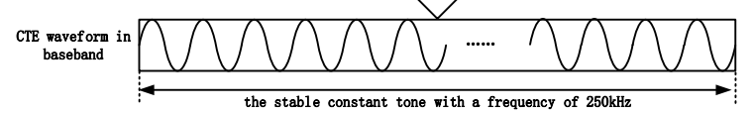
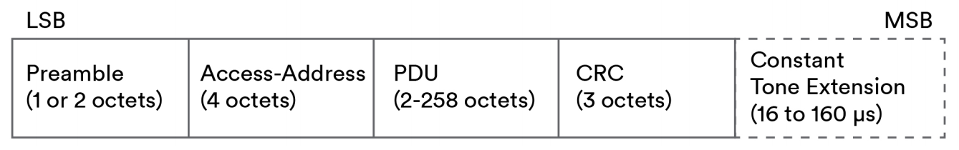
How Bluetooth direction finding works?
Bluetooth Direction Finding Signals
Direction finding signals provide a source of constant signal material that IQ sampling can be applied to.
PDUs have additional data known as the Constant Tone Extension (CTE) added to their end.
The CTE consists solely of a series of symbols, each of which represents binary 1. The number of symbols contained within the CTE may be configured by higher layers of the stack so that a suitable amount of data and time is available for IQ sampling to be performed by the receiver, whose sampling capabilities may vary.

Slide 11
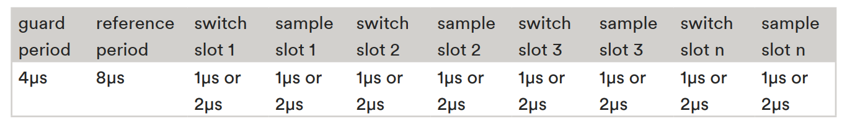
How Bluetooth direction finding works?
Timing
the time for CTE processing is divided into an initial 4µs guard period, an 8µs reference period, and then a sequence of either switch slots, sample slots, or pairs of switch and sample slots.
Sampling takes place during sampling slots and antenna switching during switch slots.

Slide 12
Using Bluetooth Direction Finding
The standard specifies :
the format of the field inside a packet that should be used to evaluate the phase-delay
the timing for performing antenna switching over this field.
The procedure for inferring the phase delay is not specified in the official documentation. How to evaluate the phase-delay φ is unclear.

Slide 13
Using Bluetooth Direction Finding
Direction Finding Applications and Solutions
Determining beacon location
Determining the point of interest (PoI)
Phone orientation
Determining details of the antenna array
Configuring CTE parameters
Configuring and enabling IQ Sampling
Algorithms and the calculation of angles from IQ sample data

Slide 14
Related work:
A Performance Evaluation Framework for Direction Finding Using BLE AoA/AoD Receivers (JIOT 2020)
Direction Finding Capability in Bluetooth 5.1 Standard (UBICNET 2019)
Dead on Arrival: An Empirical Study of The Bluetooth 5.1 Positioning System (WiNTECH 2019)
Bluetooth Low Energy-based Angle of Arrival Estimation via Switch Antenna Array for Indoor Localization (FUSION 2020)
Evaluation of Bluetooth 5.1 as an Indoor Positioning System
Indoor Positioning Bluetooth Angle of Arrival
Simulation
Empirical experiments

Slide 15
Dead on Arrival: An Empirical Study of The Bluetooth 5.1 Positioning System (WiNTECH'19)
experimentally evaluate the performance of the adopted AoA mechanism from two perspectives:
pure angular measurement accuracy
the ability to correlate two or more angular measurements in order to estimate the position in a 2D plane.
use a software-defined radio (SDR) testbed and deploy the BLE 5.1 positioning technique in its simplest form, i.e., with only two antennas at the receiver.
the first to conduct an experimental study of the BLE 5.1 positioning system and document its performance and vulnerabilities.

Slide 16
Dead on Arrival: An Empirical Study of The Bluetooth 5.1 Positioning System (WiNTECH'19)
BLE 5.1 TESTBED DEPLOYMENT
We implement Software-Defined Radio (SDR) prototypes to replicate the behavior of BLE transceivers.
two USRP Ettus B210 15boards for receiving, and a USRP Ettus N200 for transmitting.
two half-wavelength dipole antennas at a distance of 6 cm from each other; each antenna is connected to a TX/RX port of the USRP B210 using a rigid coaxial cable.

Slide 17
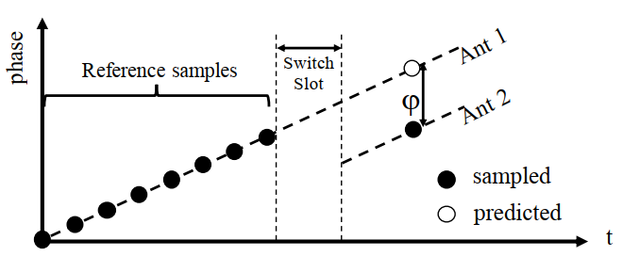
Dead on Arrival: An Empirical Study of The Bluetooth 5.1 Positioning System (WiNTECH'19)
Implementing AoA detection
BLE devices supporting the AoA mechanism have only one receiving radio chain that is connected to the different elements of the antenna array using an RF switch.
The CTE signal appears as a constant frequency tone and as such its phase increases linearly. We compare the phase of the signal on antenna 2 with the instantaneous phase of the signal on antenna 1 that we estimate using the linear model built during the reference period,

Slide 18
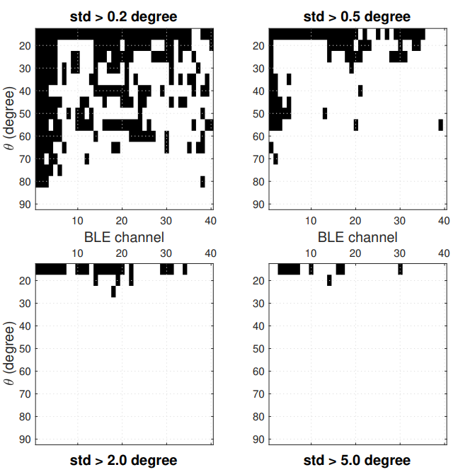
Dead on Arrival: An Empirical Study of The Bluetooth 5.1 Positioning System (WiNTECH'19)
Experimental results – angular accuracy
Angle estimation depends on the channel.
For angles close to zero there is a higher chance the phase-delay wraps around and the estimated angle bounces up to 180°.
The random dependency with the frequency suggests that averaging estimations obtained on different channels would be appropriate, to reject the uncertainty due to multipath.

Slide 19
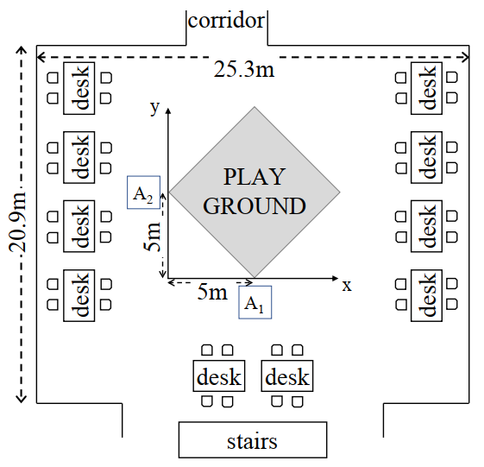
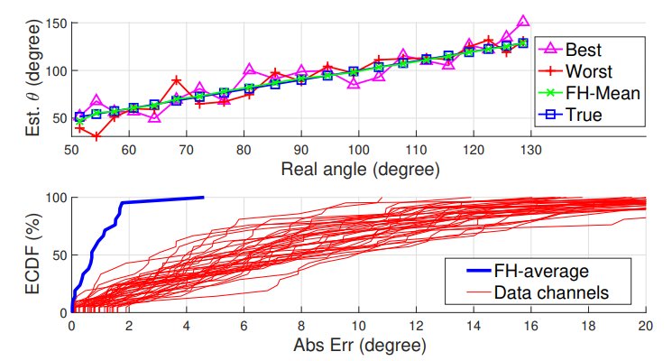
Dead on Arrival: An Empirical Study of The Bluetooth 5.1 Positioning System (WiNTECH'19)
Experimental results – angular accuracy

Slide 20
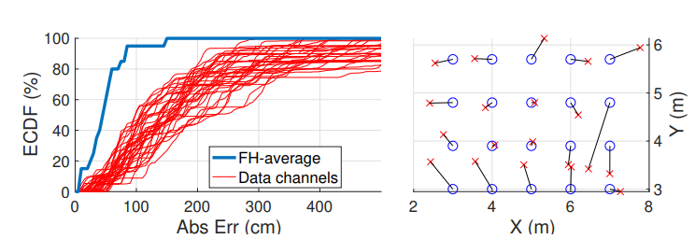
Dead on Arrival: An Empirical Study of The Bluetooth 5.1 Positioning System (WiNTECH'19)
Experimental results – positioning accuracy
the error is below 85 cm for more than 95% of the positions.
However, this is far from meeting the centimeter level accuracy expected by IoT applications, since the absolute positioning error is <10 cm only in 15% of cases.

Slide 21
Bluetooth Low Energy-based Angle of Arrival Estimation via Switch Antenna Array for Indoor Localization (FUSION'20)
put one step forward to yield a higher accuracy in location estimation scheme based on the angle of incident signal received by BLE beacons.
several associated drawbacks
multipath effects
noise
fluctuations of received signal
frequency and phase shifting
…

Slide 22
Bluetooth Low Energy-based Angle of Arrival Estimation via Switch Antenna Array for Indoor Localization (FUSION'20)
Nonlinear Least Square (NLS) curve fitting
applied on raw I/Q samples to eliminate the noise effect
Kalman Filter (KF) Smoothing
the frequency and phase shifting and switching between elements in SAA, the phase difference obtained from different samples are not similar.
Gaussian Filter (GF)
Compensate the impact of different BLE channels on the accurate angle estimation

Slide 23
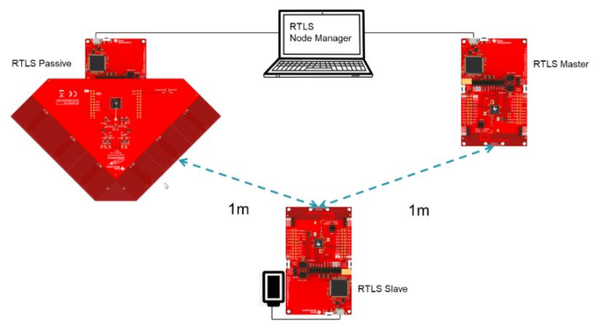
Bluetooth Low Energy-based Angle of Arrival Estimation via Switch Antenna Array for Indoor Localization (FUSION'20)
Implementation
At the beginning of the connection, the RTLS master shares some connection parameters with the computer.
RTLS passive receives packets from the slave device in terms of I/Q samples.
The RTLS slave is a device that we want to find its location.

Slide 24
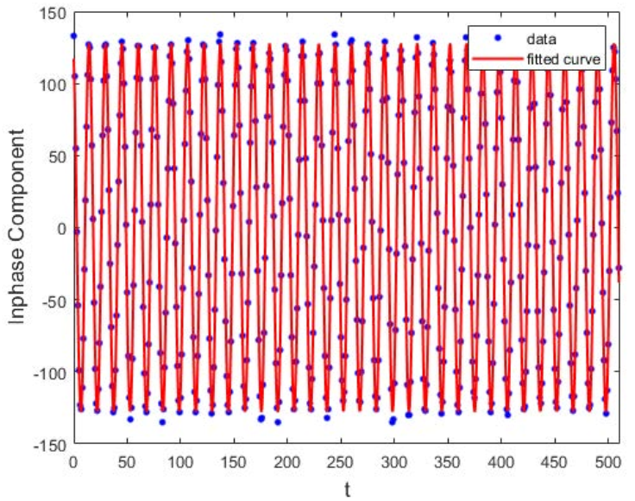
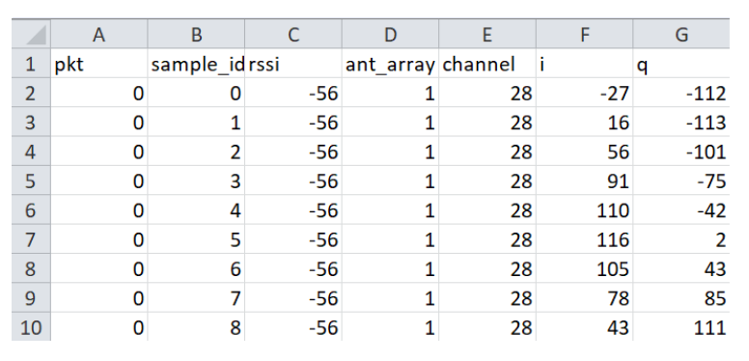
Bluetooth Low Energy-based Angle of Arrival Estimation via Switch Antenna Array for Indoor Localization (FUSION'20)
Results - NLS

Slide 25
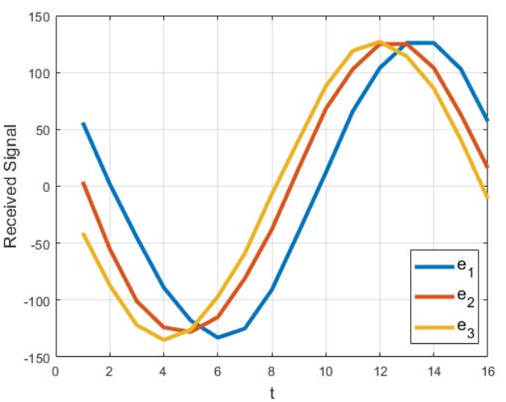
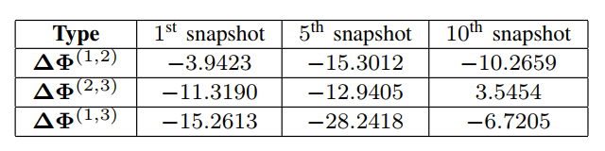
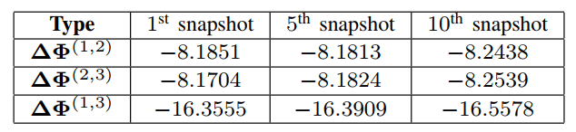
Bluetooth Low Energy-based Angle of Arrival Estimation via Switch Antenna Array for Indoor Localization (FUSION'20)
Results - KF

Slide 26
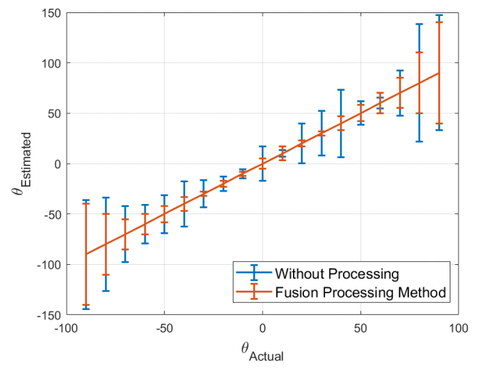
Bluetooth Low Energy-based Angle of Arrival Estimation via Switch Antenna Array for Indoor Localization (FUSION'20)
Results - GF

Slide 27
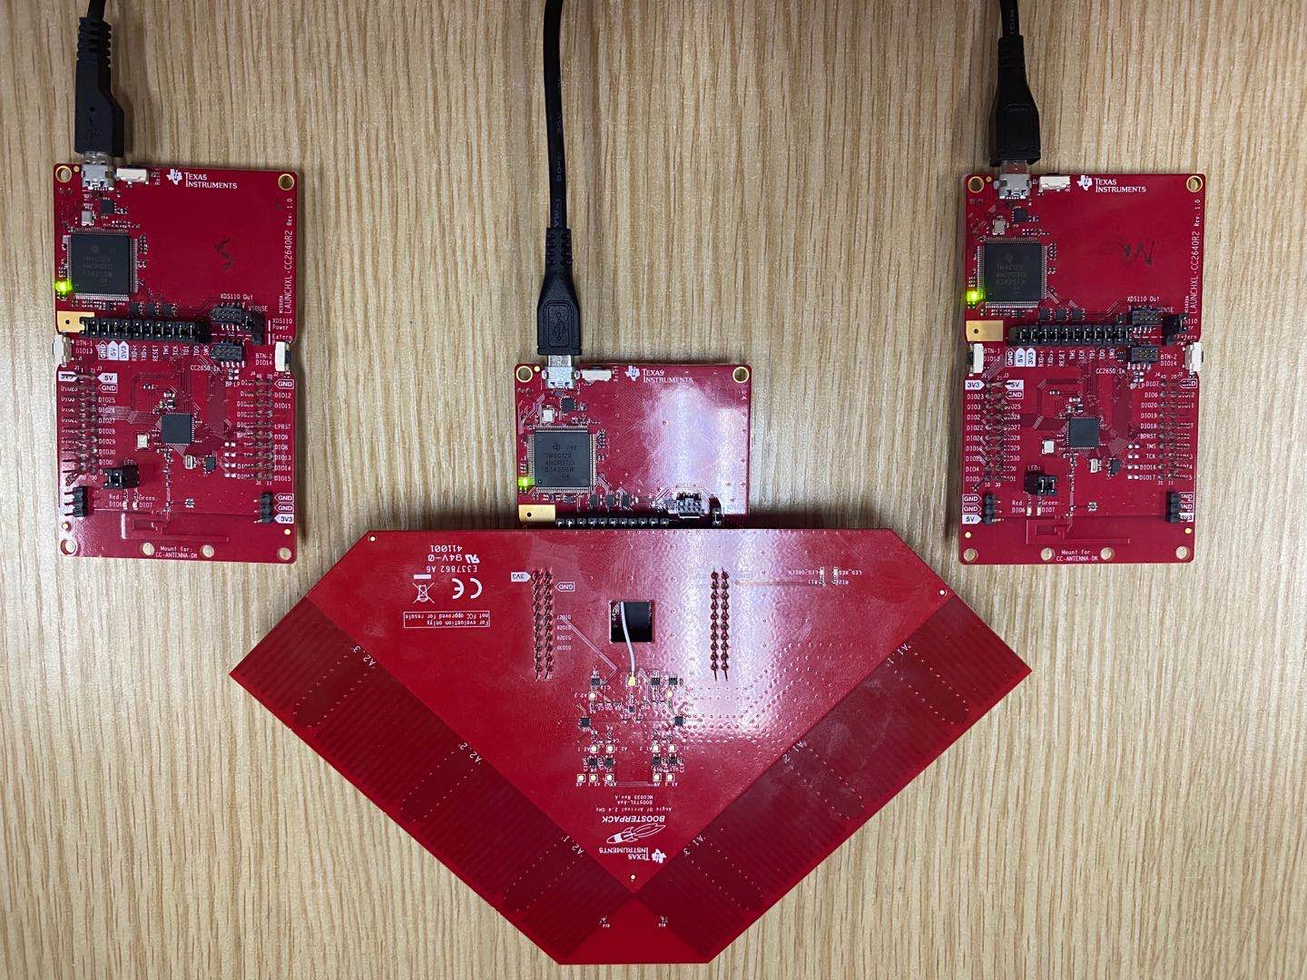
Our implementation:
Hardware
3 * CC2640R2-LAUNCHXL
1 * BOOSTXL-AoA
Task
Angular accuracy
Localization accuracy

Slide 28
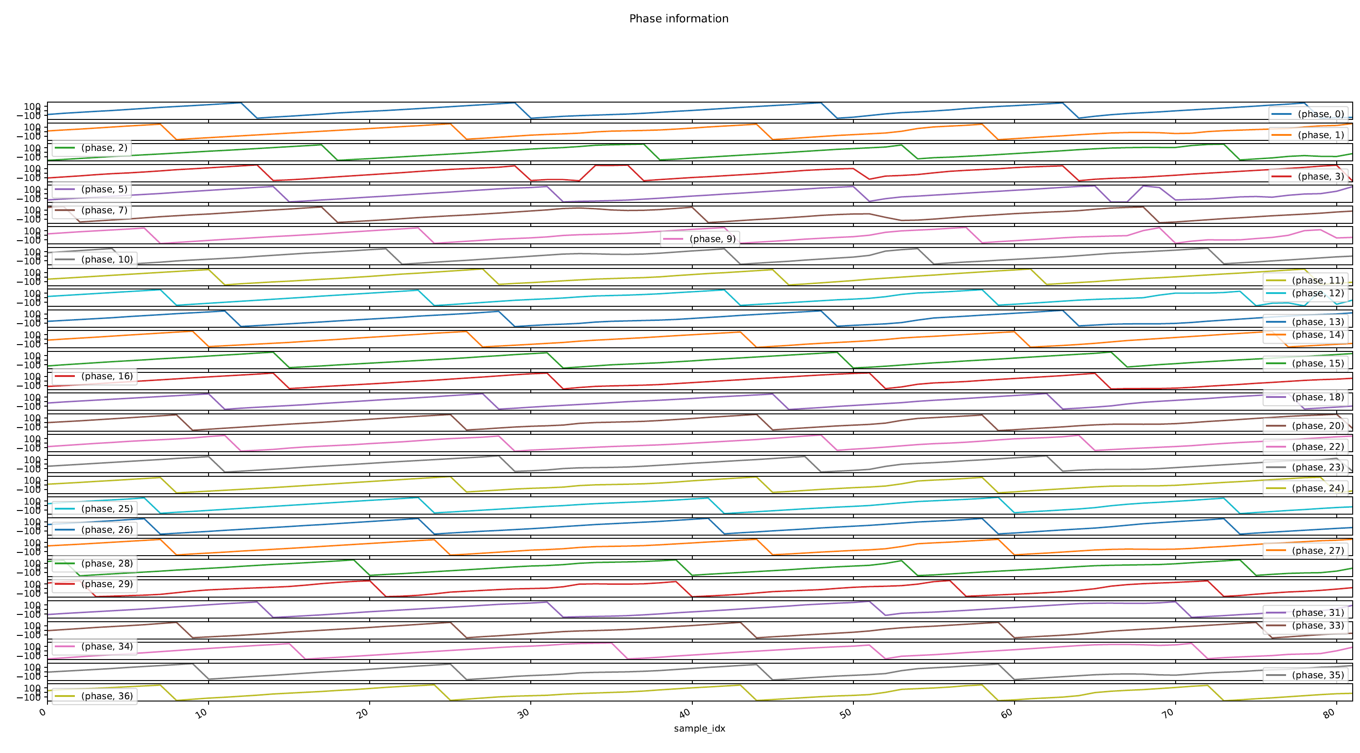
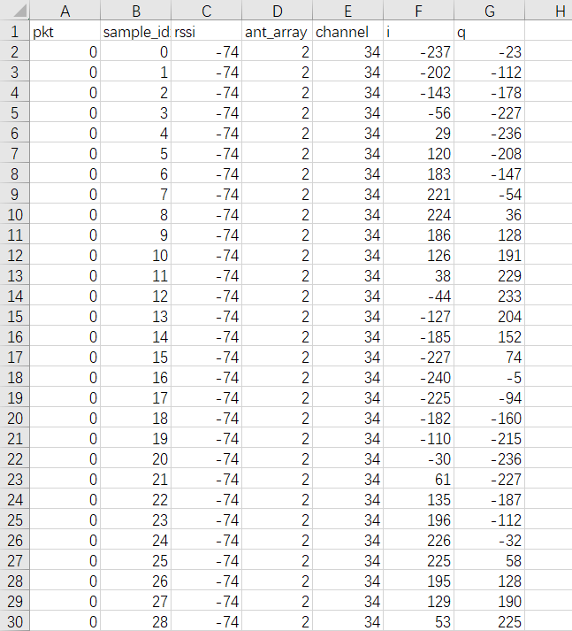
Our implementation:
Results

Slide 29
Conclusion
Opportunity
A competitive advantage
Challenge
non-existence on the part of the supplier of the chips of a development kit that included a solution with a development board, antenna array and firmware
It cannot compete at the level of efficiency in scenarios where the main objective is a precision of the order of centimeters.
Multipath effect
Noise
Frequency and phase shift
Wi-Fi interference
…

Slide 30
Future work
Accurate localization
Improve angular accuracy (multipath effect, noise, frequency and phase shift…)
Signal processing
Data-driven method
Combined with existing approaches
Fingerprint based
Multi-modality data fusion
Wearable sensing
Gesture recognition
Pose estimation

Slide 31
Thanks

