Slide 1
Livox-Mid-40
Initial investigation of a low-cost automotive LiDar system(LowCost 3D’19)
A. Ortiz Arteaga, D. Scott, J. Boehm
University College London
Loam_livox: A fast, robust, high-precision LiDAR odometry and mapping package for LiDARs of small FoV(IROS’19)
Jiarong Lin, Fu Zhang
Hong Kong university
A fast, complete, point cloud based loop closure for LiDAR odometry and mapping(ArXiv’19)
Jiarong Lin, Fu Zhang
Hong Kong university

Slide 2
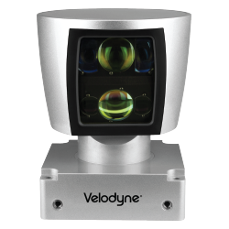
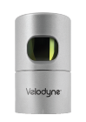
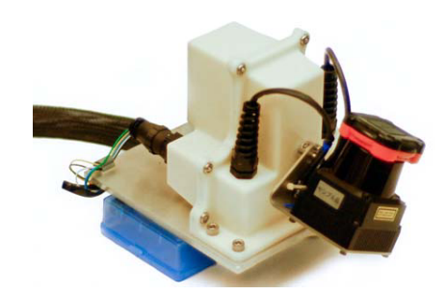
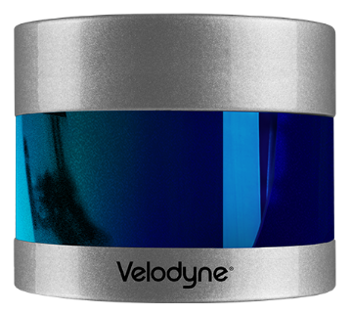
Background
Velodyne
VLP-16：$8000
HDL-32：$20000
HDL-64：$80000
Hokuyo UTM-30LX：$5590

Slide 3
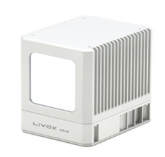
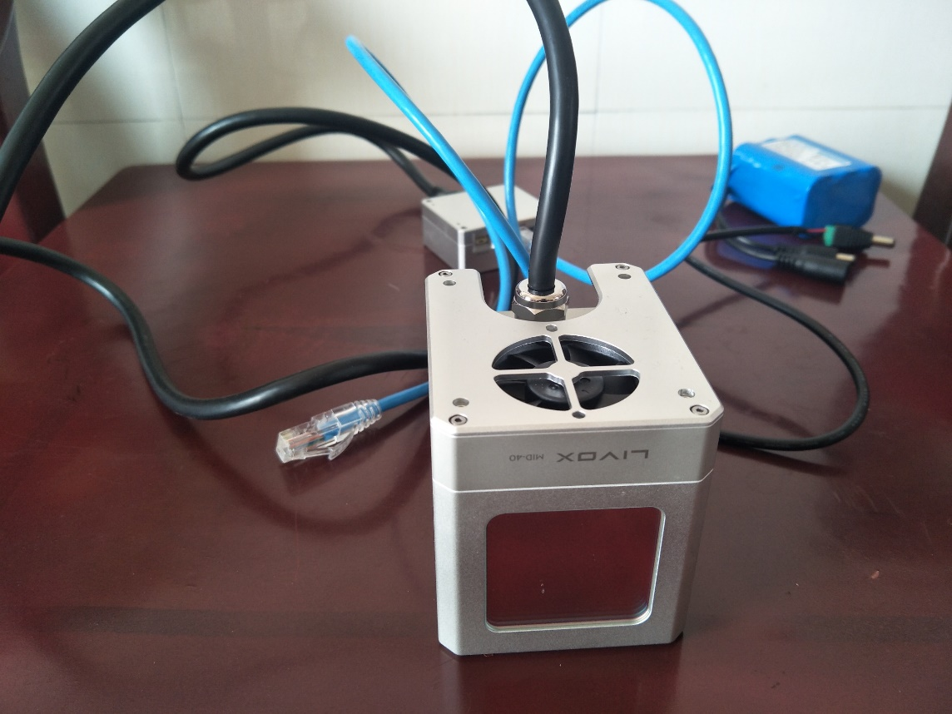
Livox Mid-40 LIDAR Sensor
Livox Mid-40：$599

Slide 4
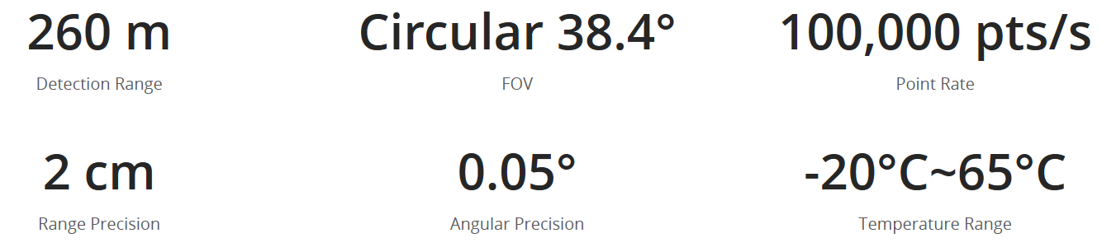
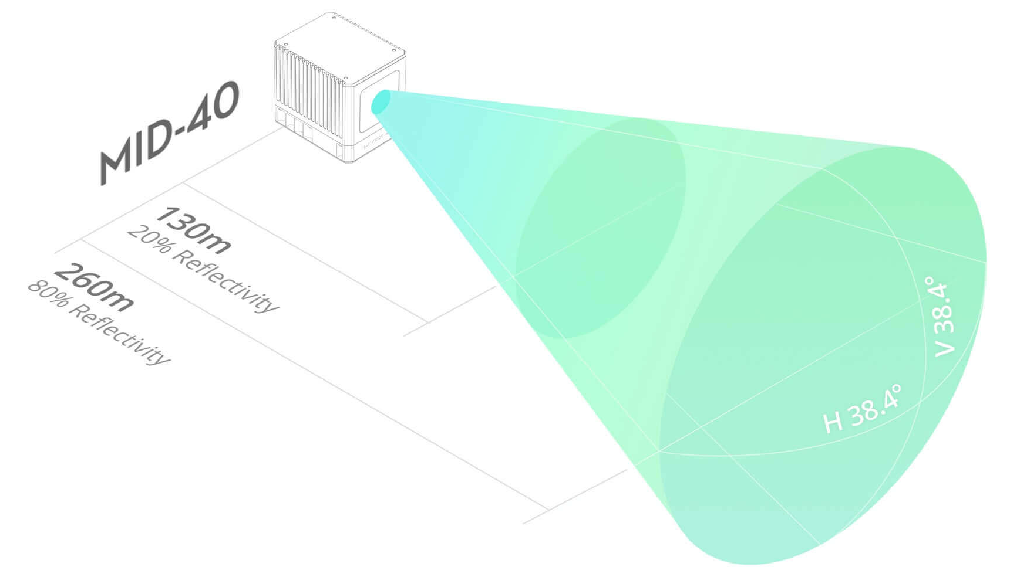
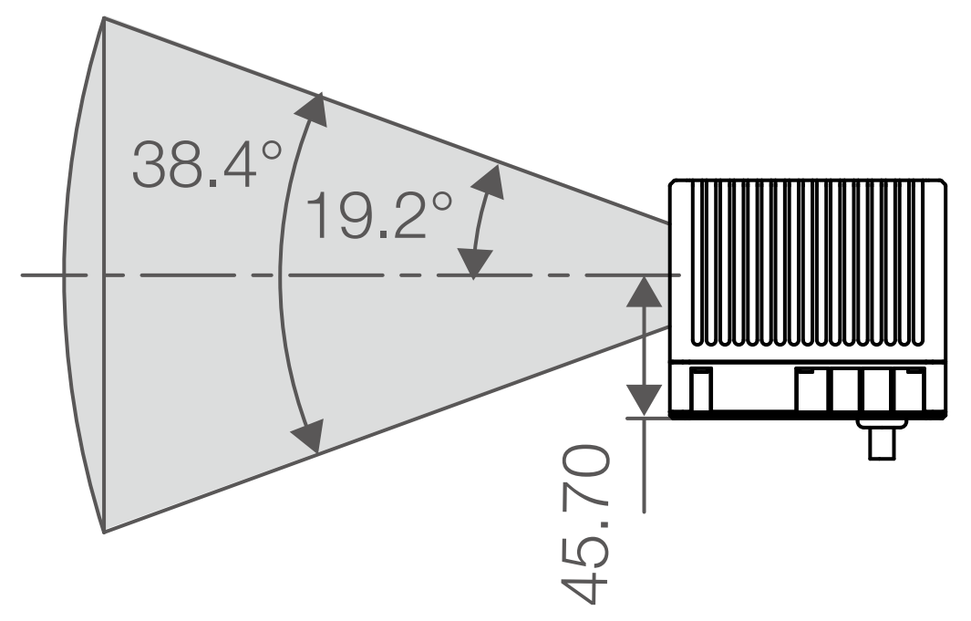
Parameters
90 m @ 10% reflectivity
130 m @ 20% reflectivity
260 m @ 80% reflectivity
Reflectivity, When in 25°
Grey concrete walls and roads：15%-30%
White plaster walls：90%-99%

Slide 5
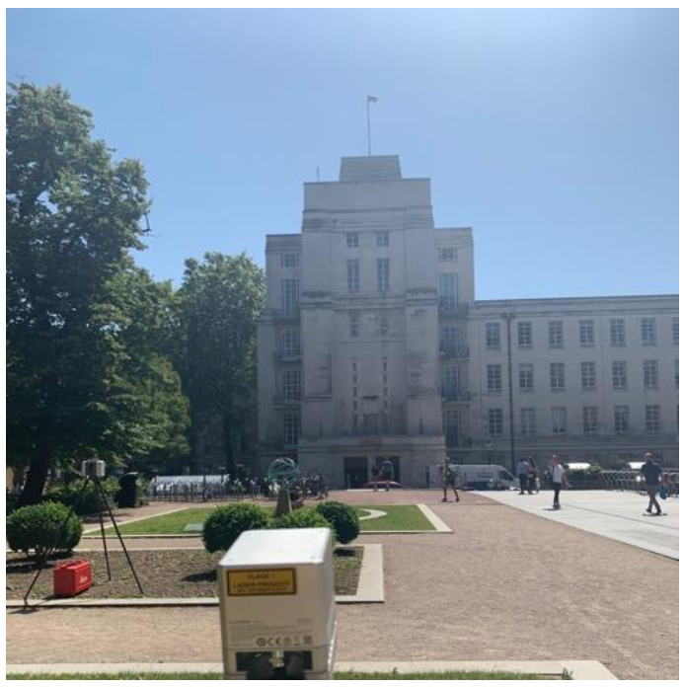
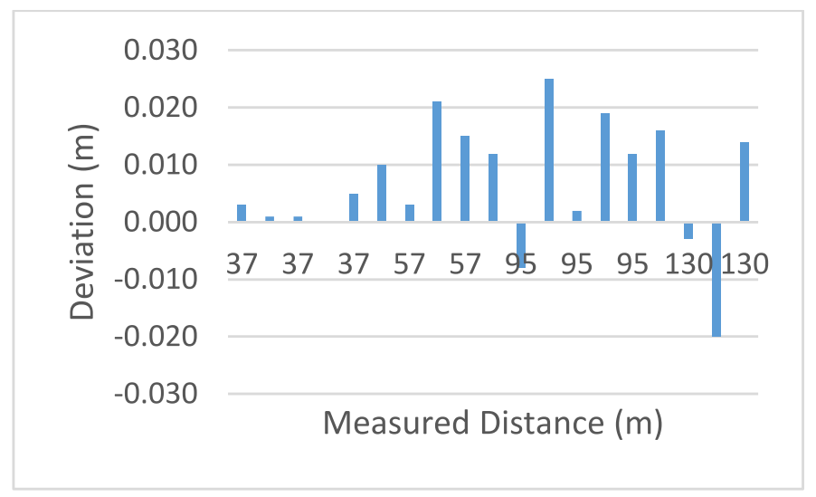
Distance Measurement
Initial investigation of a low-cost automotive LiDar system(LowCost 3D’19)
A. Ortiz Arteaga, D. Scott, J. Boehm
University College London

Slide 6
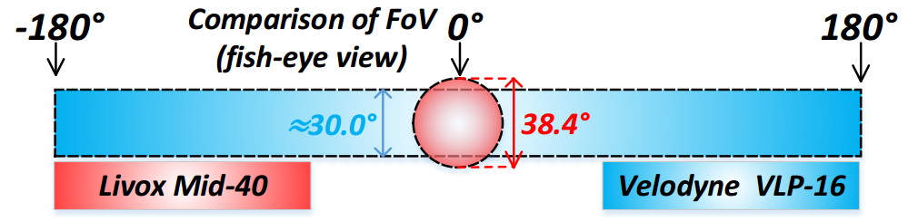
Comparison
Parameters | Velodyne VLP-16 | Livox Mid-40
Detection Range | 100m | 90 m @ 10% reflectivity 130 m @ 20% reflectivity 260 m @ 80% reflectivity
Point rate | 300000 points/s | 100000 points/s
Range Precision | 3cm | 2cm
Angular accuracy | <0.1° | <0.1°
Field of view | 360°×30° | 38.4° circular
Dimension | 88×69×76 mm | 72×72×72 mm
Weight | 760 g | 830 g

Slide 7
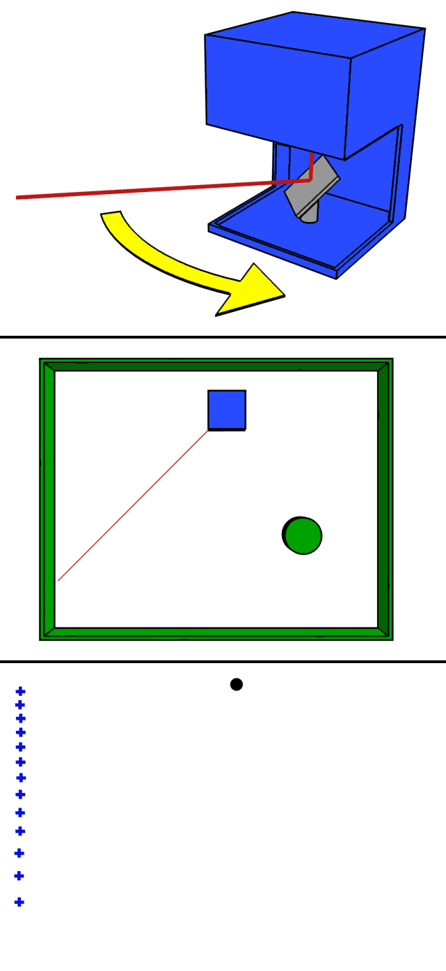
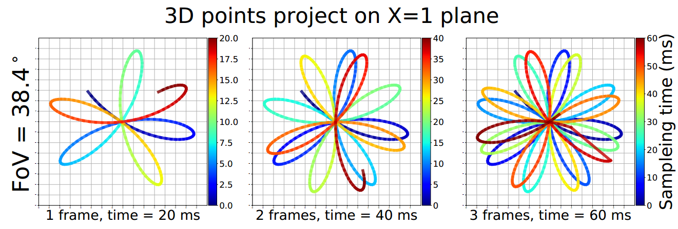
Pattern
Livox

Slide 8
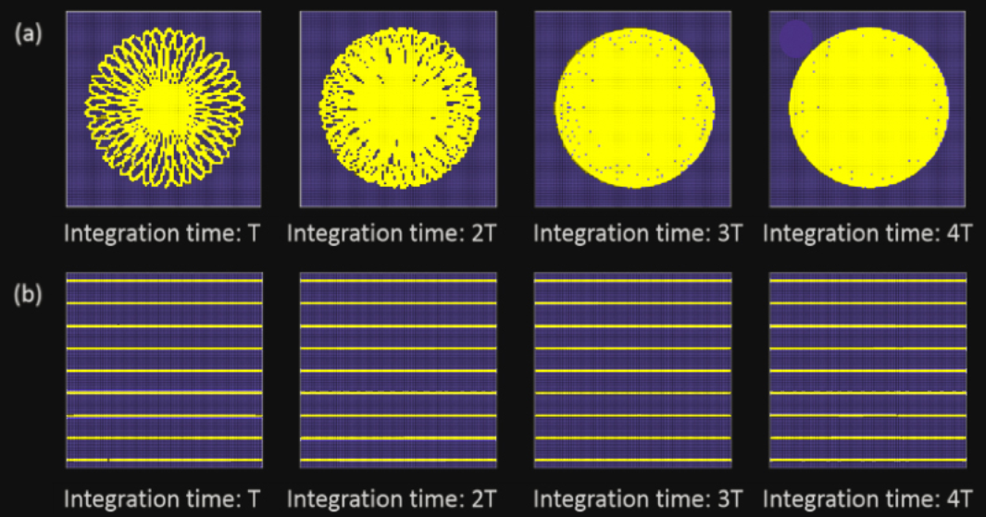
Pattern
Livox
Velodyne

Slide 9
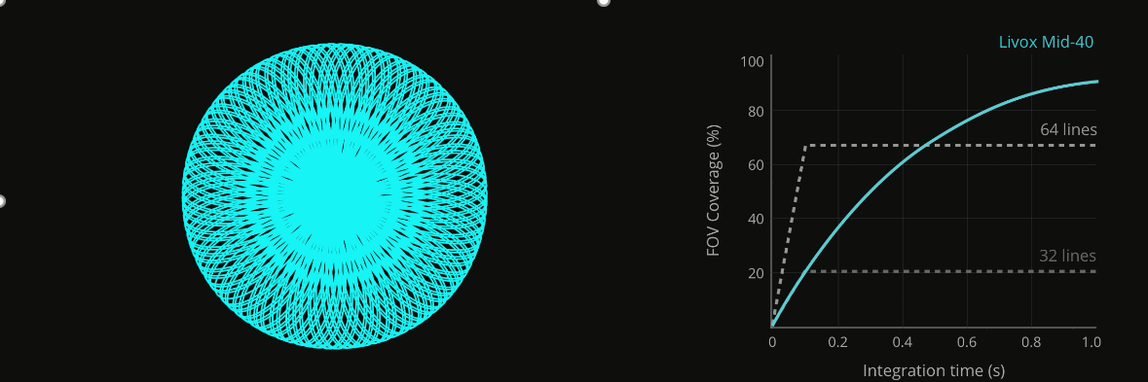
Pattern

Slide 10
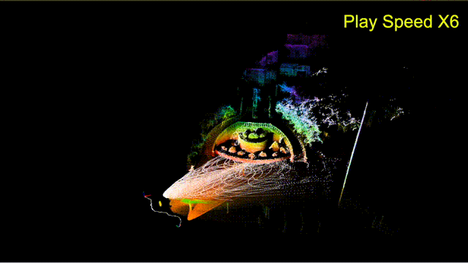
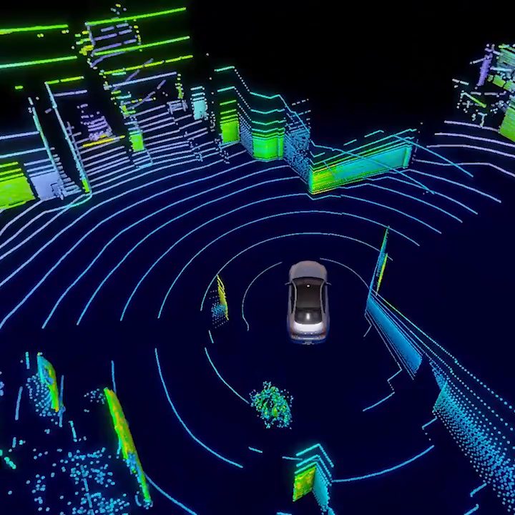
Mapping
Livox
Velodyne

Slide 11
Challenges
Small FoV
Irregular scanning pattern
Non-repetitive scanning
Motion blur

Slide 12
Loam_livox: A fast, robust, high-precision LiDAR odometry and mapping package for LiDARs of small FoV(IROS’19)
Jiarong Lin, Fu Zhang
Hong Kong university

Slide 13
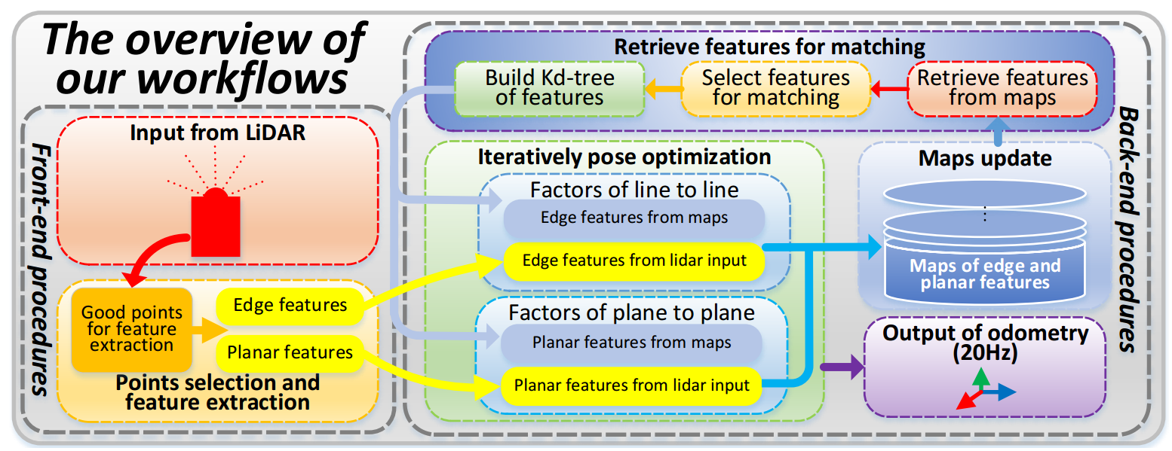
Overview

Slide 14
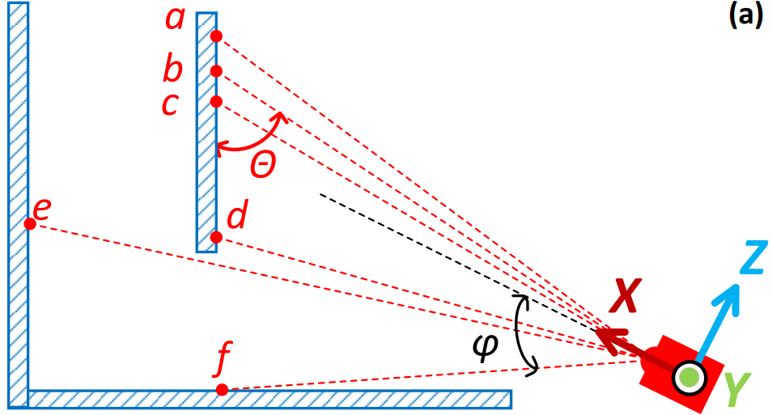




Points selection
Distance:
Deflection angle:
Incident angle:
Intensity:
Points to be removed:
Points nearing to the fringe of the FoV. (e.g. φ(P) ≥ 17°)
Points with too large or too small intensity (e.g. I(P) ≤ 7 × 10⁻³, or I(P) ≥ 1 × 10⁻¹)
Points with incident angles near to π or 0 (e.g. θ(P) ≤ 5°,or θ(P) ≥ 175°)
Points hidden behind an objects (e.g. Pe)

Slide 15
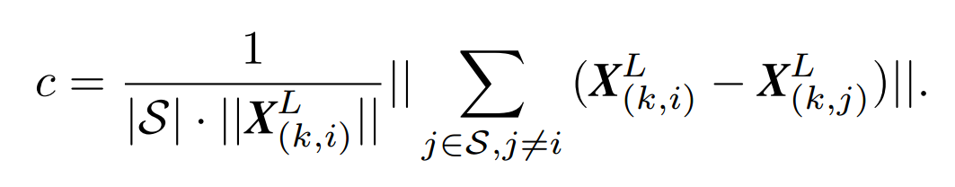
Feature extraction
LOAM: Lidar Odometry and Mapping in Real-time(RSS’14)
Ji Zhang and Sanjiv Singh
Carnegie Mellon University
Evaluate the smoothness of the local surface：
Employ the LiDAR reflectivity as another feature：
Wall
Window
Features：
Plane Or Edge
Door

Slide 16
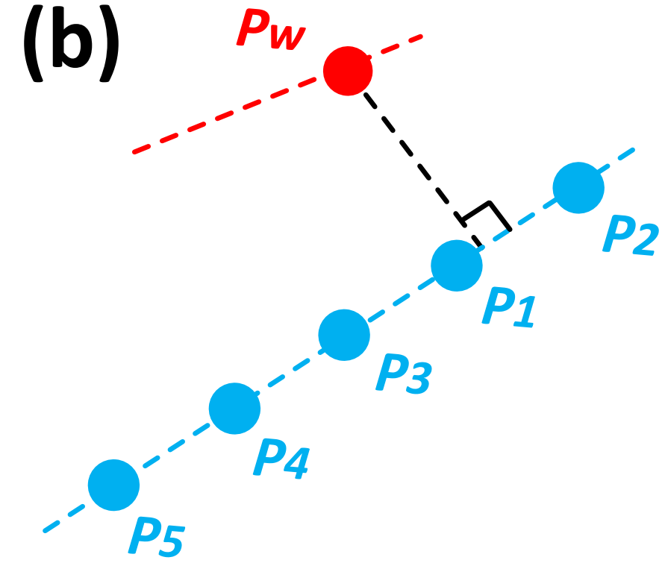

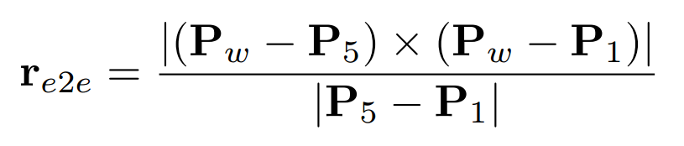
Iterative Pose Optimization—Edge
k-th frame
Project to the global map
Compute covariance matrix Σ
Biggest of eigenvalue of Σ ≥ 3× second biggest eigenvalue
Compute residual

Slide 17
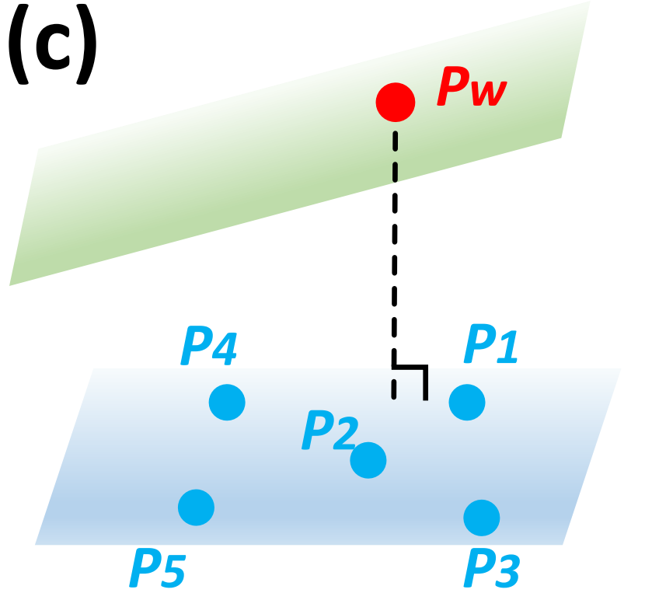
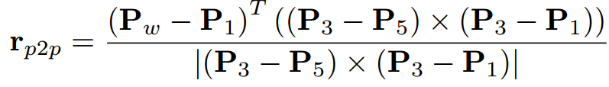
Iterative Pose Optimization—Plane
k-th frame
Project to the global map
Compute covariance matrix Σ
Smallest of eigenvalue of Σ ×3 ≤ second smallest eigenvalue
Compute residual

Slide 18
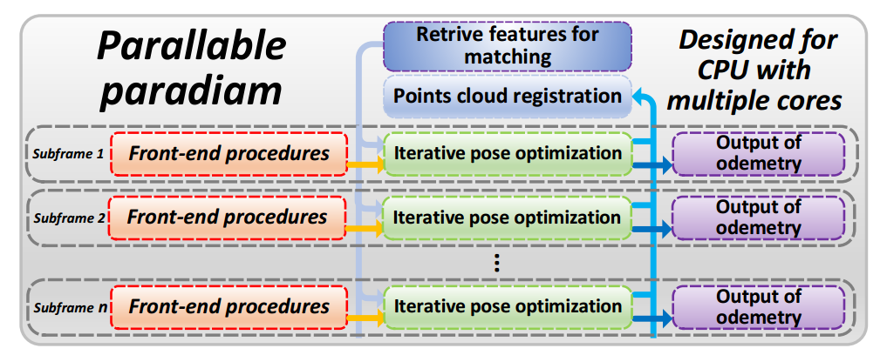
Motion Compensation
Method One
Piecewise processing
Method Two
Linear interpolation

Slide 19
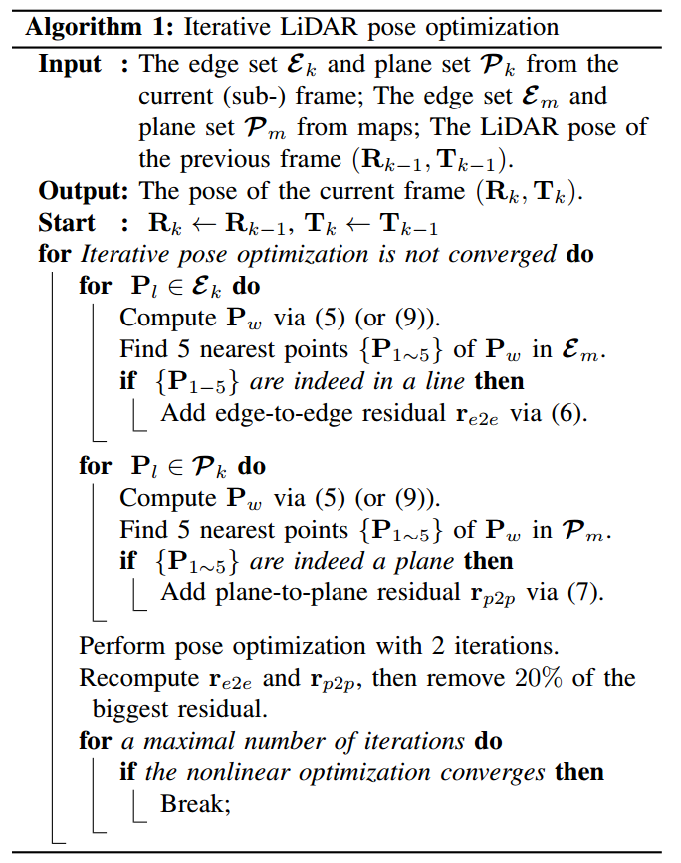
Outliers rejection and dynamic objects filtering
Remove the first 20% largest residuals

Slide 20
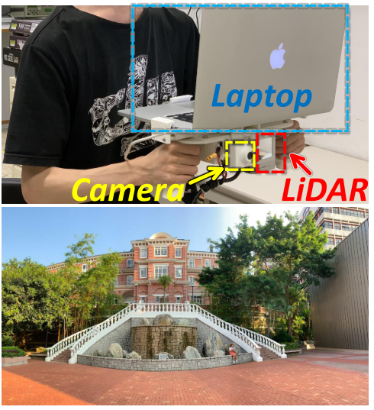
Experiment

Slide 21
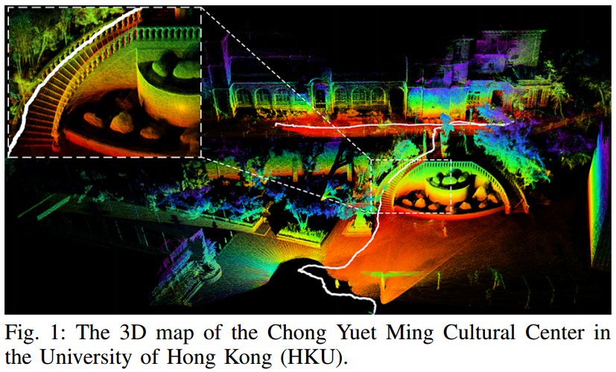
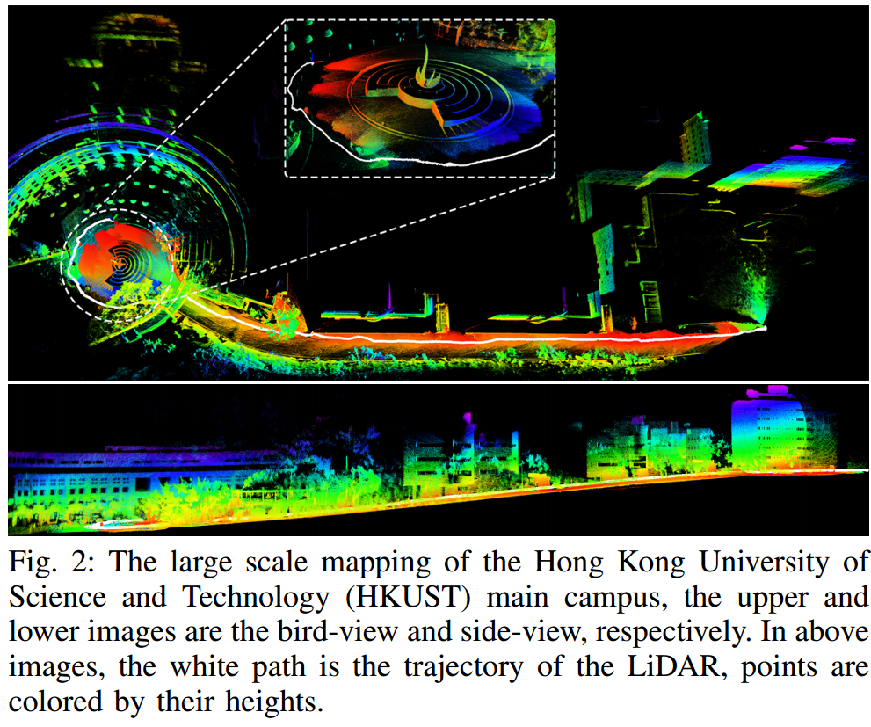
Mapping Demo

Slide 22
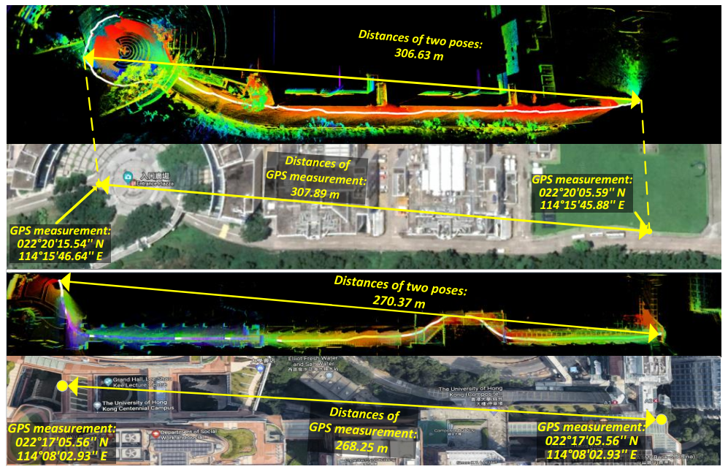
Evaluation of odometry
Compared with GPS
Outdoor
0.41% Error
Indoor
0.65% Error

Slide 23
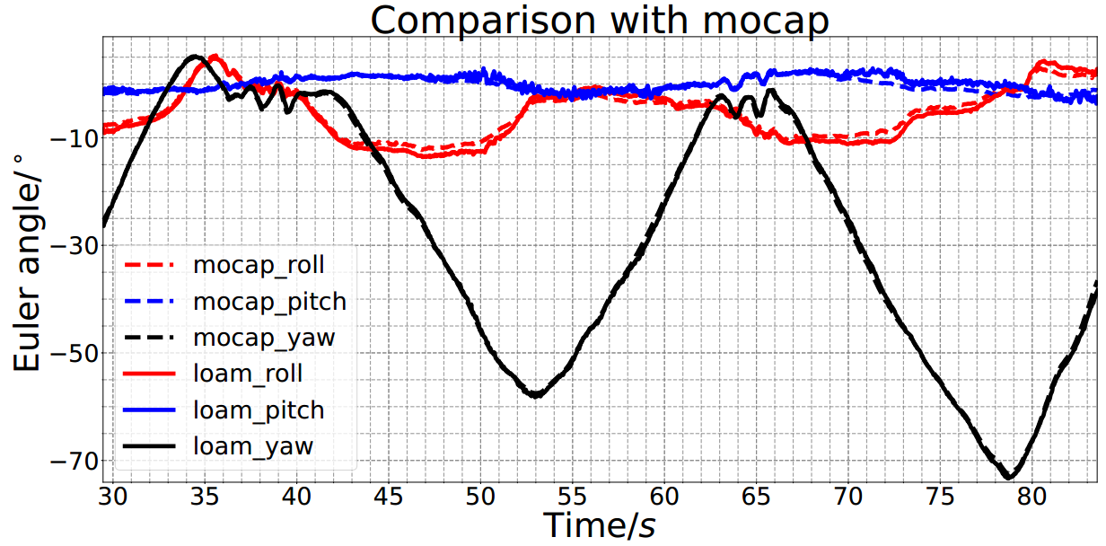
Evaluation of odometry
Average error of Euler angles in all three directions is as low as 1.1°

Slide 24
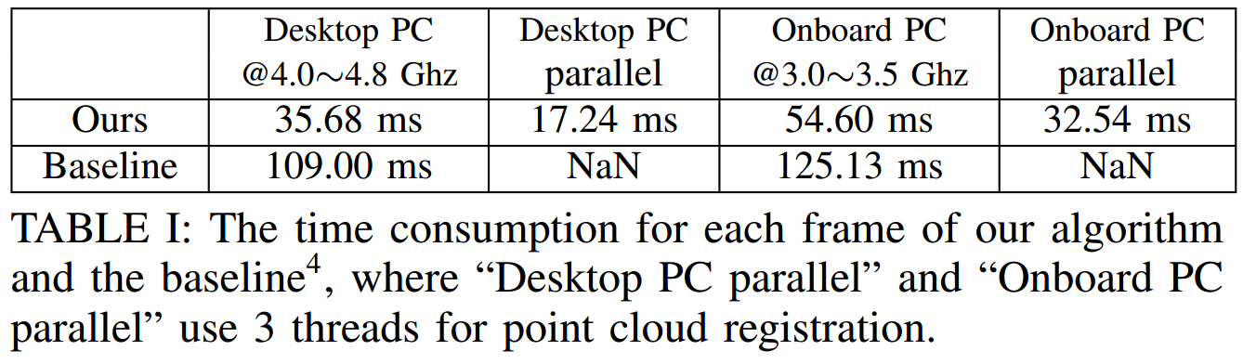
Evaluation of running performance
Baseline：A-LOAM
Real-time：20 HZ

Slide 25
A fast, complete, point cloud based loop closure for LiDAR odometry and mapping(ArXiv’19)
Jiarong Lin, Fu Zhang
Hong Kong university

Slide 26
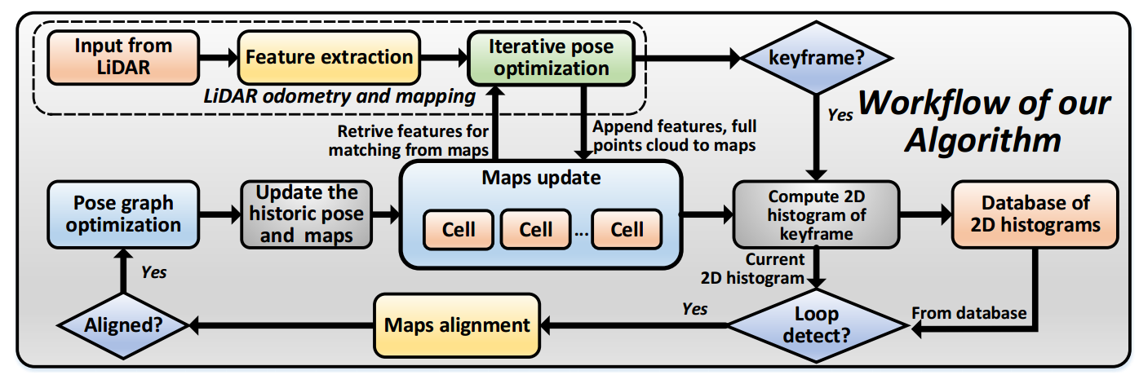
Overview

Slide 27
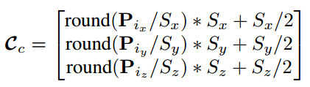
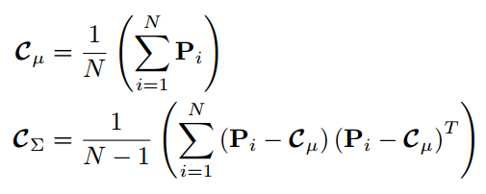



Point cloud partition
Appearance-based loop detection from 3D laser data using the normal distributions transform(ICRA’09)
Magnusson, Martin, Andreasson, Henrik, Nuchter, A., Lilienthal, A.J.
O¨rebro University
Partition the 3D space into Cells
Compute mean and covariance of Cells
Get feature type and direction in a cell
Eigenvalue decomposition on
Cell of plane shape：λ2 ﹥ ﹥ λ3
Cell of line shape：λ1 ﹥ ﹥ λ2
Cell with no feature：others

Slide 28





Rotation invariance
Make most of the feature direction are lie on X-axis
Compute the covariance Σd of all plane
feature directions in a keyframe
Eigenvalue decomposition on Σd
eigenvalues ：
eigenvector matrix：
Apply rotation transformation to all feature
directions (both plane and line)
Determine the rotation matrix R

Slide 29
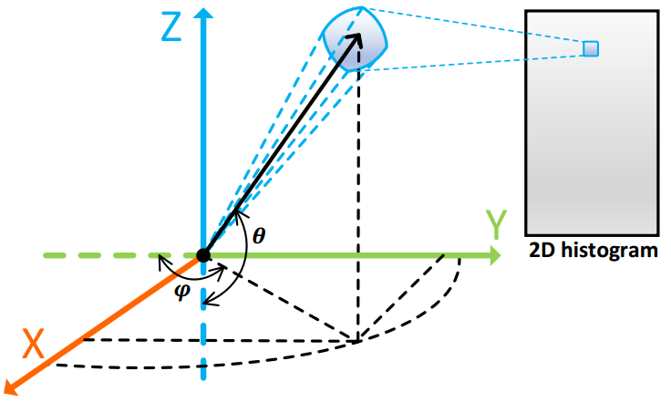

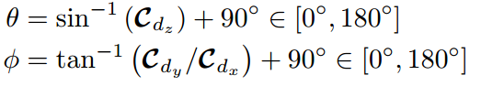
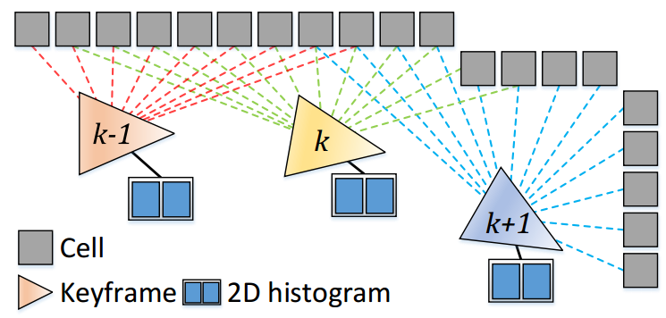
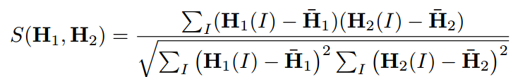
2D histogram of keyframe
Compute the Euler angle
2D histogram(60 × 60 matrix)
have 3° resolution on both pitch and yaw angle
denote the number of line/plane cells
Similarity of two keyframes
Threshold:0.90 for plane and 0.65 for line

Slide 30
Maps alignment and graph optimization
*E. Olson, J. Leonard, and S. Teller, “Fast iterative alignment of pose graphs with poor initial estimates,” in Proceedings 2006 IEEE International Conference on Robotics and Automation, 2006. ICRA 2006. IEEE, 2006, pp. 2262–2269.
*G. Grisetti, R. Kummerle, C. Stachniss, and W. Burgard, “A tutorial on graph-based slam,” IEEE Intelligent Transportation Systems Magazine, vol. 2, no. 4, pp. 31–43, 2010.

Slide 31
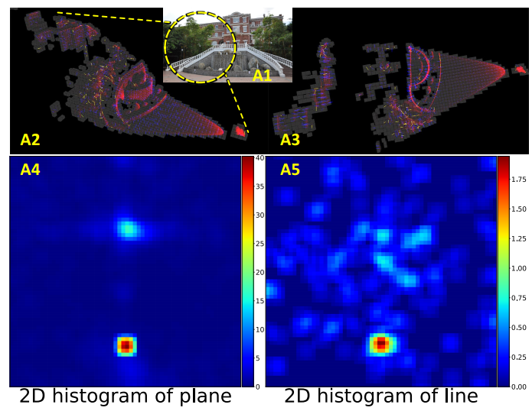
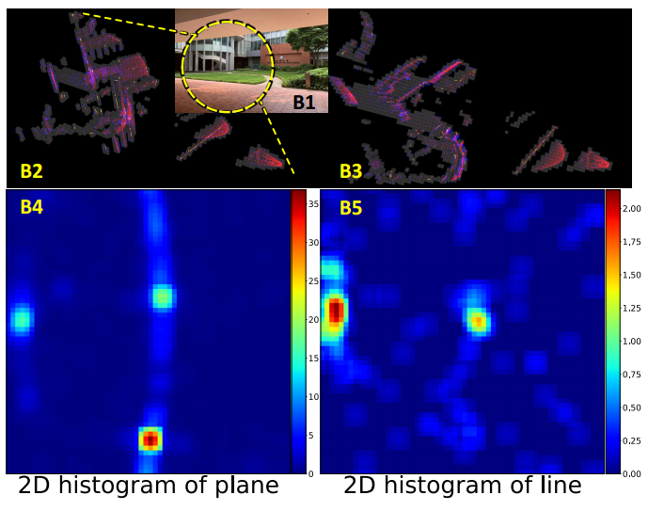
Visualization of keyframe, cells, and 2D histograms

Slide 32
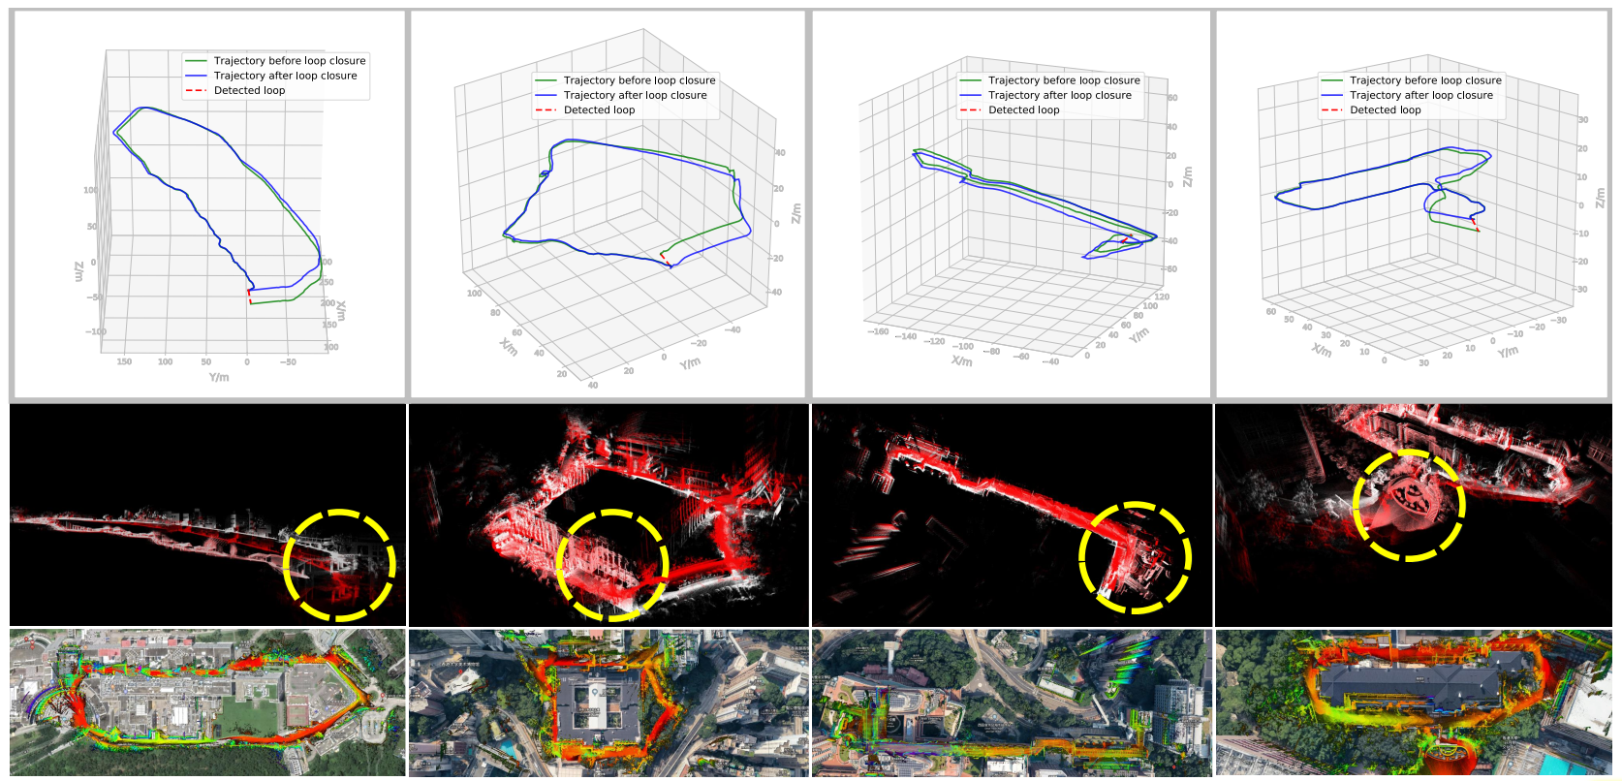
Large scale loop closure results

Slide 33
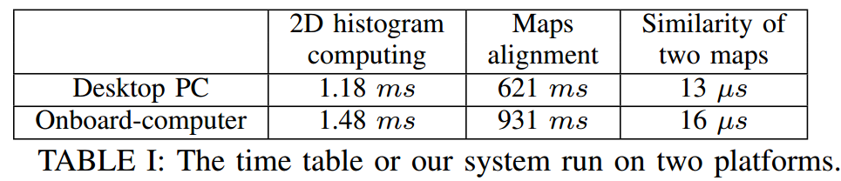
Time of computation
HKUST large scale dataset

Slide 34
Summary
  Complete, fast, robust, high-precision Lidar SLAM
  Low-cost Lidar
  Open source https://github.com/hku-mars/loam_livox

Slide 35
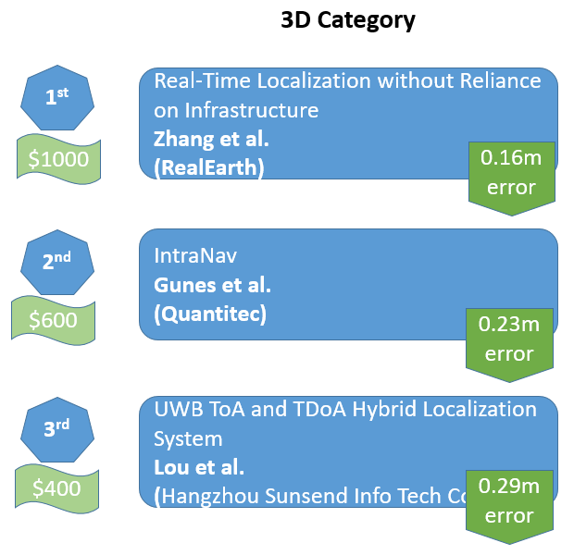
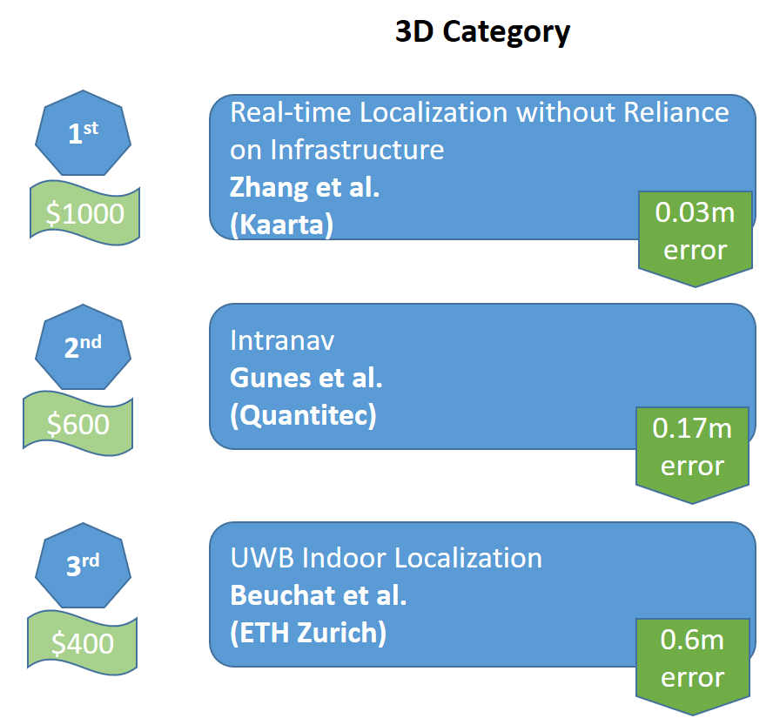
Options
Multimodal Fusion：
SLAM：Lidar + CV + IMU
Indoor Localization：Lidar + RFID/WiFi+……
Intelligent Sensing Applications
2016，2017 Microsoft Indoor Localization Competition

Slide 36
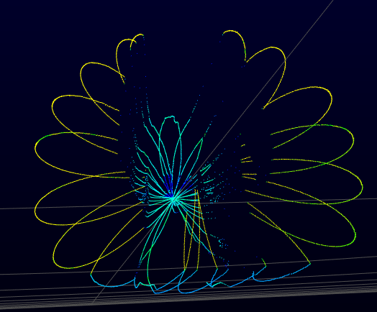
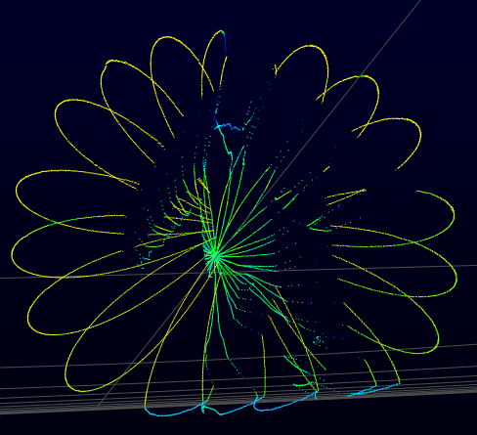
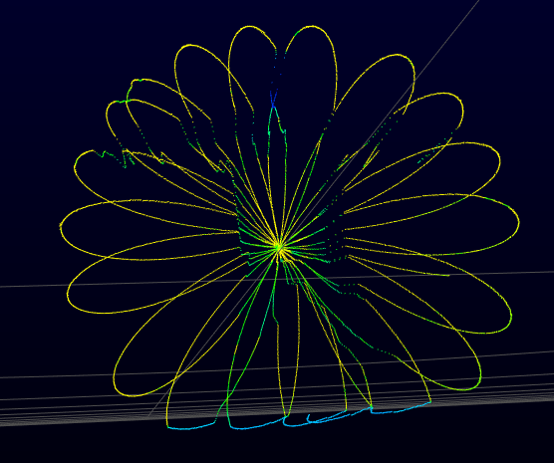
Options
Activity recognition
Intrusion detection
Human-computer interaction
Identification and Authentication
…………

