Slide 1
Primary exploration of Lidar SLAM
LOAM & V-LOAM
Ji Zhang and Sanjiv Singh
RSS2014 & IRCA 2015

Slide 2
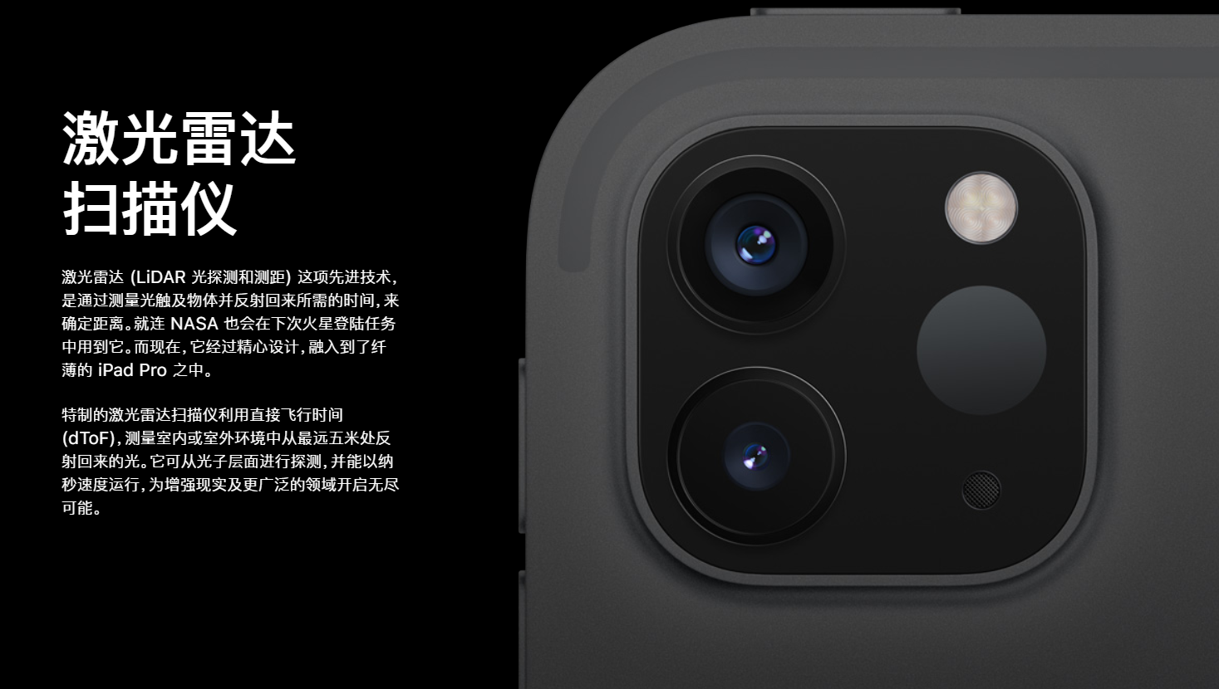
Why Lidar SLAM?
Lidar Scanner appeared on new iPad Pro
Lidar SLAM running on a smart phone may be possible

Slide 3
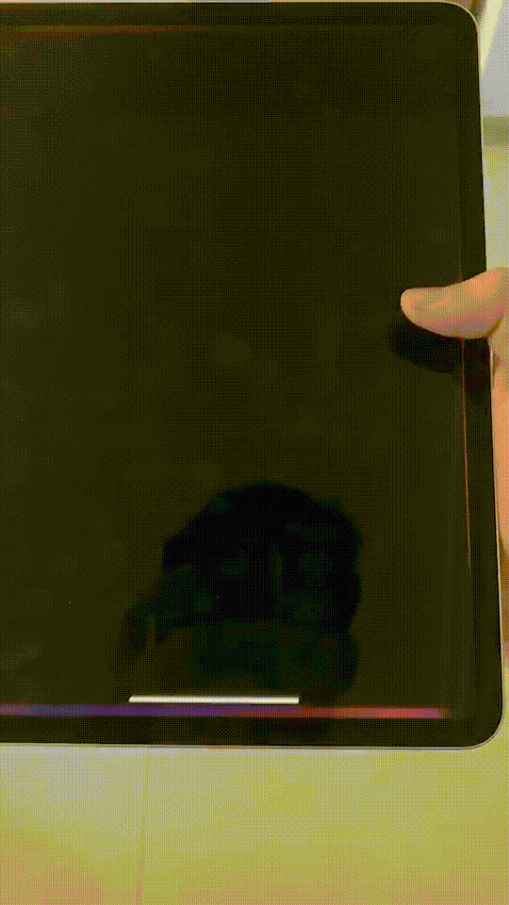
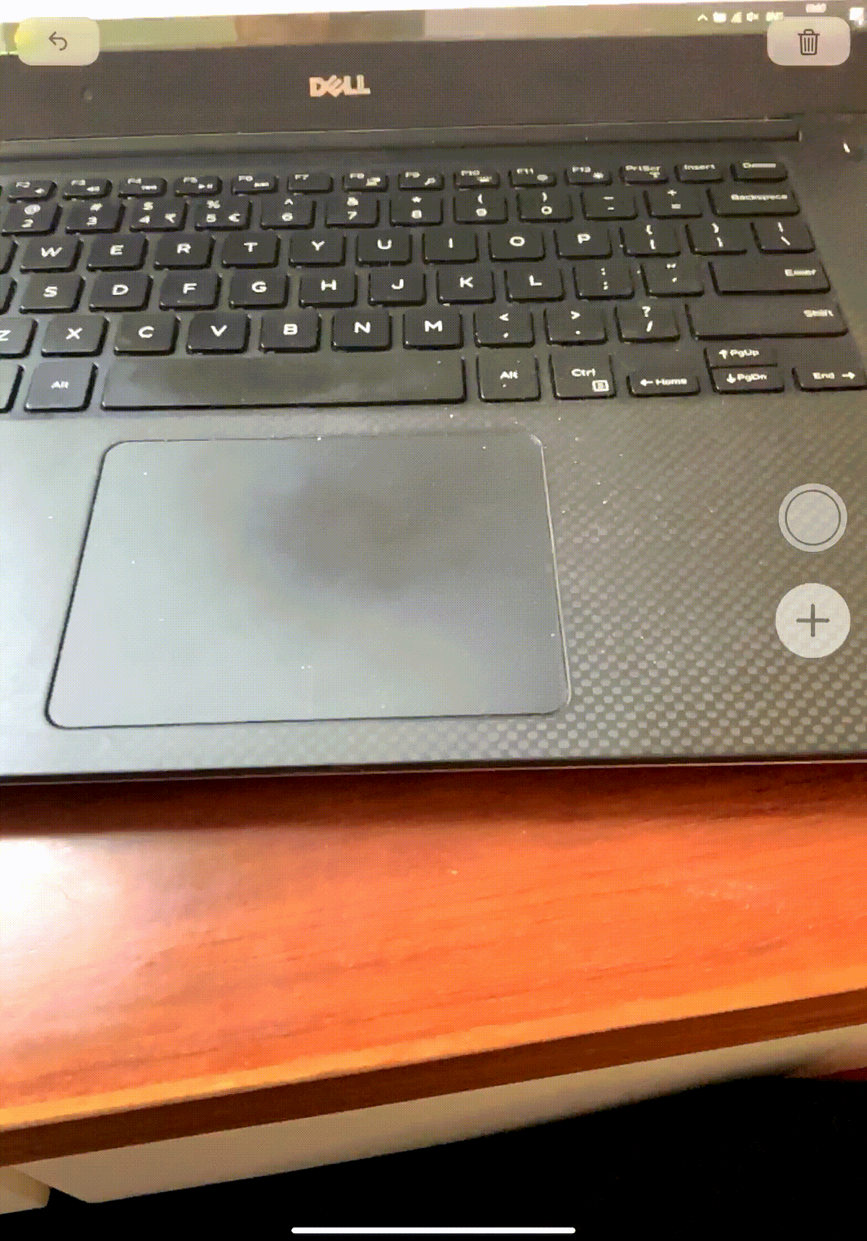
Why Lidar SLAM?
Lidar Scanner appeared on new iPad Pro
Lidar Slam running on a smart phone may be possible
More convenient and accurate AR ruler
New solution to indoor navigation

Slide 4
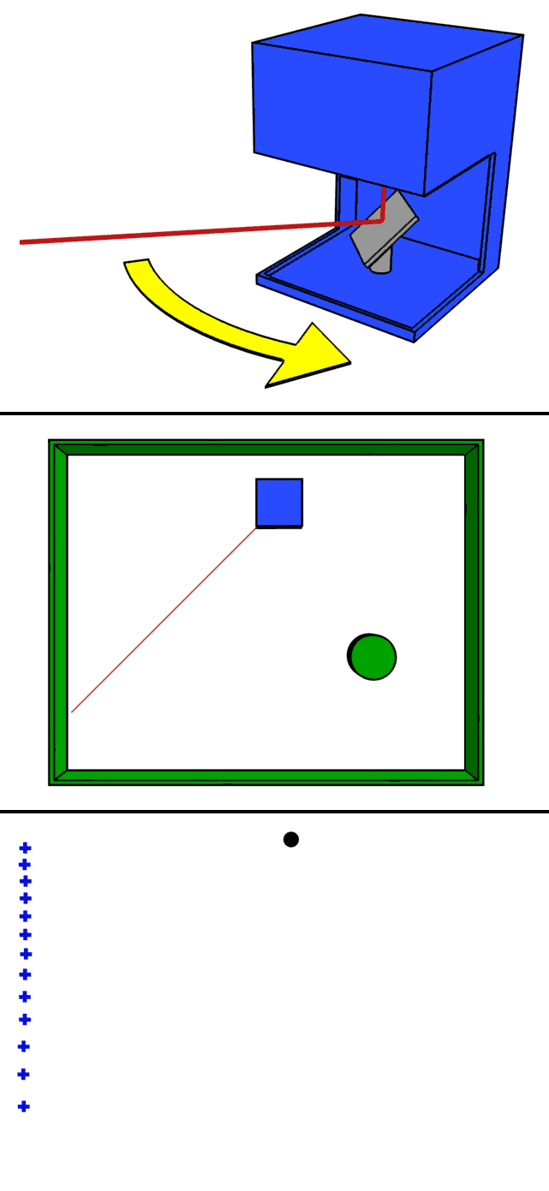
Introduction to Lidar
light detection and ranging
Some terms
  scan
Notes:
光检测与测距

Slide 5
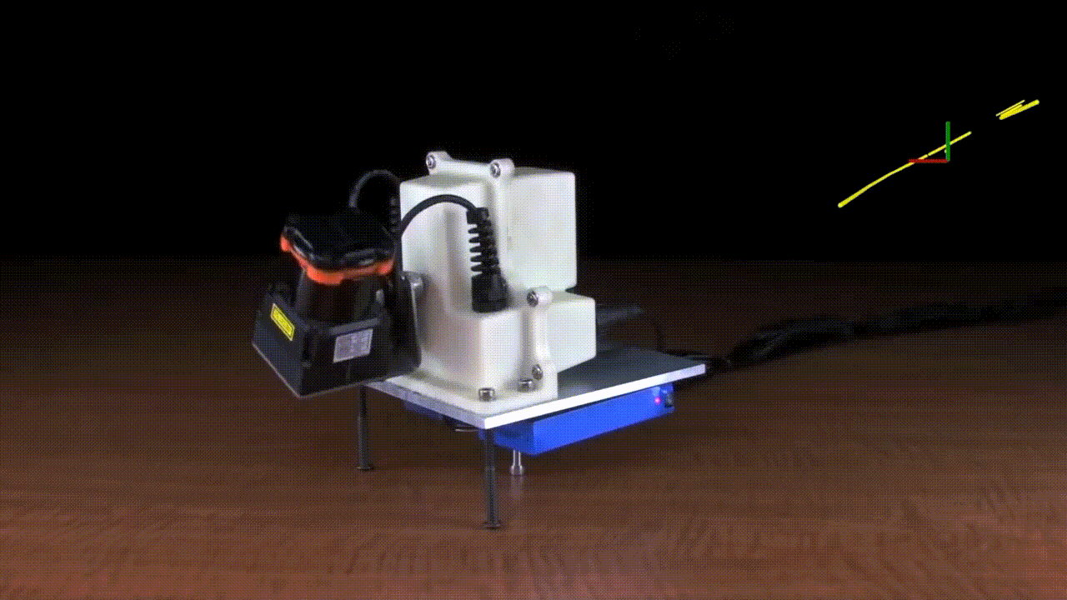
Introduction to Lidar
light detection and ranging
Some terms
  scan
  sweep

Slide 6
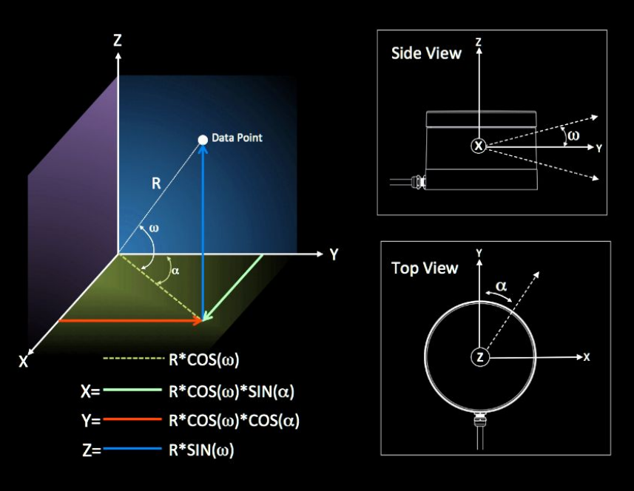
Introduction to Lidar
light detection and ranging
Some terms
  scan
  sweep
Motion compensation

Slide 7
LOAM: Lidar Odometry and Mapping in Real-time
Ji Zhang and Sanjiv Singh

Slide 8
LOAM: Video
https://www.youtube.com/watch?v=8ezyhTAEyHs

Slide 9
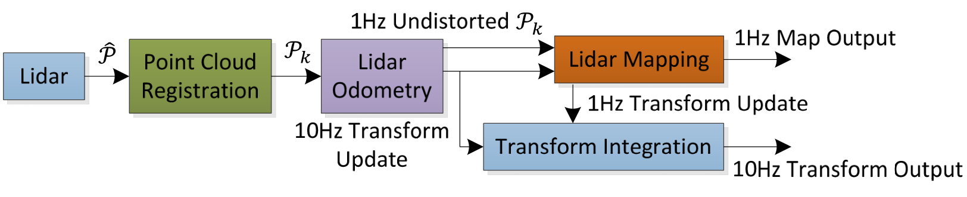

LOAM: Overview
Problem: Given a sequence of lidar cloud $P_{k}, k∈Z^{+}$, compute the ego-motion of the lidar during each sweep $k$, and build a map with $P_{k}$ for the traversed environment.

Slide 10
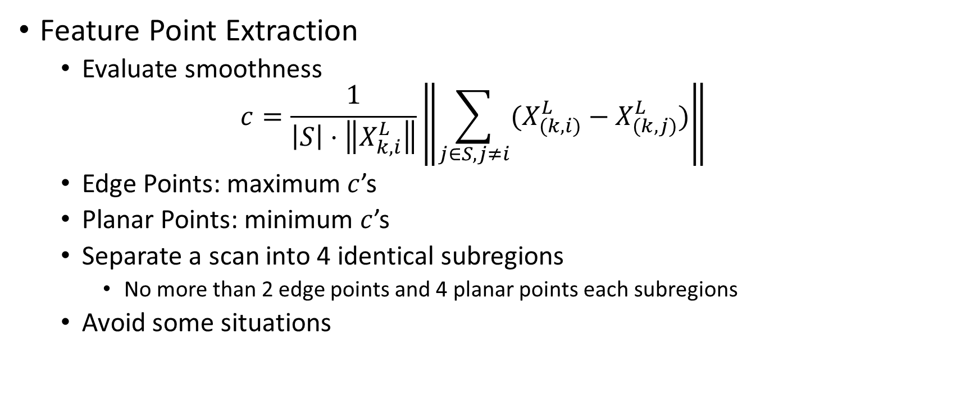
LOAM: Lidar Odometry
Feature Point Extraction
  Evaluate smoothness
  $$c=\frac{1}{\left|S\right|⋅\left\|X_{k,i}^{L}\right\|}\left\|\sum_{j∈S,j≠i}{(X_{(k,i)}^{L}−X_{(k,j)}^{L})}\right\|$$
  Edge Points: maximum $c$’s
  Planar Points: minimum $c$’s
  Separate a scan into 4 identical subregions
    No more than 2 edge points and 4 planar points each subregions
  Avoid some situations

Slide 11
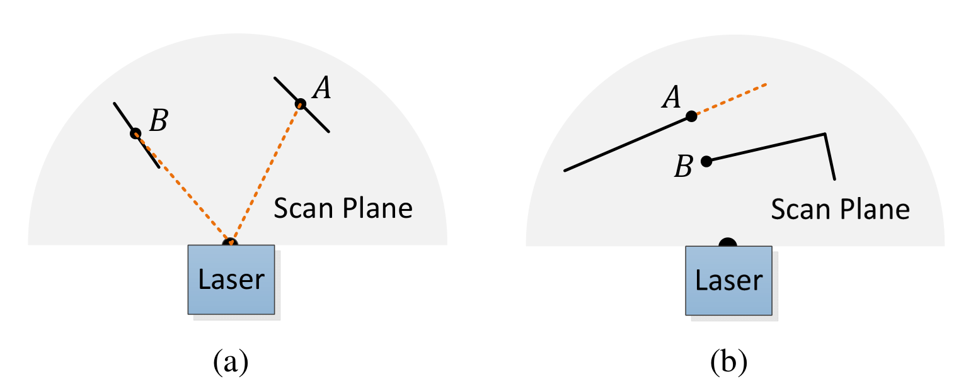
LOAM: Lidar Odometry

Slide 12
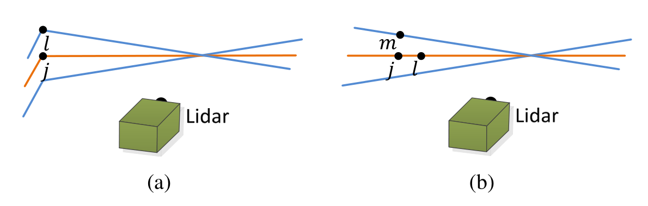
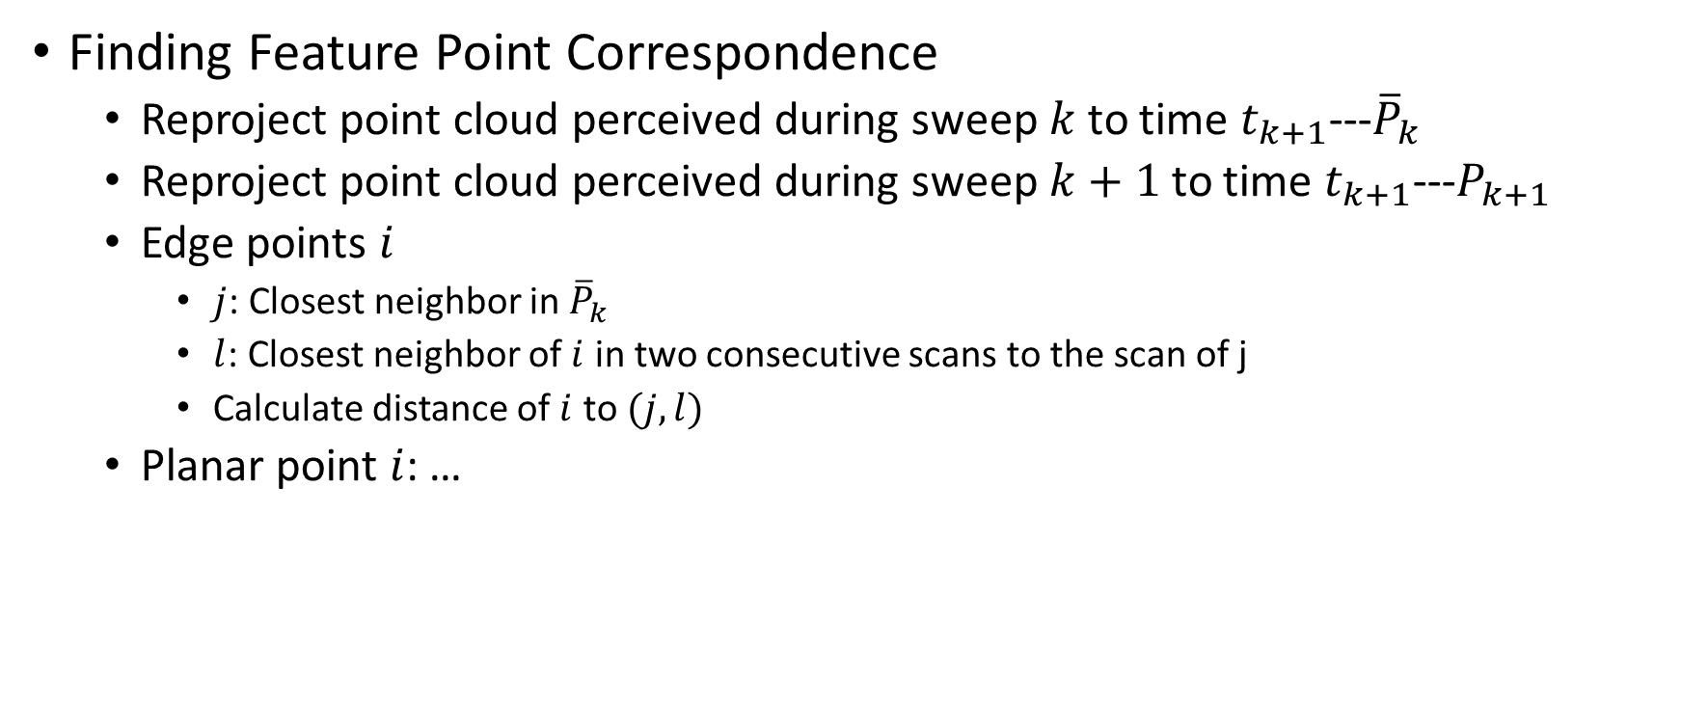
LOAM: Lidar Odometry
Finding Feature Point Correspondence
  Reproject point cloud perceived during sweep $k$ to time $t_{k+1}$---${\overline{P}}_{k}$
  Reproject point cloud perceived during sweep $k+1$ to time $t_{k+1}$---$P_{k+1}$
  Edge points $i$
    $j$: Closest neighbor in ${\overline{P}}_{k}$
    $l$: Closest neighbor of $i$ in two consecutive scans to the scan of j
    Calculate distance of $i$ to $(j, l)$
  Planar point $i$: …

Slide 13
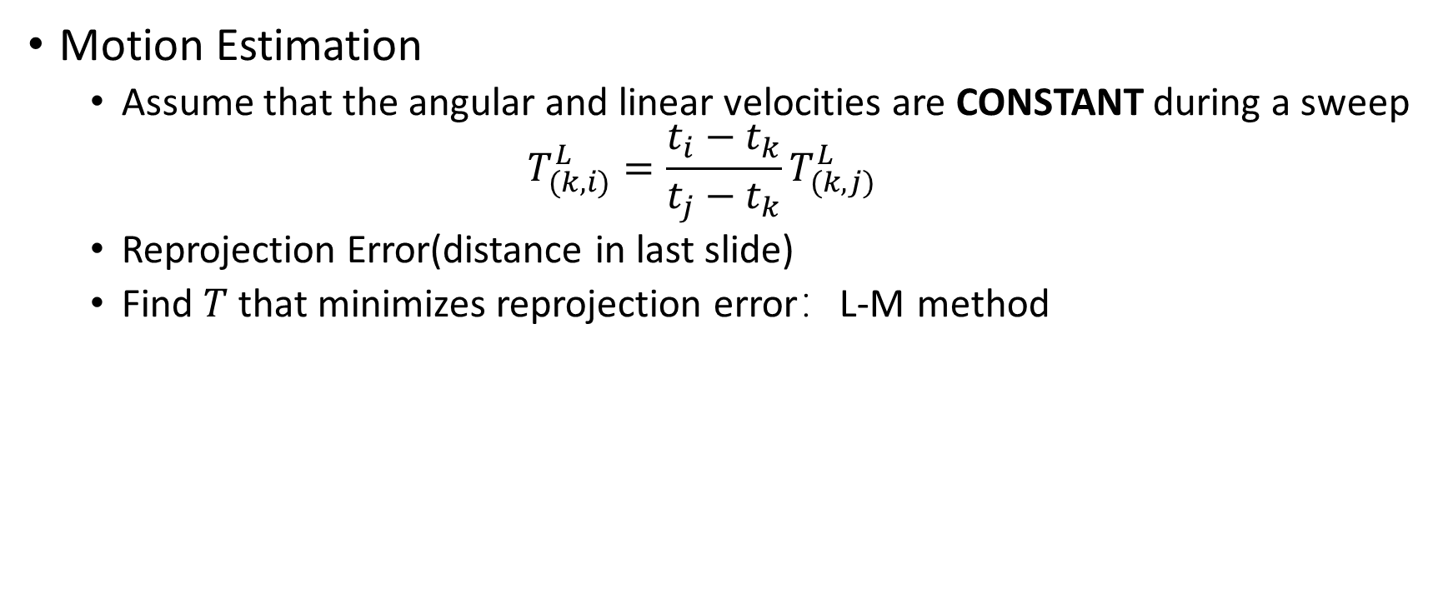
LOAM: Lidar Odometry
Motion Estimation
  Assume that the angular and linear velocities are CONSTANT during a sweep
  $$T_{(k, i)}^{L}=\frac{t_{i}−t_{k}}{t_{j}−t_{k}}T_{(k,j)}^{L}$$
  Reprojection Error(distance in last slide)
  Find $T$ that minimizes reprojection error：L-M method

Slide 14
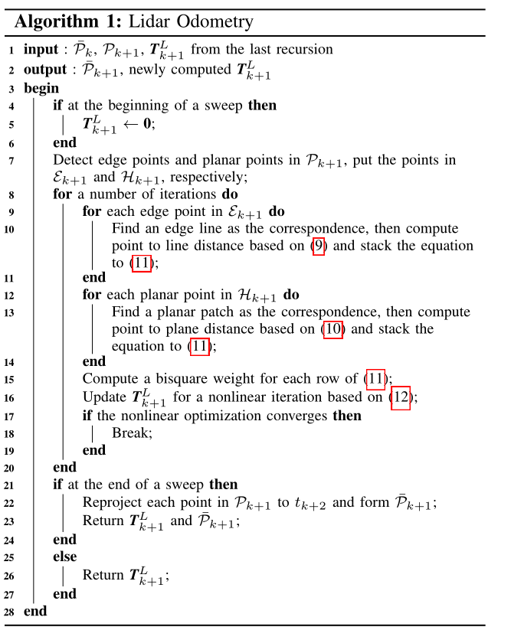

Slide 15
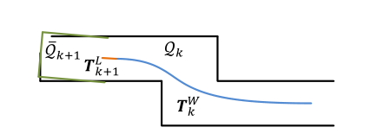

LOAM: Lidar Mapping
Feature Point Extraction
  Similar to Odometry
  extract 10 times points
Finding Feature Point Correspondence
  PCA method
Nonlinear Optimization
Frequency

Slide 16
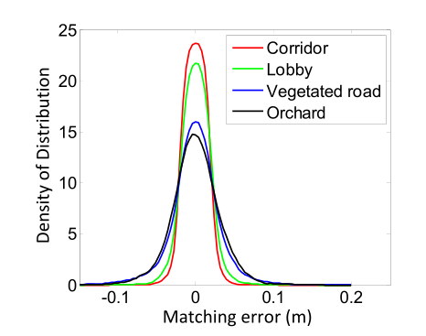
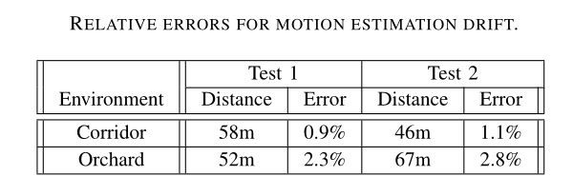
LOAM: Experiments

Slide 17
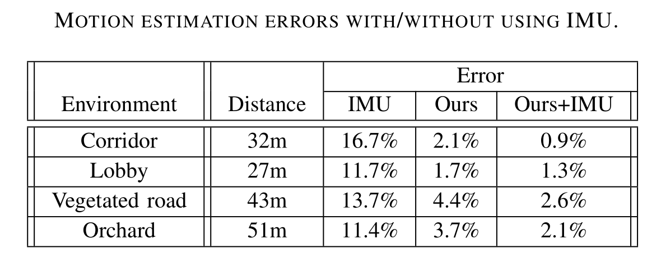
LOAM: Assistance from an IMU
Initial orientation
Acceleration measurement for motion compensation

Slide 18
Visual-lidar Odometry and Mapping: Low-drift, Robust, and Fast
Ji Zhang and Sanjiv Singh

Slide 19
V-LOAM: Video
https://www.youtube.com/watch?v=-6cwhPMAap8&t=2s

Slide 20
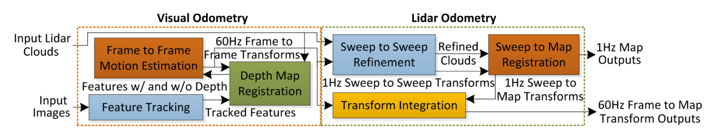

V-LOAM: Overview
Problem: Given visual images and lidar clouds perceived in $\{S\}$, determine poses of $\{S\}$ with respect to $\{W\}$ and build a map of the traversed environment in $\{W\}$

Slide 21
V-LOAM: Visual Odometry
Depth Map Registration
  New points added, old points aged
  Downsized, to constant point density
  Project to last image transform
  Associate distance to the feature
    projecting it to planar of 3 closest points
    Triangulate
Motion Esitimation
  3D-3D, 3D-2D, 2D-2D

Slide 22
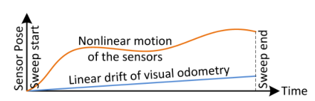
V-LOAM: Lidar Odometry
Sweep to Sweep Refinement: matches point clouds between consecutive sweeps refine motion estimates
Sweep to Map Registration: matches and registers point clouds on the map

Slide 23
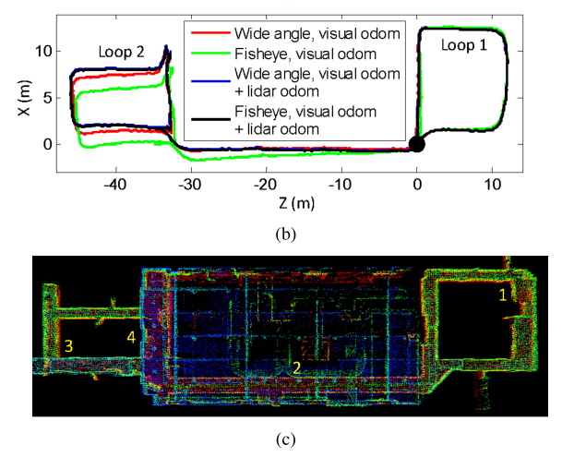
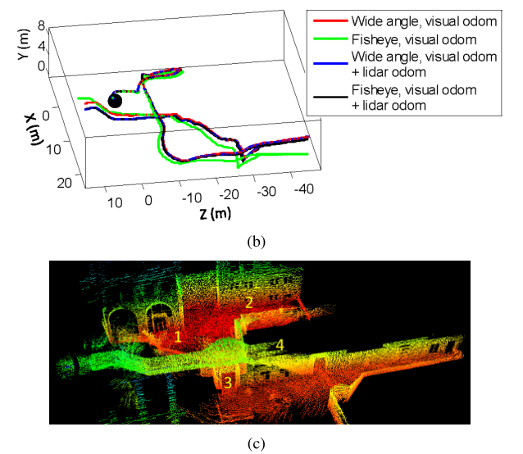
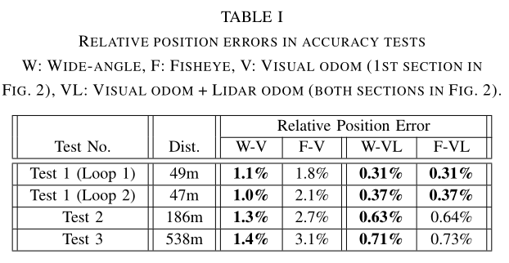
V-LOAM: Experiments(Accuracy Tests)

Slide 24
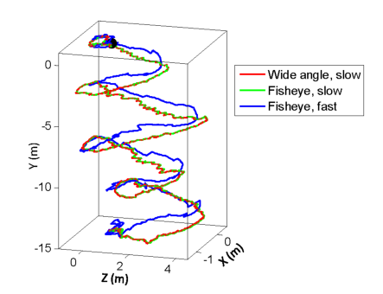
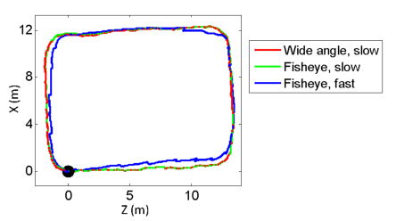
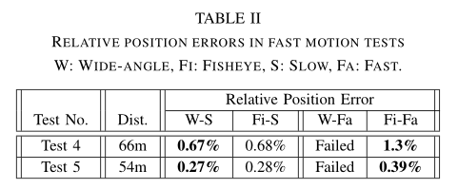
V-LOAM: Experiments(Robustness Tests)

Slide 25
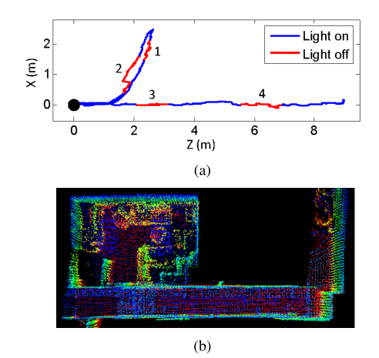
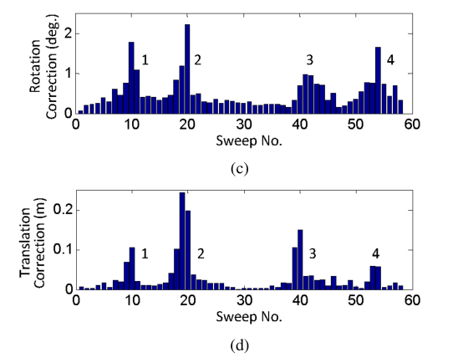
V-LOAM: Experiments(Dramatic Lighting Changes)

Slide 26
Summary
Loop detection, Relocalization
Loosely coupled
Advantages
  More convenient
  Robust in low texture scene
  Robust when light changes

Slide 27
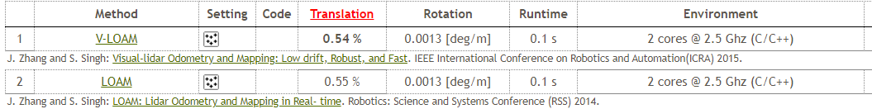
Summary
Sensor Fusion
Lidar + Camera + IMU ?
  Laser-visual-inertial Odometry and Mapping with High Robustness and Low Drift

