Slide 1
WaveEar:
Exploring a mmWave-based Noise-resistant Speech Sensing for Voice-User Interface
Chenhan Xu¹, Zhengxiong Li¹, Hanbin Zhang¹, Aditya Singh Rathore¹,
Huining Li^{1,2}, Chen Song¹, Kun Wang³, Wenyao Xu¹
1. University at Buffalo, SUNY, USA
2. Nanjing University of Posts and Telecommunications, China
3. University of California, Los Angeles, USA
Notes:
Thanks for the introductions
Today I am going to present our paper, WAVEEAR, Exploring a mmWave-based Noise-resistant Speech Sensing for Voice-User Interface
This is a joint work with my collaborators from suny buffalo, NJUPT, and UCLA

Slide 2

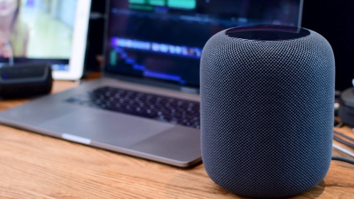

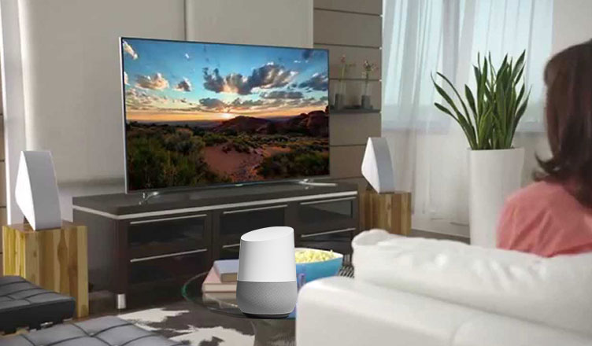
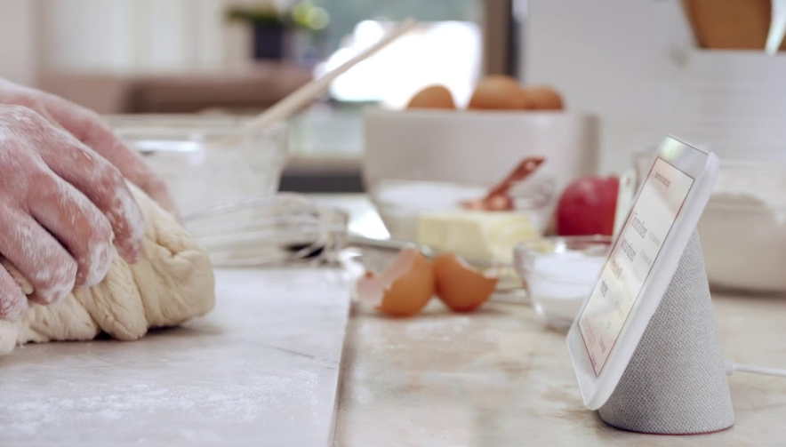
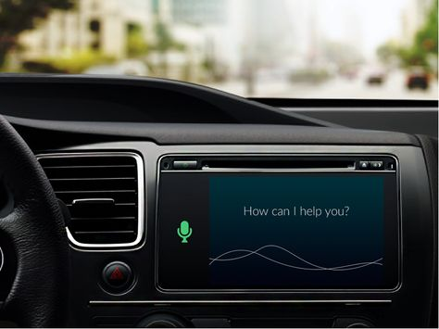
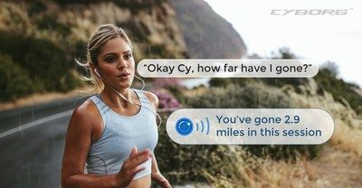

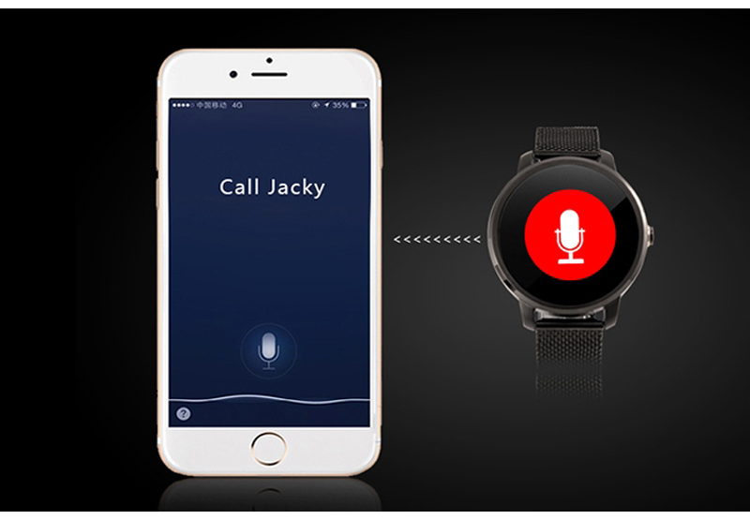
Background: Voice-User Interfaces
Travel
Work
Entertainment
Cooking
Commute
Fitness
Shopping
Business
Notes:
Recently, voice user interface or VUI is becoming more and more pervasive in daily life
Because It can provide a natural and efficient way to interact with devices without using touching or typing.
we could get the navigation by voice while driving
do a touchless search in the cookbook while cooking
Or skip lots of operations and have the files ready using voice commands
There are so many potential interesting applications that voice user interface can bring to us

Slide 3
Background: Voice-User Interfaces (VUI)
$1.3 billion voice-based smart home market
WE
ARE
HERE
[1] Smart Home Devices Market Forecast to Be Growing Globally at 31% Annual Clip, https://www.securitysales.com/research/smart-home-devices-market-forecast/, Accessed: 2018-10-12.
[2] Evangelizing and Designing Voice User Interface: Adopting VUI in a GUI world, Interaction Design Association.
Notes:
and that’s why the related market size has reached 1.3 billion dollars last year.
Let’s recall the history of user interface.
30 years ago, the bash is released and brought the trend of command line interface, today most of the bashes are running on linux server
18 years ago, the macos brought us the graphical user interfaces
Now, we are experiencing the rising of voice user interface
Here, we want to ask a question.

Slide 4
Background: Voice-User Interfaces (VUI)
$1.3 billion voice-based smart home market
Is VUI ready for the increasing demands?
WE
ARE
HERE
[1] Smart Home Devices Market Forecast to Be Growing Globally at 31% Annual Clip, https://www.securitysales.com/research/smart-home-devices-market-forecast/, Accessed: 2018-10-12.
[2] Evangelizing and Designing Voice User Interface: Adopting VUI in a GUI world, Interaction Design Association.
Notes:
and that’s why the related market size has reached 1.3 billion dollars last year.
Let’s recall the history of user interface.
30 years ago, the bash is released and brought the trend of command line interface, today most of the bashes are running on linux server
18 years ago, the macos brought us the graphical user interfaces
Now, we are experiencing the rising of voice user interface
Here, we want to ask a question.

Slide 5
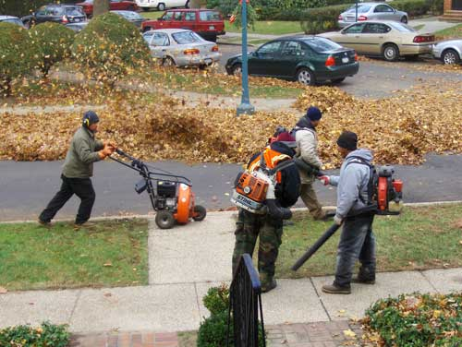
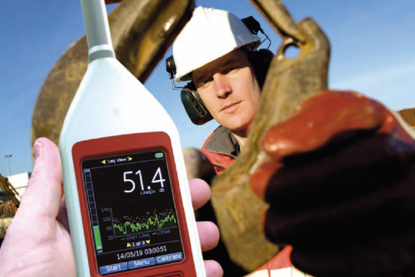

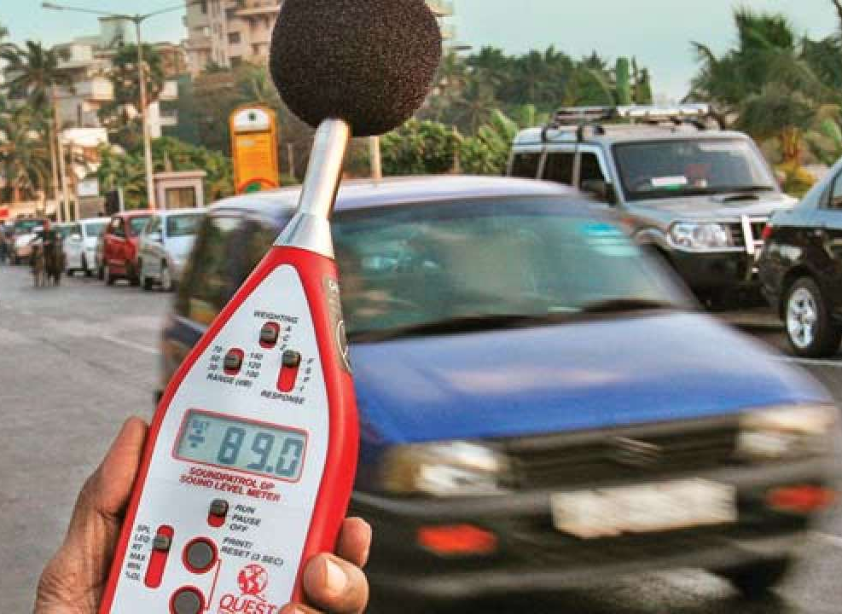
VUI is Not Ready
Residential
Noise
Construction
Noise
Traffic Noise
Crowd Noise
NOISE
No. 1 Barrier to Acoustic-based VUI
Notes:
The answer is no. the current voice user interface is not ready
Think about it, would you do any voice-based interactions when there is much noise, like traffic noise , residential noise , construction noise or crowd noise?
Obviously, we won’t because we know we will fail.
It’s a common sense that noise is the biggest barrier to acoustic based voice User interface

Slide 6
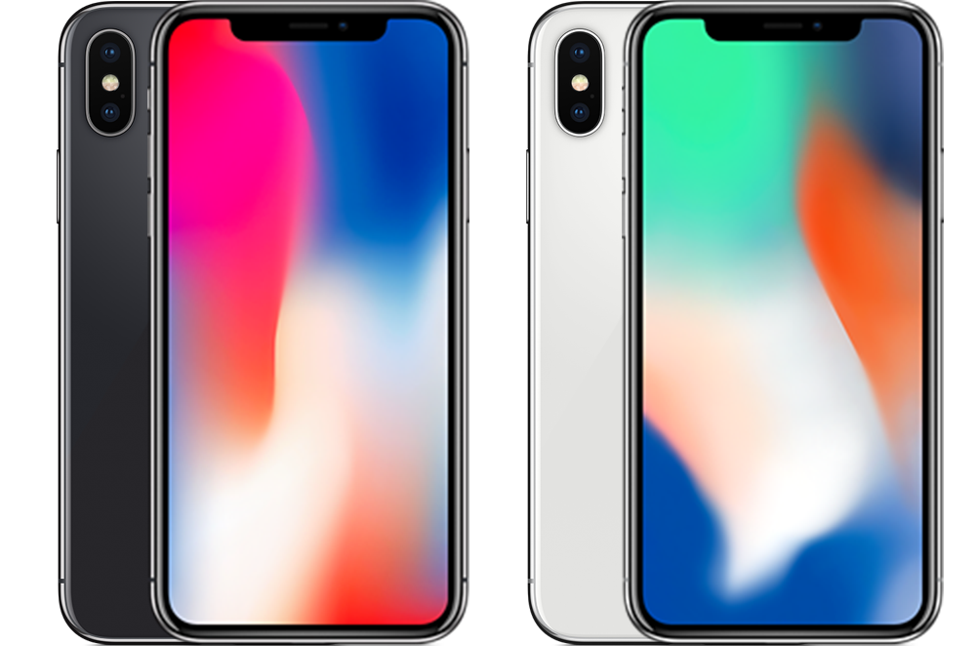
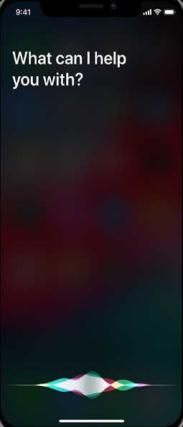
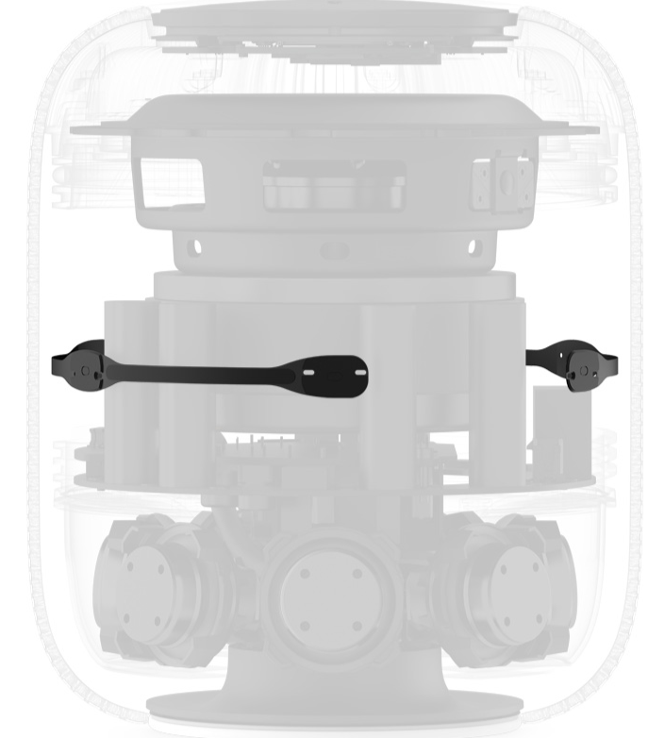
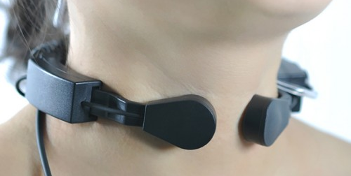
Current Practice
Rear MIC
Front MIC
6-MIC Array
Microphone Array^{[1]}
  More MICs for complex noise
  ANC algorithms are hard to design
Throat-MIC^{[2]}
  Obstruct the daily activities
  Skin irritations
Better Solution?
Bottom MIC
[1] Elko, Gary W., Jens M. Meyer, and Tomas Fritz Gaensler. "Noise-reducing directional microphone array." U.S. Patent No. 9,301,049. 29 Mar. 2016.
[2] Mathew, Lani Rachel, and K. Gopakumar. "Voice analysis using acoustic and throat microphones for speech therapy." Proc. Interspeech. 2018.
Notes:
Voice community has put much efforts on acoustic noise cancellation
Most of them are related to microphone array or throat microphone
Microphone array using multiple microphones to distinguish the voice from environmental noise, it costs and requires active noise cancellation algorithm, which is hard to design
Throat microphone provides acceptable noise resistance by stick MIC to throat but will cause skin irritations and obstruct daily activities

Slide 7
Current Practice
Rear MIC
Front MIC
6-MIC Array
Better Solution?
Bottom MIC
Notes:
So, is there any better solution for modern and future VUIs?

Slide 8
Current Practice
Better Solution?
Wave Ear
Rear MIC
Front MIC
6-MIC Array
Noise-resistant
User-friendly
Informative
Low-cost
Bottom MIC
Notes:
The solution should be noise resistant and user friendly.
It should not be influenced by noise or cause inconvenience to users
Moreover, it should be informative and low-cost, which means the quality of voice should be guaranteed and the hardware shall be cheap

Slide 9
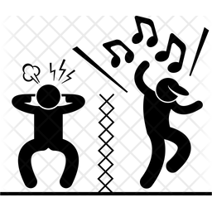


Current Practice
Wave Ear
User
(Vocal Vibration)
User
(Vocal Vibration)
Air vibration
Millimeter wave
Microphones (MEMS^{[1]})
Audio Signal Processing
Machine learning
[1] MEMS: Microelectromechanical Systems
Notes:
With these requirements in our mind, we proposed Wave Ear, a brand-new framework to facilitate a noise-resistant and non-contact voice sensing
So here is the comparison between the traditional framework and the wave ear.
The traditional framework is indirect because the user’s voice is propagated by air vibration, where many kinds of noise exists.
This composite air vibration is measured by microphones and converted to signal related to voice by mems.
Different from the current practice,
we use mmwave to directly capture the high-fidelity vocal vibration of the user, and learn the end-to-end mapping from the mmwave to voice, thereby eliminate the noise.

Slide 10
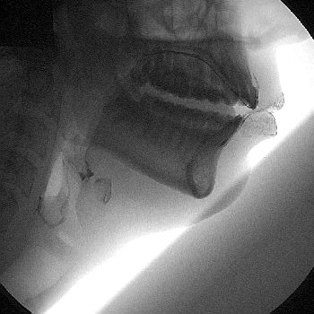
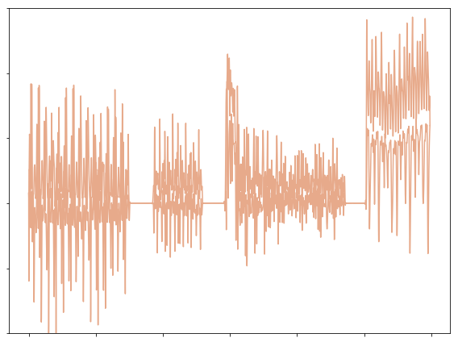
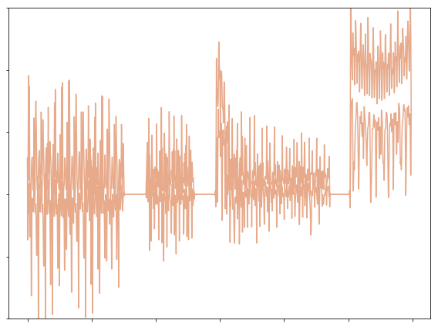
Vocal Vibration
Near-throat skin vibration
  Caused by airflow and articulatory organs
  Contains speech information
Millimeter Wave (mmWave)
  High resolution for displacement measurement
(a) mmWave data (1st trial)
(b) mmWave data (2nd trial)
Amplitude
“B”
“C”
“D”
“B”
“C”
“D”
“A”
“A”
Time
Notes:
First, we take a close look at vocal vibration.
Vocal vibration is the near-throat skin vibration caused by speech airflow and movement of articulatory organs.
And we also found mmWave can provide enough resolution to capture the minute displacement of vocal vibration.
In our initial study, we pointed the mmwave to subjects and asked them to speak ABCD for two times
the reflected mmWave from throat share the similar envelop
This indicates the feasibility of the wave ear.

Slide 11
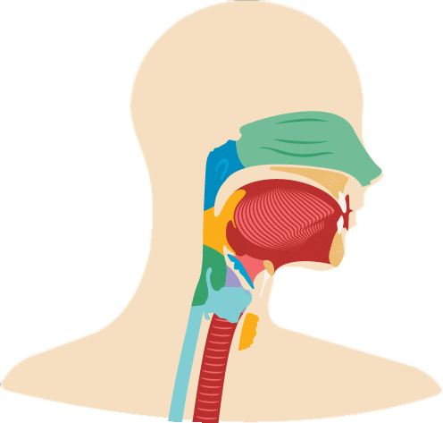
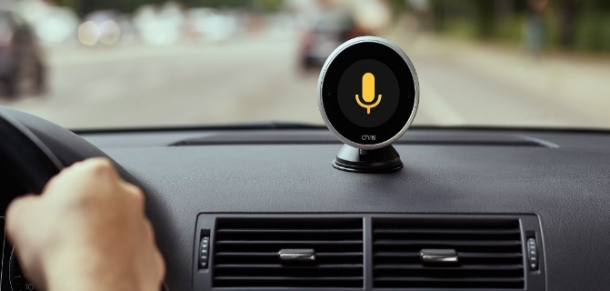
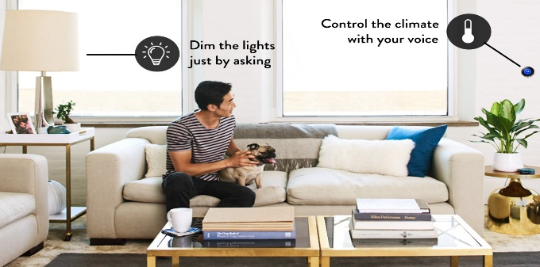


WaveEar Concept Overview
Scenarios
Get directions to my office
Turn on the light
mmWave sensing
Play my favorite music
Notes:
So here is the general idea of how WaveEar works.
WaveEar would point the mmWave to the throat of the speaking user
and the vocal vibration of the user would interfere the reflected mmWave and encode the speech information to it
We can extract the voice information in the reflected mmWave to reconstruct the user’s voice for noise resistant Voice user interactions in multiple scenarios

Slide 12
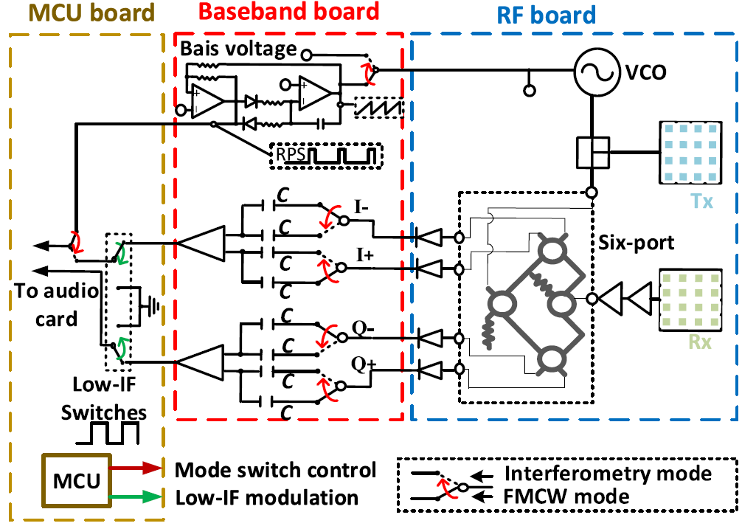
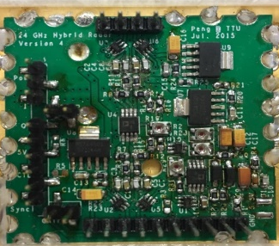
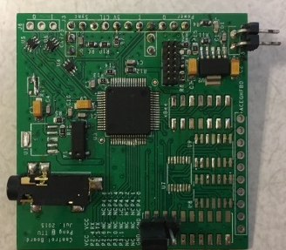
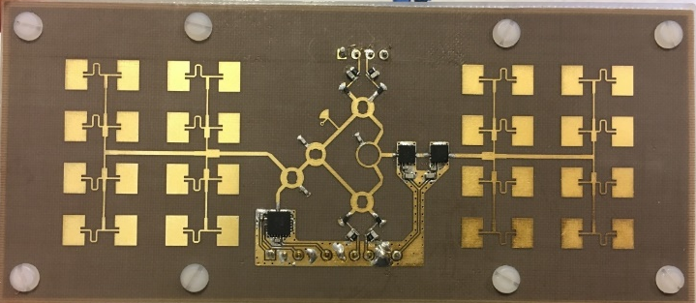
mmWave Probe
Operational-amplifier to generate an analog sawtooth signal
Analog sawtooth signal controls a free-running voltage-controlled oscillator (VCO) to generate the Frequency-Modulate Continuous-mmWave.
baseband board
MCU board
3.7mm
40mm
5mm
RF board
Notes:
let’s look at how the mmWave is generated
We design a low cost mmWave probe to facilitate FMCW mmWave generation. It contains baseband, MCU, and RF boards
The Operational-amplifier in baseband board generates an analog sawtooth signal
Analog sawtooth signal controls a free-running voltage-controlled oscillator (VCO) in RF board to generate the Frequency-Modulate Continuous-mmWave.
Using this probe, Wave Ear can emit high-frequency mmWave beam at 24 Gigaherz

Slide 13
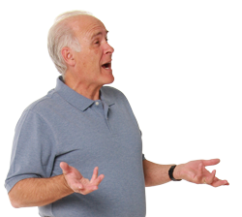

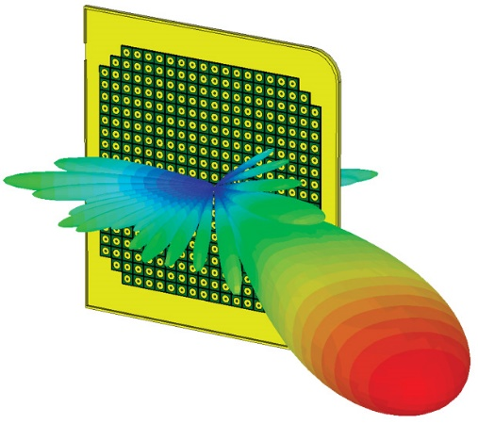
Challenge 1: Interact in unfixed position
Antenna gain attenuates rapidly in side slope
Low SNR
hurts the sensing quality
Keep that throat aimed!
Side slope
Cannot sense
Notes:
Of course, users hope to use voice in any location around the WaveEar, which means the interaction with WaveEar could happen in unfixed positions
Pointing the mmwave beam towards the throat would be very important because antenna gain attenuates rapidly in side slope.
The attenuation makes lower Signal noise ratio and hurts the sensing quality
So how could we keep the throat aimed?

Slide 14
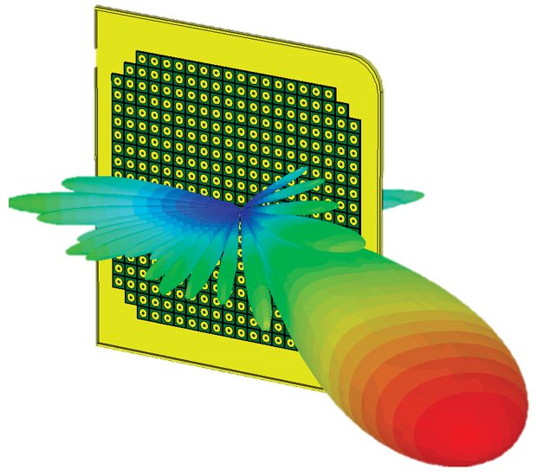

Solution 1: Throat localization
Digital beamforming
  mmWave probe steers beam in all directions
  Decision tree detects throat
Beamforming
Searching Throat
Notes:
Digital beamforming helps.
Waveear manipulates the mmWave probe to steer beam in all directions and then feeds the reflected mmwave to throat detection module.
In the module, Decision tree detects throat according to the signal features

Slide 15
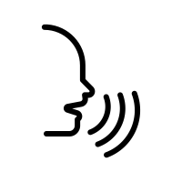
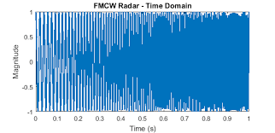
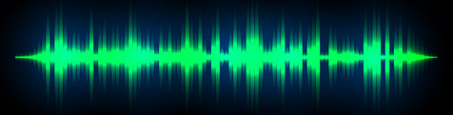


Challenge 2: Implicit Speech Information
Should we transform mmWave to voice in time domain?
Important Frequency-domain info is implicit and hard to extract
Reflected mmWave
Voice
Notes:
As throat localized, shall we start the transformation from mmWave to voice in time domain?
This would be difficult because the Important Frequency-domain speech infomation is implicit and hard to extract

Slide 16

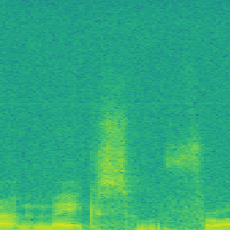

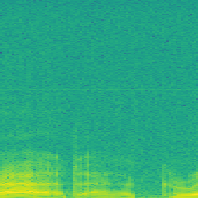

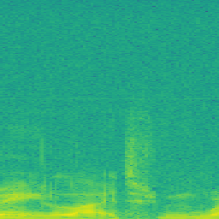
Solution 2: Spectrogram Representation to Augment Features
Presents more correlations and patterns, such as formant and sound intensity
Overlap
Window 2
Spectrogram
Window 1
Window 3
mmWave
Voice
Notes:
here we augment those implicit Frequency-domain info using the spectrogram.
Spectrogram is a visual representation of a signal in frequency domain as it varies with time. It presents more correlations and patterns that are important in voice, such as formant and sound intensity, which are very important for we humans to understand the voice
The next step the learning the voice spectrogram from that of mmWave

Slide 17


Challenge 3: Transformation between mmWave and Voice
Requires changing large part of the spectrogram to appear coherently
Minute changes in mmWave are related to huge differences in voice
Notes:
We could see that the learning requires changing large part of the spectrogram to appear coherently
And minute changes in mmWave spectrogram are related to huge differences in that of the voice

Slide 18
Challenge 3: Transformation between mmWave and Voice
Requires changing large part of the spectrogram to appear coherently
Minute changes in mmWave are related to huge differences in voice
Notes:
We could see that the learning requires changing large part of the spectrogram to appear coherently
And minute changes in mmWave spectrogram are related to huge differences in that of the voice

Slide 19

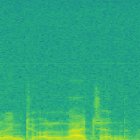


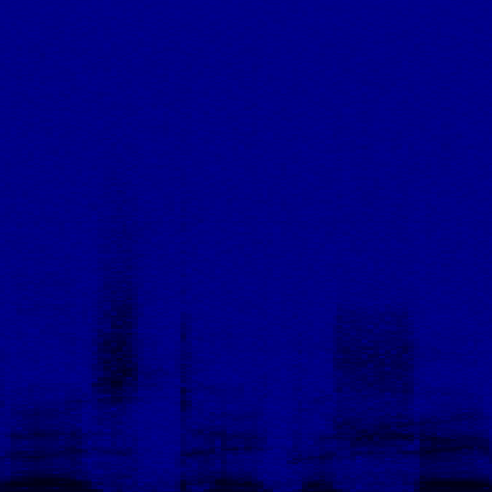


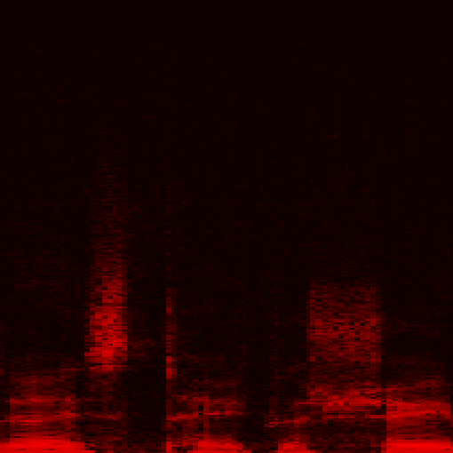
Solution 3: Wave-voice Net
Encoder exhaustively extracts vocal vibration information
Decoder decodes information to voice spectrogram
Griffin-Lim algorithm^{[1]} reconstructs voice
Encoder
Decoder
Residual Block^{[2]}
[1] Griffin, Daniel, and Jae Lim. "Signal estimation from modified short-time Fourier transform." IEEE Transactions on Acoustics, Speech, and Signal Processing 32.2 (1984): 236-243.
[2] He K, Zhang X, Ren S, et al. Deep residual learning for image recognition[C]//Proceedings of the IEEE conference on computer vision and pattern recognition. 2016: 770-778.
Notes:
So here we introduce Wave-voice net to terminate this challenge.
The wave voice net consists of encoder, decoder, and residual blcoks.
The encoder extracts vocal vibration information from the mmWave and the decoder decodes information to voice spectrogram.
The residual blocks in encoder makes the net deeper so that the short-term and long-term voice information could be exhaustively extracted
Finally, Griffin-Lim algorithm reconstructs voice from the learned spectrogram

Slide 20
Evaluation
Notes:
Then we evaluated the performance of WaveEar

Slide 21
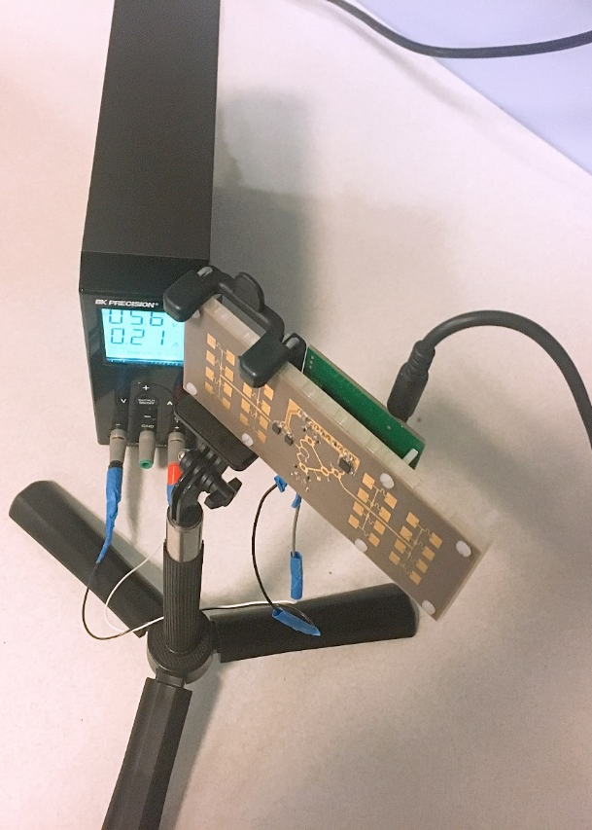
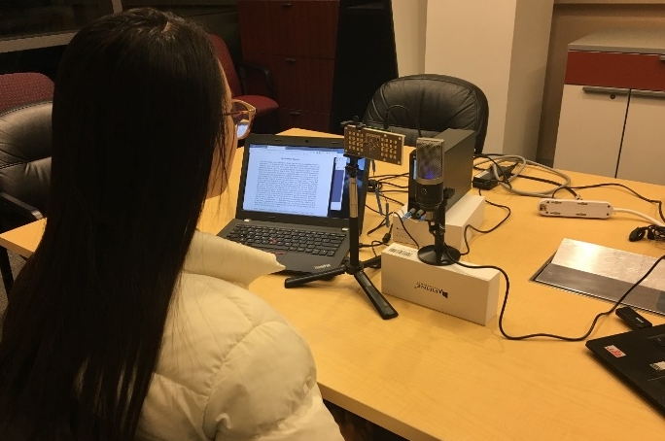
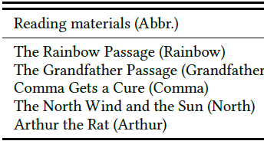
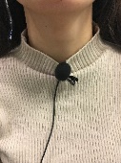
Experimental Setup
Implementation
  Customized mmWave FMCW probe
    11.8 cm×4.5 cm×1.5 cm, 45.4g, 1.23W
  Wave-voice Net is implemented in PyTorch, trained on 3 GPUs
Participants
  21 Subjects (11 males and 10 females, ages from 21 to 35)
  Read 5 materials^{[1]} including all phonemes in English, totally 43722 samples
[1] Fairbanks, G. (1969). Voice and Articulation Drillbook. (pp. 124-139). New York: Harper & Row.
Notes:
In experimental setup, we implement the Customized mmWave FMCW probe and the Wave-voice net is implemented in Pytorch trained on 3 gpus
There are totally 21 participants, including 11 males and 10 females, their ages are from 21 to 35 years old
The participants are asked to Read 5 materials listed here, which includes all phonemes in English
so we totally got more than forty thousand one-second samples

Slide 22
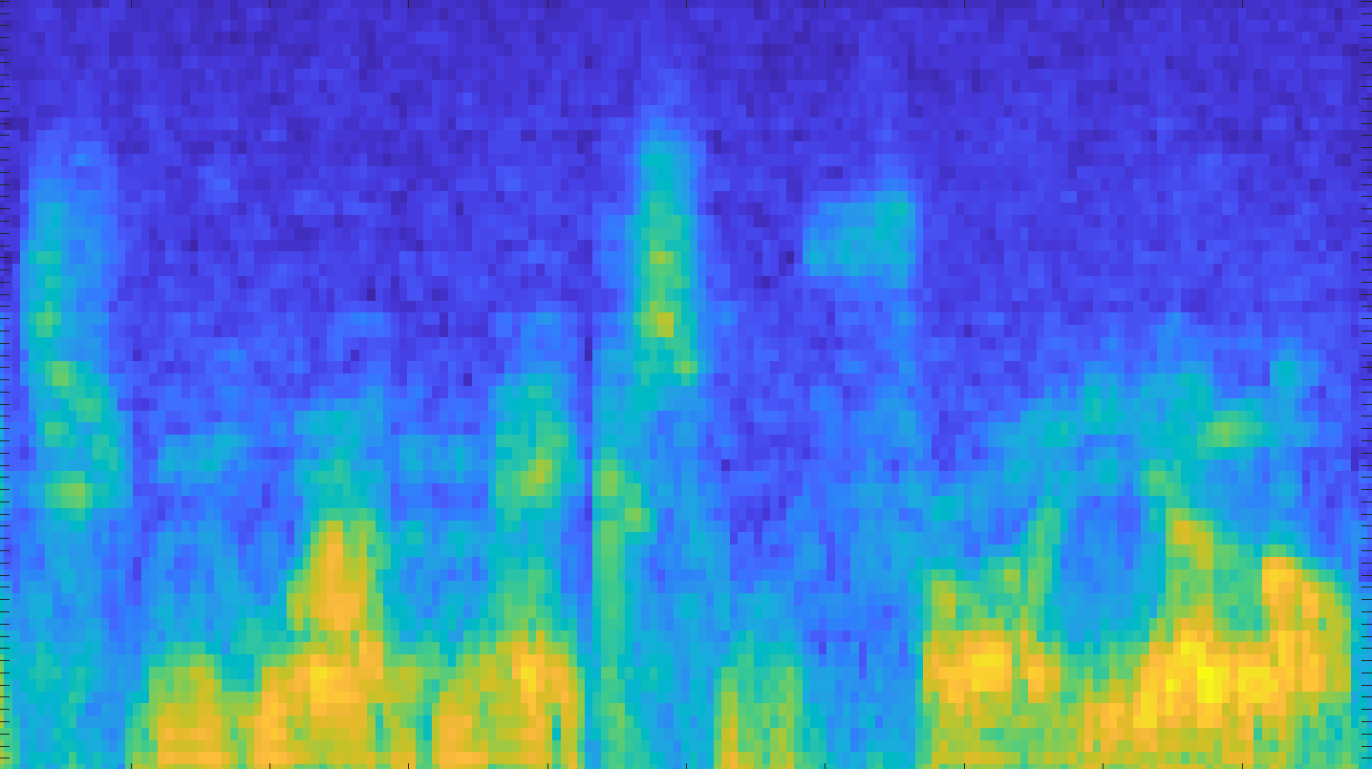
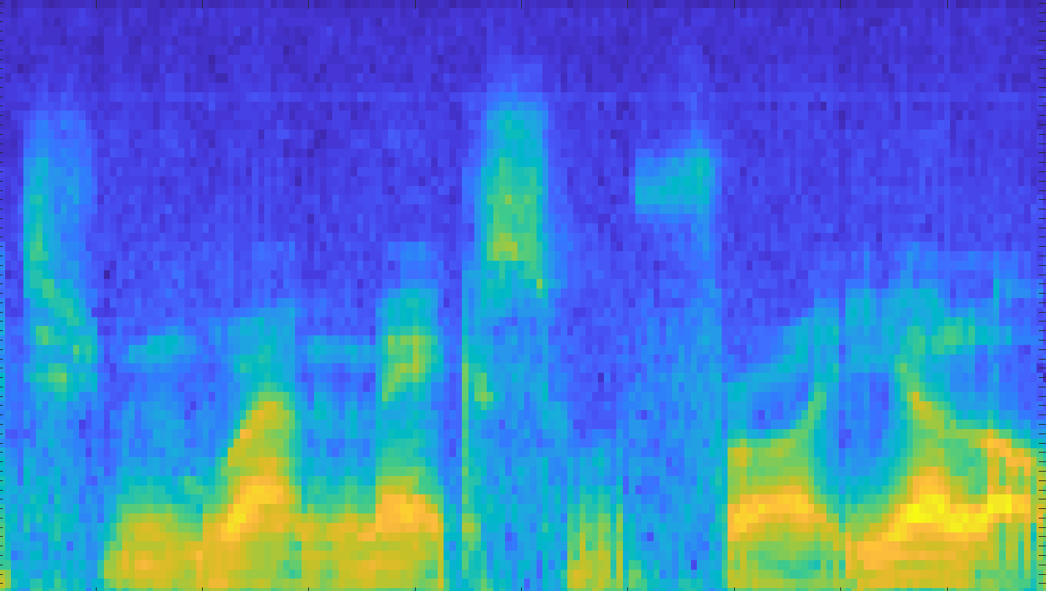
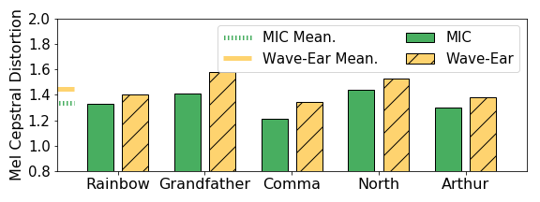
How Accurate is the Voice?
Metric: Mel-Cepstral Distance^{[1]}
Mean Square Error between two Mel-spectrograms
Reconstructed Voice
Ground truth
[1] Kubichek, R. "Mel-cepstral distance measure for objective speech quality assessment." Proceedings of IEEE Pacific Rim Conference on Communications Computers and Signal Processing. Vol. 1. IEEE, 1993.
Notes:
To evaluate our system, the first question we will still ask: how accurate is our voice?
The metric is mel-cepstral distortion or MCD. It is a psychoacoustically motivated measure, which can evaluate the voice considering the human acoustic system preference.
We compare our reconstructed voice with the ground truth in mel cepstral, and compute mean square error among every pixel.
We compare the MCD of WaveEar with that of microphone in a quiet environment. 21 subjects read the materials in front of the mmwave probe
The overall MCD of Waveear is close to that of microphone.
This indicates WaveEar can reconstruct clear and high-fidelity voice in quiet environments

Slide 23
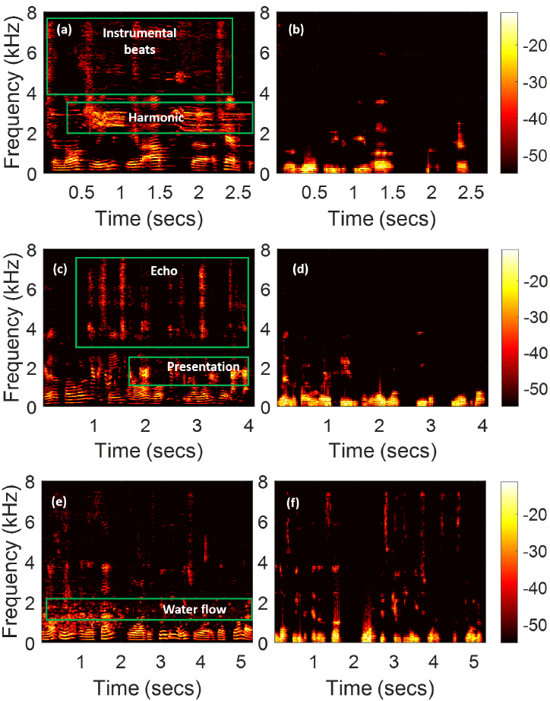
Resilience to Noise
Pop music:
Mic: beats, harmonics
WaveEar: clear speech voice
Notes:
How about noisy environments?
We do the experiment with the same setup but in more noisy environments.
The first is the pop music
The left side are the spectrograms of the microphone recorded sound and the spectrograms of WaveEar are listed in right side
We could see that the instrumental and harmonic noise cannot break into the waveear

Slide 24
Resilience to Noise
Presentation:
Mic: echo, presentation
WaveEar: clear speech voice
Notes:
The next is the presentation interference.
The presentation sound and its echo also cannot break into the waveear

Slide 25
Resilience to Noise
Water flow:
Mic: 1-2KHz water flow
WaveEar: clear speech voice
Notes:
And finally we use the sound of water flow, whose frequency is very close the human voice. We could see that the noise is not shown in the spectrogram of the reconstructed noise

Slide 26
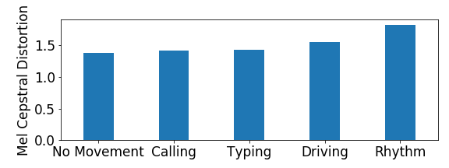
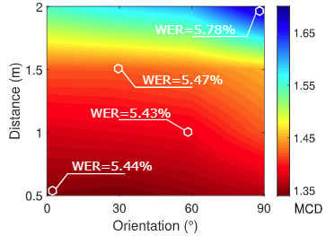
Robustness Analysis
Impact of body motion
Impact of distance and orientation
Superior performance with small-range body motions
Superior performance within 1.5m sensing distance
Notes:
A very important question we may ask is: if I interact with waveear while doing other task, for example, driving, will waveear still work?
So we conduct experiments to analyze the robustness of wave ear.
Our analysis is two-part, the first part studies the impact of body motion and the other one studies the impact of sensing distance and orientation.
In the body motion part the we see that compare with the MCD when subject keep steady, small-range body motions like calling, typing, driving, and rhythm wont increase much MCD
This means that WaveEar is robust to small range body motions
As for the sensing distance and orientation, we can see WaveEar performs well within 1.5m and 90 degrees of the orientation
We also test the word error rate of the reconstructed voice in speech to text system, which is also not influenced by distance and orientation

Slide 27
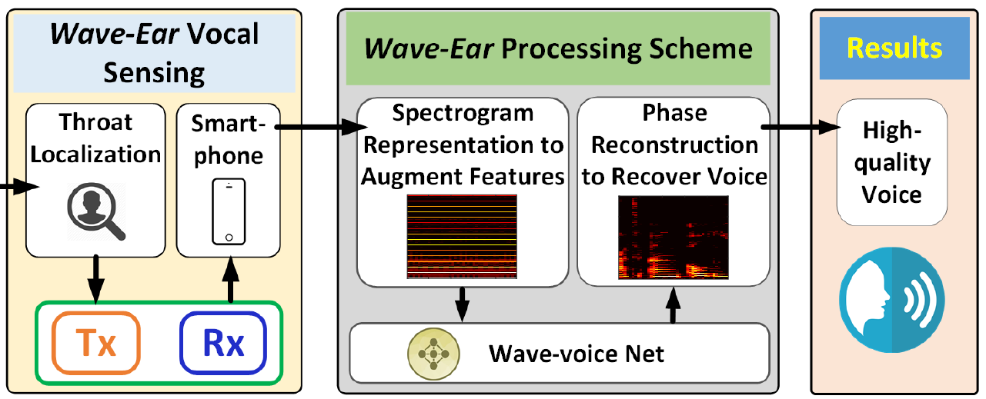
Summary
End-to-end non-contact noise-resistant vocal sensing system
Frequency-Modulated Continuous-Wave (FMCW) based mmWave probe and corresponding throat localization algorithm
Experiments to evaluate noise resistance and robustness to other influences
Wave-voice net to learn the end-to-end transformation from mmWave to voice

Slide 28
相关讨论
文章优缺点总结
  有功劳：用毫米波“感知”语音具有一定的应用创新性
  有苦劳：自主设计实现mmWave硬件
  有不足：距离近，准确率低，应用鸡肋，数据没开源
可能的改进
  提高mmWave频率以增强解析度
  领域特定/领域通用的网络结构设计
  语音鉴权功能
  检测呼吸，心跳或其他身体部分
Notes:
So this is our exploratory study and obviously there are more issues we’d like to discuss.

Slide 29
Expand idea X
X+Y
  多技术手段结合，取长补短
  VIO：VO + IMU
  Widar 3.0：WiDance + DL
X’
  应用场景的变化
  毫米波+工业场景：振动幅度/频率感知、物体（固体、液体）特性感知
  毫米波+农业场景：土壤湿度/PH值感知、非接触式的家畜健康监测
  毫米波+医疗场景：心跳/呼吸感知
  毫米波+人机交互：成像、读唇/语音/手势、识别/鉴权
  SLAM+MEC：边缘SLAM
  VIO+行人手持：VPO
X+-
  技术手段本身的演进
  From RSSI to CSI：获取了更丰富的信息，同样的事情（定位）做得更好
  Widar 1.0 -> Widar 2.0：减了链路数量，仍然能办到同样的事情
Notes:
So this is our exploratory study and obviously there are more issues we’d like to discuss.

Slide 30
Thanks
Q & A
WaveEar:
Exploring a mmWave-based Noise-resistant Speech Sensing for Voice-User Interface
Notes:
That’s all my presentation. Thanks very much for your attention

Slide 31
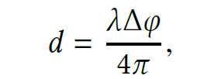
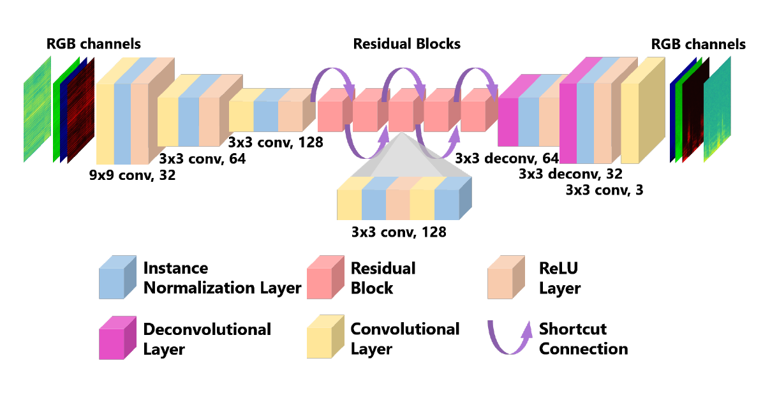
FAQ
反射的毫米波为何含有语音信息
  喉部震动模式中含有语音信息
  微小震动会引起FMCW mmWave相位变化
网络结构：
  本质上是图像到图像的转换
  个人感觉像是在很大程度上复用了Res-net
Notes:
So this is our exploratory study and obviously there are more issues we’d like to discuss.

Slide 32
FAQ
如何从语谱图中重建语音
  复用Griffin-Lim算法
  输入：初始相位+STFT结果（语谱图）
  输出：时序语音
梅尔倒谱失真MCD
  通过提取语音特征参数，评估声音是否失真
  基于听觉生理和感知心理学模型
  广泛应用在语音通信系统和语音合成领域
  没有一个十分明确和客观的可解释原理
Ground Truth
  通高清麦克风采集
Notes:
So this is our exploratory study and obviously there are more issues we’d like to discuss.

