Slide 1
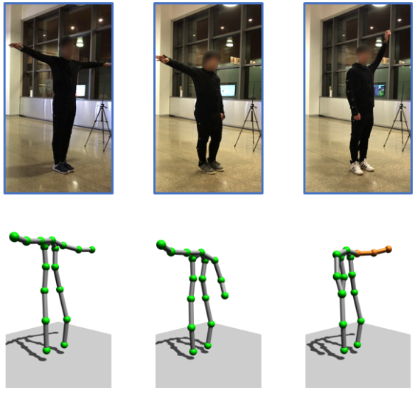
Towards 3D Human Pose Construction Using WiFi
Wenjun Jiang, Hongfei Xue, Chenglin Miao, Shiyang Wang, Sen Lin, Chong Tian, Srinivasan Murali, Haochen Hu, Zhi Sun, Lu Su
MobiCom2020

Slide 2
Video Demo
https://www.youtube.com/watch?v=puU4EvBTPxA

Slide 3
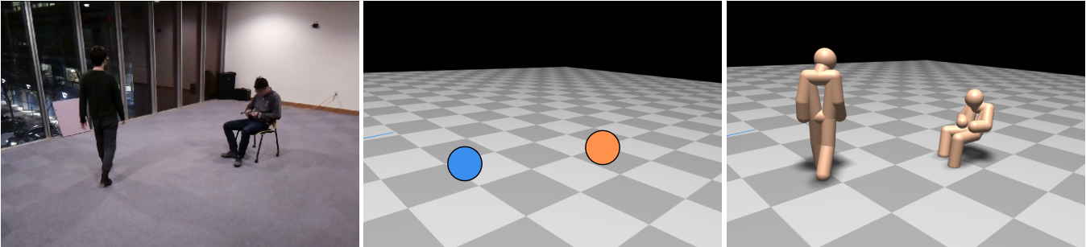
Related Work
RF-Based 3D Skeletons
Mingmin Zhao, Yonglong Tian, Hang Zhao, Muhammad Alsheikh, Tianhong Li, Rumen Hristov, Zachary Kabelac, Dina Katabi, Antonio Torralba.
SIGCOMM 2018

Slide 4
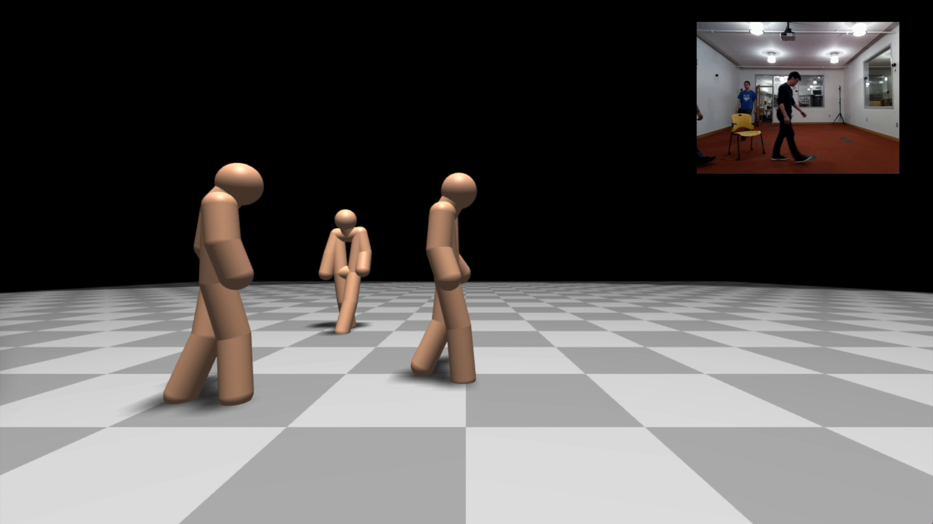
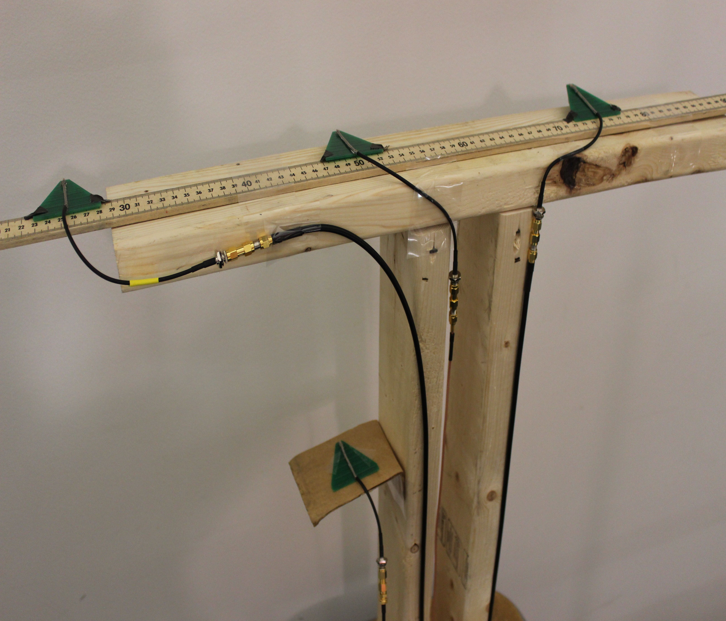
Classification Network
Segmentation Network
Classification Network

Slide 5

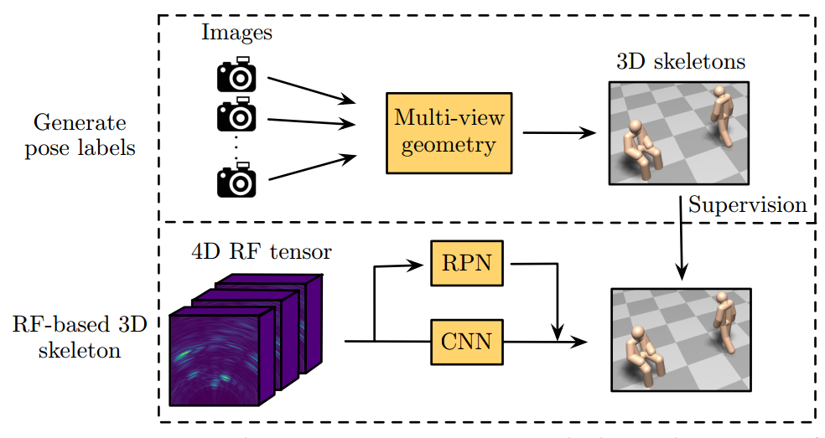
RF-Pose3D
A Review
Reconstruct Groundtruth Pose Model from CV
Vision
Model
Vision
Model
Multi-view
Geometry
Vision
Model

Slide 6





RF-Pose3D
A Review
4D Tensor of RF to Reconstruct Full Human Body
Time
Neural
Network
Neural
Network

Slide 7
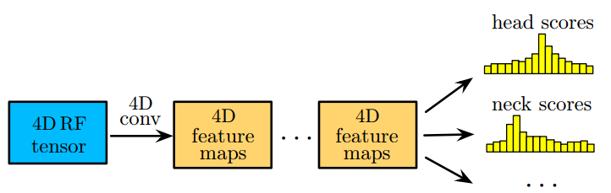
RF-Pose3D
A Review
Reconstruct Pose Model from WiFi Signal with DNN
CNN to classify each joints’ location
Prohibitive requirements in:
hardware (i.e., a carefully assembled and synchronized 16+4 T-shaped antenna array)
RF signals (i.e., FMCW with broad bandwidth of 1.78GHz)
RPN network to crop each target

Slide 8
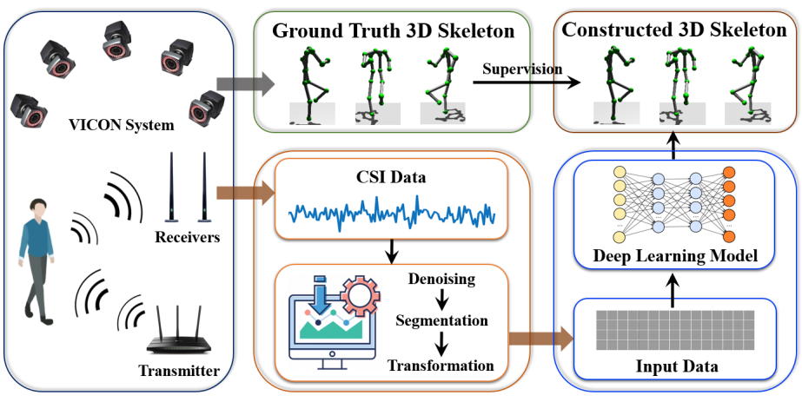
WiPose
Proposed Scheme
Groundtruth pose are estimated from VICON system;
Denoised and transformed CSI are feed into DNN as input;

Slide 9
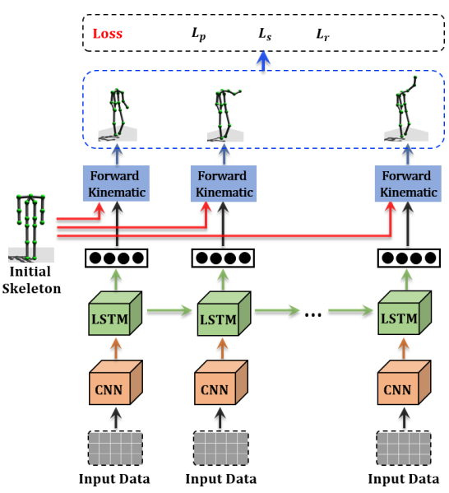



WiPose
Proposed Scheme
DNN framework
DNN are designed to estimate rotations of each joints;
Joints positions are calculated by transforming initial pose with estimated rotations;

Slide 10
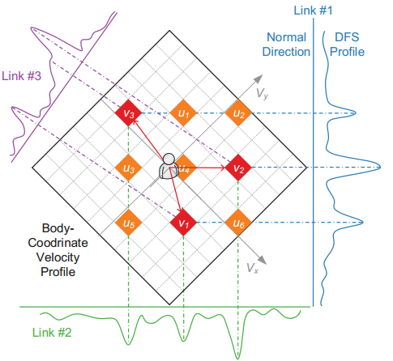
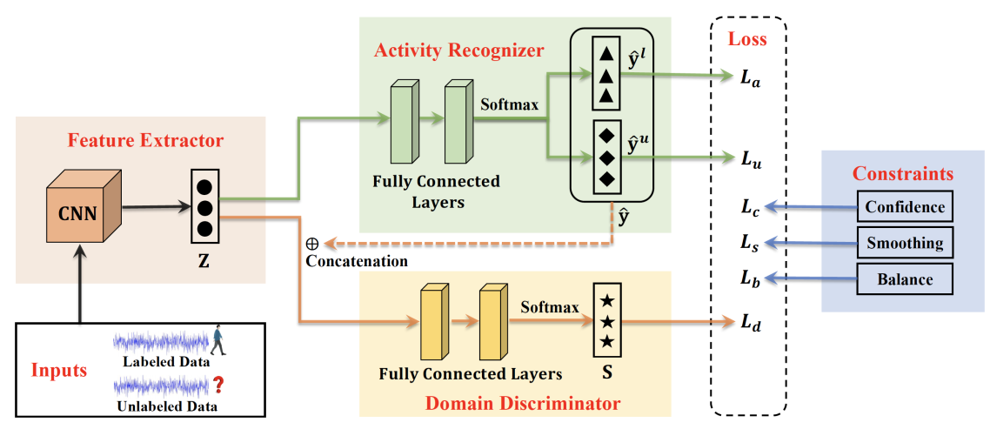
WiPose
Proposed Scheme
Cross-domain generalization
DNN - Based
BVP - Based
Move the domain generalization ability from the upper model level downward to the lower signal level.
EI - MobiCom2016
Widar3.0 – MobiSys2019
×
Significant overhead in data collection and model-retraining
√
Resilient to environment change

Slide 11
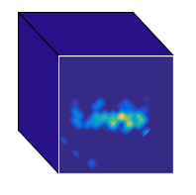
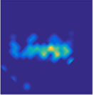


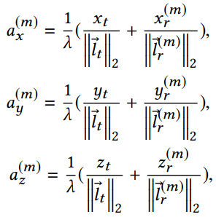
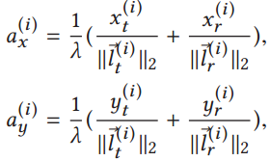







WiPose
Proposed Scheme
$$V_{z}$$
$$V_{y}$$
$$V_{y}$$
$$V_{x}$$
$$V_{x}$$
$BVP$ in 2D dimension
$3DVP$ in 2D dimension

Slide 12
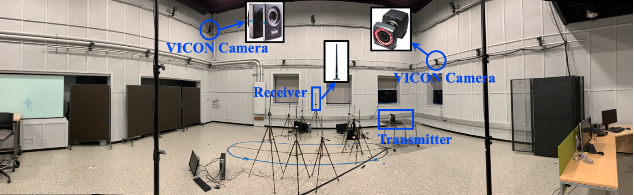
WiPose
Implementation
VICON system as ground truth
multiple WiFi antennas as RF sensor

Slide 13
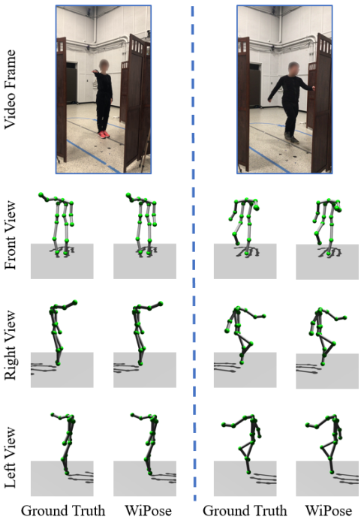
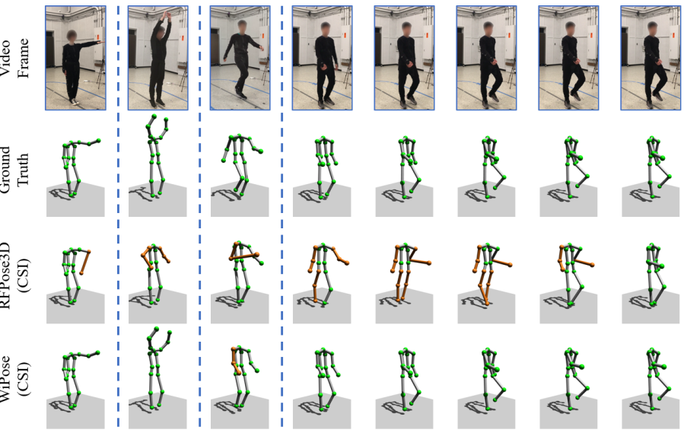
WiPose
Performance
Overall Performance
RF-Pose3D as baseline;
Experiment scenarios include occluded, furnished and randomly deployed room;

Slide 14
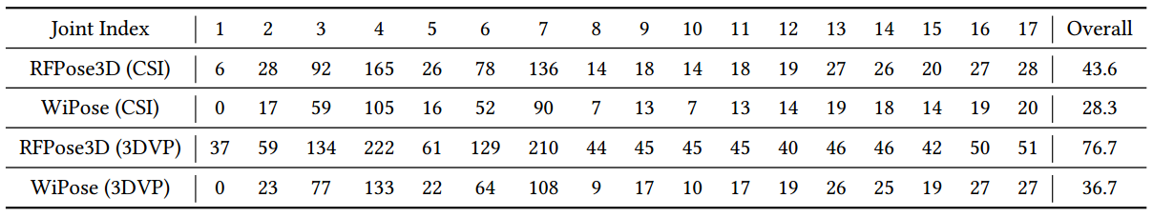
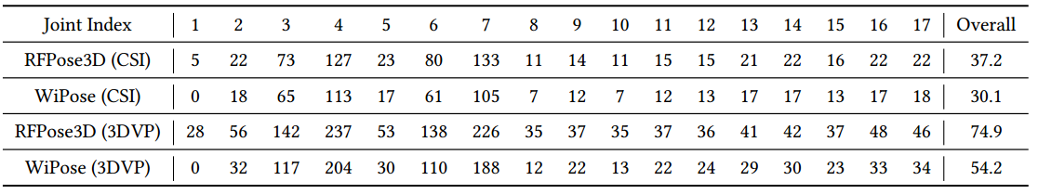
WiPose
Performance
Overall Performance
LOS
Occluded
Average 2.8cm error;
Comparable performance with RF-Pose3D;
Slightly decrease in cross-domain and occluded scenarios;

Slide 15
WiPose
Conclusion
Low cost and pervasive pose estimation with WiFi
High precision 3D pose construction under various scenarios
Cross-domain generalizability

Slide 16
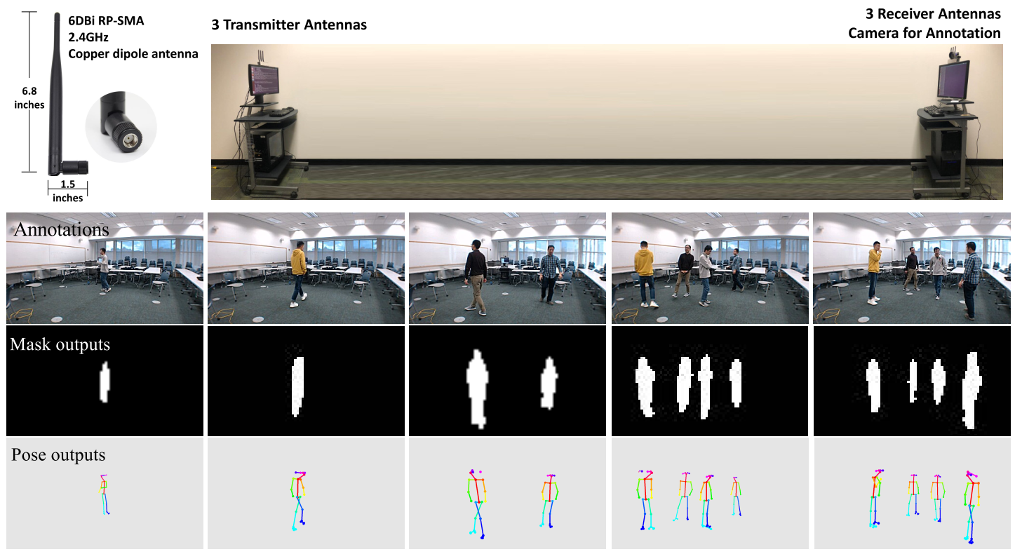
Related Work
Person-in-WiFi: Fine-grained Person Perception using WiFi
Fei Wang, Sanping Zhou, Stanislav Panev, Jinsong Han, Dong Huang
ICCV 2019

Slide 17
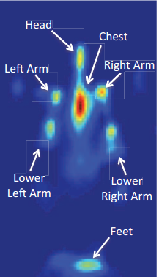
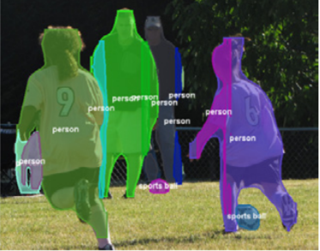
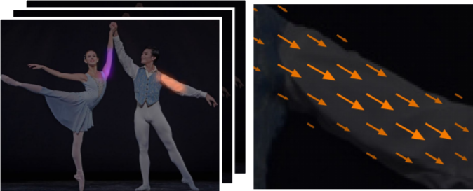
Person-in-WiFi
Segmentation Mask (SM)
Mask-RCNN
Joint Heat Map (JHM)
OpenPose
Part Affinity Fields (PAF)
OpenPose

Slide 18
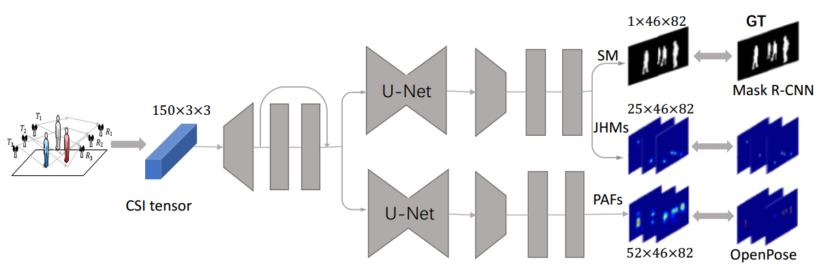






Person-in-WiFi
$$Downsample$$
$$Convolution$$
$$Convolution$$
$$Upsample$$
CSI data are directly mapped to human pose estimated from RGB frames

Slide 19
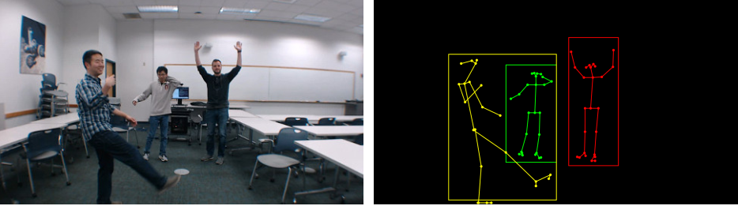
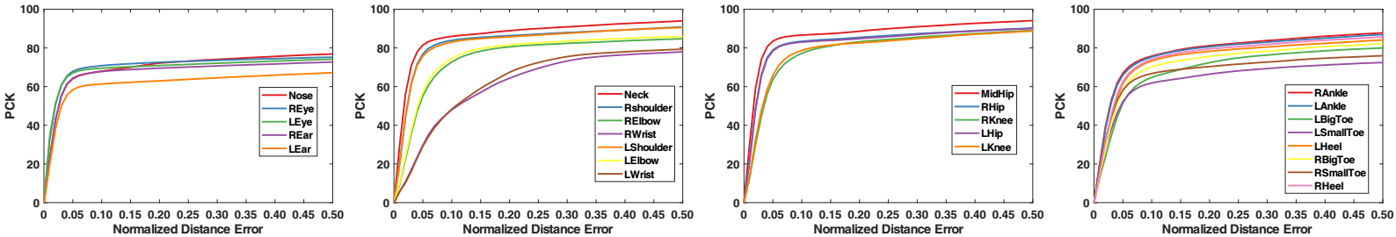
Person-in-WiFi
Performance

Slide 20
Summary to Pose Estimation with RF
RFPose3D, WiPose, Person-in-WiFi
Different decomposition of pose estimation task
Design of complex and specific DNN architecture
TODO…
More complex task of pose reconstruction
Mesh reconstruction
Application based on pose
Activity recognition from pose

Slide 21
Thanks for listening

