Slide 1
Voice Localization Using Nearby Wall Reflections
Sheng shen, Daguan Chen, Yu-Lin Wei, Zhijian Yang, Romit Roy Choudhury
MobiCom 2020

Slide 2


Background
Infer emotion and age group from the user’s voice commands
Knowing user’s age: retrieve information from the web and personalizing human-machine conversations

Slide 3
The importance of user location
Determine which device the user is referring to
“turn on the light”->turn on the light near him
Narrow down the set of possible commands
Command like “add urgent to groceries” + laundry machine ->“add detergent to groceries”
Localize sounds other than voice – say footsteps or running water – could further enrich context-awareness
Remind an independently living old man to take his medicine when he is walking by the medicine cabinet

Slide 4
Related work
VoLoc’s aim to localize arbitrary sound signals with a single device
(1) Signal strength based approaches
indoor multipath; small amplitude variations
(2) Machine learning approaches
Training would impose a prohibitive burden on the users
(3) AoA approaches
Detect additional AoAs for the multipath echoes and trace back the AoA directions to their point of intersection

Slide 5
Problems
Accurate AoAs estimation
Slow velocity, and pauses (or short silences) in acoustic signals.
Wall Geometry Estimation:
Estimating the wall’s <distance, orientation>tuple from the same voice signals
Computationally efficient fusion of AoA, wall-reflection, and user’s height(The user’s height is known)

Slide 6
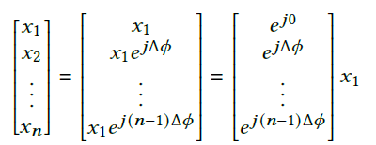
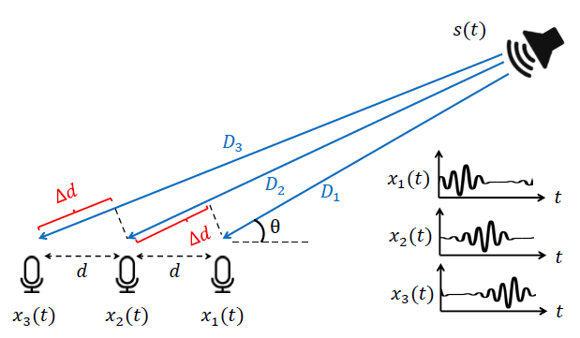
Traditional AoA measure
AoA Estimation without Multipath:
steering the array towards different directions of arrival, computing an AoA energy spectrum, and searching for the maximum peak.
The phase difference between x2(t) and x1(t) :
AoA Estimation under Multipath: No longer accurate

Slide 7
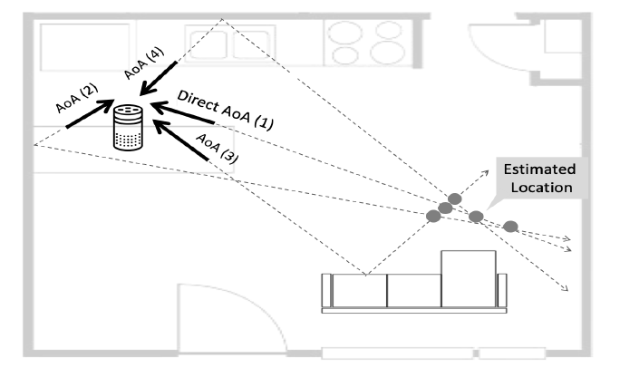
Reverse Triangulation
Past work: scan the environment with depth cameras to create 3D room models
Not all echoes are necessary for tracing back to the source location. The direct path’s AoA and one other AoA would be adequate: say, AoA(1) and AoA(2)
The location and orientation of AoA(2)’s reflector still needs to be inferred.
Require knowledge of reflectors in the environment to reverse triangulate
Smart device located near a wall to connect to a power outlet

Slide 8
Three sub-problems
Precisely estimate AoA for two signal paths in multipath-rich environments.
Estimate the distance and orientation of at least one reflector, and identify the corresponding AoA for reverse triangulation.
Fuse the AoAs, reflector, and height to geometrically infer the user’s indoor location.

Slide 9
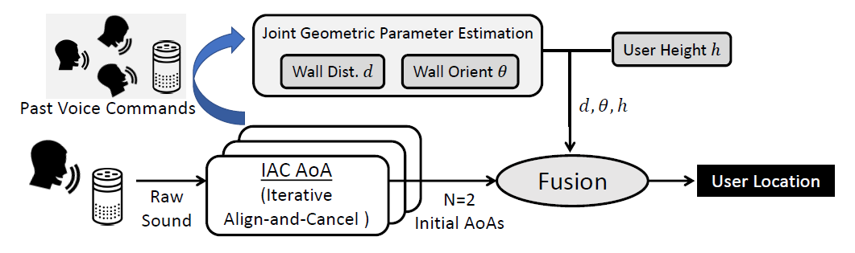
System design

Slide 10
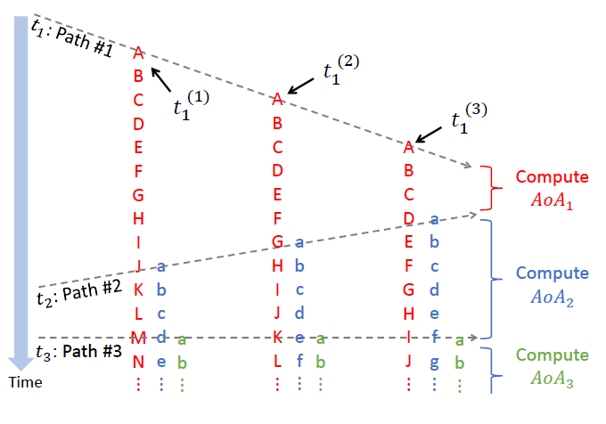
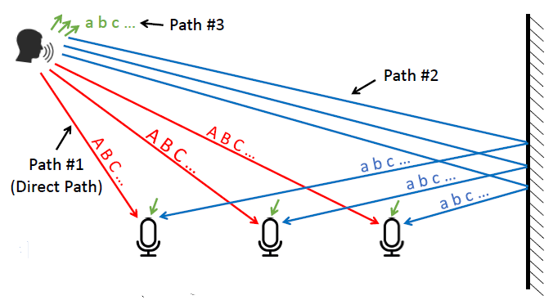
IAC (Iterative Align-and-Cancel) AoA
between 𝑡1 and 𝑡2, all the microphones hear clean, unpolluted direct path signal.
between 𝑡2 and 𝑡3, the microphones receive the signal from only the first two paths.

Slide 11
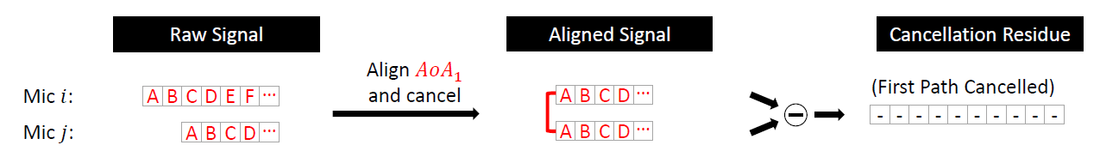
Detecting 𝐴𝑜𝐴1 for the Direct Path
Detect 𝑡1 from the rise of signal energy
select a small time window [𝑡1, 𝑡1 +Δ]
Assume we have found the correct 𝐴𝑜𝐴1; then, for any given pair of microphones,
The time delay between two mics:
Apply this delay between two mics and subtract
After searching across all possible AoAs, we choose the one which minimizes the sum of cancellation errors across all microphone pairs.

Slide 12
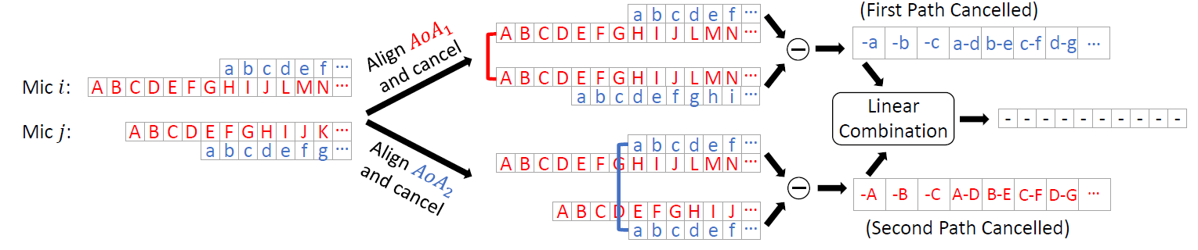
Detecting 𝐴𝑜𝐴2 for the Second Path
the two cancellation residues are identical, except for a scaling factor
align only one path at a time
t2: when the error is growing
search across all possible AoAs for path #2, and for each AoA candidate, we perform the operation in figure and run least squares (LS) over the two residues
AoA2, linear coefficients

Slide 13
Detecting More AoAs
In theory
In fact
the received signal contains 𝐾 paths, and assume we have obtained the AoAs
for the first (𝐾 − 1) paths correctly
(1) The time window [𝑡𝑘, 𝑡𝑘+1] will be very short as 𝑘 grows larger
(2) The latter echoes of the early samples are considerably weaker than the direct path samples
search for the AoA of the 𝐾-th path
when all 𝐾 AoAs are estimated correctly, the 𝐾 cancellation residues are linearly dependent
a linear combination of them (with coefficients as each path’s amplitude) will be a zero vector
VoLoc uses only the first 𝑁 = 2 AoAs

Slide 14
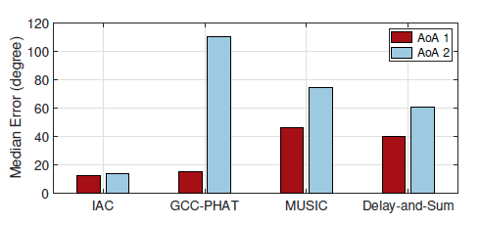
AoA calculation results

Slide 15
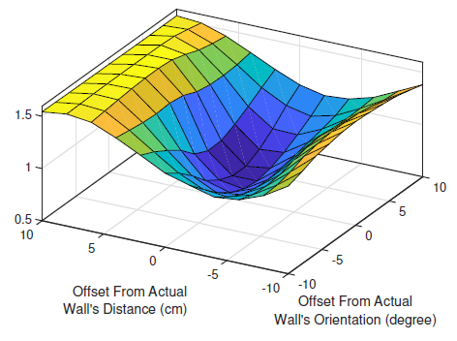
Joint Wall Parameter Estimation
Estimate the two parameters (𝑑, 𝜃) from an ensemble of recent voice samples.
(1) we utilize the direct path AoA as a trustworthy estimate
a granularity of 2 cm and 1◦
(2) our known height ℎ
minimum point of the contour proves to be at 𝑋 = 2 cm and 𝑌 = 1◦
(3) for each <𝑑𝑖 , 𝜃𝑗> candidate,
we compute the corresponding wall AoA
(4) <𝑑𝑖* , 𝜃𝑗*> minimizes the cancellation error
The 𝑋 and 𝑌 axes of the graph are 𝑑 and 𝜃 offsets from the ground truth, meaning the contour should minimize at [0, 0]

Slide 16
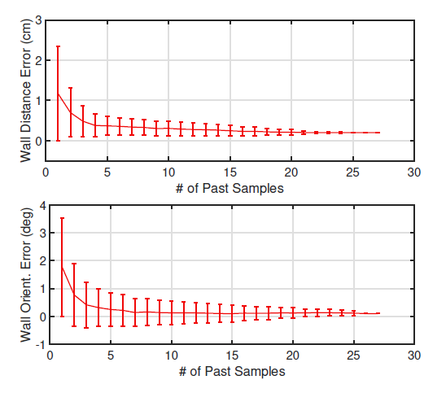
Convergence of Geometric Parameter Estimation

Slide 17
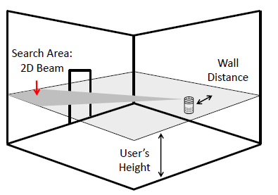
User Localization via Fusion
the two AoAs and (𝑑, 𝜃, h) are known ⟩
reduce the search space to a beam in the 2D plane by direct AoA
for each possible location on this 2D beam, we obtain the parameters for the direct path and wall reflection path using geometry, then compute the cancellation error in AoA calculation.
The best location is determined by having the minimum cancellation error

Slide 18
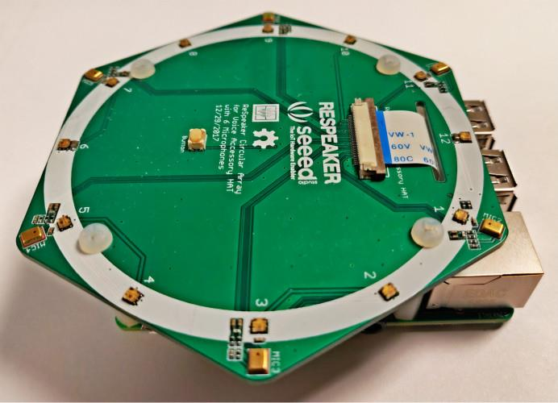
Implementation
Indoor environments:
a studio apartment,
a kitchen,
a student office,
(4) a large conference room.
6 Mics
three student volunteers speak different voice commands to the microphone array in marked position
repeated five times at each location
a total number of 2350 voice commands
some other non-voice sounds
Raspberry Pi
Sample frequency: 16kHz
The distance to the close-by wall ranges between 0.2 m and 0.8 m

Slide 19
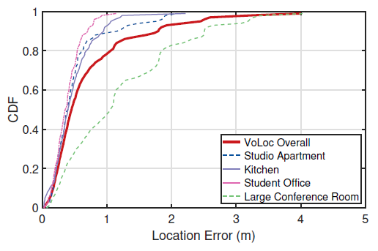
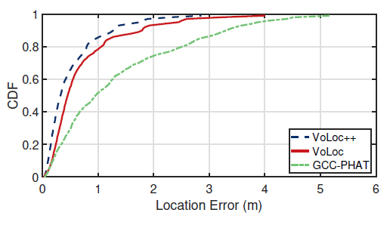
Overall Localization Accuracy
the median error is 0.44 m
the median error is 0.31m, 0.44m, 0.92m

Slide 20
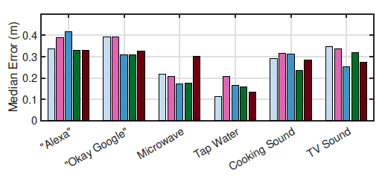
Accuracy Across Different Sounds

Slide 21
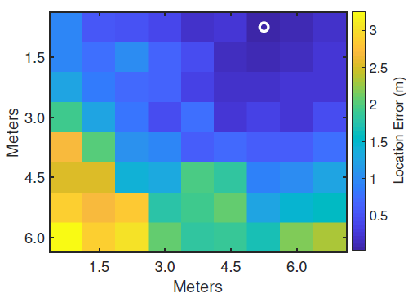
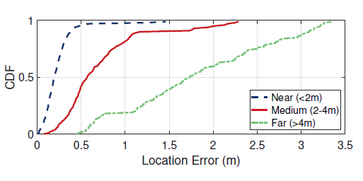
Accuracy Over Distances to device

Slide 22
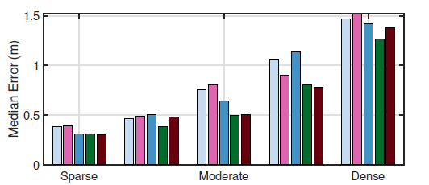
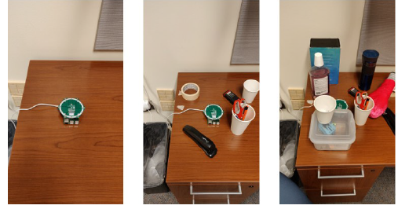
Sensitivity to the Clutter Levels

Slide 23
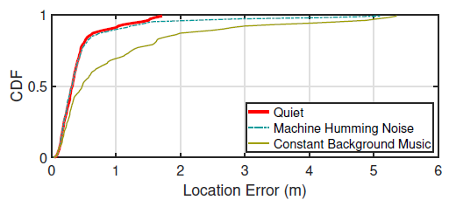
Sensitivity to Background Noise

Slide 24
Limitations and discussion
The limitations in stable reflector and user distance
Block line-of-sight path
Mobile users
Coping with variations in height
Privacy
Semantic interpretation of location

Slide 25
My opinion
Slow velocity for acoustical signal
Detecting 𝐴𝑜𝐴 for the indirect path
Optimization problem

