Slide 1

MARVEL Enabling Mobile Augmented Reality with Low energy and Low Latency
Nov. 6, 2018
Kaifei Chen, Tong Li, Hyung-Sin Kim, David E. Culler, and Randy H. Katz
Computer Science
University of California, Berkeley
Notes:
今天和大家介绍的这篇文章叫MARVEL，一个低能耗，低延迟的移动设备上的增强现实系统。它发表在2018年的Sensys上。

Slide 2
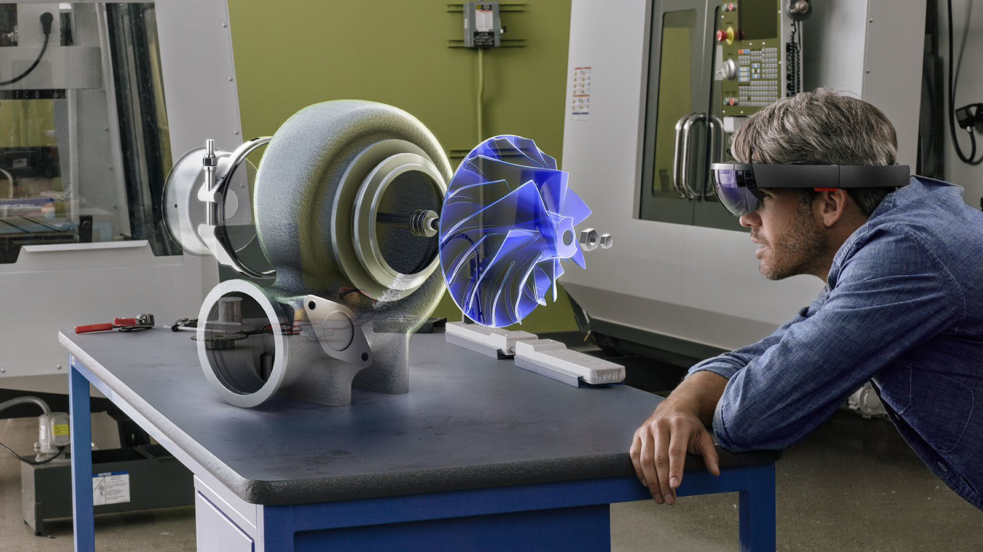
You can Enjoy Augmented Reality!
If you see the real world through a device, you can see or do something more!
Cool!
But Fancy! Expensive!
Notes:
增强现实能给人带来前所未有的新鲜体验，但前提条件是，你得肯掏钱。

Slide 3

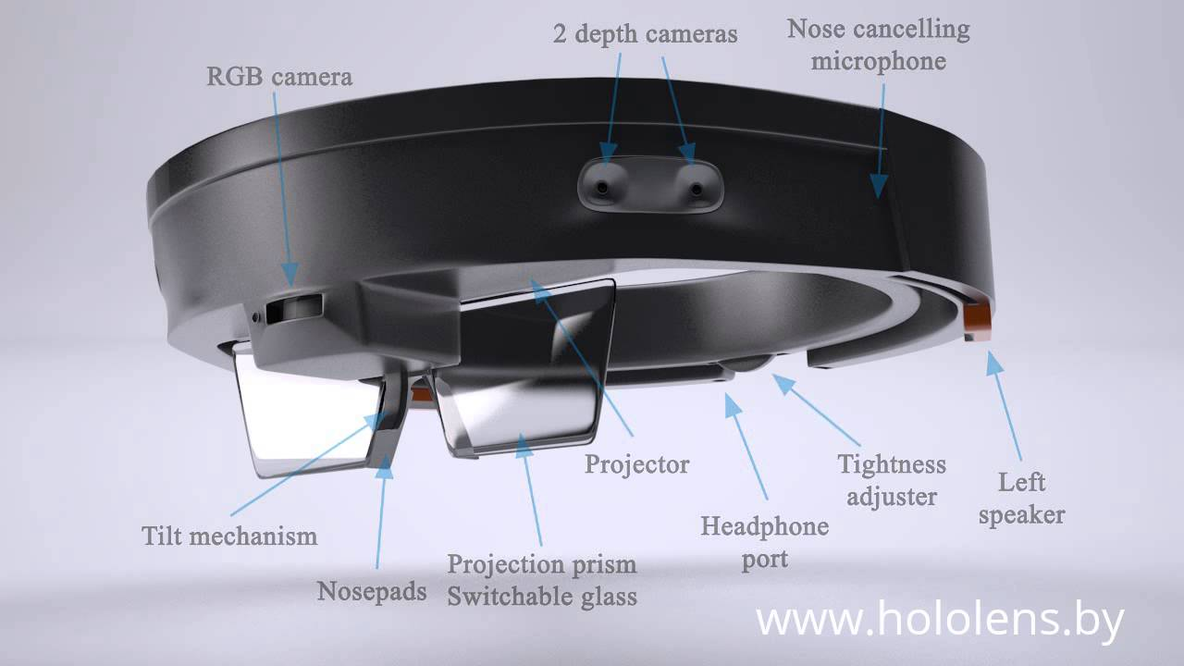
If You Pay Only $3000
If you see the real world through a device, you can see or do something more!
Cool!
But Fancy! Expensive!
Notes:
一个专门的AR设备，上面有各种各样的传感器，它的造价也是非常高的。

Slide 4
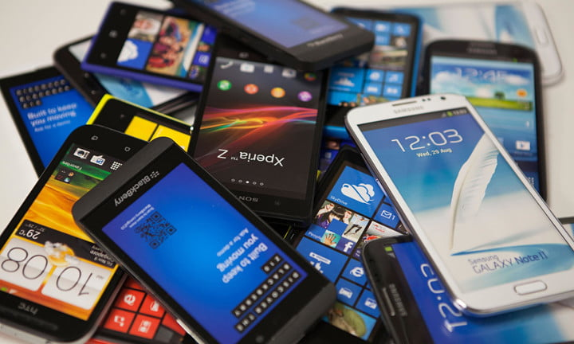
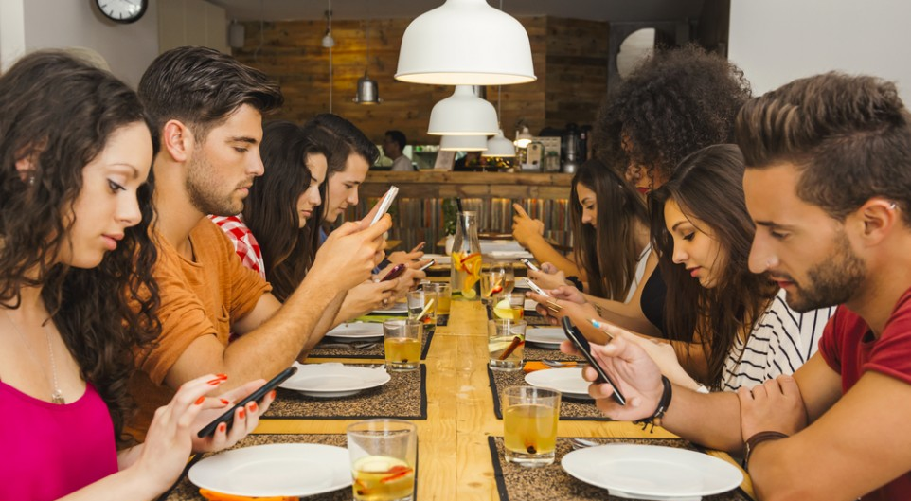
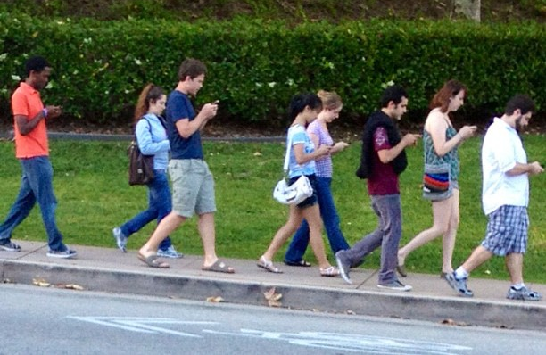
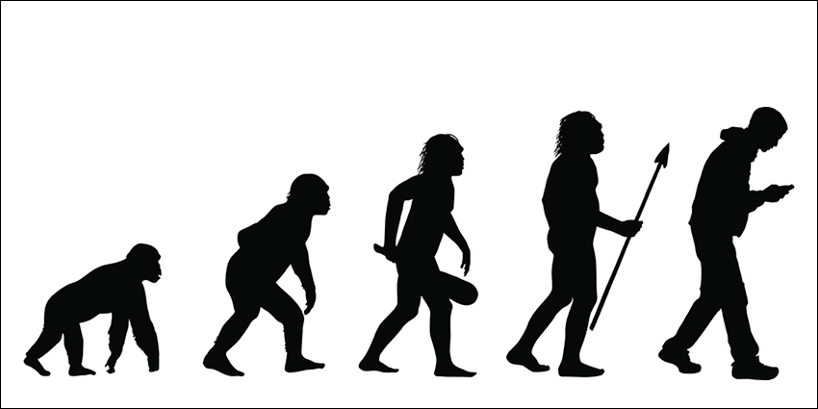
How about Using Our Smartphones?
Notes:
所以人们就想，能不能在手机上实现一个AR系统呢？

Slide 5
Mobile Augmented Reality (MAR)
- AR with a Regular Mobile Phone -
Notes:
也就是MAR的概念。

Slide 6
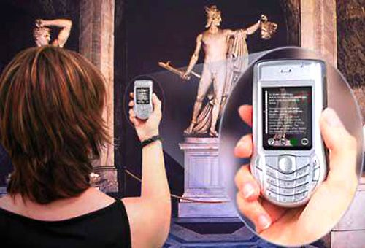
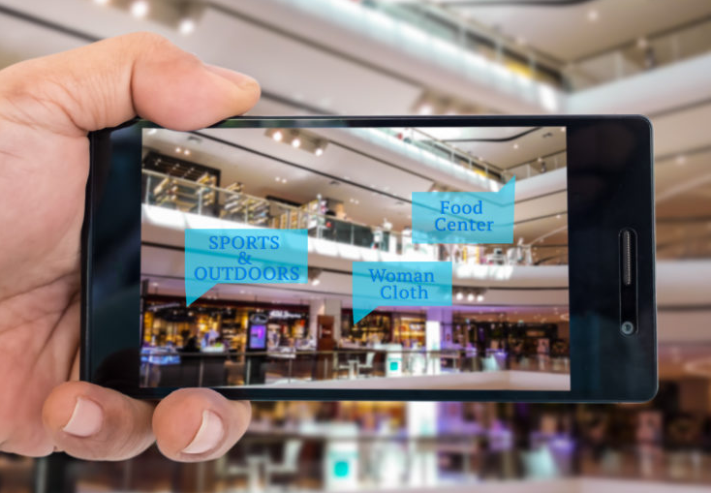
Target: Annotation Service
You get an object’s annotation by pointing your smart-phone at it! (commercial building, airport, museum..)
Notes:
这篇文章想在手机上实现这样一个AR系统，它可以自动识别出拍摄画面中有哪些物体，以及这些物体的位置在哪，这样，就可以在屏幕上为这些物体打上标签。

Slide 7

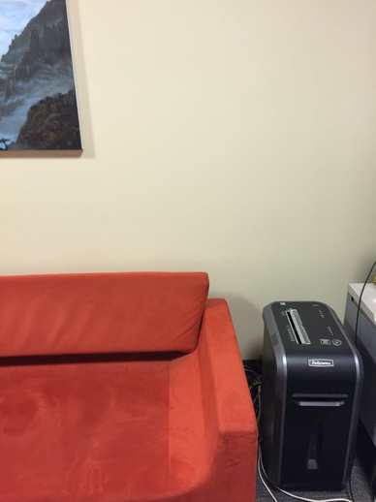
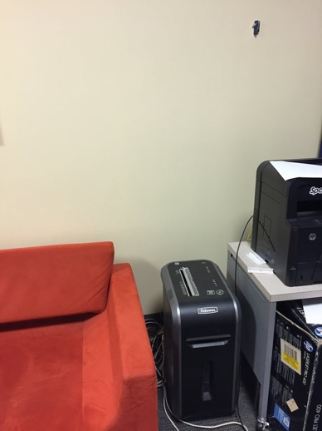
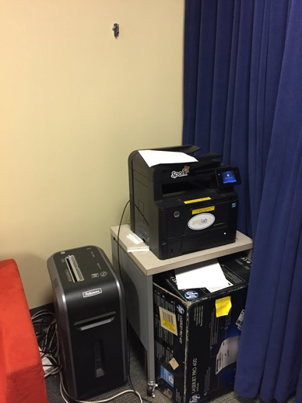
Required User Experience
Fast tracking of
an identified object
Fast Object
Identification
Fast tracking of multiple
identified objects
Fast Identification of
a partially appeared object
Printer
Room 465
Printer
Room 465
Shredder
Room 465
Shredder
Room 465
Move!
Move!
Shredder
Room 465
Notes:
这个系统要满足以下几点要求：
1. 快速从图像中识别出物体
2. 镜头移动时，标签也要跟着物体移动，并且有新物体出现时，要尽快识别出来。
3. 当有多个物体的时候也要能够实时追踪。

Slide 8
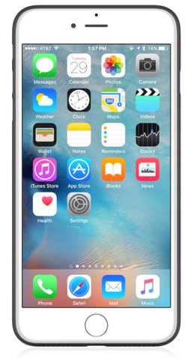









Challenges
Limited Storage
Limited Battery
Notes:
但手机自身的资源限制为MAR系统的实现带来了很多挑战。

Slide 9
Two Extreme Approaches for MAR
Notes:
我们首先介绍两种实现MAR的极端方案

Slide 10



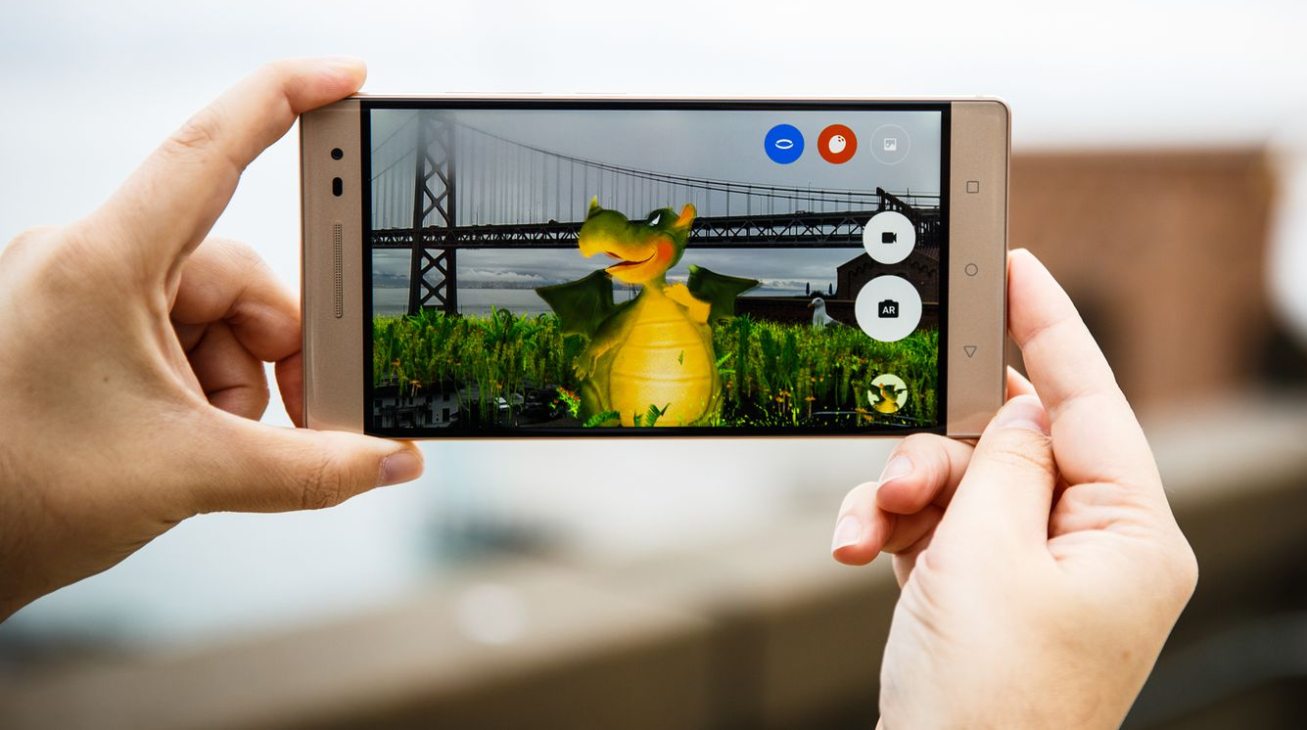
Extreme 1: Do Everything Locally!
Latest phone
(iPhone 8+, Pixel)
Latest software
(ARCore / ARKit)
3D rendering works!
Notes:
一是将所有的任务都放在本地计算，比如ARCore，ARKit，Tango等，

Slide 11
Problem: Do Everything Locally..
Battery drains
(Image computation)
When applied to
an annotation service..
Limited scalability
(Database)
Notes:
这种方案能耗太高，而且适用的规模较小。

Slide 12
Extreme 2: Rely on the Cloud!
Notes:
第二个极端方案是把所有计算都放在云端

Slide 13
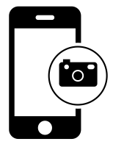
Extreme 2: Rely on the Cloud!
AR Database
Image Offloading
AR Computation
Internet
Result Return
Notes:
手机将图片上传到云服务器，服务器将计算结果返回给手机。

Slide 14
Problem: Rely on the Cloud..
70 ~ 1000 ms
~100 ms
AR Database
Image Offloading
AR Computation
Internet
Result Return
Long/Unpredictable latency
(Communication)
Notes:
这种方案的问题是，延迟比较大。

Slide 15
MARVEL
Decoupling latency from the cloud offloading/computing
Notes:
MARVEL希望能把到云端的延迟和用户感受到的延迟分离开。

Slide 16
Idea: Use Both Synergistically
Latency-sensitive,
lightweight tasks
Latency-tolerant, heavyweight tasks
Internet
Image Retrieval?
Convolutional neural network?
6DoF Localization!
Notes:
既不是所有的工作都放到服务器，也不是所有的工作都放到本地，而是二者分工合作。
对延迟敏感，且轻量级的任务放到手机上，对延迟不敏感，计算量大的任务放到服务器上做。
物体检测的方法主要有三种：Image Retrieval，CNN和6DoF Localization。
这篇文章选择的是第三种，先建立周围环境的3D地图，并标注出上面的物体，然后基于手机的位姿知道手机画面中有哪些物体。
不仅要识别物体的类别，还要知道这是哪一个。方法多样，不同的复杂度和精度。

Slide 17
Idea: Use Both Synergistically
Latency-sensitive,
lightweight tasks
Latency-tolerant, heavyweight tasks
Internet
Decision through
inertial localization and optical flow
Assistance through selective image localization
Notes:
在手机端主要依靠惯性传感器和光流法来追踪物体位置的变化，而服务器则是通过图像定位的方法识别出物体及其位置。

Slide 18
Mainly use 6DoF inertial localization
and optical flow at the smartphone
Selectively use 6DoF image localization at the cloud
Notes:
主要是在本地靠惯性传感器和光流，选择性地将图片上传到服务器定位。

Slide 19
Database Construction
Internet
3D-point cloud database (SnapLink, UbiComp’18)
Notes:
首先第一步需要构建环境的地图数据库

Slide 20
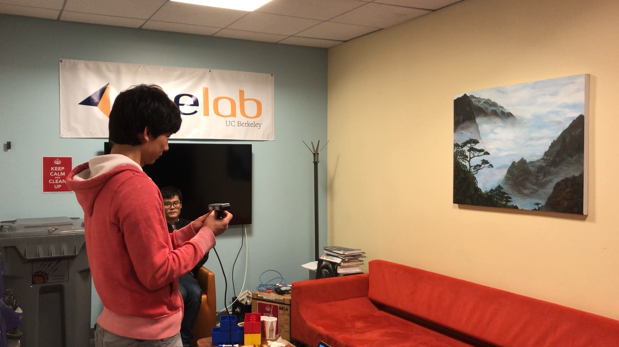
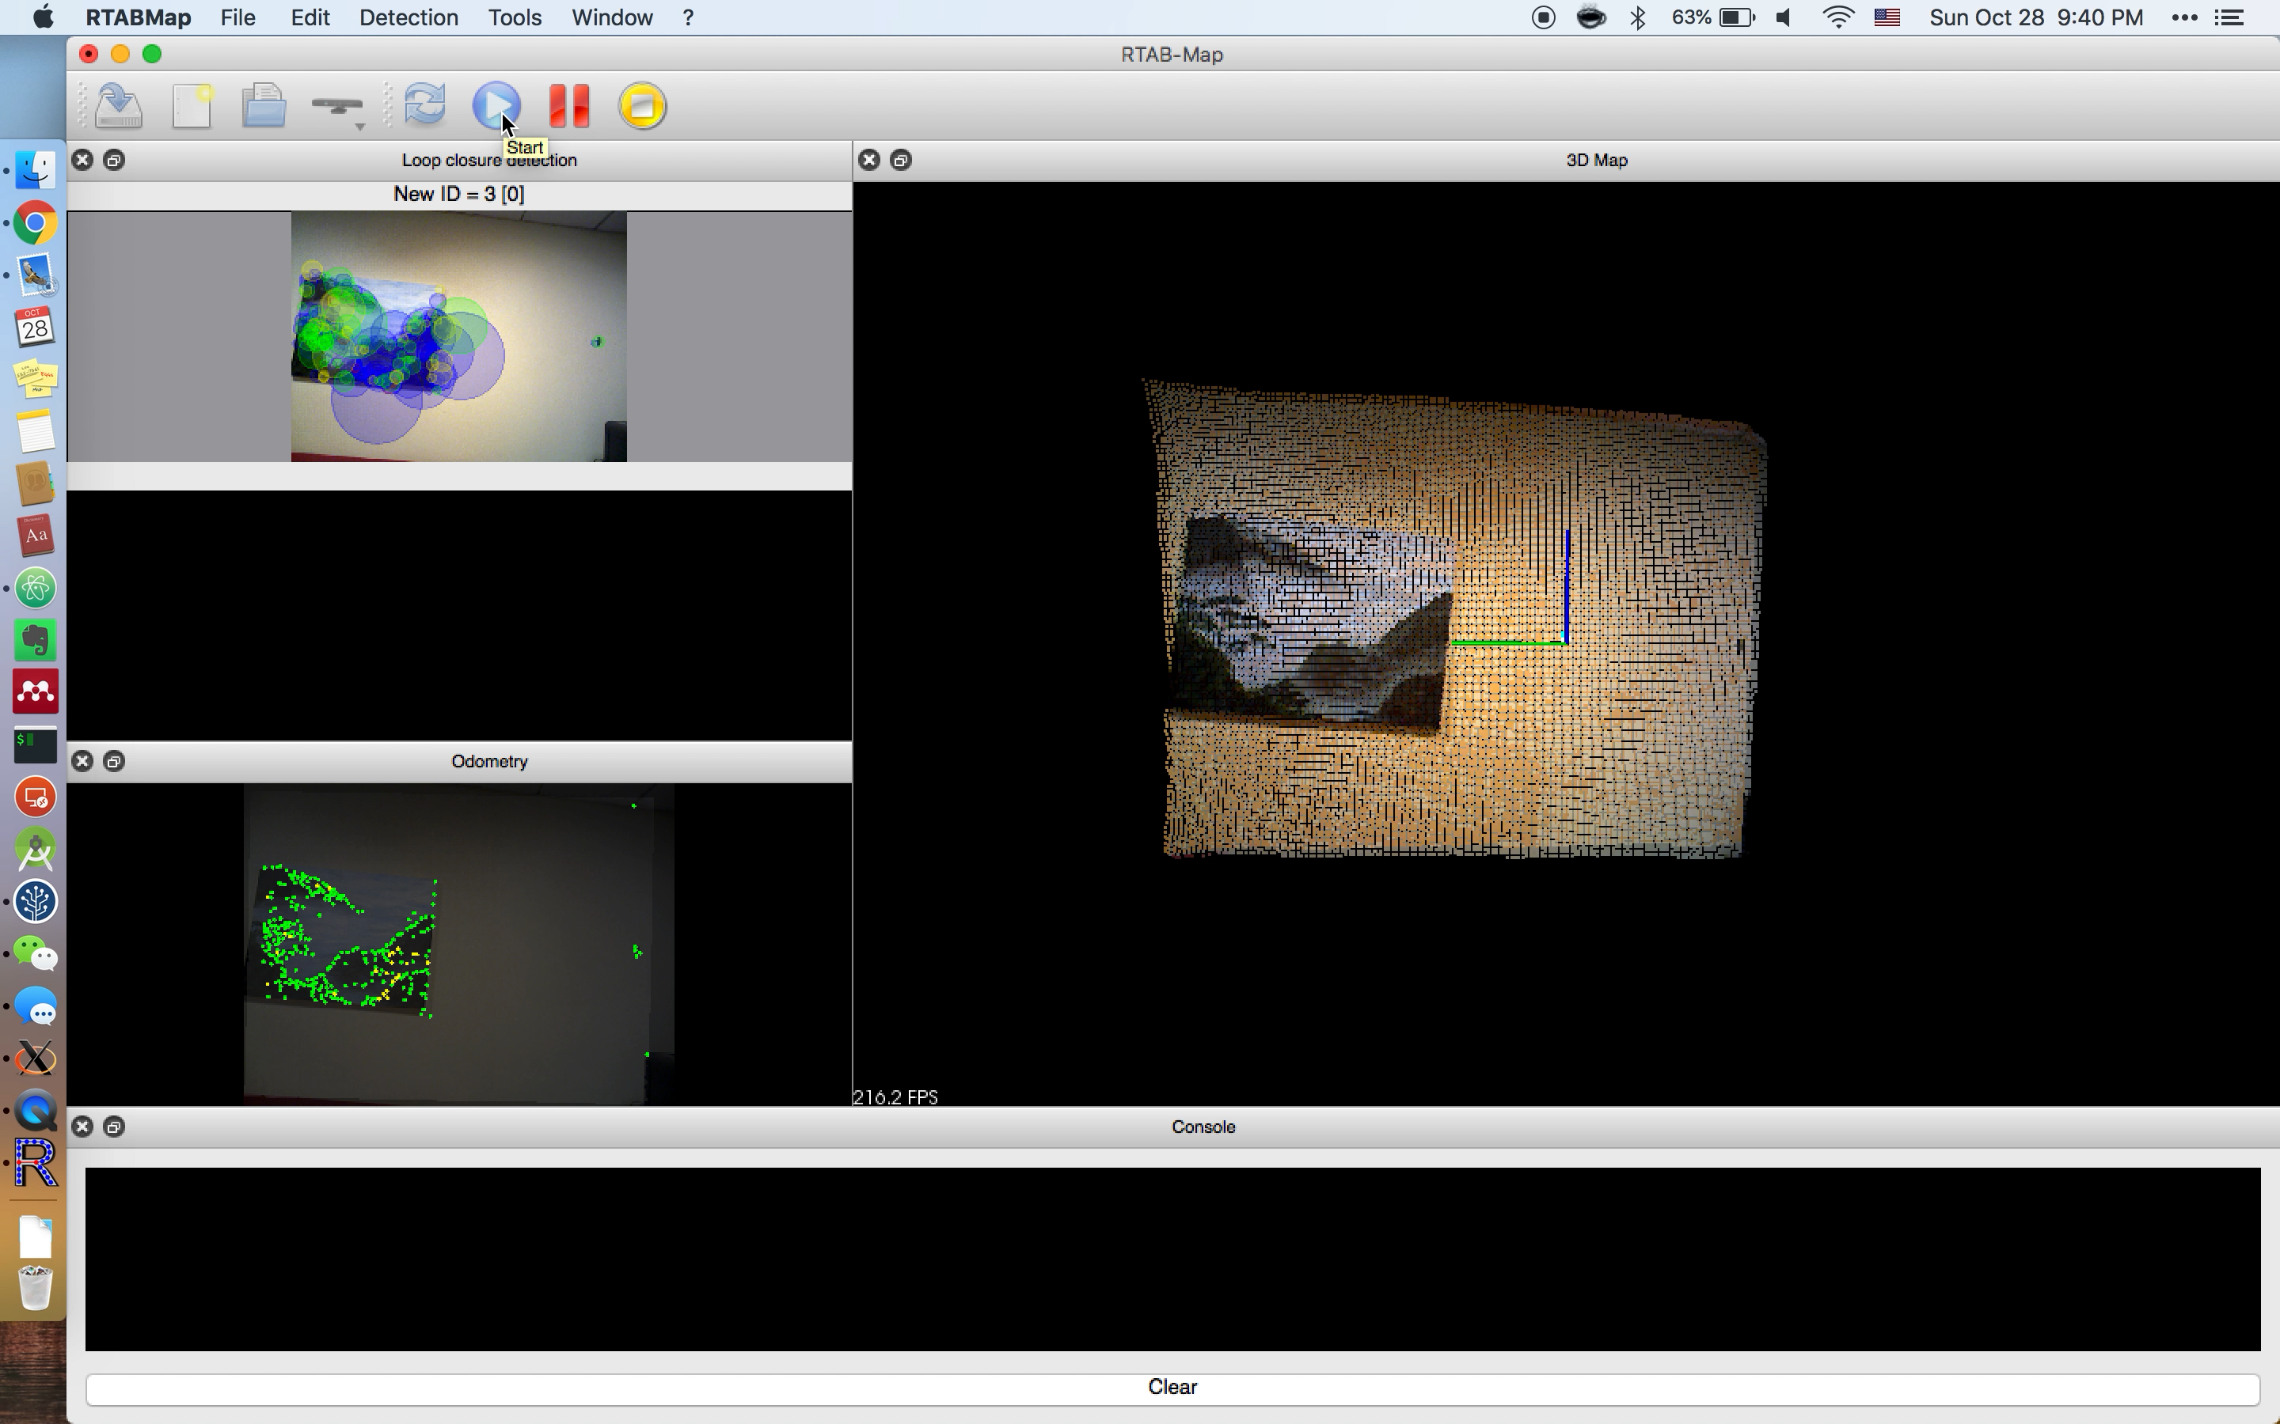
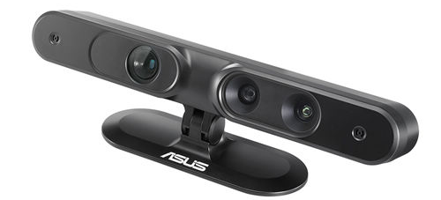
Database Construction
3D-depth camera
Notes:
需要一个人拿着摄像头在环境中走一圈，然后人工标注出存在的各个物体。

Slide 21
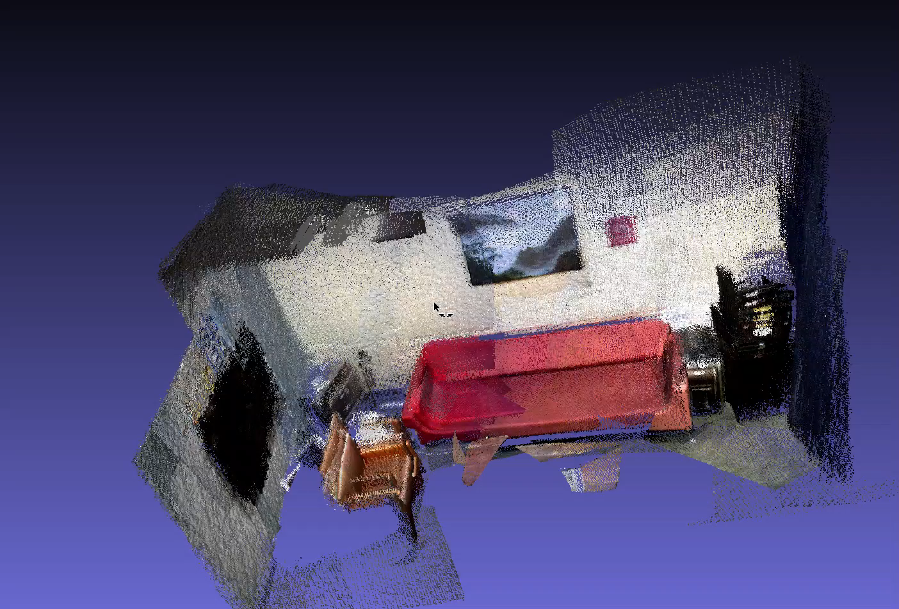
Database Construction
Object labels
(annotation, 3D-location)
Internet
Printer, (x1,y1,z1)
Lightweight
local database!
3D-point cloud database (SnapLink, UbiComp’18)
Picture (x2,y2,z2)
Shredder (x3,y3,z3)
Screen (x4,y4,z4)
Fridge (x5,y5,z5)
Notes:
当手机进入这个环境时，首先从服务器下载所有标注的位置和信息，需要注意的是，手机不需要下载整个地图数据库，所以手机上只需要存储一个小数据库即可。

Slide 22
Local Inertial Localization
local database
(3D-point labels)
Internet
Result Return
(IMU localization)
Image localization
database
(3D-point cloud)
6DoF localization of smartphone screen
Projection of 3D points onto the 2D screen surface
Show annotations for 3D points in the screen size
Fast and Lightweight!
But errors are accumulated (translation)
Notes:
系统启动后，第一帧肯定需要上传到服务器计算，因为本地的不管是惯性传感器还是光流法，计算的都是物体位置的变化量。
在本地，每一帧都会通过惯性传感器计算一个位姿变化，然后相应的移动屏幕上的物体标注，这种方法非常快，计算量也很小，但是会有累计误差。

Slide 23
Local Optical Flow
local database
(3D-point labels)
Internet
Result Return
(IMU localization)
Image localization
database
(3D-point cloud)
Result Correction
(Optical flow)
Inertial localization is robust to rotation
Optical flow is robust to translation
Gain synergy
Weighted Sum of the two results
But errors are still accumulated
Need calibration!
Notes:
所以在本地，会挑出一些帧去算光流法，对结果进行修正，但光流法的误差也会慢慢变大，所以会再挑选出一部分帧，送到服务器，用服务器返回的结果再进行修正。

Slide 24
Inconsistency Detection
Inconsistency!
local database
(3D-point labels)
Internet
Result Return
(IMU localization)
Image localization
database
(3D-point cloud)
Result Correction
(Optical flow)
How sensitively to detect inconsistency?
Offloading overhead vs. Accuracy
Notes:
什么时候上传到服务器呢？如果惯性传感器给出的结果，和光流法给出的结果相差比较多，就触发一次上传到服务器的操作。

Slide 25
Image Offloading
Image Offloading
Inconsistency!
local database
(3D-point labels)
Internet
Result Return
(IMU localization)
Image localization
database
(3D-point cloud)
Result Correction
(Optical flow)
How many images to offload?
Offloading overhead vs. Accuracy
Notes:
一次上传几张图片呢？这又是一个tradeoff，如果只上传一张，可能图片质量不行，定位不准，如果上传太多……

Slide 26
Calibration
Image Offloading
Inconsistency!
Image localization
local database
(3D-point labels)
Internet
Result Return
(IMU localization)
Image localization
database
(3D-point cloud)
Result Correction
(Optical flow)
Notes:
图片上传

Slide 27
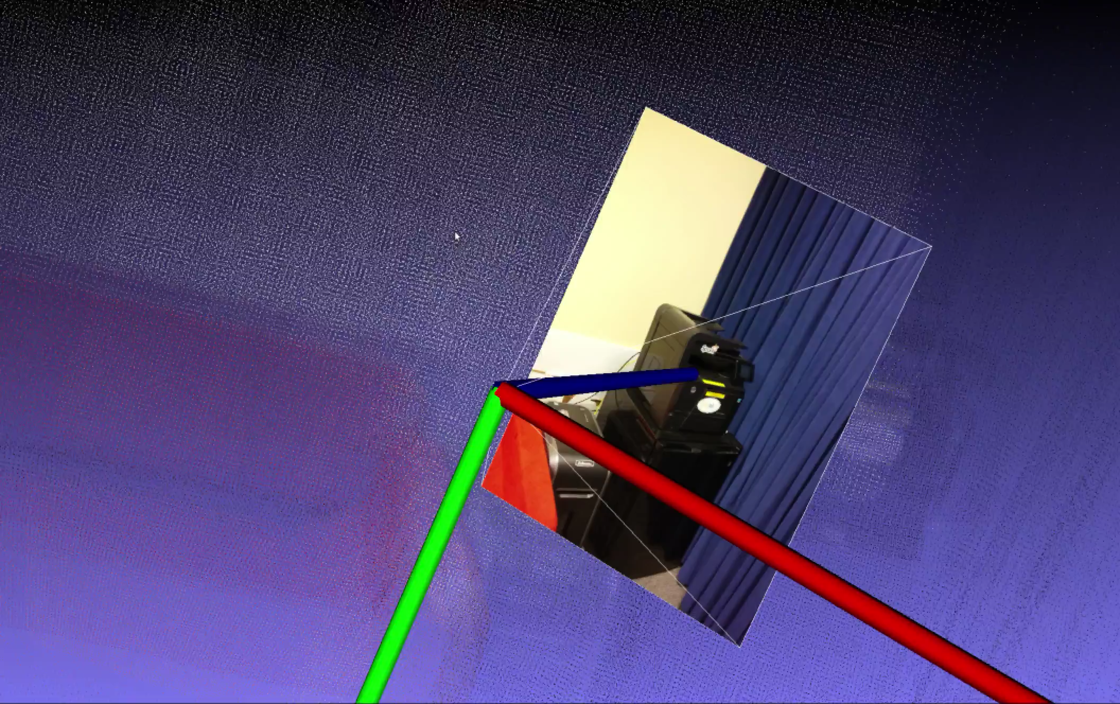
Calibration
Notes:
服务器计算

Slide 28
Calibration
Image Offloading
Inconsistency!
Image localization
local database
(3D-point labels)
Internet
Result Return
(IMU localization)
Image localization
database
(3D-point cloud)
Result Return
(IMU localization)
Result Correction
(Optical flow)
Calibration
Reference location
Notes:
结果返回，

Slide 29
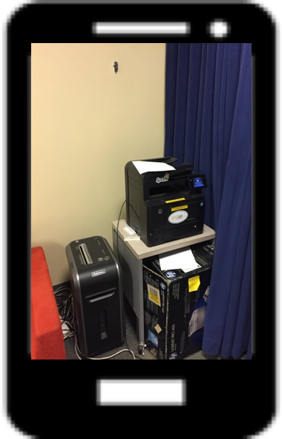
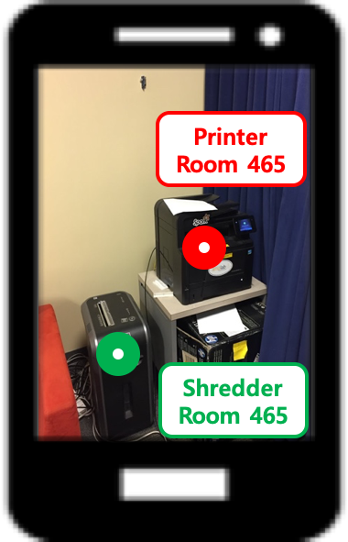
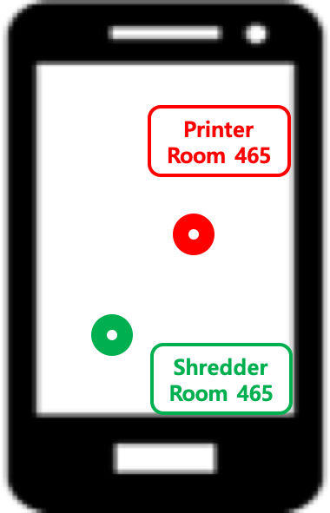
Main Operation Loop
Camera Input
IMU Input
Original View
Blurriness/
Difference test
Data
cleansing
Local Computing
Optical Flow
Computation
IMU-based
6-DOF localization
Image distance
(pixels)
6DOF location of
the device
Local Database
Final
View
2D Label Placement
Update
3D to 2D Point
Projection
Labelled
3D Points
Consistent?
2D labels of objects
(Optical Flow-based)
2D labels of objects
(IMU-based)
Yes
Fast and Lightweight!
Annotation Placement on Screen
(IMU + Optical Flow)
Annotation
View
Notes:
这里总结了系统的工作流程
加权平均

Slide 30
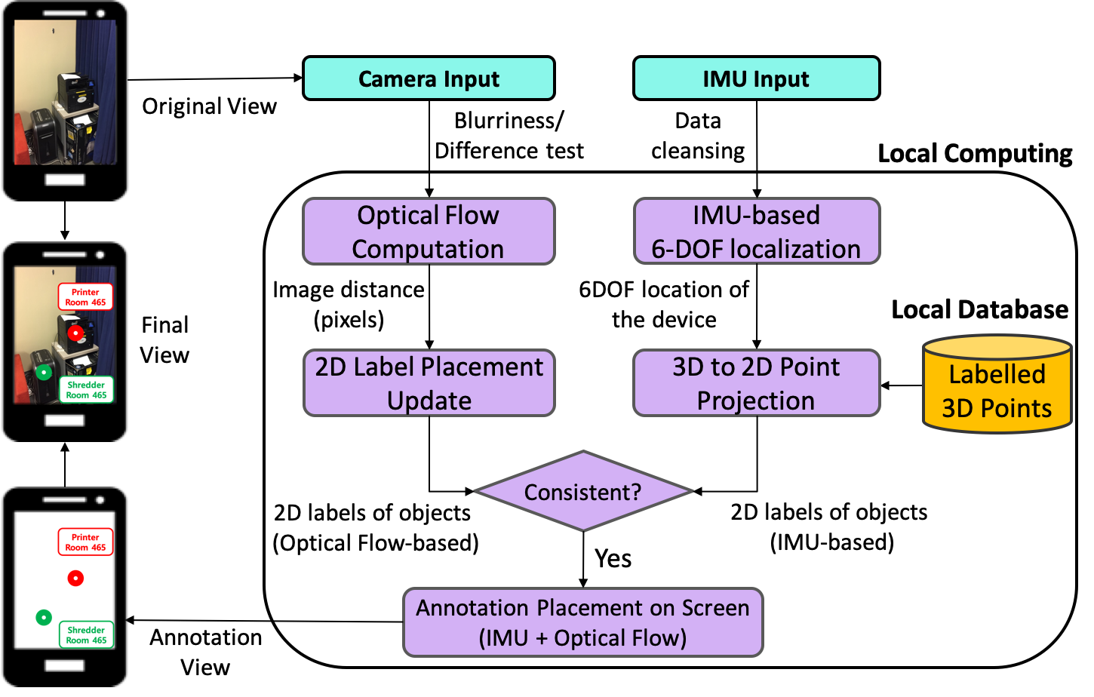
Calibration Loop
6-DOF Calibration
Offset
6-DOF Coordinate Conversion
6-DOF image location
in the 3D point cloud
Cloud Server
3D Point Cloud and Labels
6DOF Image
Localization
Calibration is triggered only when necessary
Inconsistent!
Offloading overhead
is reduced
Image Selection
for Calibration
Offload selected images

Slide 31
Summary
Annotation placement based on
inertial localization at the smartphone
Result correction based on
optical flow at the smartphone
Calibration based on
Image localization at the cloud
Notes:
总结一下，这个系统在手机端通过惯性传感器调整物体标示的位置，并通过光流法不时予以纠正，并且偶尔将图片上传到云端并用返回的结果校准本地的计算。

Slide 32
Evaluation
Notes:
Multihop topology formation is the subtlest aspect of routing in low power wireless networks.
For decades, many researchers in the world have developed numerous fancy routing protocols that perform nicely in simulations, but do not work in practice.
And then, wireless systems community developed practical routing protocols like CTP and RPL. These protocols focus on constructing a DAG while minimizing hop distance and providing reasonable link quality. They achieved a breakthrough in that they work at least on testbeds with real embedded devices.
But my question is this. How about bandwidth? How much traffic can they deliver through a multihop networks?

Slide 33
Inconsistency Detection
Trade-off
Error vs. Overhead

Slide 34
The Number of Offloading Images
Trade-off
Error vs. Overhead

Slide 35
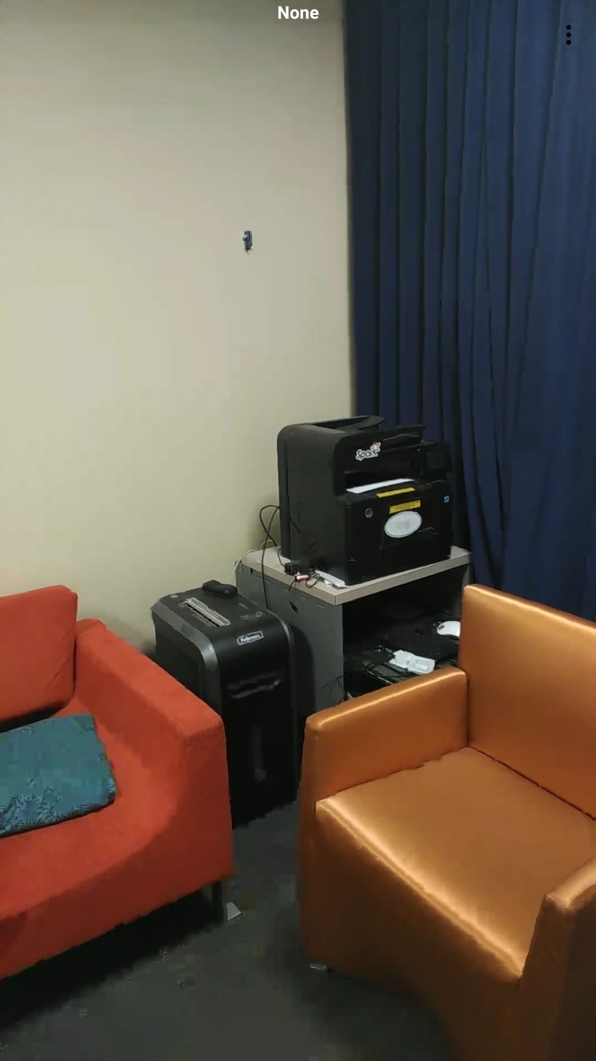
Notes:
Multihop topology formation is the subtlest aspect of routing in low power wireless networks.
For decades, many researchers in the world have developed numerous fancy routing protocols that perform nicely in simulations, but do not work in practice.
And then, wireless systems community developed practical routing protocols like CTP and RPL. These protocols focus on constructing a DAG while minimizing hop distance and providing reasonable link quality. They achieved a breakthrough in that they work at least on testbeds with real embedded devices.
But my question is this. How about bandwidth? How much traffic can they deliver through a multihop networks?

Slide 36
Operation Example
Rotation
Translation
Offloading
ZUPT
Robust
Calibration
Notes:
This slide shows why combining two different information is useful!
Rotation: optical flow has more errors
Translation: ZUPT happens when accel = 0, Offloading happens when optical flow and IMU mismatch.

Slide 37
Performance Comparison
 | Operation | Time (ms)
SnapLink (Baseline) | Camera->App | 67.3
 | App->Cloud->App | 177.7
 | App->Screen | 36.9
 | Total | 281.9
MARVEL | IMU->App | 8.7
 | IMU Computation | 0.3
 | App->Screen | 36.9
 | Total | 45.9
Notes:
Compare with the baseline which completely relies on the cloud by continuously offloading images
More than 5 times faster
Better Accuracy
Less energy consumption

Slide 38
Mobile Augmented Reality for
real-time annotation service
Finding a sweet spot of
cloud vs. edge improves performance in all aspects
Notes:
Multihop topology formation is the subtlest aspect of routing in low power wireless networks.
For decades, many researchers in the world have developed numerous fancy routing protocols that perform nicely in simulations, but do not work in practice.
And then, wireless systems community developed practical routing protocols like CTP and RPL. These protocols focus on constructing a DAG while minimizing hop distance and providing reasonable link quality. They achieved a breakthrough in that they work at least on testbeds with real embedded devices.
But my question is this. How about bandwidth? How much traffic can they deliver through a multihop networks?

Slide 39
Thanks!
Kaifei Chen <kaifei@berkeley.edu>
Tong Li <sasrwas@berkeley.edu>
Hyung-Sin Kim <hs.kim@berkeley.edu>

Slide 40
Main Operation Loop
Camera Input
IMU Input
Original View
Blurriness/
Difference test
Data
cleansing
Local Computing
Optical Flow
Computation
IMU-based
6-DOF localization
Image distance
(pixels)
6DOF location of
the device
Local Database
Final
View
2D Label Placement
Update
3D to 2D Point
Projection
Labelled
3D Points
Consistent?
2D labels of objects
(Optical Flow-based)
2D labels of objects
(IMU-based)
Yes
Fast and Lightweight!
Annotation Placement on Screen
(IMU + Optical Flow)
Annotation
View
Notes:
weighted combination

Slide 41
Calibration Loop
6-DOF Calibration
Offset
6-DOF Coordinate Conversion
6-DOF image location
in the 3D point cloud
Cloud Server
3D Point Cloud and Labels
6DOF Image
Localization
Calibration is triggered only when necessary
Inconsistent!
Offloading overhead
is reduced
Image Selection
for Calibration
Offload selected images

