Slide 1
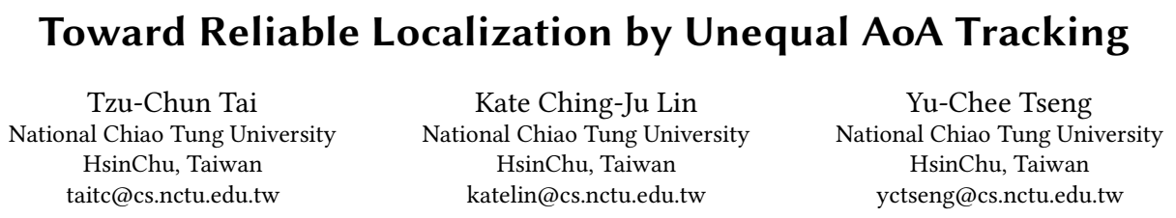
Notes:
通过对结果加入置信度来提高AoA定位准确度的工作

Slide 2

Motivation
Target: AoA localization by WIFI
State-of Art: Sub-meter level median error
Shortage: Tail performance is worse due to Unequal AoA estimation

Slide 3
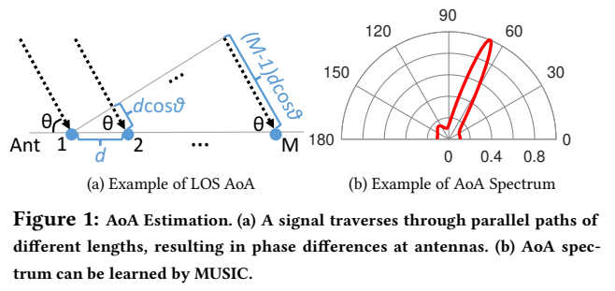

Motivation
Notes:
dcosTheta / lambda = phase difference
至少两个角度就能实现定位

Slide 4
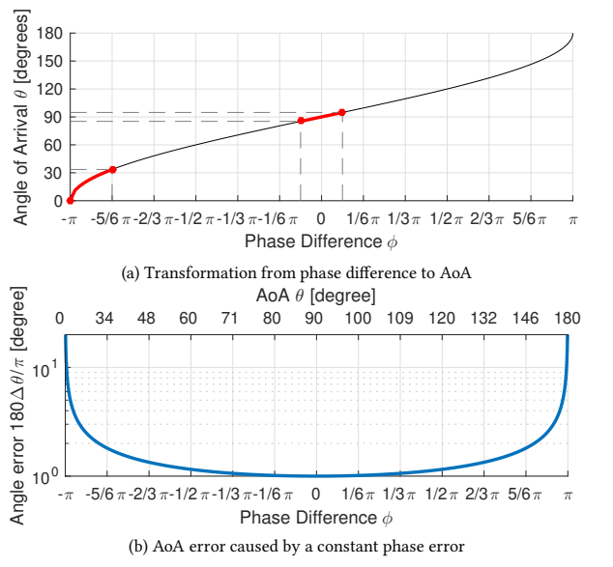
Motivation
Notes:
Non-linear function

Slide 5
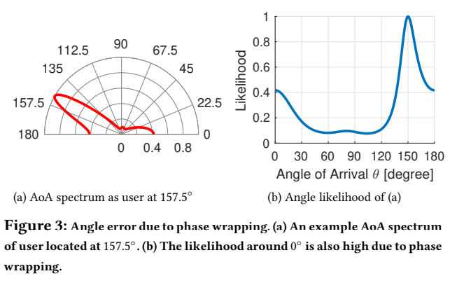
Motivation

Slide 6
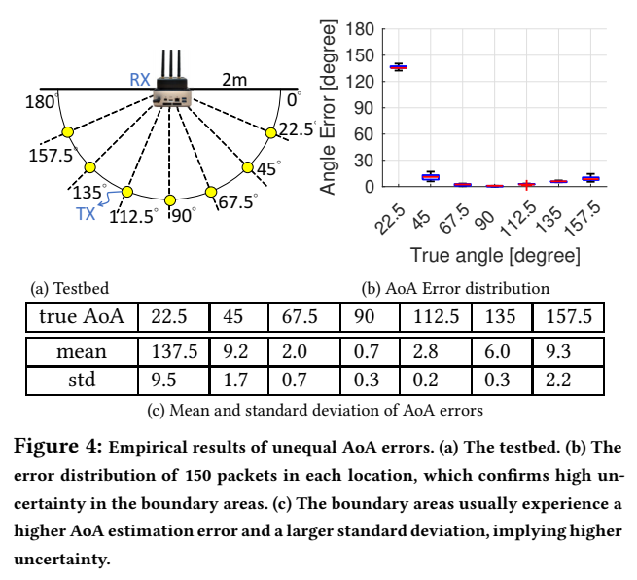
Motivation

Slide 7
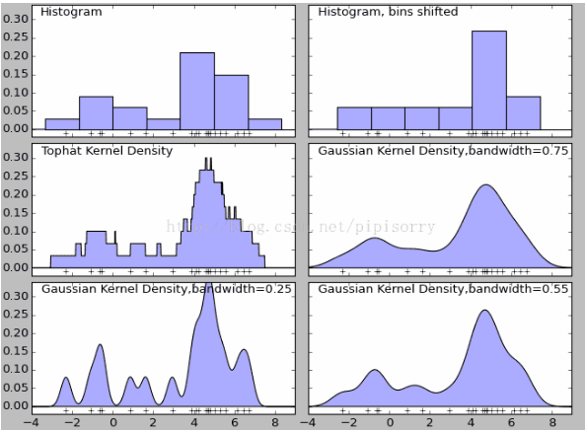

Design
Intuition
Use collected angle or phase results to form a probability density function through non-parametric test of kernel density estimation
Notes:
发送连续的包，对于得到的结果进行KDE核密度估计这种无参估计得到角度的概率分布

Slide 8
Design
20 sequential packets
KDE estimation to form probability density function
Take half of the peak as confident interval
Normalization
Intersection to localize client
Notes:
20 packet -> 无参估计 -> 概率密度函数 -> 一半的peak作为confidence zone->归一化 ->区域的交集定位

Slide 9
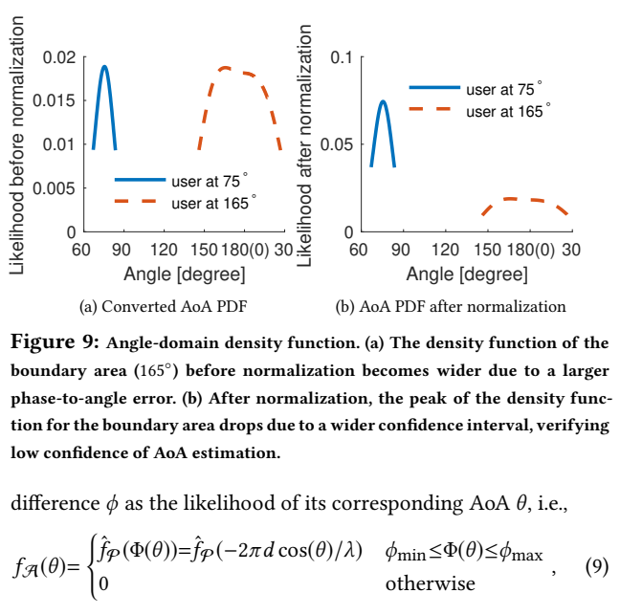
Design

Slide 10
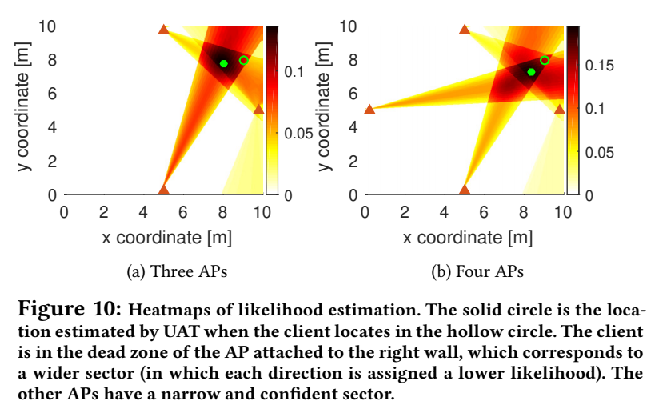
Design
Notes:
实心：估计位置
空心：实际位置

Slide 11
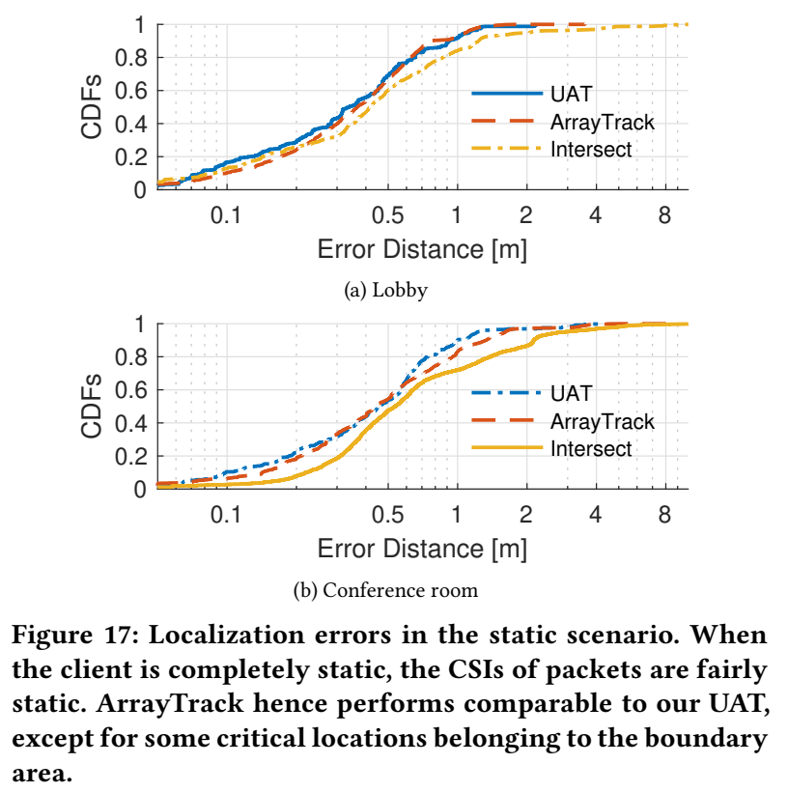
Implementation
75-percentile error from 0.96 m to 0.77 m
Notes:
Static scenario
ArrayTrack: Take –pi~ pi as confident interval, dead zone has bigger influence on the result
Intersect: 直接取峰值角度
75-percentile error from 0.96 m to 0.77 m

Slide 12
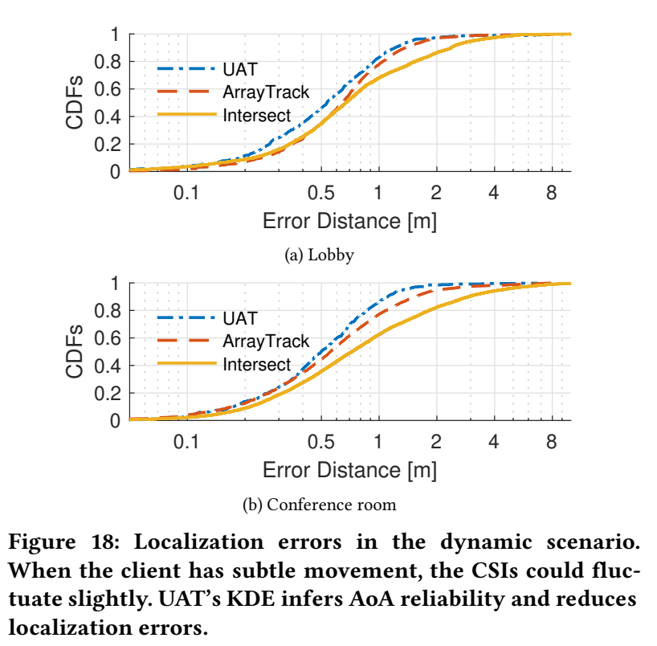
Implementation
The 90-percentile localization error can be reduced by 27.5% as compared to ArrayTrack.
Notes:
Dynamic scenario
The 90-percentile localization error can be reduced by 27.5% and 62.1% as compared to ArrayTrack and Intersection, respectively

Slide 13
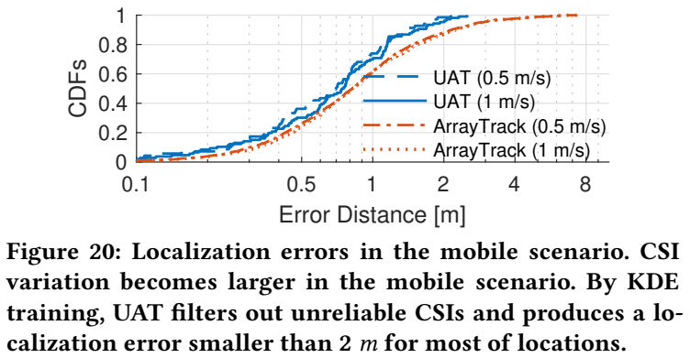
Implementation

Slide 14
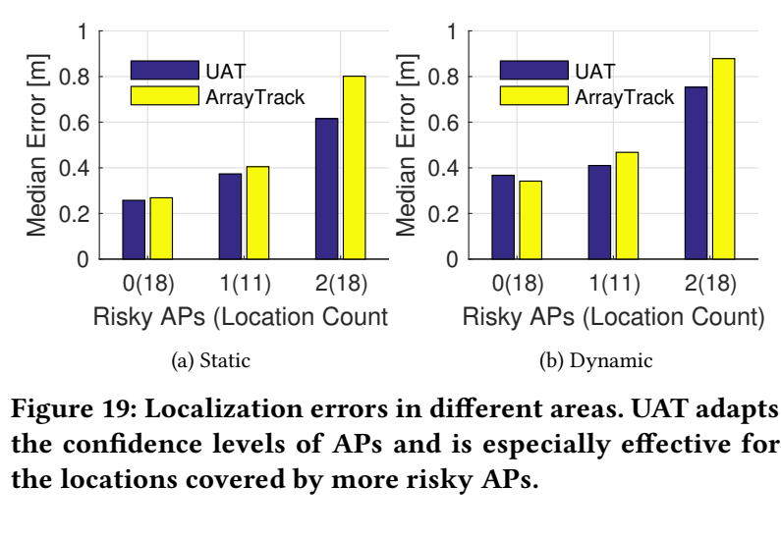
Implementation
Notes:
More dead zones, better performance than conventional methods

Slide 15

Contribution
First that qualifies the reliability of AoA estimates
We then develop a confidence-aware localization system
By UAT’s adaptive sector-based localization, the median localization error of the risky area can be reduced by 23.2% and 14.3% for the static and dynamic scenarios, respectively, as compared to reliability-oblivious localization
Notes:
Two sources of error:
Movement
Dead zone
Good: error estimation to refine localization

