Slide 1

Source Compression with Bounded DNN Perception Loss for IoT Edge Computer Vision
Xiufeng Xie, Kyu-Han Kim
MobiCom 2019
Notes:
Today, I am going to talk about a source compression technique for deep-learning based computer vision applications. This is a joint work with Xiufeng Xie. （慧与，跨国资讯科技公司，是惠普公司拆分出来的，提供物联网、边缘计算、深度学习方面的解决方案）

Slide 2
Deep-learning based computer vision for IoT devices
Motivation
Design
Evaluation
Drone
AR
Smart
Camera
Smart City
Intelligent
Shopping
Cleaning
Robot
Notes:
Deep-learning based computer vision for IoT devices has a huge potential market.

Slide 3
Problems of running DNN on IoT devices
Motivation
Design
Evaluation
Battery constraint
Hard to manage heat
Insufficient computation power/memory/storage
Notes:
However, running compute-intensive DNN on IoT devices is quite challenging, mainly because of limited computing resource and harsh deployment environment.

Slide 4
Inference at the edge
Motivation
Design
Evaluation
Offload computation task to powerful edge servers close to the IoT devices
DNN
Wireless Link
Bottleneck
Notes:
One promising solution is to offload the DNN inference tasks to powerful edge servers and send raw video or image data over networks.
However, in this scenario, wireless last-hop can become a bottleneck, and IoT devices needs to aggressively compress the source data.

Slide 5
Existing solutions do not work
Motivation
Design
Evaluation
Lossless compression (PNG): too large to scale
2.3 MB average image size for the Cityscapes dataset
Lossy compression (JPEG): small size but low accuracy
8% accuracy loss (w.r.t PNG) at JPEG Q=75 (default) for semantic segmentation
DNN-based compression: heavy computation
Note that we use compression to avoid running DNN on IoT devices.
 | PNG (lossless) | JPEG (lossy) | DNN-based compression
Size | Large | Small | Small
Inference accuracy | No loss | High loss | Small loss
Computing cost | Low | Low | High
Notes:
Obviously, compressions can help, but they also have some limitations.
Our experimental results on semantic segmentation show that the lossless PNG compression produces a more than 2 MB of file size, and this is simply too large the edge inference architecture to scale. Next, JPEG compression could reduce a file size to several hundred KB, but at the cost of more than 8% accuracy drop in the inference, compared to PNG.
Recent proposal of using DNN to compress data at source devices is an interesting approach, but it incurs heavy computation at IoT devices.
The table at the bottom summarizes the limitations of three types of compression solutions.

Slide 6
Why existing solutions fail?
Motivation
Design
Evaluation
Human-centric: make compression artifacts invisible to human eyes
DNN is not a human eye: can perceive artifacts invisible to human eyes
DNN and human eyes have
different perceptual sensitivity
w.r.t spatial frequencies.
How about making compressions DNN-aware?
Notes:
Then, what is the root cause of the limitations?
We found the the limitations come from the human-centric design of compression techniques. The existing solutions make compression artifacts invisible to human eyes or their perceptual sensitivity.
However, we found that a DNN’s perception model is very different from that of human eyes. In this slide, we visualize the perceptual sensitivity of one DNN with respect to the spatial frequency, and compare it with that of the human eyes. As we can see, there are significant differences. Some spatial frequency might be sensitive to human eyes, but not to DNN.
Then, a question is can we make source compression DNN-aware for better compression?
高空间频率代表空间剧烈变化的位置，如物体边界，细腻的纹路。低空间频率则是物体整体的形状。

Slide 7
GRAdient-driven Compression for Edge (GRACE)
Notes:
The answer is yes, and we propose a solution, called GRACE.

Slide 8




System architecture
Motivation
Design
Evaluation
1.Compression Strategy Optimization (Offline)
Probe
DNN Perception Modeling
Edge
$$𝒟$$
Perception
Model
Color Space Optimization
Quantization Table Optimization
$$W_{R}, W_{G}, W_{B}$$
$$T_{Y}, T_{U}, T_{V}$$
3.Inference
RGB
Img.
YUV
Img.
DCT
Coef.
Quantized
Coef.
To YUV
DCT
Quantize
Entropy Coding
Wireless Link
JPEG Decoder
$$𝒟$$
2.Online GRACE Encoder
IoT
Notes:
Our system runs in 3 steps:
First, the server optimizes the compression strategy offline. It estimates the target DNN’s perception model and then use the model to optimize both the quantization table and color space used in the online encoder.
Then, the encoder at the IoT device uses the optimized compression strategy for online compression. The encoder reuses the JPEG image compression framework, thus remains simple and compatible with JPEG
Finally, the edge decode the image with JPEG decoder, then perform the inference and feedback the inference results to the IoT device

Slide 9
Design space I: Quantization in spatial frequency
Motivation
Design
Evaluation
Eye’s sensitivity w.r.t DCT spectrum
JPEG quantization table
Sensitive to
low-freq. DCT coefficients
DNN has different sensitivity, thus requires different quantization table
Raw
Img
YUV
Img
DCT Coefficients
Quantized Coefficients
To YUV
DCT
Quantize
Quantize
Entropy Coding
Notes:
Let’s discuss designs of GRACE. Our first design space is the quantization.
Existing image compression like JPEG first converts the RGB image to the YUV color space for better compression, and then, uses the discrete cosine transform or DCT to convert the image to its spatial-frequency representation. Here, DCT helps concentrate most information in a few low-frequency coefficients. The next step is to quantize the DCT coefficients with a quantization table.
Since human eyes are sensitive to the low frequency DCT coefficients, existing solutions model the eye’s sensitivity with respect to the DCT spectrum, and design the quantization table accordingly.
Because the DNN has different sensitivity, it needs a different quantization table.

Slide 10
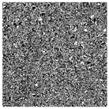
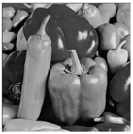






Modeling DNN’s sensitivity with gradients
Motivation
Design
Evaluation
Compression artifacts == input noise
Gradient $\frac{∂L}{∂s}$ : how much DNN loss would change if a noise adds to input
DCT Coefficients $s$
Image $x$
Ground Truth $x^{∗}$
IDCT
Input
Output
Loss $L$
DNN
Back propagation
Gradient w.r.t
DCT coefficients $∇_{s}L=\frac{∂L}{∂s}$
If a DCT coefficient has high gradient
It is important for inference
compress it less
Sensitivity map for DNN
Notes:
Then, how do we model DNN’s sensitivity?
A high-level idea is that from a DNN perspective, compression can be viewed as adding noise to the input image, and the gradient that we can estimate through the backward propagation characterizes how much a small noise in the compressed input would affect the final loss in DNN. Based on this observation, we propose to use a DNN’s gradient w.r.t the DCT coefficients, as the indicator of its perceptual sensitivity.
As shown in the left bottom, GRACE can estimate a sensitivity map that consists of the gradients with respect to every DCT coefficient.
Intuitively, if a DCT coefficient has high gradient or sensitivity, it is important for inference, and hence, we should compress it less.

Slide 11
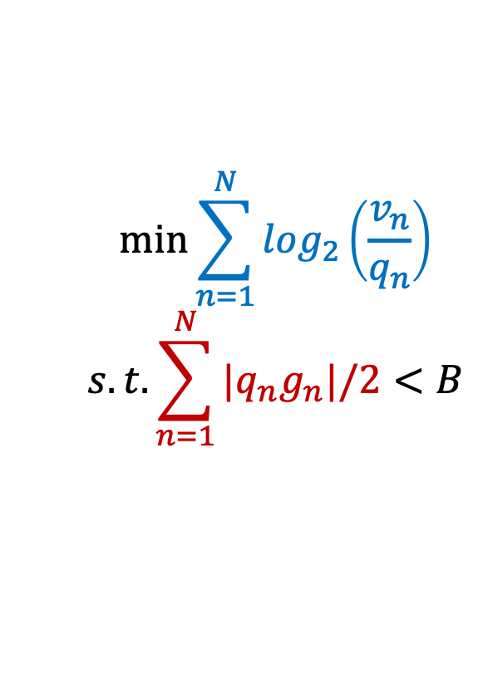
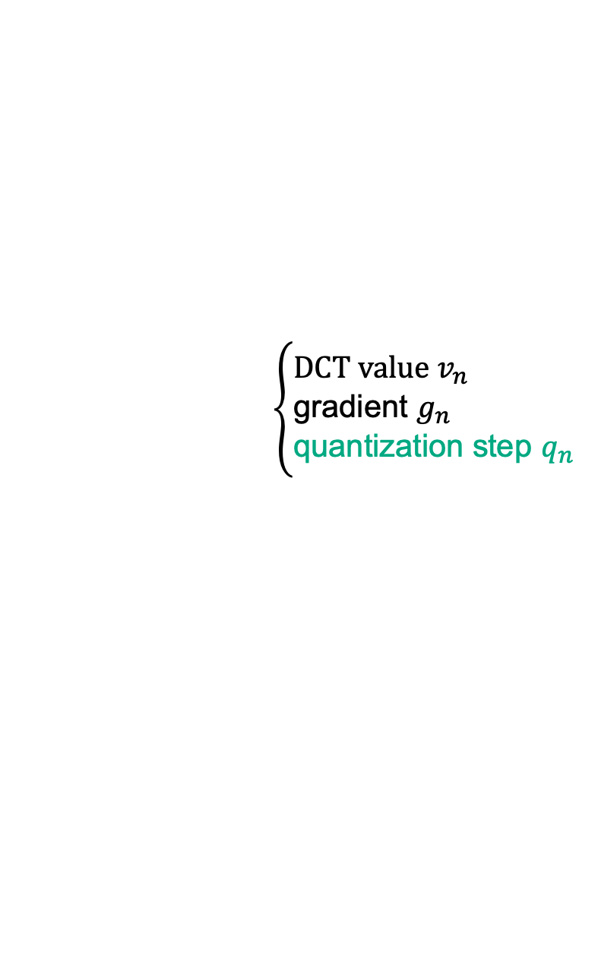
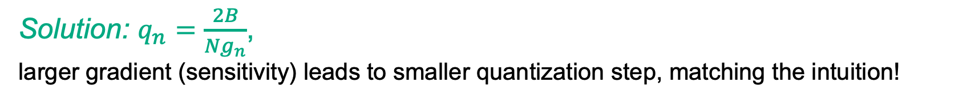
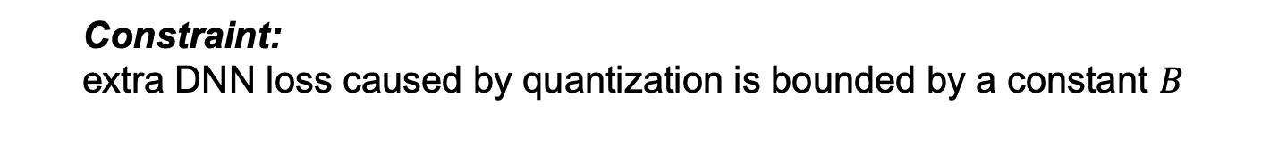
Quantization table optimization with DNN’s sensitivity
Motivation
Design
Evaluation
Optimization problem:
minimize file size under bounded DNN perception loss
DCT with $N$ coefficients
A freq. bin has
$$\left\{\begin{aligned}&\text{DCT} \text{value} v_{n} \\ &\text{gradient} g_{n} \\ &\text{quantization} \text{step} q_{n}\end{aligned}\right.$$
$$\min{\sum_{n=1}^{N}{\log_{2}\left(\frac{v_{n}}{q_{n}}\right)}}$$
$$s.t.\sum_{n=1}^{N}{{|q}_{n}g_{n}|/2}<B$$
Object:
minimizing the compressed file size
Constraint:
extra DNN loss caused by quantization is bounded by a constant $B$
Solution: $q_{n}=\frac{2B}{Ng_{n}}$,
larger gradient (sensitivity) leads to smaller quantization step, matching the intuition!
(Please see mathematical proof in our paper)
Notes:
Now, given the perceptual sensitivity map, how can we generate a quantization table for the DNN?
In quantization-based compression, an input image can be represented as N point DCT coefficients, as shown in the green matrix shape. Now, in GRACE, we extend each frequency bin to have its DCT value, its gradient from the sensitivity map, and a quantization step. Now, we can formulate this as an optimization problem as follows:
our objective is to minimize the compressed file size while quantization, subject to a constraint that extra DNN loss caused by the quantization should be bounded by a constant, B.
From the solution denoted as q_n, we can see that large gradient leads to smaller quantization step, which exactly matches the intuition

Slide 12
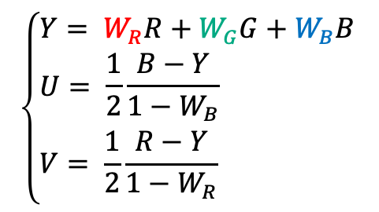
Design space II: Color sensitivity of DNNs
Motivation
Design
Evaluation
Each color image consist of 3 channels: Red, Green, and Blue
YUV color space (used in JPEG and H.264)
Brightness (Y) and colors (U&V): focus sensitive information on one channel (Y)
Allow aggressive compression on the other channels (U & V)
How: human eyes are more sensitive to green light, so give G channel higher weights
0.299
0.587
0.114
$$\left\{\begin{aligned}&Y= W_{R}R+W_{G}G+W_{B}B \\ &U= \frac{1}{2}\frac{B−Y}{1−W_{B}} \\ &V= \frac{1}{2}\frac{R−Y}{1−W_{R}}\end{aligned}\right.$$
RGB-to-YUV Conversion
Notes:
The next design space is color sensitivity.
Each color image consists of 3 channels: red, green, and blue. And, human eyes have different perceptual sensitivity to the different channels. This motivates the design of the YUV color space that is a widely used color model. Conversion from RGB to YUV format helps concentrate most salient information to the Y channel, so that the other two channels can be compressed more.
Here, YUV is the linear transform of the RGB, and they are uniquely defined by the three weights, based on perception models of human eyes.

Slide 13
Modeling color sensitivity with gradients
Motivation
Design
Evaluation
DNN (DRN-D-22) has high sensitivity on G channel, but R&B are still important
RGB
YUV
YUV format concentrates most saliency to Y channel, U&V can be compressed more
Notes:
Based on the gradient-based sensitivity measurement, we show the DCT sensitivity for each of the RGB channels.
First, for the RGB color space, the DNN has higher sensitivity on the G channel, but the R and B channels are still important so that we cannot compress them a lot.
Then for the YUV color space, we can see the amplitude of gradient w.r.t the Y channel is higher than U & V channels, which reveals how the RGB-to-YUV conversion concentrates the sensitivity information to a single channel so that the U and V channels can be compressed more.

Slide 14
Modeling Color Sensitivity with Gradients
Motivation
Design
Evaluation
DNNs and human vision system have different color sensitivity
Current RGB-to-YUV conversion weights are designed for human eye.
Can we redesign the weights for the DNN?
Notes:
Our experiments also reveal different color sensitivity between the DNNs and human eyes.
In the figure below, the R, G, or B color sensitivity is the sum gradient amplitude of the corresponding sensitivity map in the previous figure.
We test 6 different DNNs, and all of them show 2× blue-channel sensitivity compared to human be- cause human eyes have fewer blue-sensing cone cells while CV has no such limitation.
We also observe different color sensitivity across the DNN models.
As a result, it is important to optimize the color space for each particular DNN

Slide 15

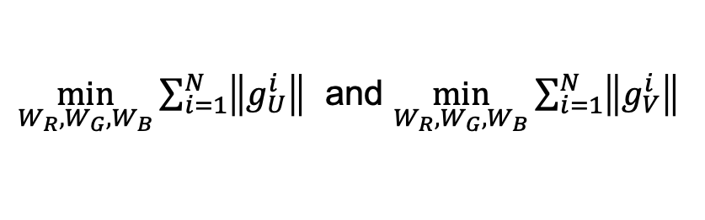

G-YUV: DNN-aware color space optimization
Motivation
Design
Evaluation
Optimize RGB-to-YUV conversion for target DNN based on gradients w.r.t colors
Input: gradient ${(g}_{R},g_{G},g_{B})$ w.r.t every DCT coefficient in R, G, and B channels
Output: optimal RGB-to-YUV conversion weights ($W_{R}$, $W_{G}$, $W_{B}$)
$$\left\{\begin{aligned}&Y= W_{R}R+W_{G}G+W_{B}B \\ &U= \frac{1}{2}\frac{B−Y}{1−W_{B}} \\ &V= \frac{1}{2}\frac{R−Y}{1−W_{R}}\end{aligned}\right.$$
Minimize gradient on U&V channels:
$\min_{W_{R}, W_{G}, W_{B}}{\sum_{i=1}^{N}{\left\|g_{U}^{i}\right\|}}$ and $\min_{W_{R}, W_{G}, W_{B}}{\sum_{i=1}^{N}{\left\|g_{V}^{i}\right\|}}$
RGB
Image
YUV
Image
DCT Spectrum
Quantized Spectrum
Convert To YUV
DCT
Quantize
Entropy Coding
Notes:
Now, GRACE redesigns the YUV color space for a DNN.
Based on the DNN’s perceptual sensitivity or gradients as an input, we want to find the optimal conversion weights that minimize sensitivity on U & V channels. Basically, this helps quantize U & V channels more aggressively in the quantization step.

Slide 16
DNN-aware color space optimization
Motivation
Design
Evaluation
Effectiveness of G-YUV
Concentrate more sensitivity in Y channel
Suppress the sensitivity of U & V channels
Notes:
This graph shows the distribution of sensitivity among three channels. We can see that compared to conventional YUV or RGB, G-YUV concentrate more sensitivity in Y channel, while suppress the sensitivity of U & V channels

Slide 17
Evaluation

Slide 18
Evaluation setup
Motivation
Design
Evaluation
2 CV Tasks
4 classification DNNs
2 segmentation DNNs
SqueezeNet
DRN-D-22
Semantic Segmentation
Image Classification
AlexNet
ResNet-18
DRN-D-38
VGG-18
2 Datasets:
Cityscapes
ImageNet
500 test images
155 test images
6 Formats:
GRACE
Notes:
We evaluate GRACE over various conditions, including 2 CV tasks, 2 datasets, 6 compression formats, and 6 DNN models. We use compressed file size and inference accuracy as metrics.

Slide 19
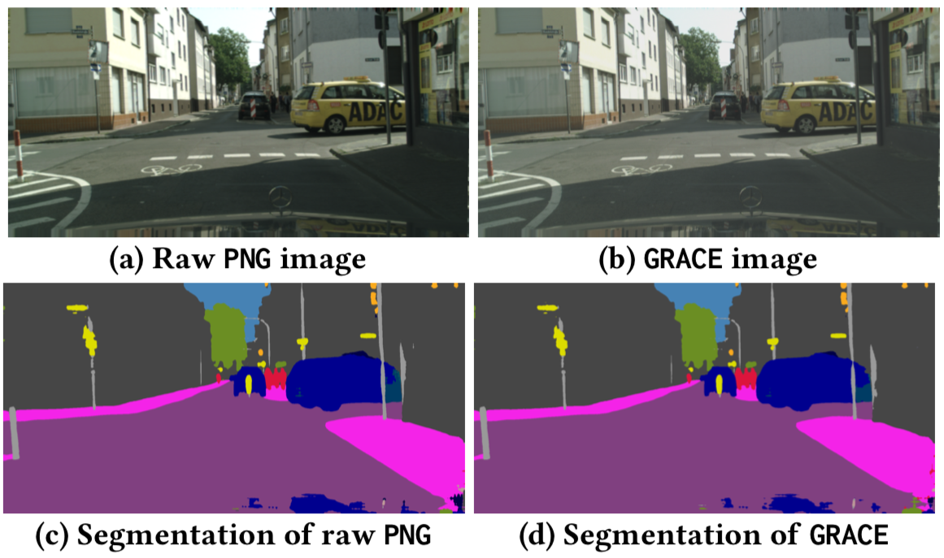
Compression for semantic segmentation
Motivation
Design
Evaluation
Human can notice the difference
DNN does not see the difference
Notes:
We first show the semantic segmentation results for both PNG and GRACE images.
Top two figures show compressed images, and we, as a human, can notice the compression artifacts of GRACE. However, their segmentation results are almost identical, as shown in the bottom figures.

Slide 20
Performance metric
Motivation
Design
Evaluation
Average across all classes
File size (compression ratio)
Tradeoff
Mean IoU (mIoU)
Notes:
We use the compressed file size and DNN inference accuracy as two performance met- rics to capture the size-accuracy tradeoff.
For semantic segmentation, the DNN inference accuracy is the mean IoU. IoU is defined as the area of the overlapping area between the prediction and ground truth divided by the union area, and mean IoU is the average of IoU across all classes

Slide 21
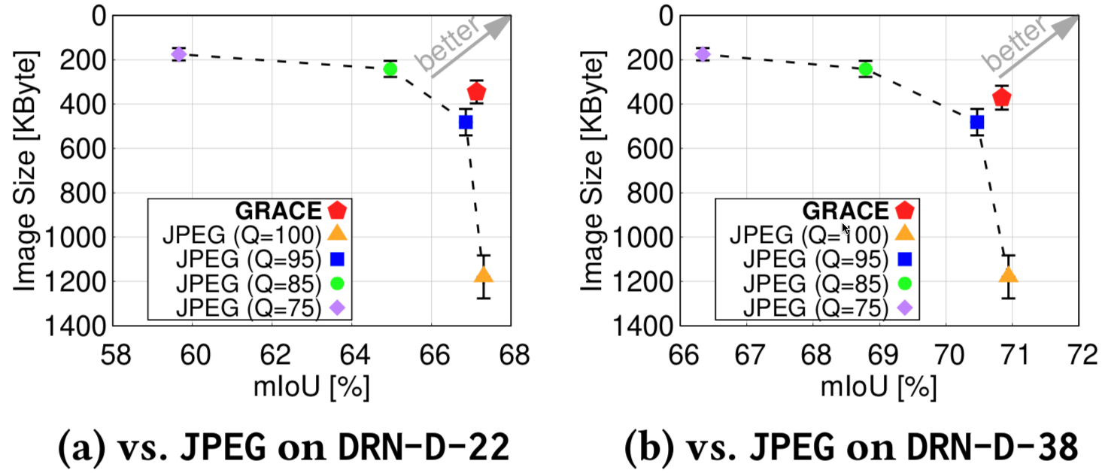
Comparison with popular formats: JPEG
Motivation
Design
Evaluation
JPEG quality levels:
In the range of 1-100
Larger number means higher quality
JPEG (95): 40% larger file size but 0.2% lower accuracy than GRACE.
JPEG (95): 30% larger file size but 0.4% lower accuracy than GRACE.
Notes:
Next, we compare GRACE with JPEG in different quality levels. The larger number, the higher quality. We use DRN-22 and DRN-33 DNN for semantic segmentation tasks.
From the left figure, we can see that JPEG (95) has 40% larger file size but 0.2% lower accuracy than GRACE.
From the right figure, JPEG (95) has 30% larger file size but 0.4% lower accuracy than GRACE.

Slide 22
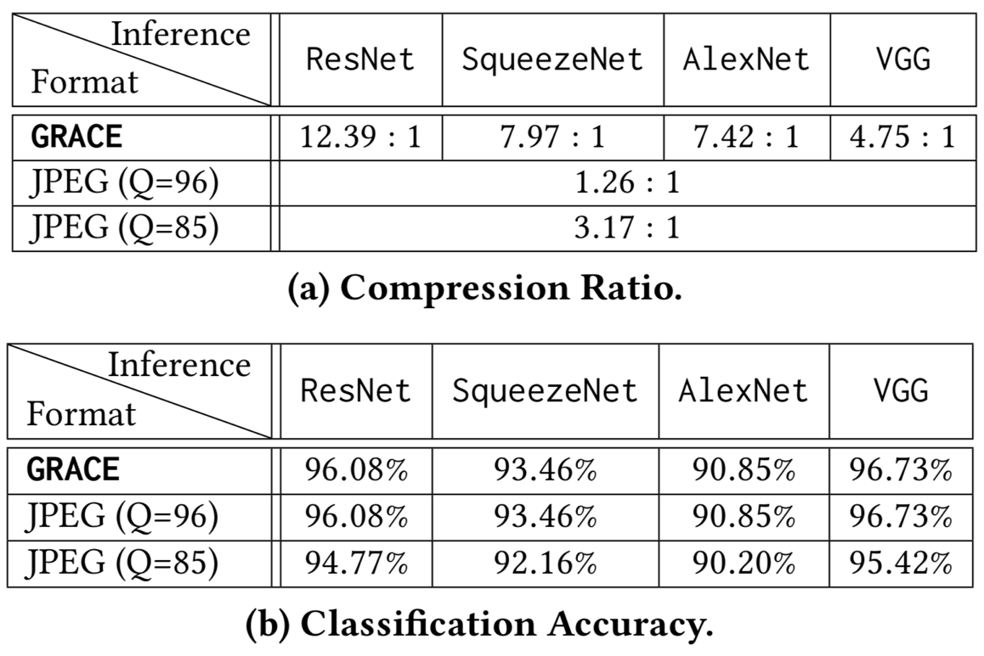
Compression for Image Classification
Motivation
Design
Evaluation
Setup: ImageNet dataset, 4 different DNNs (ResNet, SqueezeNet, AlexNet, VGG)
GRACE saves up to 90% of bandwidth (ResNet)
GRACE leads to no performance loss
Notes:
Finally, we evaluate GRACE in the image classification tasks over a large dataset and four different DNNs.
From the first table, we see that GRACE saves up to 90% of bandwidth, while GRACE causes no accuracy loss as shown in the bottom table.

Slide 23
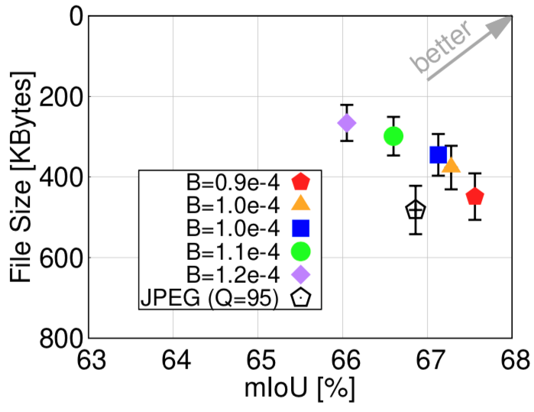
Controlling bandwidth-accuracy tradeoff with DNN loss quota
Motivation
Design
Evaluation
Tuning the loss upper bound to see how it affects the bandwidth-accuracy tradeoff
Higher loss quota => More aggressive compression => Small file size & lower accuracy
With a proper configuration of quota B, GRACE easily outperforms JPEG
Notes:
GRACE allows controlling bandwidth-accuracy tradeoff with DNN loss quota.
In this experiment, we tune the loss upper bound to see how it affects the bandwidth-accuracy tradeoff
From the results, we see that a higher loss quota makes GRACE compresses more aggressively, leading to small file size but lower accuracy
Under a proper configuration of B, GRACE easily outperforms high-quality JPEG with Q=95

Slide 24
Summary
The first work to model DNN’s perceptual sensitivity
The first work to enable data stream compression with bounded loss
Design to reuse existing compression framework
The paper has algorithms, proof, evaluations and future directions.

Slide 25
Limitation and Future Works
Limitation
We keep the DNN unchanged and only redesign encoder (for compatibility to deployed DNNs)
Further improve the performance if we optimize the DNN and encoder jointly?
Future work
DNN-aware compression for speech recognition in the edge/cloud
DNN and human ears have different audio-frequency sensitivity
Encoder
DNN
Notes:
For the limitation, currently we keep the DNN unchanged and only redesign the encoder, because we want to be compatible with the already deployed DNNs.
In future work, we plan to further improve the performance by optimizing the DNN and the encoder jointly.
Besides, since DNN and human ears have different sensitivity across the audio frequency bands, we also plan to extend the DNN-aware compression for speed recognition in the edge or clound

Slide 26
Thank you!
xiufeng.xie@hpe.com
kyu-han.kim@hpe.com

