Slide 1
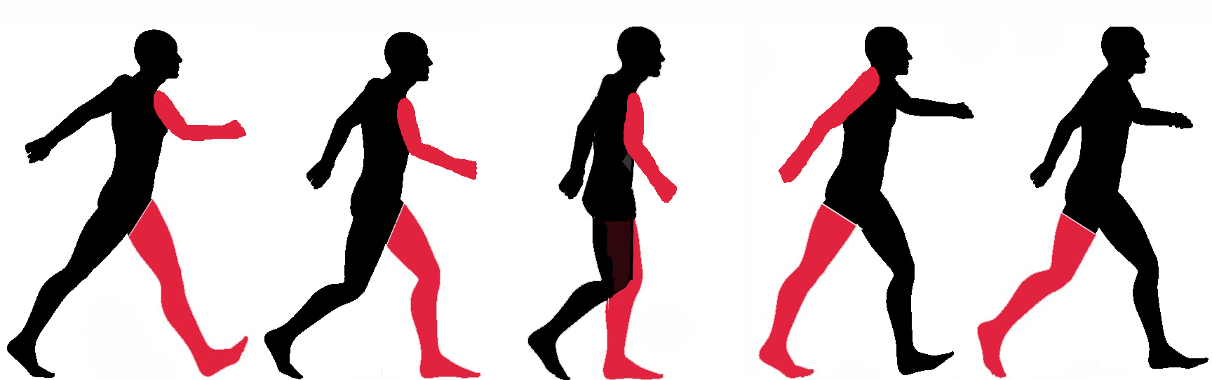
XModal-ID: Using WiFi for Through-Wall Person Identification from Candidate Video Footage
Belal Korany, Chitra R. Karanam, Hong Cai, Yasamin Mostfi(UCSB).
MobiCom 2019

Slide 2
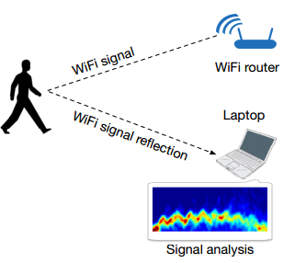
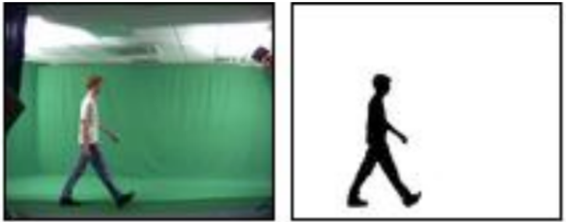
Related Work
Person Identification From Gait
RF-based
CV-based
× labor demanding
× privacy leakage
CV and RF can be combined for better performance

Slide 3
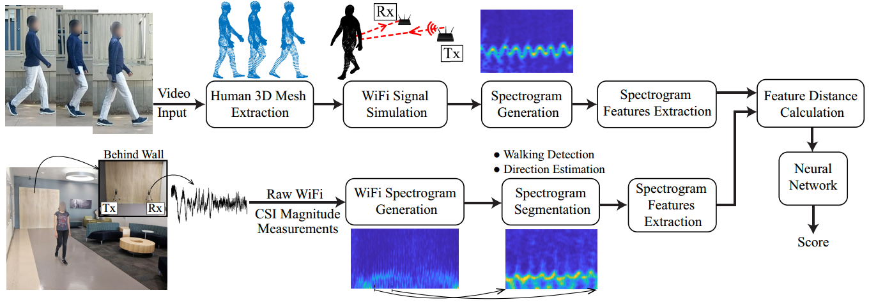
System Architecture
Video and WiFi pipelines of XModal-ID
Feature matching between CV and WiFi serves as key enabler

Slide 4
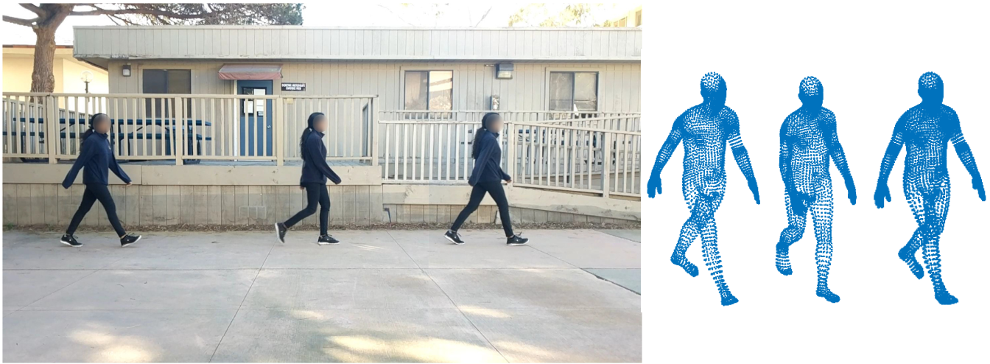
Design
-Video Branch
Construct 3D Human Model from Video Snapshot
HMR[1] algorithm is adopted to reconstruct 3D mesh of human body from 2D video frame;
Camera calibration algorithm is adopted to transform model into the real world scale;
Literature enable 3D model reconstruction from 2D image
[1]A. Kanazawa, M. J. Black, D. W. Jacobs, and J. Malik. End-to end recovery of human shape and pose. In proceedings of CVPR 2018.

Slide 5
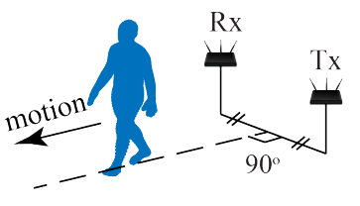


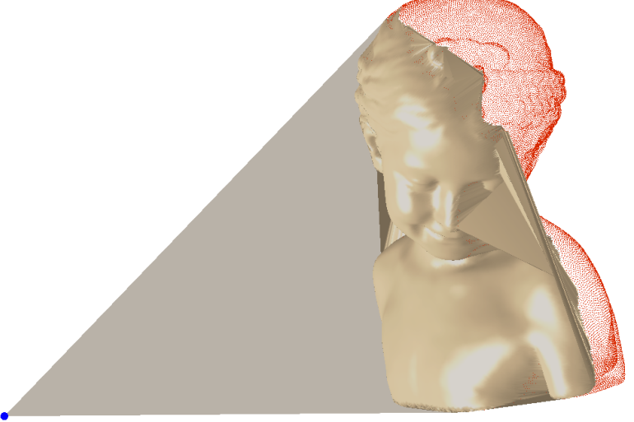
Design
-Video Branch
Remove Irrelevant Model Part
WiFi transceivers are placed to emulate real world deployment;
HPR[1] algorithm is adopted to remove potentially occluded points;
All points in croped point clouds are deemed as reflectors
[1] S. Katz, A. Tal, and R. Basri. Direct visibility of point sets. In ACM ToG 2007.

Slide 6
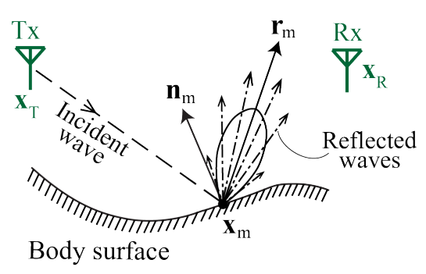
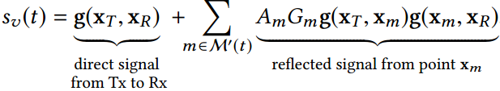

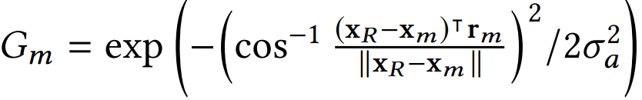
Design
-Video Branch
Generate Simulated WiFi Signal
Quasi-specular reflector[1] model is adopted for signal reflection;
Path-loss model is adopted for signal propagation;
Signal propagation and reflection theories underpin the simulation
[1] F. Adib, C.-Y. Hsu, H. Mao, D. Katabi, and F. Durand. Capturing the human fgure through a wall. ACM ToG 2015.

Slide 7
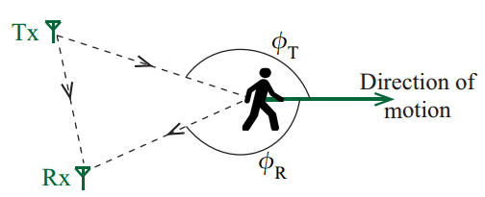


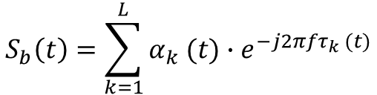

Design
-WiFi Branch
WiFi Signal Modeling
$$S_{b}\left(t\right)=α(t)∙e^{j2πfτ(t)}$$
$$S_{b}\left(t\right)=\sum_{k=1}^{L}{α_{k} (t)∙e^{−j2πfτ_{k} (t)}}$$
Human motion information is embodied in frequency of received signal

Slide 8


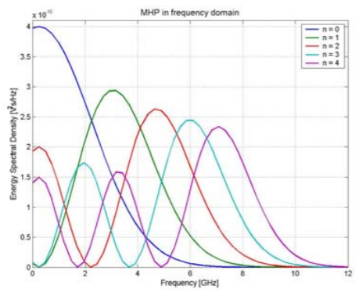
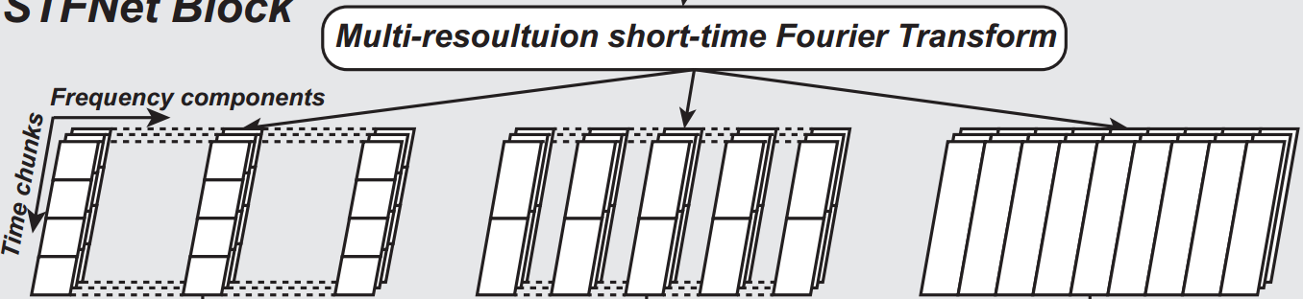
Design
-WiFi Branch
Generate Simulated WiFi Signal
Trade-off between time and frequency resolution exists for STFT;
Hermite Spectrograms[1] is adopted for better spectrum generation;
Multi-window spectrums are combined to form hologram of signal
[1] I. Orović, S. Stanković, and M. Amin. A new approach for classifcation of human gait based on time-frequency feature representations.
Signal Processing 91, 6 (2011), 1448–1456.

Slide 9
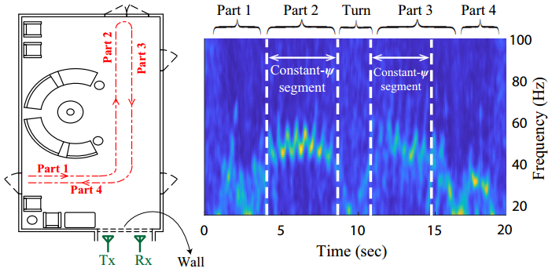
Design
-WiFi Branch
Spectrum Segmentation
To deal with casual walking path, specific signal segmentation should be isolated;
Constant doppler frequency can be observed when user walk on a straight line towards or away from the midpoint of the Tx-Rx;
The proposed approach can be utilized whenever part of the track meets the criteria

Slide 10
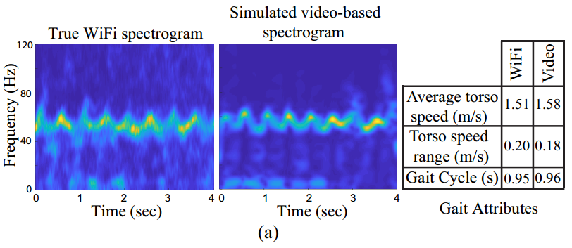
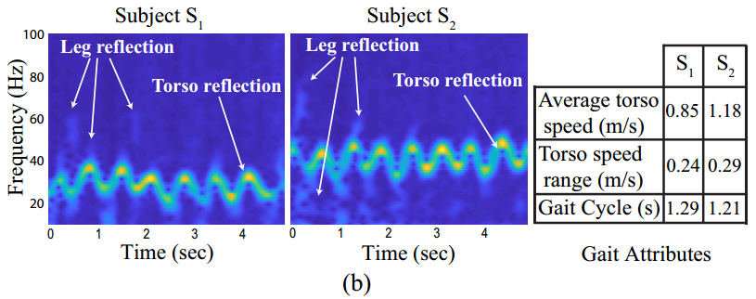
Design
Spectrum Distinguishability
WiFi signals simulated from video resembles the observed signal from WiFi chips;
Spectrums generated by different users embody discrepancy;
Spectrums from WiFi signal are embodied with significant human identity

Slide 11
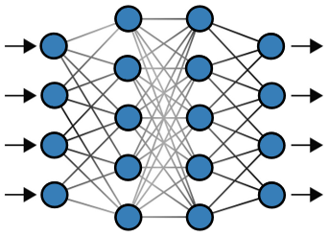
Design
Feature Extraction and Classification
Extracted features
Matching model
Frequency Distribution
Frequency Distribution 4 gait phase
Average torso speed
Average of the range of torso speed
Autocorrelation
FFT of spectrogram over time
Histogram of autocorrelation gradient
Histogram of torso speed gradient
Stride length
Feature distance
Matching score
Mathematical features are extracted from frequency and time domain;
Feature distance between video-generated and WiFi-generated features are feed into ANN for matching score estimation;
Samples from the same user have high similarity in feature space

Slide 12
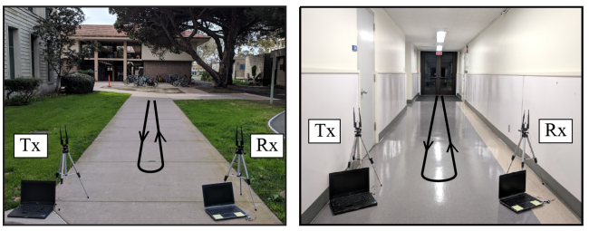
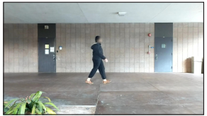
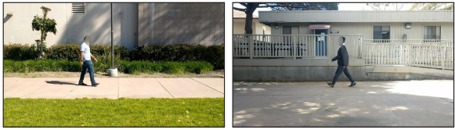
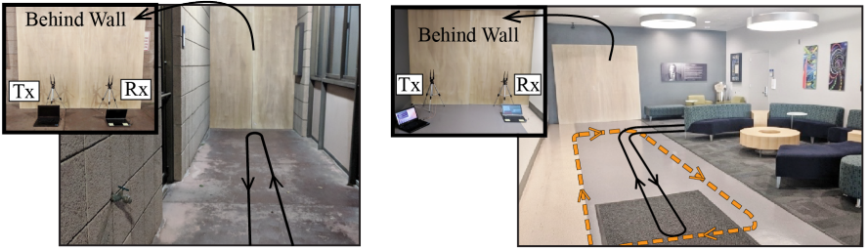
Evaluation
Implementation
Video collection area
WiFi collection area
Walking tracks are restricted while deployment scenarios are not

Slide 13
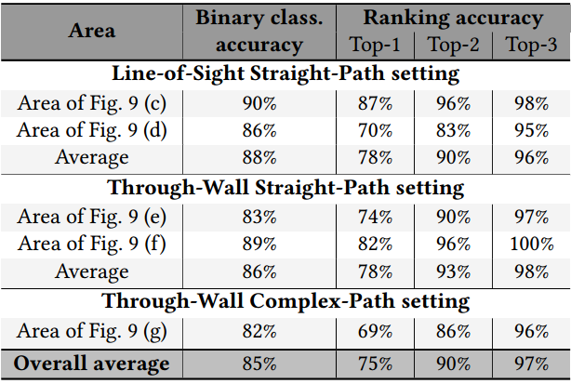
Evaluation
Performance
Binary accuracy indicate the similarity between video-generated and WiFi generated features;
Ranking accuracy indicate the discrepancy between features generated by different users;
Proposed scheme can be efficient for user identification with zero training effort

Slide 14
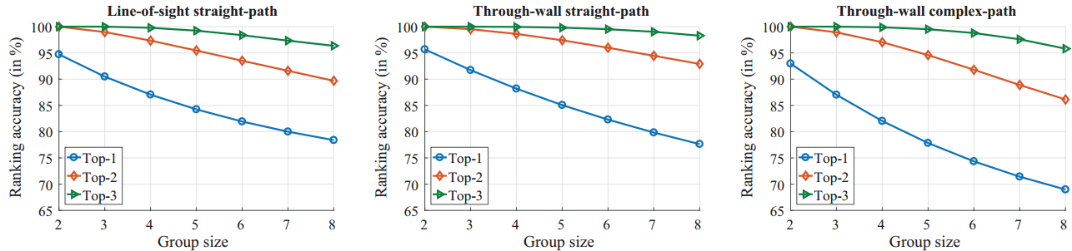
Evaluation
Performance
The proposed system can work under non-LOS scenarios;
System performance deteriorate slightly for complex path;
Proposed scheme can be efficient for user identification with zero training effort

Slide 15
Discussion
Highlights and Limitations
Highlights
Inspiring idea of simulating training samples with CV
Informative design of WiFi reflection model
Novel signal processing algorithm
Multi-windows STFT
Limitations
Reliance on 3D reconstruction accuracy of human body
Calibration of cameras are required
Strong presumption on walking track
Cumbersome solutions
ANN-based similarity measurement

Slide 16
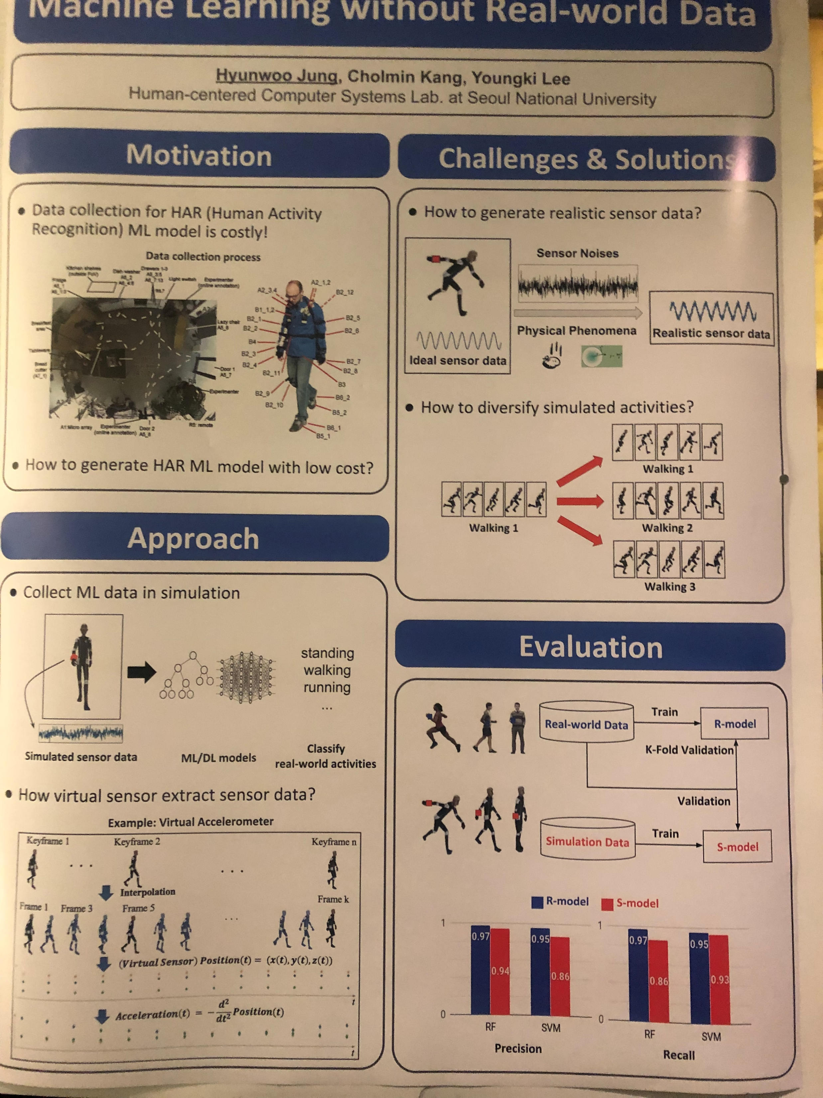
Discussion
Simulating training data for DNN serves as another key enabler (besides widar3.0) for zero-effort recognition in wireless sensing realm.

Slide 17
Discussion
Inspirations to Our Works
Cross-modal paradigm makes impossible possible (Person-in-WiFi)
Simulated data samples for training (Poster in MobiSys'19)
Creative application scenarios
Liquid testing
Soil testing
Material sensing

