Slide 1
Edge Intelligence: Paving the Last Mile of Artificial Intelligence With Edge Computing
Zhi Zhou, Xu Chen, En Li, Liekang Zeng, Ke Luo, Junshan Zhang

Slide 2



Background
Booming of AI applications and huge data at network edge promote Edge Intelligence.
AI applications: intelligent personal assistants, personalized shopping recommendation, video surveillance and smart home applications.
Data at edge: mobile computing and IoT.
Device
Limited power
Cloud
Bandwidth/Latency
Edge
Notes:
推动边缘智能发展的推手有两个。
一是AI的广泛应用。
二是在网络边缘产生的大量数据。数据作为模型训练或推导的输入。
边缘设备计算能力有限，无法支持模型的计算。
把数据全部上传到云端……
问题的解决方法也非常自然，我们把计算资源放到靠近数据来源的地方，也就是edge。

Slide 3
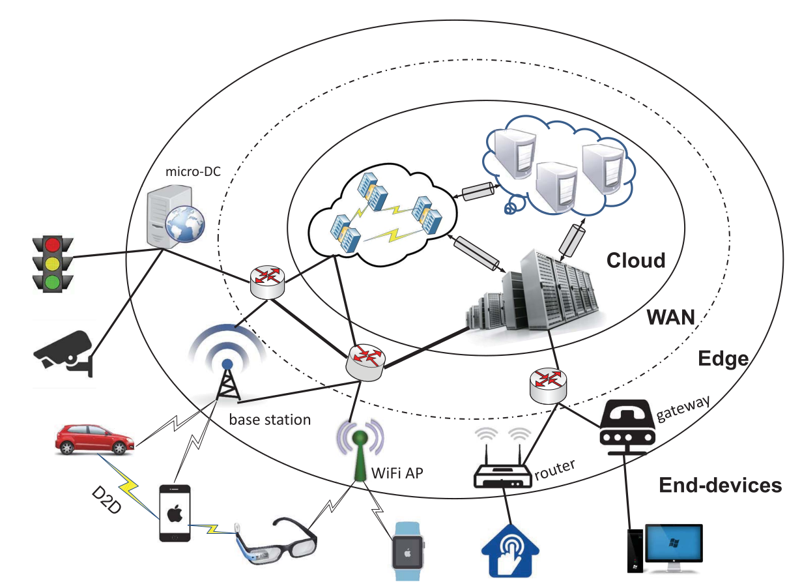
Device-Edge-Cloud
Notes:
在这张图中，End-devices包括移动设备、物联网设备等
他们通过不同的接入方式连接到基站、Wi-Fi路由器、网关等，这些都是Edge，再通过WAN连接到云端数据中心。

Slide 4
Motivation
Physical proximity to the information-generation sources is the most crucial characteristic emphasized by edge computing.
Low latency
Energy efficiency
Privacy protection
Reduce bandwidth consumption
Context-awareness
Notes:
在物理空间上靠近数据源是边缘计算最重要的特征。
这种物理空间上的接近可以带来诸多好处。
100km 5ms

Slide 5


Application Scenario of EI
Live Video Analytic
Cognitive assistance
Precision agriculture
Smart Home
Industrial IoT
Real-time video analytics is envisioned to be a killer application for edge computing.
Latency
Privacy
Notes:
Edge Intelligence的应用场景有很多，比如

Slide 6
Formal Definition and Rating of EI
EI should be the paradigm that fully exploits the available data and resources across the hierarchy of end devices, edge nodes and cloud datacenters to optimize the overall performance of training and inferencing a DNN model.
Optimization
Optimization tasks: The training and inferencing of DNN models.
Optimization resources: Data and computation power across the hierarchy of end devices, edge nodes and cloud datacenters.
Notes:
传什么，怎么传。
在哪算，怎么算。

Slide 7
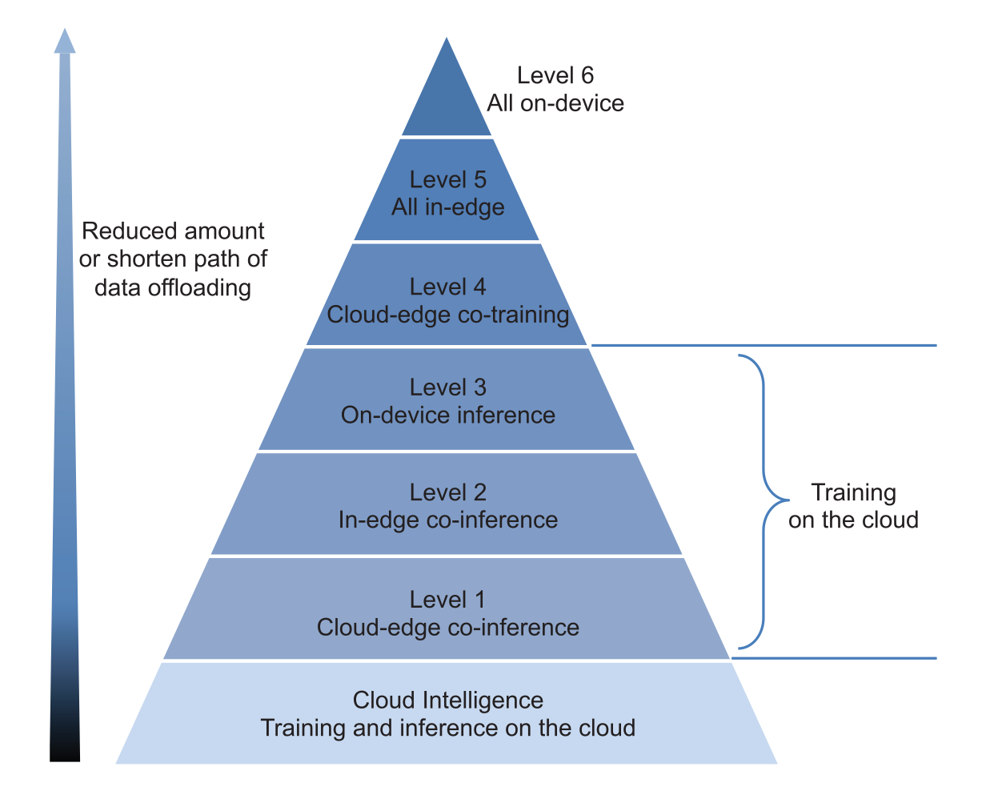
Formal Definition and Rating of EI
There is no “best-level” in general.
“Best level” is application-dependent.
Notes:
值得注意的是，并没有普遍意义上最好的level，这要依应用而定……

Slide 8
EI Model Training
Challenges: Huge data at network edge and privacy issue.
Key Question: How to train DNN models based on the data from edge devices without uploading them to a cloud datacenter?
Key technology: Distributed model training.

Slide 9
EI Model Training: Enabling Technologies
Federated Learning: Federated learning leaves the raw data distributed on the clients and trains a shared model on the server by aggregating locally computed update.
Aggregation Frequency Control: Focus on the optimization of communication overhead during DNN model training. Aggregation content & Aggregation frequency.
Gradient Compression: Focus on the optimization of communication overhead during DNN model training. Quantization & Sparsification.

Slide 10
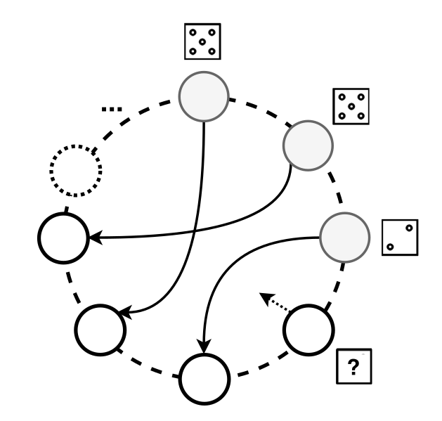
EI Model Training: Enabling Technologies
DNN Splitting: The aim of DNN splitting is to protect privacy. Leave the training of first few layers at local devices.
Gossip Training: A fully decentralized training method.

Slide 11
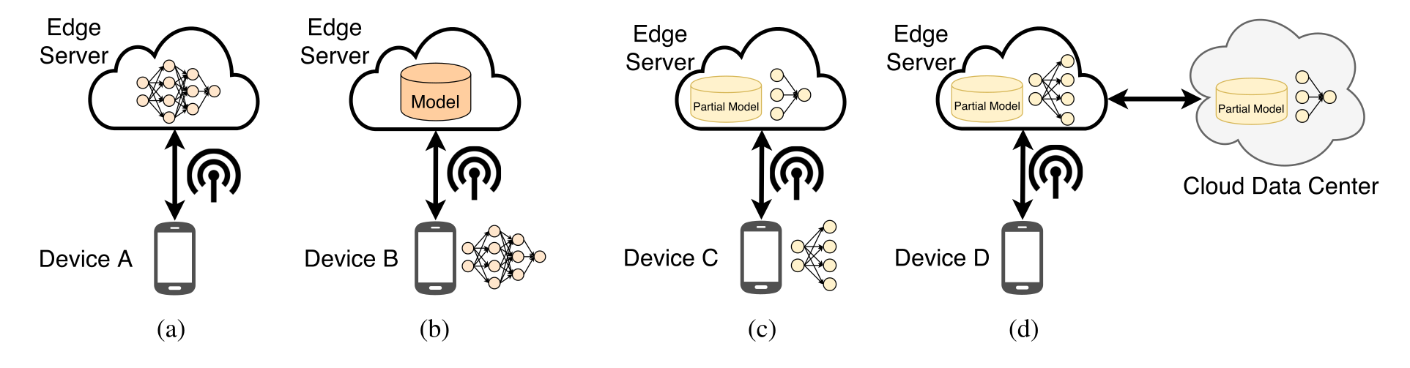
EI Model Inferencing: Architectures

Slide 12
EI Model Inferencing: Metrics
Latency
Accuracy
Energy
Privacy
Communication Overhead
Memory Footprint

Slide 13
EI Model Inferencing: Technologies
Model Compression
Weight pruning
Data quantization
Model retraining.
Reduction in size ≠ Reduction in energy consumption
Energy-aware pruning method. (EAP)

Slide 14
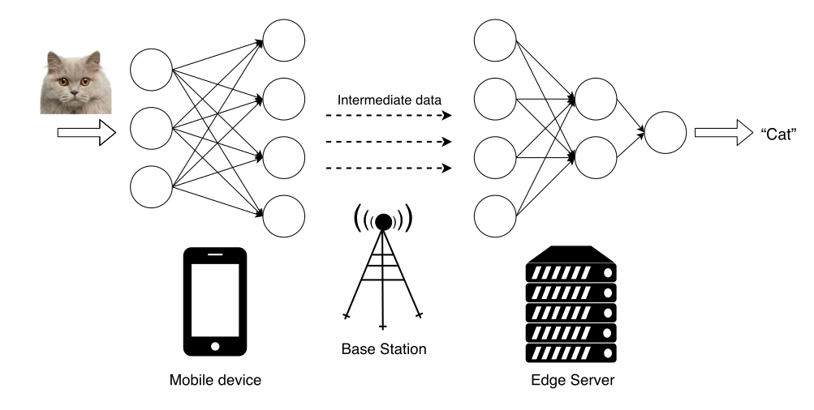
EI Model Inferencing: Technologies
Model Partition
Between device and server
  Latency?
  Privacy
Between devices (p2p)
  Mesh?
In a device
  CPU、GPU、DSP
Notes:
整数规划问题
图上的优化问题（最小割）

Slide 15
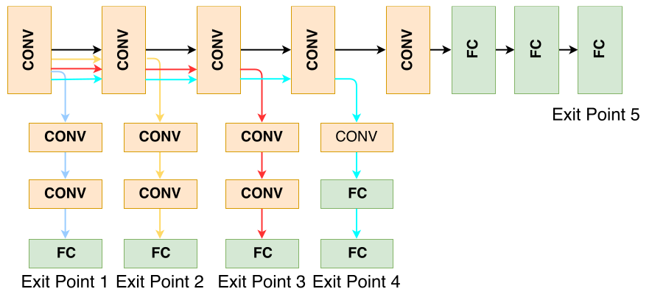
EI Model Inferencing: Technologies
Model Early Exit
Plus model partition
Policy determining whether to proceed to next layer.
Notes:
如何实现一个Early Exit的模型在ML领域已经研究得很多了。
这里的研究方向主要有两个。

Slide 16
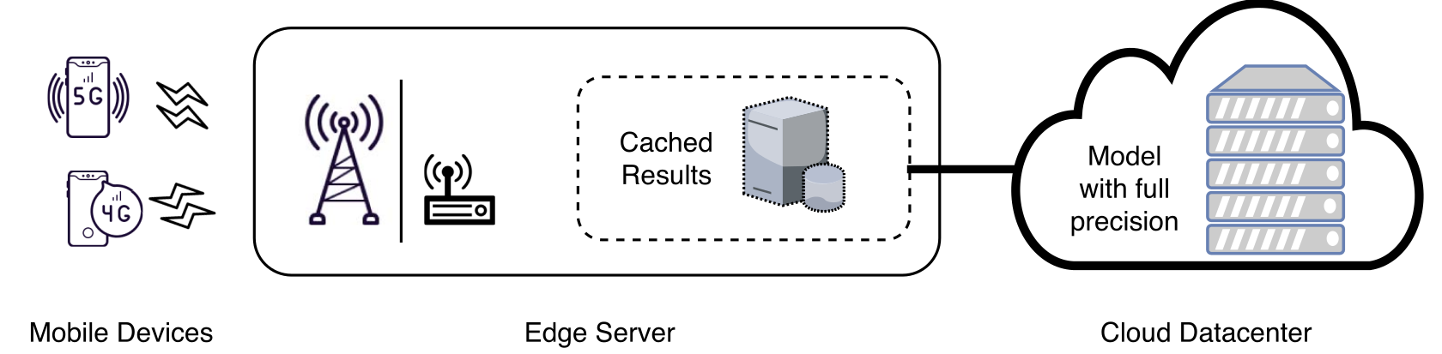
EI Model Inferencing: Technologies
Edge Caching
Key question:
  How to index images with rapid cache look-up?
  How to measure image similarity?
Glimpse
Notes:
以往的缓存是缓存内容
缓存function

Slide 17
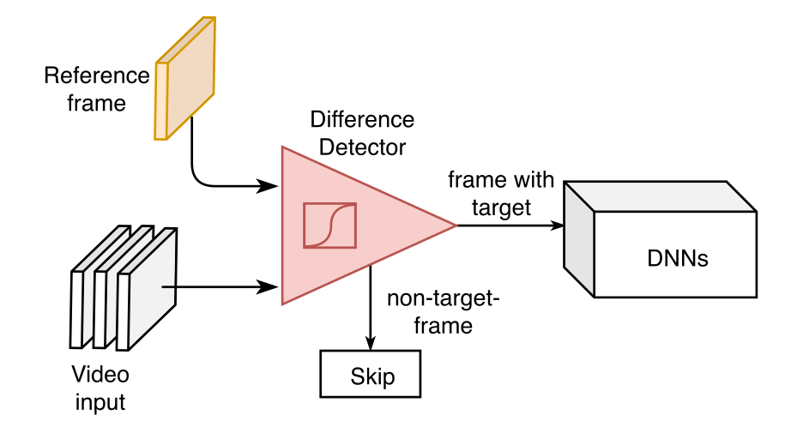
EI Model Inferencing: Technologies
Input Filtering
Remove frames that have little change.
Remove frames without target objects.

Slide 18
EI Model Inferencing: Technologies
Model Selection
Train a set of DNN models for the same task with various sizes offline and then adaptively select the best model for inference online.
Tradeoff among various metrics.
Select the most accurate model for current image.

Slide 19
EI Model Inferencing: Technologies
Support for Multitenancy
In practice, an end or edge device typically runs more than one DNN applications concurrently.
Application level: an application select different models adaptively to accommodate dynamic resources.
System level: schedule multiple tasks running concurrently on a device.

Slide 20
EI Model Inferencing: Technologies
Application-Specific Optimization
Video analytics: adjust frame-rate, resolution and bitrate adaptively.

Slide 21
Future Research Directions
Programming and Software Platforms - Heterogeneous.
Resource Friendly Edge AI Model Design.
  Model compression
  Resource-aware model design
Computation-Aware Networking Techniques.
  EI + 5G
  Autonomous edge node discovery (plug and play)

Slide 22
Future Research Directions
Resource Management.
  Service discovery protocols
  Model partition & collaboration execution
  Online Edge-resource orchestration
Security and Privacy Issues.
  Lightweight and distributed security mechanism design
  Privacy preserving model training
Incentive and Business Models.
  Blockchain with smart contract

Slide 23
Research Ideas
Feature map compression
Motivation:
  Privacy. Send feature map instead of original images.
  Reduce delay. Under the priori that we can not transmit original image due to privacy issue.
Solution:
  Differencial coding. (I-feature-map, P-feature-map)
  ROI.
  Model structure.

Slide 24
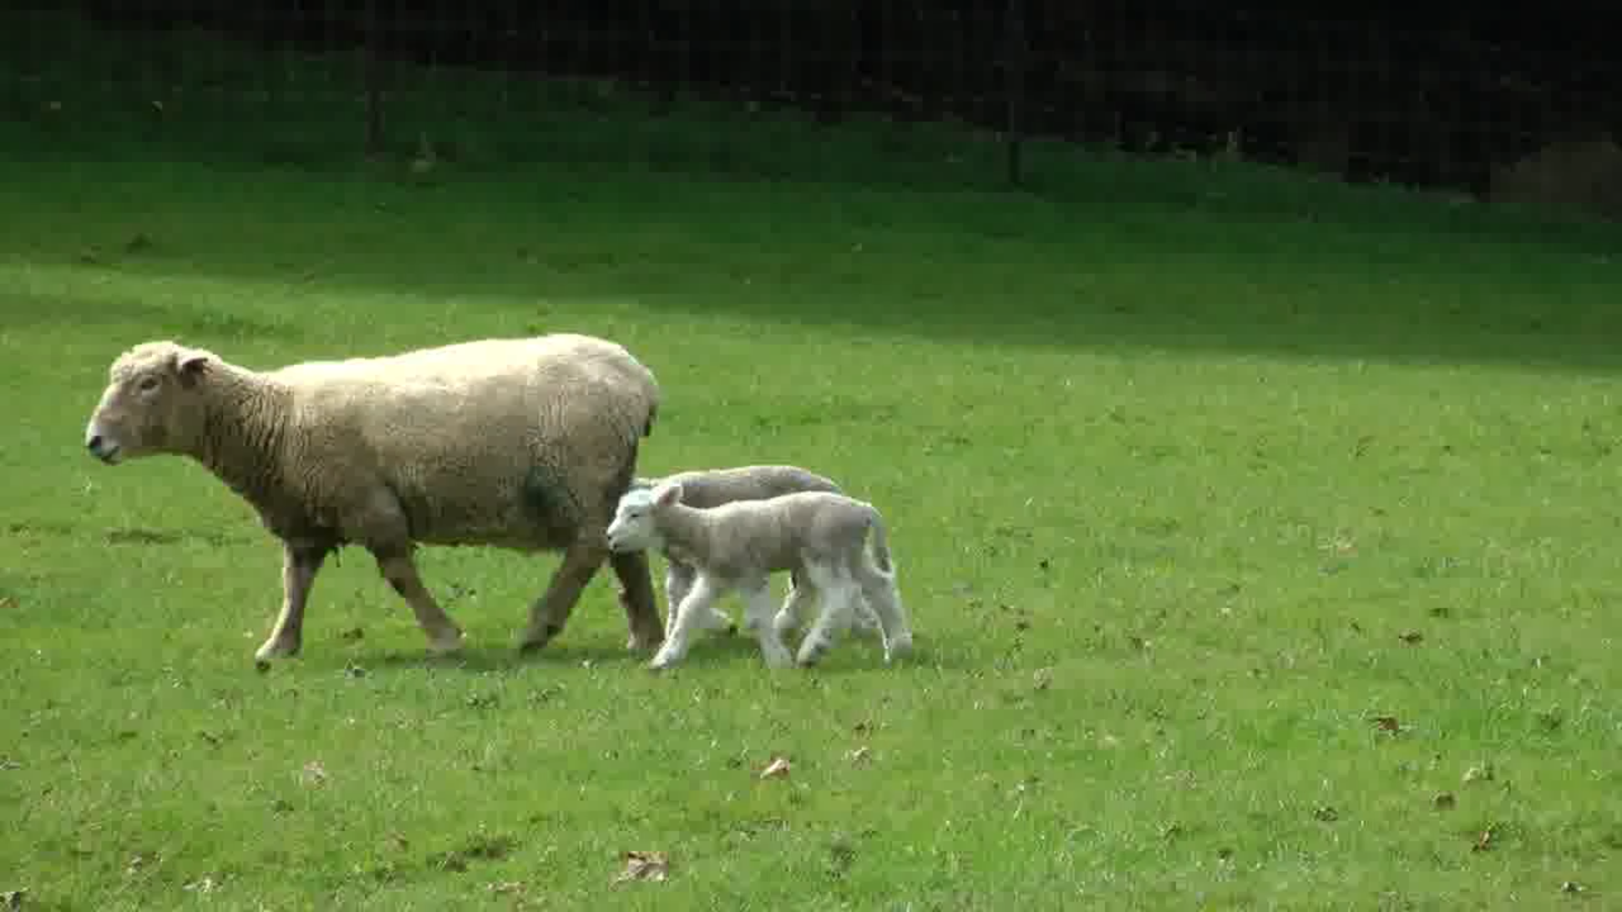
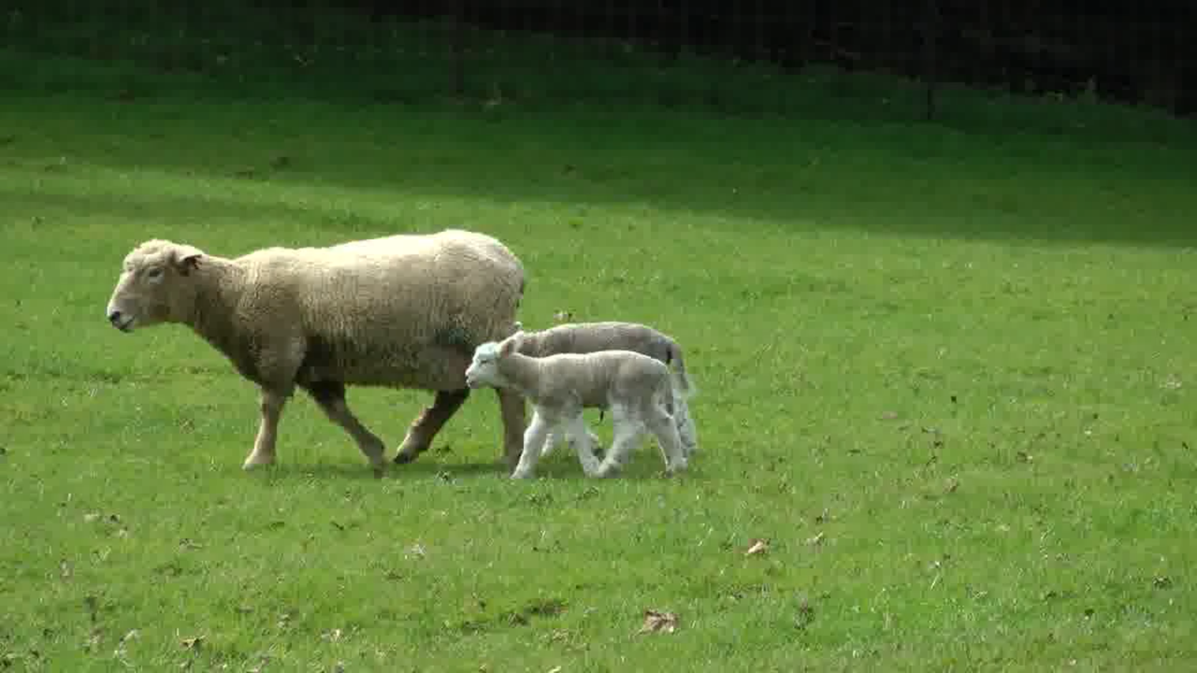
Only calculate and upload the feature map of this area
frame i
frame i+1

Slide 25
Research Ideas
Accuracy-aware task scheduling for multitenancy
Motivation:
  Previous scheduling algorithm treats every task equally. However, some tasks may be more important than others to improve overall user experience.
Solution:
  Measure the relationship between accuracy and whether a frame got processed.

Slide 26

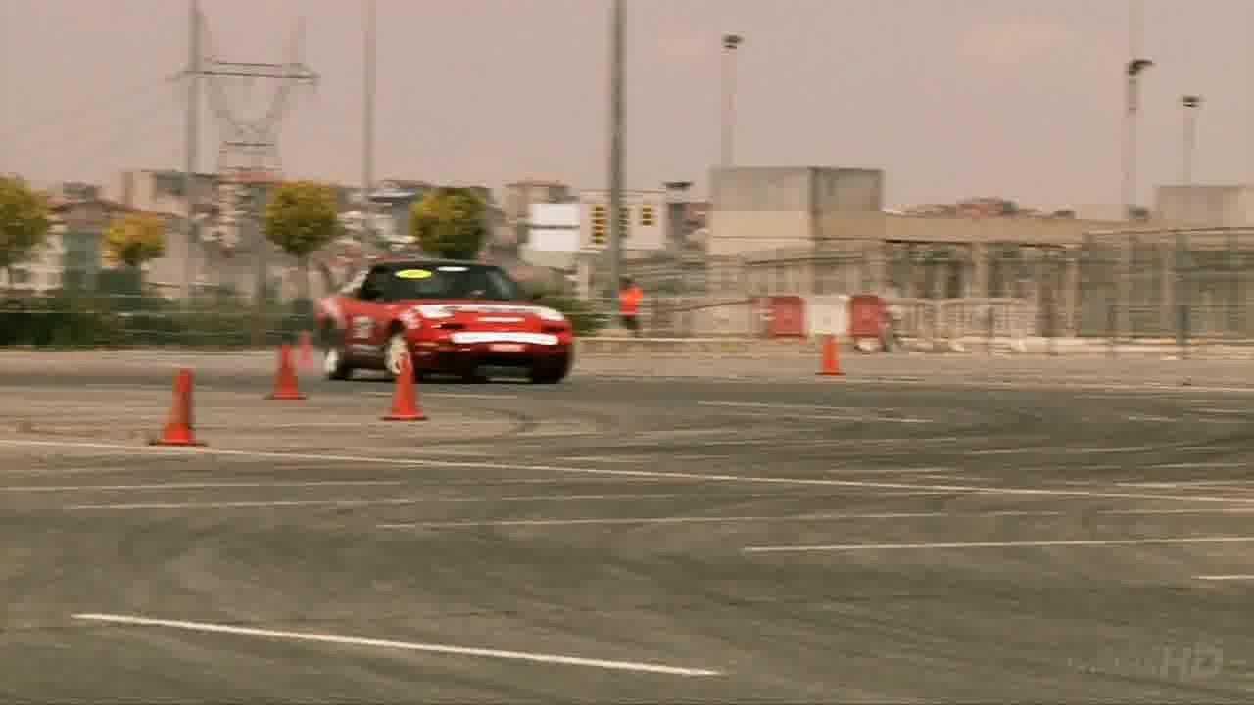
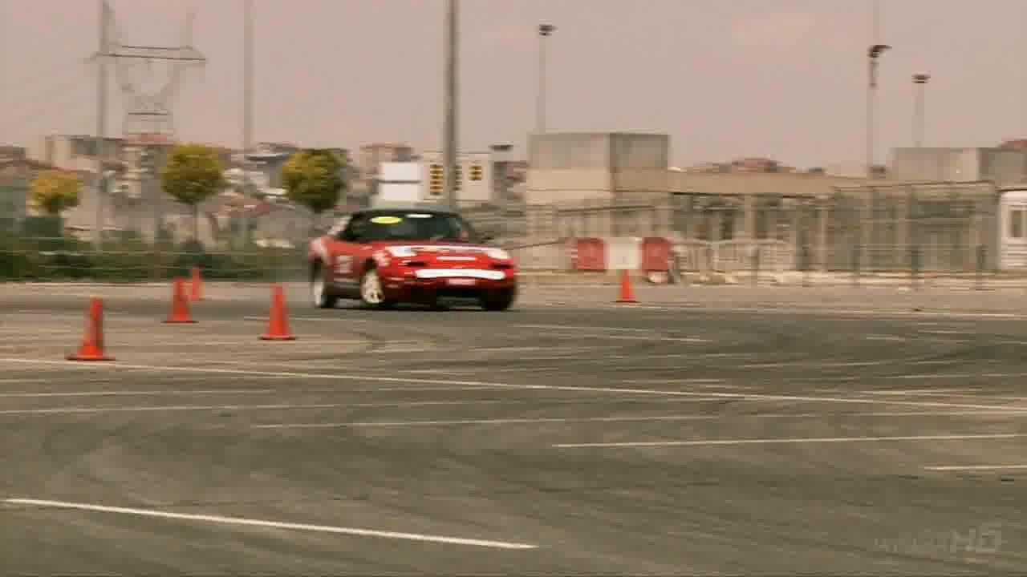
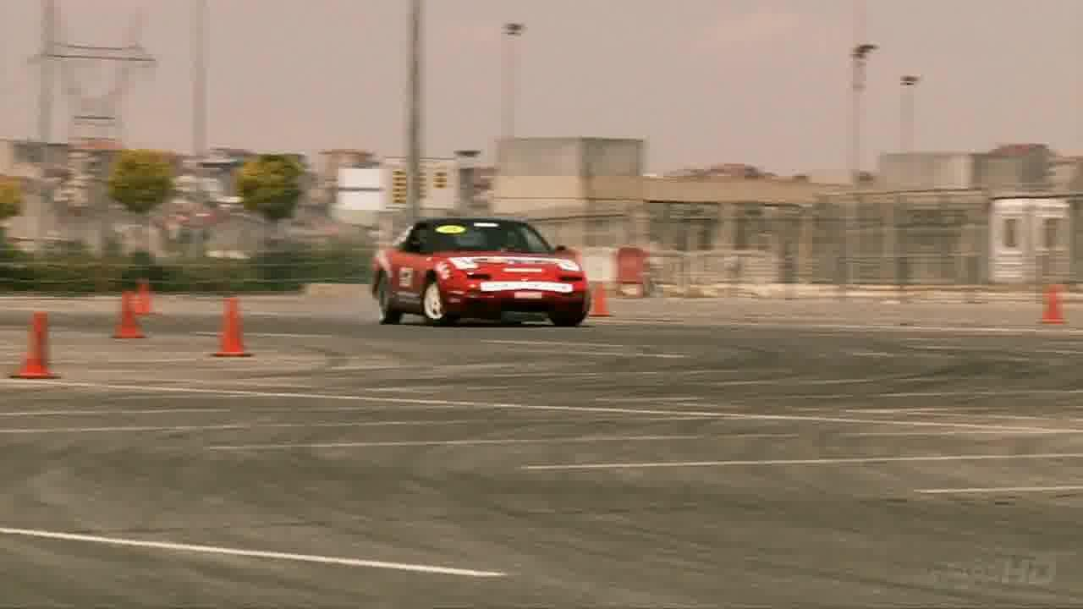
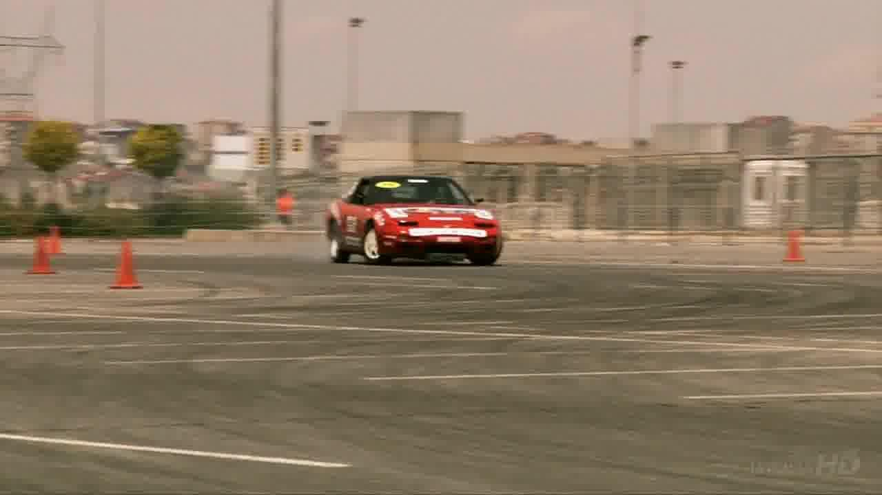
Server
Update result
accuracy1
Server
accuracy2
Key question: Estimate accuracy2-accuracy1

Slide 27
Research Ideas
Block-level edge cache
Motivation:
  Previous works take images as caching units. This may not apply to object detection.
Solution:
  SfM to cache the results of previous object detection.
  Process static and dynamic objects seperately.

Slide 28
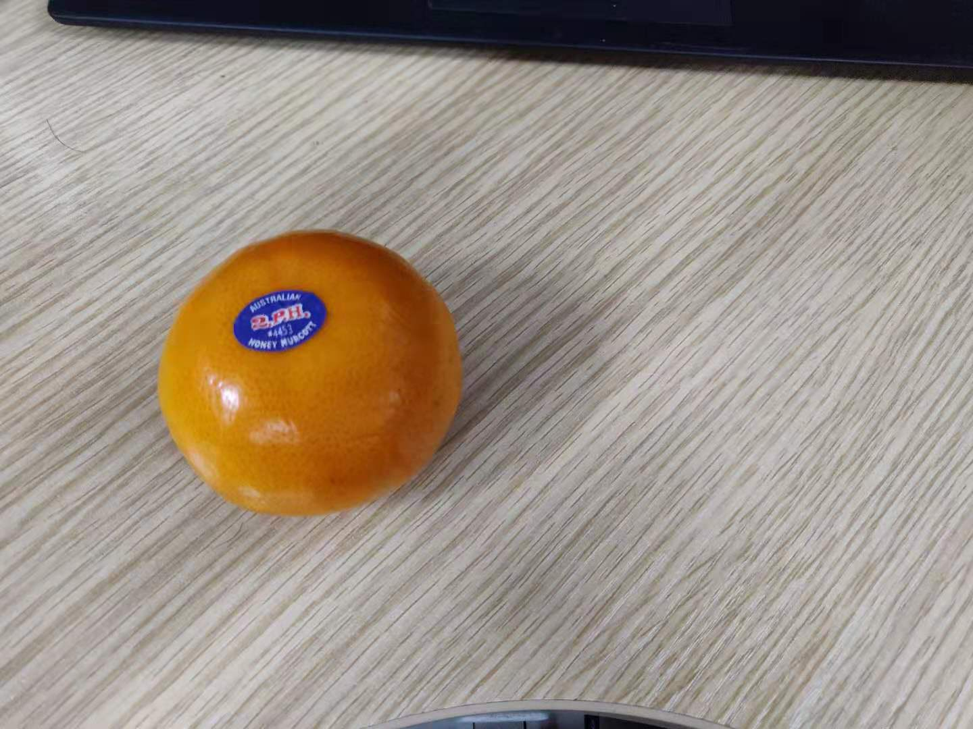
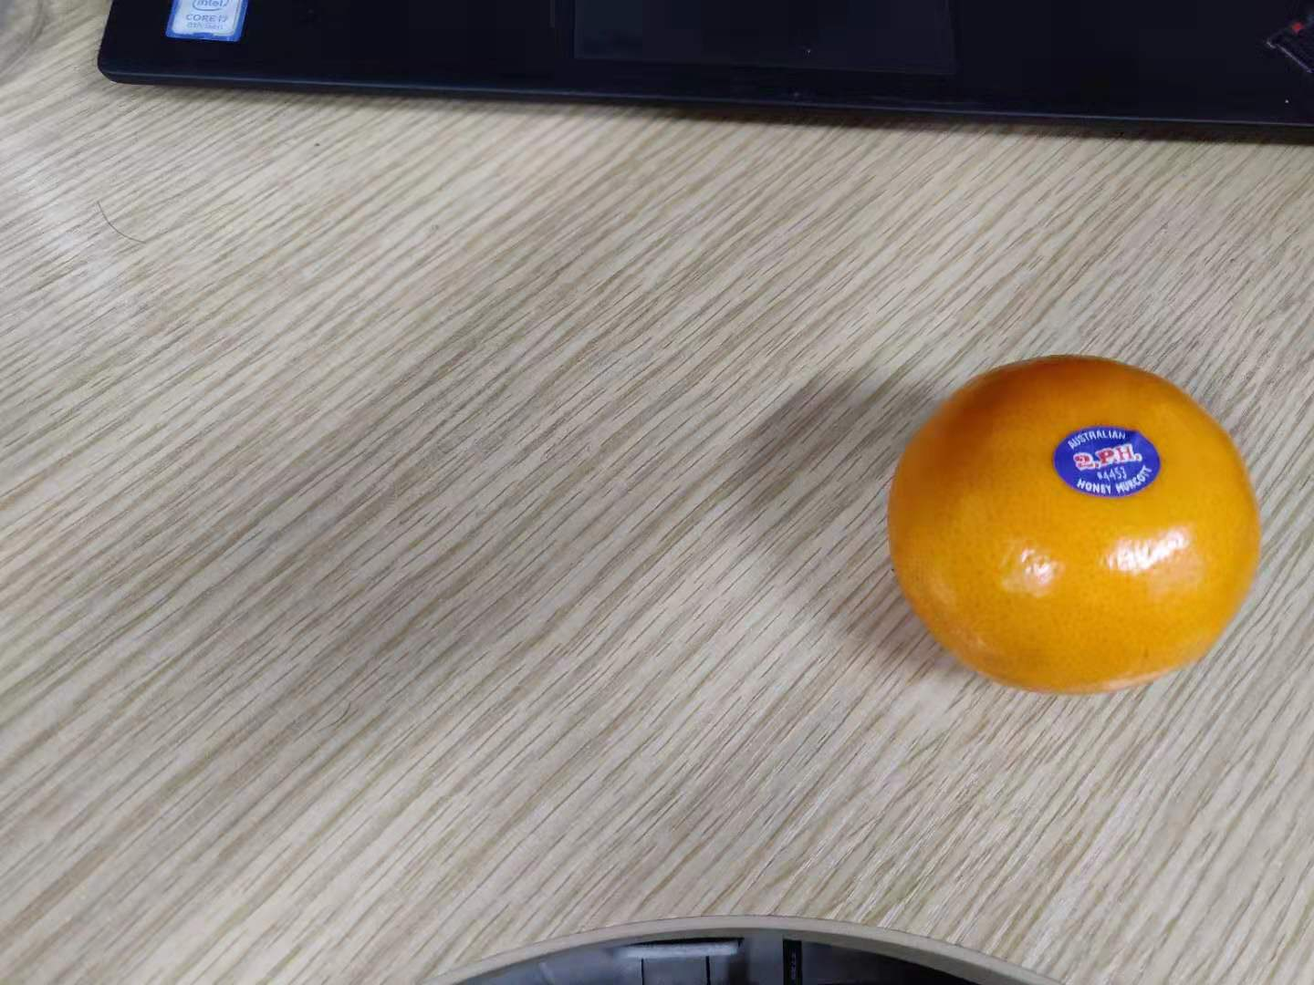
Orange
Orange
Object recognition
Image-level cache is okay.
Orange here
Orange there
Object detection
Block-level cache is needed.

Slide 29
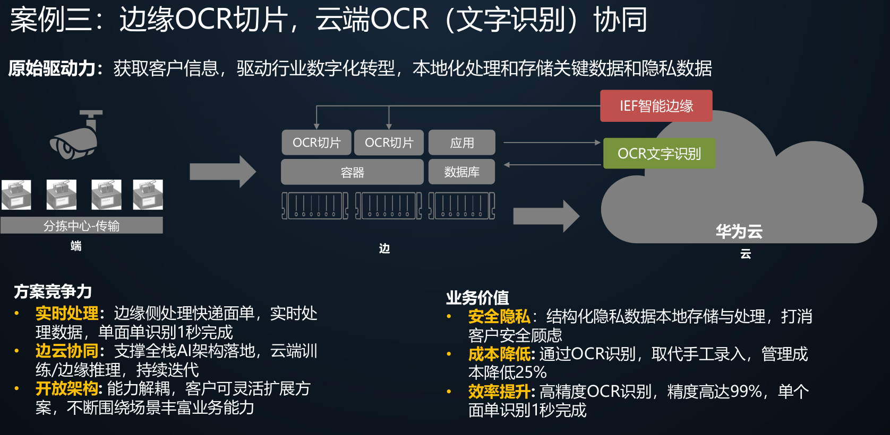
Application Scenarios

Slide 30
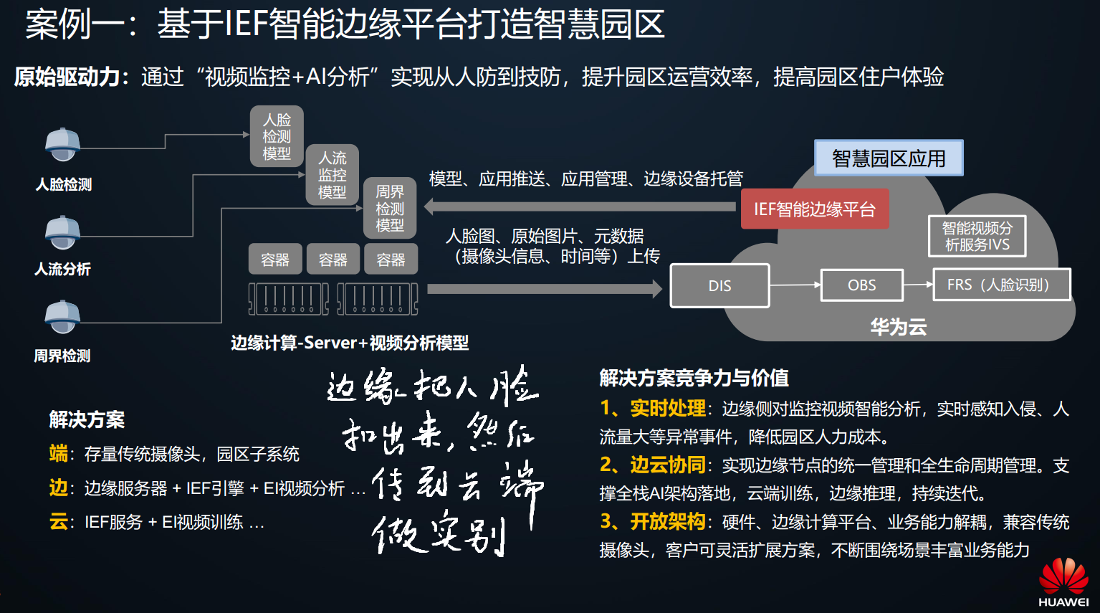
Application Scenarios

Slide 31
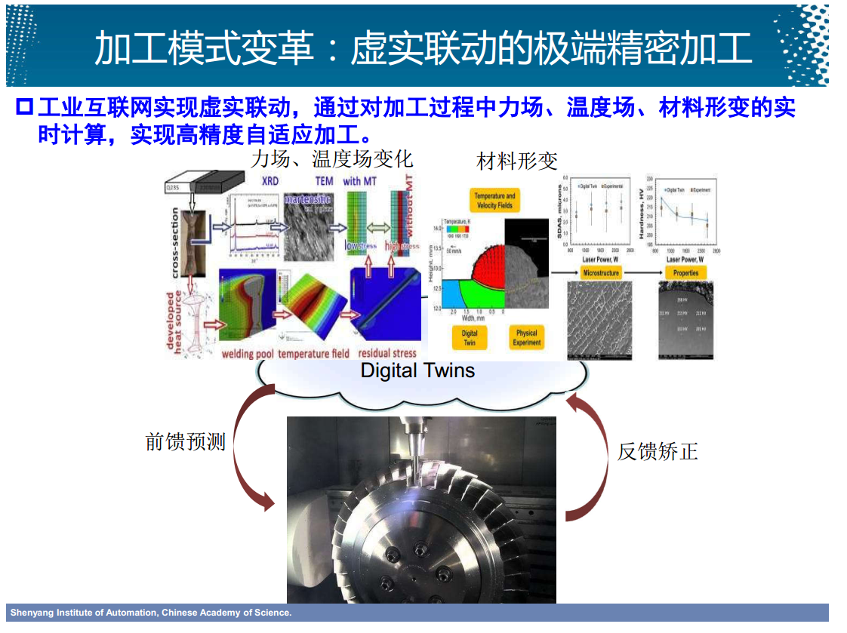
Application Scenarios

Slide 32
Thanks!
Q&A

Slide 33
Research Ideas
Online model selection
Motivation:
  Previous model selection methods are offline. Basically, they decide a model before inference based on measurements and constraints.
  Model capacity is fixed before running.
Solution:
  Change model capacity while it is running.
  Model early exit.

