Slide 1

RIM: RF-based Inertial Measurement
Chenshu Wu, Feng Zhang, Yusen Fan, K. J. Ray Liu
University of Maryland, College Park and Origin Wireless Inc.
August 20, 2019 @ ACM SIGCOMM’19

Slide 2


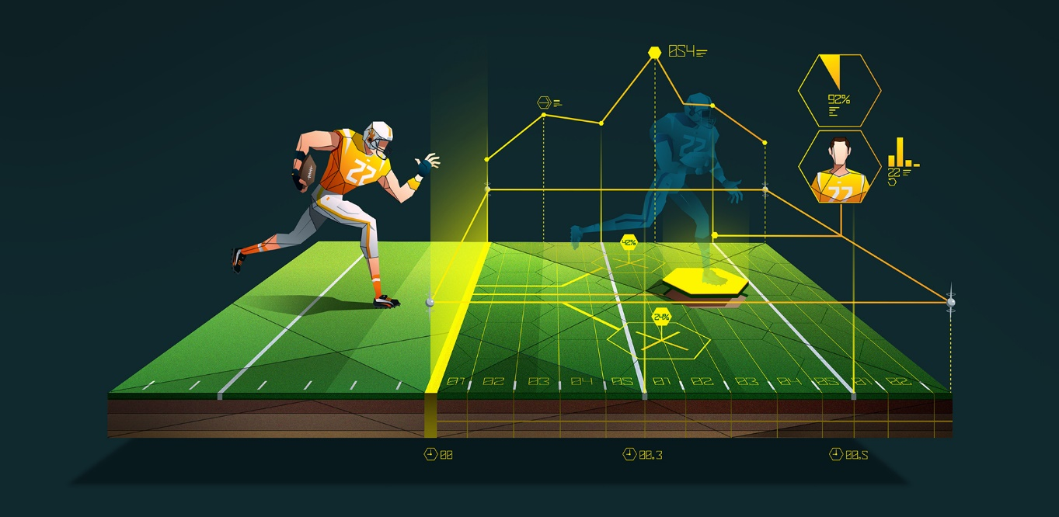



Motion Estimation
Robot Navigation
VR Gaming
Sports Analytics
Mobiles & Wearables
Robots
Drones
Notes:
Motion measurements are crucial for a large range of applications, including robot navigation, indoor tracking, and mobile gaming, and have been widely used in robots, drones, various consumer electronics, and basically anything that moves.

Slide 3
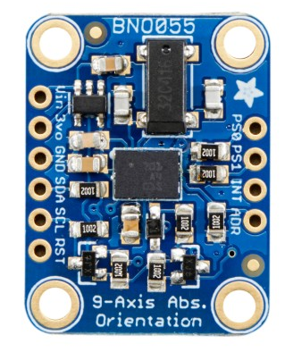
Inertial Measurement Unit
Moving Distance
Accelerometer
Heading Direction
IMU
Magnetometer
Measuring the linear acceleration
$21.74 billion IMU market by 2022!
Motion Parameters
Rotating Angle
Gyroscope
Reporting the absolute orientation
Calculating the angular velocity
Significant limitations in precise and robust motion estimation:
Accelerometer: Noisy readings
Gyroscope: Accumulative errors due to integration
Magnetometer: Environment interference, cannot infer heading direction
Notes:
To measure the motion parameters: namely the moving distance, heading direction and rotating angle, the mainstream has been resorting to inertial measure unit, which is composed of accelerometer that can measure the linear acceleration, magnetometer which estimates the magnetic north, and gyroscope calculating the angular velocity.
Because of the increasing demand for accurate motion tracking, the IMU market is forecast to reach over 21 billion by year 2022. However, there are significant limitations in IMU sensors: The accelerometer has noisy readings. The gyroscope is notorious for its accumulative error. The magnetometer is severely affected by ferromagnetic interference that is common in typical indoor environments.
These limitations prevent many applications that require accurate motion processing.

Slide 4
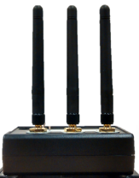

Existing Wireless Localization & Tracking
Mainly use geometric channel parameters like AoA, ToF
Require phased arrays
Multiple APs with precise location and/or orientation info
Degenerate or fail in complex multipath scenarios
Address only locations, but not motion parameters
AoA
ToF
Multipaths is still enemy!
Notes:
When your connection to the sigcomm WiFI got rejected outside the designated area, you should know that radio signals have been utilized for localization and tracking. They are mainly using geometric parameters like AoA and ToF.
To do so, they require phased arrays of many antennas; Following triangulation, they need multiple precisely installed APs with accurate location and orientation information;
However, they degenerate or even fail in complex multipath scenarios, which are typical indoors; what’s worse, they can only estimate the location, but not the motion parameters we want.
For them, because they need to extract the direct path, multipaths is still their enemy.

Slide 5

RIM: RF-based Inertial Measurement
Turns COTS WiFi radio into precise IMU that measures multiple motion parameters:
  Moving distance, Heading direction, Rotating angle
One single arbitrarily placed AP
One single arbitrarily placed AP, without knowing its location/orientation
No additional infrastructure or external sensors
Not require large bandwidth
No need of a priori calibration or fingerprinting of the environment
Works anywhere the AP signal reaches, be there LOS or through multiple walls
COTS WiFi receiver
How to achieve all these nice features in one system?
Notes:
In our work, RIM enables the RF signal to do motion measurements using commercial WiFi.
It has minimal requirements of hardware: it only needs antennas available on WiFi receivers, in addition to a single arbitrarily placed AP as a transmitter, without knowing the AP’s location or orientation.
In contrast to many prior indoor tracking techniques that are flawed in NLOS, RIM embraces multipath and works anywhere the AP signal can reach.
We painted a rosy picture here, but how do we achieve all the nice features in our system?

Slide 6


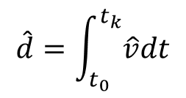
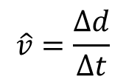

Spatial-Temporal Virtual Antenna Retracing (STAR)
Multipath Profiles as Virtual Antennas!
t₀
t₁
t₂
t₃
t₄
t_{k-3}
t_{k-2}
t_{k-1}
t_{k}
$$\vec{v}$$
1 antenna
1
1
d
Δt
t₀
t₁
t₂
t₃
t₄
t_{k-3}
t_{k-2}
t_{k-1}
t_{k}
$$\hat{v}=\frac{Δd}{Δt}$$
$$\vec{v}$$
1
2
1
1D STAR
d
$$\hat{d}=\int_{t_{0}}^{t_{k}}{\hat{v}dt}$$
Δd
Δd
2
t₀
t₁
t₂
t₃
t₄
t_{k-3}
t_{k-2}
t_{k-1}
t_{k}
Moving distance
Aligned virtual antennas
Notes:
Our key idea is that the multipath profiles observed at different locations can serve as virtual antennas.
As we can see, when the antenna moves, it captures a channel snapshot at every point along the trajectory as if it sets up a virtual antenna there.
Considering a two-antenna array, the following antenna 1 will retrace every location the leading antenna 2 has traveled.
From the time antenna 1 takes to catch up with the antenna 2, we can estimate the moving speed by dividing the travel distance $∆$d by the time offset $∆$t. Here the travel distance is identical to the antenna separation, which is known and fixed and independent of how they move.
Having the velocities calculated, the moving distance is straight forward to get.

Slide 7
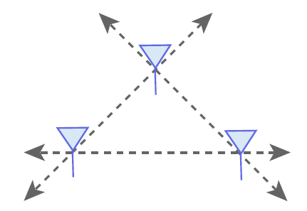
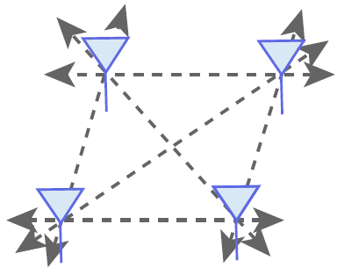
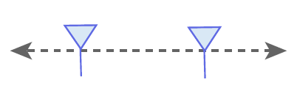
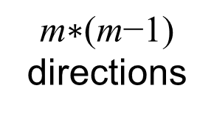
STAR in 2D space
Line:
2 directions
Triangle:
6 directions
Quadrangle:
12 directions
m∗(m-1)/2
lines
$$\text{m}\text{∗(}\text{m}\text{−1)}$$
directions
2π/(m ∗ (m - 1))
orientation resolution
m antennas
Identifying the aligned antenna pair will give the moving direction
Heading direction
Notes:
By extending the antenna arrays to two dimensional, we can track the speed in multiple directions formed by different antenna pairs.
For example, for a linear array of two antennas, we can only track two directions, either left or right. With three antennas forming a triangular array, there are six different directions that can be resolved. Generally, with more antennas, we can track more directions with higher resolution.
So, by identifying aligned antenna pairs, we can derive the heading direction.

Slide 8
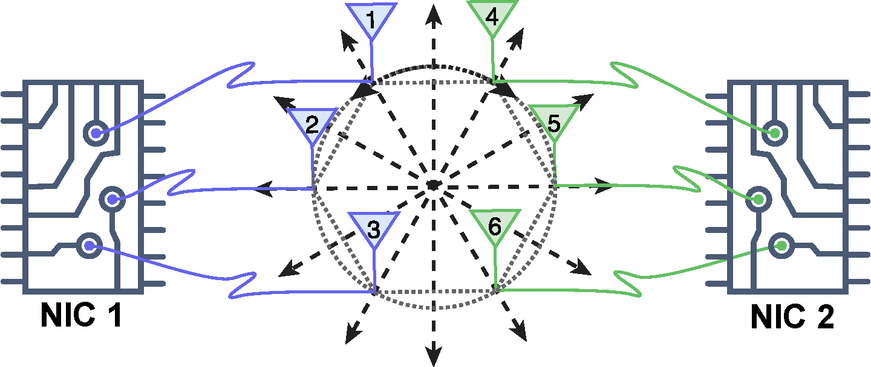
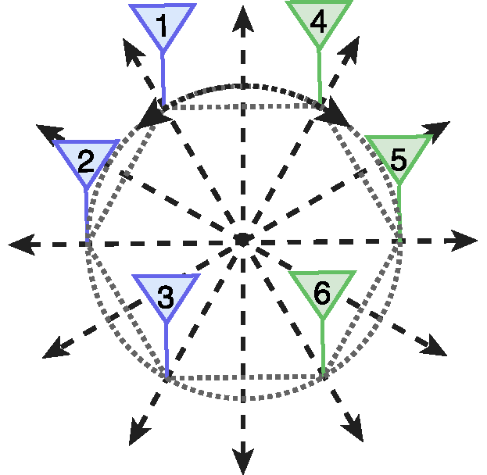
STAR in 2D space
Translational motion:
2~3 aligned pairs
Rotational motion:
All adjacent pairs will be aligned
6-element hexagonal array:
12 different directions in total and thus an orientation resolution of 30◦
Build from two COTS WiFi radios without phase synchronization
Rotating angle
Notes:
We prototype RIM using a 6-element hexagonal array, which offers 12 different heading directions with a resolution of 30 degrees.
We built it by putting together two commercial WiFi cards without phase synchronization.
For linear motion in a specific direction, there are only several antenna pairs aligned with each other.
Differently, for the in-place rotation, every adjacent pair will be aligned at the same time since all of them move along the same circle.
Thus, we can sense rotation by detecting concurrent alignment between all pairs of adjacent antennas, and further calculate the rotating angle.

Slide 9

Super-Resoalution Virtual Antenna Alignment
How to accurately pinpoint the space-time point that two virtual antennas are aligned with each other, at sub-centimeter resolution?
Time Reversal Resonating Strength
Virtual Massive Antennas
$$Δd=λ/2$$
Notes:
So far, we have shown the intuition of Virtual Antenna Alignment for multiple motion parameter estimation.
To put the idea into a practical system with high accuracy, a key challenge is how to accurately pinpoint the alignment point of two virtual antennas. Because of the huge error induced by only 1 cm error, we have to push the precision to a sub-centimeter level.
We propose a novel solution to achieve super resolution virtual antenna alignment, which involves two key techniques: time reversal resonating strength, and virtual massive antennas.

Slide 10


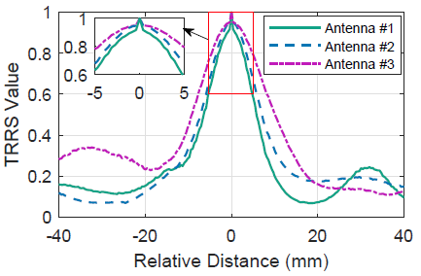



Time Reversal Resonating Strength (TRRS)
Time-Reversal Focusing Effect: The received CSI, when combined with its time-reversed and conjugated counterpart, will add coherently at the intended location but incoherently at any unintended location, creating a spatial focusing effect
$$H_{1}$$
(CIR)
$$\vec{v}$$
TRRS
(CFR)
d
$$H_{2}$$
STAR Resolution
The peak value as high as possible
The peak width as narrow as possible
The above two properties as robust as possible
Notes:
Recall virtual antenna alignment for a pair of antennas.
When comparing the multipath profiles of one antenna to a sequence of virtual antennas emulated by the other, we expect to have highest similarity at the same location.
For better precision, we require large peak value and narrow peak width, with high robustness.
To satisfy the requirements, we propose a metric named Time Reversal Resonating Strength (TRRS), which calculates the correlation between two CFRs. This is inspired by the physics Time Reversal Focusing Effect.
We show the self TRRS of three different antennas in the figure. As seen, TRRS meets all the requirements.

Slide 11

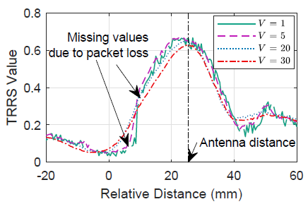



Virtual Massive Antennas
Overcome distortions in TRRS: Leveraging consecutive multipath profiles as massive virtual antennas
$$\vec{v}$$
d
$$\vec{v}$$
d
$V$ $\text{virtual} \text{antennas}$
Notes:
To suppress the noise and further improve the robustness of the super-resolution alignment, we leverage multiple virtual antennas, forming a virtual massive antenna array whose size is the number of channel snapshots.
As shown in the figure, the TRRS touches the maximum only when two antennas are closest to each other and drops when they are separated by only several millimeters.

Slide 12
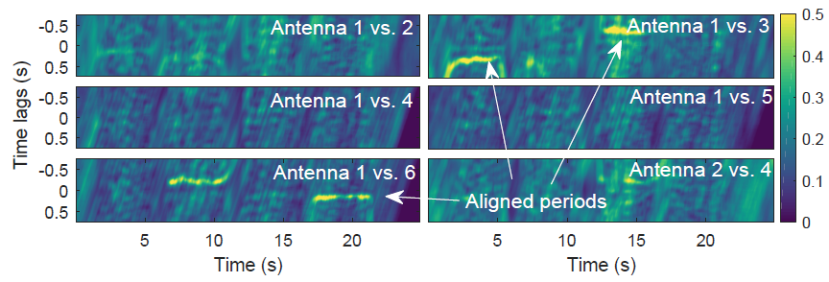
TRRS Matrix - Normal retracing
Consider a window of length 2W
TRRS vector:
TRRS matrix:
12
Notes:
To pinpoint the precise temporal delay when two antennas are spatially aligned, we match the multipath profile of one antenna against those of the other antenna throughout a sliding window, and obtain a TRRS matrix for each pair of antennas.
An important feature of the proposed virtual antenna alignment is that, even under deviated retracing, we can still obtain noticeable TRRS peaks for motion tracking.
Now, the remaining task is to find aligned antenna pairs and the corresponding alignment delays.

Slide 13
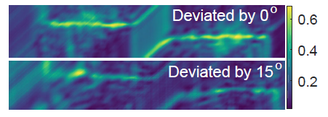
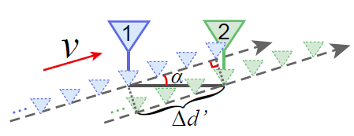
TRRS Matrix - Deviated retracing
overestimated error : 3.53%
Which antenna pair(s) is aligned and what is the alignment delay?

Slide 14
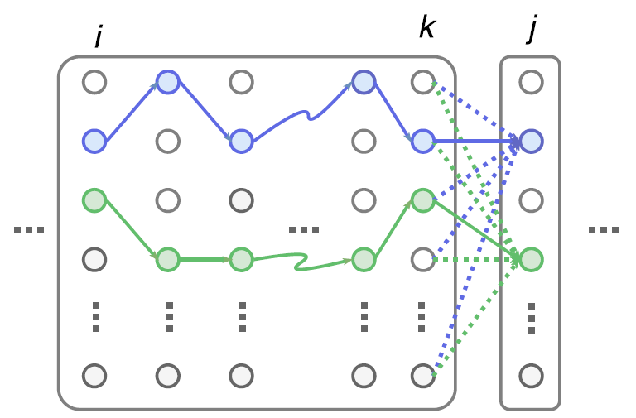

Tracking Alignment Delay
Continuously track alignment delay via Dynamic Programming
Peak value
(negative) Cost function
Notes:
We propose a dynamic programming algorithm to continuously track the alignment delay of each antenna pair during moving.
The rationale behind our algorithm is that for aligned pairs, the TRRS value should be high. Also, since the moving velocity can not change abruptly, the alignment delay should change smoothly. So we reward large peak values, and penalize large peak jumps.
Based on the score function, we select the peak trace producing the best score.

Slide 15
Detecting Aligned Pairs
1 vs 2
1 vs 3
1 vs 4
1 vs 5
1 vs 6
2 vs 3
2 vs 4
2 vs 5
2 vs 6
3 vs 4
1
6
2
5
3
4
3 vs 5
3 vs 6
4 vs 5
4 vs 6
5 vs 6
Detect the top two aligned pairs by TRRS peaks, continuity and smoothness of the peak trace, and the orientations they indicate
Notes:
Using the scores defined in the last slide, we will select two aligned pairs with highest scores.
Here’s an example of TRRS matrices for all the antenna pairs, involving 4 movements
First, the antenna array moves up, and we would expect antenna pairs 13 and 46 are best aligned.
Then, the antenna array moves toward left, the aligned pairs selected should be 16 and 34.
Next, moving downwards, the pairs 13 and 46 are again selected, but with opposite time offset.
Last, moving toward right.

Slide 16
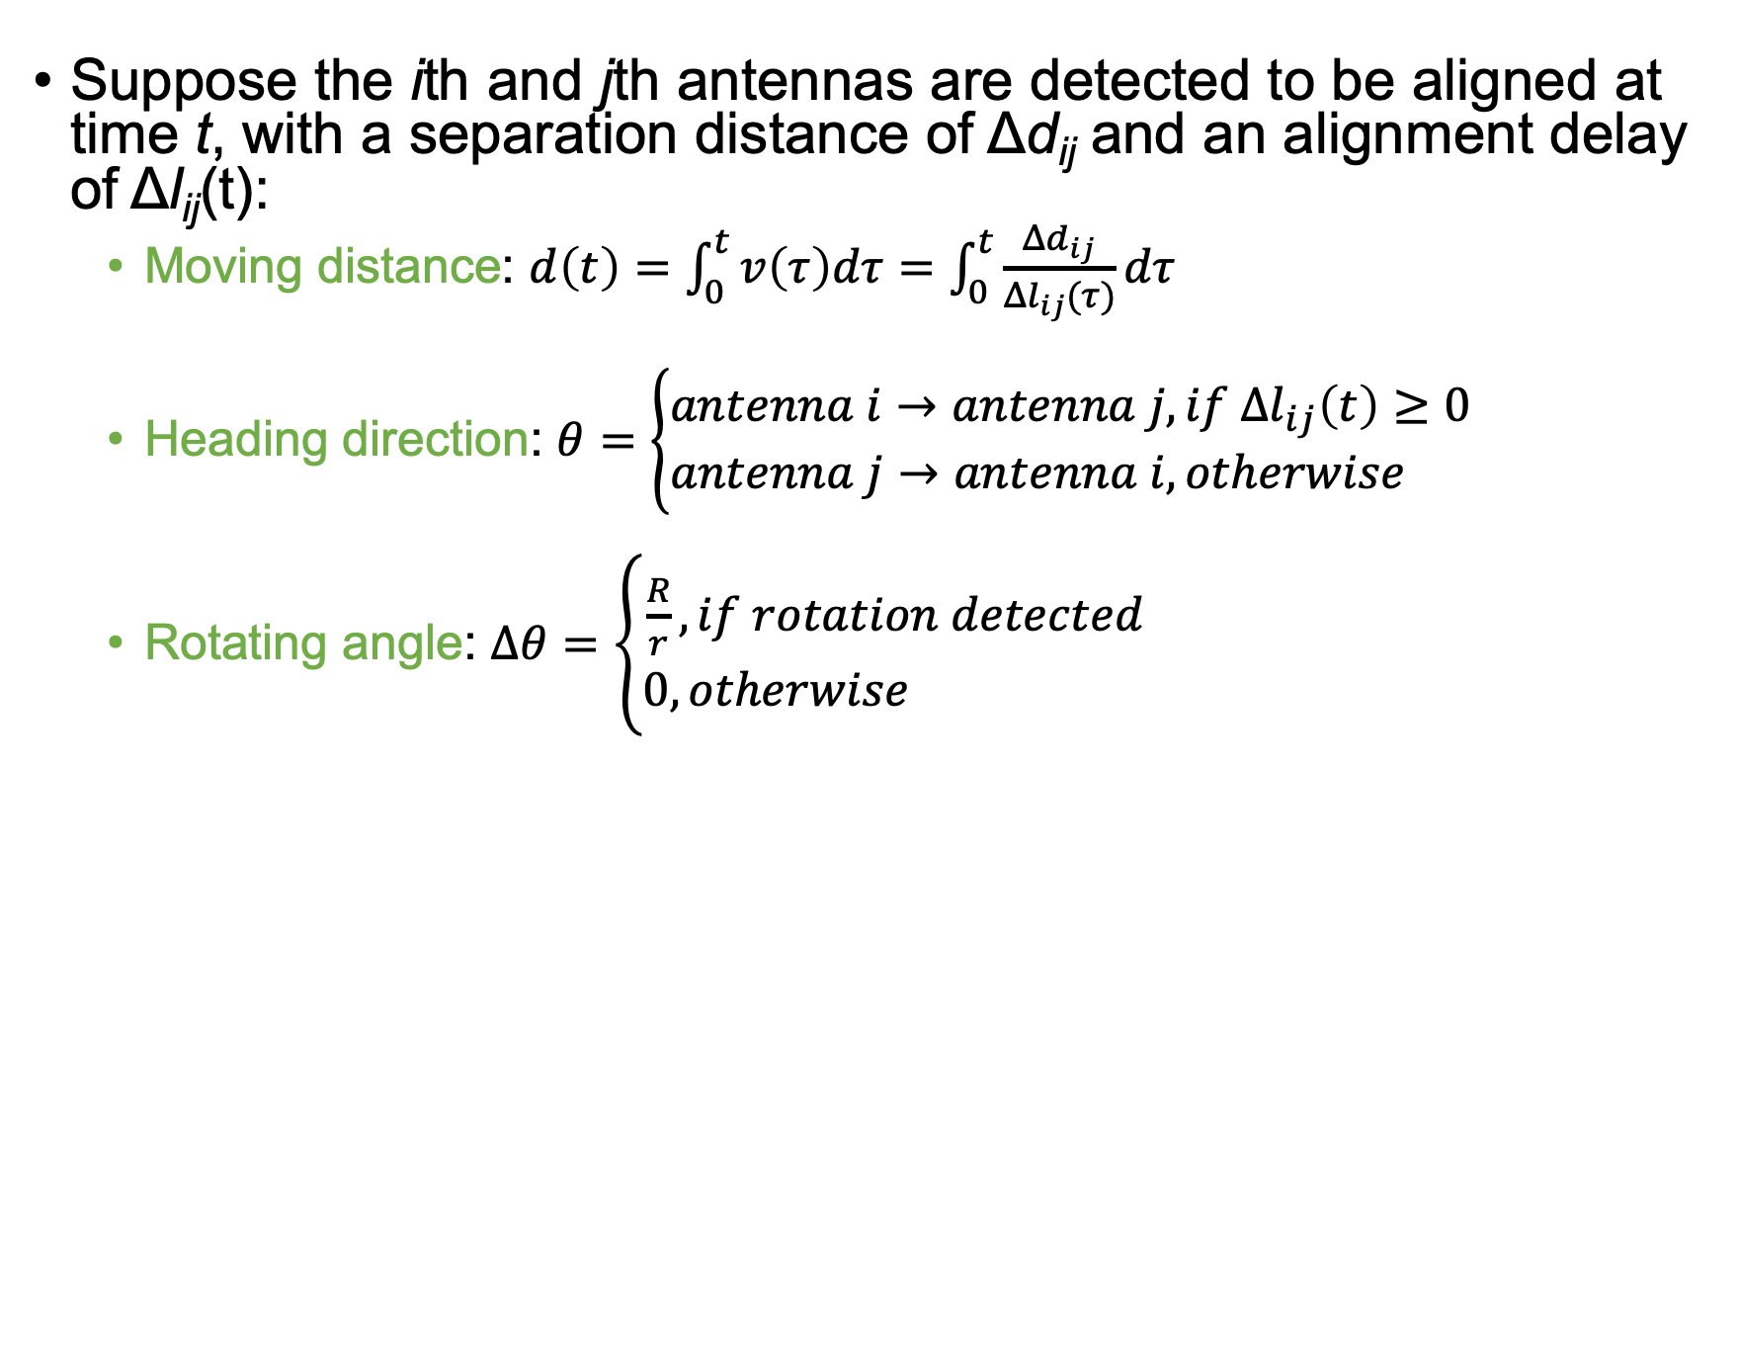
Putting It All Together
Suppose the ith and jth antennas are detected to be aligned at time t, with a separation distance of Δd_{ij} and an alignment delay of Δl_{ij}(t):
  Moving distance: $d\left(t\right)=\int_{0}^{t}{v\left(τ\right)dτ}=\int_{0}^{t}{\frac{Δd_{ij}}{Δl_{ij}(τ)}dτ}$
  Heading direction: $θ=\left\{\begin{aligned}antenna i→antenna j, if Δl_{ij}\left(t\right)≥0 \\ antenna j→antenna i, otherwise \end{aligned}\right.$
  Rotating angle: $Δθ=\left\{\begin{aligned}\frac{R}{r}, if rotation detected \\ 0, otherwise \end{aligned}\right.$
Notes:
Finally, when we identify the aligned antenna pair and the corresponding delay, we can calculate the motion parameters as follows:
The moving distance is calculated by integrating the speed estimates.
The heading direction is decided by the best aligned antenna pairs.
The rotating angle is estimated by dividing the calculated arc length by the radius of antenna array if the rotation is detected.

Slide 17
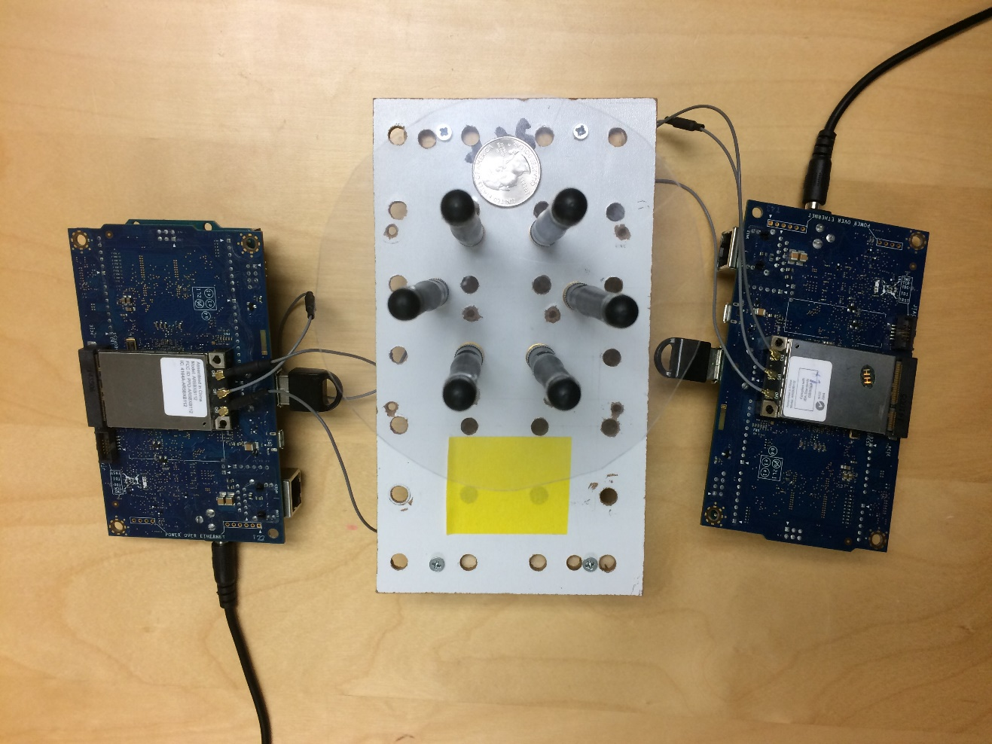
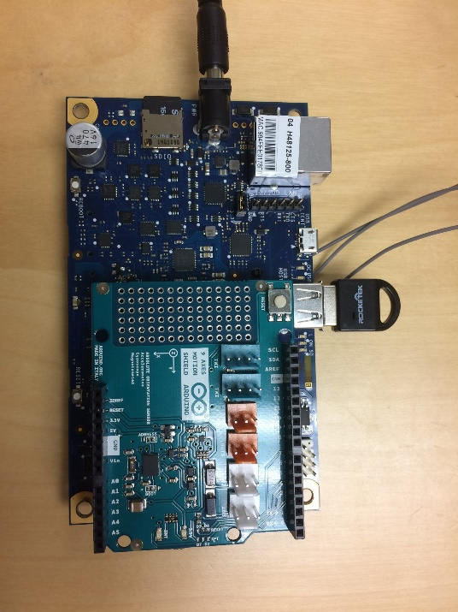
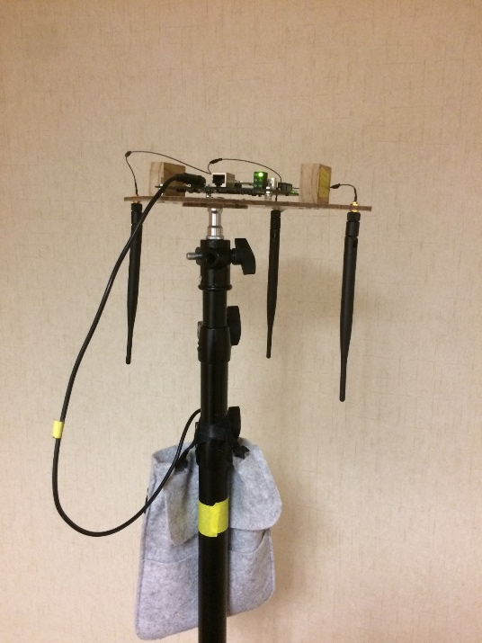
IMPLEMENTATION
Qualcomm Atheros 9k series chipset
Running on Intel Galileo Gen2 board (built with an IMU)
Antennas are spaced at a half wavelength distance (2.58 cm)
Packet level synchronization (no phase sync required)
Galileo Gen2 board
AP
Battery
WiFi NIC1
Hexagonal array
WiFi NIC2
BNO055 IMU
Notes:
Here’s our implementation details:
We implement RIM using Qualcomm WiFi chipsets.
The separation of adjacent antennas is half the wavelength.
We perform packet level synchronization for two wifi cards according to the sequence number of the received packet.
We use the same chipset as an AP and power it with a battery so that we can move it easily to different locations.

Slide 18
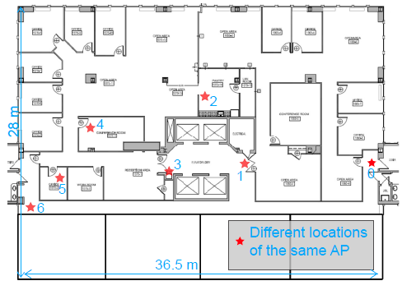
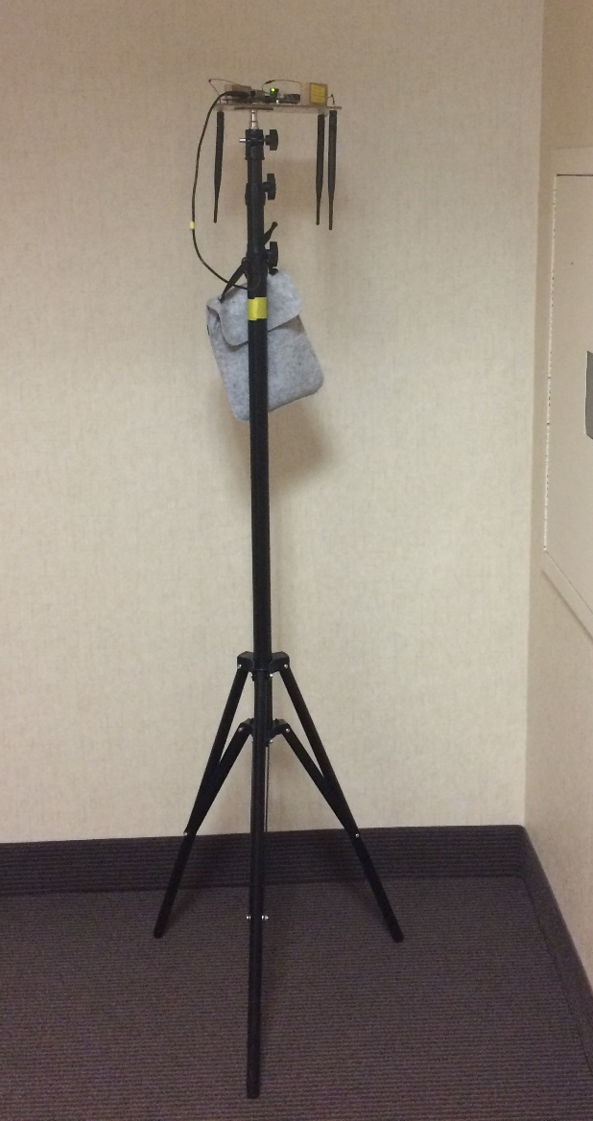
EVALUATION
A single AP, 7 different locations
Both LOS and NLOS (40m away through multiple walls)
200Hz sampling rate on a 40MHz channel in the 5GHz band
Notes:
We do experiments using a single AP, at different locations shown in the figure.
We test both LOS and NLOS areas over a large space of 28m * 36 m.
Now we show some key results.

Slide 19
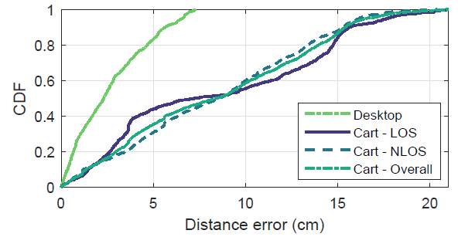
Performance - Moving Distance
On desktop: we move the array on a desk surface for traces around 1 m;
On cart: we put the array on a cart and push it straight forward by more than 10 meters in different areas.
90%: 15cm
2.3cm
8.4cm
Notes:
We test two cases for moving distance, on desktop and on cart.
The results show a median error of 2.3 cm for on desktop tracking, and 8.4 cm for on cart moving.
The 90 percentile error is only 15 cm for a moving over 10 meters.

Slide 20
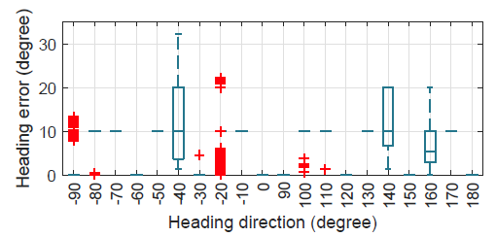
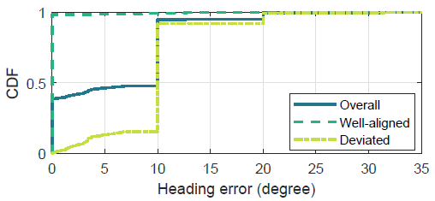
Performance - Heading Direction
Traverse a 90◦ range with an increased step of 10◦, together with each of their opposite directions
>90% of heading errors are within 10◦, with an overall average accuracy of 6.1◦
Notes:
For heading direction, we traverse a 90 degree range with an increment of 10 degrees, together with their opposite directions.
Most of the estimates are either correct without any error or with 10◦ errors, because RIM only resolves
a set of discrete directions that are integral multiples of 30◦.

Slide 21
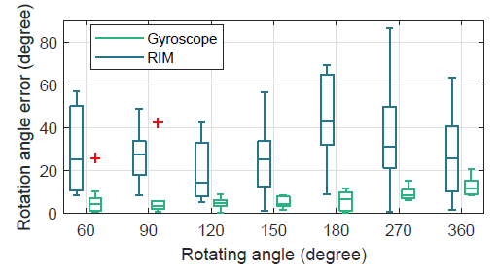
Performance - Rotating Angle
Median error of 30.1◦, corresponding to an error of merely 1.3 cm in arc lengths (i.e., moving distances)
Not as good as gyroscope (in short period)
Notes:
For the rotating angle, we manually rotate the array on the desk surface for different angles.
The results give a median error of roughly 30◦, which is worse than gyroscope.
Nevertheless, the results still validate the feasibility.

Slide 22
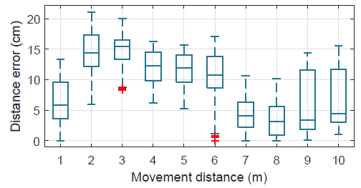
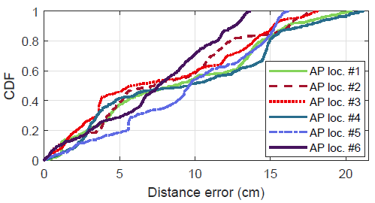
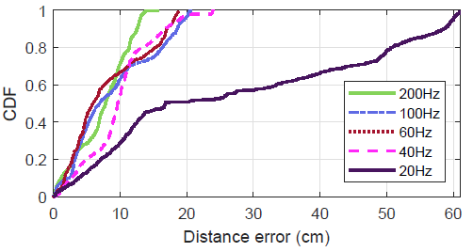
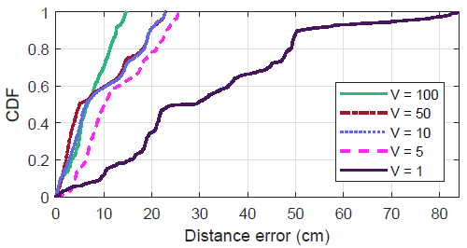
Impacts of Different Factors
AP locations
(coverage)
Total distance
Sampling rate
Virtual antennas
Notes:
We also study the impacts of several key factors.
As seen, the performance of RIM is resilient to the moving distance and the AP locations. The performance can improve significantly with higher sampling rate and more virtual antennas.

Slide 23
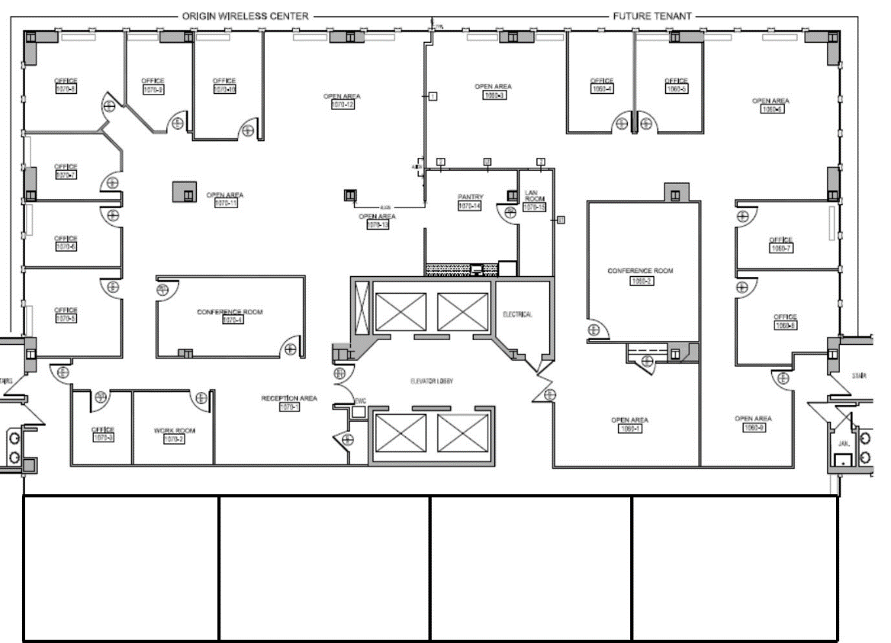
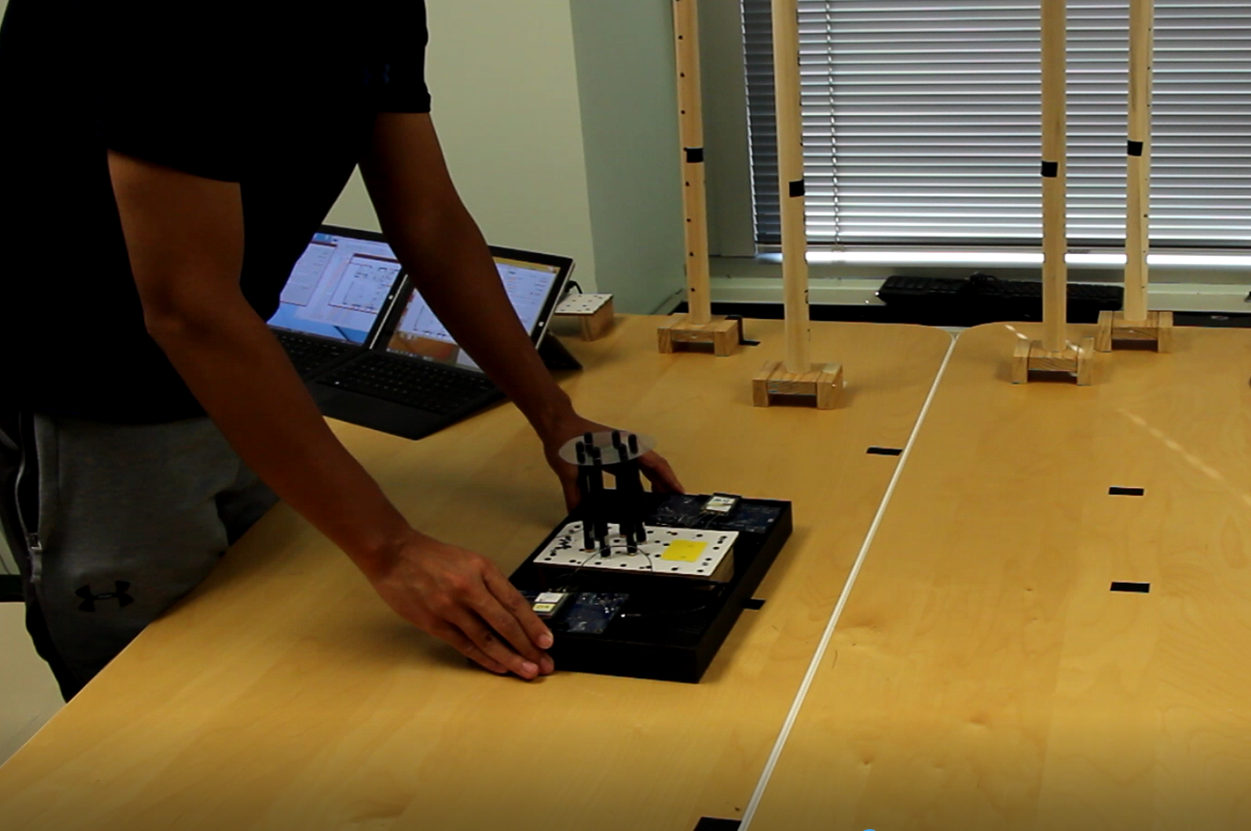
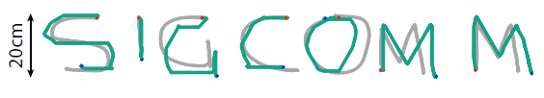
Potential Applications - Handwriting
Move the array by freely writing some letters on a desk surface
Mean error: 2.4 cm
RIM Rx
AP
By RIM
By Camera
Notes:
As the first system towards RF-based inertial measurements, we also demonstrate some potential applications.
We first show its capability for handwriting.
We write letters on a desk surface by moving the array, and the result is shown in the picture, which is pretty close to vision ground truth.

Slide 24
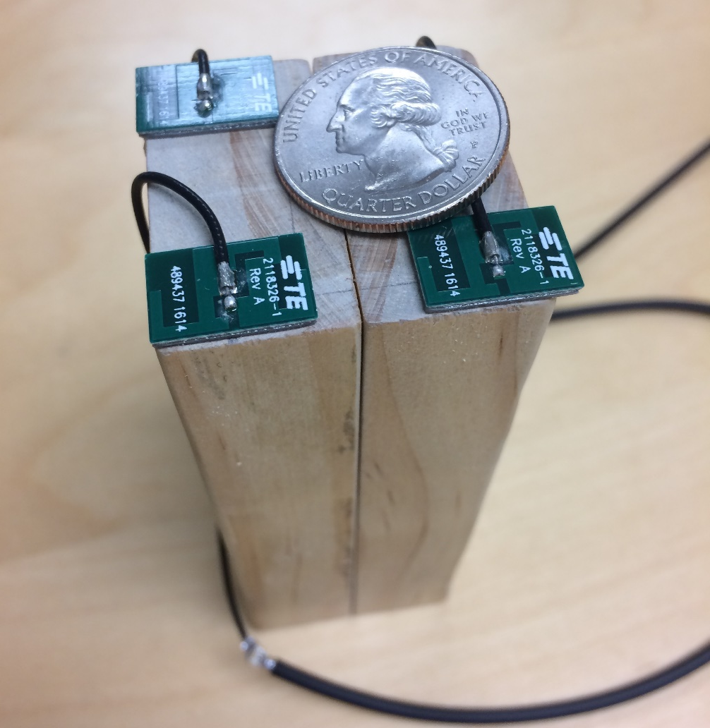
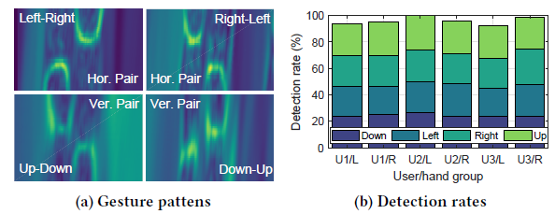
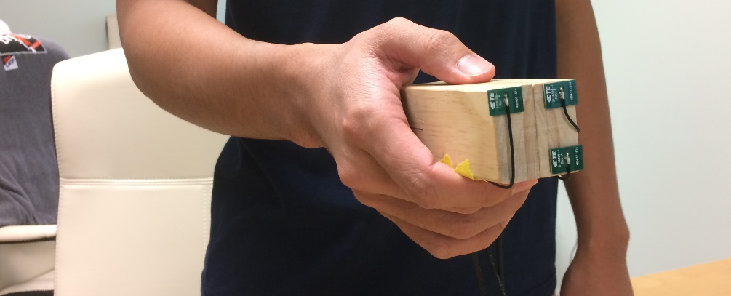
Potential Applications – Gesture Control
Integrating RIM into a pointer-like unit
One WiFi NIC with three small chip antennas arranged in an “L” shape.
96.25% detection rate
Notes:
We also built a prototype for basic gesture control with one WiFi card of three chip antennas.
The experiments involve three users, each performing four different gestures, moving towards left/right/up/down.
The results show reliable detection rate of more than 96%.

Slide 25
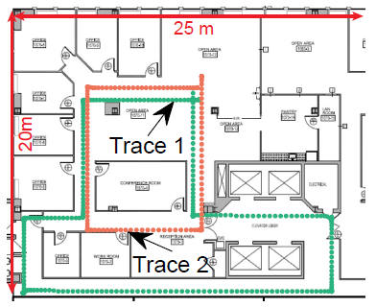
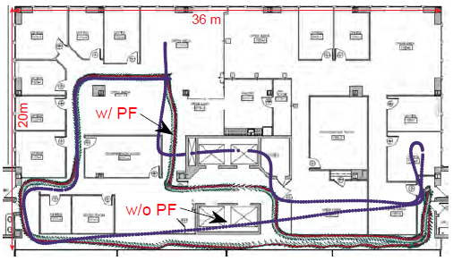
Potential Applications – Indoor Tracking
Tracking by RIM only
Tracking by RIM integrated with sensors
AP
2D hexagonal array, resolving sideway movement for AGVs
1D linear array (3 antennas), obtaining direction by IMU, augmented with a particle filter (PF)
Notes:
Finally, we integrate two setups for application in indoor tracking.
First, we directly use the hexagonal array, which can resolve sideway movement, that is common in robots and machines.
Second, we demonstrate the benefits of fusing RIM with traditional IMU. Specifically, we use RIM for distance estimation and use IMU for direction estimation. In this case, we only need one WiFi card with a linear array.
The results are shown in the figure, both showing remarkable tracking results.

Slide 26
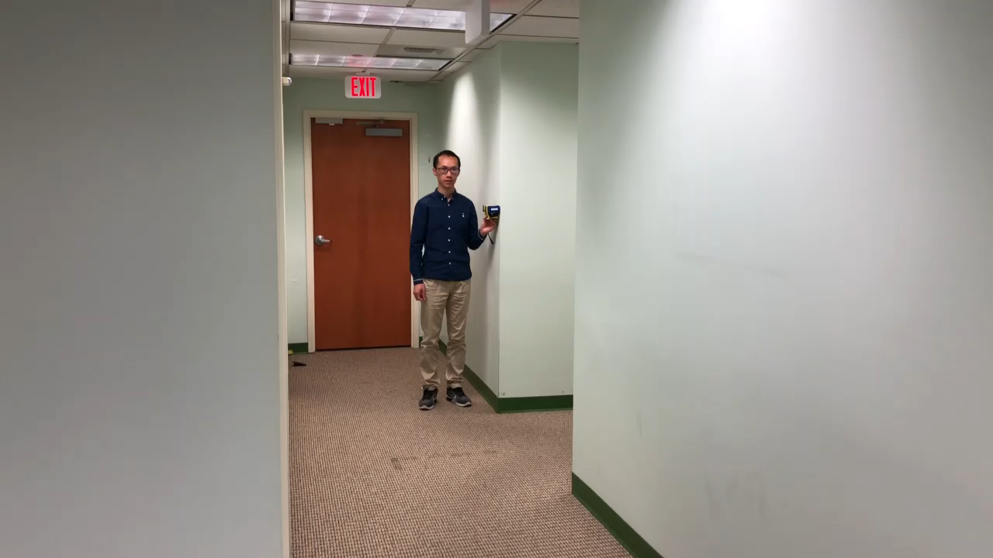
Demo: A WiFi Ruler with RIM
True Distance = 7.98 m
More interesting videos in our Demo session on Wednesday, August 21!

Slide 27
Discussions and Future Work
Angle resolution: Current RIM only exploits discrete directions defined by the antenna array. On-going work has improved continuous directions with <10º error.
Limitation of rotating angle: It remains open to estimate angular motion more accurately.
3D motion: Current RIM only addresses 2D motion. A 3D array or enhanced solutions is needed for 3D motion.
Fusing inertial sensors: Leverage the complementary advantages of both systems, as demonstrated by our application case of indoor tracking.
Notes:
RIM is an early step towards ubiquitous and precise RF-based inertial measurement, and there is obviously room for continued research in various perspectives.
Such as angle resolution, breaking the limitation of rotating angle, motion in 3D, and fusing with inertial sensors

Slide 28
My opinions
Turn a commodity WiFi device into an IMU
The arrangement of the antenna array

Slide 29
Thanks!
Q&A
http://cswu.me/rim.html
wucs32@gmail.com
“We can only see a short distance ahead, but we can see plenty there that needs to be done.”——Alan M. Turing

