Slide 1



A Distributed Orchestration Algorithm for Edge Computing Resources with Guarantees
Gabriele Castellano, Flavio Esposito, Fulvio Risso

Slide 2

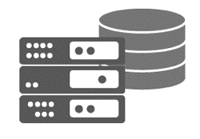

Background – Edge Computing
Notes:
Edge computing: risorse all’edge, nuove applicazioni
Edge Servers deployed at the network borders
Storage and Computing facilities distributed across the network
Low latency towards end users (and larger bandwidth)

Slide 3










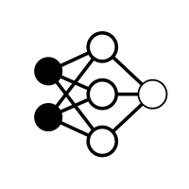






Background – Edge Computing
Service providers supply
Heterogeneous Applications
A large variety of new applications
Deployed over a shared infrastructure
Shared Edge Infrastructure
Notes:
Edge computing: risorse all’edge, nuove applicazioni
Service Providers may supply a large variety of new applications
Heterogeneous application over the same infrastructure

Slide 4





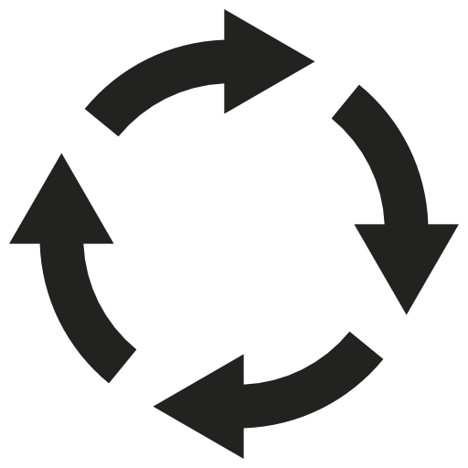

Background – Cloud-Oriented Orchestration
Dynamic allocation of slices –> Orchestrator
  Placement of application components
  Resources to assign to each of them
  Monitoring and identify needs for rescheduling
Usually exploits a one-size fits-all policy
  E.g., energy saving, latency minimization, etc.
Application
Orchestrator
Optimization Strategies
Placement
Resource allocation
Run-time monitoring
Infrastructure
slice
Hosting node 1
Hosting node 2
Hosting node 3
…
Hosting node N
Notes:
Nel cloud abbiamo un orchestratore che prende le decisioni: one-size fits-all
To dynamically allocate slices, an Orchestrator is often employed
For every application, it decides:
Where to place application components
How much resources to assign to each of them
Metrics/events signaling that application needs a rescheduling
Usually exploits a one-size fits-all policy
E.g., energy saving, latency minimization, number of used nodes, etc.

Slide 5


Problem – one-size fits-all orchestration models do not exist
Heterogeneous applications:
  Diverse and unpredictable objectives
  Necessity to differently react to same events
Use case 1.
Content Distribution Network
Objective: minimize miss rate on deployed caches
Actions: relocate/resize some cache when needed
Use case 2.
Mobile gaming
Objective: minimize latency
Actions: migrate some component
  Based on latency
  identifying convenient time
I know what you need.
I don’t think so…
State of the art edge applications rely on their own deployment algorithms and strategies
Notes:
All’edge questo non è praticabile, ogni app ha necessità completamente diverse. Ogni app ha i propri algoritmi

Slide 6


Problem – Edge Orchestration
No work on enabling such algorithms to coexists on a shared infrastructure
@#$%&!
State of the art edge applications rely on their own deployment algorithms and strategies
Notes:
Ci serve un modo per far coesistere queste app con i loro differenti algoritmi di deployment, sulla stessa infrastruttura in modo ottimale

Slide 7

Goal – Coordination
Allow each application to adopt its own deployment strategy/algorithm
Preserve the global optimality of the final placement!
Notes:
Ci serve un modo per far coesistere queste app con i loro differenti algoritmi di deployment, sulla stessa infrastruttura in modo ottimale
Allow each application to adopt its own deployment strategy/algorithm
No centralized decision entity
Prevent greedy applications from consuming all resource
Avoid violation of infrastructure feasibility constraints
Preserve the global optimality of the resulting placement

Slide 8



Model – Applications-Resources Assignment Problem
Application: composed by a (multi)set of components
Components: abstract instance of a small-scope functionality
  e.g., video transcoder, content cache, load balancer
Function: is the implementation for a given component
  Each may require different resources and provide different QoS
Applications
Functions repository
[f1, f2, …]
Private Policies
application 1
Private Policies
application 2
…
Private Policies
application $N_{a}$
[c1, c2, c3]
[c2, c4, c5, c6]
[c2, c4, c4]
Distributed Infrastructure Controller
Hosting Infrastructure
Notes:
Modello del problema: applicazioni, servizi, funzioni
Application: composed by a (multi)set of components
N_{a} concurrent application simultaneously deployed on the same infrastructure
Components: abstract instance of a small-scope functionality
N_{s} different components (e.g., video transcoder, content cache, load balancer).
Function: is the implementation for a given component
Each may require different resources and provide different QoS
N_{f} functions provided by the infrastructure

Slide 9

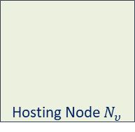
Model – Applications-Resources Assignment Problem
Hosting nodes: compose the infrastructure
Resource: provided by hosting nodes, consumed by functions
  e.g., CPU, storage, network bandwidth (and more).
Applications
Functions repository
[f1, f2, …]
Private Policies
application 1
Private Policies
application 2
…
Private Policies
application $N_{a}$
[c1, c2, c3]
[c2, c4, c5, c6]
[c2, c4, c4]
Distributed Infrastructure Controller
Hosting Infrastructure
Hosting Node 1
Hosting Node 2
Hosting Node 3
Hosting Node $N_{υ}$
Controller Agent
Controller Agent
Controller Agent
Controller Agent
Resources
Resources
Resources
Resources
…
Notes:
nodi Edge, risorse
Hosting node: provides an amount resources
N_{ʋ} hosting nodes compose the shared infrastructure
Resource: provided by hosting nodes, consumed by functions
N_{ρ} different types (e.g., CPU, storage, memory, network bandwidth)
ρ_{n} is the amount of resources available on node n$∈$ N_{ʋ}

Slide 10



DRAGON - Distributed Resources AssiGnment and OrchestratioN
Each application runs a DRAGON instance
  Phase 1. Orchestration:
    Embedding routine: finds an optimal resource assignment
    A score is generated for the new assignment
    Election routine, compute eligible assignments
  Phase 2. Agreement:
    Scores are exchanged and updated until consensus on the election result
At node level
Applications
Functions repository
Private Policies
application 1
Private Policies
application 2
…
Private Policies
application N
[c1, c2, c3]
[c2, c4, c5, c6]
[c2, c4, c4]
DRAGON
DRAGON
DRAGON
…
…
Score: benefit that an application gains from a given pool of resources.
…
Distributed Infrastructure Controller
Hosting Infrastructure
Hosting Node 1
Hosting Node 2
Hosting Node 3
Hosting Node $N_{υ}$
Controller Agent
Controller Agent
Controller Agent
Controller Agent
Resources
Resources
Resources
Resources
…
37
45
21
13
Notes:
Each application runs a DRAGON instance
Orchestration Phase:
Runs an embedding routine to find an optimal resource assignment for the application
A score is generated for the new assignment
DRAGON uses latest known scores to perform an election routine
Steps above are repeated until an eligible assignment (if any) is found
Agreement Phase:
Known scores are exchanged and updated until there is consensus on the election result
- DOPO embedding routine:
At this point, the goal of DRAGON is to evaluate which application benefits more from the resources it demanded.
To this aim, a score is generated for each pool of resources needed on each node ….
[…] The election routine works similarly to a distributed auction process, but […]. This routine give precedence to highest known scores, taking also into account the amount of demanded resources.

Slide 11



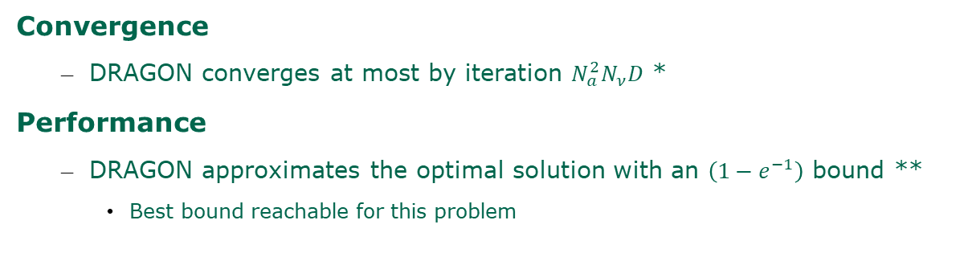
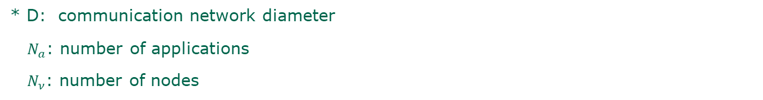
Algorithm Guarantees
Convergence
  DRAGON converges at most by iteration $N_{a}^{2}N_{ν}D$ *
Performance
  DRAGON approximates the optimal solution with an $\left(1−e^{−1}\right)$ bound **
    Best bound reachable for this problem
* D: communication network diameter
$N_{a}$: number of applications
$N_{ν}$: number of nodes
** $\left(1−e^{−1}\right)≅0.63$

Slide 12

Prototype Evaluation
Parameter space
  Up to 20 concurrent applications
    starts deployment at the same time
  4 hosting nodes
    Resources: CPU, storage, bandwidth
  3 components AVG per application
    ≈8 applications saturate the resources
concurrent applications
c1
c2
c3
infrastructure nodes
Prototype Implementation: https://github.com/netgroup-polito/dragon
Notes:
Parameter space
Up to 20 concurrent applications
starts deployment at the same time
4 hosting nodes
Providing three different resources (CPU, storage, bandwidth)
average of 3 components per application
≈8 applications saturate the resources

Slide 13

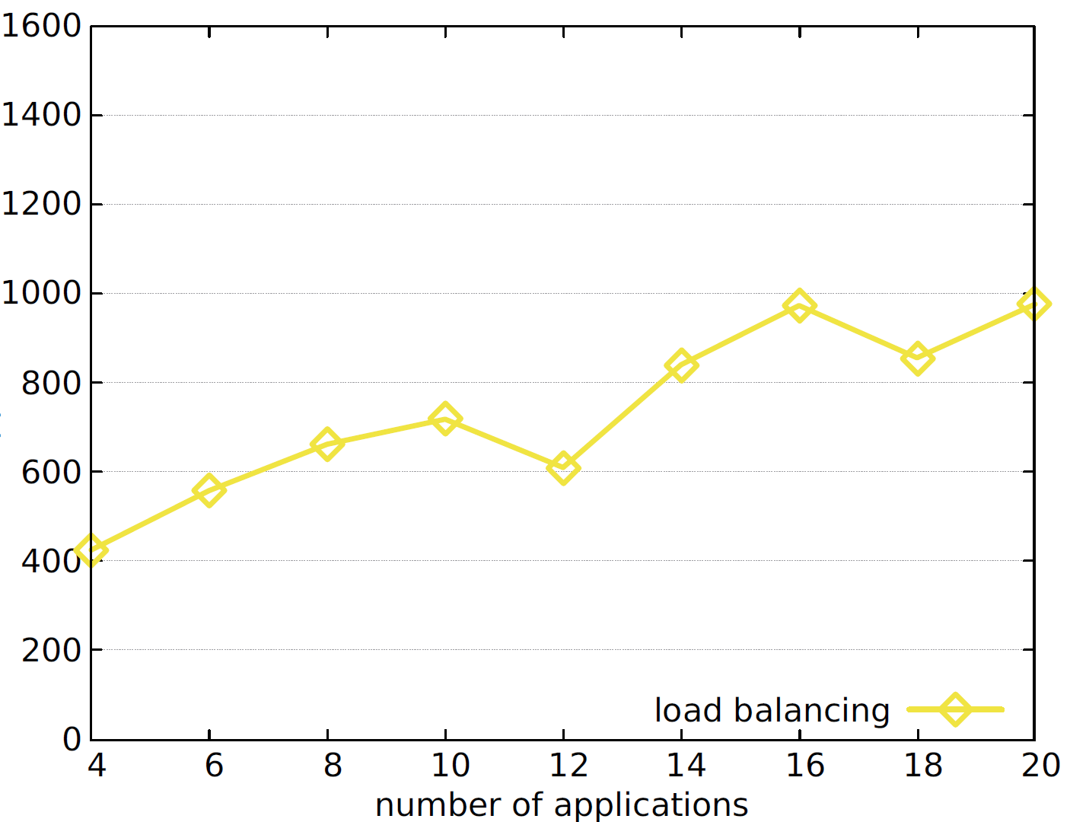
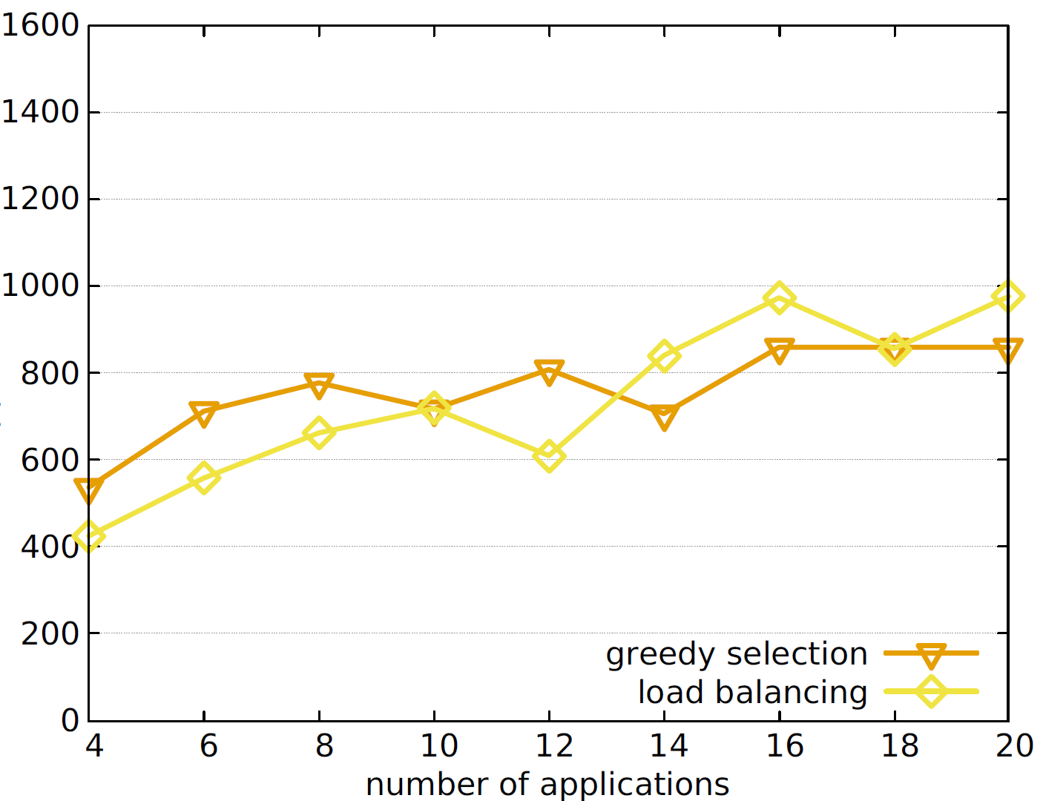
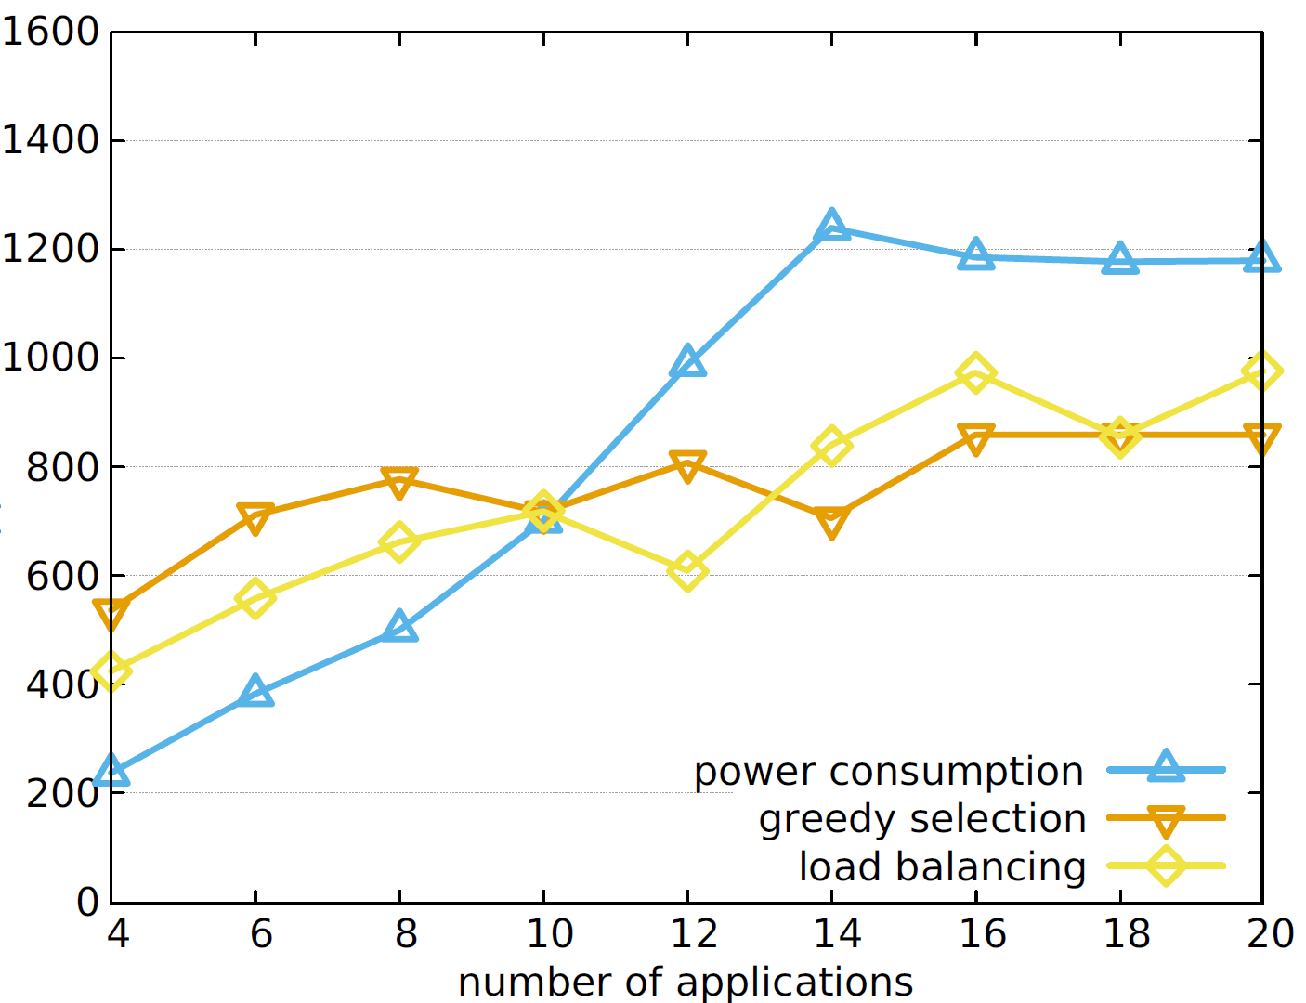
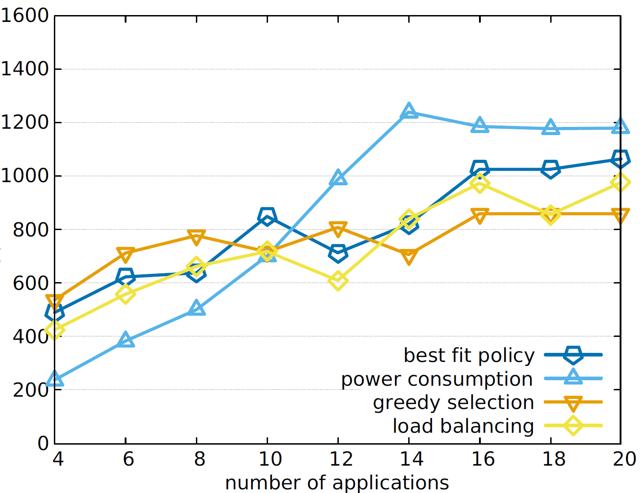
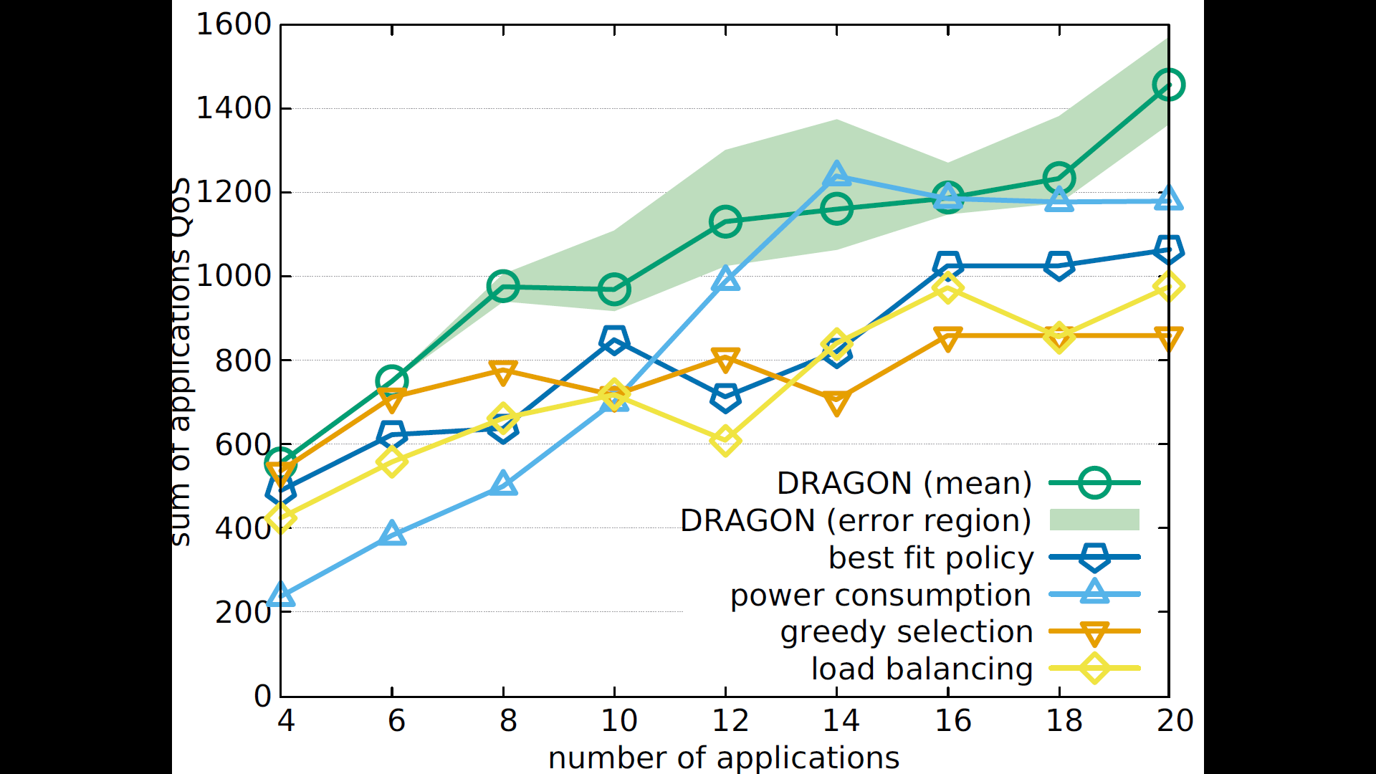
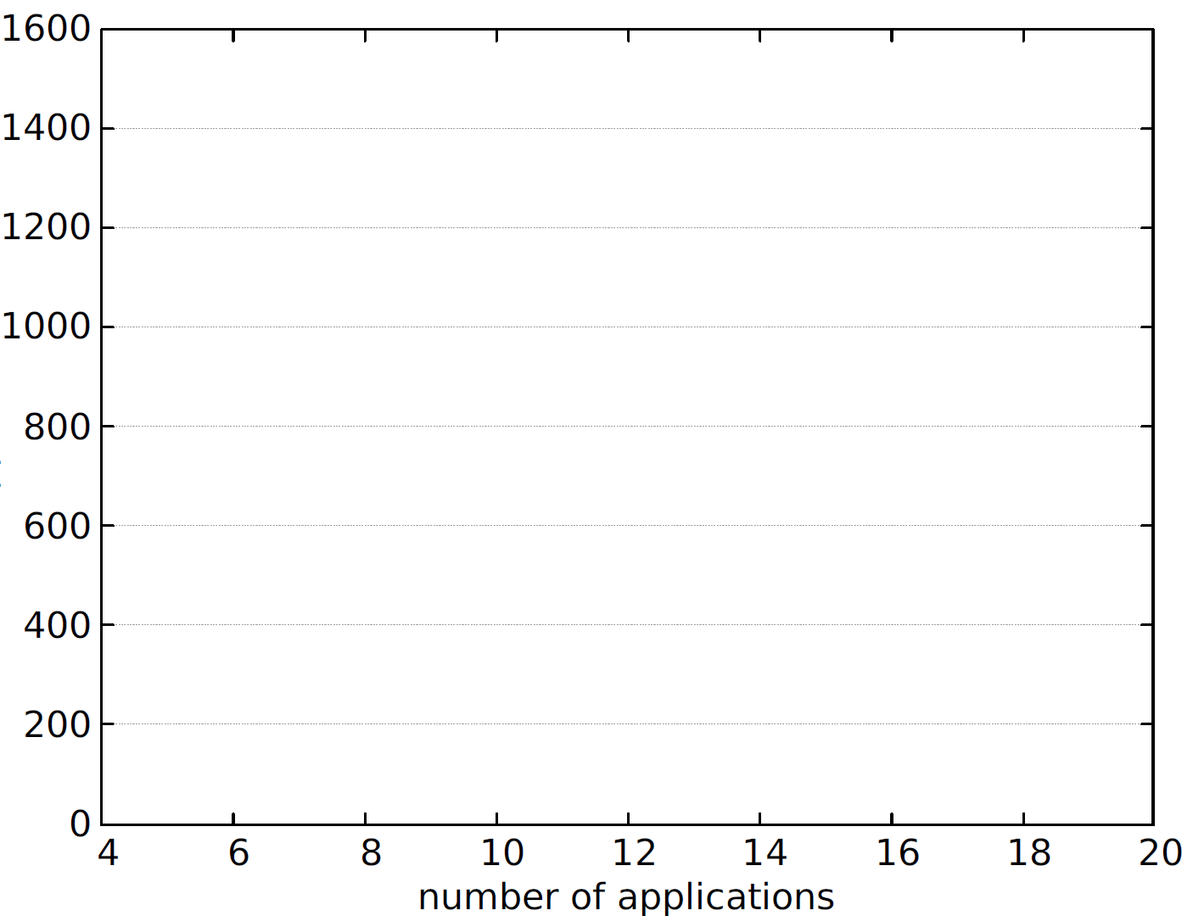

Prototype Evaluation – Performance
*
DRAGON performance compared against one-size fits-all conventional approaches.
*QoS are normalized to 100 for each application component.
Notes:
11,2x14,59
5,3 ; 3,12
14,59 – 5,3

Slide 14
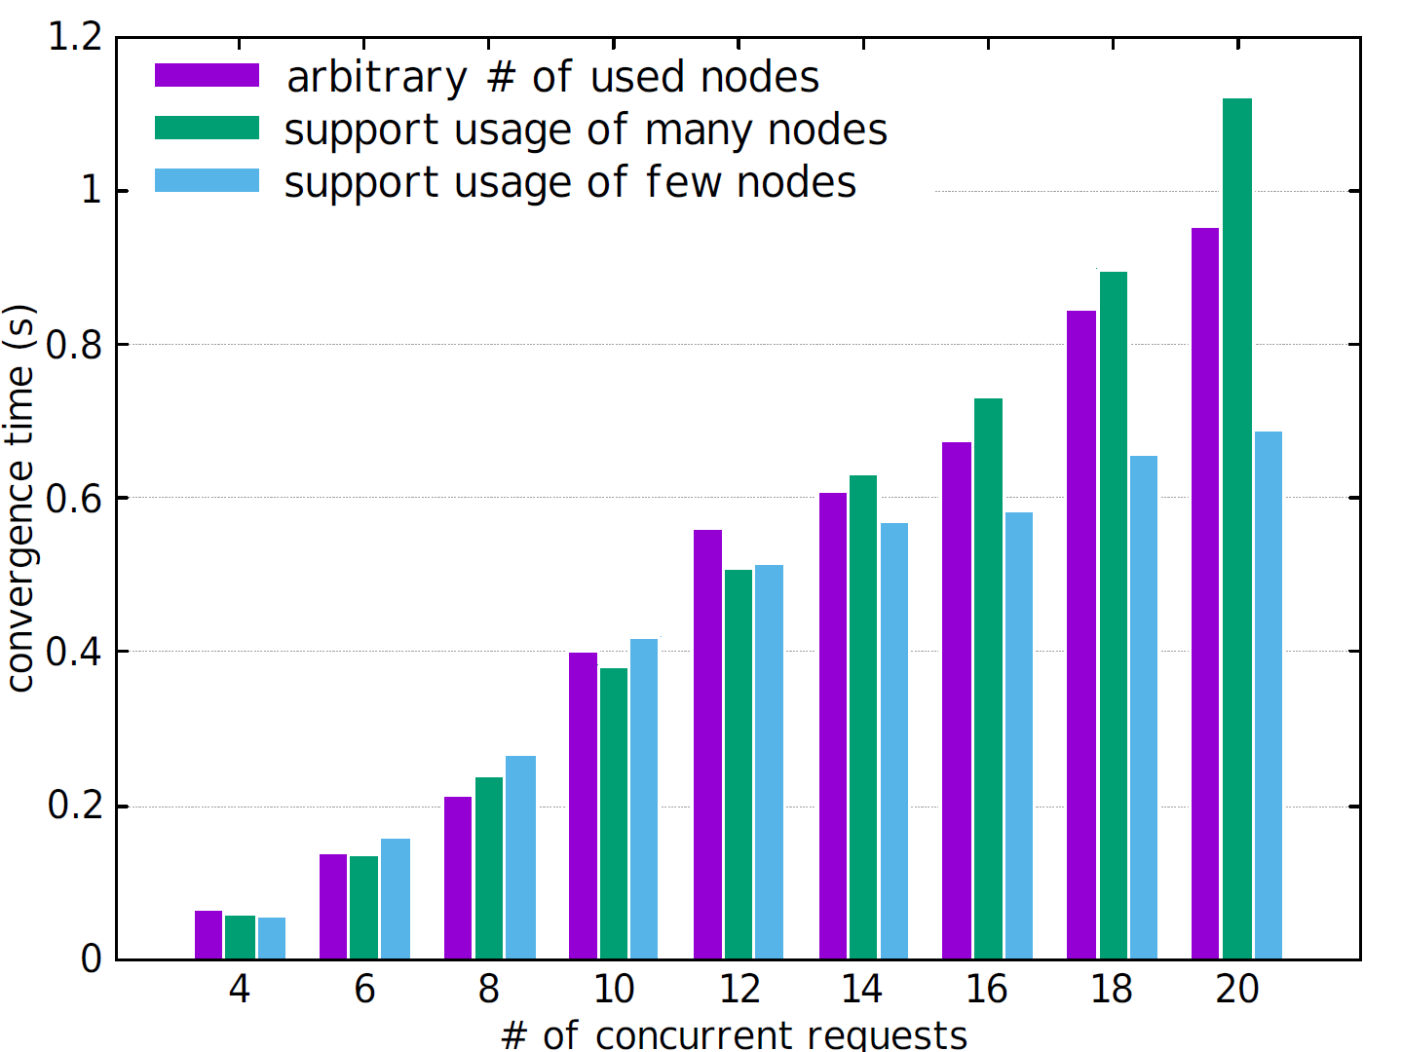
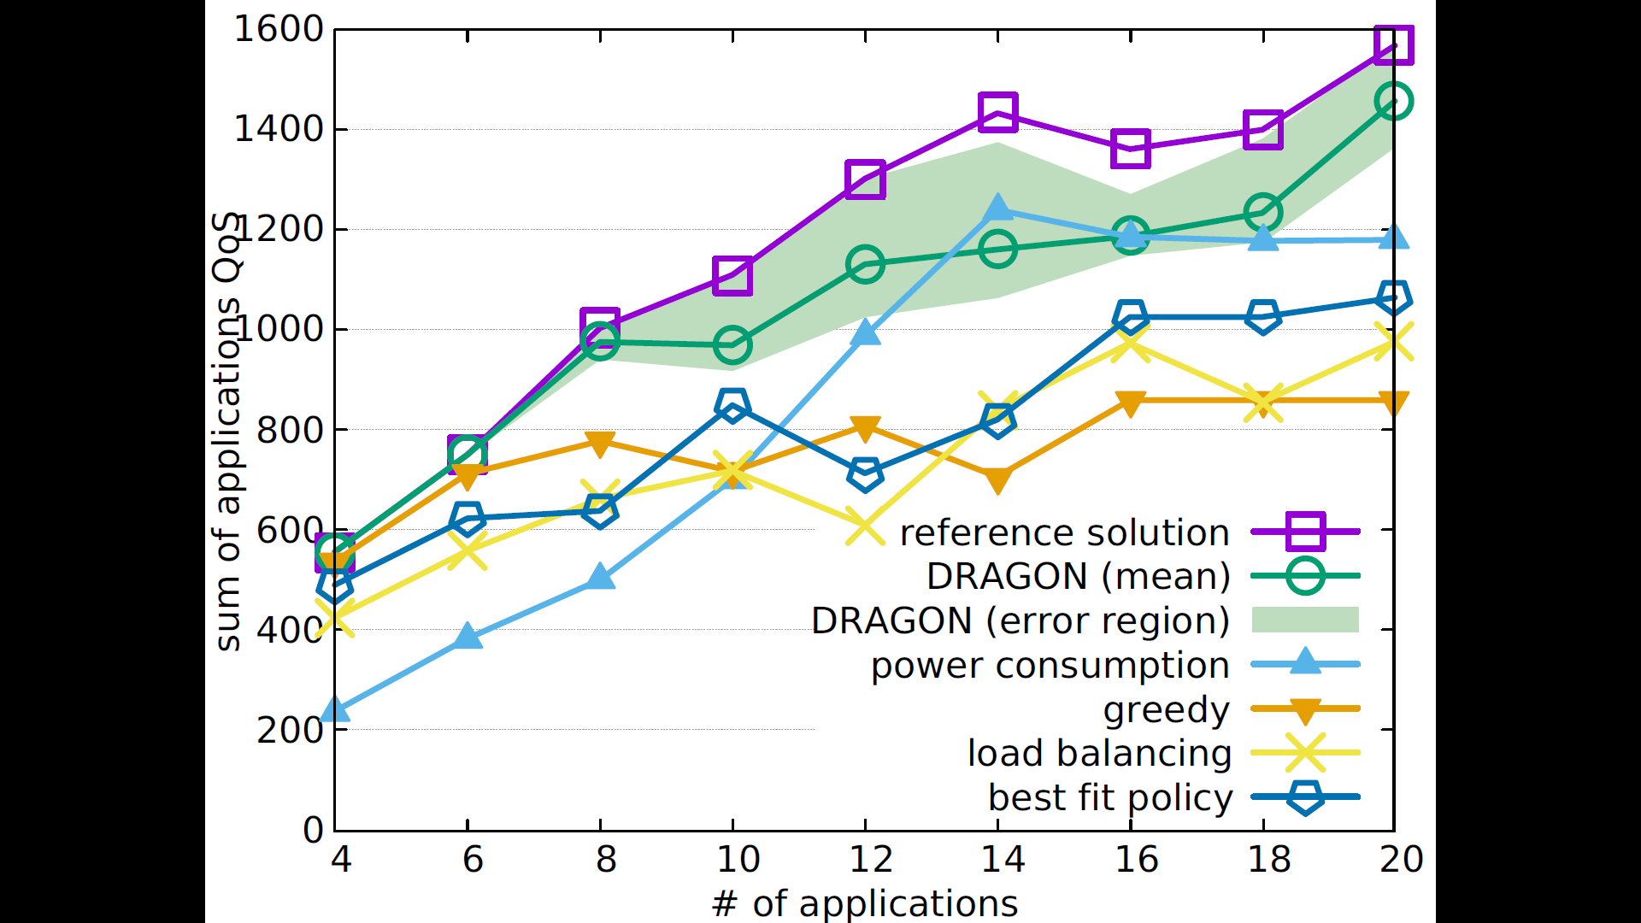
Prototype Evaluation – Convergence
Convergence comparing different system policies.

Slide 15


Conclusions
Heterogeneous applications over a shared edge infrastructure
  Each one needs different state-of-the-art deployment algorithm
  Cannot rely on a one-size-fits-all orchestrator
DRAGON enables such different algorithm to coexist
  Distributed consensus on resource assignment
Formal guarantees on convergence and performance
Open Problems:
  What about the infrastructure objective?
  Online deployment: stability/optimality tradeoff

Slide 16



Thanks!
DRAGON Prototype
  https://github.com/netgroup-polito/dragon
Contacts
  gabriele.castellano@polito.it
  flavio.esposito@slu.edu
  fulvio.risso@polito.it

Slide 17
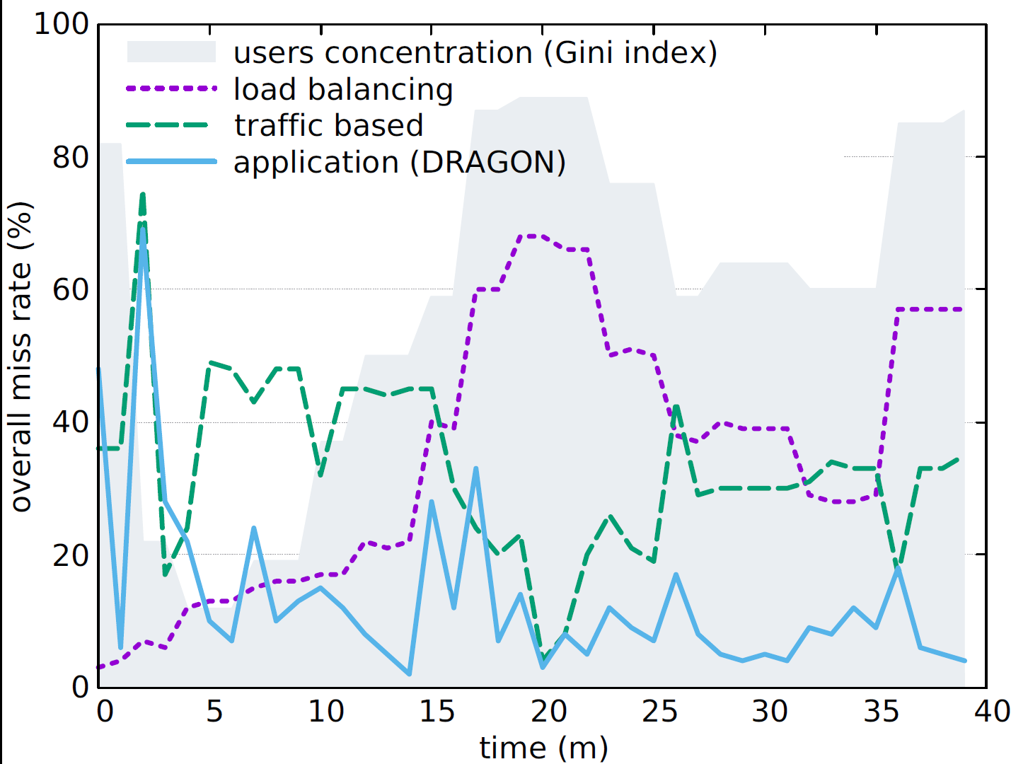
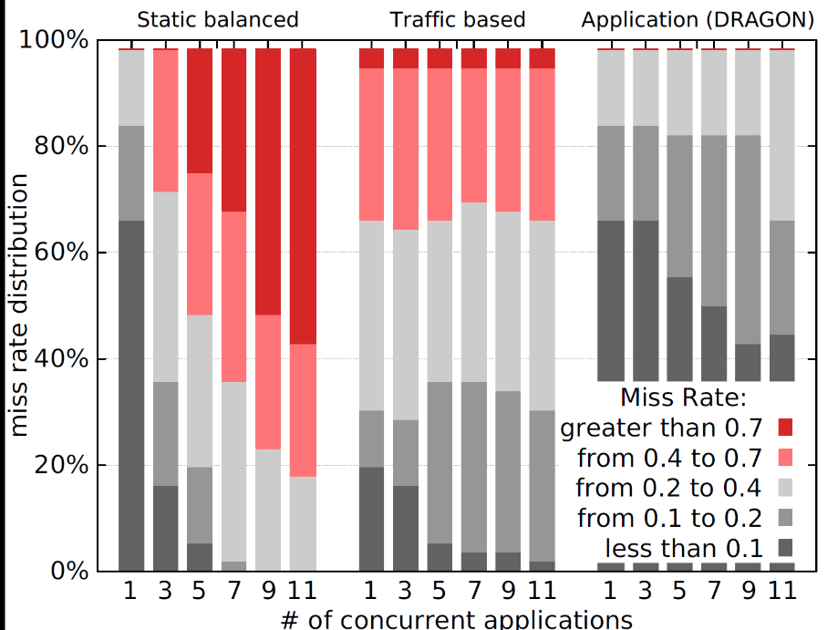
Experimental Results – CDN Caching Use Case
  Content caches are provided over an edge network
    user density dynamically changes across edge nodes
  The provider wants to minimize the average miss-rate on deployed caches

Slide 18
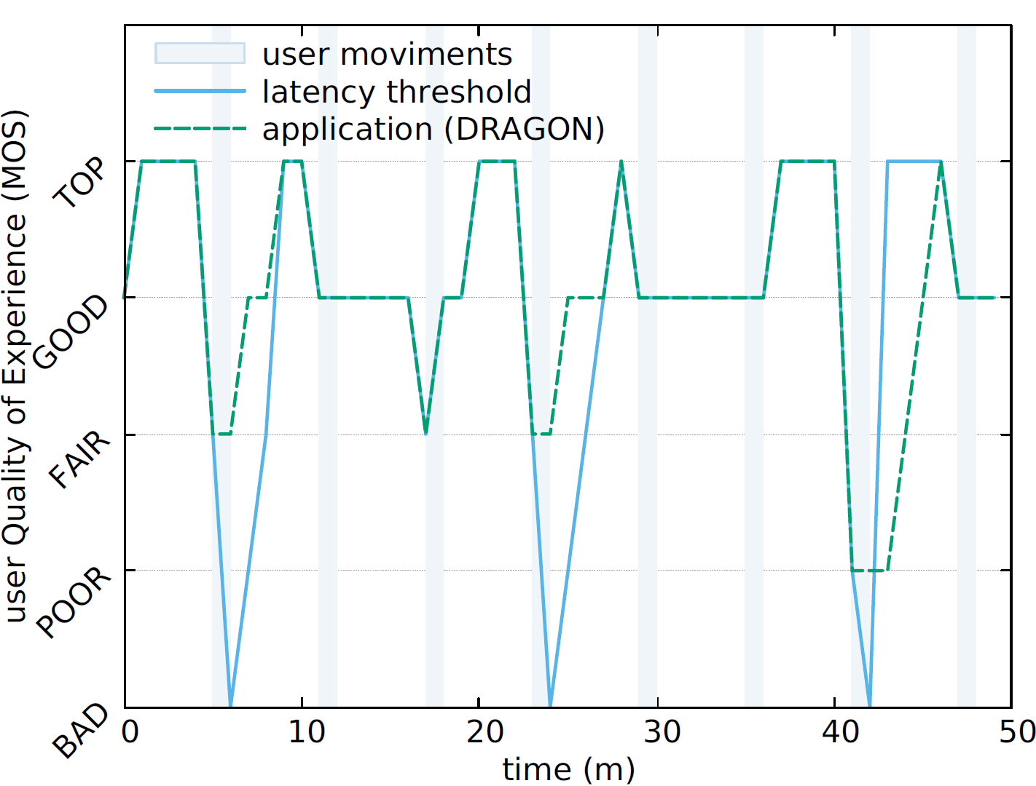
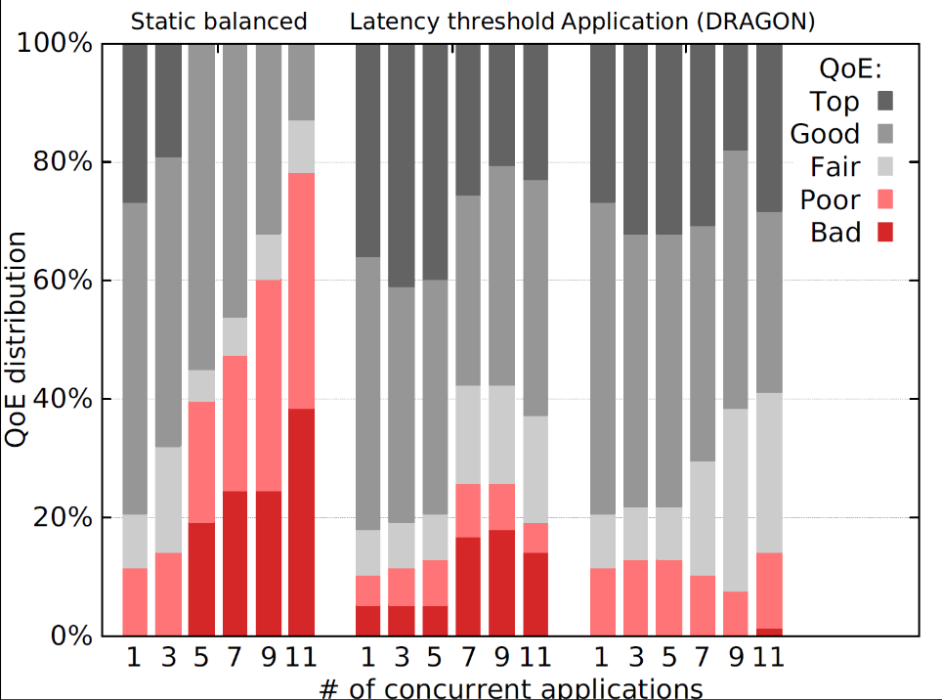
Experimental Results – Mobile Gaming Use Case
  A gamer moves into an area served by multiple edge nodes
  The application may consider relocating part of the game edge functions
  Relocation during crucial phases of the game should be avoided

Slide 19
Prototype Evaluation – Performance
DRAGON performance compared against one-size fits-all conventional approaches. Reference solution has been obtained through a centralized solver embedding all applications different optimization strategies.

Slide 20

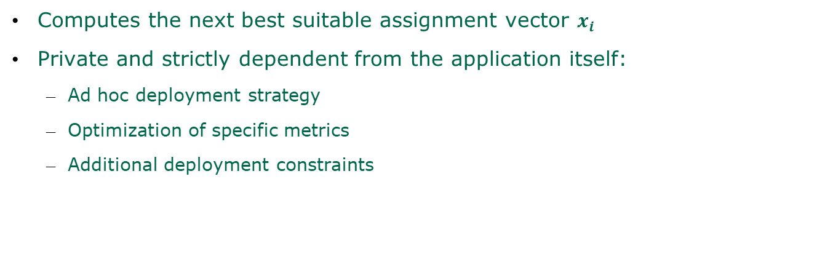
Orchestration Phase – Embedding Routine
Computes the next best suitable assignment vector $x_{i}$
Private and strictly dependent from the application itself:
  Ad hoc deployment strategy
  Optimization of specific metrics
  Additional deployment constraints
Private Policies
application 1
[c1, c2, c3]
Functions Repository
Function
f3
s1
f1
f2
f3
f4
Specifics:
___________
______
________
s2
f5
f6
Required Resources:
s3
f7
f8
f9
f10
f11
f12
f13
…
Provided utility:
$$u()$$
?

Slide 21
Orchestration Phase – Scoring Routine
The scoring routine:
  If the new assignment vector is valid
    It assigns a score to the new assignment vector
    Also updates the amount of resources needed on the hosting node
  Otherwise
    Set a null score
The score is computed by a score function based on the system utility
  Remember: “it is the marginal utility that the system gains by assigning those resources to that application”
  The system utility is mainly based on the application private utility
Score Function
System Utility
Demanded Resources
Private Utility
?
?
Vote
Assignment Vector

Slide 22

Orchestration Phase – Election Routine
Decides which application can allocate resources on the shared node
  Applications with the highest scores and less resource consumption are favored
Algorithm:
  Start with an empty set of winners W
  At each iteration:
    Remove from candidates all applications that exceed residual resources
    Pick the one with the highest ratio score to demanded resources
    Reduce residual resources accordingly
  Repeat until there are no more valid candidates
*For performance guarantees, the actual algorithm enumerates solutions for sets with size ≤ 3
Candidates
winners
Hosting Node
app1
79
app2
30
app3
65
Residual Resources
app4
15
app5
21
app6
45
application
app7
67
app8
82
app9
43
$$\frac{score}{\left\|consumption\right\|}$$

Slide 23
Algorithm Generalization – Multi Node Version
Agreement Phase:
  Identical to the base version, just repeated for each hosting node
Orchestration Phase:
  For each needed service, the embedding routine selects both:
    The function that is going to implement it
    The hosting node where the function will be allocated
  The score routine is repeated once for each node involved in the assignment
  The election routine is computed separately for each node
    An application needs to win all hosting nodes involved in its assignment vector
    Additional conflict resolution procedure to handle potential partial allocation
node 1
node 2
node 3
node 4
The election-recount subroutine identifies which application should be removed from the election so that the solution results optimized.
Dependencies are resolved recursively.
app. #2
app. #3
app. #3
app. #5
app. #1
app. #2
app. #4
app. #4
Election results per node
app. #5
winners
losers

Slide 24
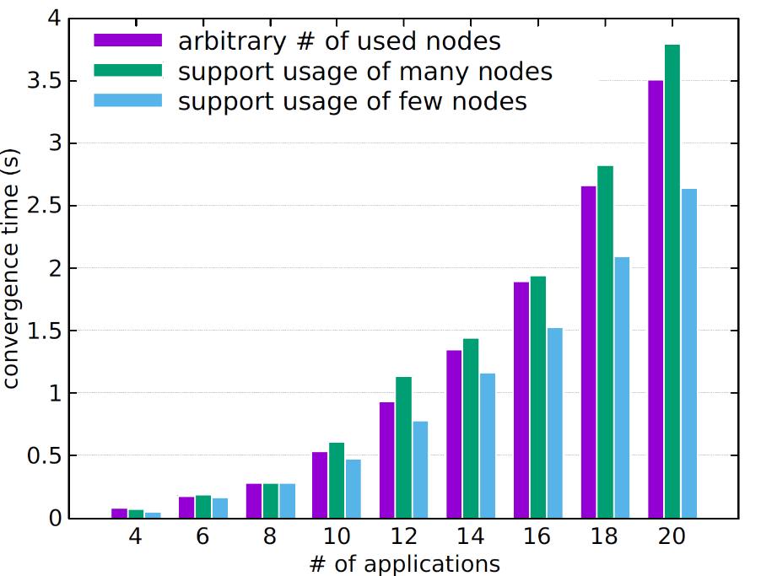

Experimental Results – Convergence and Performance
Convergence comparing different system policies
DRAGON Performance compared against one-size fits-all common approaches

Slide 25
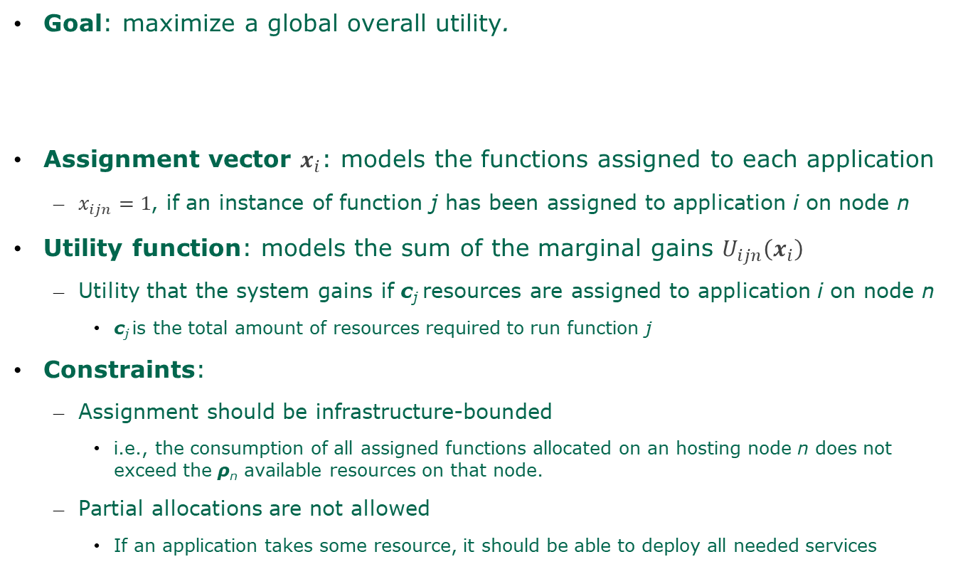
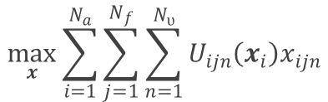
Model – Applications-Resources Assignment Problem (1)
Goal: maximize a global overall utility.
Assignment vector $x_{i}$: models the functions assigned to each application
  $x_{ijn}=1$, if an instance of function j has been assigned to application i on node n
Utility function: models the sum of the marginal gains $U_{ijn}\left(x_{i}\right)$
  Utility that the system gains if c_{j} resources are assigned to application i on node n
    c_{j} is the total amount of resources required to run function j
Constraints:
  Assignment should be infrastructure-bounded
    i.e., the consumption of all assigned functions allocated on an hosting node n does not exceed the ρ_{n} available resources on that node.
  Partial allocations are not allowed
    If an application takes some resource, it should be able to deploy all needed services
$$\max_{x}{\sum_{i=1}^{N_{a}}{\sum_{j=1}^{N_{f}}{\sum_{n=1}^{N_{ʋ}}{U_{ijn}\left(x_{i}\right)x_{ijn}}}}}$$
Notes:
We identified an utility function that maximizes the benefits of each application, seeking a Pareto optimal.

