Slide 1
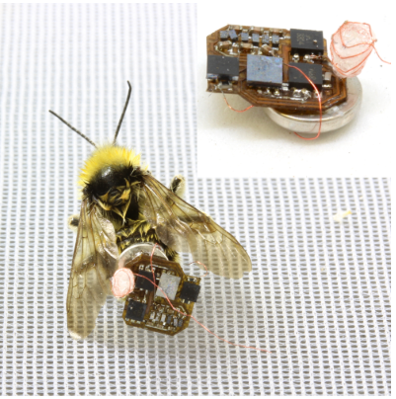
Living IoT: A Flying Wireless Platform on Live Insects
Vikram Iyer*, Rajalakshmi Nandakumar*
Anran Wang*, Sawyer B. Fuller, Shyamnath Gollakota
(*Co-student Primary Authors)
MobiCom 2019

Slide 2
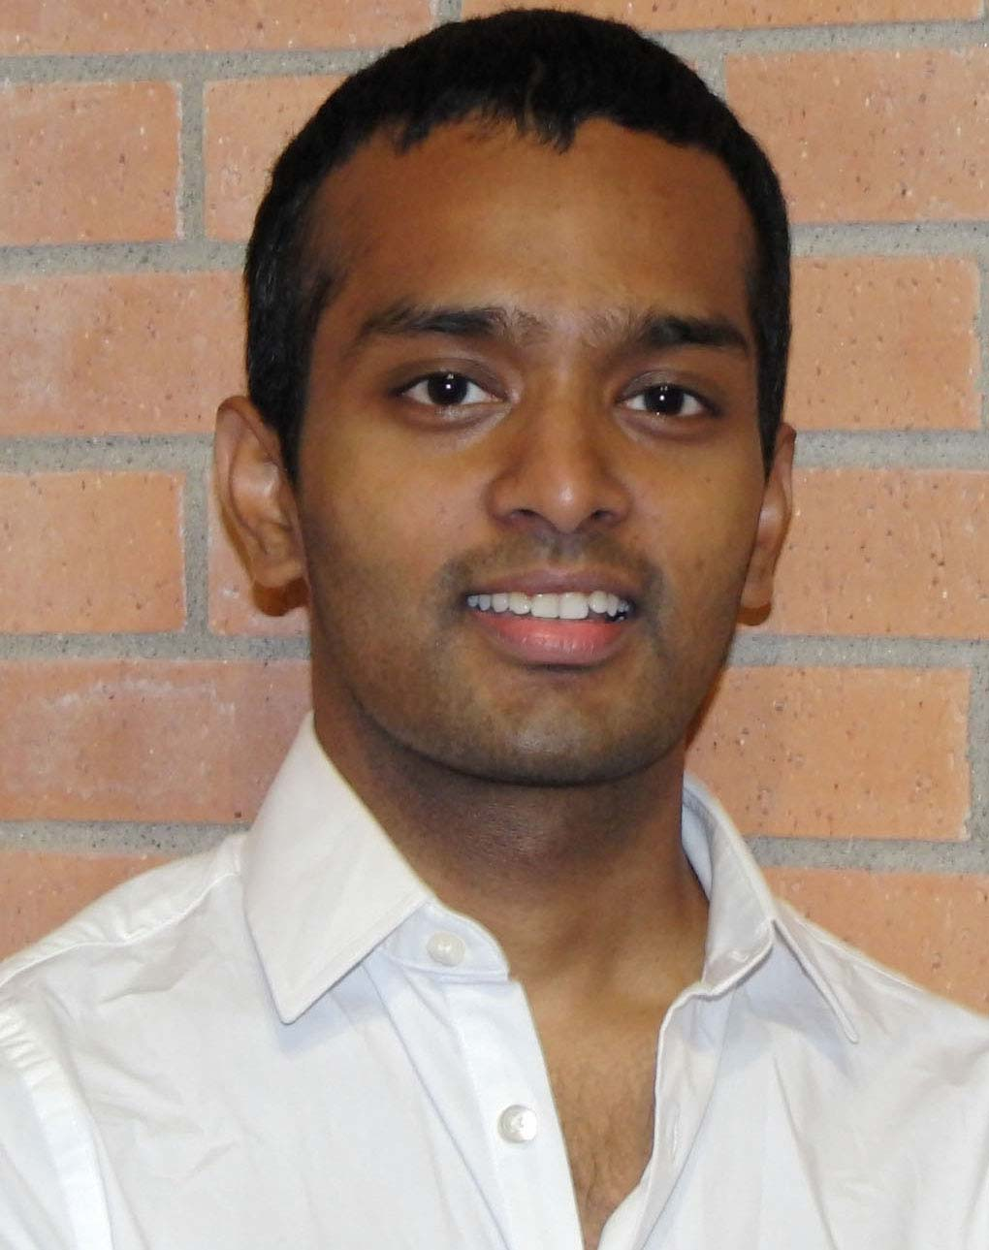
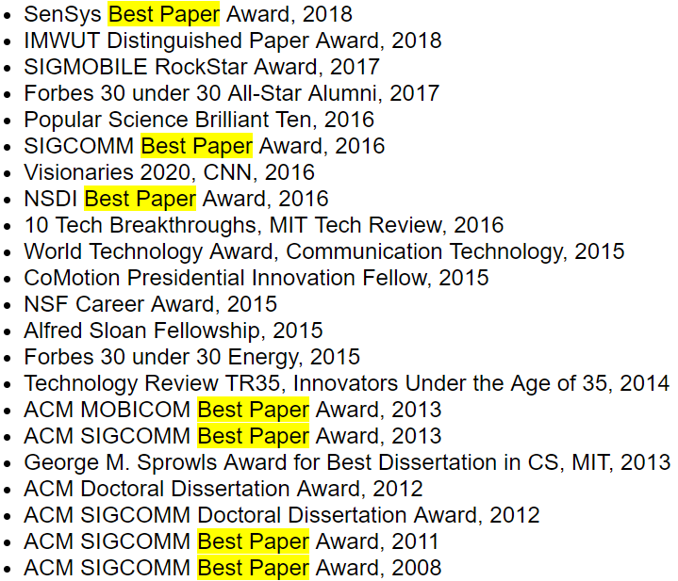
Shyamnath Gollakota
Detecting middle ear fluid using smartphones. (Science Translation Medicine 2019)
Charging a Smartphone Across a Room Using Lasers(Ubicomp 2018)
3D Printing Wireless Connected Objects(SIGGRAPH 2017)
Battery-free Cellphone(Ubicomp 2017)
Enabling On-Body Transmissions with Commodity Devices(Ubicomp 2016)
…

Slide 3
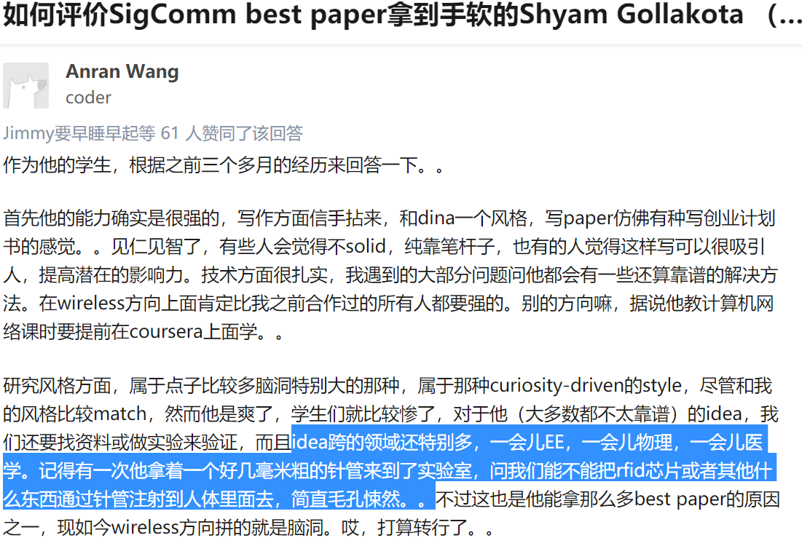
Shyamnath Gollakota

Slide 4
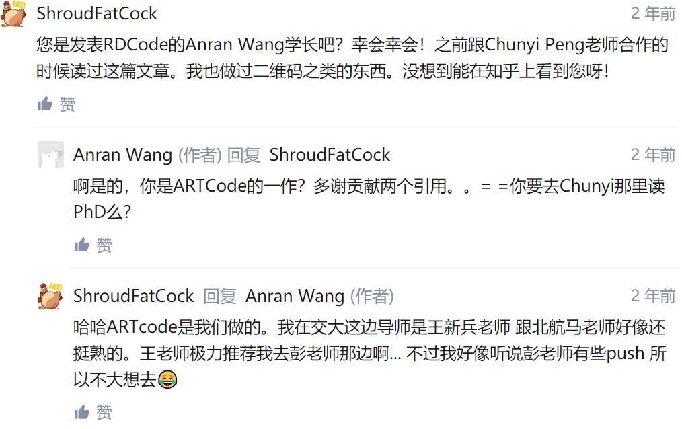
Shyamnath Gollakota

Slide 5
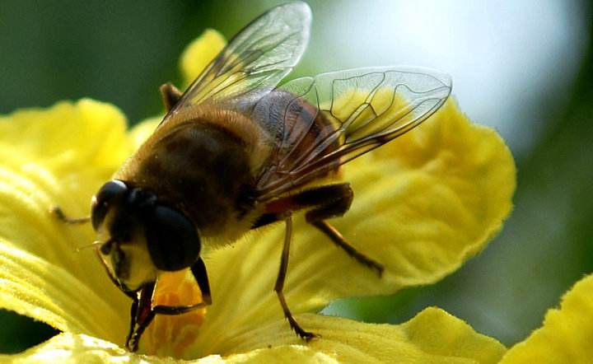
Application Scenarios
Moisture, humidity and light monitoring at unreachable places in farm;
Pollination patterns monitoring for genetic diversity maintenance purpose in farm;
Detailed information at particular places based on localization of bees in farm;

Slide 6
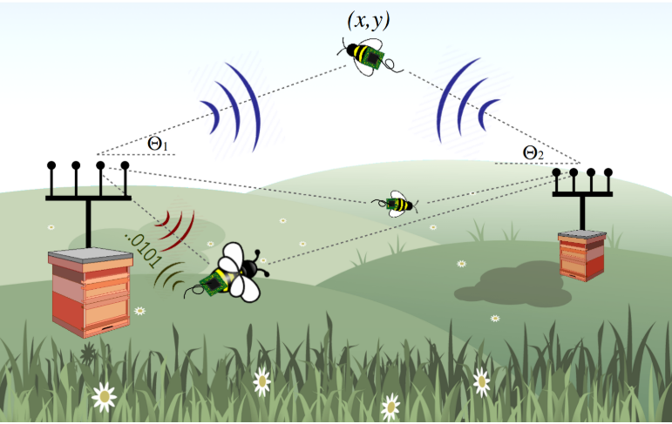
System Design
Lightweight battery powered electronics package including sensors, RF module, micro-controller and battery, capable of self-localization, data collection and communication;
Multi-antenna access points with dedicated power source for backscatter and localization;

Slide 7
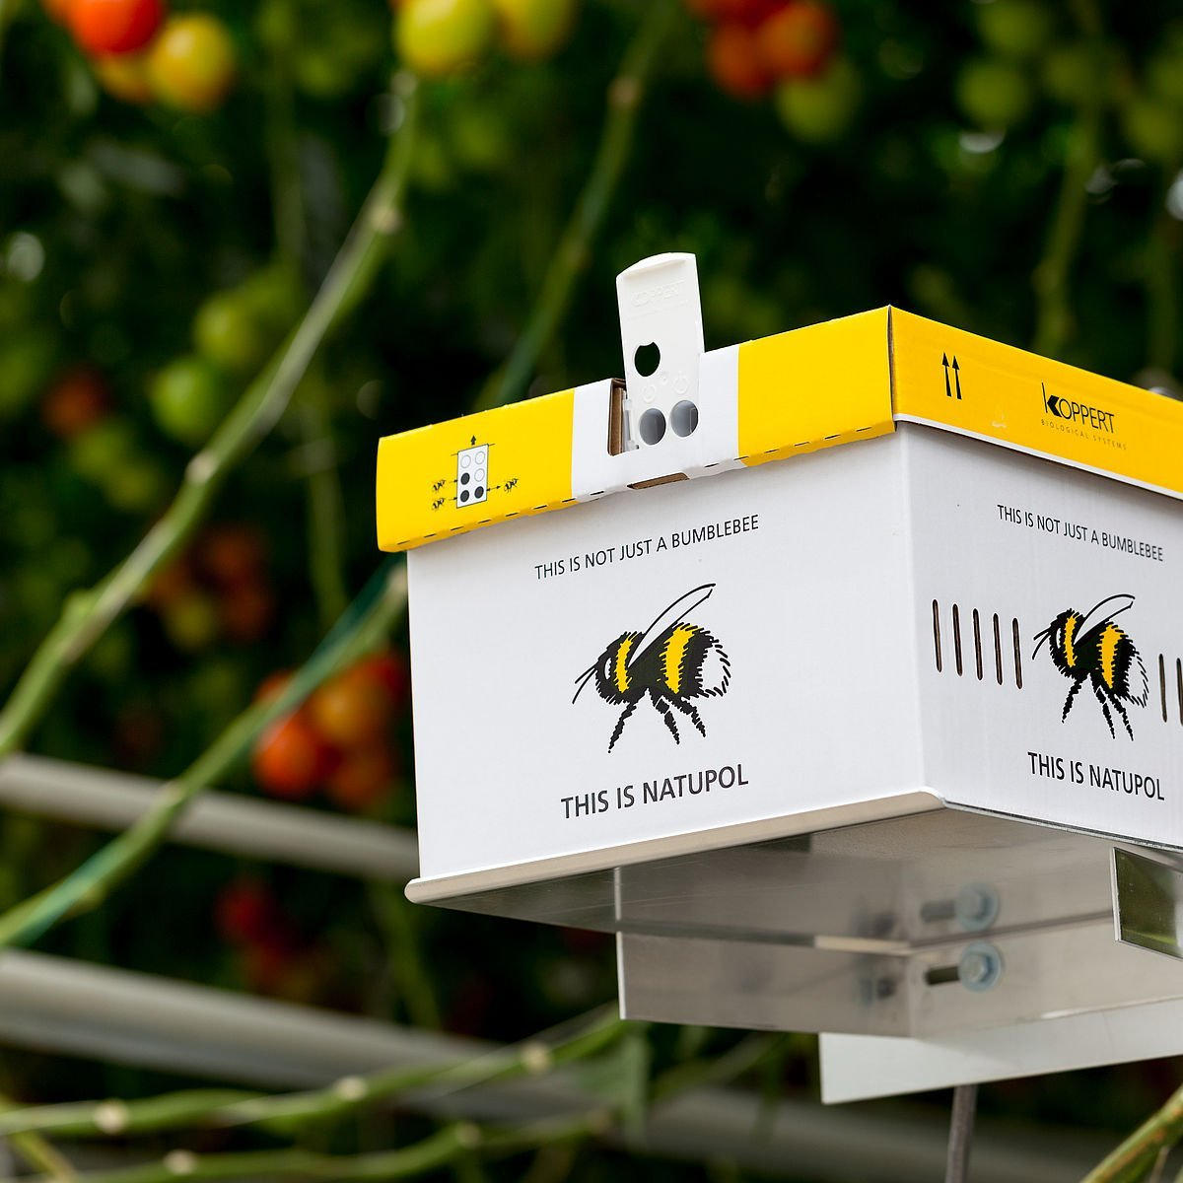
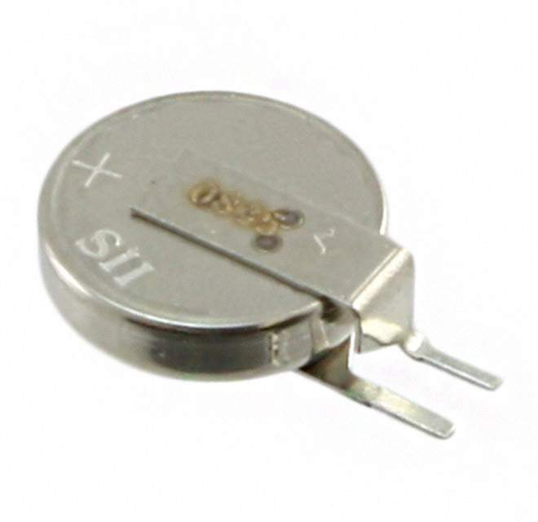
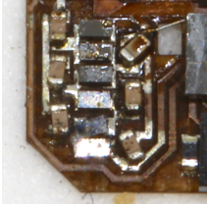
Platform Constraints
By progressively adding weight onto insects, it is observed that bees can have a controlled flight while carrying maximum of 105mg weight;
70mg consumed by battery, 35mg left for communication, sensing, computing and self-localization;

Slide 8
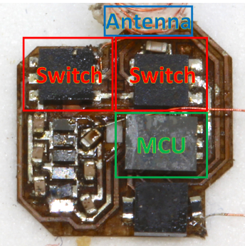
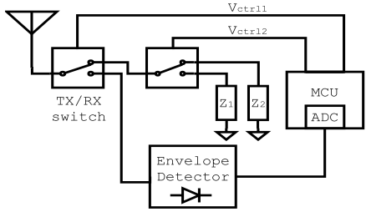
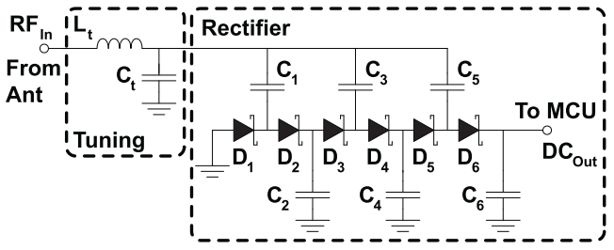
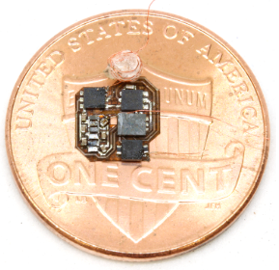
Hardware Design
Inductance shaped antenna are chosen due to the antenna length limitation, weighted 4.6mg
Two switches are used to transform between Tx/Rx states and implement OOK modulation, weighted 3.3mg each;
KL03z ARM MCU weight 4.1mg;
Envelope detector are tuned at 915 MHz ISM band for OOK modulation;

Slide 9
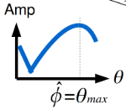
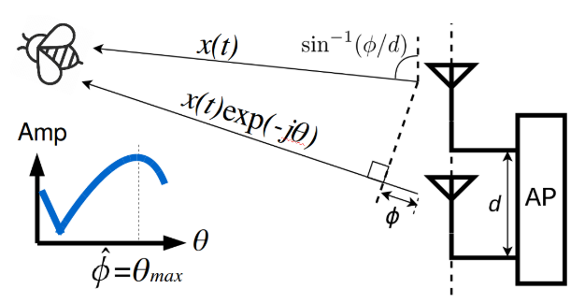
Self-localization Design
2D location is identified using angles from two Aps;
Phase information can hardly be obtained due to hardware limitation;
By intentionally introducing phase difference between antennas at AP, AoA can be extracted according to received amplitude change;

Slide 10
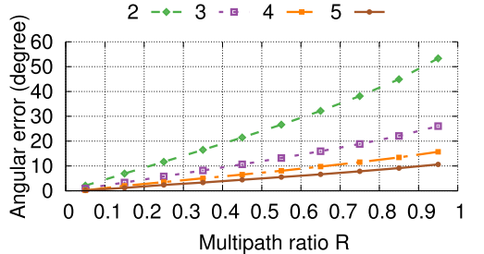

Self-localization Design
When multiple path exist, amplitude of LOS path will dominate and the above algorithm still hold;
By increasing the number of antennas, angular error can be decreased to acceptable level;

Slide 11
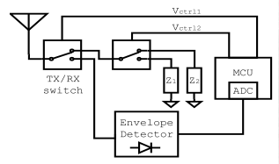
Backscatter Design
The second switch is used to select between two impedance states to implement OOK modulation;
The APs broadcast continuous signal, which will be reflected by antennas;
2 MHz square signal are generated by MCU to shift the backscattered signal 2 MHz away from the received signal to mitigate interference;

Slide 12
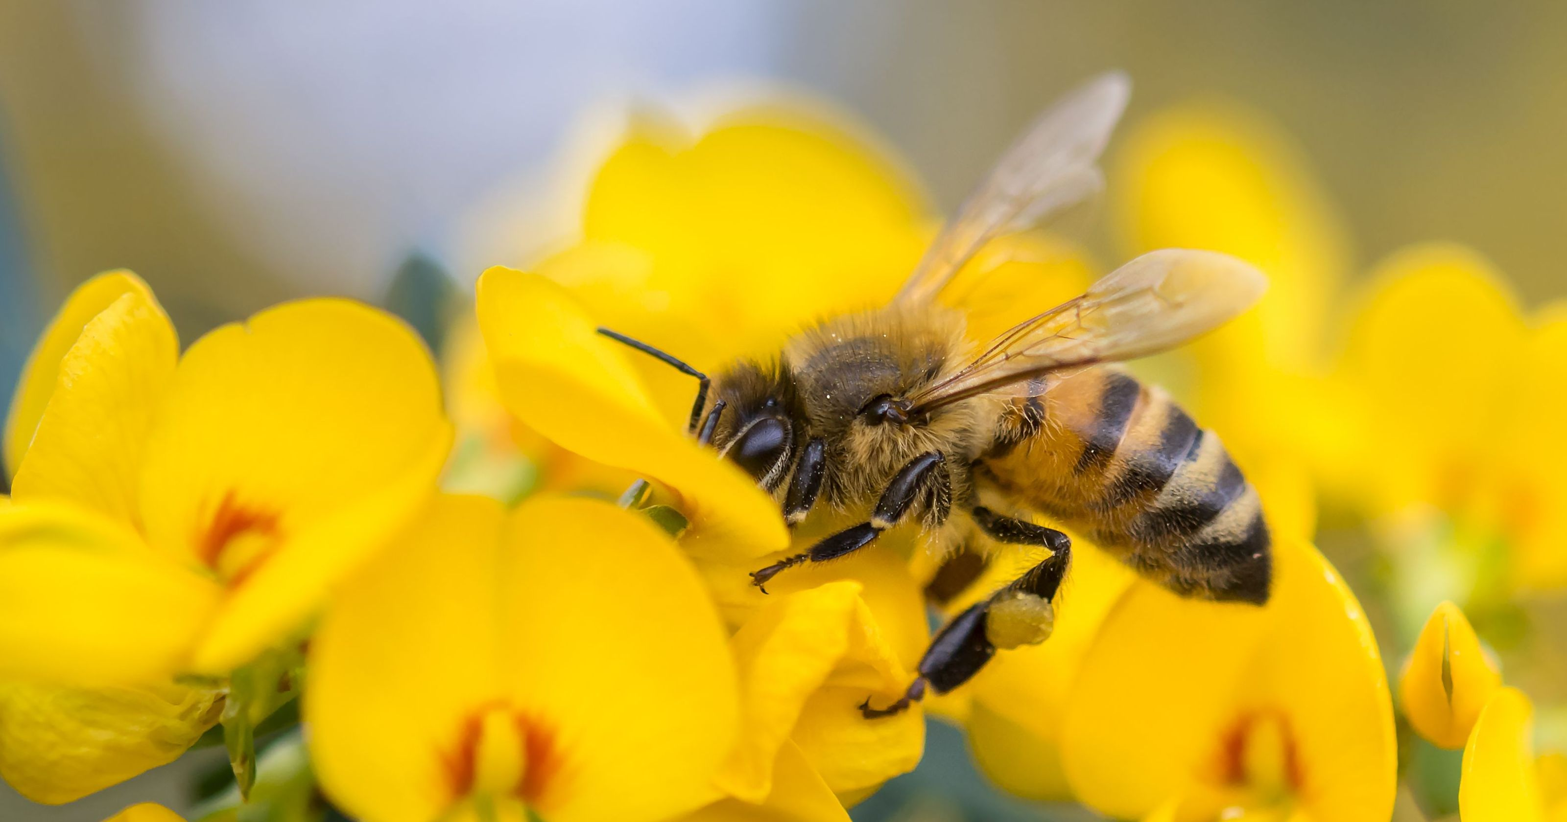
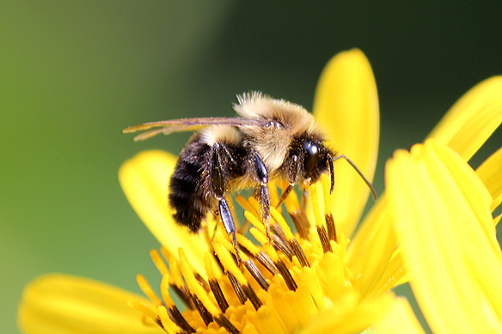
Evaluation
Self-localization Performance
20 or more bees can be observed in a single 1 m^2 square;
Wild bees typically fly at average speed of 1-5m/s;
Settle in one region slowly hovering or landing at individual flowers
Honeybee
Bumblebee

Slide 13
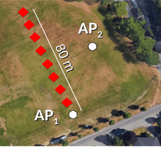
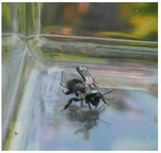
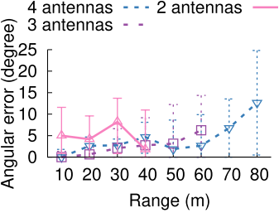
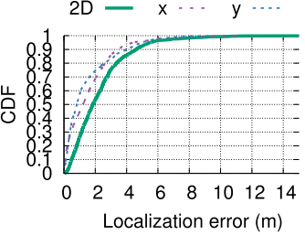
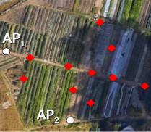
Evaluation
Self-localization Performance
100x100 m soccer field
Place a bee in a plastic container, which is placed at different locations at the farm;
Angular error can hold within 10 degrees up to 80 meters away from AP;
A median static localization error of 1.9 m can be achieved;
90x120 m farm

Slide 14
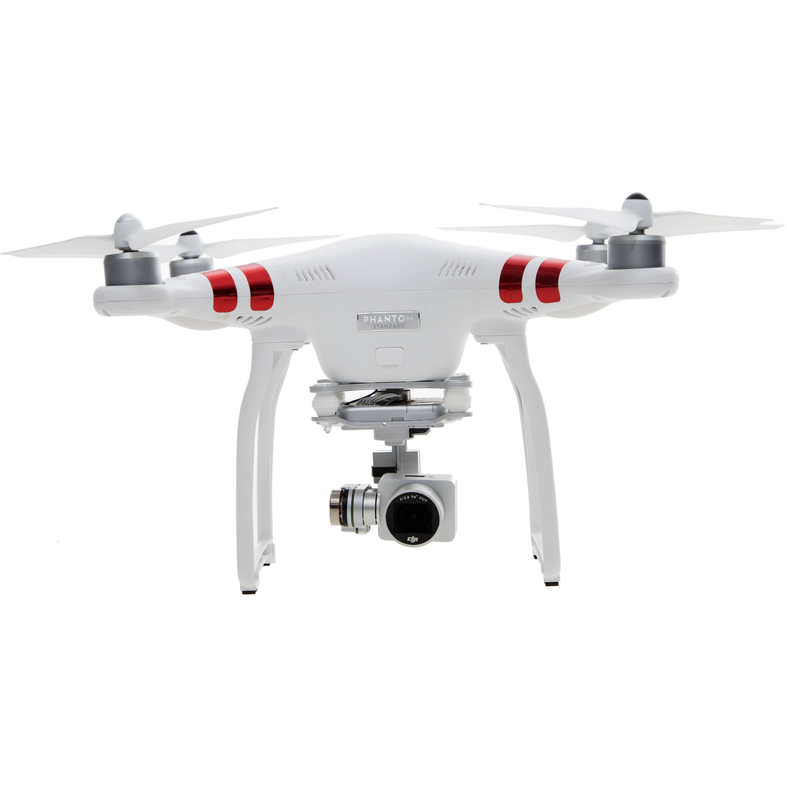
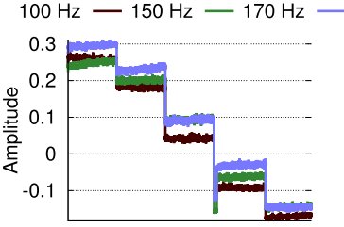
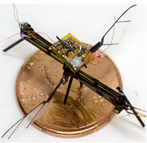
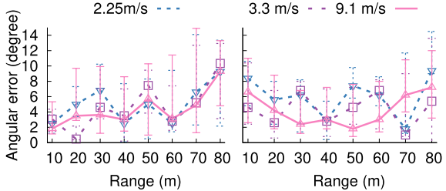
Evaluation
Self-localization Performance
Platform is placed on a drone to simulate high-speed movement on a bee;
Fluctuation due to multi-path fading can be mitigated by exponential smoothing;
An insect scale robot with flapping wings is designed to evaluate the effect of flapping speed;

Slide 15
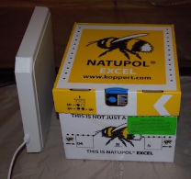
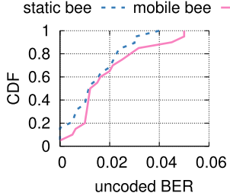
Evaluation
Backscatter Performance
System is designed to upload data while bees are back to hive;
AP is placed 1m away from hive for data transmission purposes;
Communication BER is evaluated on dead and live bees in plastic bottle;
Channel coding and channel interleaving can be applied to further decrease BER;

Slide 16
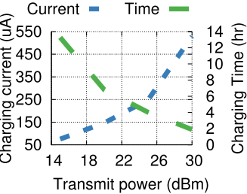
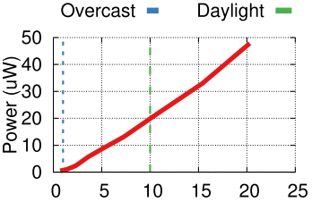
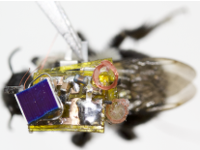
Evaluation
Power Harvesting Performance
20 dBm AP could charge 1 mAh battery in about 6 hours;
Solar harvesting can provide up to 50uW power in typical daylight, enabling battery-free platform;

Slide 17
Discussion
Fancy idea
Impressive implementation
Solid verification
But
Limited application prospect

