Slide 1









Pushing the Range Limits of Commercial Passive RFIDs
Jingxian Wang
Junbo Zhang, Rajarshi Saha, Haojian Jin, Swarun Kumar
Carnegie Mellon University

Slide 2
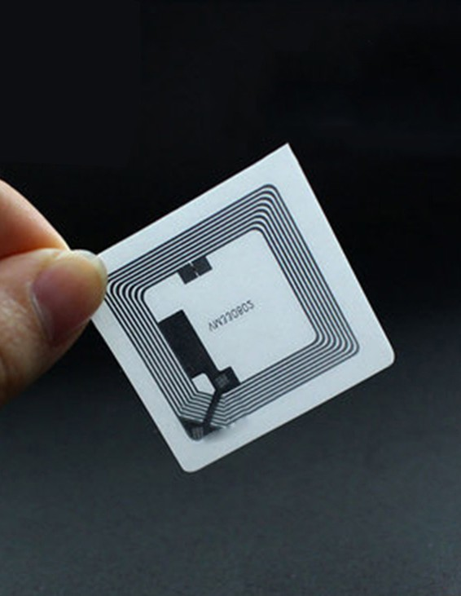
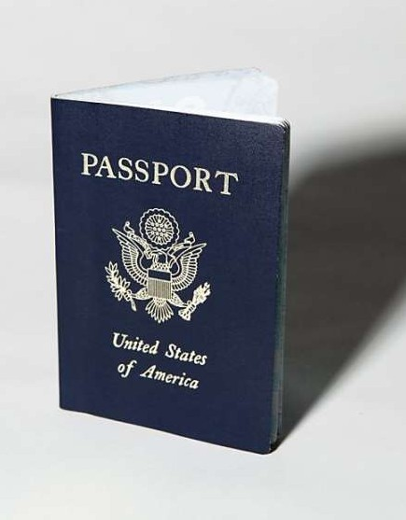

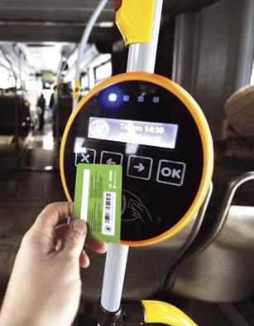
RFID Tags
Battery-free Machine Washable

Slide 3


RFIDs used in factories, warehouses, stores
Cashierless Store (Amazon Go)
Conveyor in the factory

Slide 4
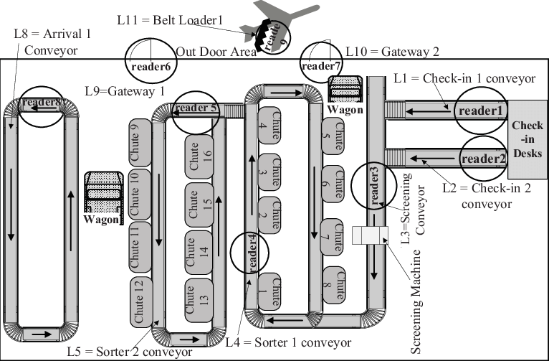

RFIDs for Baggage Tracking in Airports
RFID tags can be only detected at specific checkpoints!

Slide 5

RFIDs for Baggage Tracking in Airports
RFID systems have very short communication range from 5 to 10 meters.
RFID tags can be only detected at specific checkpoints!

Slide 6
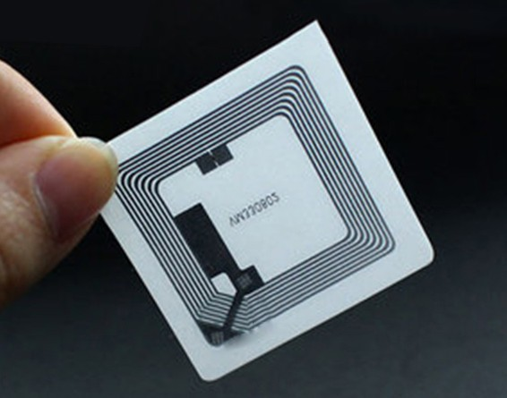

Two-fold Reason for short range
No battery in RFID tags (passive)
Power limits of RFID reader

Slide 7
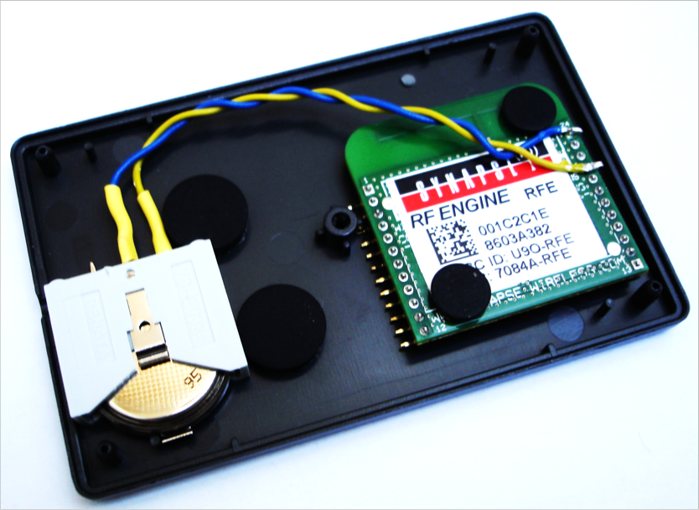
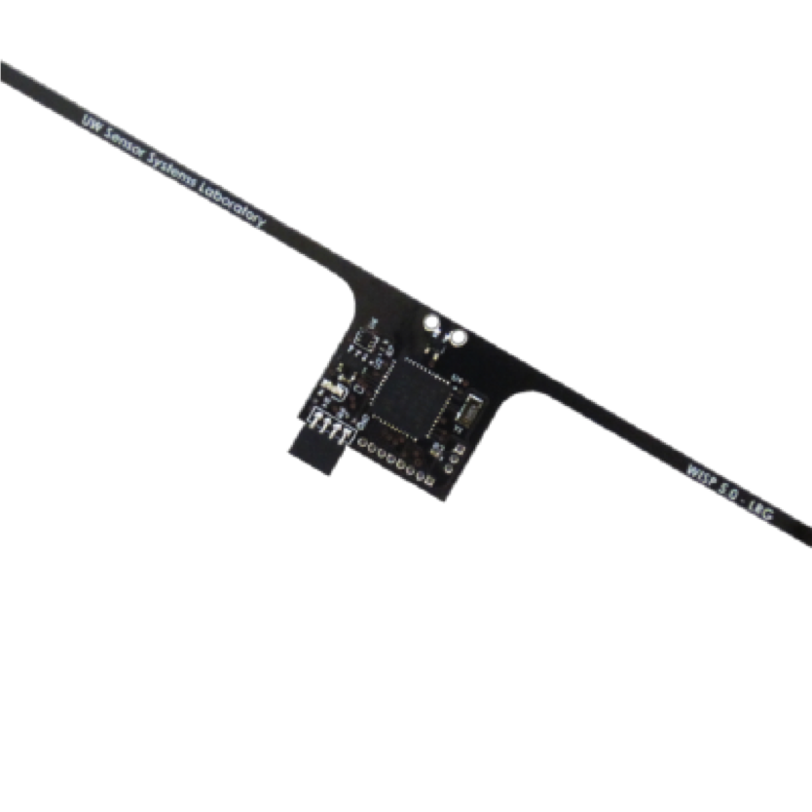
Related Work: Modified RFID Tags
Active Tag
Hardware Customized Tag
5 x improvement in range
2 x improvement in range
Bulky, limited battery life, high cost
High cost

Slide 8





Related Work: Multi-antenna MIMO
Vulnerable to obstacles
Sensitive to orientation of RFID tags
Limited by FCC power limits

Slide 9
PushID
- 8 times improvement in range (64 meters)
- without modifying RFID tags
- robust in various tag location and orientation

Slide 10

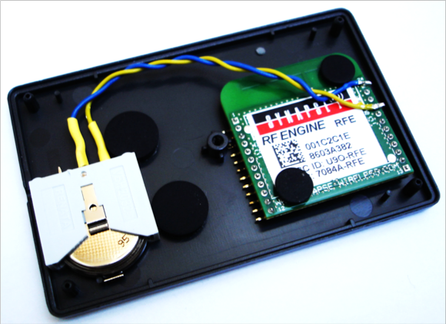


PushID
Prior Work
Without modifying the hardware
vs.
Robust in various tag location and orientation
vs.

Slide 11
PushID key idea
Exploit the collaboration between distributed RFID readers in the existing infrastructure.

Slide 12

Exploit the Collaboration between RFID readers
RFID-based baggage management system
11

Slide 13

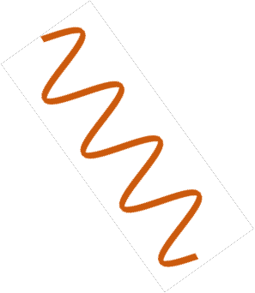

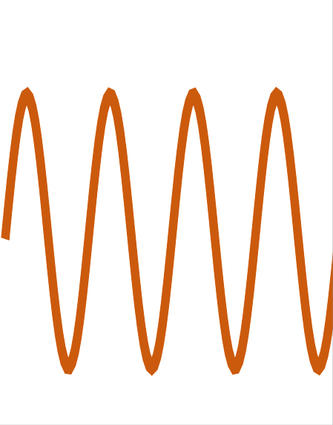
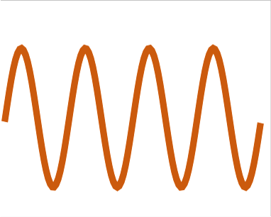
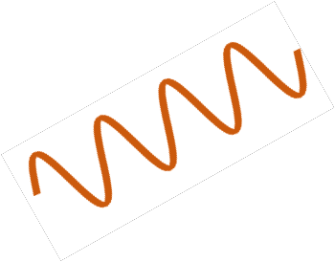


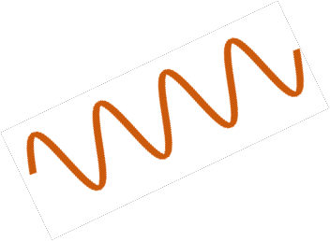

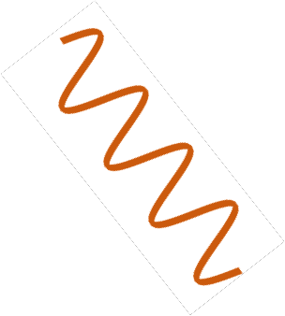


Distributed Beamforming
'"
'%
+
=
=
'$
+
'&
+
=
Beamforming weights: [!", !$, !%, !&]

Slide 14





RFID Tag
Main goal
⎯ Find the optimal beamforming weights to power as many as possible RFID tags at various unknown locations

Slide 15










Existing Approach – Channel Reciprocity in Wi-Fi
[!"#, !"%, !"&, !"']

Slide 16







Existing Approach – Channel Reciprocity
No energy…
Where is the tag?

Slide 17





Iterate over all beamforming weights?
RFID Tag
~ 26 hours

Slide 18
PushID System Design
Develops a novel blind distributed beamforming
Goal: discover all tags at unknown locations over a given geographic region.

Slide 19




Iterate over all individual points?

Slide 20
Iterate over all individual points?
Beamforming weights: [!", !$, !%, !&]

Slide 21
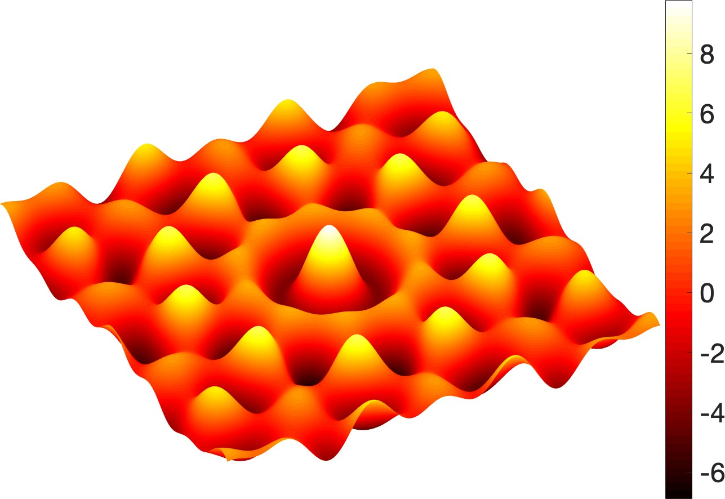




PushID models the received signal power at each point in space for each beamforming vectors.
Beamforming weights: [!", !$, !%, !&]

Slide 22
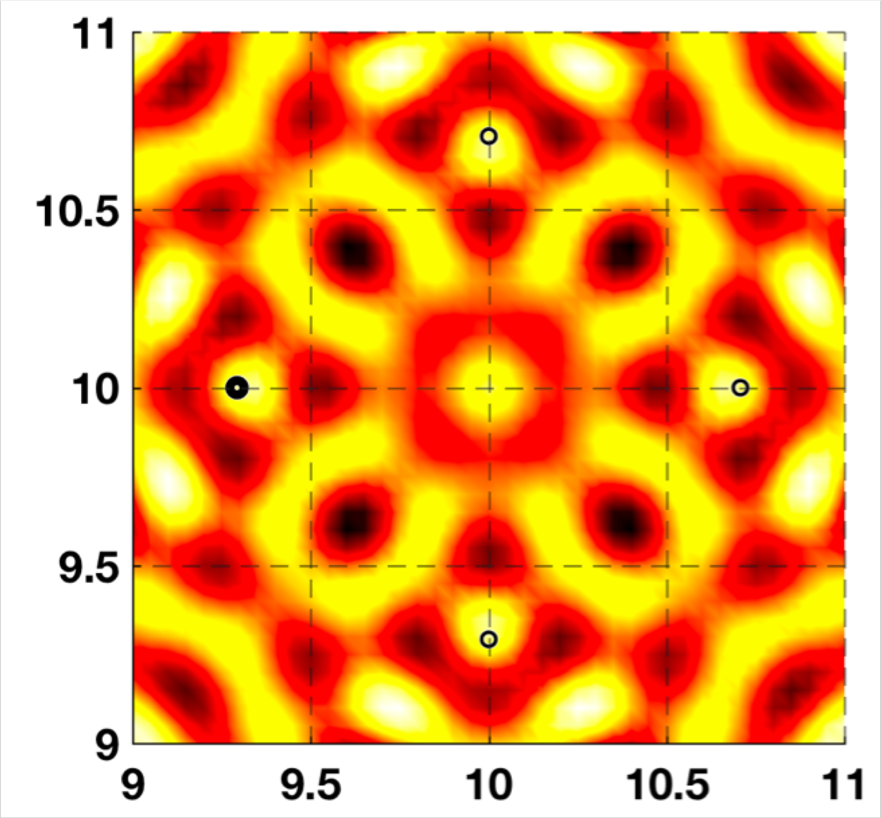
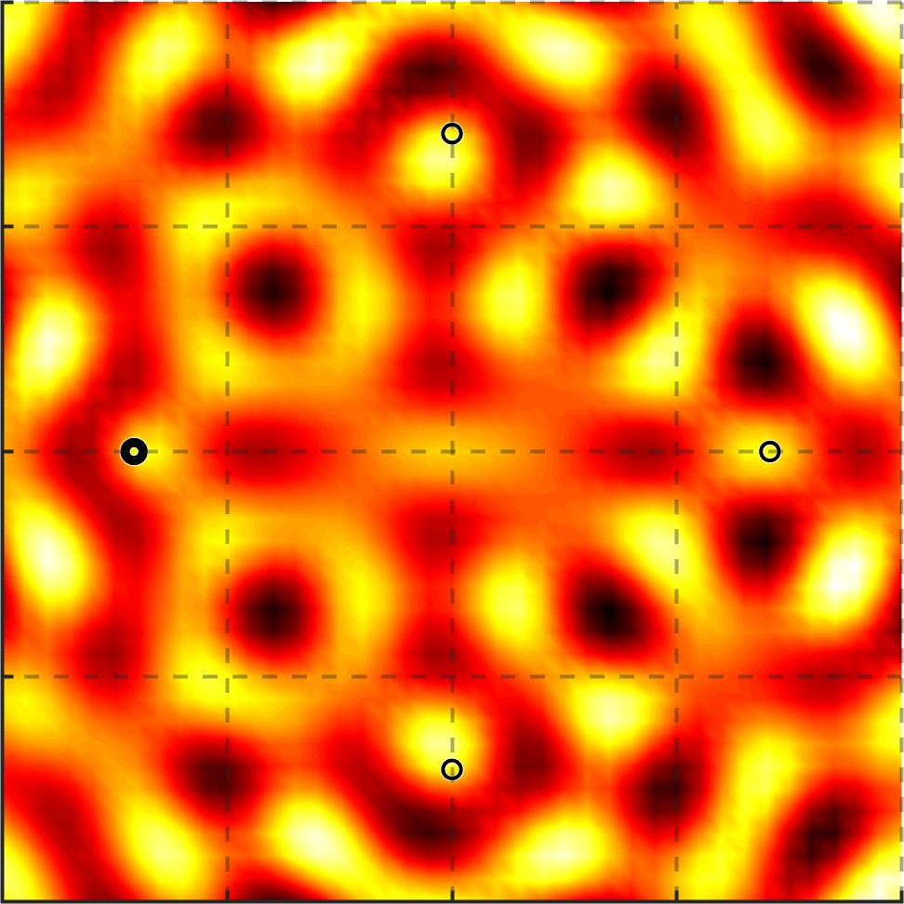
Energy Overlapping
[!", !$, !%, !&]
[!', !₍, !₎, !*]
Y axis (m)
X axis (m) X axis (m)
Iterating all beamformers to focus on individual points would lead to
much overlap and inefficiency.
21

Slide 23
Observation 1
⎯ PushID seeks to minimize overlap between energy patterns of beamforming vectors.

Slide 24
Problem Formulation
PushID
Find the smallest number of beamformers among n
beamformers
Aim to cover all discrete points in the desired area.
Set Cover Problem
Find the smallest number of sets among n sets, each
containing a few integers in
the range 1,…,N
Whose union is precisely the
universal set.

Slide 25
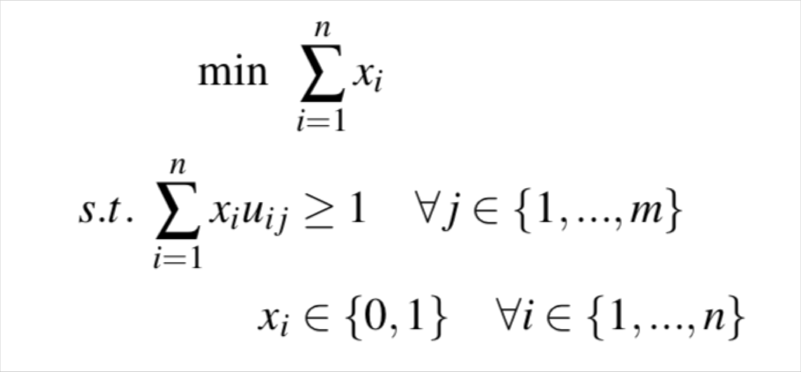
Modified set cover problem
n: the number of beamformer candidates
How can we reduce the search space of beamformers?

Slide 26

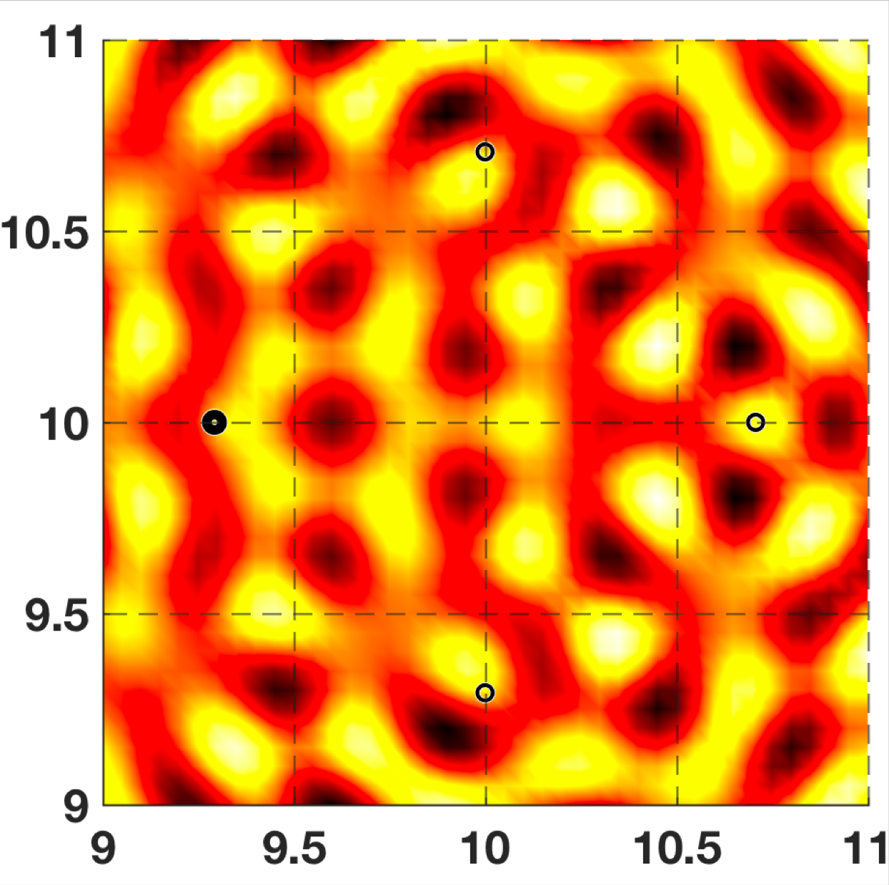
Energy Spreading
[!", !$, !%, !&]
(⁾+
[!"' , !$, !%, !&]
*
Y axis (m)
X axis (m)
X axis (m)

Slide 27

PushID favors the beamformers between two extremes.
Energy Threshold
Too narrow
Just right!
Too flat

Slide 28
Observation 2
⎯ PushID must favor beamforming weights with maximal total area where RFID tags remain powered.

Slide 29
Gradient-Based Beamforming Vector Pruning
Generate n beamformer randomly
Refine beamformers with maximized coverage area using gradient
Feed new beamformers into search space
See details in our paper.
28

Slide 30
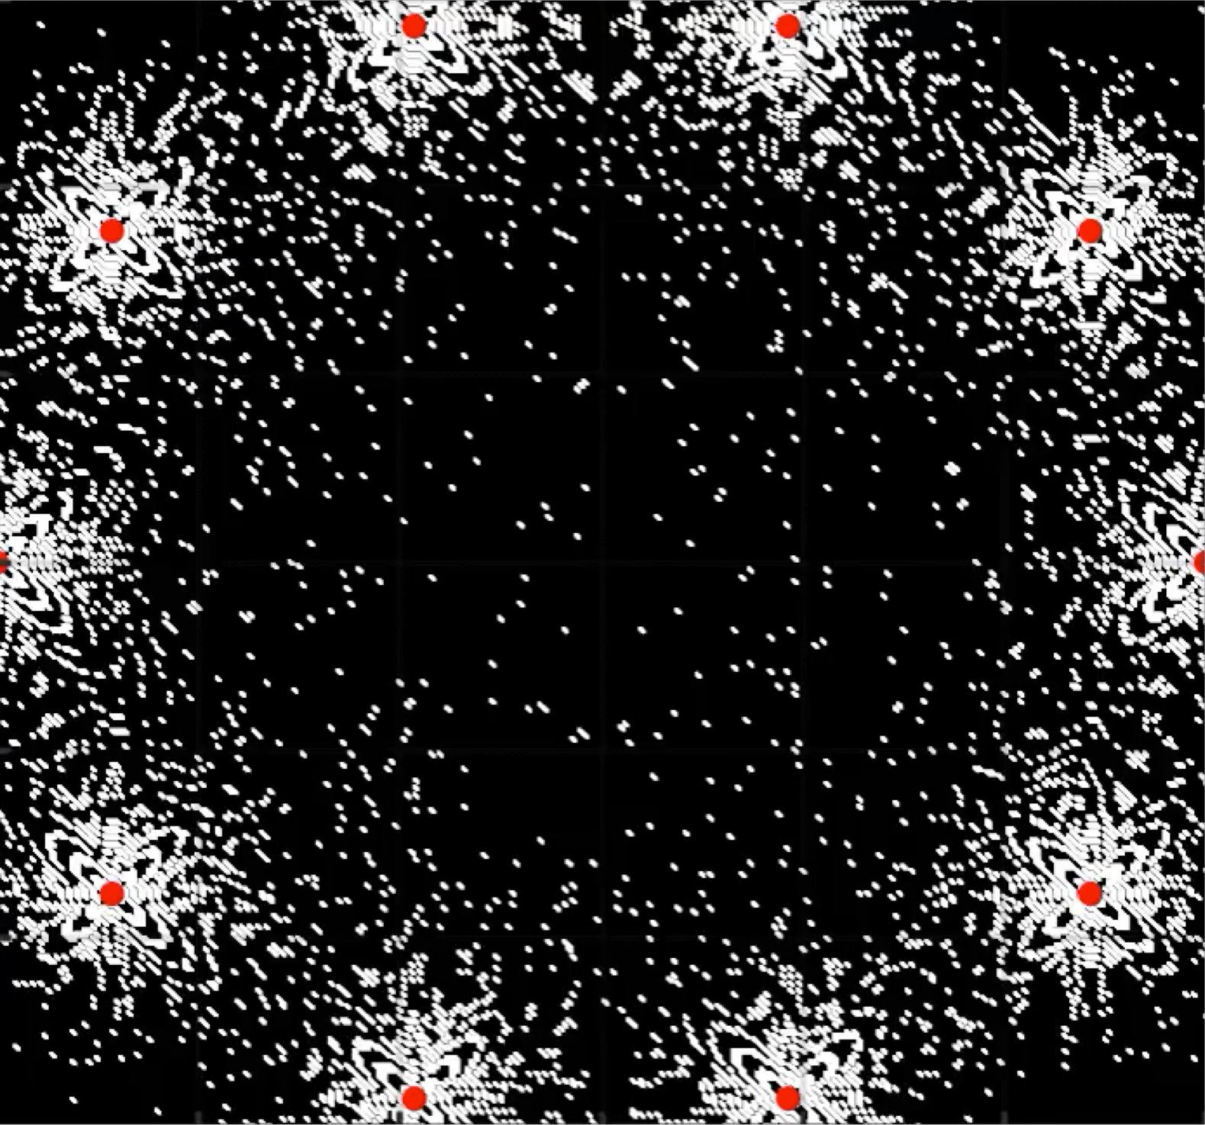
PushID - Find the optimal set of beamformers
Seek the beamformers that have minimized overlap.
Gradient-based beamformers pruning.

Slide 31
System Design
Blind Distributed Beamforming
Accounting for Multipath
Spanning Tree for Distributed Synchronization
See details in our paper.

Slide 32
Evaluation
⎯ range, tag orientation, mobility, coverage

Slide 33

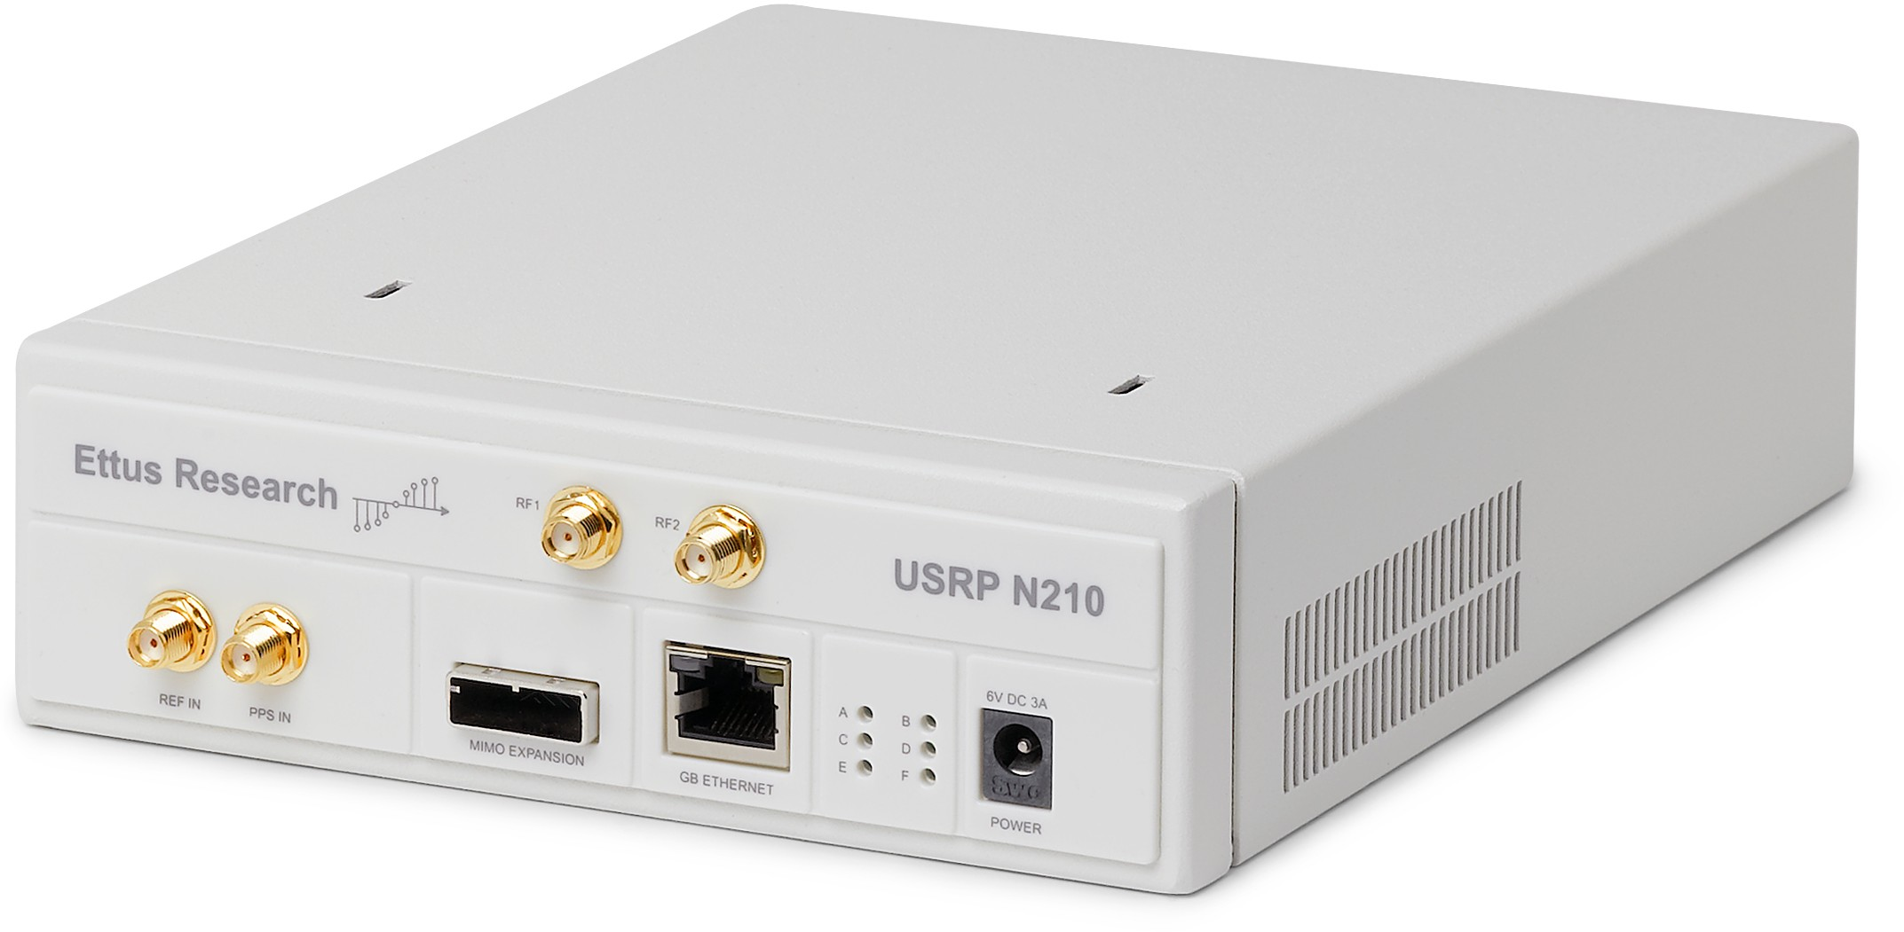
Implementation
Commercial Passive RFID tags
8.7 meters communication range
USRP N210 as the PushID Readers
Running full duplex Gen2 RFID protocol

Slide 34
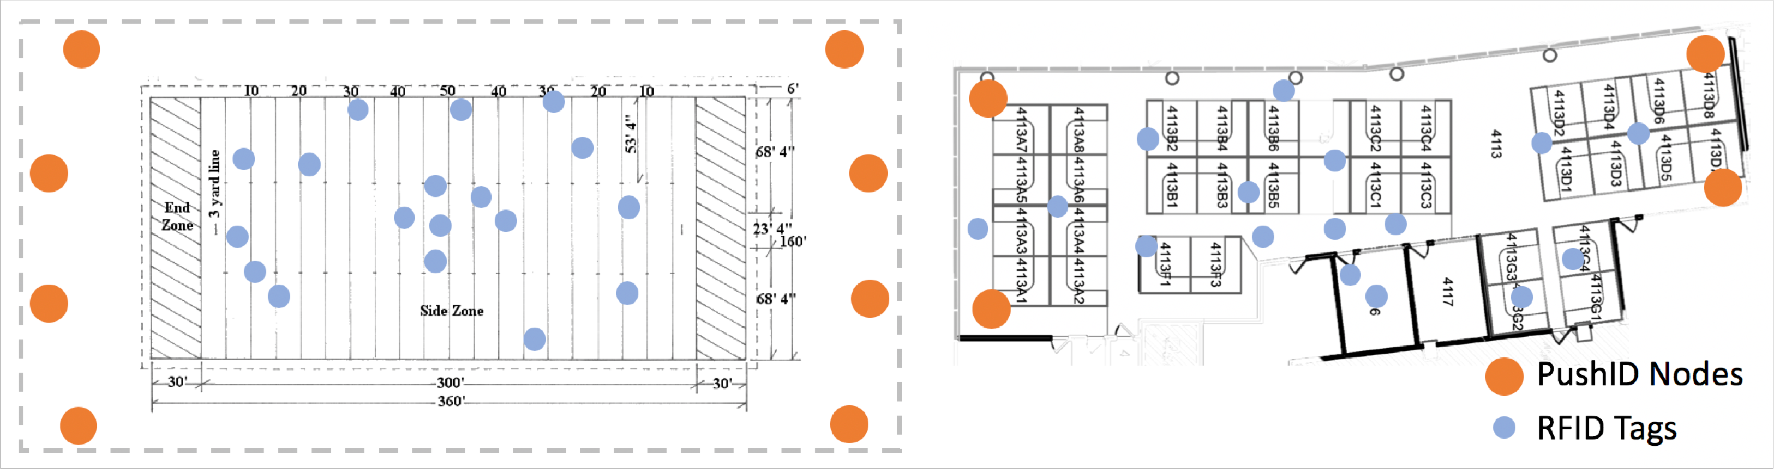
Evaluation Configuration
Baselines: Multi-antenna MIMO, Closest reader
LoS and NLoS radio environment.
Mobility test: walking speed.
Football Field
Office Area

Slide 35
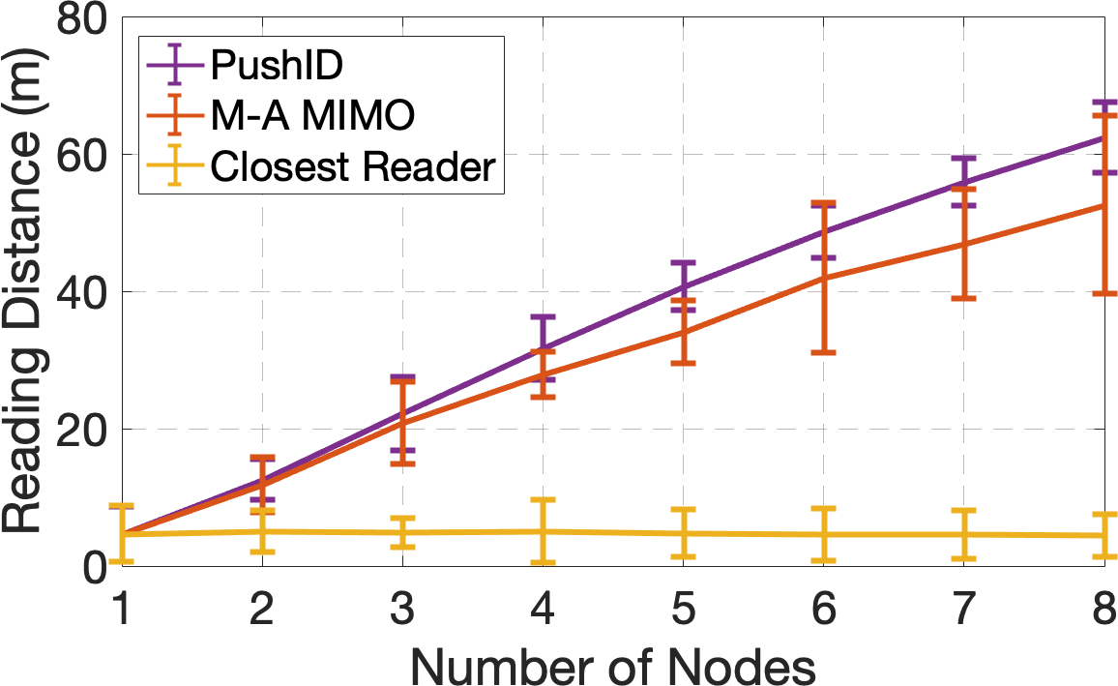
Range vs. Number of Readers
PushID achieves a communication range of 64 meters.

Slide 36
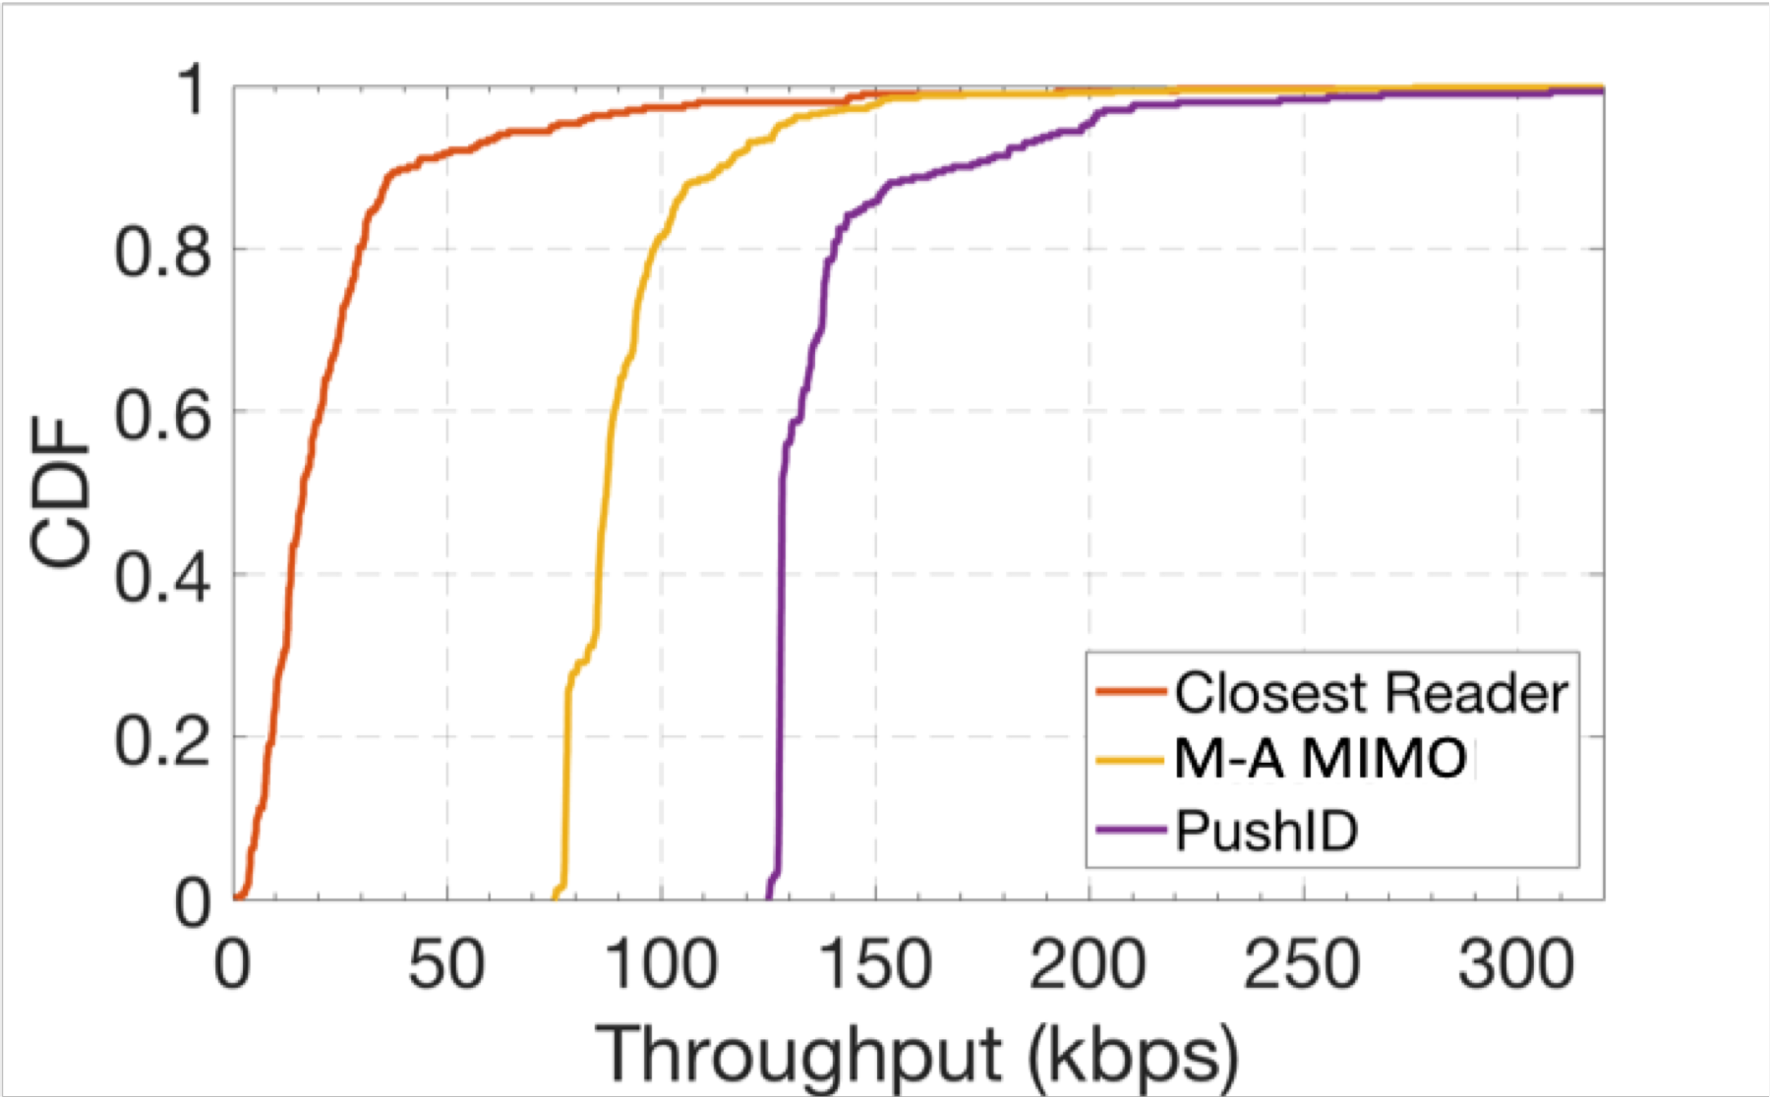
Impact of Tag Orientation
PushID is more robust in various tag orientation.

Slide 37
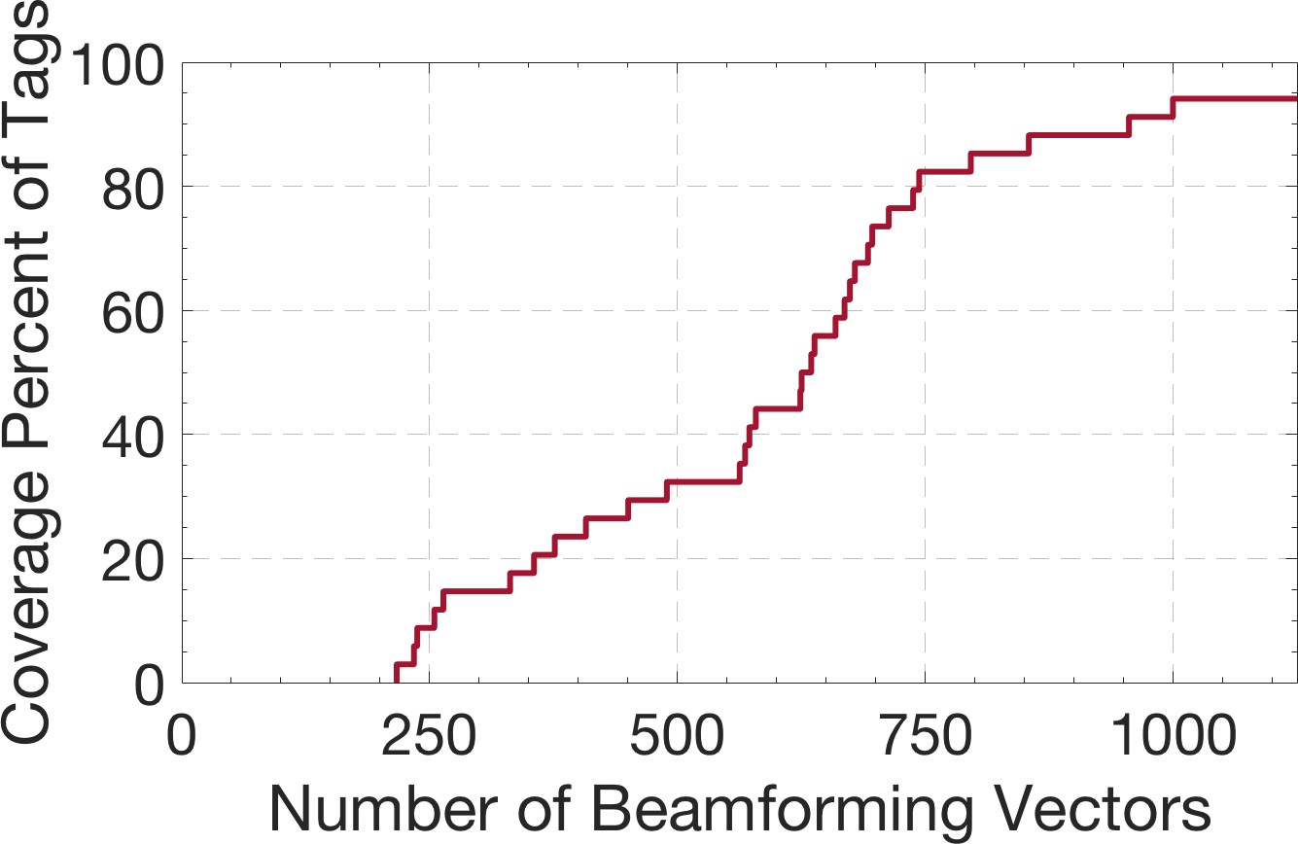
Coverage vs. Number of Beamformers
980 beamformers to cover 95%.
4.4 s.

Slide 38
More evaluation…
Throughput vs. distance
Throughput vs. number of nodes
Number of beamformer needed vs. distance
Impact of Mobility
See details in our3p7 aper.

Slide 39









PushID - Conclusion
First distributed MIMO system for commercial passive RFID tags.
Develops a novel blind distributed beamforming.
8 times improvement in range vs. commercial RFID systems.
witechlab.com/pushid
38

