Slide 1
SolarGest: Ubiquitous and Batery-free Gesture Recognition using Solar Cells
Dong Ma, Guohao Lan, Mahbub Hassan, Wen Hu,
Mushfka B. Upama, Ashraf Uddin, Moustafa Youssef
University of New South Wales, Alexandria University,
ACM MobiCom 2019
Notes:
Thanks to Prof. Lu Su for the introduction. I’m advised by Prof. Zheng Yang. Today I want to present you our work: ChromaCode, a fully imperceptible screen-camera communication system, with me and Chenshu Wu as co-primary authors, and this is a joint work with Prof. Chunyi Peng.

Slide 2
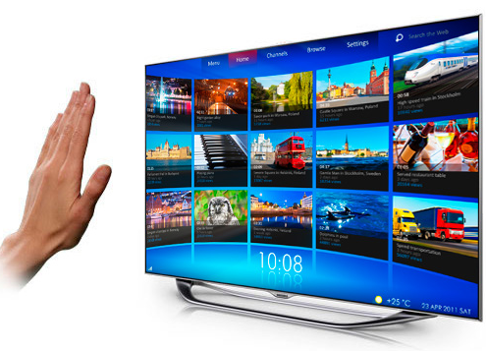
Motivation
Growing trend to integrate gesture recognition to consumer electronics
Work with any device and consume zero energy
Notes:
Currently, it is reported that 65 percent of people skip online video advertising, mainly due to the intrusiveness. Delivering advertising content as side information without tampering primary video itself will not only guarantee viewing experience but also enhance user interaction. A common real-life example towards this paradigm is QR code. QR code spatially occupies a small area in the corner of a screen, and has extra information embedded inside. However, QR code is obtrusive for viewing and affects viewing experience. They may overlay important original video contents, especially in small monitors with limited screen spaces. QR code is mainly used for device-to-device communication, and is meaningless to human eyes.
What we hope is to make advertisements and other information invisible to viewers, to achieve simultaneous viewing and communication without affecting viewing experience.

Slide 3
Related Works
WiFi (electromagnetic)
Camera (image)
Microphone (acoustic)
Accelerometer (motion)
Light sensor (ambient light)
None of them harvest, but consume energy.
Notes:
Related works have been made to enable hidden screen-camera communication. For example, InFrame++ leverages low-pass flicker fusion property of human eyes and achieves hidden data frame embedding by complementary lightness modification. TextureCode only embeds in textured regions to improve data frame invisibility.

Slide 4
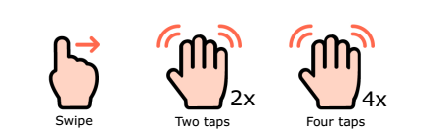
Solar-based gesture recognition
Batery-free Visible Light Sensing (ACM Workshop on Visible Light Communication Systems, pages 3–8. ACM, 2017 )
Differentiating only three gestures based on the number of times the user repeats.
Lack of a theoretical model to simulate solar gesture recognition under different parameters.
Notes:
Related works have been made to enable hidden screen-camera communication. For example, InFrame++ leverages low-pass flicker fusion property of human eyes and achieves hidden data frame embedding by complementary lightness modification. TextureCode only embeds in textured regions to improve data frame invisibility.

Slide 5
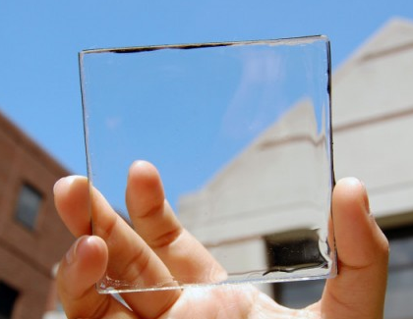
Solar-based gesture recognition
Solar panels
Transparent solar cells
Notes:
Currently, it is reported that 65 percent of people skip online video advertising, mainly due to the intrusiveness. Delivering advertising content as side information without tampering primary video itself will not only guarantee viewing experience but also enhance user interaction. A common real-life example towards this paradigm is QR code. QR code spatially occupies a small area in the corner of a screen, and has extra information embedded inside. However, QR code is obtrusive for viewing and affects viewing experience. They may overlay important original video contents, especially in small monitors with limited screen spaces. QR code is mainly used for device-to-device communication, and is meaningless to human eyes.
What we hope is to make advertisements and other information invisible to viewers, to achieve simultaneous viewing and communication without affecting viewing experience.

Slide 6

Transparent solar cells
Solar panels now can be fitted to the entire device body, including on top of the screen.
Energy harvesting.
Visible lights
Notes:
Currently, it is reported that 65 percent of people skip online video advertising, mainly due to the intrusiveness. Delivering advertising content as side information without tampering primary video itself will not only guarantee viewing experience but also enhance user interaction. A common real-life example towards this paradigm is QR code. QR code spatially occupies a small area in the corner of a screen, and has extra information embedded inside. However, QR code is obtrusive for viewing and affects viewing experience. They may overlay important original video contents, especially in small monitors with limited screen spaces. QR code is mainly used for device-to-device communication, and is meaningless to human eyes.
What we hope is to make advertisements and other information invisible to viewers, to achieve simultaneous viewing and communication without affecting viewing experience.

Slide 7
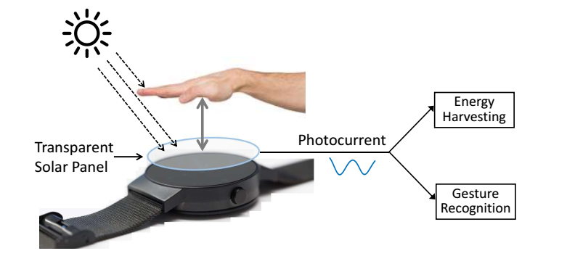
SolarGest
Any hand gesture interferes with incident light rays on the solar panel in a unique way, leaving its distinguishable signature in harvested photocurrent’s time series data.
Machine learning
Notes:
There are mainly three key goals in hidden screen-camera communication. They are
Invisibility,
Reliability
And throughput.
However, these three key goals can be conflicting. For example, we can increase lightness adjusting amount to achieve more reliable data transmission, but more flickers may be observed by human eyes. Previous works usually made a trade-off among them. In our work, ChromaCode aims to achieve all three goals while retaining watching experience to users.

Slide 8
SolarGest
Combining solar energy harvesting law with geometry, we propose a model to simulate photocurrent waveforms produced by arbitrary hand gestures.
Notes:
There are mainly three key goals in hidden screen-camera communication. They are
Invisibility,
Reliability
And throughput.
However, these three key goals can be conflicting. For example, we can increase lightness adjusting amount to achieve more reliable data transmission, but more flickers may be observed by human eyes. Previous works usually made a trade-off among them. In our work, ChromaCode aims to achieve all three goals while retaining watching experience to users.

Slide 9
Challenge
Both duration and amplitude of the waveform can vary significantly from sample to sample for the same gesture.
Validate the model.
Notes:
We achieve fully imperceptible data frame embedding firstly with some color space studies. Colors are not objective existence, but are perception in visual center of human brain. To show colors in electronic devices, color spaces are developed to model human vision system. There are exactly three kinds of cone cells in human eyes, shaping the trichromatic human vision system. The first color space CIERGB was built from human eyes experiments. However, CIERGB has chromaticity distributions in negative axis, which leads to inconvenience for calculation.

Slide 10



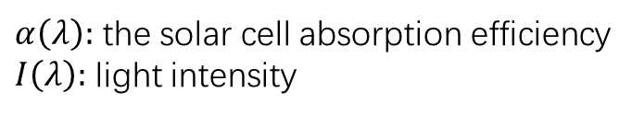
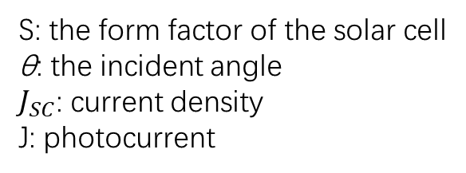
Solar gesture simulator
Combining solar energy harvesting law with geometry.
$α\left(λ\right):$ the solar cell absorption efficiency
$I\left(λ\right):$ light intensity
S: the form factor of the solar cell
θ: the incident angle
$J_{SC}$: current density
J: photocurrent
Notes:
We achieve fully imperceptible data frame embedding firstly with some color space studies. Colors are not objective existence, but are perception in visual center of human brain. To show colors in electronic devices, color spaces are developed to model human vision system. There are exactly three kinds of cone cells in human eyes, shaping the trichromatic human vision system. The first color space CIERGB was built from human eyes experiments. However, CIERGB has chromaticity distributions in negative axis, which leads to inconvenience for calculation.

Slide 11
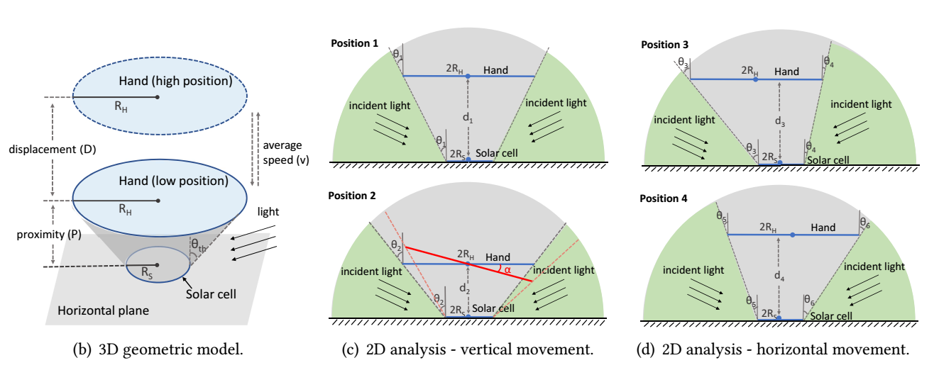
Solar gesture simulator
Combining solar energy harvesting law with geometry.
Notes:
We achieve fully imperceptible data frame embedding firstly with some color space studies. Colors are not objective existence, but are perception in visual center of human brain. To show colors in electronic devices, color spaces are developed to model human vision system. There are exactly three kinds of cone cells in human eyes, shaping the trichromatic human vision system. The first color space CIERGB was built from human eyes experiments. However, CIERGB has chromaticity distributions in negative axis, which leads to inconvenience for calculation.

Slide 12

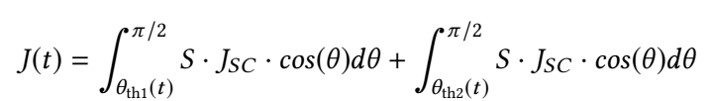
Solar gesture simulator
Combining solar energy harvesting law with geometry.
up
Notes:
We achieve fully imperceptible data frame embedding firstly with some color space studies. Colors are not objective existence, but are perception in visual center of human brain. To show colors in electronic devices, color spaces are developed to model human vision system. There are exactly three kinds of cone cells in human eyes, shaping the trichromatic human vision system. The first color space CIERGB was built from human eyes experiments. However, CIERGB has chromaticity distributions in negative axis, which leads to inconvenience for calculation.

Slide 13
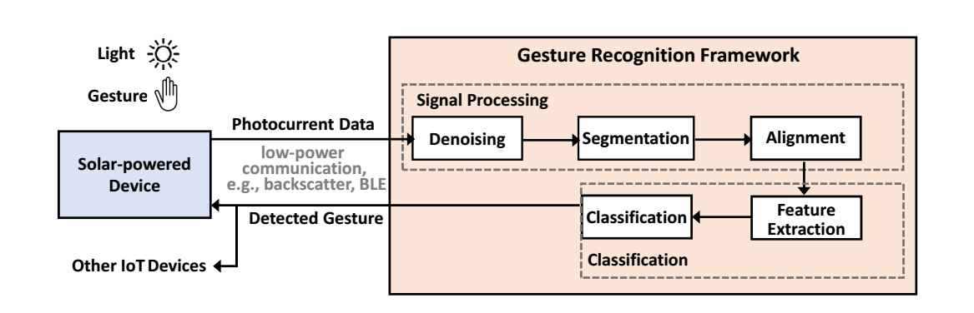
Overview
Recognition framework
Notes:
This slide shows the overall architecture of ChromaCode.
Origin data is encoded through concatenated encoding
And then modulated to generate data frame.
The data frame is then embedded into primary video with adaptive embedding, so that when the video is being played
Human eyes can only see origin video contents.
But cameras can capture the embedded data frame
And then retrieve embedded data by demodulation and decoding.

Slide 14
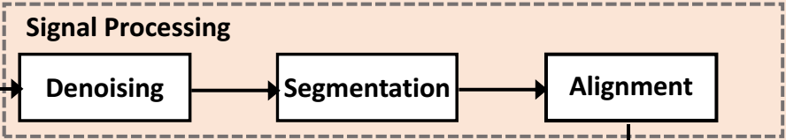
Signal processing
Notes:
Firstly let’s review how hidden screen-camera channel is achieved.
This is achieved by leveraging low-pass flicker fusion property of human eyes. Human eyes can not see flicker with frequency larger than 100Hz, but instead can only see the average lightness. So we can generate high frame rate complementary frames by complementary lightness modification to embed data frames unobtrusively into origin video. But the data frame can stilled be captured with high capturing rate cameras.
However, the hiding quality is still not good enough in related works.

Slide 15
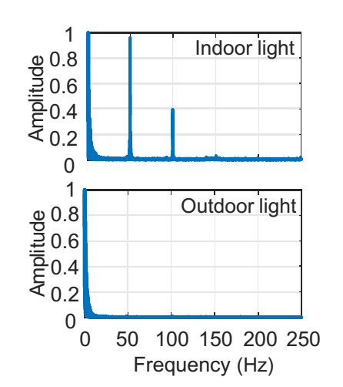
Signal processing
DWT to filter noise from both time and frequency domain.
Notes:
Firstly let’s review how hidden screen-camera channel is achieved.
This is achieved by leveraging low-pass flicker fusion property of human eyes. Human eyes can not see flicker with frequency larger than 100Hz, but instead can only see the average lightness. So we can generate high frame rate complementary frames by complementary lightness modification to embed data frames unobtrusively into origin video. But the data frame can stilled be captured with high capturing rate cameras.
However, the hiding quality is still not good enough in related works.

Slide 16
Signal processing
the standard deviation of the samples in current window is lower than a pre-defined threshold stdThr .
the diﬀerence between the last sample in current window and the mean of all the samples in the window is higher than a threshold meanThr .
a length constraint which ensures gestures less than 0.2s or greater than 1.4s are discarded.
Notes:
Firstly let’s review how hidden screen-camera channel is achieved.
This is achieved by leveraging low-pass flicker fusion property of human eyes. Human eyes can not see flicker with frequency larger than 100Hz, but instead can only see the average lightness. So we can generate high frame rate complementary frames by complementary lightness modification to embed data frames unobtrusively into origin video. But the data frame can stilled be captured with high capturing rate cameras.
However, the hiding quality is still not good enough in related works.

Slide 17
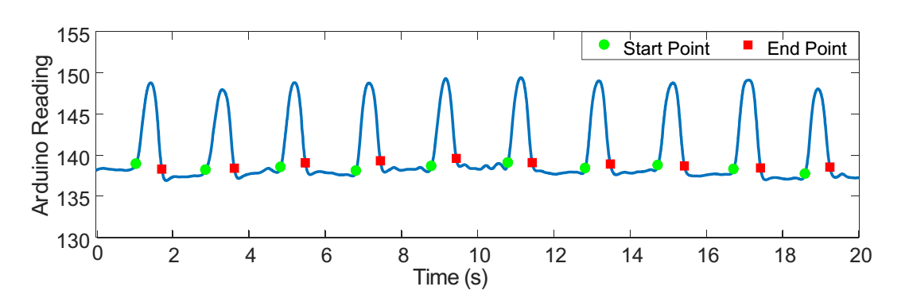
Signal processing
Notes:
Firstly let’s review how hidden screen-camera channel is achieved.
This is achieved by leveraging low-pass flicker fusion property of human eyes. Human eyes can not see flicker with frequency larger than 100Hz, but instead can only see the average lightness. So we can generate high frame rate complementary frames by complementary lightness modification to embed data frames unobtrusively into origin video. But the data frame can stilled be captured with high capturing rate cameras.
However, the hiding quality is still not good enough in related works.

Slide 18
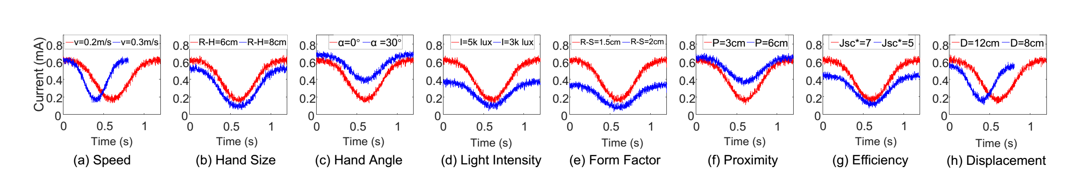
Signal processing
Notes:
Firstly let’s review how hidden screen-camera channel is achieved.
This is achieved by leveraging low-pass flicker fusion property of human eyes. Human eyes can not see flicker with frequency larger than 100Hz, but instead can only see the average lightness. So we can generate high frame rate complementary frames by complementary lightness modification to embed data frames unobtrusively into origin video. But the data frame can stilled be captured with high capturing rate cameras.
However, the hiding quality is still not good enough in related works.

Slide 19
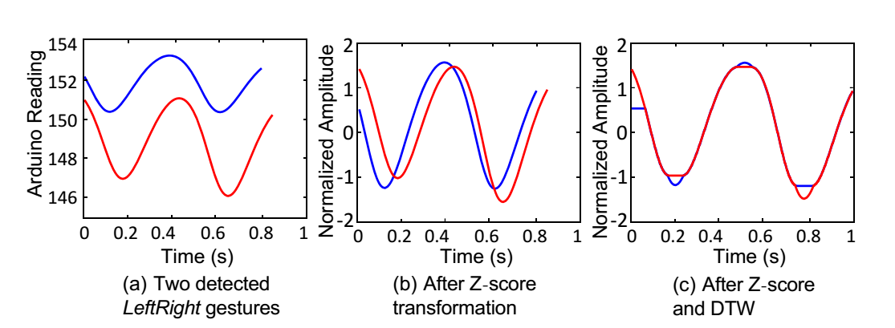
Signal processing
Z-score transformation + DTW
Notes:
Firstly let’s review how hidden screen-camera channel is achieved.
This is achieved by leveraging low-pass flicker fusion property of human eyes. Human eyes can not see flicker with frequency larger than 100Hz, but instead can only see the average lightness. So we can generate high frame rate complementary frames by complementary lightness modification to embed data frames unobtrusively into origin video. But the data frame can stilled be captured with high capturing rate cameras.
However, the hiding quality is still not good enough in related works.

Slide 20
Feature selection and classification
Statistical features: include 22 typical time and frequency domain features, such as MEAN, STD, IQR, SKEW, KURT, Q2, DominantFrequency.
DWT coefficients: Employing DWT detail coefficients as features in classification has been extensively demonstrated in a wide range of human sensing applications.
Classifiers: SVM, KNN, Decision Tree, Random Forrest.
Notes:
Firstly let’s review how hidden screen-camera channel is achieved.
This is achieved by leveraging low-pass flicker fusion property of human eyes. Human eyes can not see flicker with frequency larger than 100Hz, but instead can only see the average lightness. So we can generate high frame rate complementary frames by complementary lightness modification to embed data frames unobtrusively into origin video. But the data frame can stilled be captured with high capturing rate cameras.
However, the hiding quality is still not good enough in related works.

Slide 21
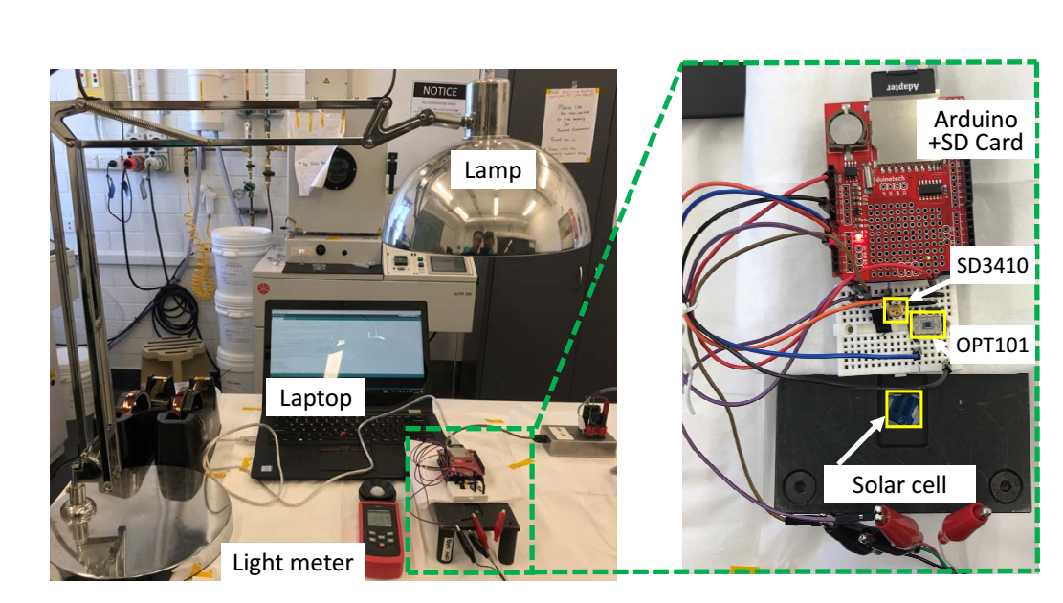
Evaluation
Notes:
Our evaluation contains two major parts, a user study part that evaluates the user perceived data hiding quality and a data transmission benchmark that measures the throughput and BER under various conditions. We select a group of videos as primary videos for experiments. A key consideration during the video selection is to find a set of representative videos with various characteristics, e.g., incorporating both plain and textured frames, involving both sharply and gradually switching scenes, containing both dark and bright scenarios, and covering both high and standard video qualities.

Slide 22
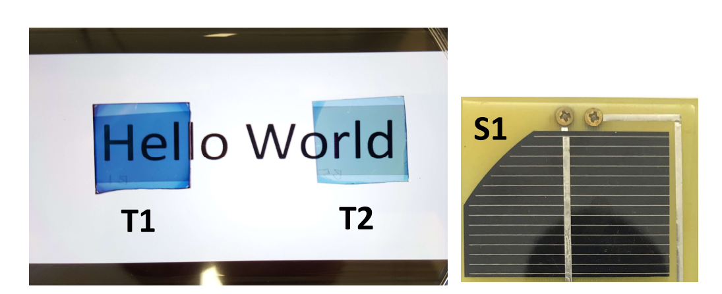
Evaluation
Notes:
Our evaluation contains two major parts, a user study part that evaluates the user perceived data hiding quality and a data transmission benchmark that measures the throughput and BER under various conditions. We select a group of videos as primary videos for experiments. A key consideration during the video selection is to find a set of representative videos with various characteristics, e.g., incorporating both plain and textured frames, involving both sharply and gradually switching scenes, containing both dark and bright scenarios, and covering both high and standard video qualities.

Slide 23
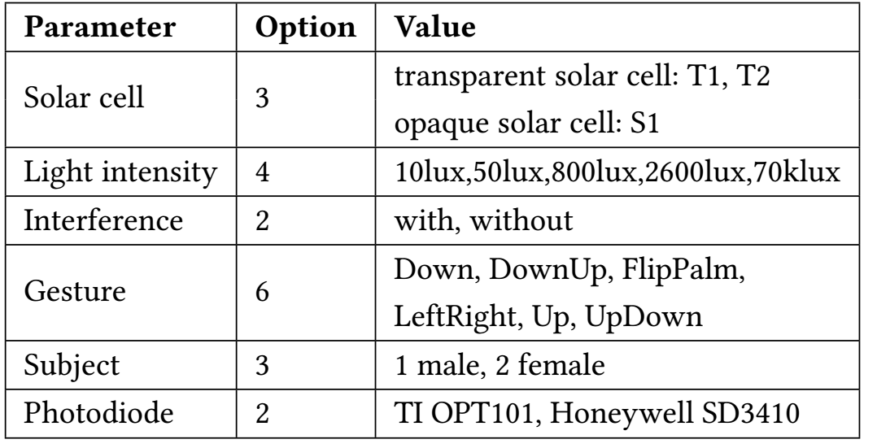
Evaluation
6960 gestures
Notes:
Our evaluation contains two major parts, a user study part that evaluates the user perceived data hiding quality and a data transmission benchmark that measures the throughput and BER under various conditions. We select a group of videos as primary videos for experiments. A key consideration during the video selection is to find a set of representative videos with various characteristics, e.g., incorporating both plain and textured frames, involving both sharply and gradually switching scenes, containing both dark and bright scenarios, and covering both high and standard video qualities.

Slide 24
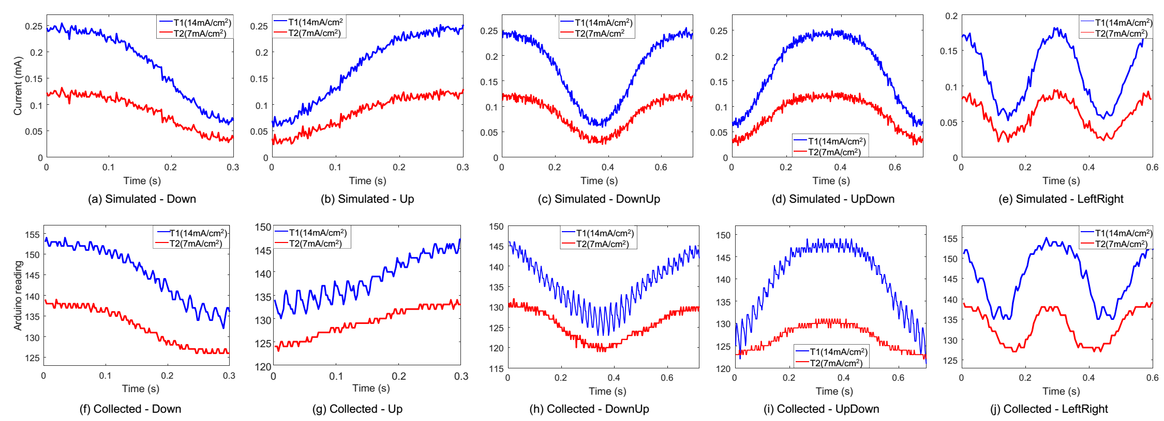
Simulated vs. Real Waveforms
our model can be an effective tool to study gesture performance of next generation solar cells under a variety of scenarios.
Notes:
Our evaluation contains two major parts, a user study part that evaluates the user perceived data hiding quality and a data transmission benchmark that measures the throughput and BER under various conditions. We select a group of videos as primary videos for experiments. A key consideration during the video selection is to find a set of representative videos with various characteristics, e.g., incorporating both plain and textured frames, involving both sharply and gradually switching scenes, containing both dark and bright scenarios, and covering both high and standard video qualities.

Slide 25
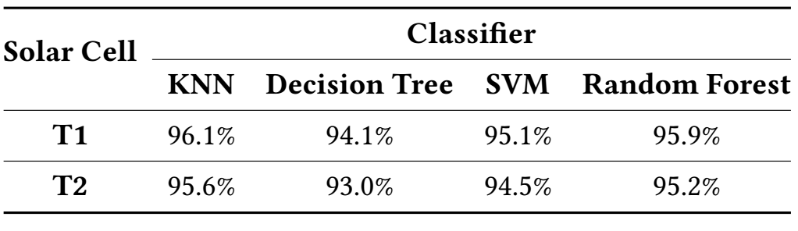
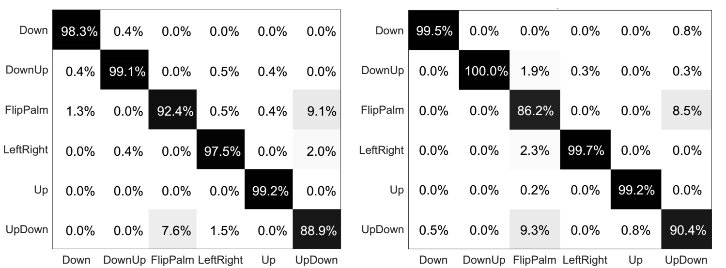
Gesture recognition performance
Notes:
Our evaluation contains two major parts, a user study part that evaluates the user perceived data hiding quality and a data transmission benchmark that measures the throughput and BER under various conditions. We select a group of videos as primary videos for experiments. A key consideration during the video selection is to find a set of representative videos with various characteristics, e.g., incorporating both plain and textured frames, involving both sharply and gradually switching scenes, containing both dark and bright scenarios, and covering both high and standard video qualities.

Slide 26
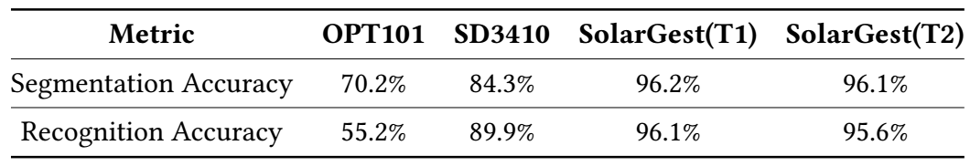
Gesture recognition performance
Notes:
Our evaluation contains two major parts, a user study part that evaluates the user perceived data hiding quality and a data transmission benchmark that measures the throughput and BER under various conditions. We select a group of videos as primary videos for experiments. A key consideration during the video selection is to find a set of representative videos with various characteristics, e.g., incorporating both plain and textured frames, involving both sharply and gradually switching scenes, containing both dark and bright scenarios, and covering both high and standard video qualities.

Slide 27
Power measurements
SolarGest: MCU sampling + data transmission
Light sensor: MCU sampling + data transmission + powering the light sensor
Notes:
Our evaluation contains two major parts, a user study part that evaluates the user perceived data hiding quality and a data transmission benchmark that measures the throughput and BER under various conditions. We select a group of videos as primary videos for experiments. A key consideration during the video selection is to find a set of representative videos with various characteristics, e.g., incorporating both plain and textured frames, involving both sharply and gradually switching scenes, containing both dark and bright scenarios, and covering both high and standard video qualities.

Slide 28
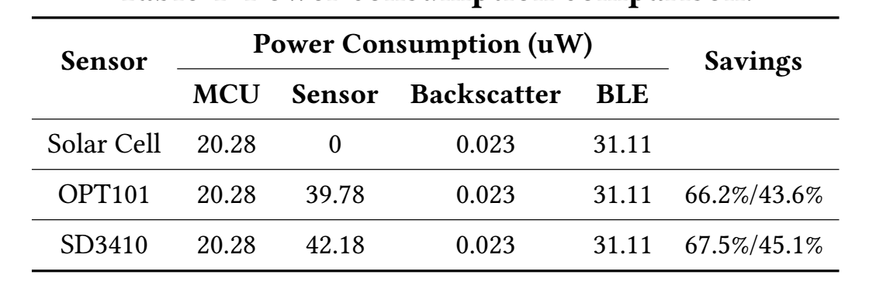
Power measurements
Notes:
Our evaluation contains two major parts, a user study part that evaluates the user perceived data hiding quality and a data transmission benchmark that measures the throughput and BER under various conditions. We select a group of videos as primary videos for experiments. A key consideration during the video selection is to find a set of representative videos with various characteristics, e.g., incorporating both plain and textured frames, involving both sharply and gradually switching scenes, containing both dark and bright scenarios, and covering both high and standard video qualities.

Slide 29
Conclusion
We have proposed SolarGest, a solar-based gesture recognition system for ubiquitous solar-powered IoTs.
Using solar energy harvesting fundamentals and geometric analysis, we derived a model that accurately simulates arbitrary hand gestures and enables estimation of gesture recognition performance under various conditions.
Employing real solar cells, both opaque and transparent, we have demonstrated that our system can detect six gestures with 96% accuracy under typical use scenarios while consuming 44% less power compared to light sensor based approach.
Notes:
To summarize, we present ChromaCode, a system that achieves all three goals on unobtrusive, high-rate, reliable screen-camera communication. We prototype ChromaCode and evaluated it by experiments. The results demonstrate its superior performance over previous schemes in terms of invisibility, throughput and BER.

Slide 30
My opinion
Few prior work on solar based gesture recognition.
Propose a mathematical model.
Simple signal processing method and simple feature extraction.
Ignore the impact of backlight on gesture recognition.
Notes:
To summarize, we present ChromaCode, a system that achieves all three goals on unobtrusive, high-rate, reliable screen-camera communication. We prototype ChromaCode and evaluated it by experiments. The results demonstrate its superior performance over previous schemes in terms of invisibility, throughput and BER.

