Slide 1
Taprint: Secure Text Input for Commodity Smart Wristbands
Wenqiang Chen, Lin Chen, Yandao Huang, Xinyu Zhang, Lu Wang, Kaishun Wu.
MobiCom 2019

Slide 2
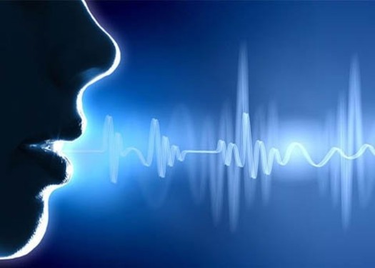
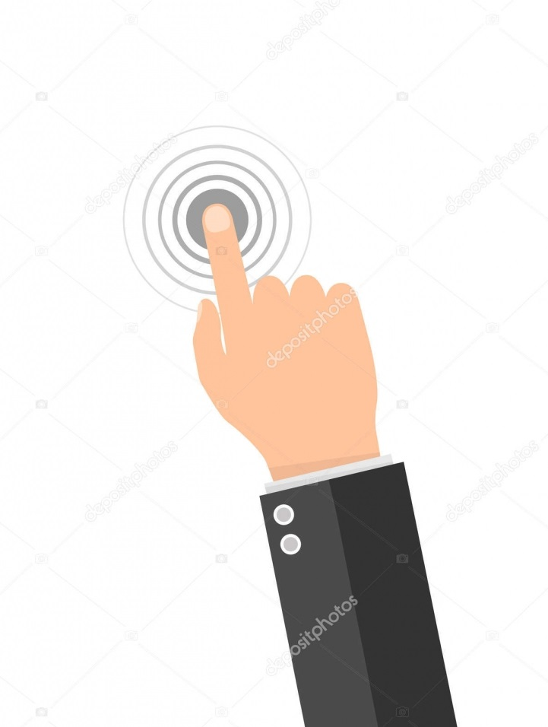

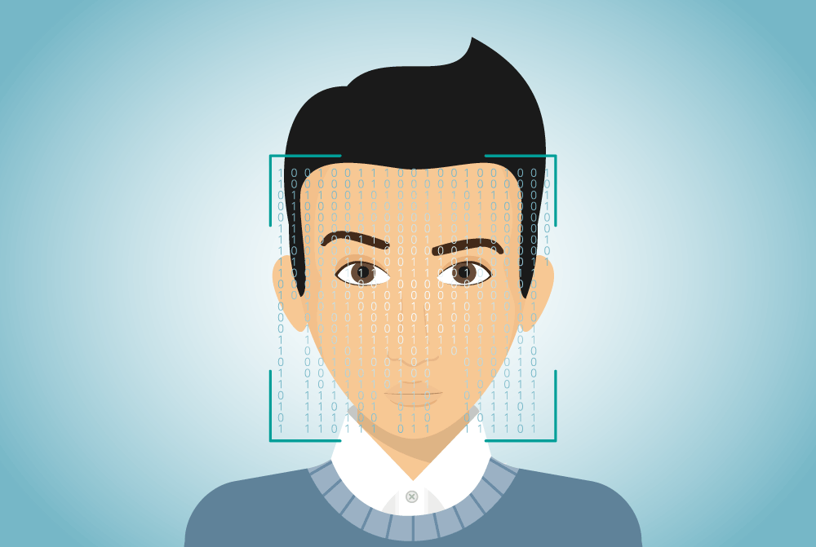
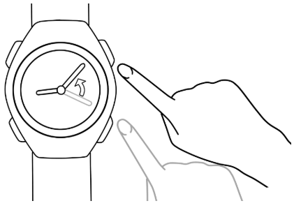
Background
Interaction Mechanism For Smart Watch
}
Voice Recognition
× Privacy
Screen Touch
}
× Cost
Fingerprint
Face Recognition
√ User-friendly
Gesture Recognition

Slide 3
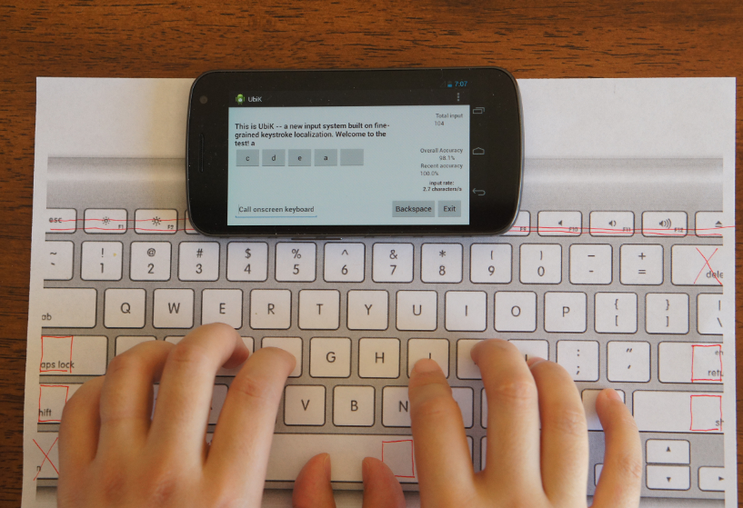
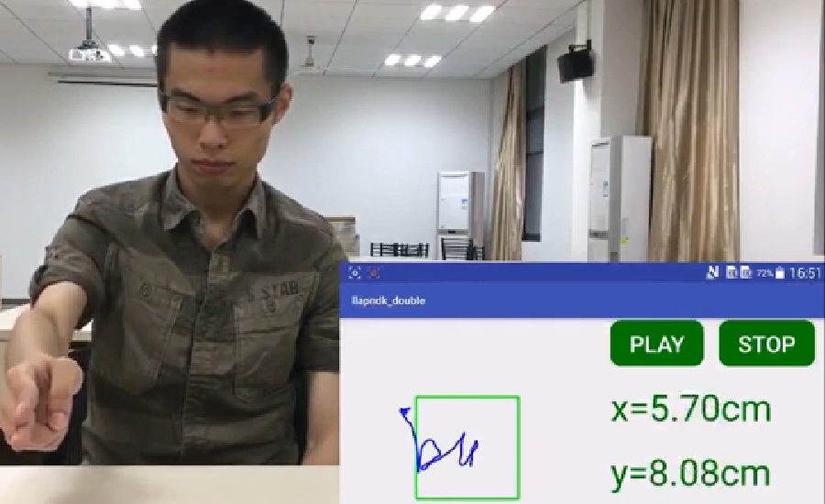
Related Work
Gesture Recognition For Smart Mobile Device
UbiK, Xinyu Zhang, et al
MobiSys 2014
LLAP, Wei Wang, et al
MobiCom 2016
Gesture Recognition Using Acoustic Signal

Slide 4
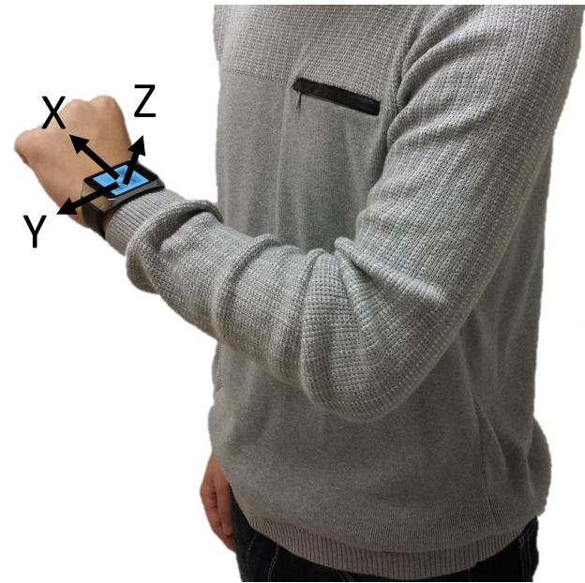
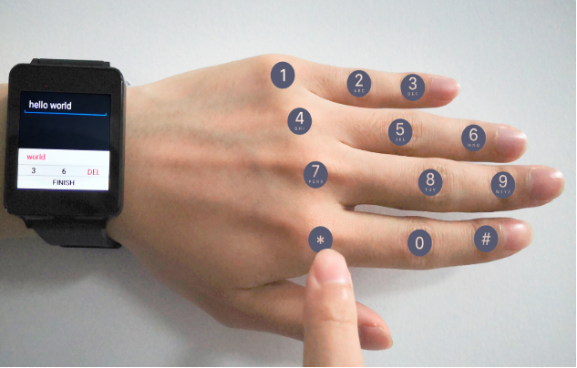
Proposed Scheme
Gesture Recognition With IMU On Smart Watch
Tapping on different knuckles would possibly induce different IMU readings in smart watch on wrist due to the discrepancy between fingers.
Text input and user authentication could potentially be enabled by IMU readings

Slide 5
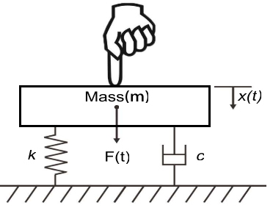




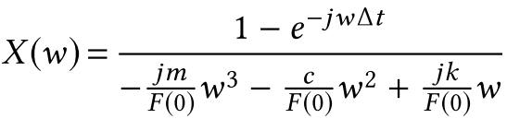
Tapping Model
Physical Model of Tapping on Fingers
Fingers are model with rigid body connected to static mass with springer and damping
Vibration after tapping may be featured by the inherent attribute of fingers

Slide 6
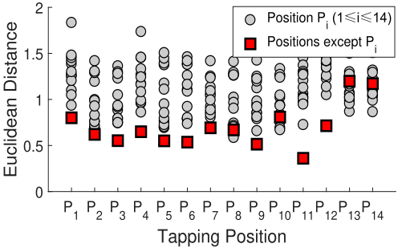
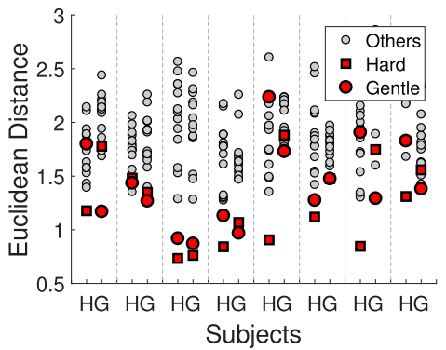
Feasibility Study
IMU Reading Induced By Tapping
Vibration at different locations
Vibration with different strength
Discrepancy of fingers from each user enables text input

Slide 7
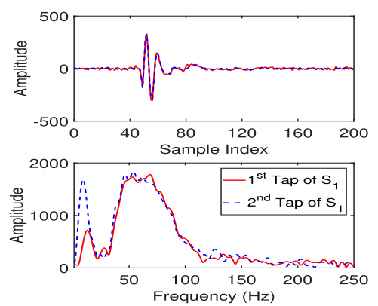
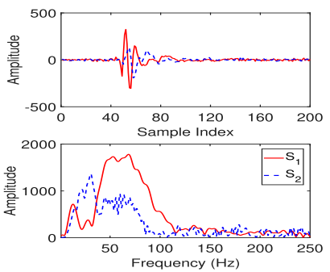
Feasibility Study
IMU Reading Induced By Tapping
Vibration profile of time and frequency domain from single people
Vibration profile of time and frequency domain from two people
Discrepancy of fingers from different people enables user authentication

Slide 8
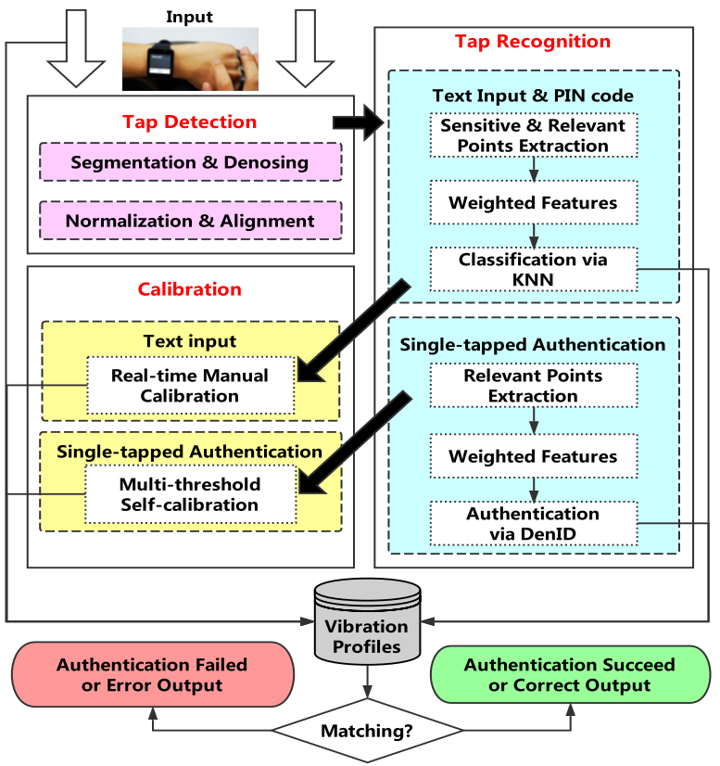
System Overview
Signal pre-process
Feature Extraction
Classification

Slide 9
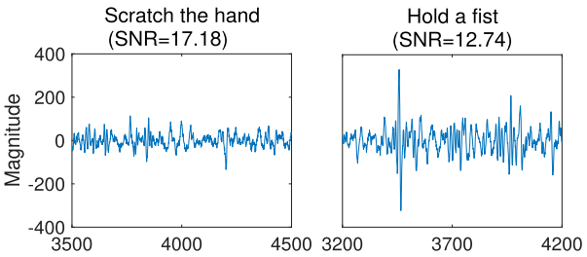
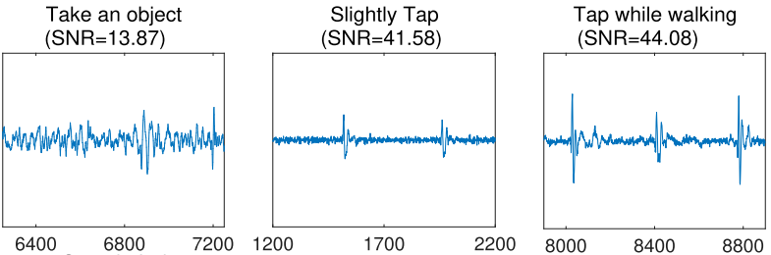
Pre-processing
LPF is applied to partially remove signal vibration induced by torso movement;
Amplitude normalization is applied to partially compensate tapping strength;
SNR is used to differentiate tapping and other human activities;
Signal is segmented by SNR threshold

Slide 10
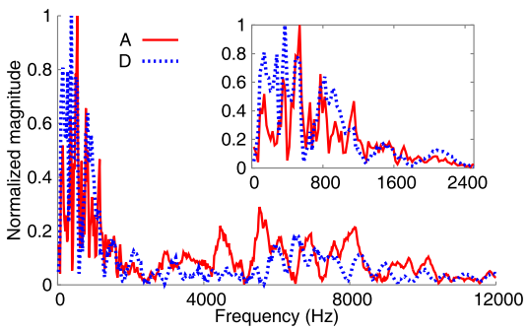
Feature Extraction
ASD Features Tapping Attributes
Directly feed ASD(Amplitude Spectral Density) into Deep Learning architecture generate much computational complexity and noise
Raw Frequency Spectrum Should Be Condensed Before Feed Into Classifier

Slide 11
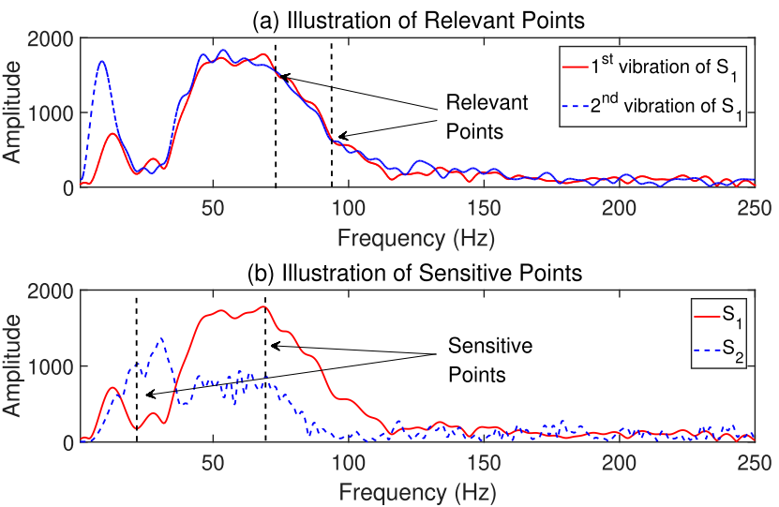
Feature Extraction
Assign Weight To ASD To Mitigate Noise Data
Location-relevant points change little between multiple tapping on single knuckle;
Location-sensitive points change a lot between tapping on different knuckles;
Location-relevant And Location-sensitive Frequency Points Feature Tapping Better

Slide 12
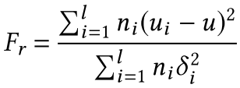
Feature Extraction
How To Assign Weights To Frequency Points?
The ascent ratio of projection line represents the importance of each dimension of feature
Fisher Score is used to determine the importance of each dimension of feature in Machine Learning
Fisher-Score Is An Ideal Parameter To Illustrate The Importance Of Dimensions Of Feature

Slide 13
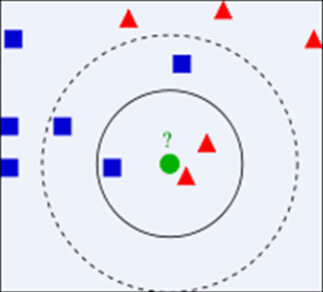

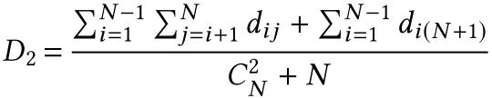
Classification
Text Input
User Authentication
Weighted ASD feature is feed into KNN classifier to recognize tapping positions
Feature density of tapping on specific knuckle is static for individuals
Mathematical Classifier Rather Than DL Is Adopted To Avoid Computational Complexity

Slide 14
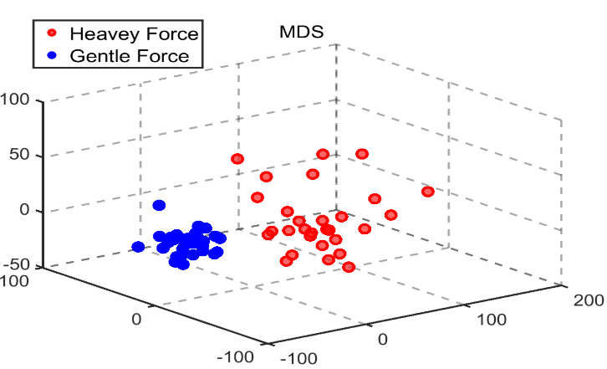
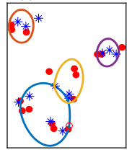
Classification
Tapping Strength Adaptation
Text Input
User Authentication
By adding manually corrected text input case, KNN is robust to touching strength variance.
Inspired by fingerprint sensor calibration on smartphones, users are required to collect variety strength of training data, which are clustered into multi-threshold classes.
Strength Adaptation Can Be Achieved By Real Time Calibration And Multi-threshold Self-calibration

Slide 15
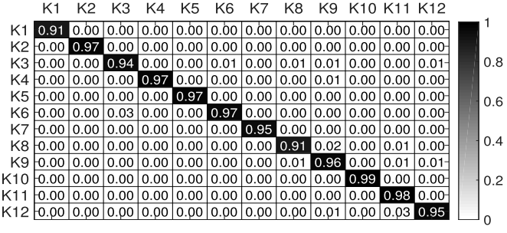
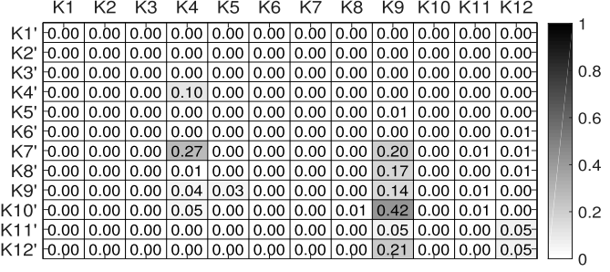
Evaluation
Overall
An average accuracy of 95.64% is achieved for twelve keys
Taprint can hardly work for adversaries
Taprint Can Both Achieve Input And Authentication Goals

Slide 16
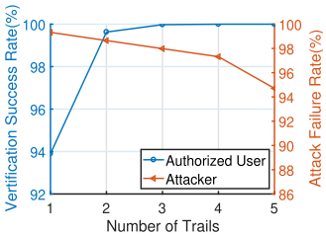
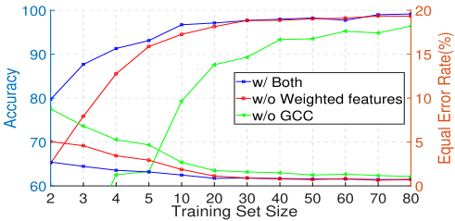
Evaluation
Parameter Study
Text Input
User Authentication
System security can still hold for up to 5 times of trials
With little training data, Taprint can achieve satisfying authentication performance

Slide 17
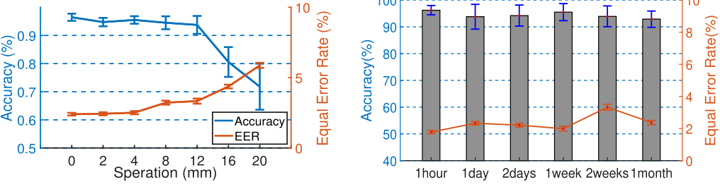
Evaluation
Parameter Study
Taprint is robust to watch displacement and time shift

Slide 18
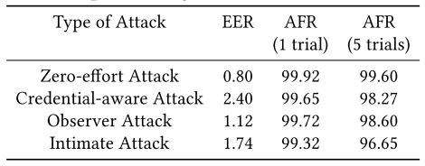
Evaluation
Security Analysis
Zero-effort Attack: No knowledge of PIN, authentication knuckle and key-to-knuckle mapping;
Credential-aware Attack: Know PIN and authentication knuckle;
Observer Attack: Know all;
Intimate Attack: Know all and have access to legitimate user’s hand;
Taprint Can Provide High-level Secure Human-Computer-Interaction

Slide 19
Discussion
Fancy idea
Solid verification
Intuitive solution
Broad application prospect

Slide 20
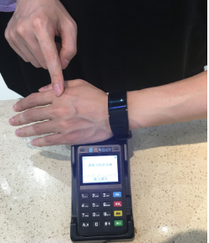
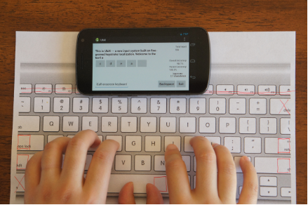
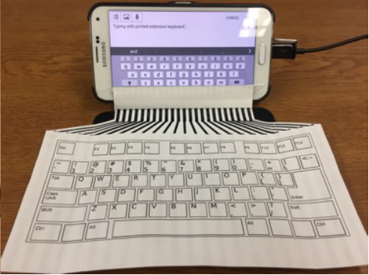
Discussion
Xinyu Zhang’s Keystroke Recognition Papers
UbiK, MobiSys2014
InkPut, MobiCom2018
Taprint, MobiCom2019
Acoustic-based
Capacitive sensor-based
IMU-based
Observation -> Modeling -> Feasibility Study -> Feature Extraction -> Classification -> Evaluation
Other sensors-based keystroke recognition: Bluetooth/Wi-Fi/NFC/…

