Slide 1
Edge Assisted Real-time Object Detection for Mobile Augmented Reality

Slide 2
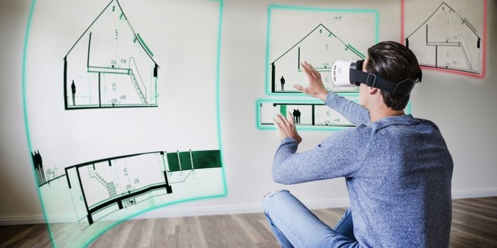

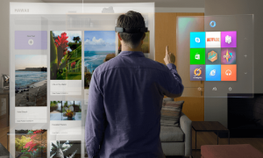
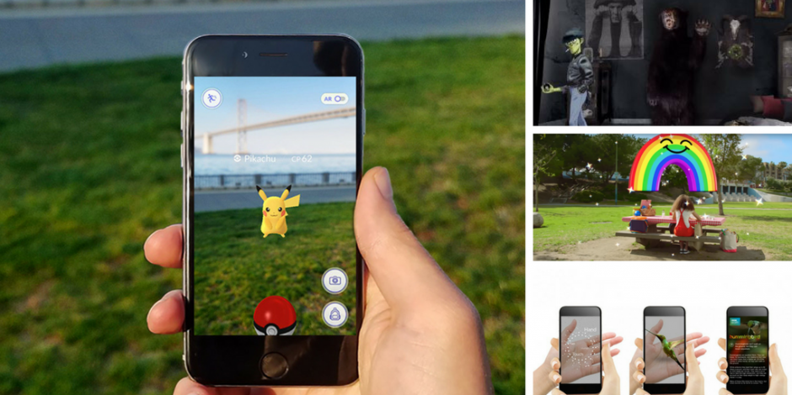
Augmented/Mixed Reality
Notes:
AR的出现丰富了人们的生活

Slide 3

Mobile AR/MR
ARKit & ARCore Solutions
Understand 3D geometry
Detect surfaces
……
Classical CV algorithms
HoloLens 2
Edge assisted Solutions
Image Classification
Object Detection
Instance Segmentation
Notes:
移动端AR的不同实现方式 利用手机上的Arcore与Arkit开发框架，使用传统CV算法来实现
利用边缘节点或者服务器的能力来进行复杂的运算

Slide 4
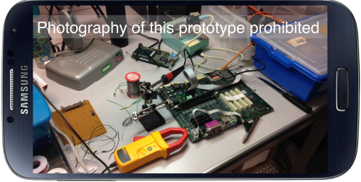
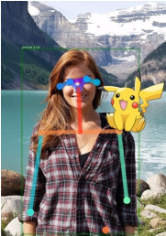
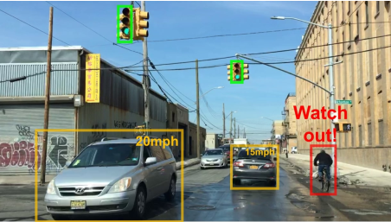
Edge Assisted Mobile AR/MR
Classification
Detection
Segmentation

Slide 5
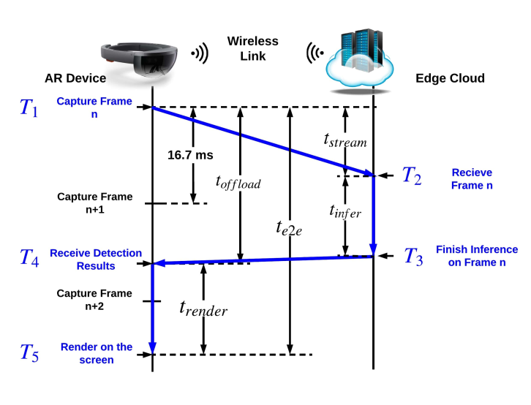
Challenges & Analysis
Latency
Unable to run at 60fps
Notes:
当然了，利用边缘协作AR还面临着很多的挑战

Slide 6
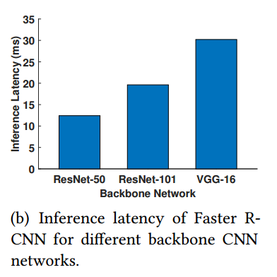
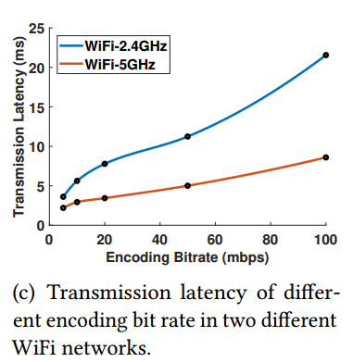
Challenges & Analysis
Latency & Accuracy
Unable to run at 60fps (mainly caused by Transmission & Inference)
Notes:
跑得慢的原因

Slide 7
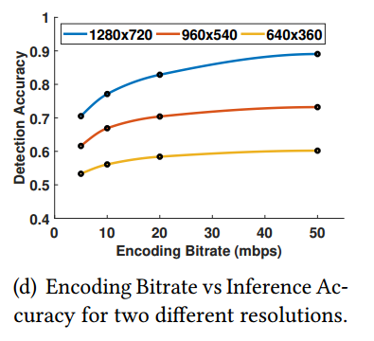
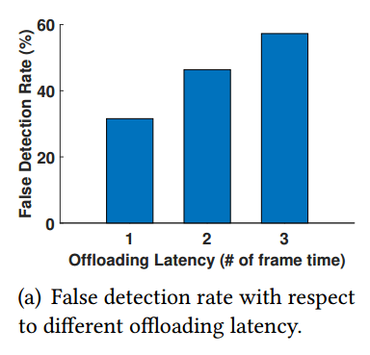
Challenges & Analysis
Latency & Accuracy
Unable to run at 60fps (mainly caused by Transmission & Inference)
Latency harms Accuracy (calculate IoU)
Notes:
跑得慢带来了精度上的大幅度降低

Slide 8
Observations & Solutions
Dynamic RoI Encoding
Adaptive Offloading
Object Tracking
Parallel Streaming and Inference

Slide 9
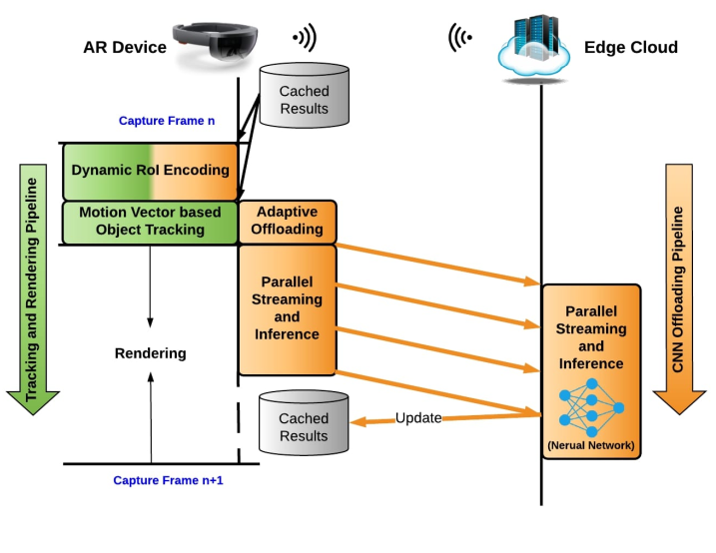
Observations & Solutions

Slide 10
Observations & Solutions

Slide 11
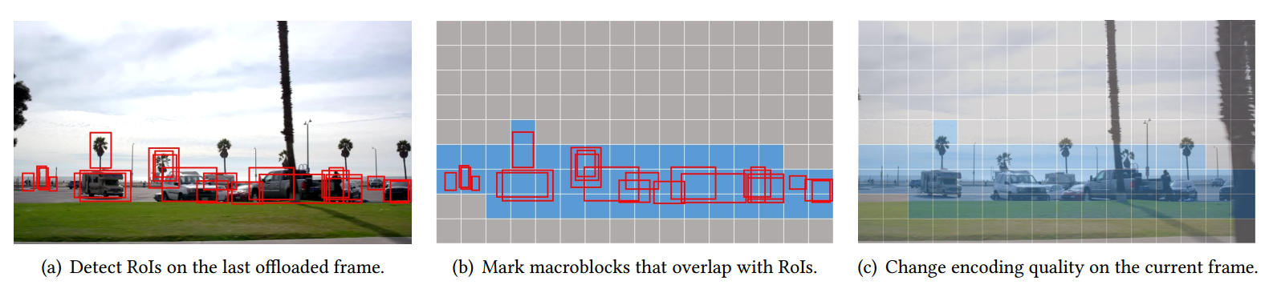
Dynamic RoI Encoding
RoI (Region of Interests)
Used in object detection like R-CNN
Used in video compression for streaming like H.264, H.265
Exploit this similarity and tie these two concepts together!
Notes:
RoI在两种技术之中都经常使用

Slide 12
Observations & Solutions

Slide 13
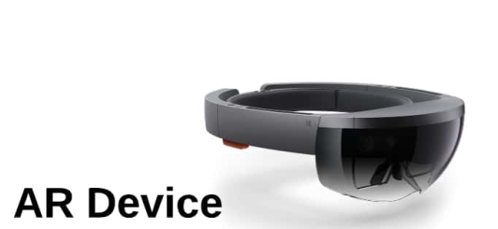


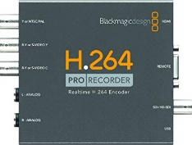
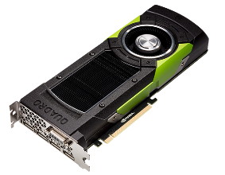
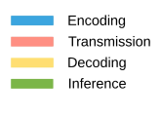
Parallel Streaming and Inference
Different tasks require different resources

Slide 14
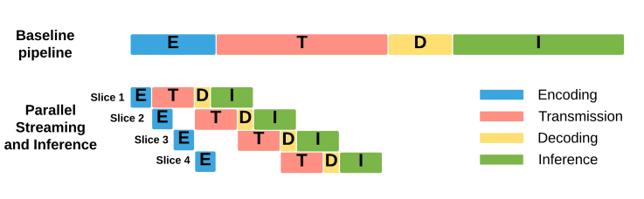
Parallel Streaming and Inference
Different tasks require different resources
Parallel Encoding + Transmission + Decoding

Slide 15
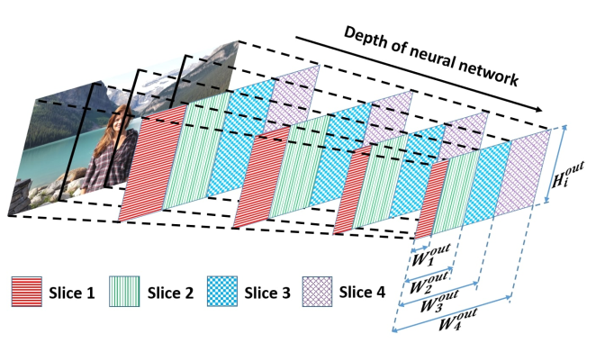
Parallel Streaming and Inference
Different tasks require different resources
Parallel Encoding + Transmission + Decoding
Parallel Inference: Dependency Aware Inference

Slide 16
Observations & Solutions

Slide 17
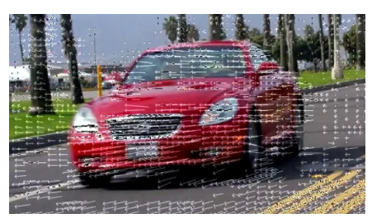
Moving Vectors based Object Tracking
Motion vector
Broadly used by modern video encoding approaches like H.264, H.265
Indicate the offset of pixels among frames

Slide 18
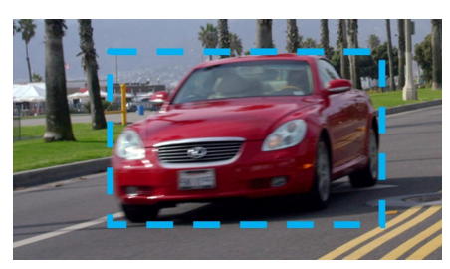
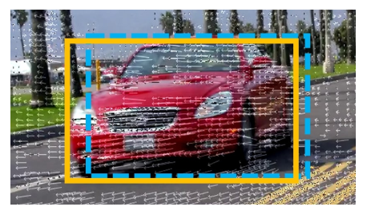
Moving Vectors based Object Tracking
Motion vector
Coarse object tracking with motion vector
Shift the bounding box

Slide 19
Observations & Solutions

Slide 20
Adaptive offloading
Two principles
Previous offloaded frame has been completed received by the edge cloud
Require the system to be aware of the transmission latency
Current frame differs significantly from the last offloaded frame
Whether large motions (Sum of all motion vectors)
Whether considerable amounts of changed pixels (number of intra-predicted macroblocks)

Slide 21
Implementation & Evaluation
Client
Nvidia Jetson TX2 + Camera API
Server
Intel 8700K CPU + Nvidia Titan XP GPU
Frame
1280 * 720 resolution
Router
TP-Link AC1900
2.4G + 5G

Slide 22
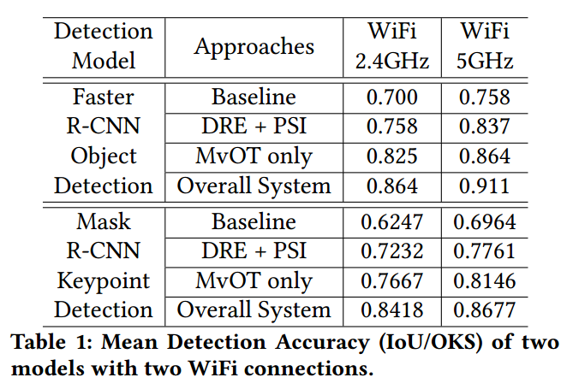
Implementation & Evaluation
Overall Performance

Slide 23
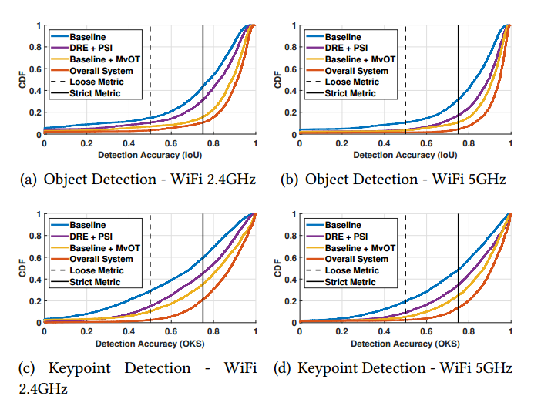
Implementation & Evaluation
Overall Performance

Slide 24
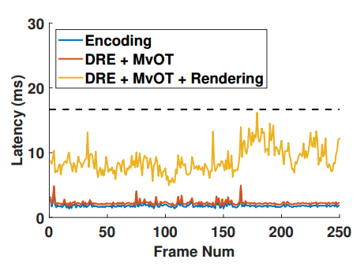
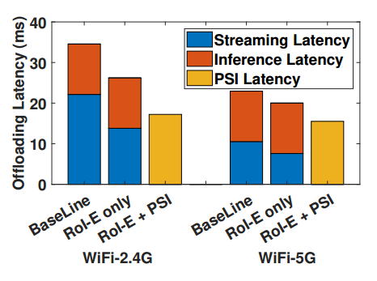
Implementation & Evaluation
Latency
60fps

Slide 25
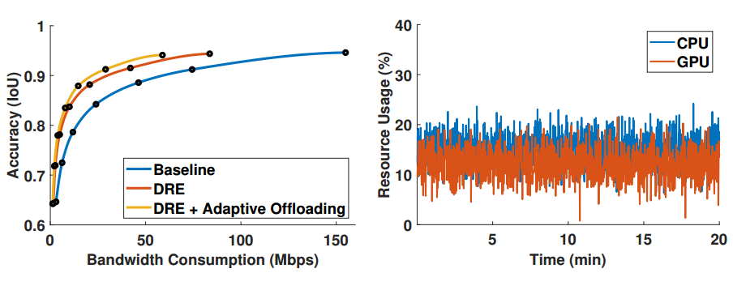
Implementation & Evaluation
Resource Consumption

Slide 26
Conclusion
第一个利用边缘协作模式实现实时物体检测的移动AR工作
边缘协作AR：移动端+服务端+传输端
移动端：Adaptive Offloading
传输端：Dynamic RoI Encoding
服务端：Parallel Streaming and Inference
实验比较充分，突出强调了实时性，很有启发
论文书写
Section 2 细致分析了延时性的来源，并且做了实验量化分析，靶子立得很明确，显得文章很有说服力

Slide 27
Conclusion
这篇文章还是属于直接在结果上复用，是目标导向的。不像DeepCache那种，在运算上复用，任务导向。
很多点比如Dynamic Encoding, Moving Vector都已经是H.264标准的一部分，感觉贡献体现在任务调度并行上
一些小问题
Dynamic RoI Encoding不是在某种程度上增加了移动端和服务端的编解码延时？同时就算图片分辨率低也不会降低系统运算的速度
Adaptive Offloading的标准有点过于粗暴
本质上还是使用上一帧的运算结果+Moving vector计算这一时刻应该在的位置，还是不太能实现实时计算+渲染当前帧的目标，另外光流法本身也不是太准

Slide 28
Conclusion

Slide 29
Conclusion
继续从三个端的角度分别进行优化，并且考虑彼此促进的可能性
移动端：利用VO较准确知道物体大概位置，减少需要Adaptive Offloading 需要计算的帧数
传输端：每张图只传输需要计算的部分？
服务端：利用缓存（只计算需要计算的部分），修改网络（如RPN部分）来加速计算？

Slide 30
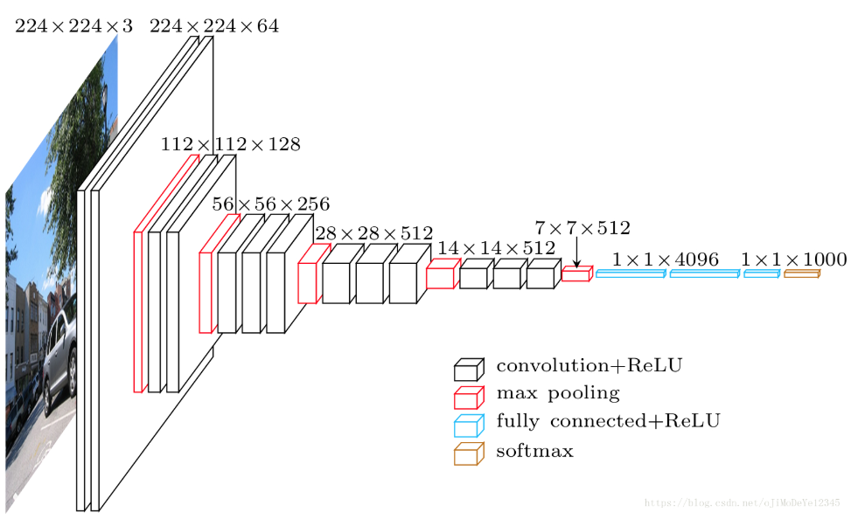
VGG16 Architecture
Used for Faster RCNN or Mask RCNN
原图上每一个点最多和周围16个点产生运算上的关联

Slide 31
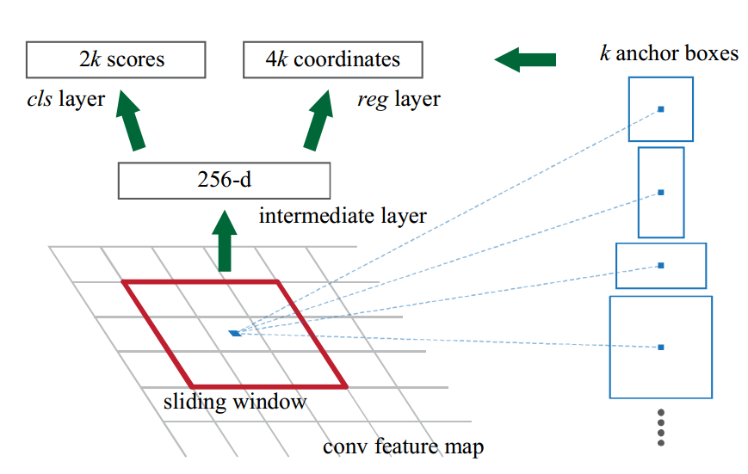
RPN Architecture
如果已经知道物体的大概位置，是否还需要每一个anchor都生成 k 个搜索区域去搜索呢？

Slide 32
Thanks!
Q&A
Jingao Xu
Tsinghua University
xujingao13@gmail.com

