Slide 1
TOAST： Ten-Finger Eyes-Free Typing on Touchable Surfaces
Weinan Shi，Chun Yu， Xin Yi， Zhen Li， Yuanchun Shi
Notes:
Thanks for the introduction. Good afternoon everyone, I’m Weinan Shi from Tsinghua University. I’m very happy to present our work: TOAST: Ten-finger eyes-free typing on touchable surfaces.

Slide 2
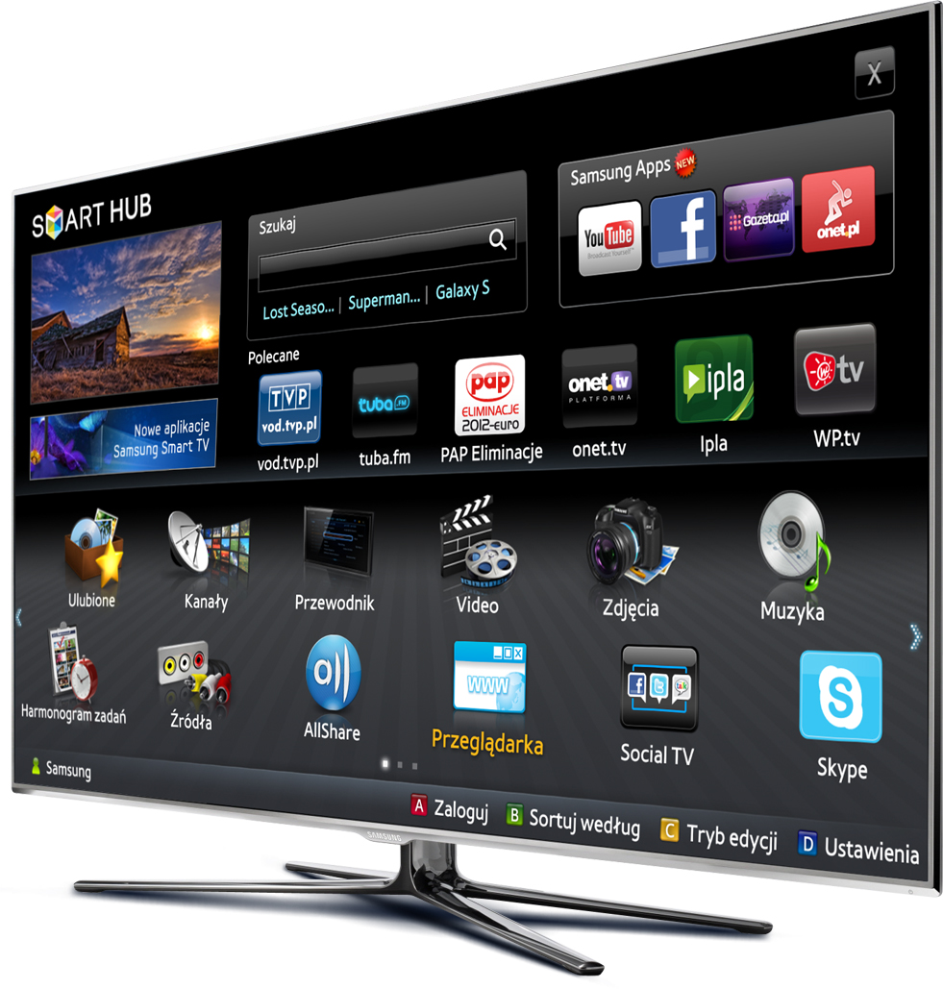
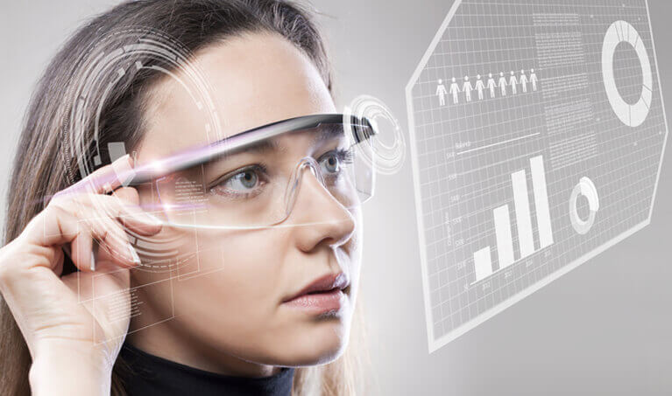
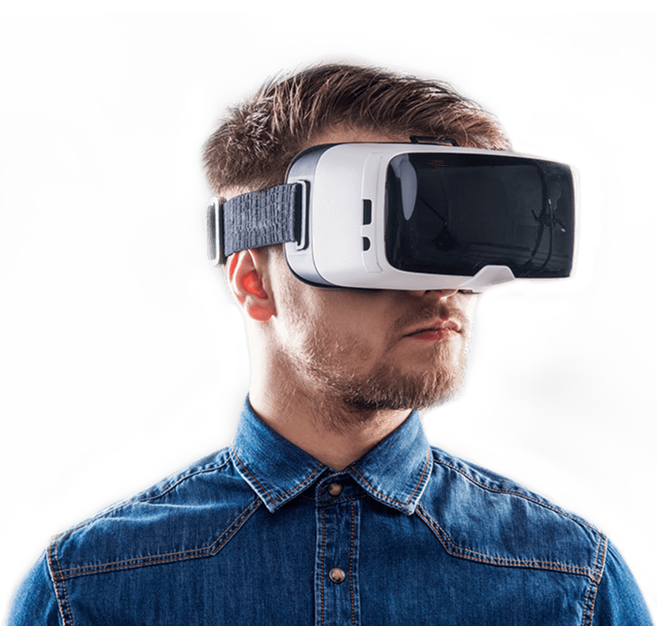
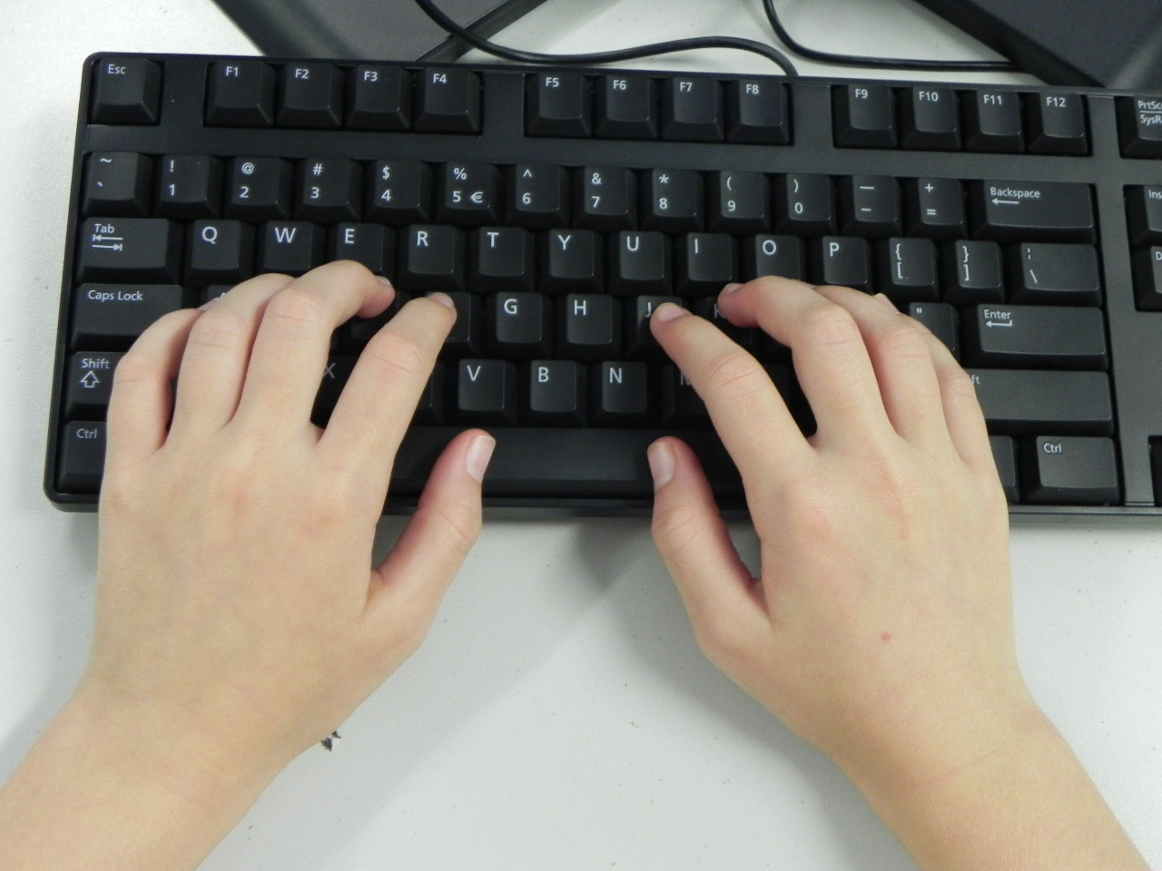
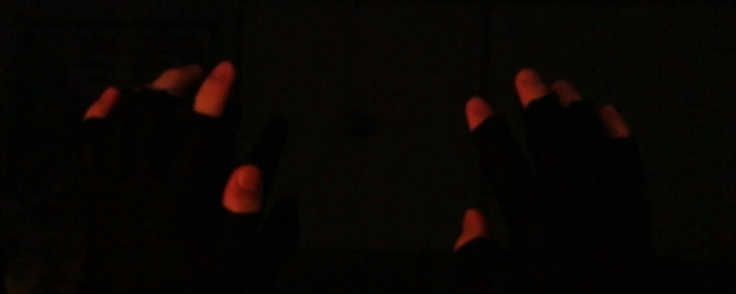
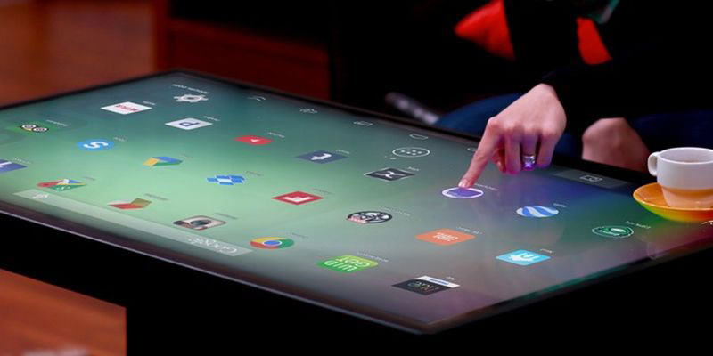
Background
Notes:
With the popularity of ubiquitous computing environments, the need for text entry under these scenarios has increased significantly. However, the challenge of providing text entry experience with high efficiency still bothers users and researchers. Among possible alternatives, ten-finger typing on a flat surface offers a natural and potentially most efficient text entry experience, (动画） as users are able to transfer their muscle memory from physical keyboards to this scenario.

Slide 3
Notes:
In this paper, we present a technique， TOAST， which can support ten-finger eyes-free typing on flat surfaces, as shown in the video.

Slide 4
Challenges
No visual keyboard
Low touch accuracy
Hand drifting
Notes:
Specifically, TOAST can solve the challenges mentioned before.

Slide 5
Challenges
No visual keyboard Keyboard parameter fitting
Low touch accuracy
Hand drifting
Notes:
we found the invisible keyboard by fitting the parameters of user’s keyboard.

Slide 6
Challenges
No visual keyboard Keyboard parameter fitting
Low touch accuracy Input prediction algorithm
Hand drifting
Notes:
Developed an input prediction algorithm to reduce the input noise of user’s input.

Slide 7
Challenges
No visual keyboard Keyboard parameter fitting
Low touch accuracy Input prediction algorithm
Hand drifting Dynamic adaption strategy
Notes:
And performed a dynamic adaption strategy for hand drifting problem.

Slide 8
Outline
Related Work
Problem Definition
Examining Behavior
Input Prediction Algorithm
Evaluation
Conclusion

Slide 9
Outline
Related Work
Problem Definition
Examining Behavior
Input Prediction Algorithm
Evaluation
Conclusion

Slide 10
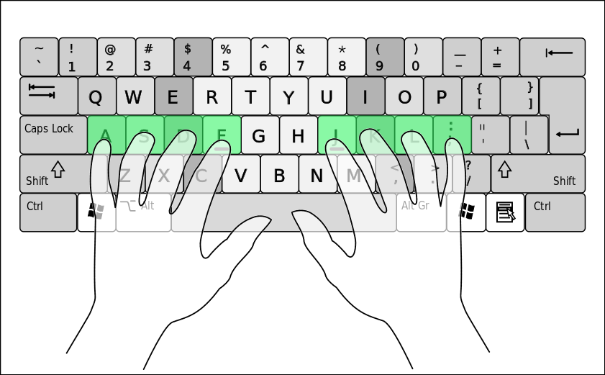
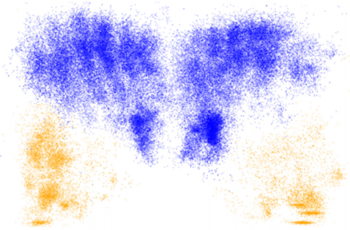
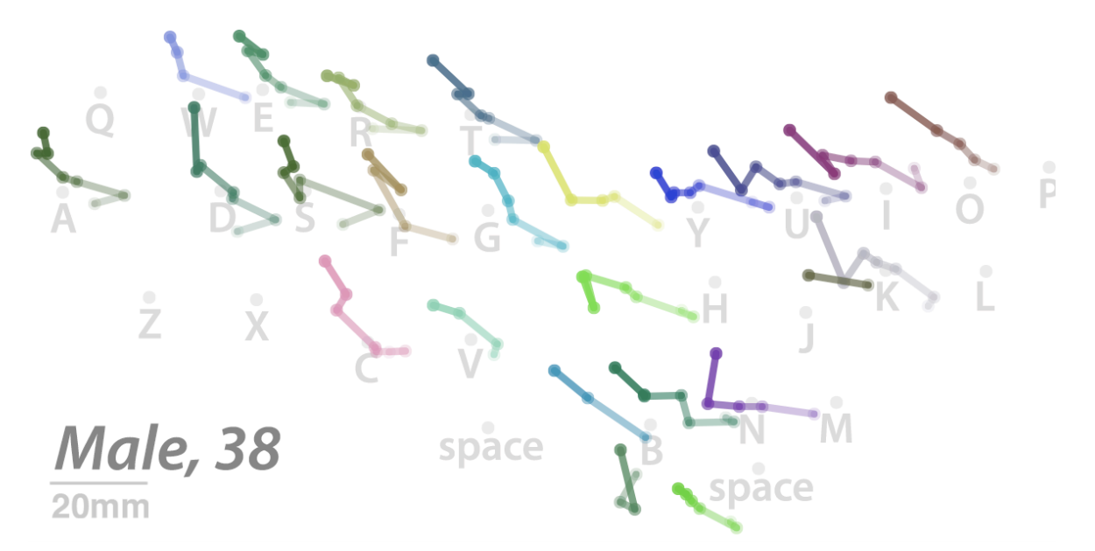
Understanding Ten-finger Typing Behavior
Touch typing
Typing on flat glass
Hand drifting
[1] https://en.wikipedia.org/wiki/Touch_typing
[2] Leah Findlater, Jacob O Wobbrock, and Daniel Wigdor. 2011. Typing on flat glass: examining ten-finger expert typing patterns on touch surfaces.
[3] Frank Chun Yat Li, Leah Findlater, and Khai N Truong. 2013. Effects of hand drift while typing on touchscreens.
Notes:
Ten-finger typing on a physical keyboard is very common for inputting text. Usually, users can leverage the muscle memory and the tactile feedback to input text eyes-freely, which is so-called touch typing. However, it is difficult for users to transfer this experience to a soft keyboard due to the lack of tactile feedback. This will lead to imprecision of touch and hand drifting, thus resulting in a much lower text entry speed.

Slide 11
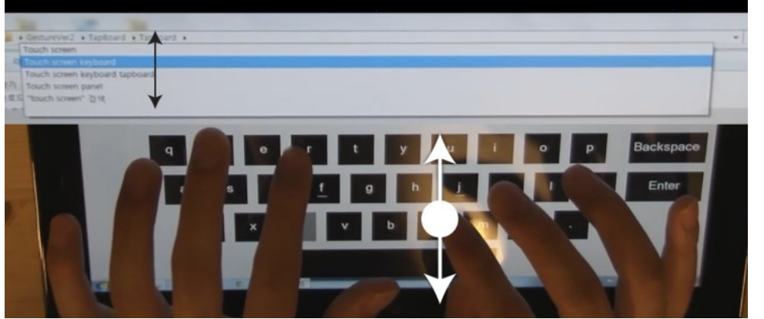
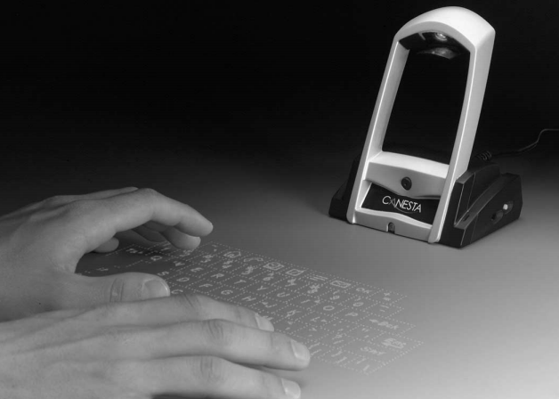
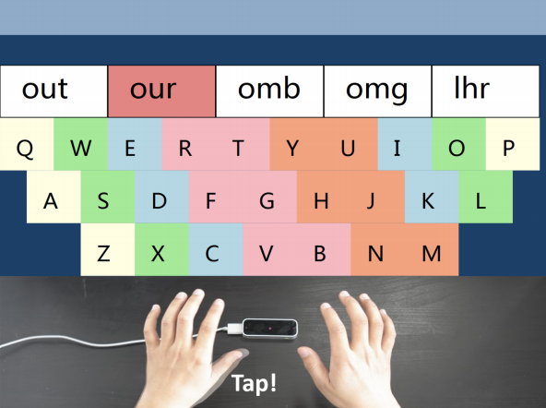
Ten-finger Typing Techniques
TapBoard
Typing in the air
ATK
[1] Sunjun Kim, Jeongmin Son, Geehyuk Lee, Hwan Kim, and Woohun Lee. 2013. TapBoard: making a touch screen keyboard more touchable.
[2] Helena Roeber, John Bacus, and Carlo Tomasi. 2003. Typing in thin air: the canesta projection keyboard-a new method of interaction with electronic devices.
[3] Xin Yi, Chun Yu, Mingrui Zhang, Sida Gao, Ke Sun, and Yuanchun Shi. 2015. Atk: Enabling ten-finger freehand typing in air based on 3d hand tracking data.
Notes:
TapBoard允许把手放在屏幕上，通过识别手指的敲击来识别按键，但是他们都不是在正常的键盘布局上打字，所以人们不那么容易适应。

Slide 12
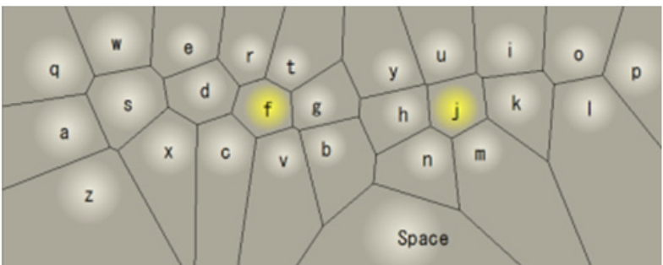
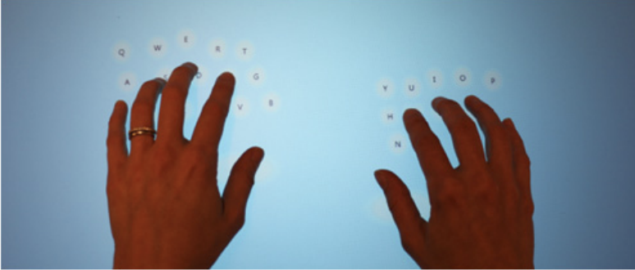
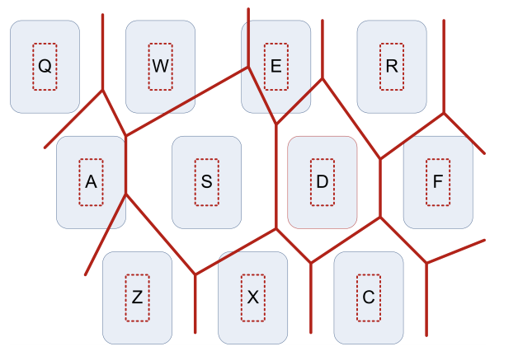
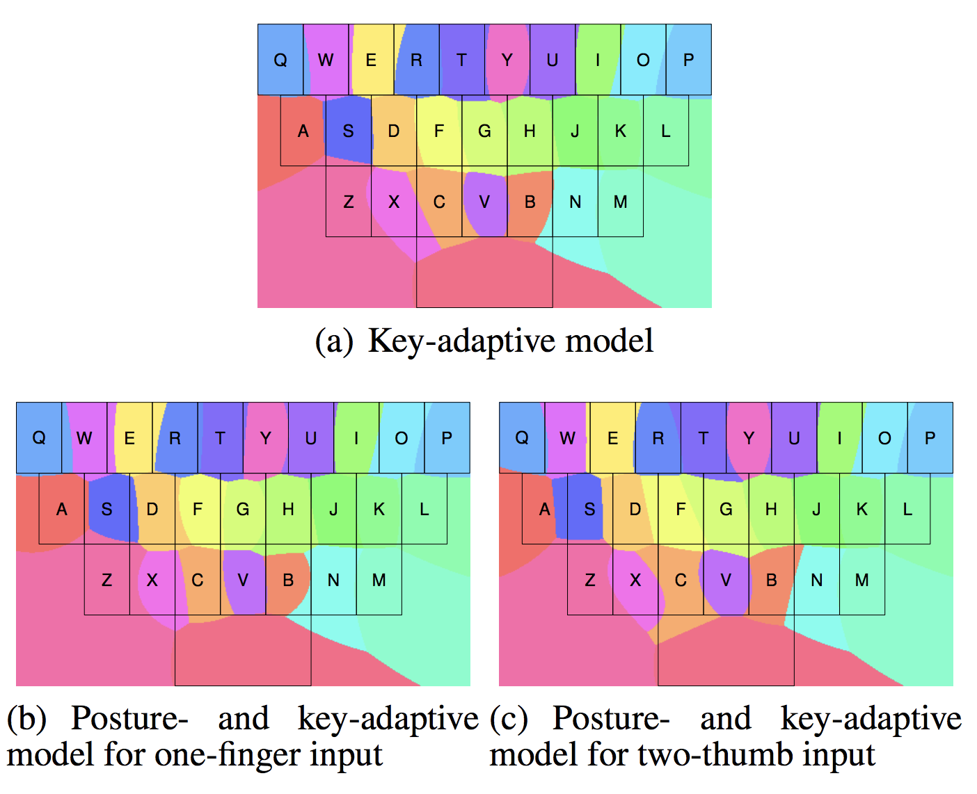
Adaptive Keyboard
[1] Kentaro Go and Yuki Endo. 2007. CATKey: customizable and adaptable touchscreen keyboard with bubble cursor-like visual feedback.
[2] Leah Findlater and Jacob Wobbrock. 2012. Personalized input: improving ten-finger touchscreen typing through automatic adaptation.
[3] Asela Gunawardana, Tim Paek, and Christopher Meek. 2010. Usability guided key-target resizing for soft keyboards.
[4] Ying Yin, Tom Yu Ouyang, Kurt Partridge, and Shumin Zhai. 2013. Making touchscreen keyboards adaptive to keys, hand postures, and individuals: a hierarchical spatial backoff model approach.
Notes:
同样也有一些工作也提出了在用户打字的时候，键盘的大小自适应地改变，但是他们都需要眼睛看，也就是不支持eyse-free的场景。所以本文就克服了这两类工作的缺陷。

Slide 13
Outline
Related Work
Problem Definition
Examining Behavior
Input Prediction Algorithm
Evaluation
Conclusion

Slide 14
Outline
Related Work
Problem Definition
Examining Behavior
Input Prediction Algorithm
Evaluation
Conclusion
Notes:
Then we will give a formal definition of the problem.

Slide 15
Keyboard Model
Location
Size
Orientation
Shape
: 0
: Rectangle
Noise: Normal
[1] Shiri Azenkot and Shumin Zhai. 2012. Touch behavior with different postures on soft smartphone keyboards.
Notes:
首先我们对问题进行一个定义。外框的x轴y轴是指屏幕的左上角。
下面这个长方形就是用户心中的键盘，之所以说是心中的键盘，是因为这个键盘人眼实际上是看不见的。
Location是某个固定按键的中心点的坐标，比如Q
Size是指每个按键的长度和宽度
Orientation是指键盘和水平方向的角度
Noise是指用户在按键的时候，不一定总是敲击按键的中心，到中心的偏差就看做噪声。
为了简化模型，作者提出了三个假设。
一个是旋转角度为0，键盘的形状是长方形，噪声符合正态分布。接下来作者就设计了实验来验证这三个假设是合理的。

Slide 16


Keyboard Model
$${index}_{x}$$
Location
Size
Orientation: 0
Shape: Rectangle
$${index}_{y}$$
Noise: Normal
position = offset + size * index + noise
Notes:
而其中只有offset和size是不确定的，也就是Q的坐标和按键的按键的大小，需要设计模型把他们两个求出来。

Slide 17

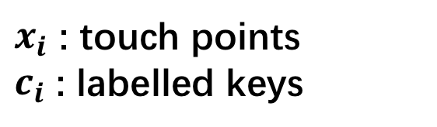

Fitting Keyboard Parameters
$$\left(\hat{x},\hat{s_{x}}\right)$$
$$=\underset{(x, s_{x})}{arg max}{P\left(x_{1}⋯x_{n}\right|c_{1}⋯c_{n})} =\underset{(x, s_{x})}{arg max}{\prod_{i=1}^{n}{P(x_{i}|c_{i})}}=\underset{(x, s_{x})}{arg max}{\prod_{i=1}^{n}{\frac{1}{\sqrt{2π}σ}exp(−\frac{{\left(x_{i}−μ_{i}\right)}^{2}}{2σ^{2}})}}=\underset{(x, s_{x})}{arg min}{\sum_{i=1}^{n}{{\left(x_{i}−μ_{i}\right)}^{2}}}=\underset{(x, s_{x})}{arg min}{\sum_{i=1}^{n}{{\left(x_{i}−x−s_{x} ∙k_{xi}\right)}^{2}}}$$
$x_{i}$ : touch points
$c_{i}$ : labelled keys
Notes:
手按键的位置和对应的按键的中心的距离是服从高斯分布的。容易知道x轴和y轴的公式是一样的，

Slide 18
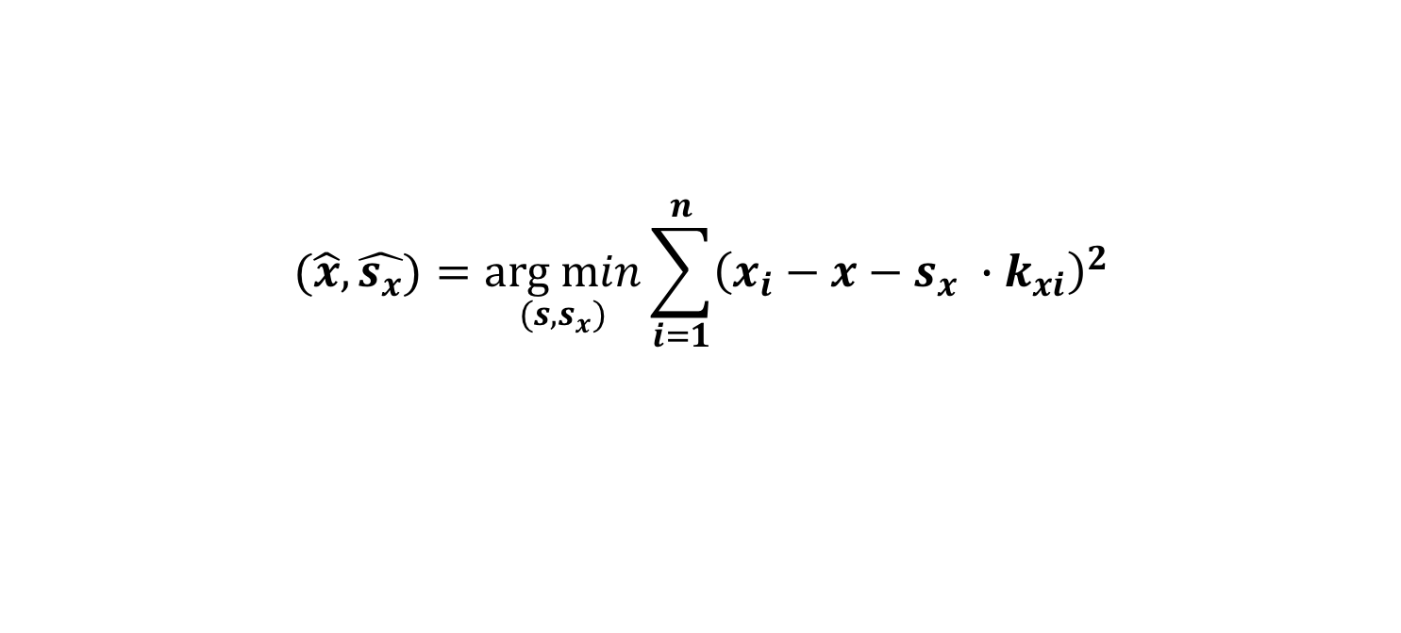
Fitting Keyboard Parameters
$$(\hat{x},\hat{s_{x}})=\underset{(s, s_{x})}{arg min}{\sum_{i=1}^{n}{{\left(x_{i}−x−s_{x} ∙k_{xi}\right)}^{2}}}$$
$R^{2}=1$ => Keyboard shape is rectangle
Notes:
可以看出这就是一个最小二乘法的拟合问题。通过拟合可以知道x和sx，也就是按键Q的坐标和按键的大小。
这个R^2代表拟合的好坏程度，是在0-1之间的，越接近1说明拟合得越好，如果R^2=1，就说明是完完全全正确地拟合了

Slide 19
Outline
Related Work
Problem Definition
Examining Behavior
Input Prediction Algorithm
Evaluation
Conclusion

Slide 20
Outline
Related Work
Problem Definition
Examining Behavior
Input Prediction Algorithm
Evaluation
Conclusion
Notes:
接下来作者就来验证，用户的按键行为是不是符合前面设计的那种模型。

Slide 21
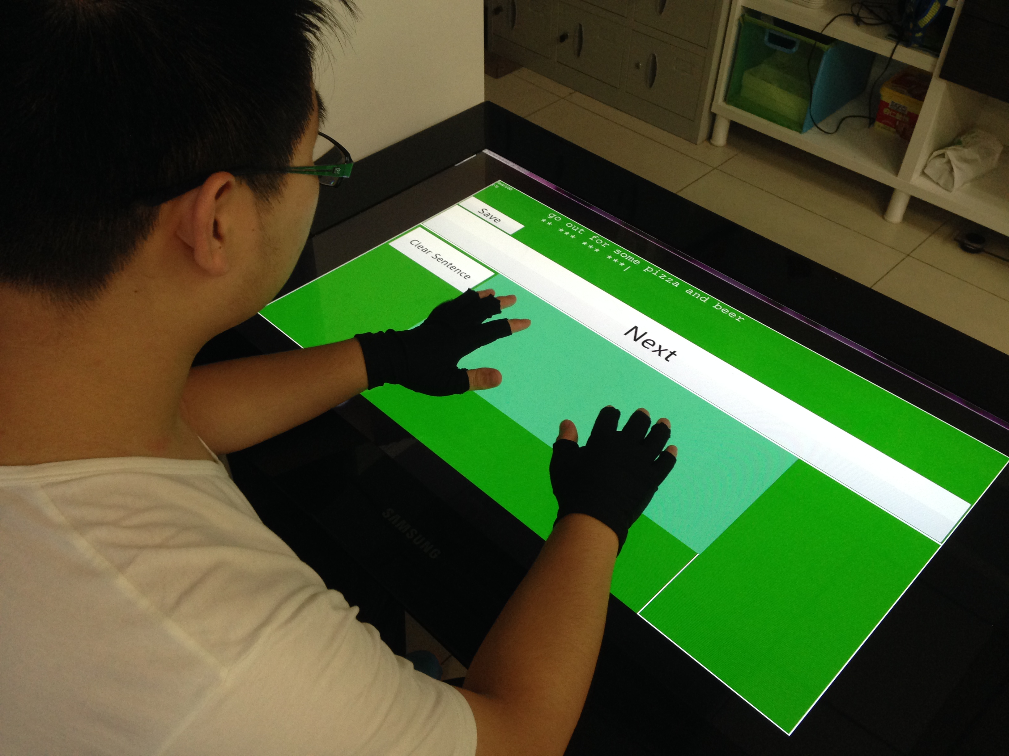
Study: Examining Typing Behavior
[1] Leah Findlater, Jacob O Wobbrock, and Daniel Wigdor. 2011. Typing on flat glass: examining ten-finger expert typing patterns on touch surfaces.
Notes:
The experiment setup is similar to a previous work,

Slide 22
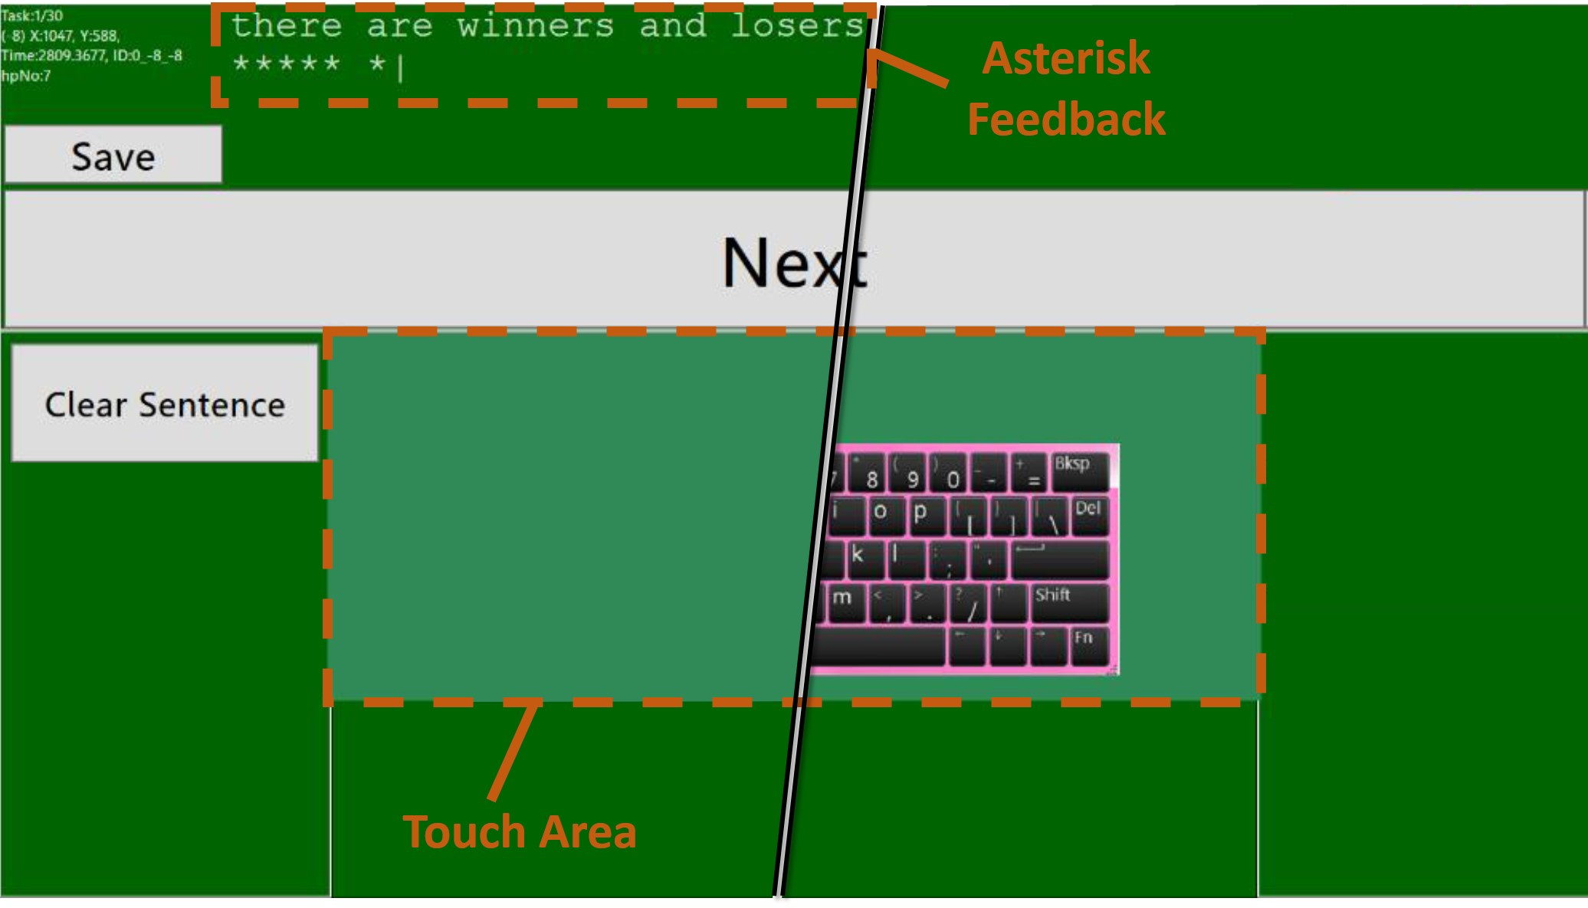
Study: Examining Typing Behavior
Participants: 15 (10 males, 5 females)
Average speed: 55.5 WPM
Task: transcribe 30 phrases
Design:
Asterisk feedback
No keyboard during test
Notes:
1 pixel=0.46 mm

Slide 23
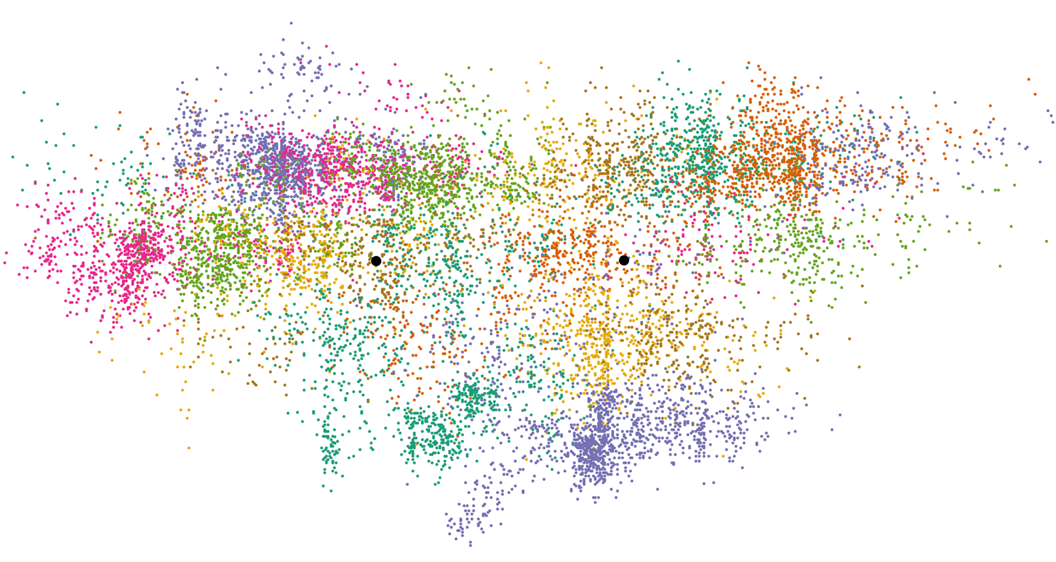
Results: touch points
Notes:
这是所有测试人员的左手和右手的按键的分布图，分布以两个黑点为中心，左边的黑点是F，右边的黑点是J，颜色代表不同的按键。可以看出，整个的分布是比较乱的，作者认为这是因为每个用户的打字习惯都是不一样的，所以需要为每个用户设计他自己的键盘模型。

Slide 24
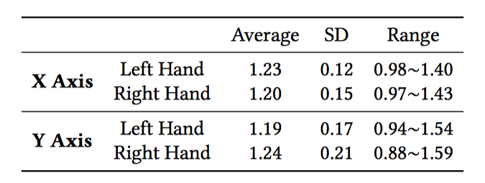
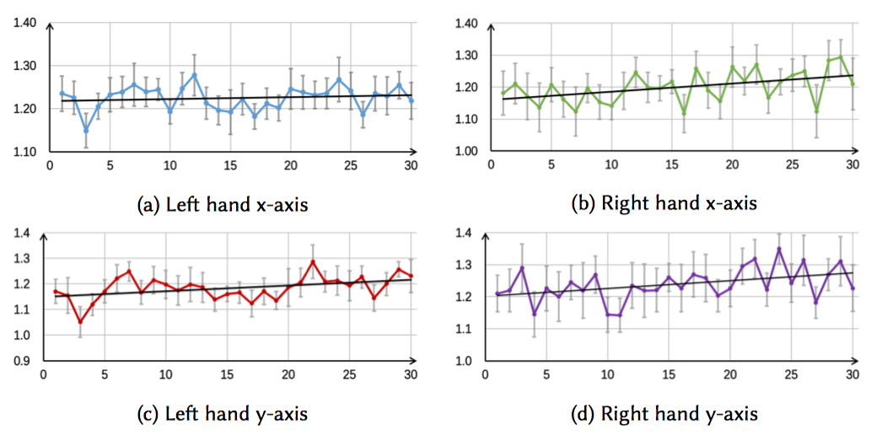
Results: fitting keyboard size
Notes:
作者把F和J的中点看做原点，然后把这些点都拟合到一个标准大小的键盘上去，用之前提到的方法求出Location、Size和Noise.然后作者发现，拟合出来的键盘的大小和标准的键盘大小是不一样的，他们之间有一个比例。
为了检验键盘大小随时间的变化关系，作者对每个单独的句子都进行拟合，估计出对应的参数，然后画出他们随时间的变化。可以看出，随着时间的变长，键盘的大小变得越来越大。

Slide 25
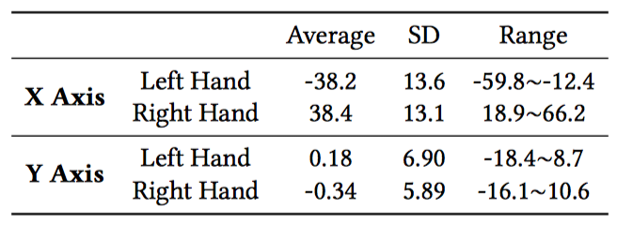
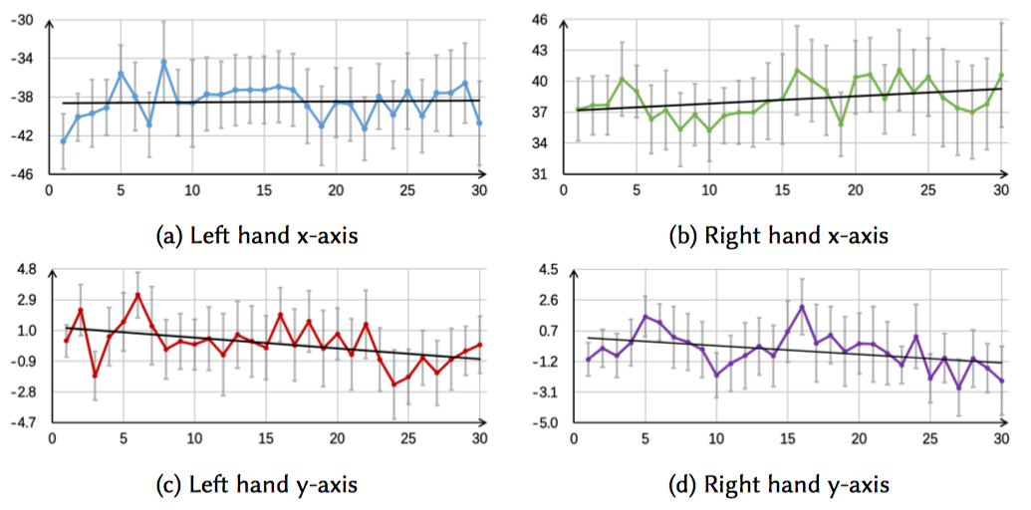
Results: fitting keyboard location
Notes:
这个表中显示的是左手按的F的平均坐标和右手按的J的平均坐标。它们相距了4个按键的距离，但是实际上F和J的中心应该只隔三个。这说明用户在打字的时候左右手趋向离得更远，可能是保证左右手不会碰到，是比较合理的。

Slide 26
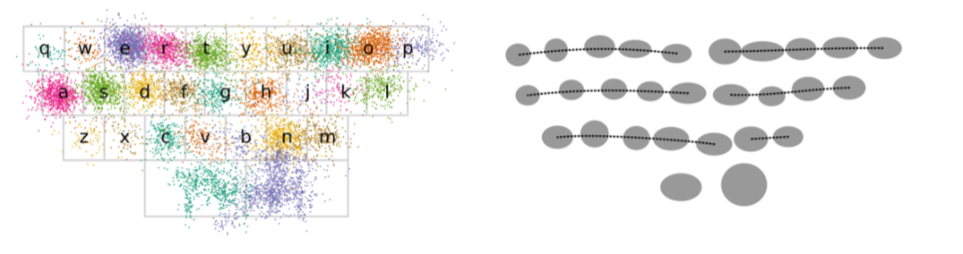

Results: fitting keyboard shape
$$R^{2}>0.98$$
Notes:
通过之前拟合键盘的大小我们知道了每个用户心中的键盘和标准的键盘的大小是有一个缩放比例的。所以作者把所有的用户的按键都还原成标准键盘的比例。就得出了这样的一个分布。可以看出，大致是和我们标准的键盘分布一致的。同时R^2也超过了0.98，说明拟合的效果非常好，也验证了之前键盘为长方形的的一个假设。

Slide 27
Outline
Related Work
Problem Definition
Examining Behavior
Input Prediction Algorithm
Evaluation
Conclusion

Slide 28
Outline
Related Work
Problem Definition
Examining Behavior
Input Prediction Algorithm
Evaluation
Conclusion
Notes:
Based on the analysis of users’ input data, we designed input prediction algorithm and evaluated different designs through simulation.

Slide 29
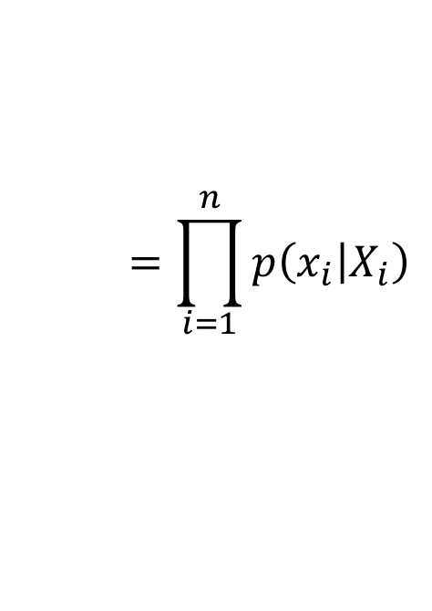







Prediction algorithm
$$w^{∗}=\arg{\max_{w∈D}{p\left(w | I\right)}}$$
$$p\left(w | I\right)=p\left(I | w\right)·p\left(w\right)/p\left(I\right)$$
$p\left(I | w\right)=p\left({\left\{\left(x_{i},y_{i}\right)\right\}}_{i=1}^{n} | {\left\{c_{i}\right\}}_{i=1}^{n}\right)$
$$=p\left({\left\{\left(x_{i},y_{i}\right)\right\}}_{i=1}^{n} | {\left\{\left(X_{i},Y_{i}\right)\right\}}_{i=1}^{n}\right)$$
$$=p\left({\left\{x_{i}\right\}}_{i=1}^{n} | {\left\{X_{i}\right\}}_{i=1}^{n}\right)$$
$$·p\left({\left\{y_{i}\right\}}_{i=1}^{n} | {\left\{Y_{i}\right\}}_{i=1}^{n}\right)$$
absolute
$$=\prod_{i=1}^{n}{p\left(x_{i} | X_{i}\right)}$$
$$=p\left(left hand sequence\right)∙p(right hand sequence)$$
relative
$$=p\left(x_{l1} | X_{l1}\right)\prod_{i=2}^{ln}{p\left({∆x}_{li} | ∆X_{li}\right)}∙p\left(x_{r1} | X_{r1}\right)\prod_{i=2}^{rn}{p\left({∆x}_{ri} | ∆X_{ri}\right)}$$
[1] J Goodman, G Venolia, K Steury, and C Parker. 2002. Language Modeling for Soft Keyboards.
Notes:
经典的做法是一种贝叶斯算法。也就是假设每个按键动作都是独立的。但是这个方法有一个缺点就是手的中心在打字的时候是会移动的，很难去确定哪个坐标对应着哪个按键。所以作者提出要利用按键的一个相对位置的关系，也就是下一次按键和上一次按键的位置是有关系的，符合马尔科夫过程。
用来初始化的一个概率是利用上面绝对位置的方法计算出来的。
A classical Bayesian algorithm was first presented by Goodman. This algorithm is word-level, it computes a probability for each word and select the word with the highest probability. The probability was calculated through a sequence of touch points. We call it an absolute algorithm.
We propose a relative algorithm, which separate the touch point sequence into two parts and calculate each sub-sequence by a relative way. In this way, except for the first touch point, the probability of the vectors between two successive touch points were calculated.

Slide 30
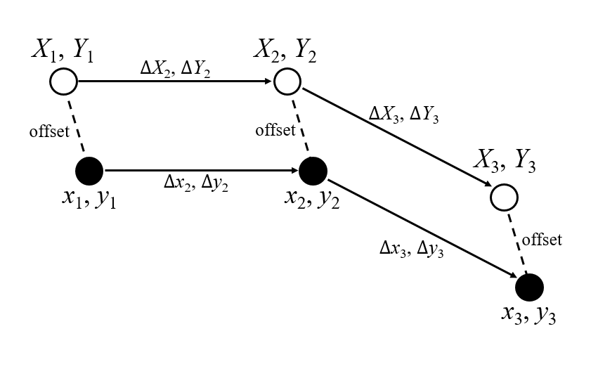

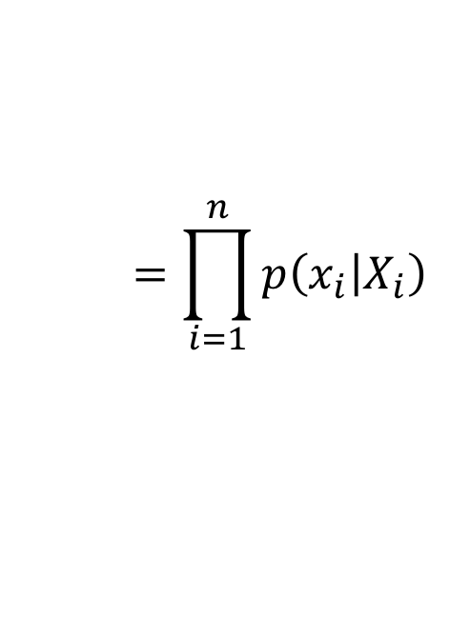
Prediction algorithm
absolute
$$=\prod_{i=1}^{n}{p\left(x_{i} | X_{i}\right)}$$
$$=p\left(left hand sequence\right)∙p(right hand sequence)$$
relative
$$=p\left(x_{l1} | X_{l1}\right)\prod_{i=2}^{ln}{p\left({∆x}_{li} | ∆X_{li}\right)}∙p\left(x_{r1} | X_{r1}\right)\prod_{i=2}^{rn}{p\left({∆x}_{ri} | ∆X_{ri}\right)}$$
Notes:
黑点是按键的位置。白点是实际的位置。This example shows the benefit of using a relative method. The black points denote touch points and the white points denote key centers. Though touch points were offset from the target position, the relative positions did not change. By using an absolute algorithm, the offset was calculated 3 times, however, by using a relative algorithm, only the first offset was calculated, the two vectors remain the same and will not affect the probability. For more details, please refer to the paper.

Slide 31
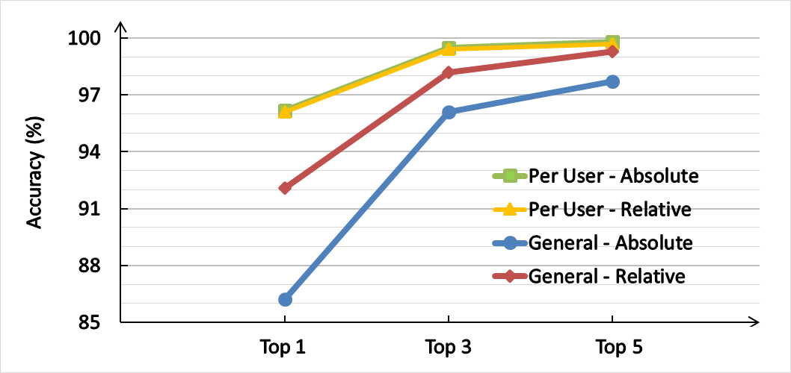
Simulation
Absolute
General
Relative
Per User
Notes:
To compare the performance of absolute and relative algorithms, as well as the personalized model mentioned before, we ran a series of simulation on the collected data. According to the results, we should adopt a per-user relative algorithm in a real typing technique as expected.

Slide 32
Adaption
N words
Current Model
New Model
Word₁
Word₂
…
Word_{i-1}
Word_{i}
Next Word
N = 10
Notes:
In real usage, the user should start with a general keyboard model and the keyboard should dynamically adapted to the user’s behavior.
Each time the user confirmed the selection of a word,
we would fit a new keyboard model using the data of the latest N words, and replace the older model with the new one. N was chosen as 10 according to another simulation

Slide 33
Outline
Related Work
Problem Definition
Examining Behavior
Input Prediction Algorithm
Evaluation
Conclusion

Slide 34
Outline
Related Work
Problem Definition
Examining Behavior
Input Prediction Algorithm
Evaluation
Conclusion

Slide 35
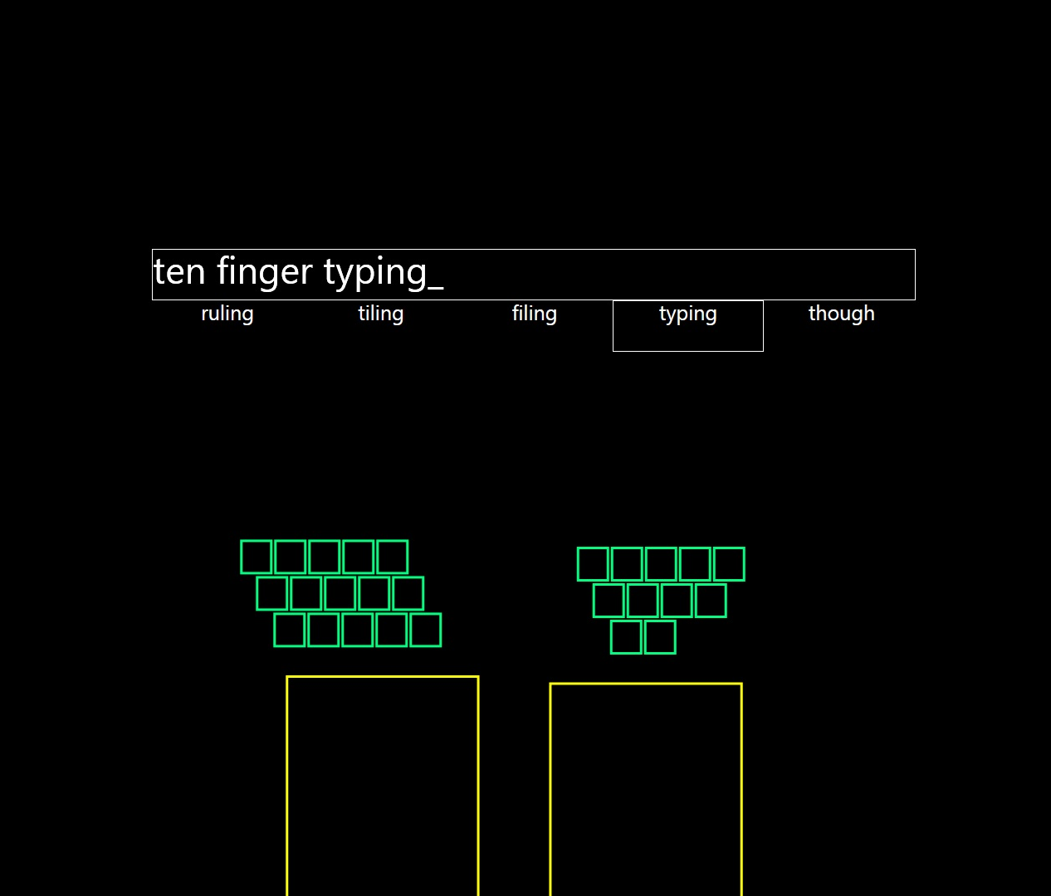
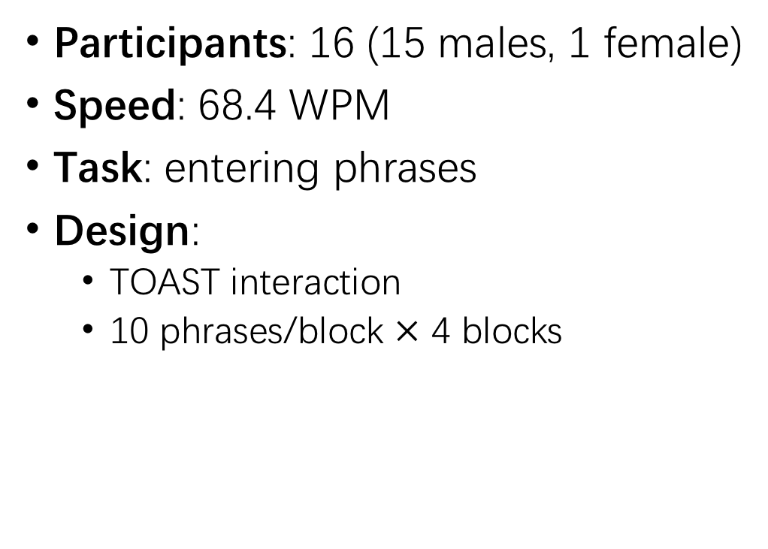
Evaluation
Participants: 16 (15 males, 1 female)
Speed: 68.4 WPM
Task: entering phrases
Design:
TOAST interaction
10 phrases/block $×$ 4 blocks
Notes:
We evaluated the performance of TOAST through a second experiment. We first developed and implemented a prototype and then recruited 16 participants to enter 40 phrases in 4 blocks.

Slide 36
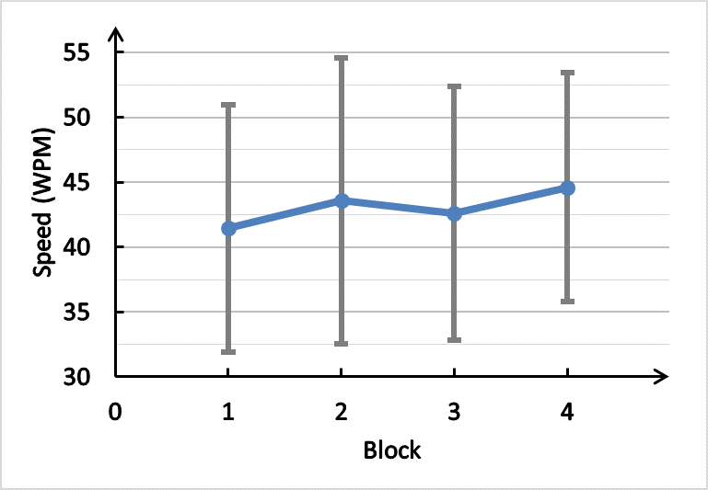
Results: Speed
Speed: 43.1 WPM (2/3 physical)
Fastest: 66.1 WPM
Existing techniques:
30 WPM [1] (44% higher)
38.68 WPM [2] (11% higher)
[1] Leah Findlater and Jacob Wobbrock. 2012. Personalized input: improving ten-finger touchscreen typing through automatic adaptation.
[2] Sunjun Kim, Jeongmin Son, Geehyuk Lee, Hwan Kim, and Woohun Lee. 2013. TapBoard: making a touch screen keyboard more touchable.
Notes:
The average typing speed was 43.1 WPM, about 2/3 of their speed on physical keyboard and 11% to 44% higher than some existing techniques. The fastest participant could even reach 66.1 WPM.

Slide 37
Results: Speed & Error rate
Speed: 43.1 WPM (2/3 physical)
Fastest: 66.1 WPM
Existing techniques:
30 WPM [1] (44% higher)
38.68 WPM [2] (11% higher)
Block | 1 | 2 | 3 | 4
Error rate | 0.6% | 0.9% | 0.4% | 0.6%
SD | 0.8% | 0.9% | 0.6% | 0.6%
[1] Leah Findlater and Jacob Wobbrock. 2012. Personalized input: improving ten-finger touchscreen typing through automatic adaptation.
[2] Sunjun Kim, Jeongmin Son, Geehyuk Lee, Hwan Kim, and Woohun Lee. 2013. TapBoard: making a touch screen keyboard more touchable.
Notes:
The character-level error rate was low.

Slide 38
Results: Interviews
“At first is was hard to type without a visual keyboard, but the keyboard dynamically followed my hands, which makes typing very easy.”
“It is amazing I can type so fast. I can type word correctly even when I missed some keys.”
Notes:
According to the interview, participants liked the typing experience and the correction ability of TOAST.

Slide 39
Results: Interviews
“At first is was hard to type without a visual keyboard, but the keyboard dynamically followed my hands, which makes typing very easy.”
“It is amazing I can type so fast. I can type word correctly even when I missed some keys.”
“Selecting and confirming words with thumbs is natural. But it bothers me when the system confused space key and character keys.”
“I have to type every character to see whether the input is correct. I wish word prediction could be supported “
Notes:
They also called for a more robust implementation and an auto-prediction feature.

Slide 40
Outline
Related Work
Problem Definition
Examining Behavior
Input Prediction Algorithm
Evaluation
Conclusion

Slide 41
Outline
Related Work
Problem Definition
Examining Behavior
Input Prediction Algorithm
Evaluation
Conclusion

Slide 42
Conclusion
Ten-finger Eyes-free Typing on a Flat Surface
Understanding ten-finger typing behavior
Prediction Algorithm
Relative
Adaption
TOAST: Typing On Any Surface with Ten fingers!
Notes:
To summarize, we present a novel algorithm, TOAST, for enabling ten-finger eyes-free typing on a flat surface with ….
TOAST reflects our deep understanding of users eyes-free typing behavior and advances the state-of-art text entry techniques to deal with different source of variations. Two improvements were made based on the classical algorithm: a relative prediction method and an adaption strategy.
Though in this paper, we design TOAST based on the reported touch points on a touchable surface, we believe our algorithms can be incorporated with more advanced sensing techniques. In this way, we may push the goal a step further towards our ultimate goal: which is the meaning of toast: ….

Slide 43
Thanks for listening!
Q&A
Notes:
That’all. Thank you for listening. I am more than happy to take questions.

