Slide 1
Accelerate Deep Learning on Mobile Devices
Notes:
今天和大家分享的是一个survey，在移动设备上加速深度神经网络。

Slide 2
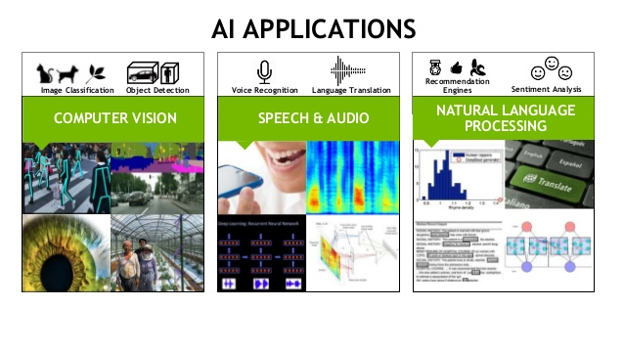
Notes:
近几年，AI技术在许多领域的发展都非常迅速。在移动设备中，也有许多适合用深度学习的应用场景。

Slide 3
Limited Resources on Mobile Devices
 | Nvidia GTX 980 | Adreno 330 (Samsung Note4) | Ratio (Nvidia / Adreno)
Number of ALUs (CUDA cores) | 2048 | 128 | 16x
Memory Bandwidth | 224GB/s | Shared 12.8GB/s | 17.5x
Peak Performance (Gflops) | 4600 | 166.5 | 27.6x
CNN Execution Time VGG-16 (ms) | 238.59 (Caffe) | 6315 | ~26.5x
Notes:
但是深度学习所需要的巨大的计算资源是移动设备提供不了的。

Slide 4
Upload to Cloud?
Server Cost
Privacy
Bandwidth
Latency
Acceleration of DNN on mobile devices is needed.

Slide 5
Two directions
There are mainly two directions to accelerate deep learning on resource-constrained mobile devices:
Model Compression
Caching
Notes:
Model compression reduce the computation, storage and memory cost of models. Caching reuse previous
results to reduce redundant computation caused by similar input.

Slide 6
D1-Model Compression Techniques
Weight Compression. Remove weights that are not important.
Convolution Decomposition. Approximate convolution layers with less-computation-intensive layers.
Special architecture layers. Replace traditional layers with newly designed light-weight layers.
Notes:
模型压缩的技术可以分成三类。

Slide 7
D1-System Design to Apply Compression Techniques
Accommodating these techniques to various needs in mobile scenarios needs extra efforts on system design.
Different platforms have different resource constraint. Different applications have different performance needs.
The resources available in a mobile device are usually dynamic.
Notes:
要把这些压缩技术应用到移动设备上，还有一些系统设计方面的问题要解决。比如……

Slide 8
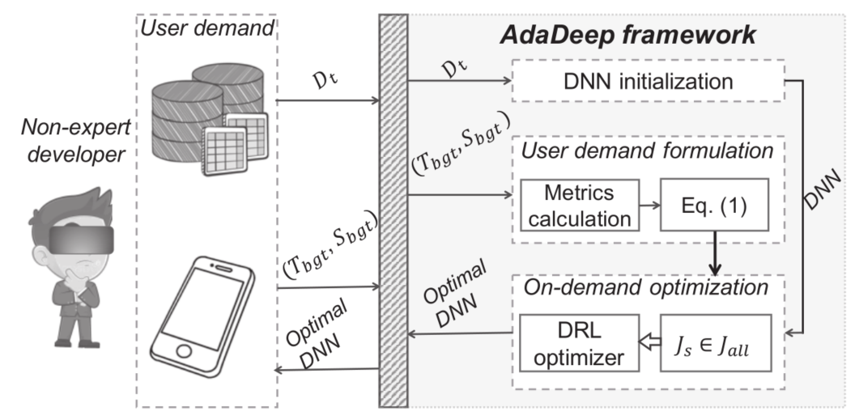
AdaDeep MobiSys’18
Notes:
AdaDeep研究针对具体的资源限制和性能需求，如何将现有的压缩技术最优化地进行组合。
比如现在一共有10种压缩技术，我们可以同时用其中的3种、4种、5种，压缩程度越高，意味着精度就越低，资源占用越少。
不同的压缩技术对不同资源的节省是不一样的，有的能节约CPU资源，有的能节约内存资源，等等。
AdaDeep设计了一个深度强化学习模型，能够针对用户给定的资源限制和性能需求，求解最佳的压缩技术组合方案。

Slide 9
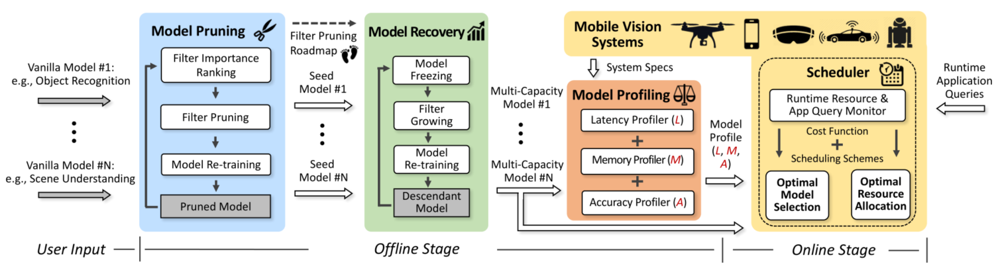
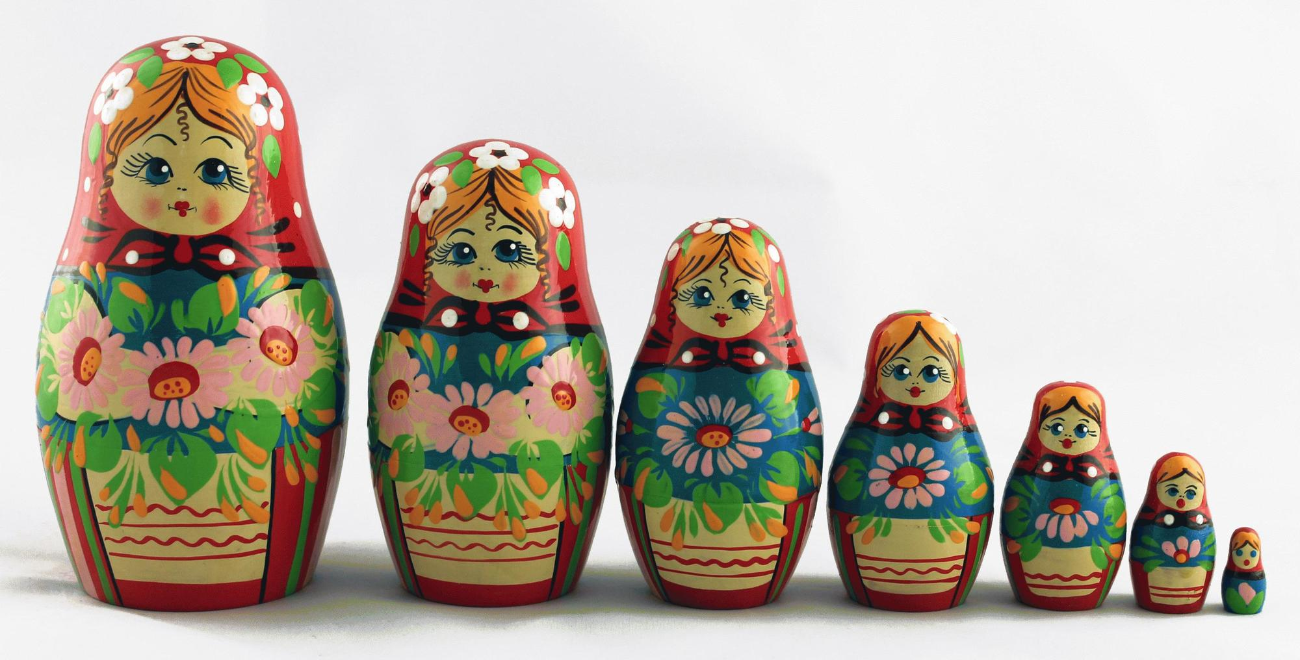
NestDNN MobiCom’18
Notes:
第二项工作，NestDNN，应用在运行过程中，可用的计算资源是动态变化的。
它以一种迭代的方式对模型进行压缩。……。
在运行的时候，如果可用资源较多，就用……。
这样做的好处是所有模型是嵌套的，它只需要占用一个模型的存储空间。

Slide 10
D2-Caching
Inside an application.
Utilizing the temporal continuity of video.
Notes:
缓存可以在三个层级进行，第一个层级，在一个应用内部进行缓存，这主要针对视频类的应用，这部分我们放到最后进行介绍。

Slide 11
D2-Caching
Among different applications in the same device.
Notes:
不同的应用（模型），他们处理的输入可能是相同的，比如，它们都在处理用户当前实时拍摄的画面。

Slide 12
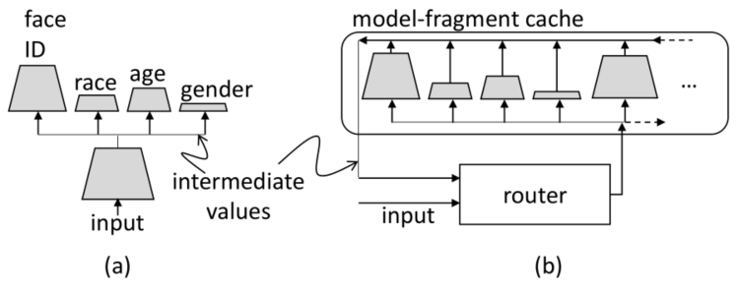
MCDNN MobiSys’16
Notes:
MCDNN [ 7 ] shares the lower layers across DNN models: the layers of a
DNN can be viewed as increasingly abstract representations, so it is conceivable the representations captured by lower
levels are shareable across many high-level tasks.
不同应用的神经网络，他们可以共用底层的卷积层来提取图像的基础特征。

Slide 13
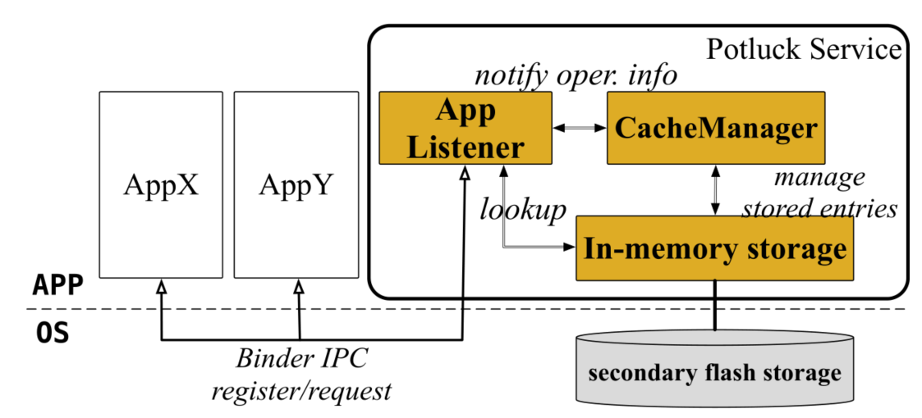
Potluck ASPLOS’18
Notes:
Potluck [ 5 ] reuses the results of function calls across different
applications. When an application calls certain processing functions, it first queries the cache for any existing results.
The input data are turned into a feature vector, which serves as the key. Then a lookup attempt is made with the key
and the function name.
当某一函数被调用时，系统会查询缓存，之前这个函数有没有相似的输入。如果有……

Slide 14
D3-Caching
Among different devices.
Notes:
最后是在不同的设备之间进行缓存。

Slide 15
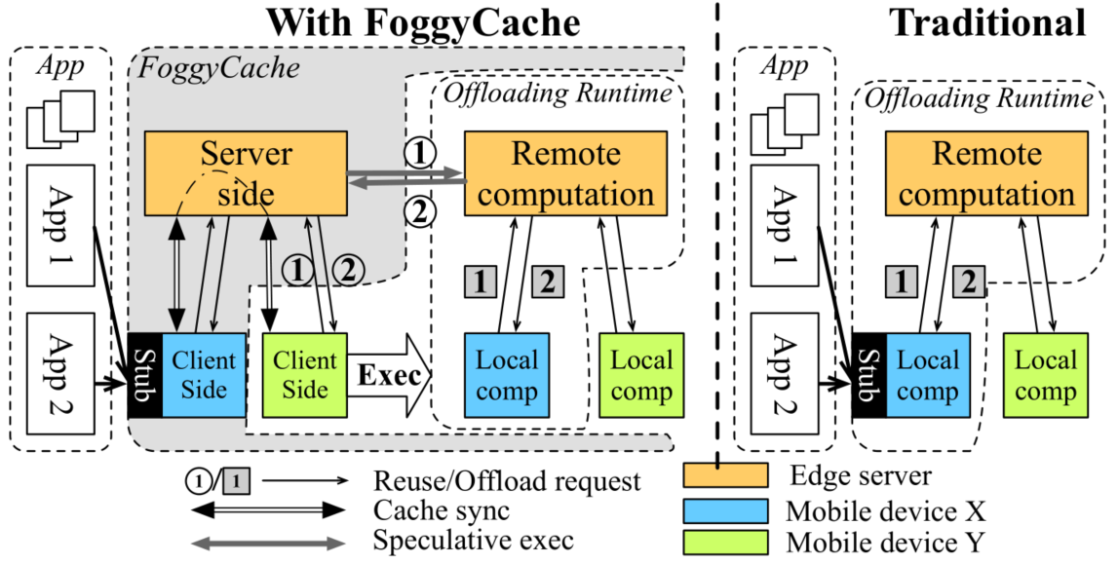
FoggyCache MobiCom’18
Notes:
Same applications can be installed on multiple devices, which generate similar
requests when in a similar context. FoggyCache [ 4 ] observes cross-device fuzzy redundancy in mobile and IoT
scenarios and eliminate them by approximate computation reuse on edge servers.
人们在相似的环境中会有相似的行为，和手机有关的相似行为就会产生对服务器的相似请求，比如……
FoggyCache设计了一种在边缘服务器上的缓存机制来减少冗余的请求。

Slide 16
Cache between Consecutive Frames
Notes:
对于处理视频的神经网络，利用视频帧的连续性来减少计算开销。

Slide 17


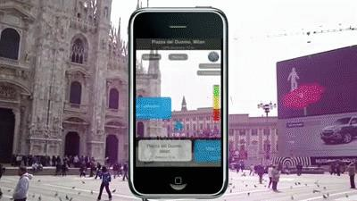
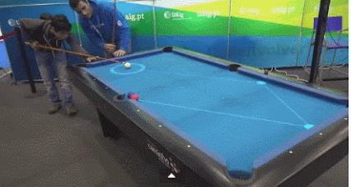


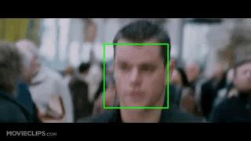

Background: Mobile Vision
Your mobile device sees what you see, and does what you cannot do
Core: computer vision algorithm
Augmented
Reality
Game
Recognition
& Detection
Face Beauty
Notes:
移动视觉有很多应用场景。

Slide 18
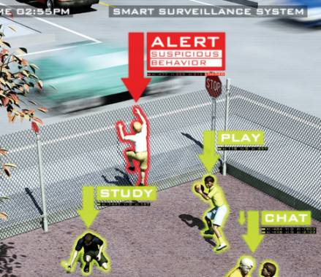
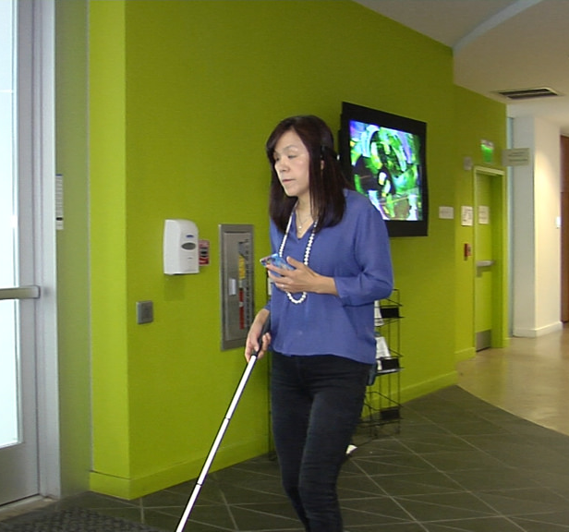
Background
Video Analysis
Naïve Method: Inference frame by frame

Slide 19
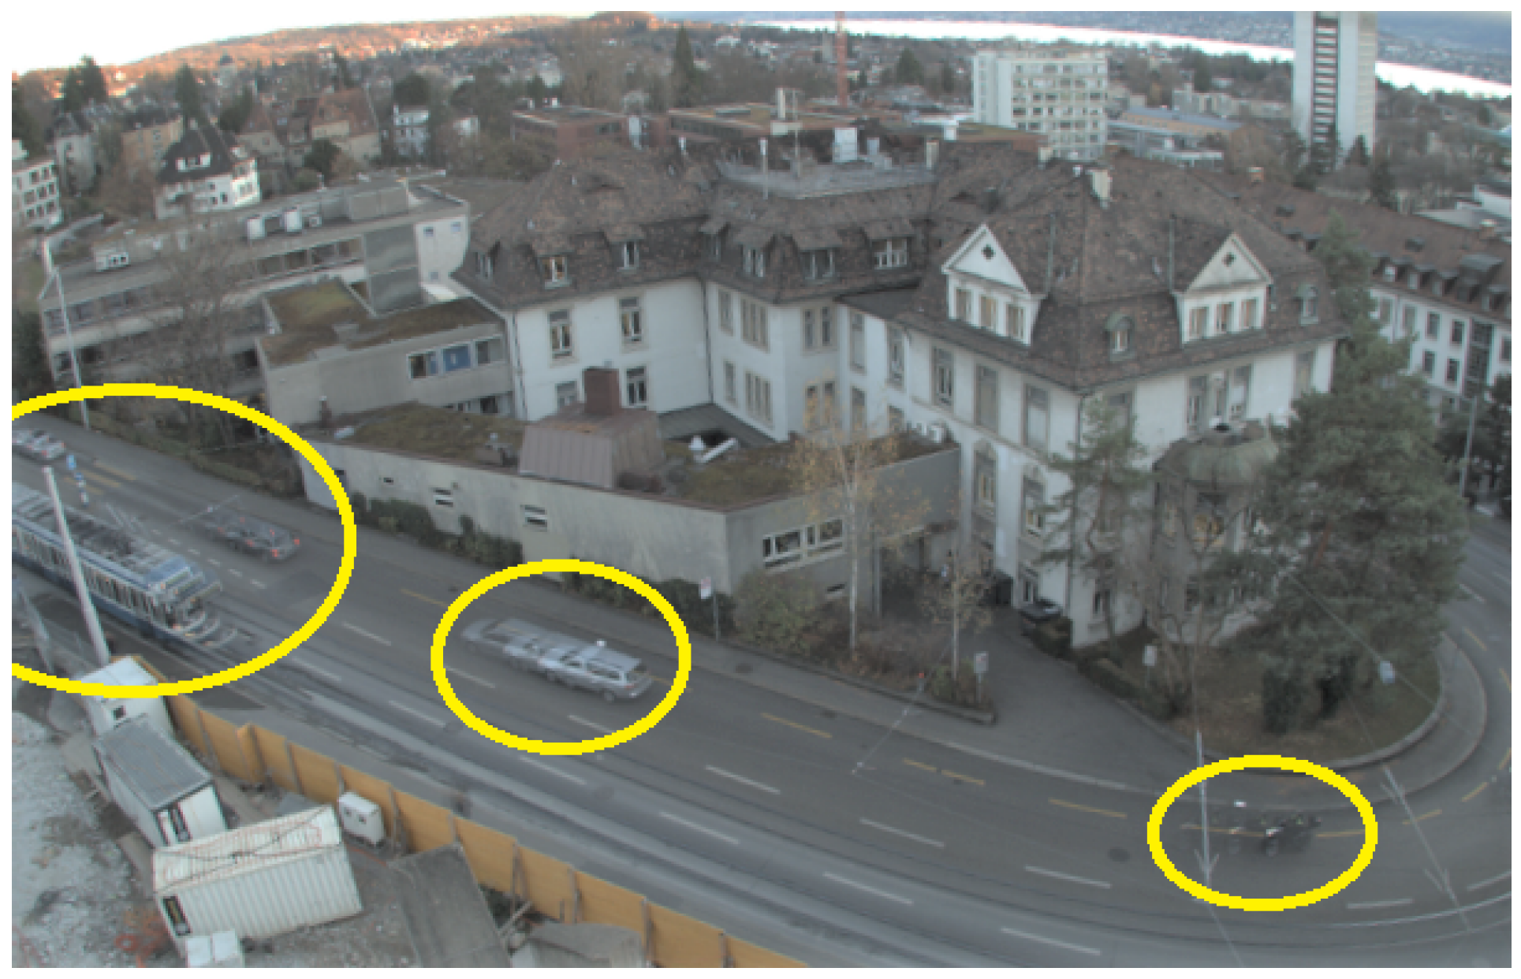
Solution
Cache based on the similarity of consecutive frames.
Notes:
针对这种特征，一种最简单的方案就是：

Slide 20
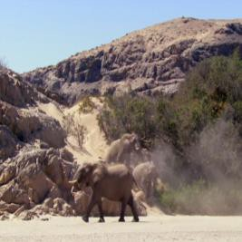
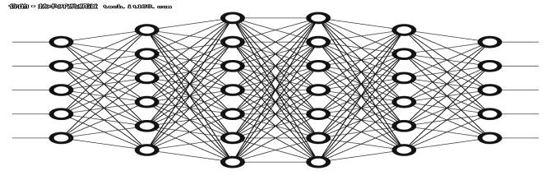

Solution 0 – a naïve approach
Just cache/reuse the final results based on input image
_{i}th frame
input
ouput
Inference
Engine
Class: elephant
Pos: (-1.5, 7.9)

Slide 21
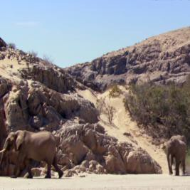
Caching Mobile Vision – a naïve approach
Just cache/reuse the final results based on input image
_{i}th frame
input
ouput
Inference
Engine
Class: elephant
Pos: (-1.5, 7.9)
Similar?
(i+1)^{th} frame

Slide 22
Caching Mobile Vision – a naïve approach
Just cache/reuse the final results based on input image
_{i}th frame
input
ouput
Inference
Engine
Class: elephant
Pos: (-1.5, 7.9)
YES: Let’s Reuse
Similar?
(i+1)^{th} frame
Class: elephant
Pos: (-1.5, 7.9)

Slide 23
Caching Mobile Vision – a naïve approach
Just cache/reuse the final results based on input image
_{i}th frame
input
ouput
Inference
Engine
Class: elephant
Pos: (-1.5, 7.9)
YES: Let’s Reuse
Similar?
NO: Do Computation
(i+1)^{th} frame
Inference
Engine
Class: elephant
Pos: (-1.1, 9.3)

Slide 24


Caching Mobile Vision – a naïve approach
Just cache/reuse the final results based on input image
Why it’s not enough?
Coarse-grained: whole image as comparison unit
Cannot handle position-sensitive tasks
Two images are similar
Similar background
Similar animals
But the elephant position is different!
Notes:
这样做粒度太粗了，两帧之间往往有相似的部分也有不同的部分。

Slide 25
Solution 1
Point comparison, cache for each layer.
L. Cavigelli, P. Degen, and L. Benini, “CBinfer: Change-Based Inference for Convolutional Neural Networks on Video Data,” in Proceedings of the 11th International Conference on Distributed Smart Cameras, New York, NY, USA, 2017, pp. 1–8.
Notes:
以像素为单位进行对比，对每一层卷积都重新计算可复用区域。

Slide 26
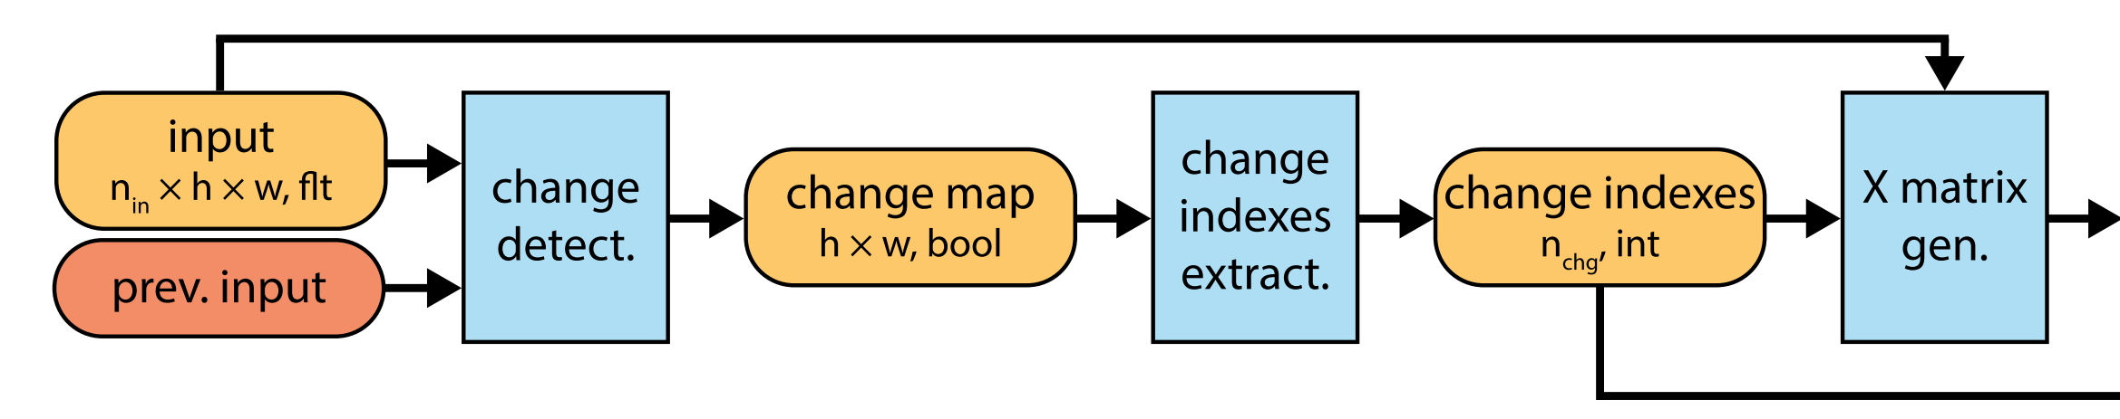
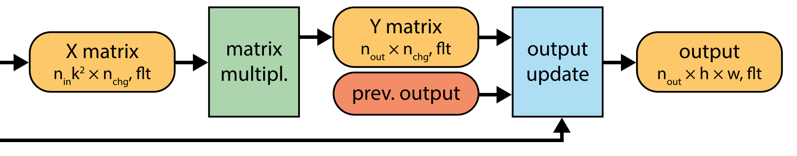
CBinfer: Algorithm Overview
Concept:
Replace all convolution layer with change-based approach
Repeat pixel-wise change detection:
abstract information more temporally consistent?
output again well localized (segmentation, detection)
Processing Sequence:
leverage highly-optimized GEMM kernel!
Notes:
只能处理静态背景，无法处理物体的移动和摄像头的移动或转动。

Slide 27
Solution 2
Block comparison, cascade through layers.
L. N. Huynh, Y. Lee, and R. K. Balan, “DeepMon: Mobile GPU-based Deep Learning Framework for Continuous Vision Applications,” in Proceedings of the 15th Annual International Conference on Mobile Systems, Applications, and Services, New York, NY, USA, 2017, pp. 82–95.
Notes:
以块为单位的比较，可重用区域只在原始图像上计算，并推导到后续卷积层。

Slide 28
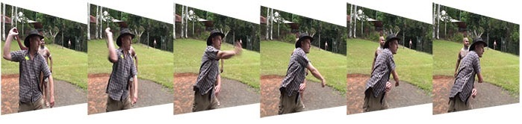
Opt. 2: Reducing Redundancy Computation
Similar regions
Background tends to be static
Processing backgrounds for every frame is unnecessary
Cache features from background – Convolutional Caching
a
Notes:
We further investigated videos of people doing some activities and figured out that there are many similar regions between many frames.
Usually the background is static and if we process these regions from frame to frame, it is resource wasteful.
So you came up with an idea of caching the features extracted from previous frame and applying them in the current frame.
We call it convolutional caching.
在连续的视频帧当中，背景经常是不变的。

Slide 29
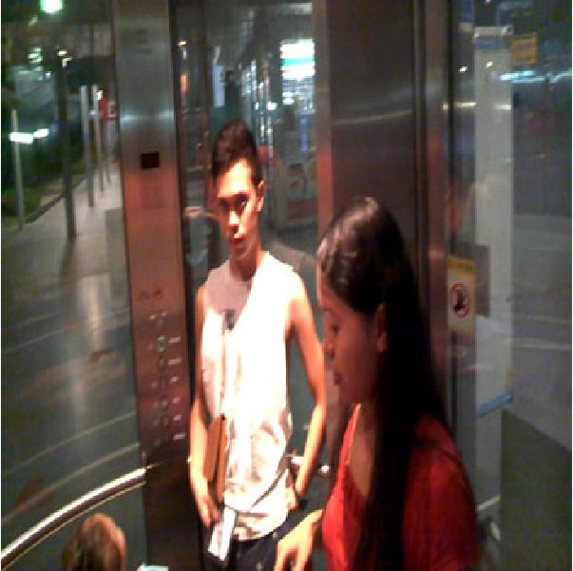

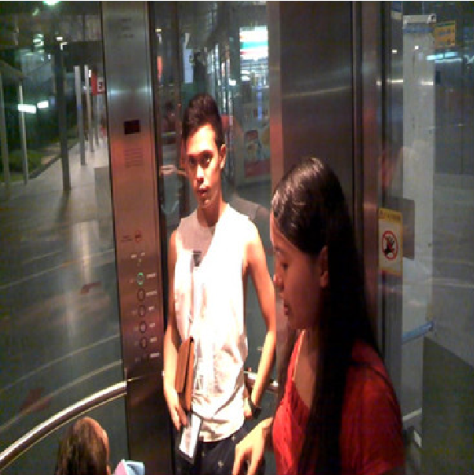

Opt.2 Solution: Convolutional Caching
16 bins color histogram
Chi square distance
If distance < 0.005, block is reusable
Convolutional Caching
Ops.
Histogram Based
Image Comparison
yes
Reusable?
Normal
Convolutional
Ops.
Cache Manager
no
Notes:
The intuition of convolutional caching works as follow,
If we have 2 consecutive frames, the first frame is the upper one.
We divide them into grid of blocks, and try to compare two blocks to each other using very fast histogram based image comparison.
In our work, we used 16 bins color histogram with the chi square distance as a metric to measure the similarity between two blocks.
If the distance is less than a threshold, we call it reusable.
If it is reusable, we only need to use features extracted from previous block for the current block.
If not, we will do the normal convolutional operation and store the new features inside cache manager if needed.

Slide 30
Solution 3
Flexible block comparison, cascade through layers.
M. Xu, M. Zhu, Y. Liu, F. X. Lin, and X. Liu, “DeepCache: Principled Cache for Mobile Deep Vision,” in Proceedings of the 24th Annual International Conference on Mobile Computing and Networking, New York, NY, USA, 2018, pp. 129–144.

Slide 31
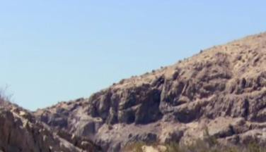


Caching Mobile Vision – DeepCache
Treat image as a collection of blocks, and cache/reuse them at a fine granularity.
KEY IDEA
cache & reuse
Reuse the CNN computations of similar regions
previous frame
current frame
Notes:
相似的区域，哪怕他们不在同一个位置，也是能够匹配上的，从而进行复用。

Slide 32
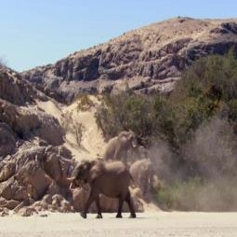
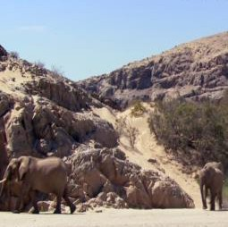
DeepCache Design: Image Matching
Principles: high similarity, low overhead, and merged to big ones.
Input: two raw images
Output: a set of matched rectangles
(x₁, y₁, w, h) in current frame -> (x₂, y₂, w, h) in previous frame
Notes:
镜头移动，大象移动
这篇文章基于一种叫Diamond Search的算法设计了他们的图像匹配算法，发现相邻帧之间的相似区域并尽量合并成较大的区域，

Slide 33
Caching Mobile Vision – DeepCache
Treat image as a collection of blocks, and cache/reuse them at a fine granularity.
_{i}th frame
input
ouput
Inference
Engine
Class: elephant
Pos: (-1.5, 7.9)
matching
layer-level cache/reuse
reusable
regions
(i+1)^{th} frame
Inference Engine (revised)
Class: elephant
Pos: (-1.1, 9.3)

Slide 34
Evaluation
Delay (Computation time)
Accuracy degradation
Memory
Battery

Slide 35
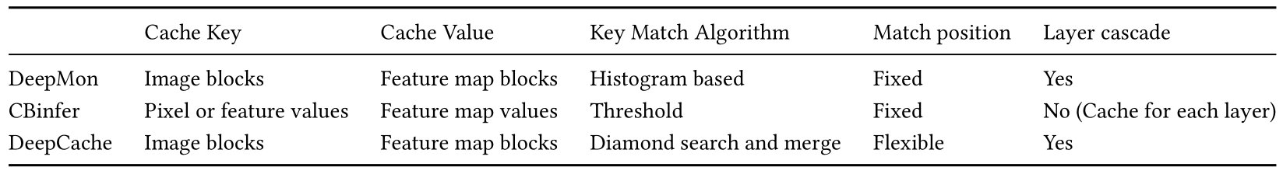
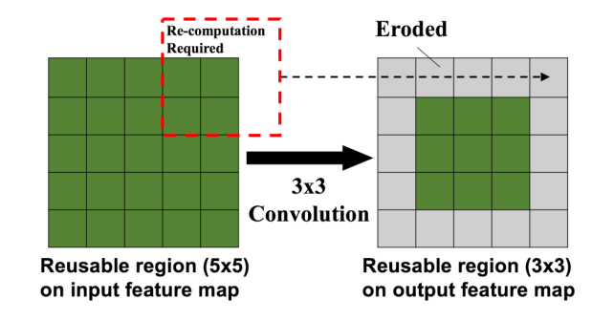
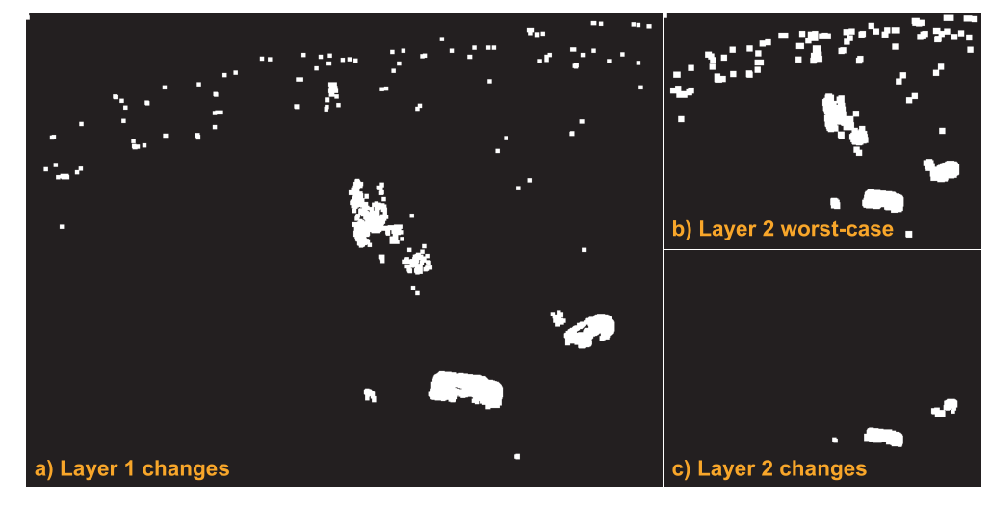
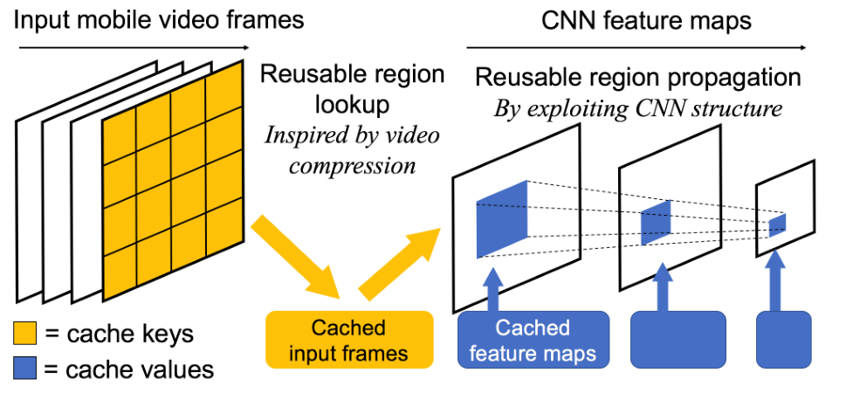
Summary

Slide 36
Future Directions
Image transformation that previous works do not consider:
Image becomes lighter or darker as a whole.
Rotate
Scale
Special convolution operations that are insensitive to these transformation?

