Slide 1

Networking Across Boundaries
Enabling Wireless Communication through the Water-Air Interface
JunSu Jang
Notes:
Hello everyone! Thank you very much Deepak for your introduction, and thank you everyone for being here. I am JunSu Jang from MIT. I am very excited to be here today to tell you about our research on networking across boundaries, specifically about enabling wireless communication through the water-air interface.

Slide 2

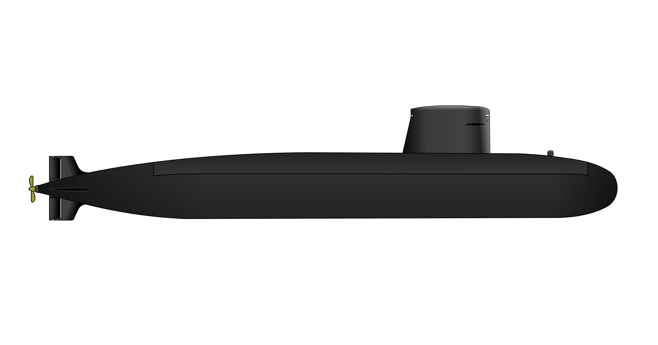
Submarines Cannot Communicate with Airplanes
Airplane
Submarine
Notes:
Let me start by asking you a question: Did you know that a deeply submerged submarine cannot communicate with an airplane?
For example, this submarine that you see over here cannot communicate directly with the airplane above the surface. In fact,

Slide 3
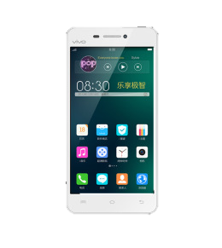
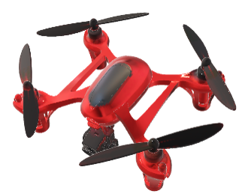
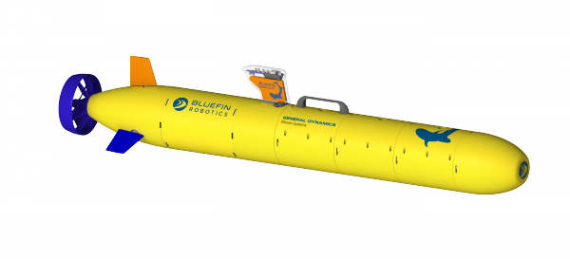
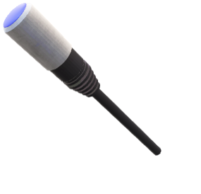
Direct Underwater-Air Communication is Infeasible
Notes:
Any deeply submerged underwater node like underwater drones or sensors cannot directly communicate with nodes above the water surface. And you might be wondering why. The reason is that

Slide 4
Direct Underwater-Air Communication is Infeasible
Wireless signals work well only in a single medium
Notes:
Wireless signals work well only in a single medium. For example, they can either work well only in air or only in water, but they cannot work well across both. For example,

Slide 5
Wireless Signals Work Well Only in a Single Medium
Acoustic
or SONAR
Notes:
a submarine can communicate with another submarine using acoustic signals or SONAR. Cellphones and phone towers

Slide 6
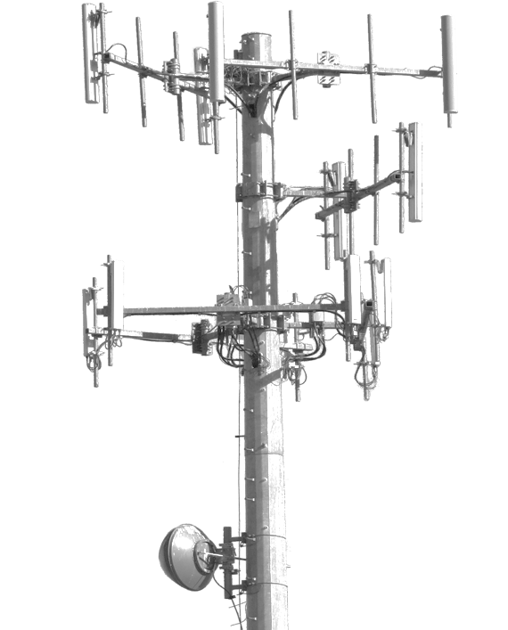
Wireless Signals Work Well Only in a Single Medium
Radio
Acoustic
or SONAR
Notes:
can also communicate with each other using radio signals like cellular or Wi-Fi. But neither of these work well in the other medium. A simple question one might ask is,

Slide 7
Use Acoustic signals?
Reflects off
the Surface
Acoustic
Notes:
why don't we just use acoustic signals to communicate with nodes in the air? Well, the reason is that if we were to send an acoustic signal to the water surface, it will reflect back, and it will not be able to cross the surface boundary.

Slide 8
Use Acoustic signals?
Use Radio Signals?
Reflects off
the Surface
Radio Signals
Die in Water
Acoustic
Radio
Notes:
So why not transmit radio signals? This is because radio signals die in water, so they will not even reach the water surface. In fact, this is why we use acoustic signals in the water in the first place. So how do people overcome this problem today? One approach to work around this problem is

Slide 9
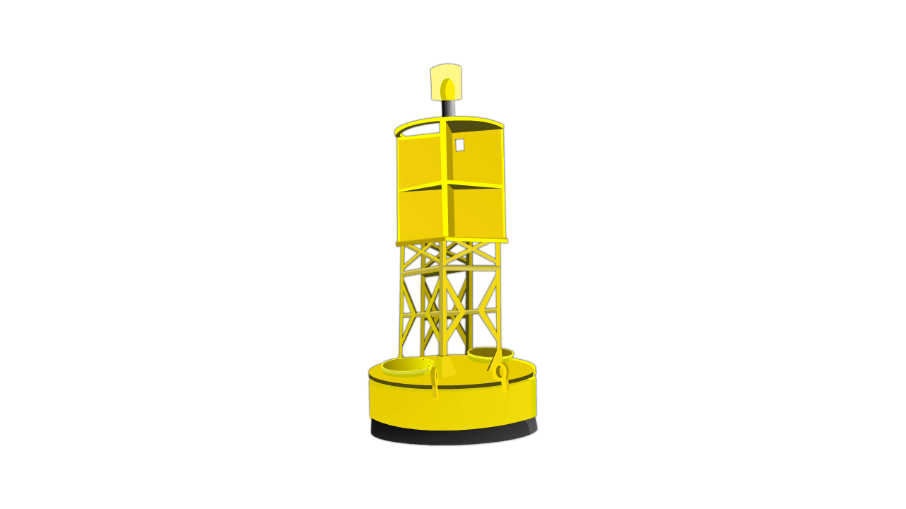
Approach #1: Relay Nodes
[OCEANS’07, ICC’11, ICC’14, Sensors’14]
Antenna
Relay
Acoustic Transceiver
Notes:
to use relay nodes. Let me tell you what I mean by that. You have a relay node that is partially submerged underwater. The relay node has an acoustic transceiver in the water and an antenna in the air. So for example,

Slide 10
Approach #1: Relay Nodes
[OCEANS’07, ICC’11, ICC’14, Sensors’14]
Radio
Antenna
Relay
Acoustic
or SONAR
Acoustic Transceiver
Notes:
if a submarine wants to communicate with the radio tower, it transmits an acoustic signal or SONAR, the relay receives it, and it re-transmits it to the air as a radio signal. That is how the relays work.
The problem, however, is that these relay nodes easily drift away with waves which cuts the communication link. Not only that, you cannot furnish the entire ocean surface with these relay nodes. So another approach that people use today

Slide 11
Approach #2: Surfacing
[ICRA’06, MOBICOM’07, OCEANS’10, ICRA’12]
Radio
Notes:
Is that the underwater vehicle needs to surface to a depth at which it can effectively communicate using radio signals. However, it would take forever for an underwater drone to go up and down and up and down, and it becomes a very time-consuming and expensive process. Also if a submarine surfaces, it would compromise its location to its adversary
So today, there is still no effective approach for underwater devices or submarines to communicate with other devices above the water surface.

Slide 12
This Talk: First Technology that Enables Wireless Communication Across the Water-Air Interface
Notes:
In this talk, I will be telling you about the first technology that enables wireless communication across water-air interface. Now, we are not going to enable a submarine to communicate with an airplane. But, we will enable an underwater sensor to communicate with another sensor above the water surface. Here is our idea.

Slide 13


This Talk: First Technology that Enables Wireless Communication Across the Water-Air Interface
RADAR
Measure Surface Vibration
Surface
Vibration
Acoustic
Underwater speaker
Notes:
We will use an underwater speaker which transmits an acoustic signal. This signal travels as a pressure wave.
When the pressure wave hits the surface, it causes a small vibration. To measure this vibration, we use a sensitive RADAR. The RADAR transmits a radio signal, which reflects off the water surface and comes back. The RADAR uses the reflected signal to measure the water surface vibration.
Now, whenever the underwater speaker transmits a different signal, the vibration at the surface changes, and the radar will be able to detect these changes. This is how we can enable an underwater device to communicate through water-air boundary. Effectively, what we have done is to transform the water surface itself from an obstacle to a communication medium. We call this,

Slide 14
Translational Acoustic RF Communication (TARF)
RADAR
Surface
Vibration
Acoustic
Underwater speaker
Notes:
translational acoustic RF communication or TARF. It uses a translation from an acoustic signal to a radio signal in order to enable the communication. This allows us to achieve the best of the both worlds. Acoustic for underwater and radio in the air. In this talk, I will be telling you about this technology.

Slide 15
Translational Acoustic RF Communication
Theoretically achieves the best of both RF and acoustic signals in their respective media
Deals with practical challenges of communicating across water-air interface including natural surface waves
Implemented and tested in practical environments
Notes:
It is the first technology that enables wireless communication across water-air interface.
Theoretically, it achieves the best of both RF and acoustic signals in their respective media
I will also tell you how we can deal with practical challenges of communicating across water-air interface like water surface waves.
Finally, I will tell you how we implemented and tested the system in practical environments.
Before I go into more details, let me tell you about how this technology paves way to future applications.

Slide 16
Key Idea
RADAR
Surface
Vibration
Acoustic
Underwater speaker
Notes:
The key idea was that the underwater acoustic transmitter will transmit an acoustic signal, which travels as a pressure wave. This pressure wave will cause a small vibration on the water surface, which is picked up by a sensitive RADAR.
So the first question one might ask is, can we sense the surface vibration?

Slide 17
Can We Sense the Surface Vibration Caused by the Transmitted Underwater Acoustic Signal?
Notes:
Can we sense the surface vibration caused by the transmitted underwater acoustic signal? To answer this question, we ran an experiment.

Slide 18
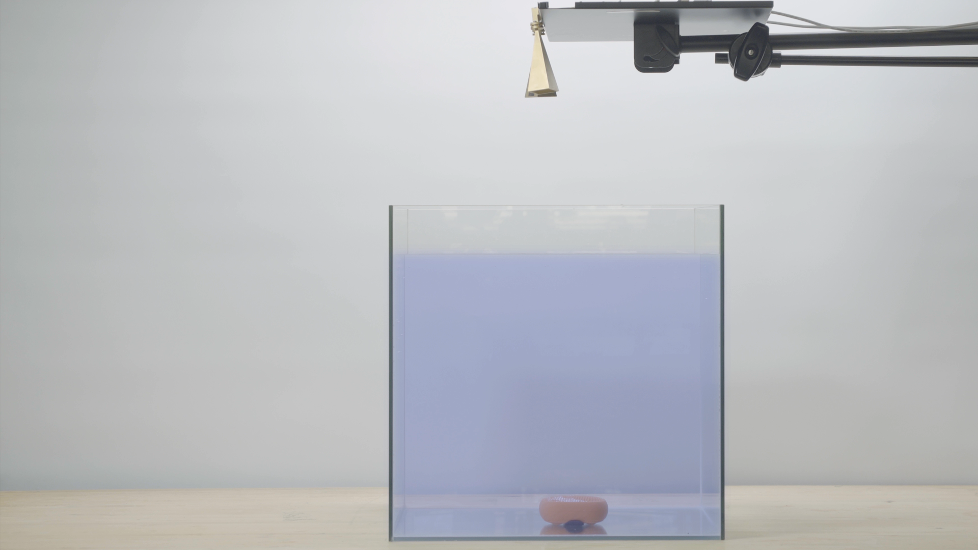
Recording the Surface Vibration
Experiment: Transmit Acoustic Signals at 100Hz
Water Surface
Water Tank
Underwater
Speaker
Notes:
We transmit acoustic signals at 100Hz. We transmit these signals from an underwater speaker and we measure the vibration here at the surface.

Slide 19
Recording the Surface Vibration
Experiment: Transmit Acoustic Signals at 100Hz
10µm
Underwater
Speaker
Notes:
So over here, I am going to plot these vibrations. The x-axis shows time and the y-axis the displacement.
When we transmit at 100Hz, this is the signal that we get in blue.
So you get a surface displacement that also varies at 100Hz, but the interesting thing is that the peak-to-peak of the vibration is only 10um.
This is a very tiny signal.

Slide 20
How Can We Sense Microscale Vibration?
Idea: Use RADAR to measure the surface vibration
RADAR
Radio
Acoustic
Underwater
Speaker
Notes:
So how can we sense microscale vibration? Remember that our idea is to use a RADAR to measure surface vibration.
However, the problem with this idea is that

Slide 21
How Can We Sense Microscale Vibration?
Idea: Use RADAR to measure the surface vibration
RADAR
Radio
Acoustic
Underwater
Speaker
Problem: Measuring micrometer vibrations requires 100s of THz of bandwidth → Impractical & Costly
Notes:
Measuring micrometer vibration requires 100s of THz of bandwidth. This is a million times larger than the bandwidth of a state-of-the-art WI-FI or LTE devices. Not only is this impractical and costly, but there is simply nothing like this that exists today. so how can we overcome this problem?
To overcome this problem,

Slide 22
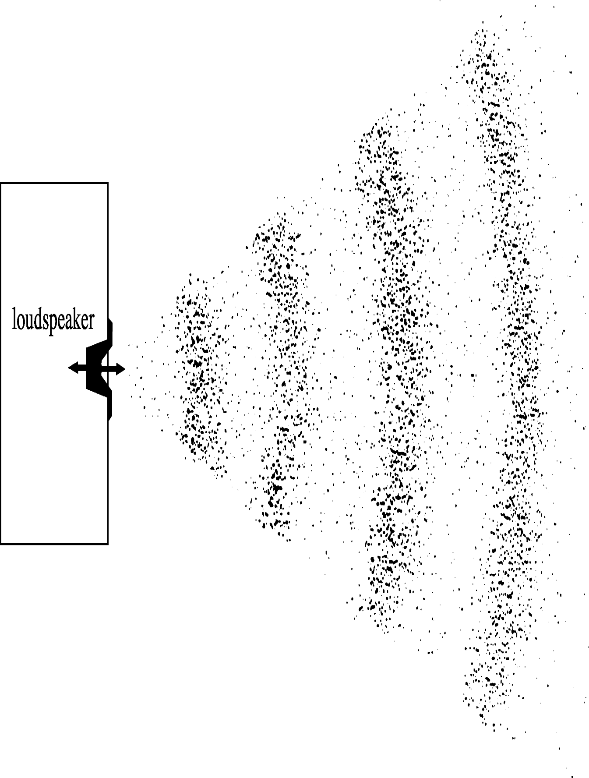
Solution: Measure Changes in Displacement Using the Angle of Millimeter-Wave RADAR
RADAR
Radio
Wave
Angle
Variation
Pressure Wave
Underwater speaker
Notes:
What we are going to do is to measure changes in displacement using the angle of millimeter-wave RADAR. Let me tell you what I mean by that. Radio signals travel as waves and they have an angle. This angle changes with any change in displacement. When the pressure wave hits the surface and causes the vibration, that leads to a change in the angle of the radio signals.

Slide 23

Solution: Measure Changes in Displacement Using the Angle of Millimeter-Wave RADAR
RADAR
$Angle$=$360×\frac{displacement}{wavelength}$
5mm
Angle
Variation
The angle of the milimeter-wave RADAR encodes
transmitted information from underwater
Pressure Wave
Underwater speaker
Notes:
Angle of a wave can be written as 360 * displacement / wavelength. This is nice because with a wavelength of 5mm and a displacement amplitude of 10um, the angle will vary 7.2 degrees which is detectable by our sensor. Now, the angle of the millimeter-wave RADAR encodes transmitted information from underwater.
Great! Now we have a mechanism for us to sense the surface vibration caused by the transmitted underwater acoustic signal. So are we done? Well, no, there still remains one problem, and it is the naturally occurring surface waves.

Slide 24
Natural Surface Waves Mask the Signal
On Calm Days, Ocean Surface Ripples (Capillary Waves)
Have 2cm Peak-to-Peak Amplitude
1,000 Times Larger than Surface Vibration
Caused by the Acoustic Signal
Notes:
For example, even on calm days, ocean surface ripples, also called capillary waves, have 2cm peak-to-peak amplitude.
This is 1000 times larger than the vibrations caused by the underwater acoustic signal transmitted, and it masks our signal.
How can we even sense the vibration in the presence of even such weak ocean ripples? Here is our idea.

Slide 25
Natural Surface Waves Can Be Treated as
Structured Interference and Filtered Out
Frequency
Naturally occurring waves
(e.g., ocean waves) are relatively slow
1 – 2Hz
Acoustic signals
are transmitted at higher frequencies
100 – 200Hz
Notes:
Natural surface waves can be treated as a structured interference and filtered out. Naturally occurring waves like ocean waves are relatively slow. Their frequency varies from 1 to 2Hz.
On the other hand, the acoustic signal transmitted at higher frequencies varies between 100Hz and 200Hz. Because they are separated from each other in frequency, we can use filtering.

Slide 26
Natural Surface Waves Can Be Treated as
Structured Interference and Filtered Out
Natural Surface Waves
Transmitted Signal
Notes:
For example, if you have a look at the frequency domain. Over here, the x-axis is the frequency and y-axis the power.
This is a representative signal in the frequency domain.
This part over here at low frequencies correspond to the ocean wave,
and this part over here at higher frequencies corresponds to our transmitted signal.
A simple solution would be to filter out the ocean waves and just look at the portion of the signal from 100Hz to 200Hz. So we went ahead and tried it, but unfortunately, it still did not work.

Slide 27
Natural Surface Waves Can Be Treated as
Structured Interference and Filtered Out
Natural Surface Waves
Transmitted Signal
Filtering alone does not work
Notes:
So, filtering alone does not work. Let me explain to you why.

Slide 28

Dealing with Waves
$Angle$=$360×\frac{displacement}{wavelength}$
Notes:
Previously, I told you that the angle is 360 x displacement / wavelength. This is not the whole story.

Slide 29


Dealing with Waves
$Angle$=$360×\frac{displacement}{wavelength}$
$$mod 360$$
Notes:
Actually, there is modulus 360. This means that the angle wraps around every 360 degrees. So when we plot the displacement

Slide 30


Dealing with Waves
$Angle$ =$360×\frac{displacement}{wavelength}$
$$mod 360$$
Wraps Around
5mm
Notes:
as a function of time, I get a result that looks like this.
Over here, you could see that the signal is varying with 5mm peak-to-peak which is much larger than the vibrations that we were seeing before. The thing that you notice over here is that the angle wraps around every 5mm. The reason is mod 360degrees. This wrapping around is non-linear so corrupts our signal. This is why filtering out alone does not solve the problem.

Slide 31
Dealing with Waves
Notes:
But if we can somehow track the natural surface waves, then we may be able to eliminate their impact. And this is exactly what we do. So let me show you what happens,

Slide 32
Dealing with Waves
Track & Unwrap
2cm
Transmitted
signal
Trend is Water
Surface Wave
Notes:
If we track and unwrap the natural surface waves, then we are able to eliminate this wrapping.
This trend that you see over here corresponds to the water surface. As you can see, this has peak-to-peak amplitude of 2cm. The small vibration on top of it corresponds to the transmitted signal from underwater.

Slide 33
Dealing with Waves
Track & Unwrap
Filter
Notes:
So now, we can go ahead and filter out the impact of the natural surface waves. When we do that, we get an output like this. Again on the x-axis I plot the time and y-axis displacement.

Slide 34
Dealing with Waves
Vibration at 100Hz
Notes:
We can see the 100 Hz signal transmission from underwater.
By treating natural surface waves as structured interference, we are able to track and eliminate their impact on our signal.
Great, so now we have a mechanism that allows us to sense vibrations at the surface and deal with natural surface waves.

Slide 35
How Can We Decode?
0? 1?
Notes:
How can we transmit bits of 0s and 1s? Here is a very simple example,

Slide 36
Decoding Information
Angle
Variation
100Hz
200Hz
RADAR
Rx
Rx
Surface
Vibration
100Hz
200Hz
Tx: 100Hz
Bit 0
Underwater
Speaker
Tx: 200Hz
Bit 1
Notes:
Now let us say that we want to transmit a bit 0. The underwater speaker can transmit at 100Hz.
This causes a surface vibration of 100Hz. This causes an angle variation at 100Hz.
On the other hand, if we want to transmit a bit 1, we can simply transmit at 200Hz,
This causes a surface vibration at 200Hz which also causes angle variation at 200Hz.
So if I want to transmit a bits of zeros and one, I can simply switch between 100Hz and 200hz.
Of course, what I have described to you over here is a very simplified example that borrows an existing technique called frequency shift keying. In practice, our new communication modality has unique properties.

Slide 37
Decoding Information
Angle
Variation
100Hz
200Hz
RADAR
Rx
Rx
Surface
Vibration
100Hz
200Hz
Tx: 100Hz
Bit 0
Underwater
Speaker
Tx: 200Hz
Bit 1
Notes:
The paper introduces algorithms for optimal power allocation and rate adaptation algorithm for water-air communication.

Slide 38
Implementation
Receiver
Custom made FMCW Millimeter-Wave RADAR
Center Frequency: 60GHz
Bandwidth: 3GHz
Antennas: 23dBi Gain Horn Antennas
Radar acts as daughterboard to a USRP(N210) software radio
Transmitter (low power)
Electro-Voice UW30 Underwater Loudspeaker
Center Frequency: 150Hz
Bandwidth: 100Hz
Pre-amplifiers
OSD 75W Compact Subwoofer Amplifier
Pyle 300W Stereo Receiver
Notes:
To implement TARF, for the receiver, we built our own FMCW mmWave RADAR operating at center frequency of 60GHz with a bandwidth of 3GHz. The RADAR acts as a daughterboard to a USRP software radio.
As for the transmitter, we use an electro-voice underwater loudspeaker at center frequency of 150Hz with a bandwidth of 100Hz. It was connected to two different types of pre-amplifiers to transmit at two different powers.

Slide 39
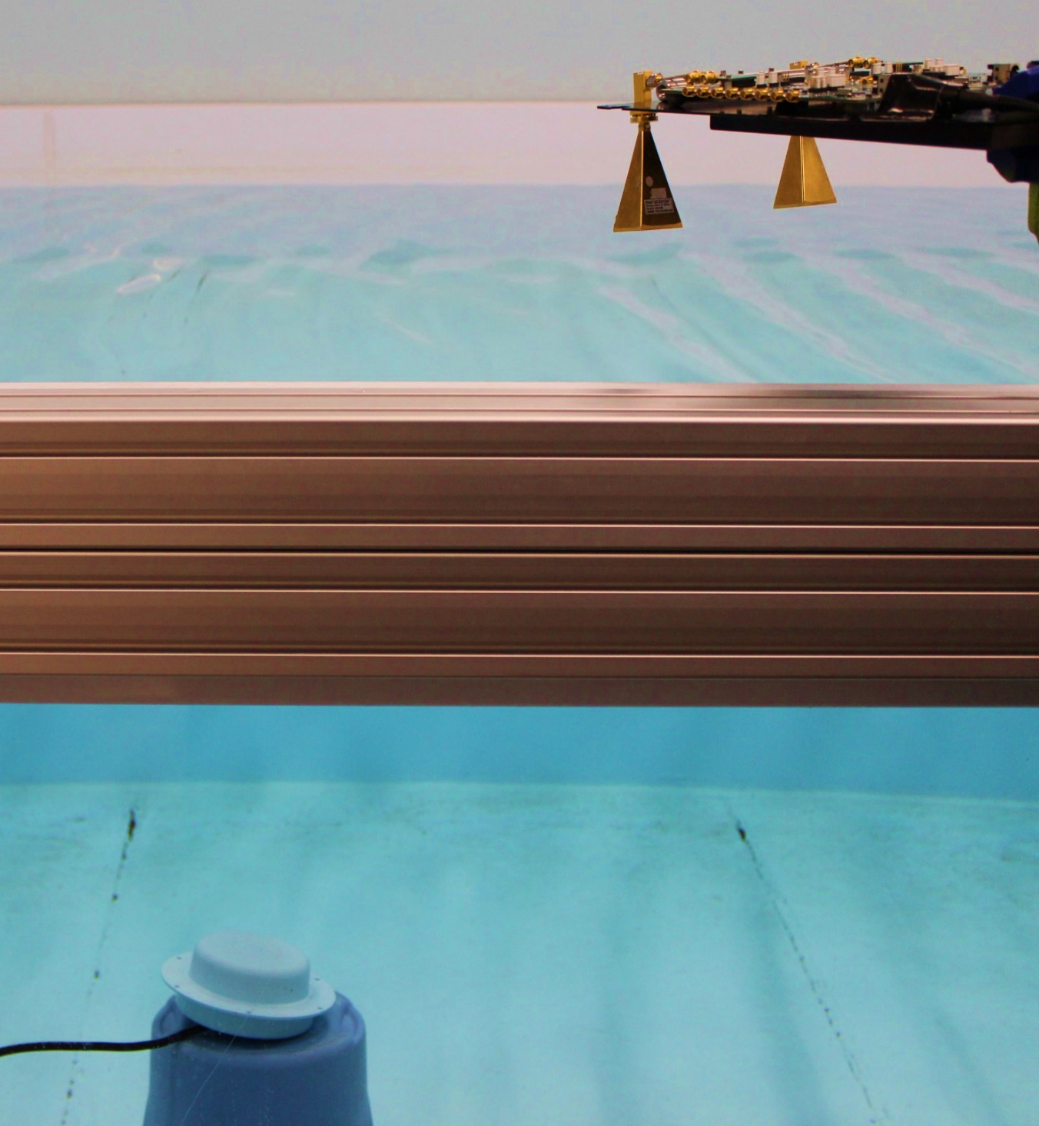
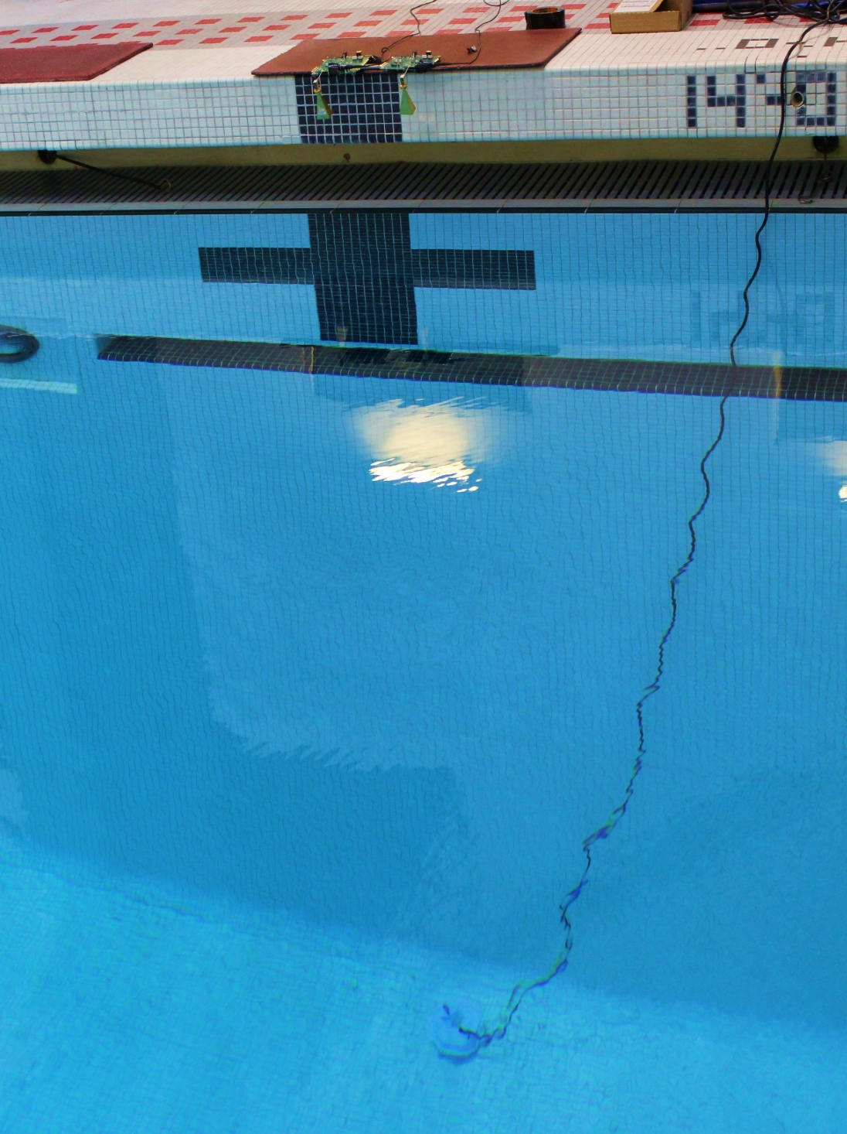
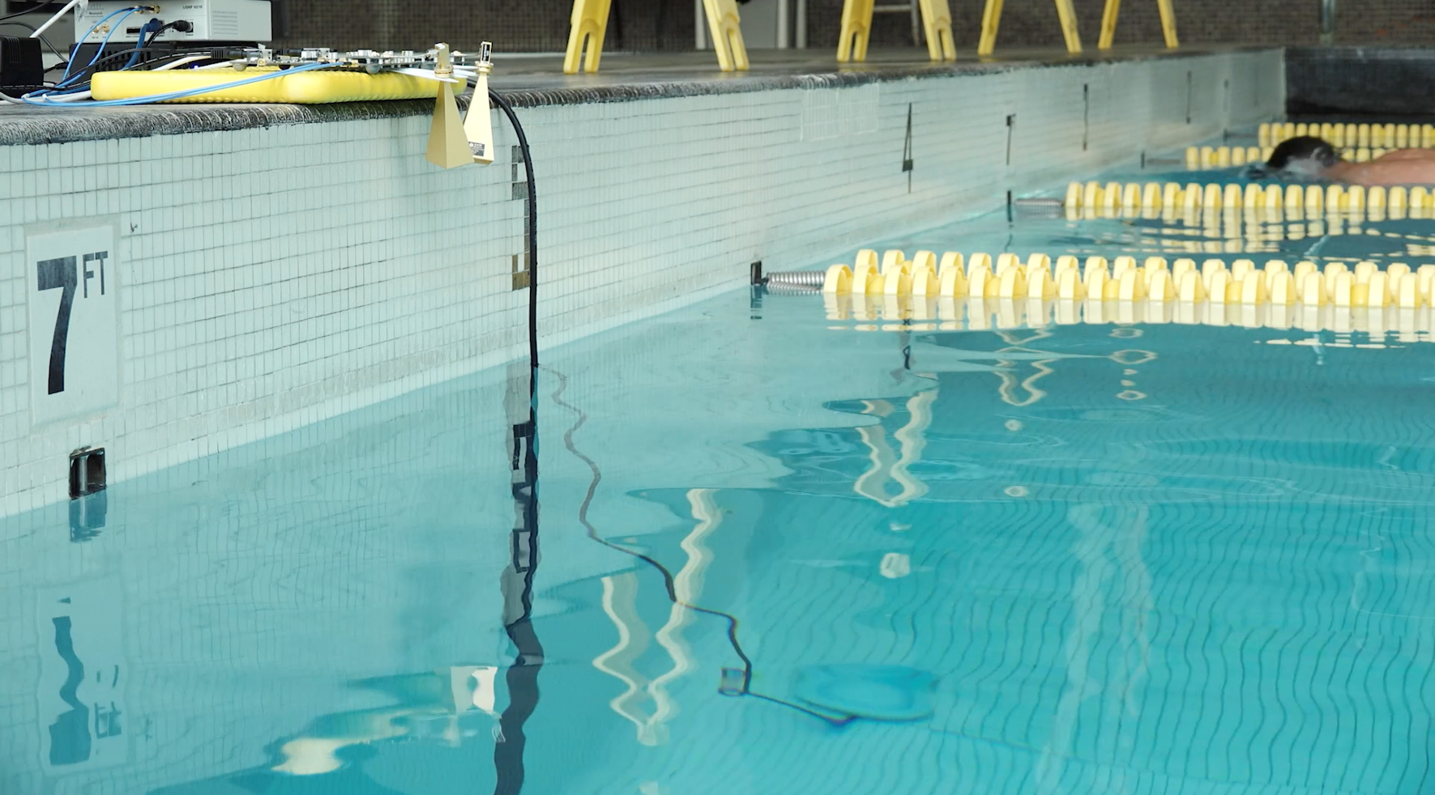
Evaluation
Water Tank
Swimming Pool
Swimming Pool with swimmers
RADAR
RADAR
Acoustic
Transmitter
Acoustic
Transmitter
Notes:
We evaluated our system in different settings.
For controlled evaluation, we use a water tank, over here you can see an acoustic transmitter and a RADAR receiver.
To evaluate at larger depths and less controlled settings, we also performed experiments in a swimming pool, as well as in the presence of swimmers as you can see over here. In the swimming pool, the swimmers and circulation currents caused continuous random ripples. And here are the acoustic transmitters and the radars.

Slide 40
Throughput Results
Experiment: Vary the Power and Depth of Underwater Transmission
BPSK
QPSK
16QAM
Adaptation
Notes:
First, let me show you our throughput result.
We ran an experiment where we vary the power and the depth of the underwater transmission.
Over here, I plot the SNR in dB on the x-axis and the throughput in BPS in the y-axis. We evaluated how the system performs with different modulation schemes. First, let me show you the results in the case of BPSK,

Slide 41
Throughput Results
Experiment: Vary the Power and Depth of Underwater Transmission
BPSK
QPSK
16QAM
Adaptation
Notes:
which is the lowest modulation scheme. As expected, the throughput increases with the SNR, and rises up to 100bits per second at high SNRs. We also tested the experiment with QPSK and 16 QAM. This is for QPSK

Slide 42
Throughput Results
Experiment: Vary the Power and Depth of Underwater Transmission
BPSK
QPSK
16QAM
Adaptation
Notes:
and 16QAM.

Slide 43
Throughput Results
Experiment: Vary the Power and Depth of Underwater Transmission
BPSK
QPSK
16QAM
Adaptation
Notes:
As expected, higher modulation schemes give us higher throughput.
And finally, this is the result

Slide 44
Throughput Results
Experiment: Vary the Power and Depth of Underwater Transmission
BPSK
QPSK
16QAM
TARF’s Optimal Adaptation
Notes:
of using our optimal power and rate adaptation scheme. As you can see, it generally outperforms the other modulation schemes.
Another thing I would like to note is that this throughput of hundreds of bps is typical for underwater communication. So this shows that TARF is a valid communication technology and can adapt to different channels.

Slide 45

SNR vs Depth
SNR
$$1/{{depth}^{2}}$$
Notes:
Next, I want to show you our results for the signal to noise ratio versus depth. Over here, the x-axis shows depth and y-axis the signal-to-noise ratio. And this is our result. As expected, the signal to noise ratio degrades with depth. In fact, it closely follows the theoretical trend of 1/depth^2.

Slide 46
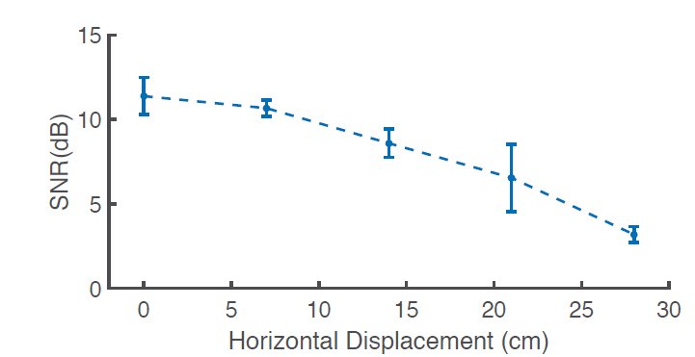
SNR with Alignment

Slide 47
Dealing with Waves
Experiment: Generate Waves of Peak-to-Peak Amplitudes
Capillary Wave
Notes:
Finally, I want to show you the ability of our system to deal with waves.
We ran experiments where we manually generate waves of different peak-to-peak amplitudes.
The x-axis is the wave height in centimeters and y-axis is the normalized throughput. In the absence of waves, the normalized throughput is 1. And, this is the throughput that we get with the waves of amplitude 2cm peak to peak. Remember that this is similar to the capillary waves which are dominant on the ocean on the calm days. The throughput here is very similar to that in the absence of waves. We also stress-tested our system to evaluate its performance with different wave heights, and these are our results.
Notice that beyond 20cm peak to peak, the system cannot establish a communication link. However, even for waves up to 16cm, we are able to achieve half of the normalized throughout. This means that our technology can communicate even in the presence of water surface waves that are 10,000 times larger than the acoustic vibrations.

Slide 48
Limitations
One-directional Communication
Ocean Wave Amplitude
Misalignment

Slide 49
Conclusion
The first technology that enables wireless networking across the water-air interface
Allows uplink wireless communication between an underwater and airborne node
Deals with practical challenges like natural surface waves

