Slide 1
AIM: Acoustic Imaging on a Mobile
Wenguang Mao, Mei Wang, and Lili Qiu
The University of Texas at Austin
MobiSys 2018, June 14th

Slide 2

Smartphone Based Imaging
Camera
RF
In darkness
Under obstruction
Special hardware
Resolution

Slide 3

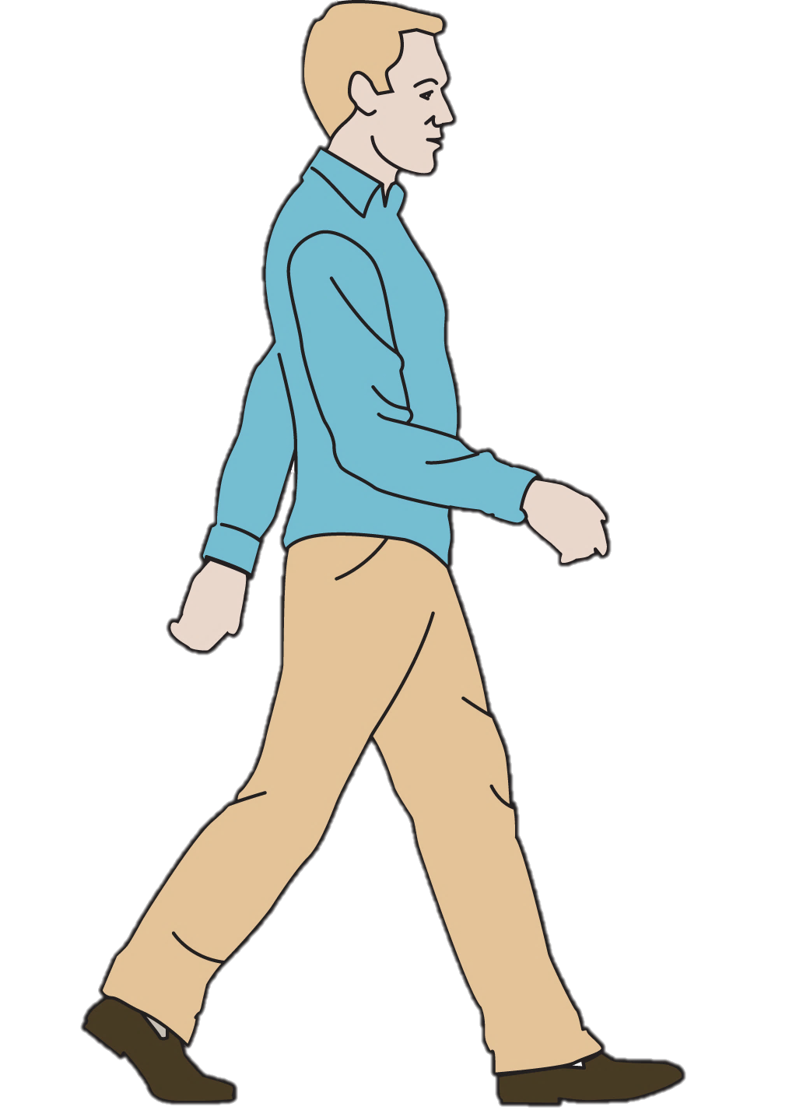

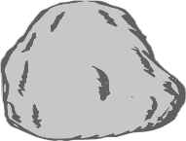
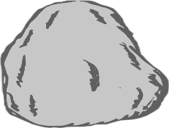
Acoustic Imaging
Work under darkness

Slide 4
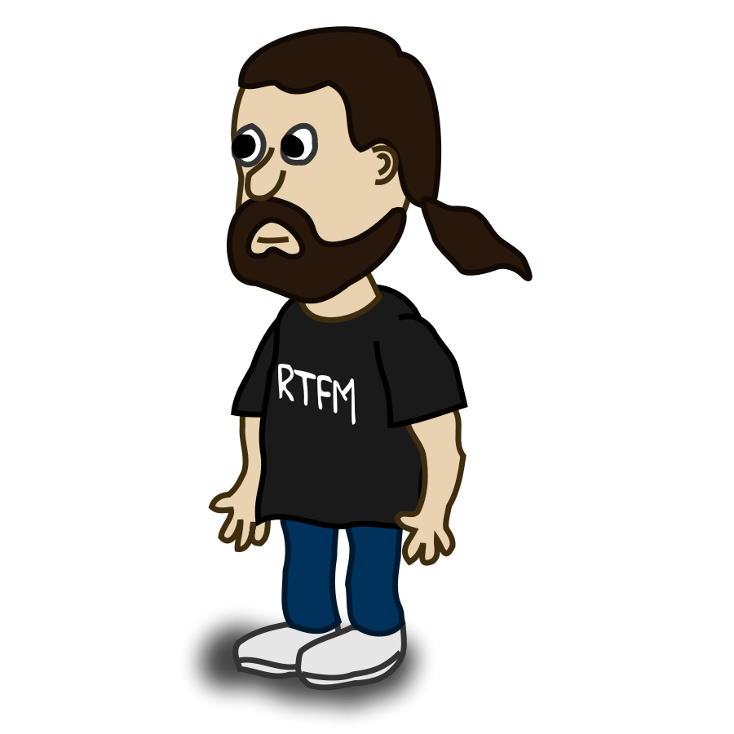
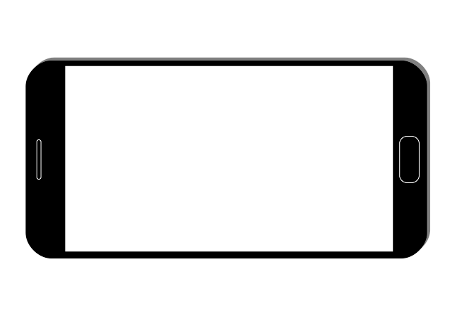

Acoustic Imaging
Penetrate many materials

Slide 5




Acoustic Imaging
Propagate around obstruction
?

Slide 6

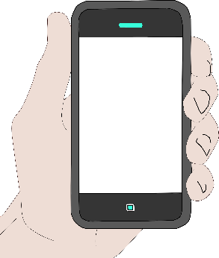
Synthetic Aperture Radar
Transducer Array
  Commonly used for acoustic imaging
  Sizable for good resolution
Synthetic Aperture Radar (SAR)
  Use one pair of speaker and microphone
  Move them by hand
  Emulate a virtual array
Target object
Speaker
Mic

Slide 7









Synthetic Aperture Radar
Position index
$$Y$$
Sample index
$$(x,y)$$
Move and record
$$s(n,k)$$
$$X$$
Data formatting
SAR
$$F_{k}$$
$$(cx,cy)$$
2-D FFT
$$i\left(n,k\right)=e^{jc(xn+yk)}$$
$$F_{n}$$

Slide 8
New Challenges
Strong self and background interference
Deviation from the desired trajectory due to hand jitters
Speaker and microphone distortion
All these factors significantly degrades the image quality

Slide 9
AIM
Acoustic Imaging on a Mobile
Interf. cancel
MPGA
SAR
Focus

Slide 10
Interference Cancellation
Acoustic Imaging on a Mobile
Interf. cancel
MPGA
SAR
Focus

Slide 11


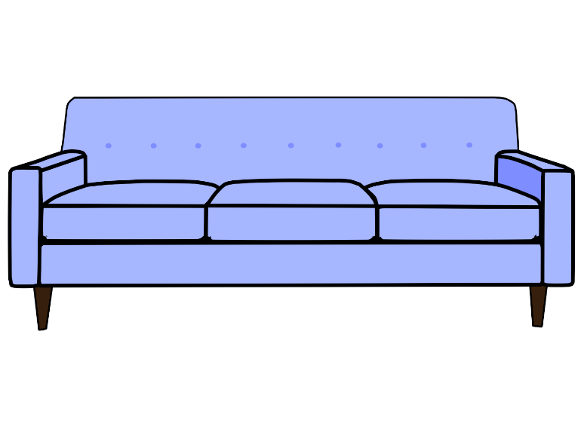

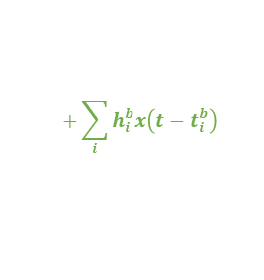
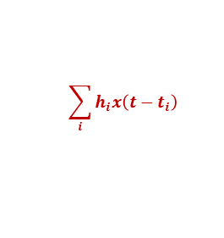
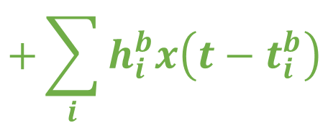
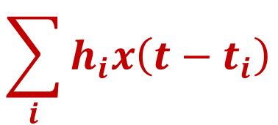
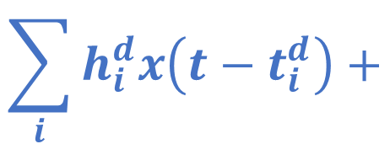
Two Types of Interference
target refl.
direct tx
background refl.
$$\sum_{i}{h_{i}^{d}x\left(t−t_{i}^{d}\right)+}$$
$$\sum_{i}{h_{i}x\left(t−t_{i}\right)}$$
$$+\sum_{i}{h_{i}^{b}x\left(t−t_{i}^{b}\right)}$$
$$y(t)=$$
$$\sum_{i}{h_{i}x\left(t−t_{i}\right)}$$
$$+\sum_{i}{h_{i}^{b}x\left(t−t_{i}^{b}\right)}$$

Slide 12
Two-Stage Cancellation
Stage 1
target refl.
direct tx
background refl.
Record in advance
Subtract from rcv. samples
Consider AGC
(unique to commercial devices)

Slide 13





Two-Stage Cancellation
Stage 2
$$\sum_{i}{{\tilde{h}}_{i}^{d}x\left(t−t_{i}^{d}\right)+}$$
$$\sum_{i}{h_{i}x\left(t−t_{i}\right)}$$
$$+\sum_{i}{h_{i}^{b}x\left(t−t_{i}^{b}\right)}$$
$$\tilde{y}(t)=$$
Find $\{{\tilde{h}}^{d},h, h^{b}\}$ to fit above equation best

Slide 14
Cancellation performance
SUB: subtracting direct path signals w/o considering AGC
CE: directly using channel estimation for cancellation
S1: Stage 1
S2: Stage 2
41dB
36dB
30dB
29dB
Our two-stage approach achieves best cancellation

Slide 15
MPGA
Acoustic Imaging on a Mobile
Interf. cancel
MPGA
SAR
Focus

Slide 16
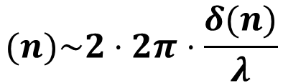


Impact of Motion Errors
Count for round trip
Target object
$$(n)\sim 2⋅2π⋅\frac{δ(n)}{λ}$$
$$m_{e}$$
wavelength
$$δ(n)$$

Slide 17
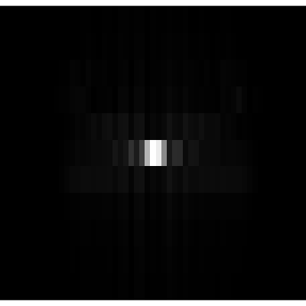
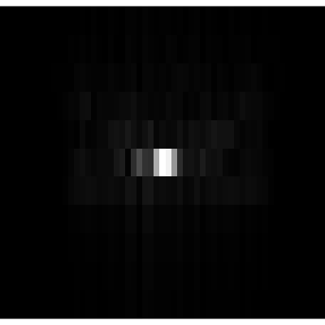
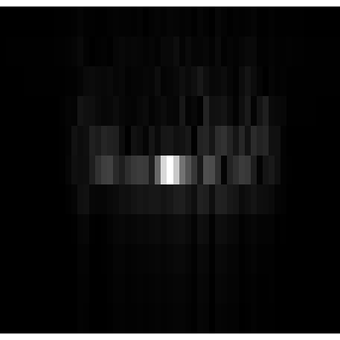
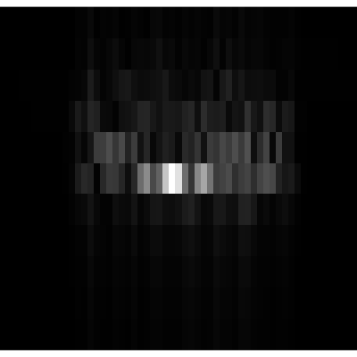
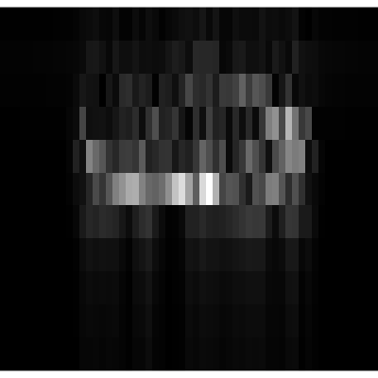
Impact of Motion Errors
Images of a point with phase errors
(a) 0 rad
(b) 0.2 rad
(b) 0.4 rad
(b) 0.8 rad
(b) 1.6 rad

Slide 18
Why PGA does not work?
Acoustic signals
  Low carrier frequency vs bandwidth ratio
  Slow propagation speed
  Slow sampling rate
Mobile setup
  Short distance between the target and mobile

Slide 19


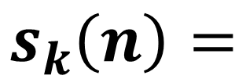
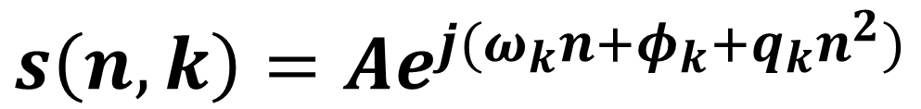
Estimate Phase Errors Due to Hand Jitters
Consider a point reflector
constant
linear term
quadratic term
$$s\left(n,k\right)=Ae^{j(ω_{k}n+φ_{k}+q_{k}n^{2}+m_{e}\left(n\right))}$$
$$s_{k}\left(n\right)=$$
$$s\left(n,k\right)=Ae^{j(ω_{k}n+φ_{k}+q_{k}n^{2})}$$
$$=E\left(n\right)$$
$$m_{e}\left(n\right)=E\left(n\right)−q_{k}n^{2}$$

Slide 20
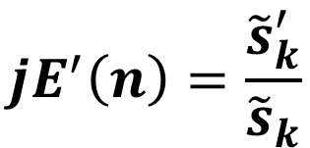





Estimate E(n)
$$ω≈ω_{k}$$
FFT
Shift
$$s_{k}={Ae}^{j(ω_{k}n+φ_{k}+E\left(n\right))}$$
Remove linear phase term
IFFT
Integral
Divide
Derivative
$$jE^{′}\left(n\right)=\frac{{\tilde{s}}_{k}^{′}}{{\tilde{s}}_{k}}$$
$$E\left(n\right)$$
$${\tilde{s}}_{k}^{′}={jAE′(n)e}^{j(φ_{k}+E\left(n\right))}$$
$${\tilde{s}}_{k}={Ae}^{j(φ_{k}+E\left(n\right))}$$

Slide 21



Remove Quadratic Terms
+
=
$$m_{e}(n)$$
$$q_{k}n^{2}$$
$$E(n)$$

Slide 22

MPGA Effectiveness
(a) Object
(b) No MPGA
(c) MPGA
MPGA is effective to remove phase errors and get high quality images

Slide 23
Focus Algorithm
Acoustic Imaging on a Mobile
Interf. cancel
MPGA
SAR
Focus

Slide 24
Blur Effect
The frequency response of speaker & mic is not flat
Ground truth image of a point
Blurred image

Slide 25



Evaluate Distortion Pattern
The blur pattern is deterministic
$$=$$
$$R$$
$$⋅$$

Slide 26







Focus and Denoise
$$I$$
$$=$$
$$R$$
$$⋅$$
$$X$$
Blurred image generated with distorted signals
Undistorted image of the object
Blur pattern
$${\left|I −RX\right|}^{2}+λ|X|$$

Slide 27
Focus Effectiveness
(a) Object
(b) No Focus
(c) Focus
Focus is necessary to remove blur effect

Slide 28
More details
Interference cancellation
  How to compensate the scaling difference
MPGA
  How to support wide-beam signals
  How to support multiple reflectors
  How to remove quantization errors
Focus
  How to measure the frequency response
  How to determine the matrix R

Slide 29
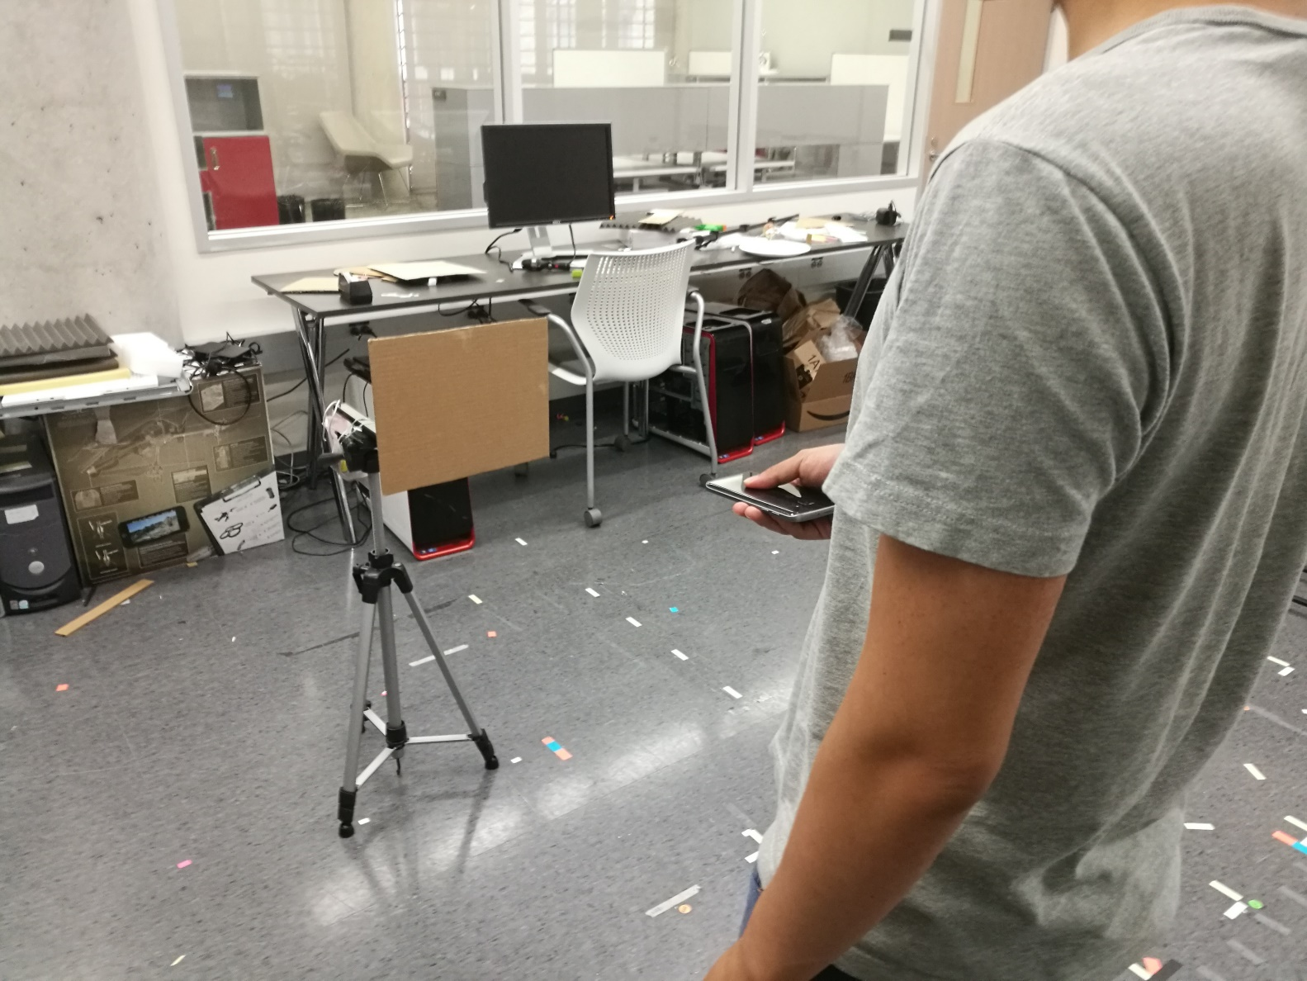
Evaluation
Implement AIM on Samsung S7
Use signals over 10KHz - 22KHz
Swipe the phone
  At 40cm in front of the target
  Over a 25cm straight line
  In 5s
Target

Slide 30
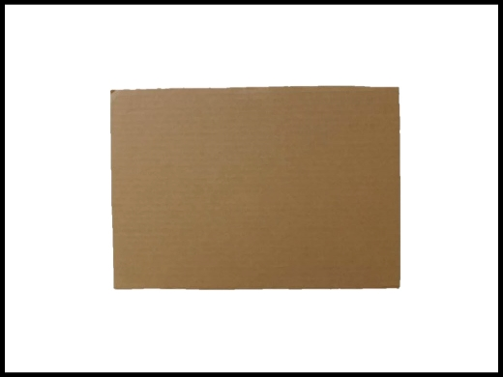
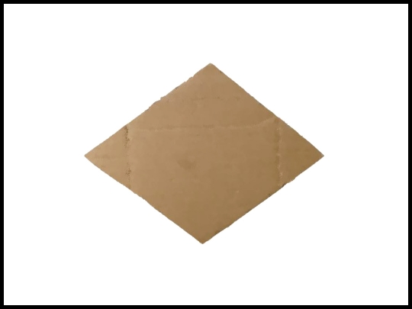
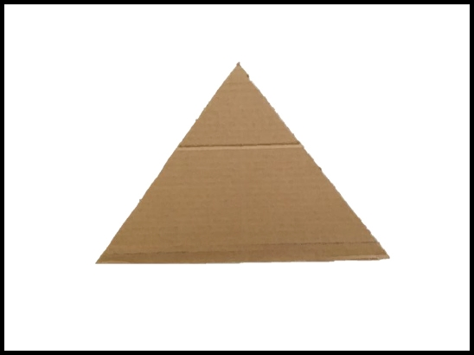

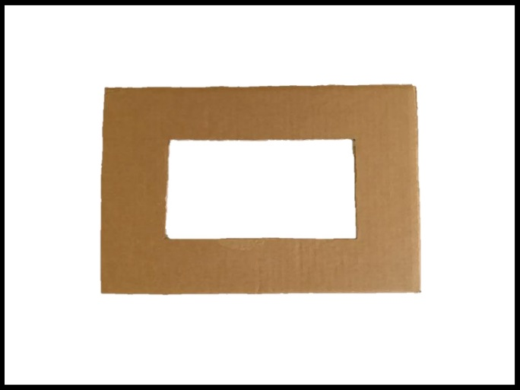






Results
Imaging different shapes
25 cm $×$ 18 cm
23 cm $×$ 17 cm
24 cm $×$ 17 cm
19 cm $×$ 19 cm
28 cm $×$ 18 cm
AIM can effectively capture the shapes of objects
(a) Rectangle
(b) Diamond
(c) Triangle
(d) Circle
(e) Hollow rect
Similarity:
$$\frac{S_{c}}{\sqrt{S_{i}S_{g}}}$$
0.86
0.85
0.79
0.72
0.89

Slide 31
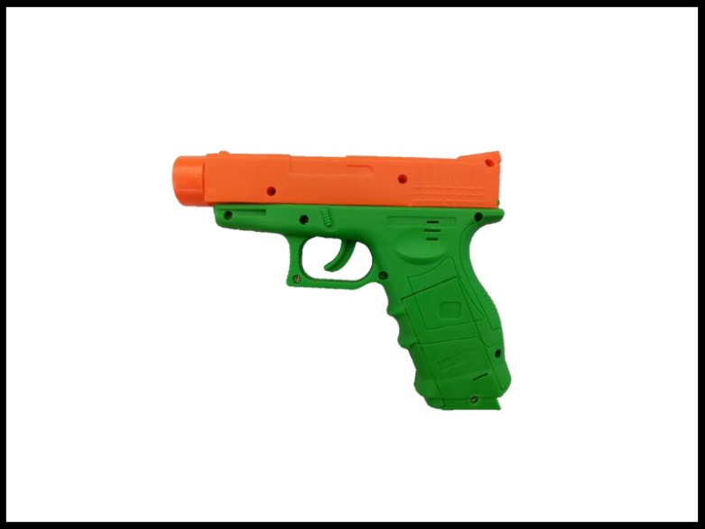
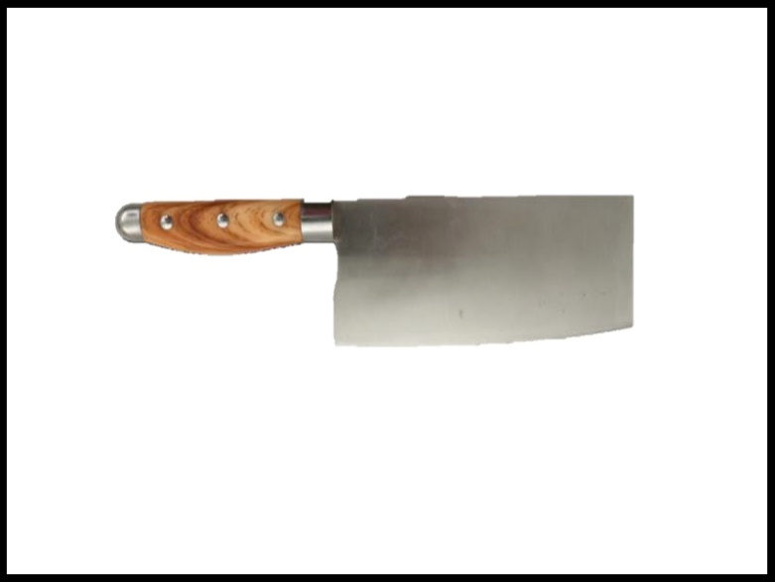


Results
Imaging weapons
18 cm $×$ 14 cm
27 cm $×$ 10 cm
Similarity:
0.81
0.87
(a) Gun
(b) Cleaver

Slide 32
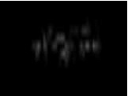
Results
Imaging weapons under clothes
(a) No weapon
(b) Gun
(c) Cleaver
Similarity:
0.76
0.77
AIM can be used for under-clothes imaging

Slide 33
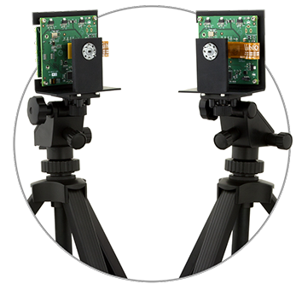
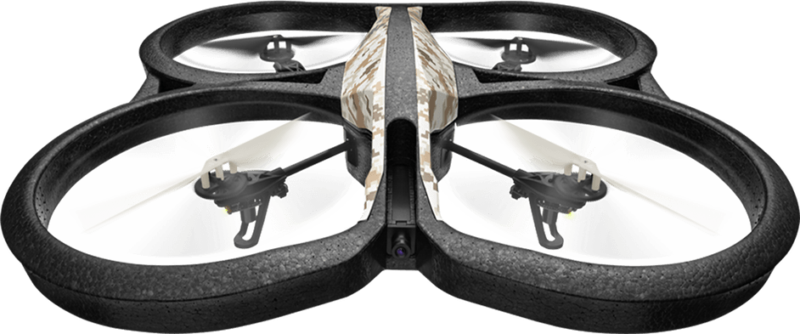
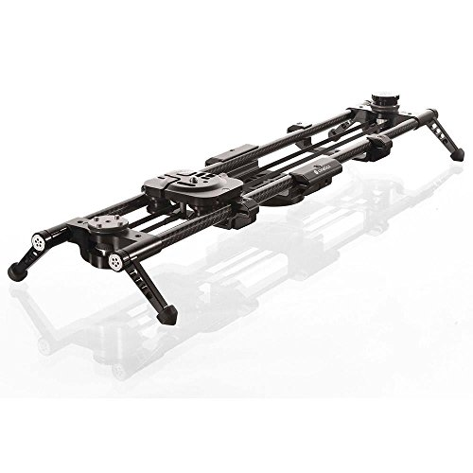
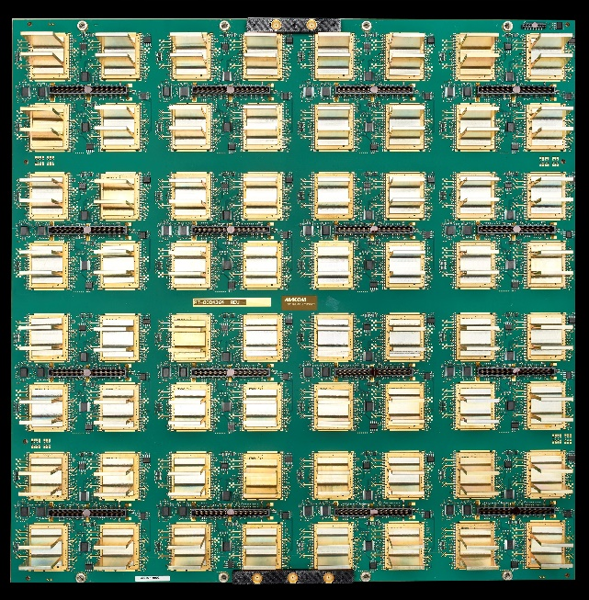
Related Work
RF based imaging
  Y. Zhu et al., MOBICOM’ 15
  F. Adbi et al., SIGGRAPH’ 15
  C. Karanma et al., IPSN’ 17
  J. Wang et al., MOBICOM’ 17
Acoustic based imaging
  H. Bedri et al., SIGGRAPH’ 14
  S. Ahn et al., IEEE IUS’ 15
  A. Izquierdo et al., Sensors’ 16

Slide 34
Conclusion
Develop smartphone based acoustic imaging system
Propose a new phase error correction algorithm
Design an approach to remove blur and noise from images
Implement the system on commercial phones
Future work: improve the range and support 3-D imaging

Slide 35
My Opinion
“迁移”的思想。
“迁移”的同时有足够的创新点（MPGA）。
有数学推导，理论证明。

