Slide 1
CrossSense: Towards Cross-Site and Large-Scale WiFi Sensing
Jie Zhang, Dingyi Fang, Meng Li, Xiaojiang Chen, et al, NWU
MobiCom 2018

Slide 2
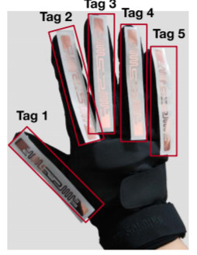
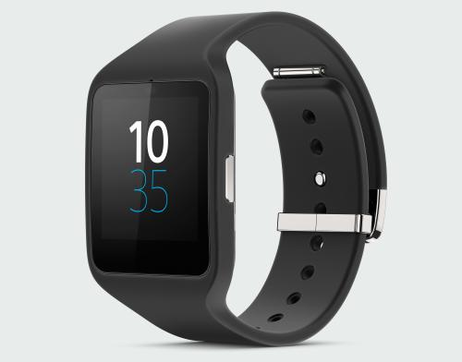
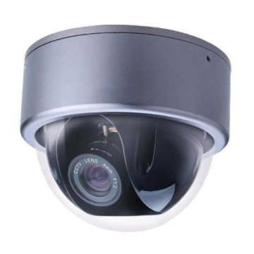
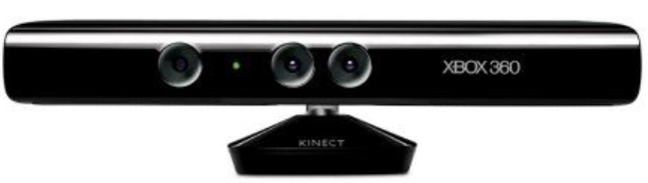
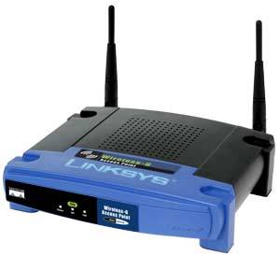
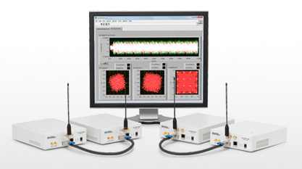
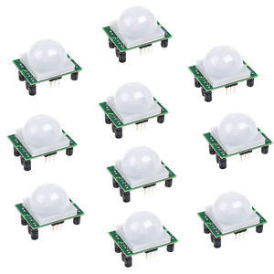
Activity Recognition
Sensor based
CV based
RF based

Slide 3
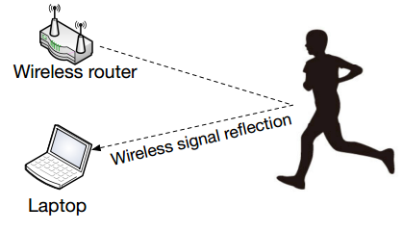
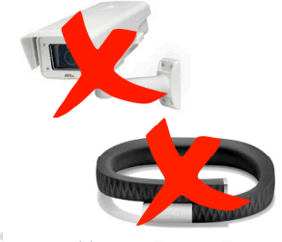
WiFi-based Activity Recognition
Using commercial WiFi devices to recognize human activities.
Advantages
Work in darkness
Better coverage
Less intrusive to users
Low cost

Slide 4
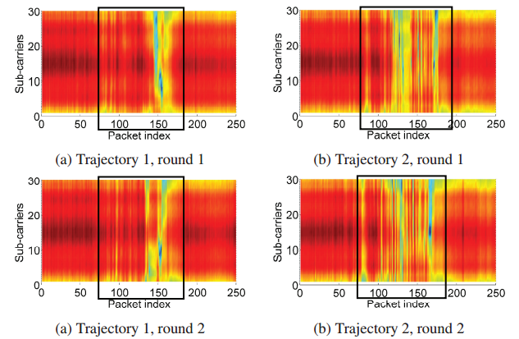
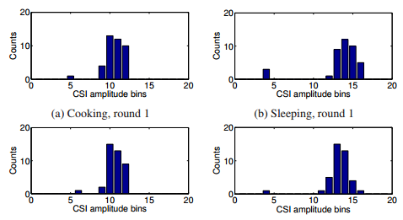
State-of-the-art
E-Eyes (MobiCom14)
Activities are characterized by CSI amplitude
Walking activity
In-place activity
Dynamic Time Warping(DTW)
Earth Mover Distance(EMD)

Slide 5
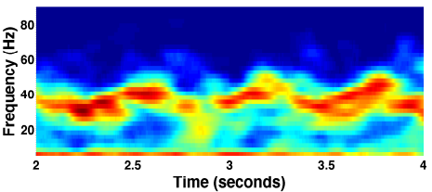
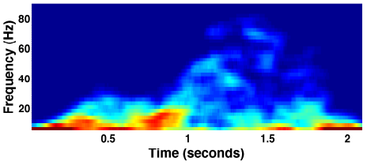
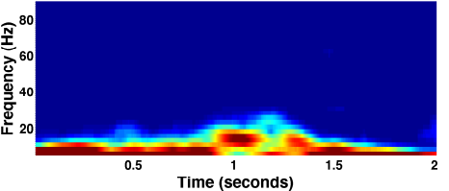
State-of-the-art
Activities are characterized by differential of CSI amplitude corresponding to:
Movement speeds
Change in movement speeds
Speeds of different body part
CARM (MobiCom15)
Walking
Discrete Wavelet Transform(DWT)
HMM model for activity classification
Falling
Sitting Down

Slide 6
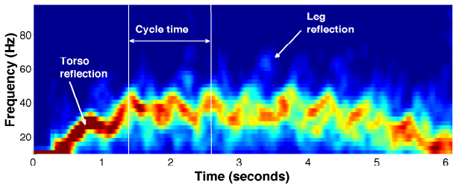
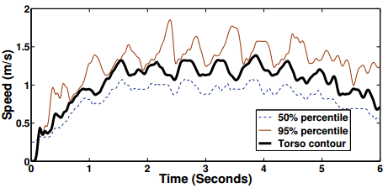
State-of-the-art
WifiU (Ubicomp16)
Movement of different body parts are characterized by different component of spectrum
Spectrogram signature
Torso speed
Gait cycle time
Leg swinging speed
Still relay on intensive training data collection for each site.

Slide 7
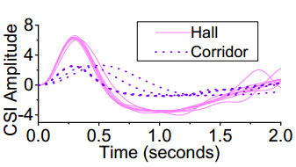
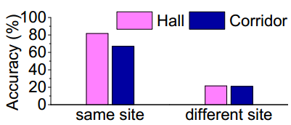
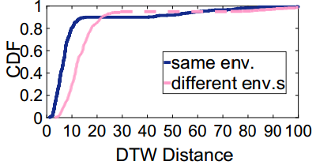
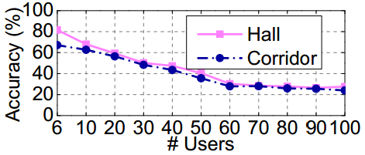
Motivations
Gait recognition accuracy drops significantly using training data collected from another site
CSI amplitude for the same person is qualitatively and quantitatively different across sites
Accuracy drops gradually as problem size increases

Slide 8
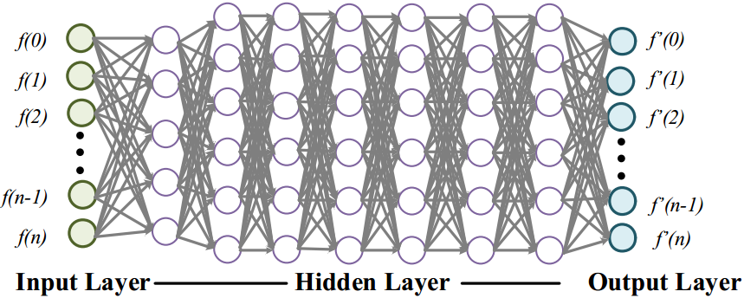
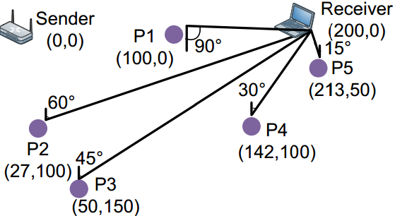
Proposed Scheme
To enable cross-site sensing
Classifier training data is only collected from one site due to intensive labor
Roaming Model is build with multi-layer ANN to map WiFi measurements from one site to another

Slide 9
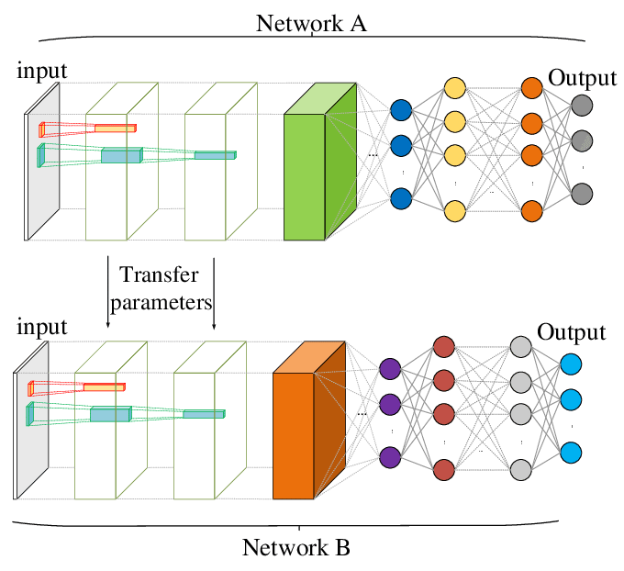
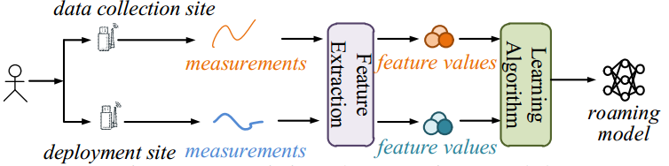
Proposed Scheme
To enable cross-site sensing
Roaming Model needs to be trained with supervised method using paired training instances
To reduce training cost for new environment,
fine-tune mechanism in Transfer Learning is adopted

Slide 10
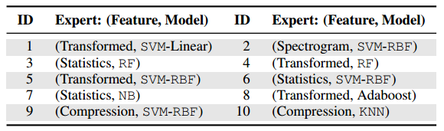
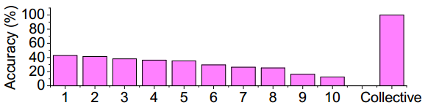
Proposed Scheme
To scale to larger problem size
No single classifier can identify over 50% of the test cases, collectively, they can identify all

Slide 11
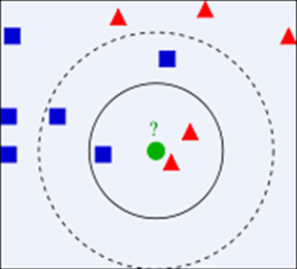
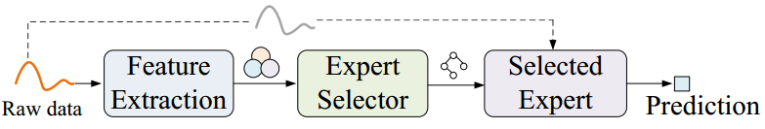
Proposed Scheme
To scale to larger problem size
Expert selector decide which classifier to use based on on-site measurement
KNN with DTW distance is used as expert selector

Slide 12
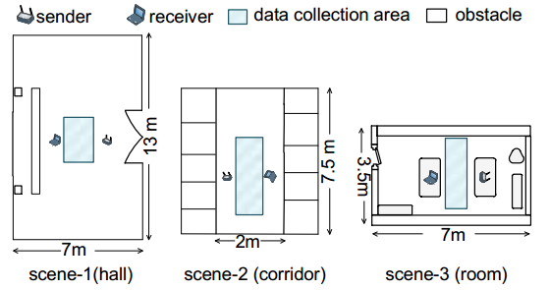
Experimental Setup
Gait
WiWho & WifiU
100 users X 20 measurements per user X 3 sites
Gesture
WiG & WiAG & TelepathicPhone
100 users X 40 gestures X 10 times per gesture X 2 channel metrics X 5 positions X 3 evaluation sites
Three sites and five positions for each

Slide 13
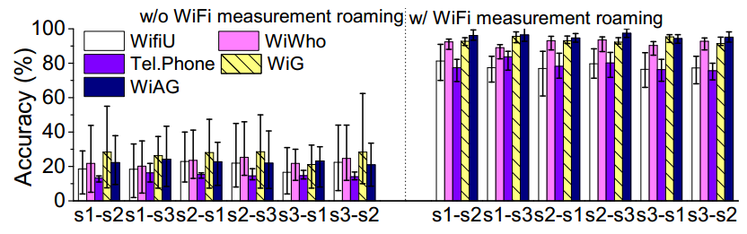
Experimental Results
Cross-site sensing
Roaming Model helps existing methods to achieve comparable performance as if the samples were collected from each deployment site.

Slide 14
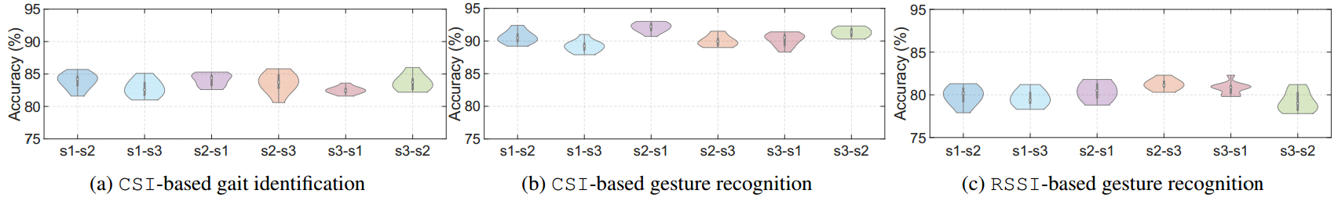
Experimental Results
Cross-site sensing
The proposed scheme delivers consistent performance across site pairs

Slide 15
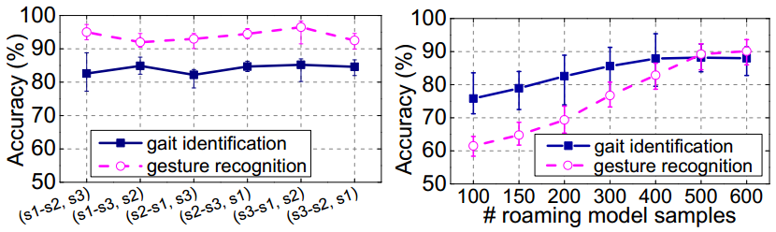
Experimental Results
Cross-site sensing
Transfer Learning reduces the number of samples required to learn a new roaming model;
TL use only ¼ of the samples to achieve comparable accuracy than w/o TL

Slide 16
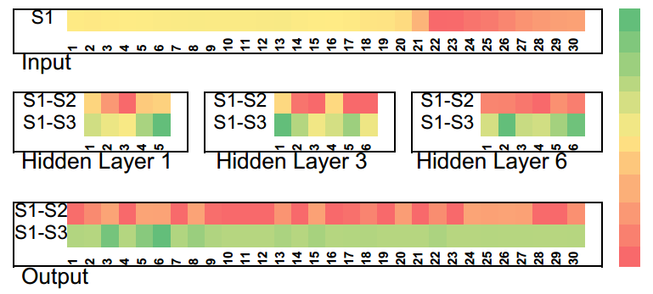
Experimental Results
Cross-site sensing
Visualization of ANN Layers’ States
The top hidden layers are less specified to target deployment environment and thus can be reused between Roaming Models

Slide 17
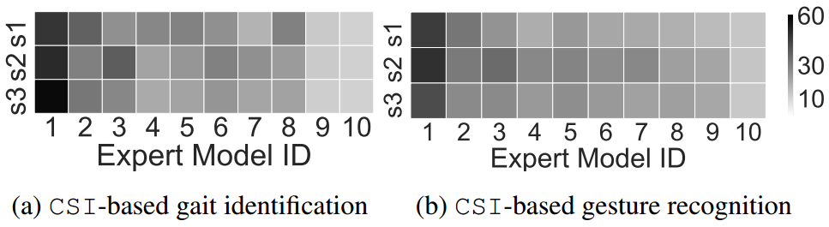
Experimental Results
Larger Problem Size
No single classifier can identify more than 60% of the test cases, meaning that a combined method is needed for large-scale and cross-site sensing

Slide 18
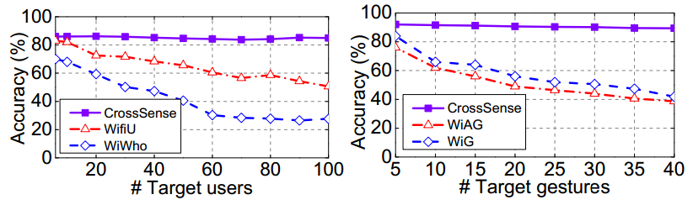
Experimental Results
Larger Problem Size
Combined method produces consistently good performance regardless of the problem size

Slide 19
Conclusions
The proposed scheme can efficiently reduce training data collection labor
The proposed scheme can scale the existing sensing system to larger problem size
Still sensitive to environment change
Roaming Model should be retrained for each position and orientation
Classifier should be trained for each position and orientation

