Slide 1
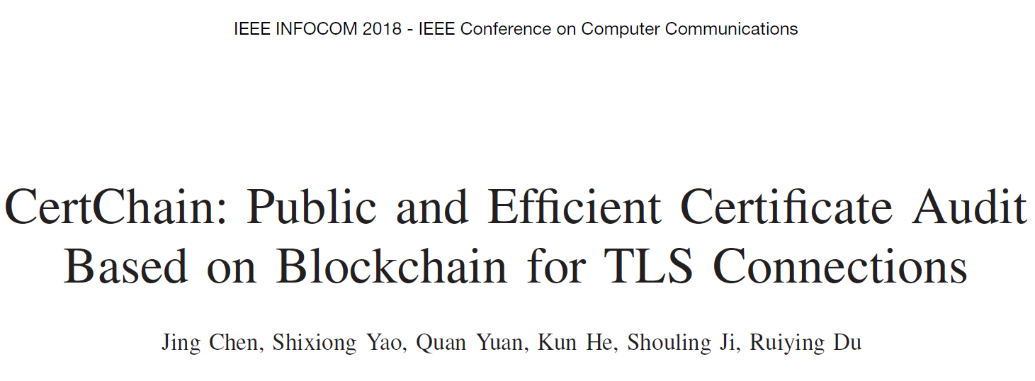
Presented by Kehong Huang

Slide 2
Index
Introduction
Problem Statement
Certchain Design
Analysis & Experiment
Conclusion & My opinion

Slide 3
Introduction
Introduction
Problem Statement
Certchain Design
Analysis & Experiment
Conclusion & My opinion
HTTPS and TLS(Transport Layer Security): based on Public Key Infrastructure(PKI), whose core component is certificate authorities(CAs).
However, recent real-world attacks have demonstrated existing CAs’ vulnerability.
CA-based trust disperse schemes
log-based misbehavior monitor schemes
In log-based misbehavior monitor schemes…

Slide 4
Introduction-challenges
Introduction
Problem Statement
Certchain Design
Analysis & Experiment
Conclusion & My opinion
Centralization in practice: consensus protocols in blockchain
Mandatory traversal: history searching
Block size limitation: needed size of certificate revocation list is larger than the normal size of a block in blockchain
Design a distributed dependability-rank based consensus protocol
Propose a new data structure called CertOper
Exploit a revocation checking method based on DCBF(dual counting bloom filter)

Slide 5
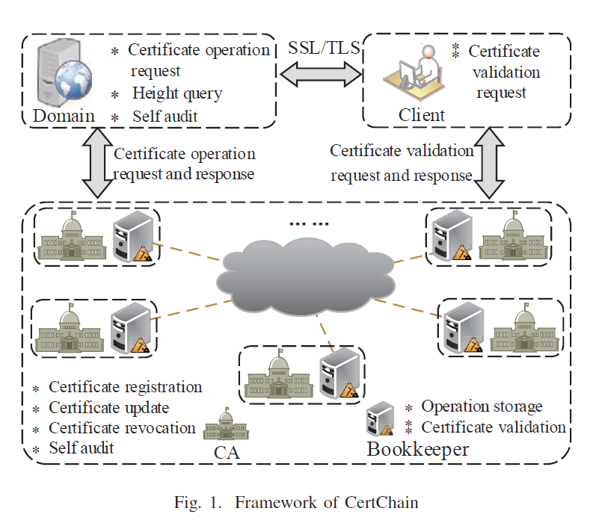
Problem Statement
Introduction
Problem Statement
Certchain Design
Analysis & Experiment
Conclusion & My opinion
System Model
Threat Model
Design Goals

Slide 6
Problem Statement
Introduction
Problem Statement
Certchain Design
Analysis & Experiment
Conclusion & My opinion
System Model
Threat Model
Issue a certificate for a malicious domain without being detected
Insert, delete, or tamper the certificate operations for making clients’ certificate validation failure
Control the blockchain by attacking some bookkeepers (assume that an adversary cannot control more than 51% bookkeepers in blockchain)
Design Goals

Slide 7
Problem Statement
Introduction
Problem Statement
Certchain Design
Analysis & Experiment
Conclusion & My opinion
System Model
Threat Model
Design Goals
Consensus fairness
High query efficiency
Intrusion tolerance

Slide 8
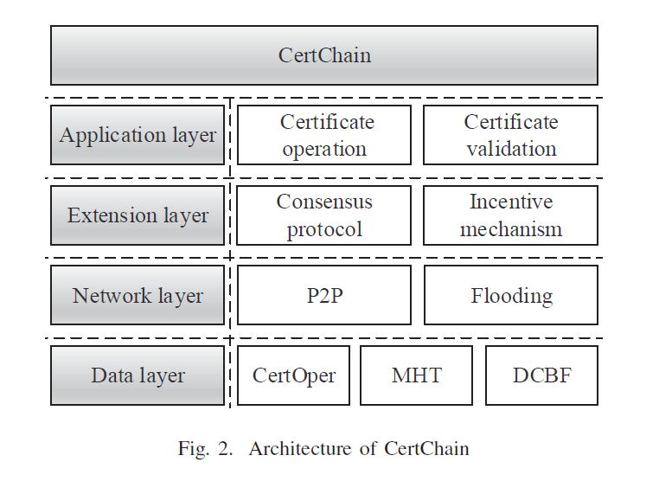
CertChain Design-Overview
Introduction
Problem Statement
Certchain Design
Analysis & Experiment
Conclusion & My opinion

Slide 9
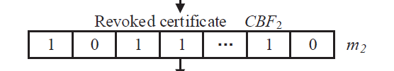

CertChain-Data layer
Introduction
Problem Statement
Certchain Design
Analysis & Experiment
Conclusion & My opinion
CertOper
Subject Name
Operator Name
Operation Type
Timestamp & NoteAfter
Current Certificate Hash
Last Operation Height
DCBF-Dual Counting Bloom Filter

Slide 10
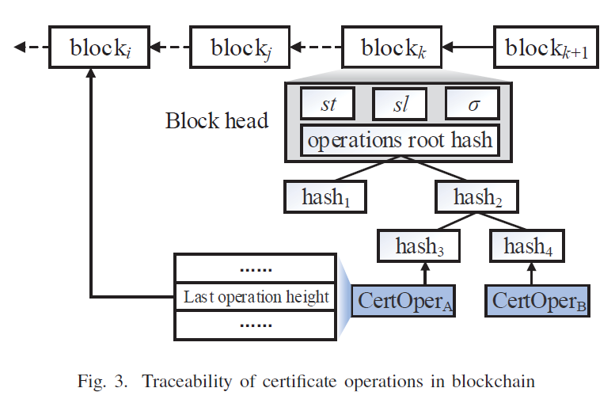
CertChain-Extension layer
Introduction
Problem Statement
Certchain Design
Analysis & Experiment
Conclusion & My opinion
The block and blockchain
The dependability-rank based consensus protocol
Incentive mechanism

Slide 11
CertChain-Extension layer
Introduction
Problem Statement
Certchain Design
Analysis & Experiment
Conclusion & My opinion
The block and blockchain
The dependability-rank based consensus protocol
Initialization：broadcast public key and dependability-rank
Chain extension
Incentive mechanism
Every CA shares the dependability-rank with the corresponding bookkeeper

Slide 12
CertChain-Application layer
Introduction
Problem Statement
Certchain Design
Analysis & Experiment
Conclusion & My opinion
Certificate Operations
Certificate registration
Certificate update
Certificate revocation
From Domain to CA, generate CertOper and update DCBF
Certificate validation
From client
Verify the signature
Check the expiration date
Check certificate operation in blockchain
Check the certificate status

Slide 13
Analysis & Experiment
Introduction
Problem Statement
Certchain Design
Analysis & Experiment
Conclusion & My opinion
Analysis
In CertChain, the certificate operation can be traced efficiently and certificate revocation checking can be fed back efficiently without false positives under DCBF.
By self and public audit, CertChain can tolerate the failure of defense mechanisms implemented in CAs or bookkeepers under the threat model.
CertChain’s security against:
DoS attacks
Rogue certificates or operations
CA’s private key leakage
Experiment

Slide 14
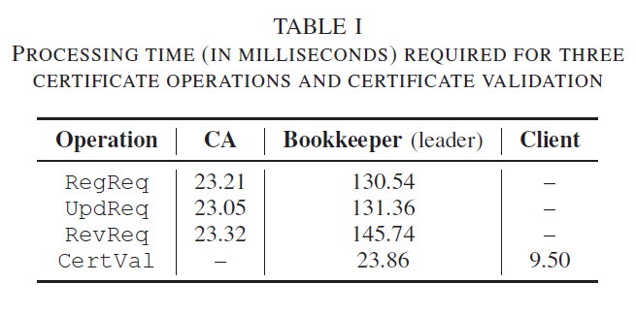
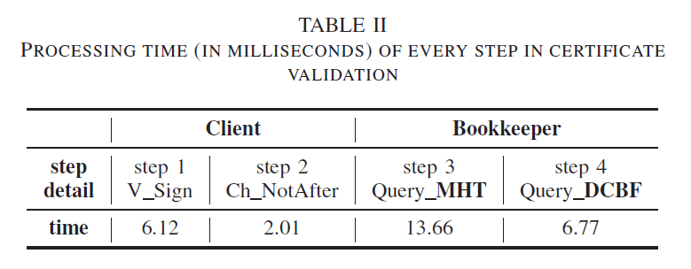
Analysis & Experiment
Introduction
Problem Statement
Certchain Design
Analysis & Experiment
Conclusion & My opinion
Analysis
Experiment
(10CAs, Block size = 2MB, generate every block for 6.7s on avg)

Slide 15
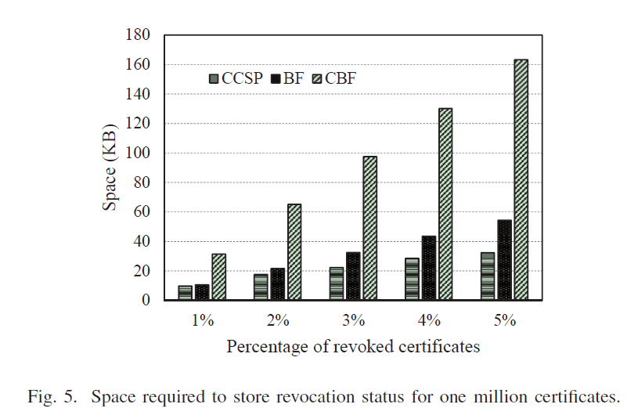
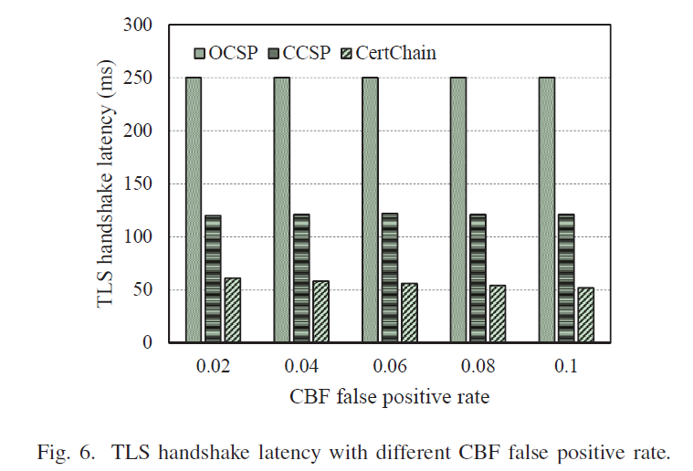
Analysis & Experiment
Introduction
Problem Statement
Certchain Design
Analysis & Experiment
Conclusion & My opinion
Analysis
Experiment
(10CAs, Block size = 2MB, generate every block for 6.7s on avg)

Slide 16
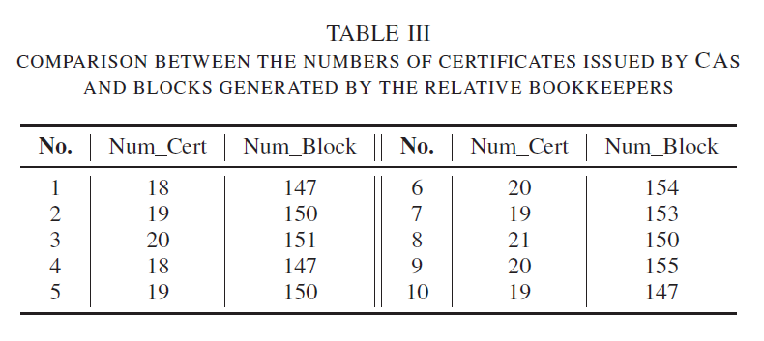
Analysis & Experiment
Introduction
Problem Statement
Certchain Design
Analysis & Experiment
Conclusion & My opinion
Analysis
Experiment
(10CAs, Block size = 2MB, generate every block for 6.7s on avg)

Slide 17
Conclusion & My opinion
Introduction
Problem Statement
Certchain Design
Analysis & Experiment
Conclusion & My opinion
Conclusion
A public and efficient certificate audit scheme based on blockchain
A distributed dependability-rank based consensus protocol
A new data structure called CertOper
A method that utilizes Dual Counting Bloom Filter(DCBF)
My opinion
Combine the blockchain
Not complex but comprehensive

Slide 18
Thank you!

