Slide 1
MPiLoc: Self-Calibrating Multi-Floor Indoor
Localization Exploiting Participatory Sensing
Chengwen Luo, Hande Hong,
Mun Choon Chan, Jianqiang Li,
Xinglin Zhang, Zhong Ming
IEEE TRANSACTIONS ON MOBILE COMPUTING, VOL. 17, NO. 1, JANUARY 2018
Notes:
IEEE TRANSACTIONS ON MOBILE COMPUTING 18
利用dead-reckoning的方法构建wifi fingerprint map进行定位的方法

Slide 2

Background
Fingerprint-based indoor localization
  Offline：calibration stage to build a radio map for the target location
  Online：localization with WIFI fingerprint floor plan
Labor-intensive site surveys and system maintenance
  Massive cost of deployment and update of WIFI map
Notes:
构建和更新fingerprint map

Slide 3

Goal
Build and update WIFI fingerprint map
  Without priori knowledge of floor plan or AP locations
  Automatically update the map
Dead-reckoning with crowdsourcing to build and update WIFI fingerprint map

Slide 4
Challenge vs Key ideas
Challenge: cumulated error over time
  Without priori knowledge for correction
Solution: Trajectory match and merging
  Collect trajectories by crowdsourcing
  Match and merge trajectory segment in the same location to reduce error
Notes:
积累的误差越来越大
把众包的到的轨迹数据进行match和merge
利用均值减小误差

Slide 5
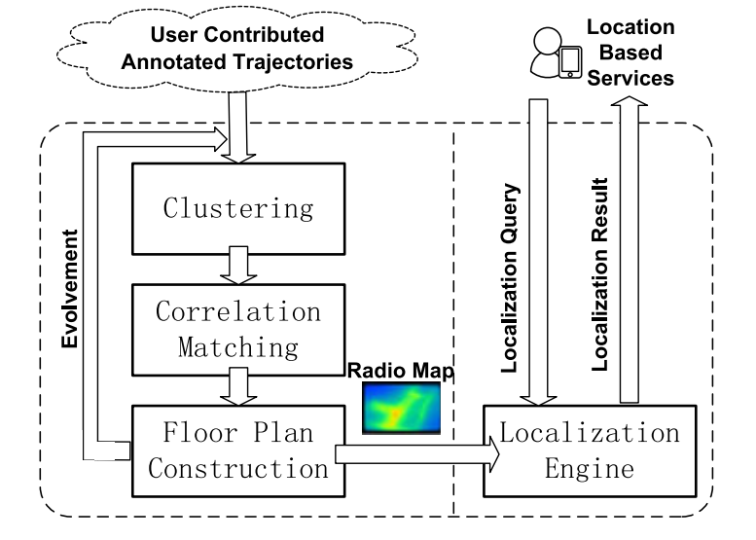
Overview
Notes:
android手机上获取加速度信息，RSS信息，气压计读数，把加速度信息转换成轨迹
Clustering，把得到的轨迹按照楼层聚类，然后划分成straight line和turn两种segment
Segment匹配和合并，构建带有wifi信息的平面图
利用平面图进行定位

Slide 6
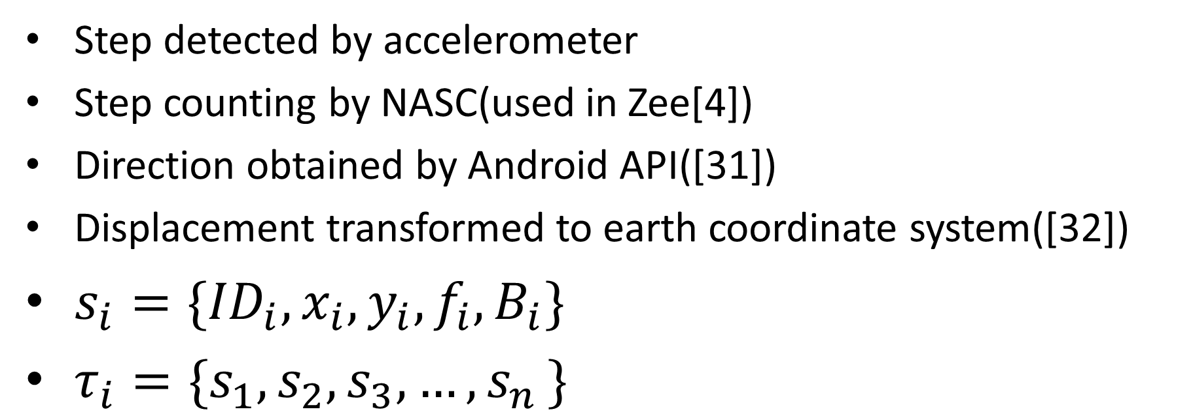
0.Data Collection
Step detected by accelerometer
Step counting by NASC(used in Zee[4])
Direction obtained by Android API([31])
Displacement transformed to earth coordinate system([32])
$s_{i}=\{{ID}_{i},x_{i},y_{i},f_{i},B_{i}\}$
$τ_{i}=\{s_{1},s_{2},s_{3}, …{,s}_{n}\}$
[4] A. Rai, K. K. Chintalapudi, V. N. Padmanabhan, and R. Sen, “Zee: Zero-effort crowdsourcing for indoor localization,” in Proc. 18th Annu. Int. Conf. Mobile Comput. Netw., 2012, pp. 293–304.
[31] Android motion sensors. [Online]. Available: https://developer. android.com/guide/topics/sensors/sensors_motion.html
[32] Y. Jin, H.-S. Toh, W.-S. Soh, and W.-C. Wong, “A robust deadreckoning pedestrian tracking system with low cost sensors,” in Proc. IEEE Int. Conf. Pervasive Comput. Commun., 2011, pp. 222–230.
Notes:
每一步的信息包括
全局的id，x,y的空间坐标
RSS向量
气压计的读数
得到的是相对坐标，每条轨迹只需要一个和真实位置重合的点即可得到实际坐标

Slide 7
1.Trajectory Clustering
(1).AP clustering
(2).Floor-level clustering
(3).Path Segment separation
Notes:
Ap clustering
Floor-level clustering
把一条轨迹按照straight line和turn划分成不同的segment

Slide 8

(1).AP clustering
$C=\{c_{1},c_{2},c_{3}, …{,c}_{n}\}$
Notes:
划分之后不同的cluster内的轨迹信息上没有重合的AP

Slide 9
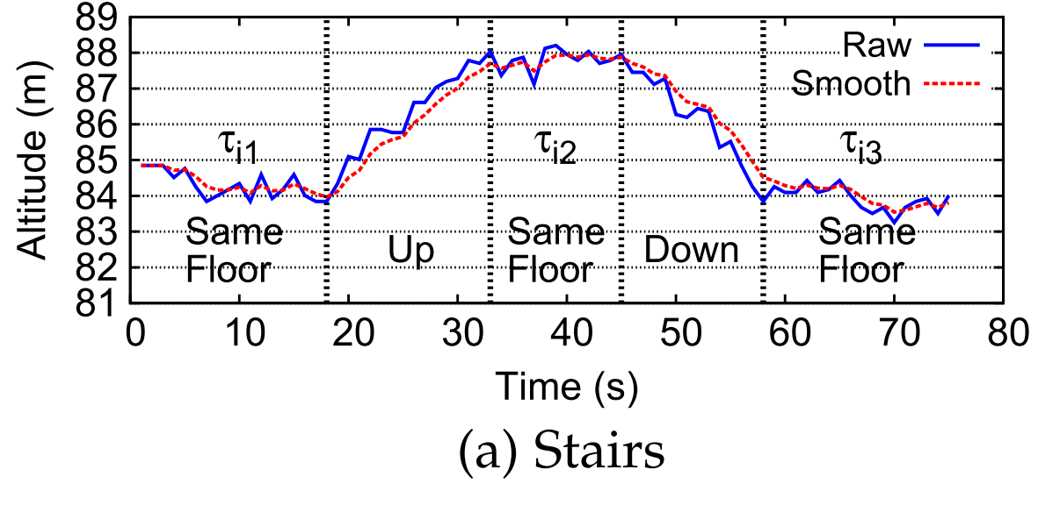
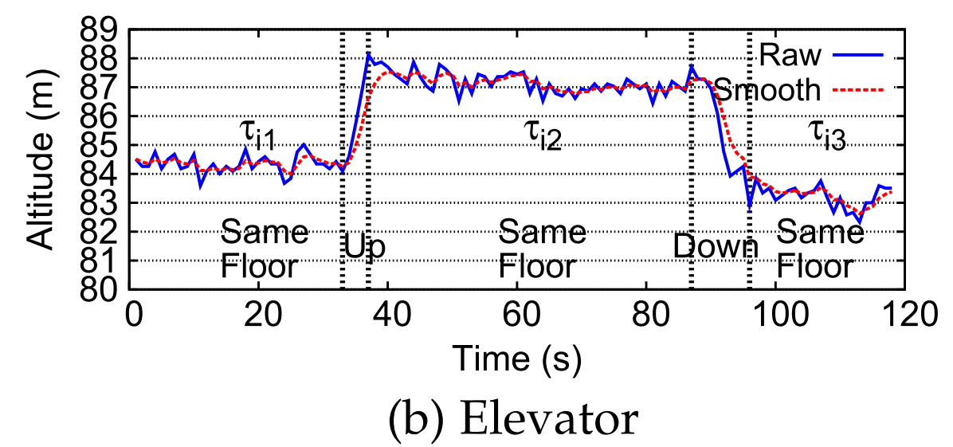
(2).Floor clustering
1.Floor Transition Detection
Notes:
设置一个滑动窗口，滑动窗口两端的读数差超过阈值即认为发生了floor transition，
把一条长的轨迹划分成不同楼层的轨迹
并且得到了这些轨迹之间上下楼的约束

Slide 10
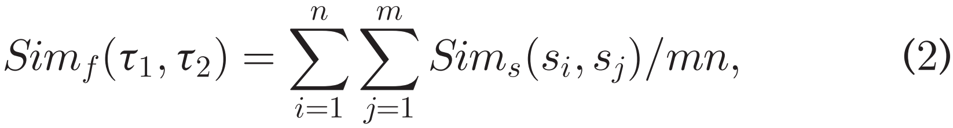
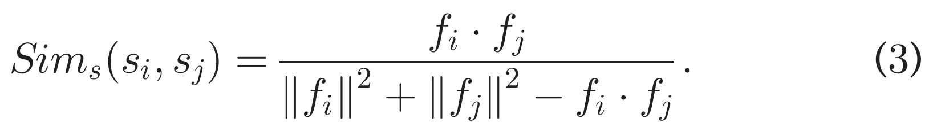
(2).Floor clustering
2.Floor Level Clustering by Tanimoto Coefficient[35]
[35] Y. Chon, N. D. Lane, F. Li, H. Cha, and F. Zhao, “Automatically characterizing places with opportunistic crowdsensing using smartphones,” in Proc. ACM Conf. Pervasive Ubiquitous Comput., 2012, pp. 481–490
Notes:
检测哪些轨迹是属于同一层楼的，两条轨迹上有越多相似的wifi fingerprint，相似度越高。

Slide 11
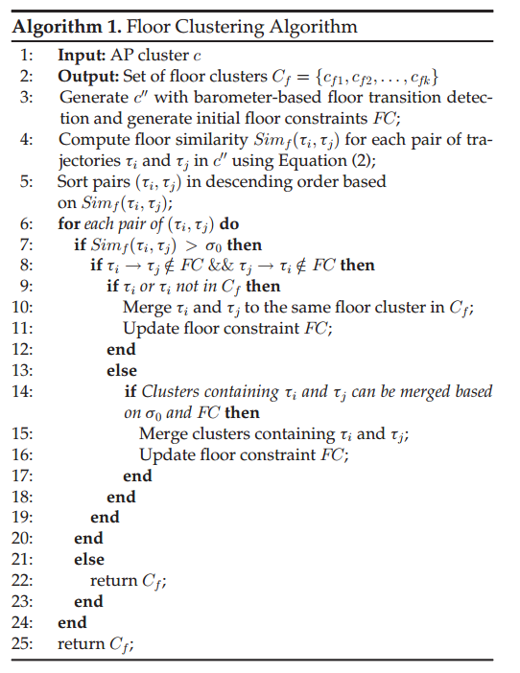
Floor-level clustering
Floor transition detection generating Floor Constraints and trajectory separation
Calculate the average similarity as threshold
Cluster trajectories with high similarity under FC
Update FC and iterate
Notes:
Floor transition detection把长的轨迹划分成不同的短的轨迹，并且轨迹之间有楼层上下的约束关系
计算任意两段轨迹的相似度，取均值作为判断是否为同一层的阈值
把超过阈值并且不违反楼层约束关系的合并

Slide 12
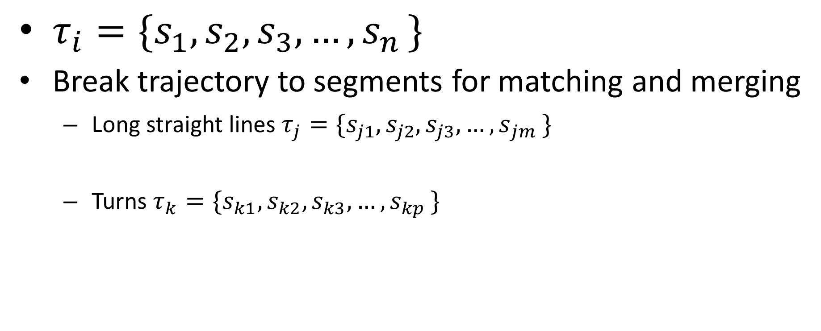
(3).Path Segment Separation
$τ_{i}=\{s_{1},s_{2},s_{3}, …{,s}_{n}\}$
Break trajectory to segments for matching and merging
  Long straight lines $τ_{j}=\{s_{j1},s_{j2},s_{j3}, …{,s}_{jm}\}$
  Turns $τ_{k}=\{s_{k1},s_{k2},s_{k3}, …{,s}_{kp}\}$
Notes:
把一条轨迹划分成straight line和turn两种segment

Slide 13
2.Trajectory Matching
(1).Path Correlation
(2).Signal Correlation
(3).final matching
Notes:
把划分好的segments进行匹配

Slide 14
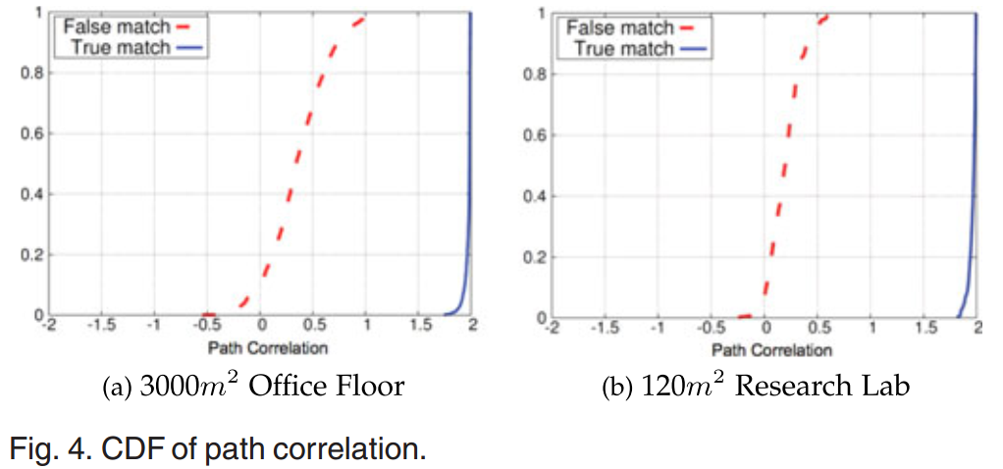

(1).Path Correlation
Calculate path similarity by Pearson correlation
Pick 1.9 as threshold for matching
Notes:
通过pearson相关系数计算path correlation
X的相关系数+y的相关系数
90%的正确匹配超过1.9的相似度

Slide 15
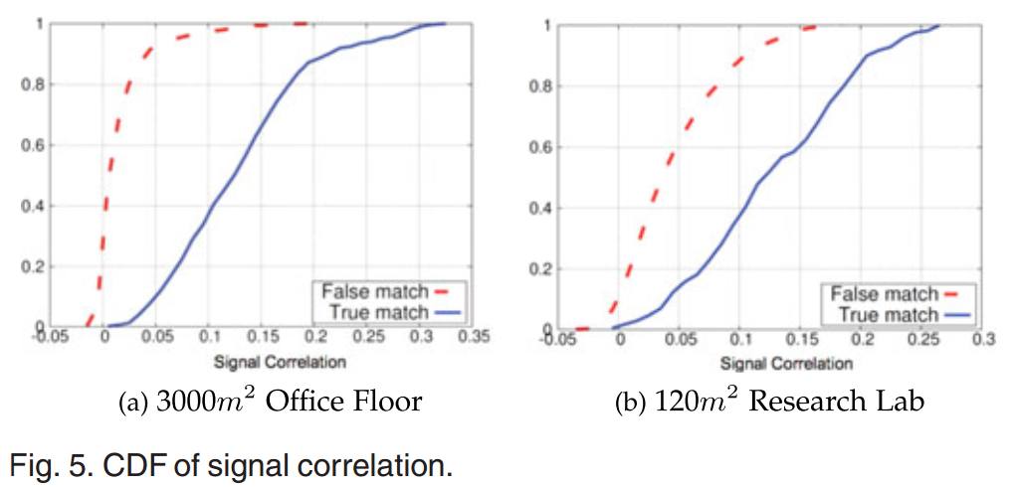

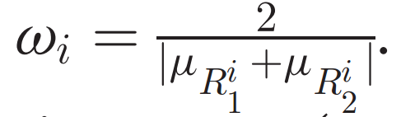
(2).Signal Correlation
Similar average RSS
High Pearson correlation
Larger average RSS with larger weight
Pick 0.15 as threshold
Notes:
Ri1表示轨迹1的得到的第i个AP的RSS sequence，Ri2表示轨迹2得到的第i个AP的RSS sequence
匹配考虑三个条件
对同一个AP的RSS的均值相近
对同一个AP的RSS sequence的pearson相关系数高
对于不同的AP进行加权平均，RSS均值越大的AP权重越高
42%的正确匹配超过0.15，98%的错误匹配低于0.15

Slide 16
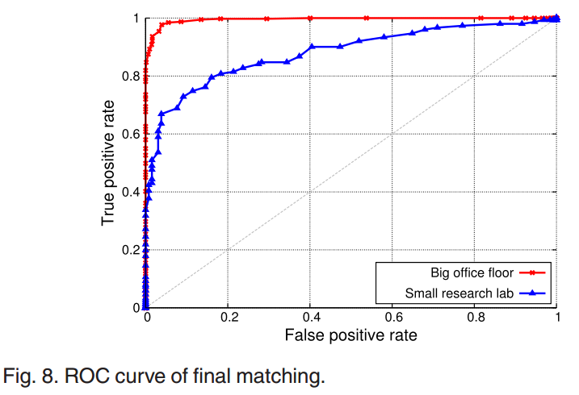
(3)Final Matching

Slide 17
3.Floor plan construction
Notes:
构建带有wifi指纹信息的平面图

Slide 18
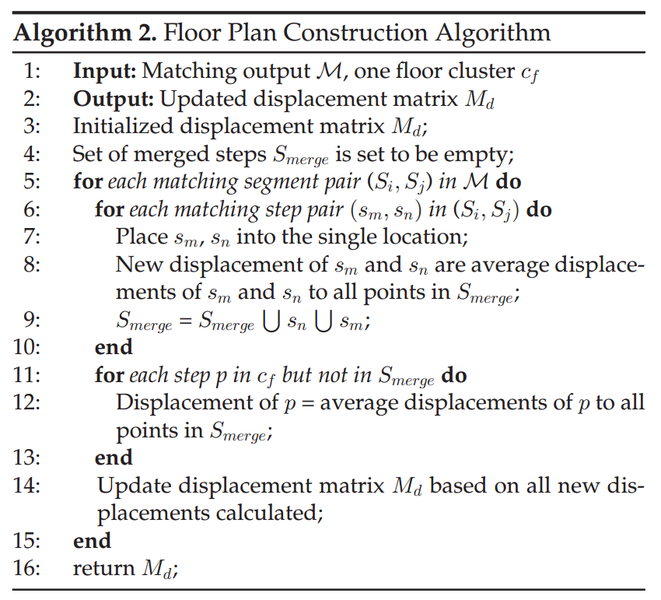
Floor plan Construction
Notes:
对于合并的segment，先把这两个点合并，再计算合并的点到merged，即已经merged的点的距离，取均值，然后把这些点加入到merged集合中
对于不是合并的segment的点，计算到所有merged的点的距离，取均值
Online的方法，对于采集到的新的数据，可以直接更新到旧的数据上

Slide 19
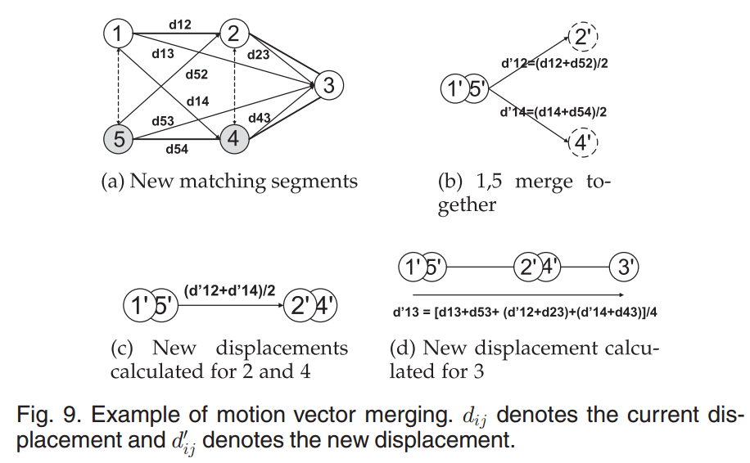
Floor plan construction
Update displacements for merged steps
Update displacements between merged steps and other steps
Notes:
最开始Smerge为空
1，5合并，加入到Smerge
2，4合并，更新2,4到1，5的距离
更新3到1，5，2，4的距离

Slide 20
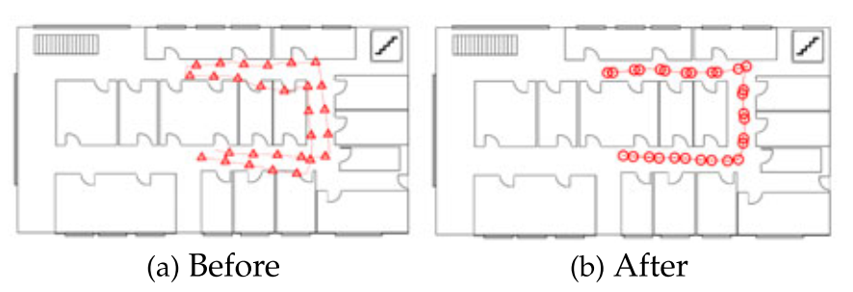
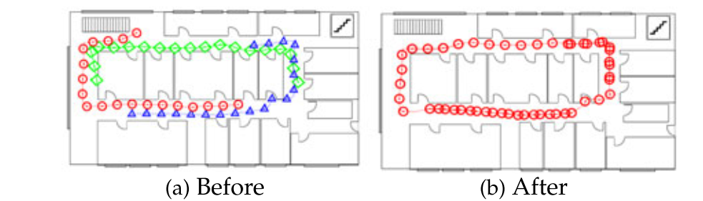
Floor plan construction
Notes:
在matched segment内可以merge，在不同的segment之间也可以merge

Slide 21
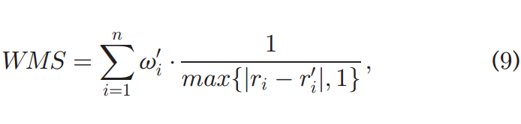

4.Locolization
APs with larger average RSS have larger weight
Notes:
ri，是接收到RSS相对于第i个AP的分量，
ri’是map上对应的分量
不同AP的RSS分量的权重不同，均值大的AP，即一般来说离得越近AP权重越高。
取使得weighted maximum similarity最大的ri’为定位结果

Slide 22
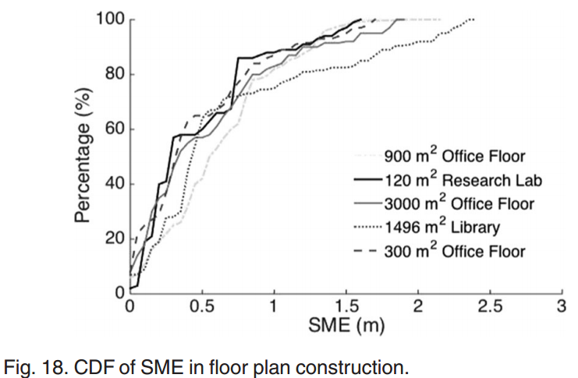
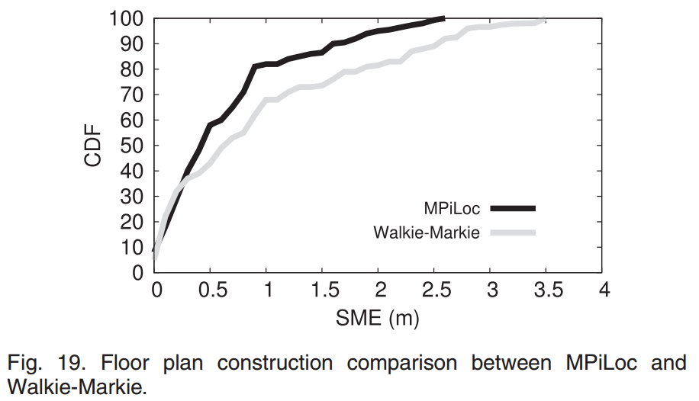
Floor Plan Construction
Notes:
Ground truth
App上带有建筑地平面图，在走的时候每走一步点击平面图上对应地位置
Floor plan过程的结果
平均0.76m的误差
结果要优于Walkie-Markie

Slide 23
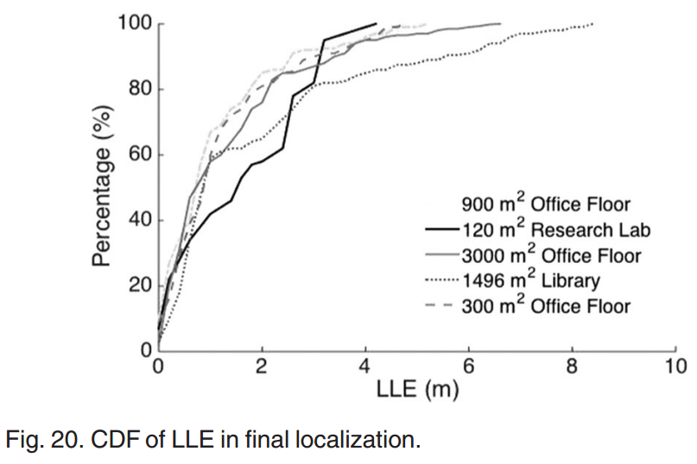
Final Localization
Notes:
定位的结果，均值1.82m，80%的定位误差小于3m

Slide 24
Comparison
MPiLoc VS Zee/UnLoc
  MPiLoc: Correct by crowdsourced trajectory matching and merging
  Zee：Correct by priori knowledge of floor plan
  UnLoc: Correct by priori knowledge of landmark(e.g. door) location
MPiLoc VS Walkie-Markie
  MPiLoc: Utilize sequence of RSS for matching
  Walkie-Markie: Match by tipping points
Notes:
积累误差的处理
MPiLoc利用众包获取的多个重复的segment进行match，merge，取均值的方式减小误差
Zee利用事先得到的建筑平面图修正轨迹
UnLoc利用实现得到的平面图的一些landmark进行修正
Segment利用RSS序列的相似度进行匹配的方式
Walkie-markie利用峰值的特征进行匹配
MPiLoc利用RSS序列整体的Pearson相关系数进行匹配

Slide 25
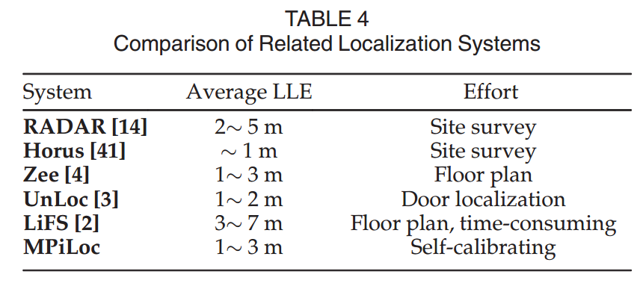
Comparison
Notes:
实验的环境有差异，
但是可以看到MPiLoc在利用的建筑信息最小的情况下可以得到和其他方法相当的精度

Slide 26
Shortcomings
Open area with complicated trajectory
Large open area (e.g. Hall)hinder barometer readings accuracy
Notes:
不只是直线和turn这两种segment
大的开放的几层楼的空间

Slide 27
Thanks!

