Slide 1
Understanding Ethereum via Graph Analysis
Ting Chen, Yuxiao Zhu, Zihao Li, Jiachi Chen, Xiaoqi Li, Xiapu Luo, Xiaodong Lin, Xiaosong Zhang
Center for Cybersecurity, University of Electronic Science and Technology of China
Department of Computing, The Hong Kong Polytechnic University
School of Management, Guangdong University of Technology
School of Big Data and Strategy, Guangdong University of Technology
Department of Physics & Computer Science, Wilfrid Laurier University
Presented by Kai Zhang
Notes:
INFOCOM 2018 Best Paper Award

Slide 2

INTRODUCTION
Ethereum
The largest blockchain that supports running smart contracts, with around 20 billion USD market capitalization.
Not only supports its cryptocurrency named Ether but also provides a decentralized platform to execute smart contracts in the Ethereum virtual machine (EVM).
However, little is known about the characteristics of its users, smart contracts and the relationships among them.

Slide 3
INTRODUCTION
This paper’s contributions:
The first systematic investigation on Ethereum via graph analysis:
We propose a new approach to collect all transactions data.
Then construct money flow graph (MFG), smart contract creation graph (CCG), and smart contract invocation graph (CIG).
We obtain many new observations and insights about Ethereum by conducting various graph analysis on MFG, CCG, and CIG.
We propose new approaches based on cross-graph analysis to handle two security issues in Ethereum, including attack forensics and anomaly detection.

Slide 4
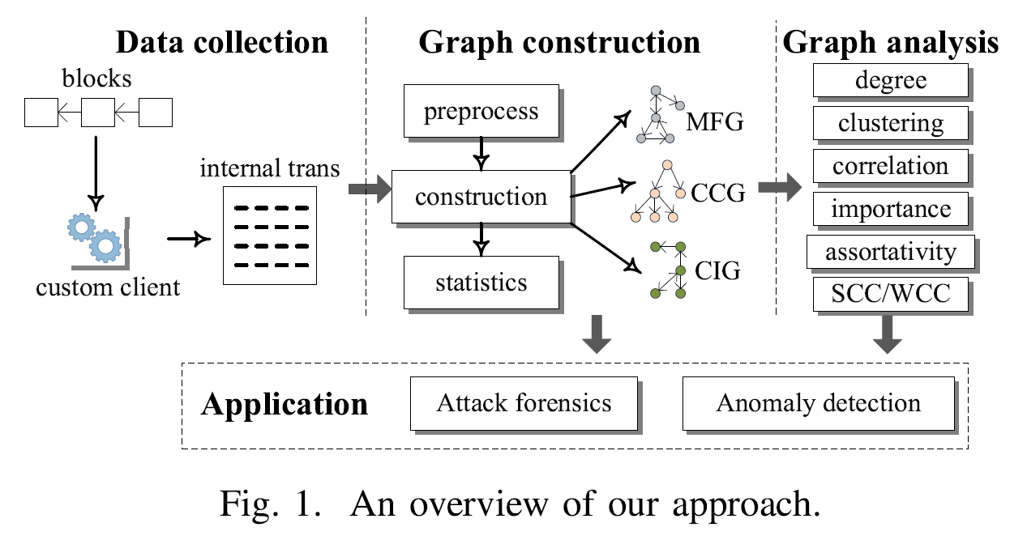
OVERVIEW

Slide 5
BACKGROUND
Ethereum
Account type:
External owned account (EOA), controlled by human.
Smart contract (SC)
Transaction type:
External: sender is EOA
Internal: sender is SC

Slide 6
DATA COLLECTION
Collect all transactions (28502131 external and 19759821 internal transactions) from 2015/7/30 to 2017/6/10.
Challenge: internal transactions result from the execution of smart contracts, and they are not stored in the blockchain.
We collect all internal transactions by replaying external transactions in our customized EVM.
We insert the instrumentation code for operations related with internal transactions and log them.

Slide 7
GRAPH CONSTRUCTION
Preprocess stage
Exclude four types of transactions that are not related to money transfer, contract creation and contract invocation activities.
Transactions for smart contract creation are not considered when building CIG, even if they will execute the construction function of the created smart contract.
After preprocessing, 2721080 accounts (2121146 EOAs and 599934 smart contracts) are obtained.

Slide 8
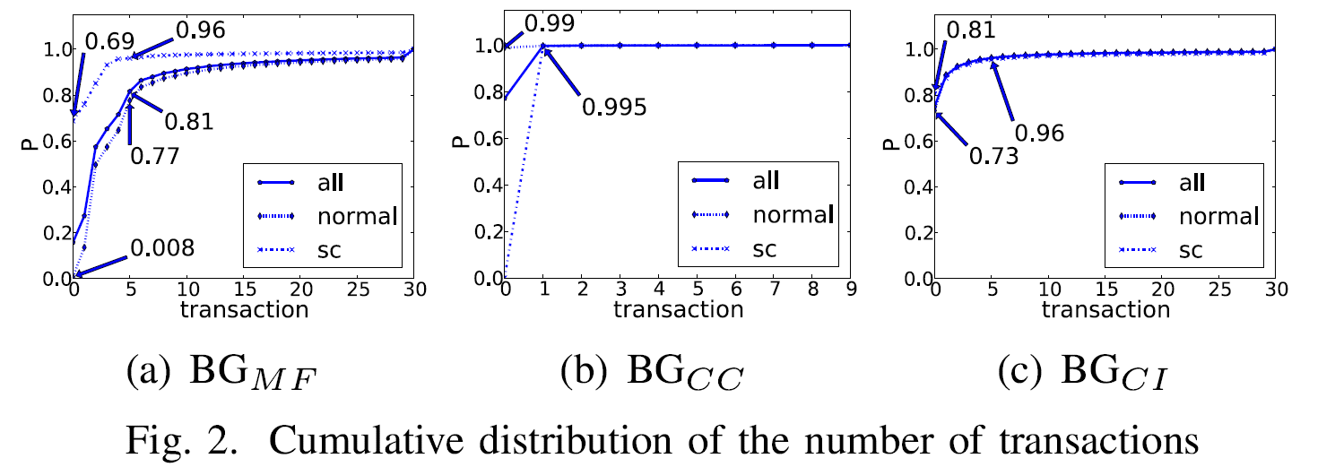
GRAPH CONSTRUCTION
Construction stage
Divide transactions into three groups (i.e., BG_{MF}, BG_{CC}, and BG_{CI}), corresponding to MFG, CCG, and CIG to be constructed.
The distribution of the number of transactions related to the accounts in BG_{MF}, BG_{CC}, and BG_{CI} :

Slide 9
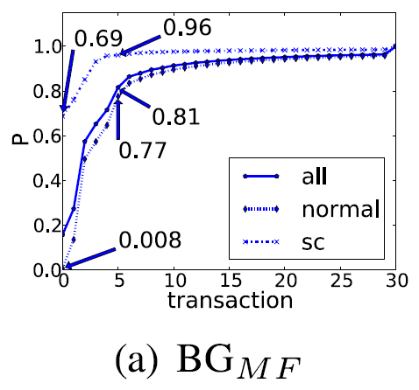
GRAPH CONSTRUCTION
BG_{MF}
0.8% of EOAs do not transfer Ether. In other words, almost all EOAs transfer Ether.
About 81% of accounts (96% of smart contracts and 77% of EOAs) are involved in no more than 5 transactions. That is, most accounts (especially smart contracts) are infrequent in transferring money.

Slide 10
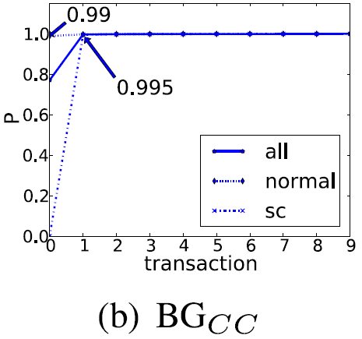
GRAPH CONSTRUCTION
BG_{CC}
99% of EOAs do not create contracts. The proportion of developers is just 1% of total users.
99.5% of smart contracts are involved in only 1 transaction. Hence, almost all contracts do not create contracts. Maybe Ethereum is a too young platform that developers rarely exploit this advanced functionality.

Slide 11
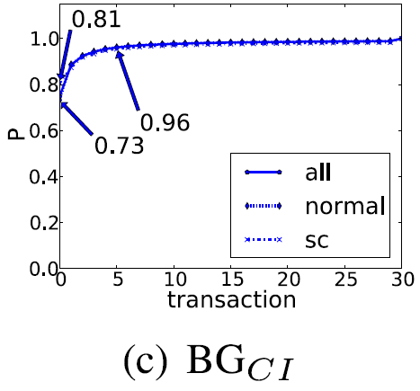
GRAPH CONSTRUCTION
BG_{CI}
73% of EOAs do not invoke smart contracts and 81% of smart contracts are not invoked.
96% of EOAs call smart contracts no more than 5 times. Not all users use smart contracts frequently.
60% of smart contracts neither transfer money nor be invoked, thus considerable resources (e.g., network, disk) are wasted to synchronize and store them.

Slide 12
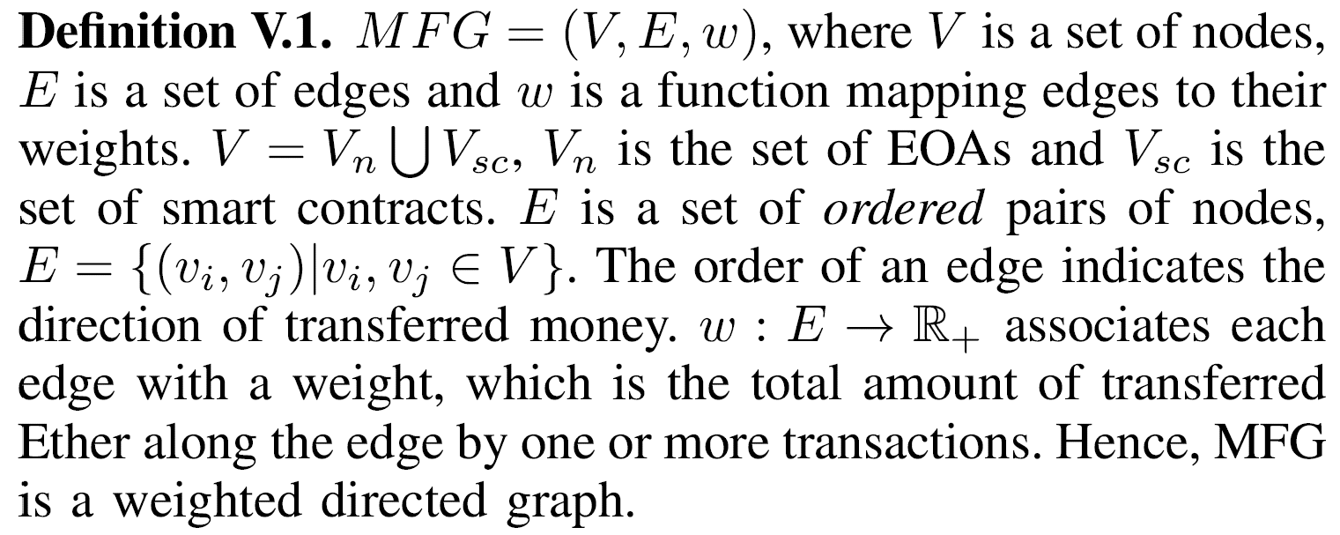
GRAPH CONSTRUCTION
MFG Construction

Slide 13
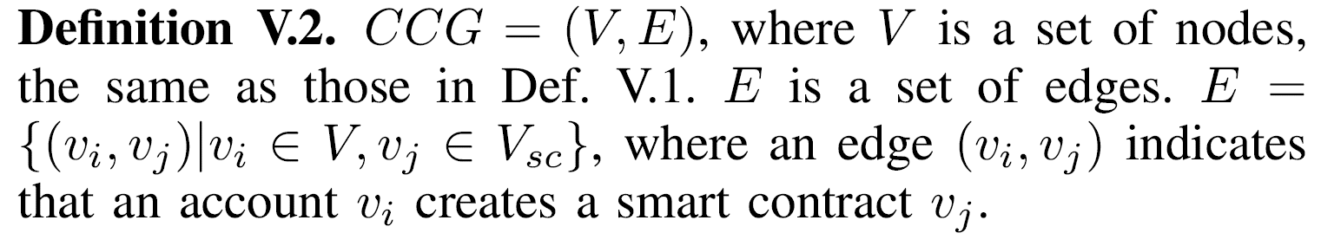
GRAPH CONSTRUCTION
CCG Construction

Slide 14
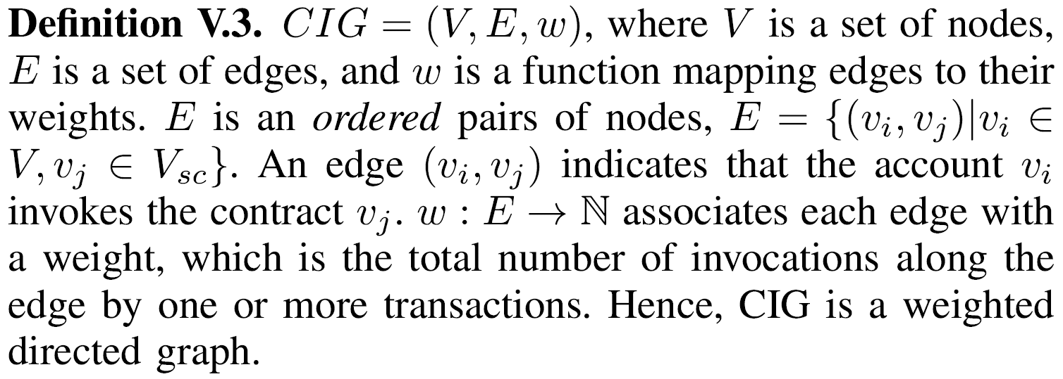
GRAPH CONSTRUCTION
CIG Construction

Slide 15
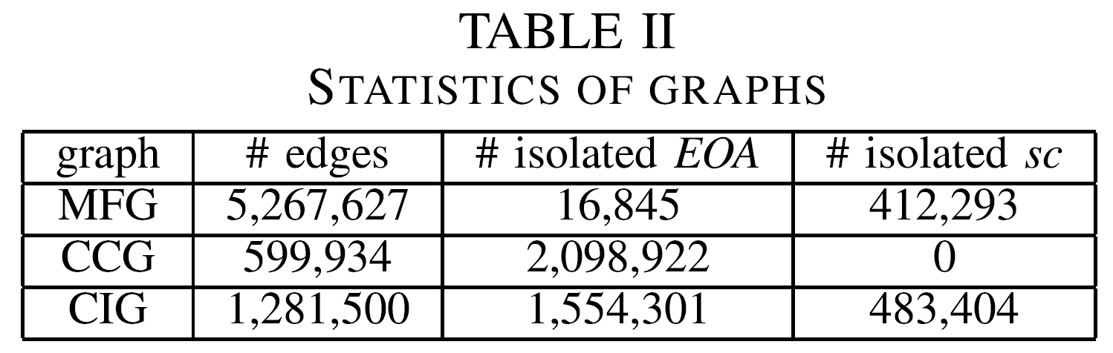
GRAPH CONSTRUCTION
Statistics stage
MFG: Only 16845 EOAs (compared to 2121146 in total) do not transfer money since they are isolated.
CCG: Vast majority of EOAs are isolated, i.e., they do not create contracts.
CIG: 73% of EOAs do not call smart contracts, and 81% of smart contracts are not invoked.

Slide 16
GRAPH CONSTRUCTION
Three insights
Insight 1. Users prefer transferring money on Ethereum instead of using smart contracts. One possible reason is that many users of Ethereum may have experiences in using Bitcoin or other cryptocurrency blockchains.
Insight 2. The smart contracts are not widely used. One possible reason is that as shown later there are only a few applications supported by smart contracts and most of them are for financial applications.
Insight 3. Not all users frequently use Ethereum. One possible reason is that most users just try Ethereum and deploy toy contracts on it.

Slide 17
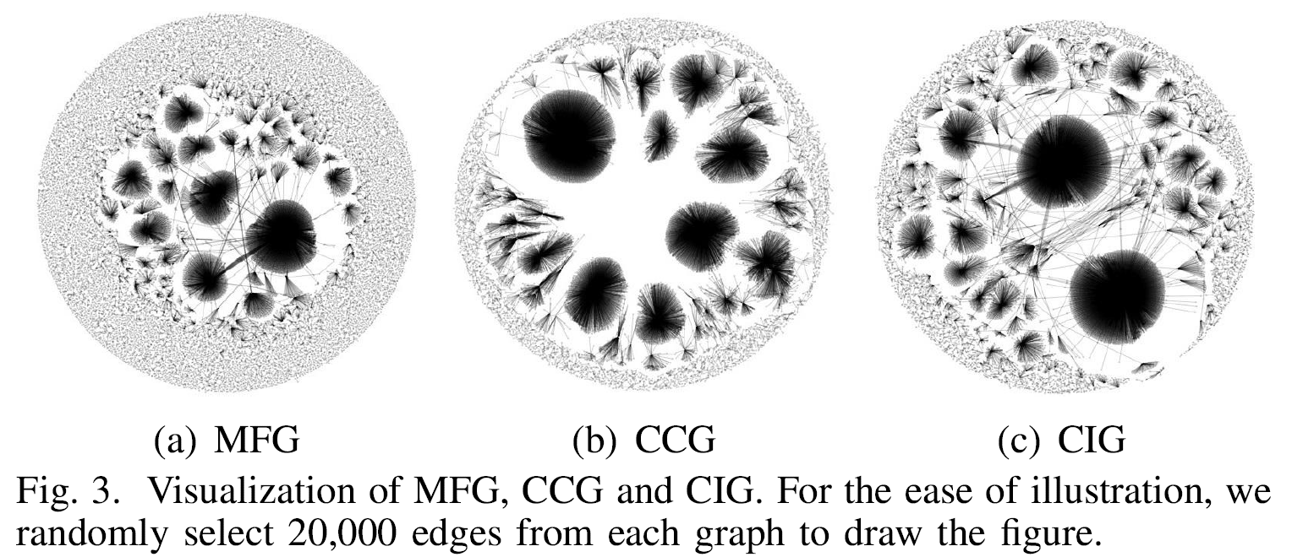
GRAPH VISUALIZATION
A few large degree nodes and many small degree nodes. In other words a few accounts play a vital role in Ethereum.

Slide 18
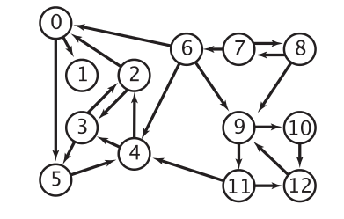
GRAPH ANALYSIS
Some graph theory basics:
Degree, indegree, outdegree
Strong/weak connected component (SCC/WCC)
SCC: The maximal set of nodes such that for any nodes u and v, directed paths from u to v and from v to u exist.
WCC: The maximal set of nodes such that for any nodes u and v, undirected paths from u to v and from v to u exist.

Slide 19
GRAPH ANALYSIS
Some other techniques:
Compute the global clustering coefficient to evaluate the extent to which nodes in a graph tend to cluster together.
Use Pearson coefficient to evaluate the correlation between the indegree and the outdegree of nodes.
Compute the assortativity coefficient to study the preference for nodes to attach to others.
Evaluate node’s importance using the PageRank algorithm.

Slide 20
GRAPH ANALYSIS
Inferring Node Identity
It’s difficult to discover an account’s identity because its address instead of the identity is enough for an account to use Ethereum.
We exploit account’s identity from many sources, such as name tags, smart contract’s source code, discussion borads, forums, search engines.
We propose a new method that exploits the WCC of CCG to infer the identity of a group of accounts, as all nodes in a WCC have the same identity.

Slide 21
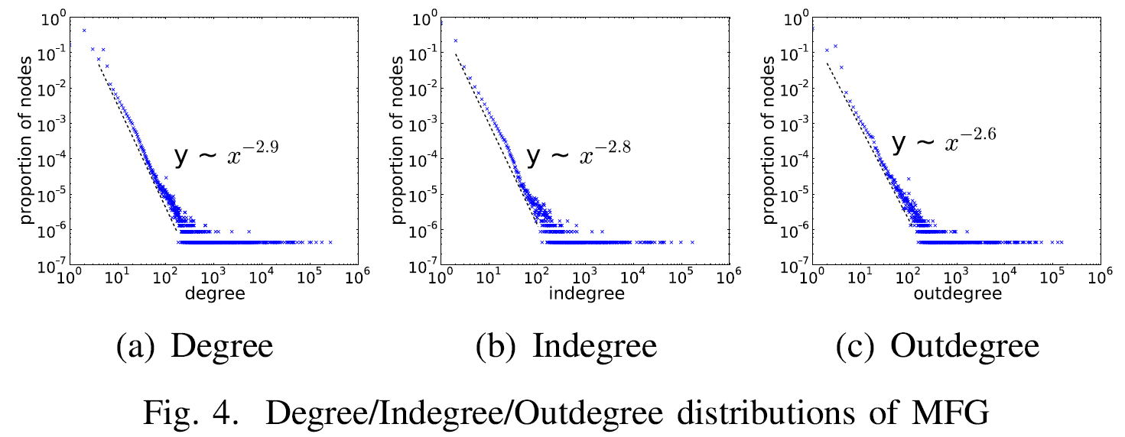
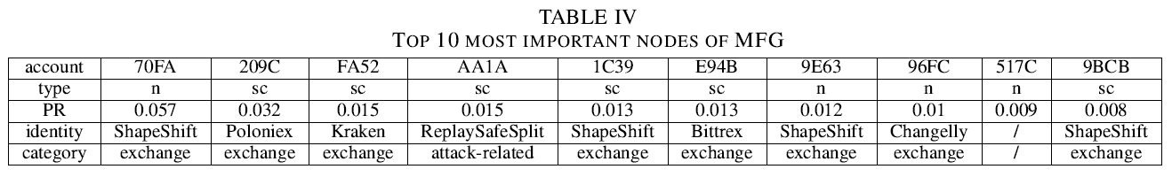
GRAPH ANALYSIS
MFG Analysis
Degree distributions follow the power law.
A few exchange markets have large degree. The small degree nodes may be the individuals trading with exchange markets.

Slide 22
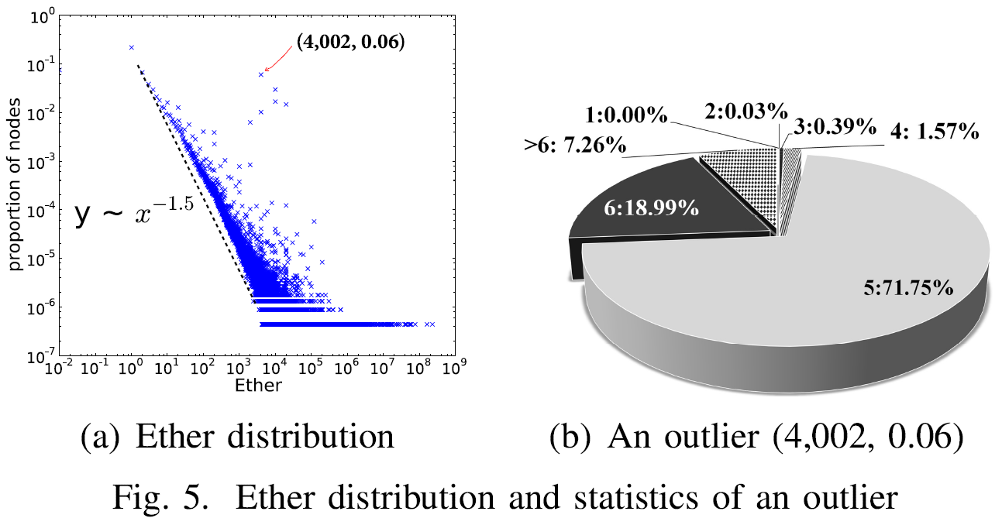
GRAPH ANALYSIS
MFG Analysis
Ether distribution follows the power law, denoting that a few accounts transfer a lot of money.
The outliers are small-degree accounts transferring a lot of money.
The degree of nearly 93% accounts in an outlier is no larger than 6.

Slide 23
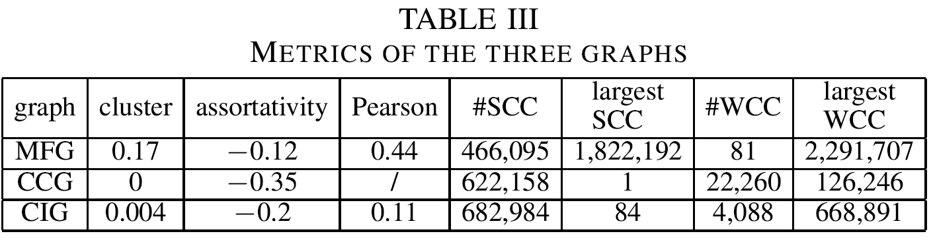
GRAPH ANALYSIS
MFG Analysis
The clustering coefficient is large
If A, B trade with C, A and B are likely to trade with each other.
The assortativity coefficient is negative
Large degree accounts prefer to trade with a small degree account. Possible reason is an exchange tends to serve many individuals rather than other exchange markets.

Slide 24
GRAPH ANALYSIS
MFG Analysis
Pearson coefficient is moderately strong
A node with large indegree is likely to have large outdegree and vice versa.
The size of the largest SCC is huge (86%)
There should be hub nodes. They may be exchange markets.

Slide 25
GRAPH ANALYSIS
MFG Analysis
The number of SCCs is far more than that of WCCs
A WCC may contain many SCCs, and the money transfer among different SCCs should be unidirectional. Maybe it’s because of several steps in some processes or businesses.

Slide 26
GRAPH ANALYSIS
MFG Analysis
Exchange markets play a key role in money transfer.
Results to negative assortativity coefficient and huge SCC.
The smart contract, ReplaySafeSplit is used frequently.
The risk of replay attack has received significant attention.

Slide 27
GRAPH ANALYSIS
Replay attack: caused by hard fork.

Slide 28
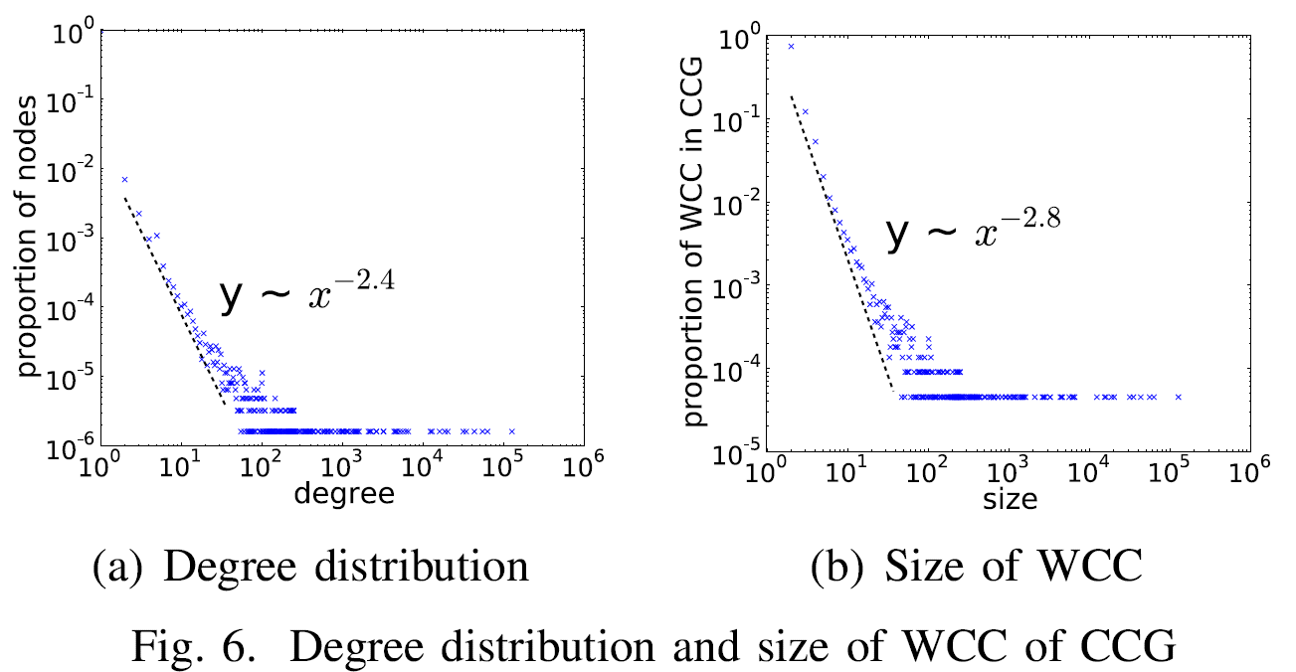
GRAPH ANALYSIS
CCG Analysis
Only take outdegree into account as indegree is always 0 or 1.
Degree distributions follow the power law.
Smart contracts outnumber application developers.

Slide 29
GRAPH ANALYSIS
CCG Analysis
Clustering coefficient equals to zero
If two contracts are created by the third node, they can’t create each other.
The size of largest SCC is 1: no cycles in CCG
The assortativity coefficient is negative
If an account creates lots of contracts, the created smart contracts are unlikely to create many other smart contracts.

Slide 30
GRAPH ANALYSIS
CCG Analysis
Surprisingly, the size of the largest WCC accounts for 21% of total smart contracts.
An EOA (FDB3) directly or indirectly created 21% of the total smart contracts!
However, most WCCs are very small.

Slide 31
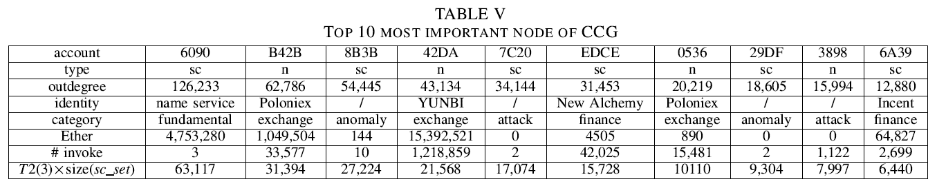
GRAPH ANALYSIS
CCG Analysis
6090 is a smart contract created by FDB3. It’s a name service for users interacting by names rather than addresses.
6090 makes lots of copies.
Attacks on Ethereum can be detected by inspecting the activities of contract creation.

Slide 32
GRAPH ANALYSIS
CCG Analysis
Without counting the contracts created by attacks and abnormal accounts, 62% of smart contracts are created by six accounts, 5 of whom are for finance.
Insight 4. A small number of developers created lots of smart contracts. There are only 6% unique smart contracts.

Slide 33
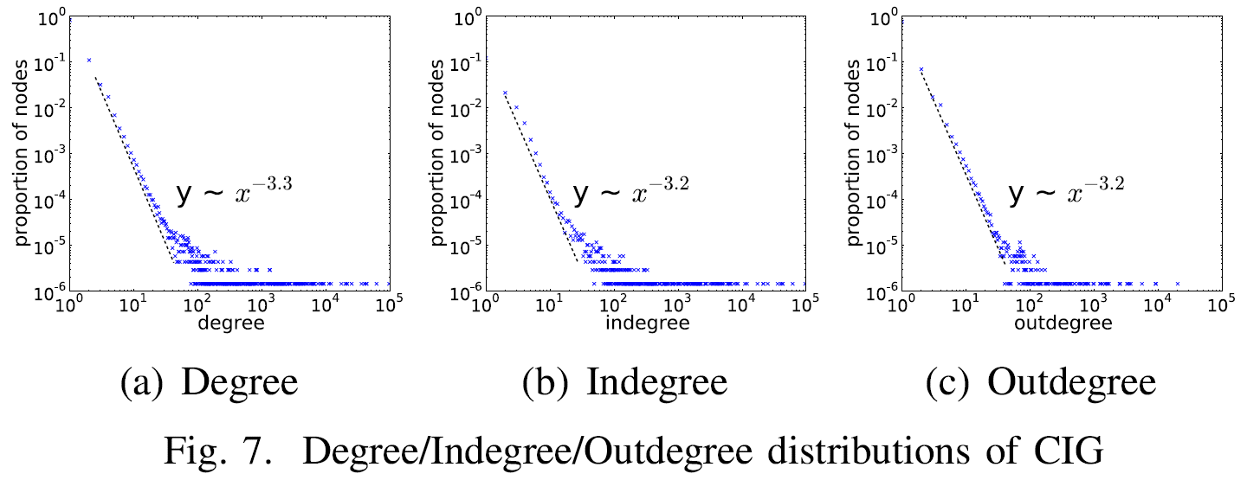
GRAPH ANALYSIS
CIG Analysis
Degree distributions follow the power law.
The majority of contracts are invoked by a few accounts. Most accounts invoke a few contracts.
Not all contracts are widely used and not all users frequently use Ethereum.

Slide 34
GRAPH ANALYSIS
CIG Analysis
The clustering coefficient approaches zero
If A calls B and C, B and C are very unlikely to call each other.
Possible reason is that most contracts are too simple to invoke others.
Negative assortativity coefficient.

Slide 35
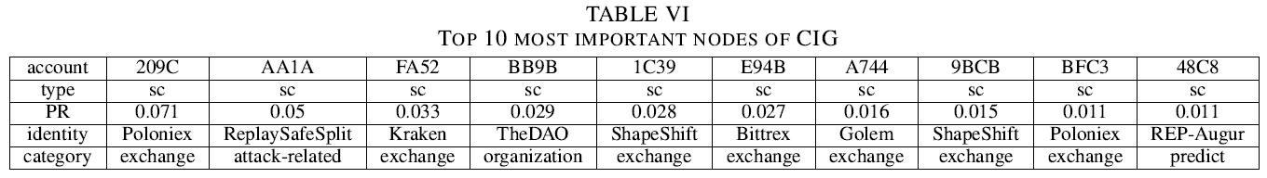
GRAPH ANALYSIS
CIG Analysis
Contract AA1A prevents replay attacks.
All except two smart contracts are exchange markets.
Insight 5. Financial applications, such as exchange markets, dominate Ethereum.

Slide 36
APPLICATIONS
Attack Forensics
Given a malicious smart contract, attack forensics intends to find all accounts controlled by the attacker.
We correlate CCG and CIG to obtain all smart contracts created by the attacker and all accounts invoking such smart contracts.
First compute the WCC containing the malicious contract from CCG.
For each node in the WCC, locate all EOA callers from CIG.

Slide 37
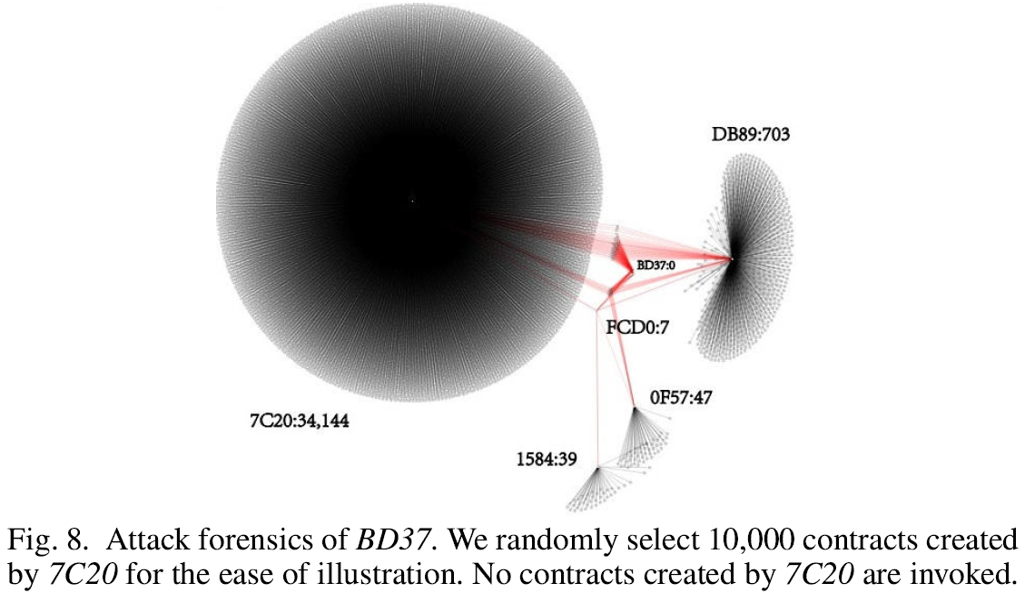
APPLICATIONS
Attack Forensics : A real case
Node BD37 is a malicious contract for a DoS attack.
The WCC containing BD37 roots in the node FCD0.
Highlight nodes in red if they are invoked and the edges connecting to red nodes.

Slide 38
APPLICATIONS
Anomaly Detection
We design a new approach to detect abnormal contract creation, which consumes lots of resources.
Regard an account as abnormal if it creates lots of contracts that are rarely used to transfer money or invoked.

Slide 39
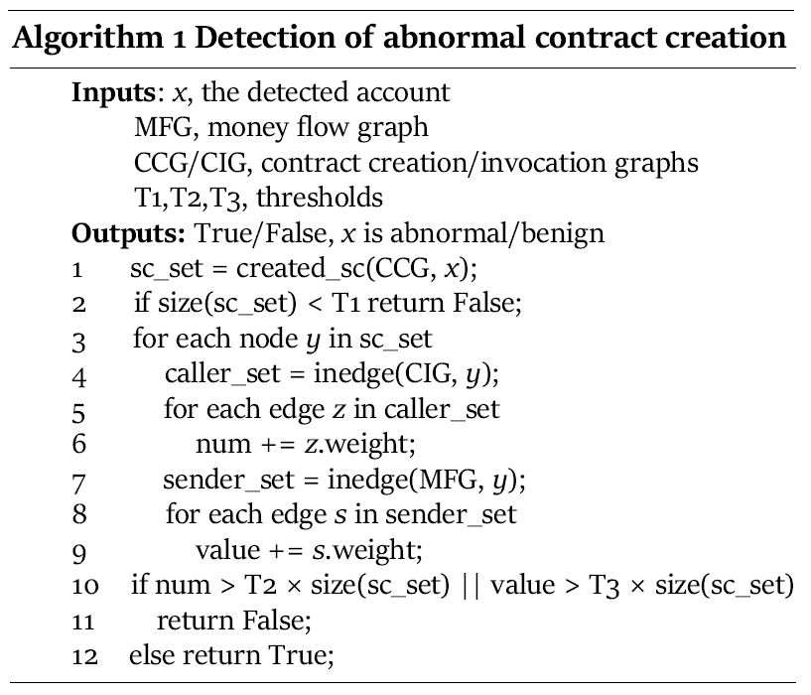
APPLICATIONS
Anomaly Detection
By setting T1, T2, and T3 to be 10000, 0.5, 0.5, we detect 4 abnormal accounts, 7C20, 3898, 8B3B and 29DF.

Slide 40
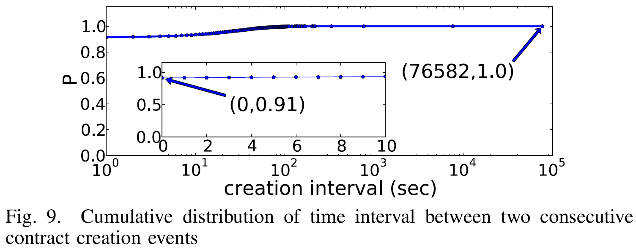
APPLICATIONS
Anomaly Detection
Contract creation events due to 3898: 91% of contracts are created in a very short period of time.
Contract creation time interval can serve as another indicator for detecting abnormal activities.

Slide 41
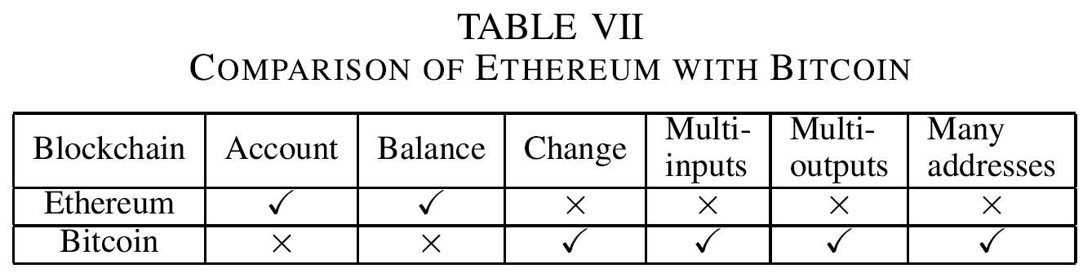
RELATED WORK
Ethereum vs. Bitcoin

Slide 42
RELATED WORK
Graph Analysis of Bitcoin
There are already some graph analysis of Bitcoin, some mainly focusing on communication network.
Some others abstract Bitcoin into a transaction graph or user graph.
These approaches cannot be directly applied to Ethereum due to differences between Ethereum with Bitcoin.

Slide 43
我的评价
能想到可以做这么一件事很重要
相比之下文章所用的理论和方法还是比较基础的，思路也比较自然
代码、数据全部公开
文章的主要思路是建模，统计，然后根据现象得到一些结论
然而对结论原因的分析主要靠猜测，不能实锤

