Slide 1
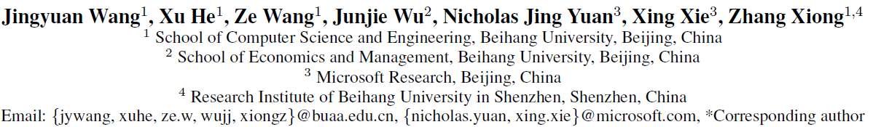
CD-CNN: A Partially Supervised Cross-Domain Deep Learning Model for Urban Resident Recognition
AAAI 2018
Presenter: Jing Chu

Slide 2


Background
The immigration proportion increased
Residents who grew up out of the city they work and live in
5.4 hundred million people migrate from rural to cities
Deal with social issues that caused by migration
Analysis of migration behavior

Slide 3


Related Work
Limited by the channels and costs of data collection
Sparsely sampled questionnaire surveys
Non-individual level statistical data
Recognize native or migrant attribute of an urban resident
from mobile phone signaling data

Slide 4
Challenges
How to extract users’ behavioral features from mobile phone data
How to fuse knowledge from multiple domains
How to handle incomplete label information of data sets

Slide 5
Framework Overview
Sample
Selection
Mobile Phone Signaling Data
Dimensionality Balancing
Population Census
Communication Domain
Cross-domain Feature Extraction
Cross-domain Features Fusion
Behavioral Analysis
Volunteer Survey Data
Location Domain
Home Returning Prediction
Feature Matrix Generation
Cross-domain Co-training for CD-CNN
Data Collection
Data Preprocessing
Cross-Domain Convolutional Neural Network (CD-CNN)
Application

Slide 6
Framework Overview
Sample
Selection
Mobile Phone Signaling Data
Dimensionality Balancing
Population Census
Communication Domain
Cross-domain Feature Extraction
Cross-domain Features Fusion
Behavioral Analysis
Volunteer Survey Data
Location Domain
Home Returning Prediction
Feature Matrix Generation
Cross-domain Co-training for CD-CNN
Data Collection
Data Preprocessing
Cross-Domain Convolutional Neural Network (CD-CNN)
Application

Slide 7
Data set
Mobile phone signaling data of Wuxi
<user ID, station ID, user event, code, time stamp>
Including calls and SMS information
October, 2013 - March,2014
5 million residents
The volunteer survey data set
Selected residents who voluntarily offer their mobile phone number, growth up place, and working place information
30 thousands volunteers: 50% natives and 50% migrants

Slide 8
Framework Overview
Sample
Selection
Mobile Phone Signaling Data
Dimensionality Balancing
Population Census
Communication Domain
Cross-domain Feature Extraction
Cross-domain Features Fusion
Behavioral Analysis
Volunteer Survey Data
Location Domain
Home Returning Prediction
Feature Matrix Generation
Cross-domain Co-training for CD-CNN
Data Collection
Data Preprocessing
Cross-Domain Convolutional Neural Network (CD-CNN)
Application

Slide 9
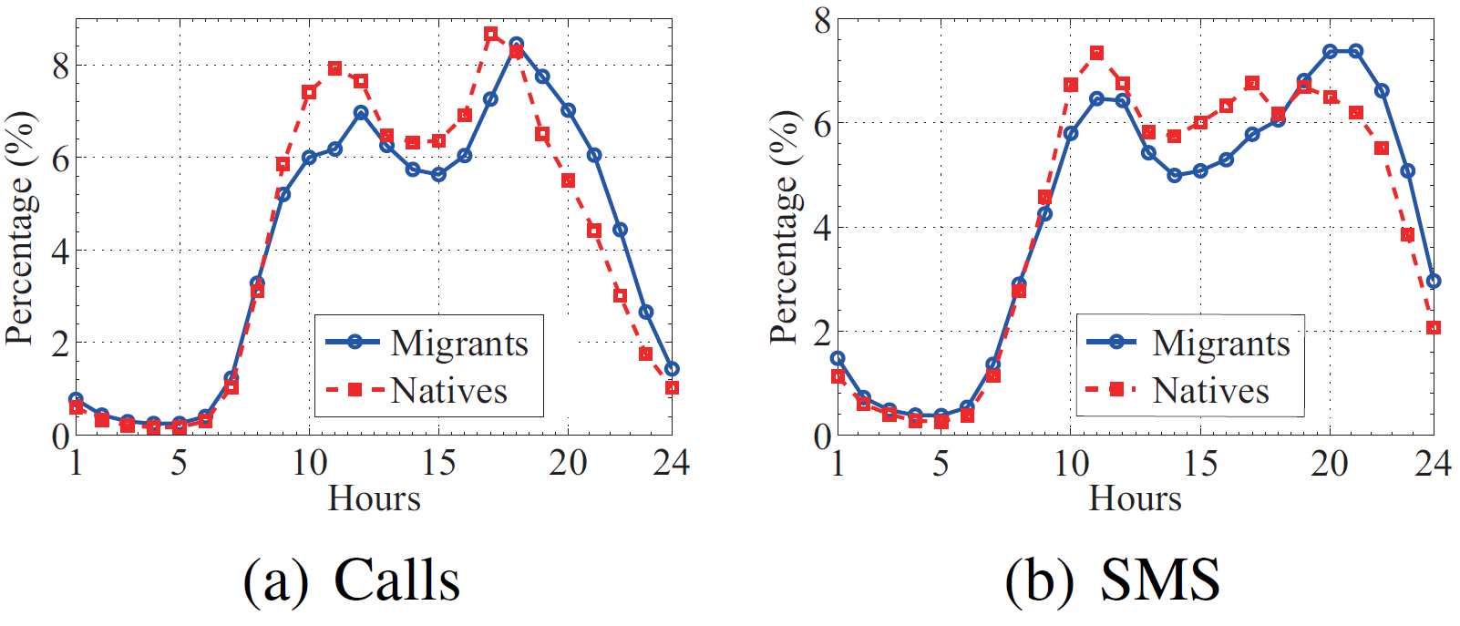
Communication Domain
Calls & SMS of natives in the working period is larger
The evening peak of calls and SMS for migrants is later than the natives

Slide 10
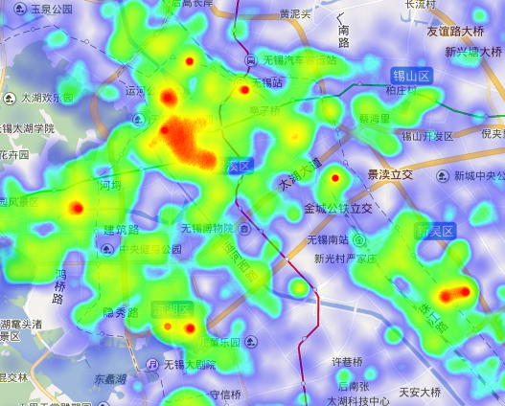
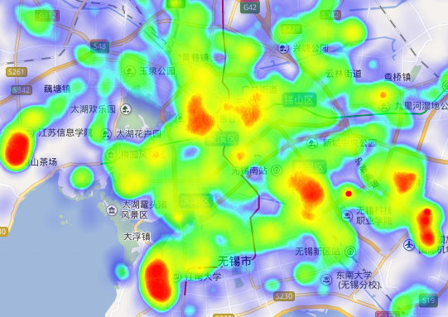
Location Domain
Working place of natives
Working place of migrants
Natives: downtown area
Migrants: near the universities

Slide 11
Framework Overview
Sample
Selection
Mobile Phone Signaling Data
Dimensionality Balancing
Population Census
Communication Domain
Cross-domain Feature Extraction
Cross-domain Features Fusion
Behavioral Analysis
Volunteer Survey Data
Location Domain
Home Returning Prediction
Feature Matrix Generation
Cross-domain Co-training for CD-CNN
Data Collection
Data Preprocessing
Cross-Domain Convolutional Neural Network (CD-CNN)
Application

Slide 12
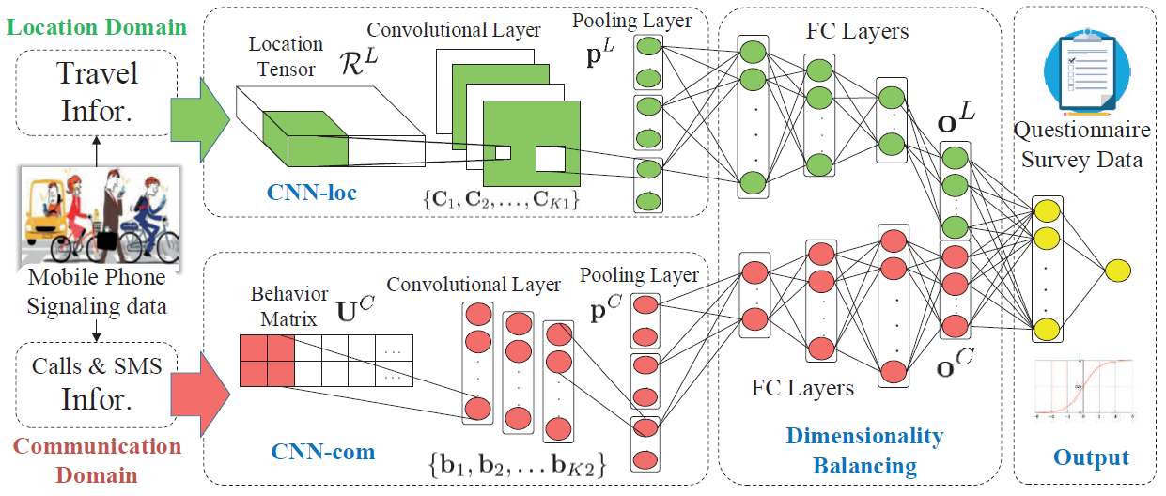
Cross-Domain Convolutional Neural Network
CNN for Location Domain: locality characteristics; the dimensionality is very high
CNN for Communication Domain: locality characteristics; adjacent time slices have correlations

Slide 13
Dimensionality Balancing
Doubles its neurons layer by layer
Low-dimensional
Communication Features
Submerged
Halves its neuron
layer by layer
High-dimensional Location Features

Slide 14
Cross-domain Co-training for CD-CNN
Lack of labels: only 30 thousands native/migrant labels
Partially supervised network algorithm based on the co-training scheme
Three training steps:
1) Domain separated pre-training
2) Domain crossed co-training
3) Supervised fine tuning

Slide 15
Cross-domain Co-training for CD-CNN
Domain separated pre-training
Convolutional
Pooling
FC-Layer
Bahavior Matrix
Logistic regression
Location Tensor

Slide 16
Cross-domain Co-training for CD-CNN
Domain crossed co-training
1) selects a batch of unlabeled samples for training
Convolutional
Pooling
FC-Layer
Bahavior Matrix
Logistic regression
CN model
Unlabeled samples U
3) Choose top-k higher prediction confidences
2) Choose top-k higher prediction confidences
Location Tensor
LN model

Slide 17
Cross-domain Co-training for CD-CNN
Supervised fine tuning
Convolutional
Pooling
FC-Layer
Bahavior Matrix
Logistic regression
Location Tensor

Slide 18
Experimental Data
Training dataset
25 thousands labeled samples and the remaining data as the validation set
10% unlabeled samples (0.5 million) for co-training step
Zone partition
Divide Wuxi into 88 * 115 = 10120 square zones
Each with a size of 1km *1km

Slide 19
Evaluation
Metrics
Precision
Recall
F1 Score
Baselines
LN model: Only the information in the location domain
CN model: Only the information in the communication domain
No Balancing Network (NoBal): removes the dimensionality balancing subnetwork
No Co-training (NoCo): only uses the labeled samples to train CD-CNN
CD-SAE: replaces the CNN structure of CDCNN by Stacked Auto-Encoders

Slide 20
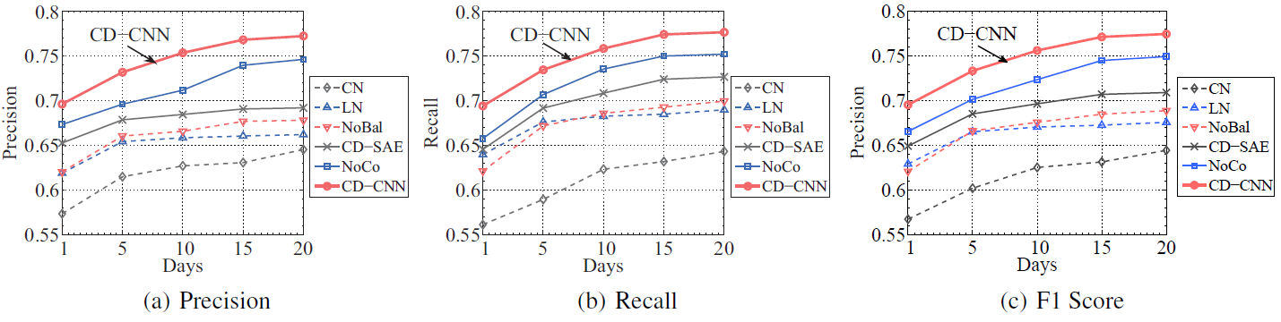
Results
Classification with varying data collecting days
CD-CNN model achieves the best performance
When the collecting time is longer than 15 days, the marginal benefit becomes very low

Slide 21
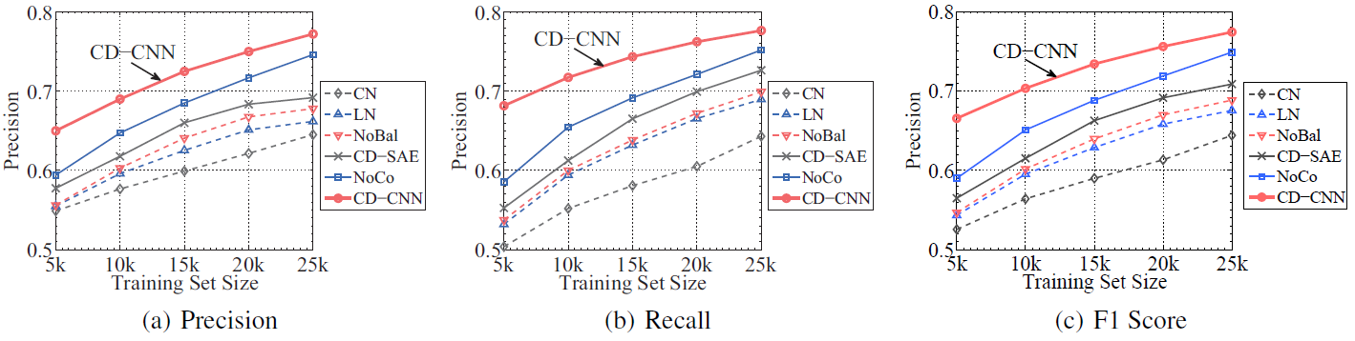
Results
Classification with varying sizes of labeled samples
CD-CNN model performs relatively robustly over the small label-size data

Slide 22
Framework Overview
Sample
Selection
Mobile Phone Signaling Data
Dimensionality Balancing
Population Census
Communication Domain
Cross-domain Feature Extraction
Cross-domain Features Fusion
Behavioral Analysis
Volunteer Survey Data
Location Domain
Home Returning Prediction
Feature Matrix Generation
Cross-domain Co-training for CD-CNN
Data Collection
Data Preprocessing
Cross-Domain Convolutional Neural Network (CD-CNN)
Application

Slide 23
Population Census
Prediction Result
35% residents in Wuxi are migrants
65% are natives
Compare with the Statistical Yearbook of Wuxi (census data)
32% are migrants
Advantage: Deliver predictions in a timely and economical way

Slide 24
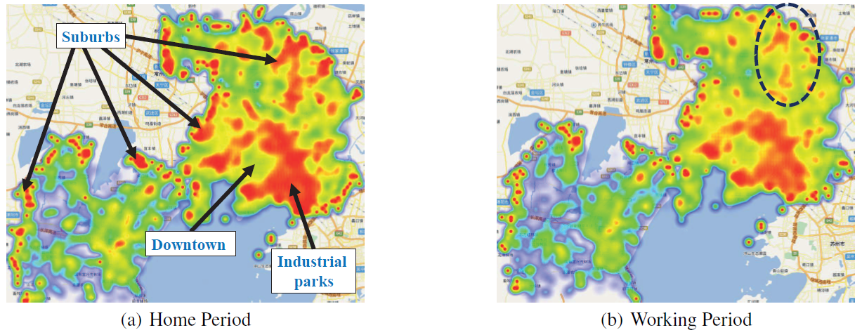
Behavioral Analysis
Higher migrant places: the areas surrounding the downtown, industrial parks and the suburbs of the city

Slide 25
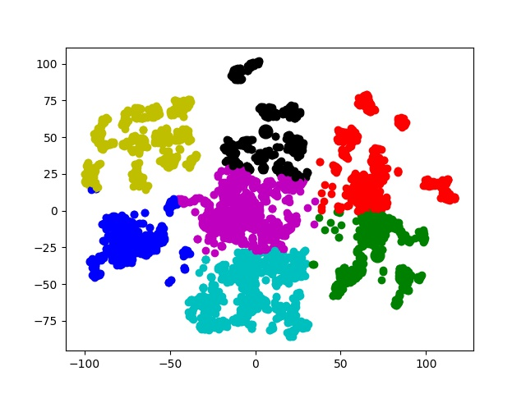
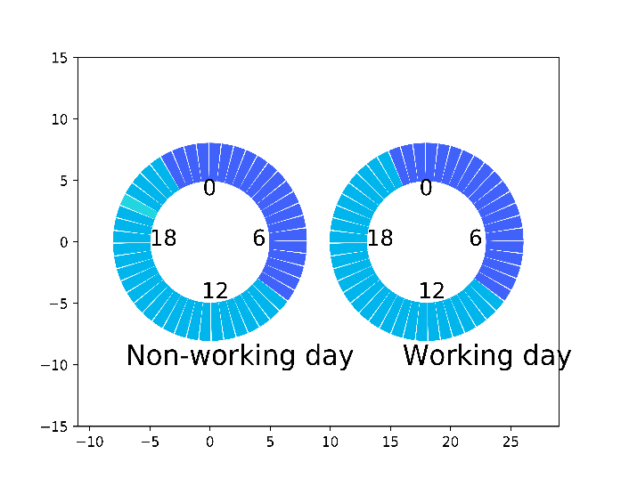
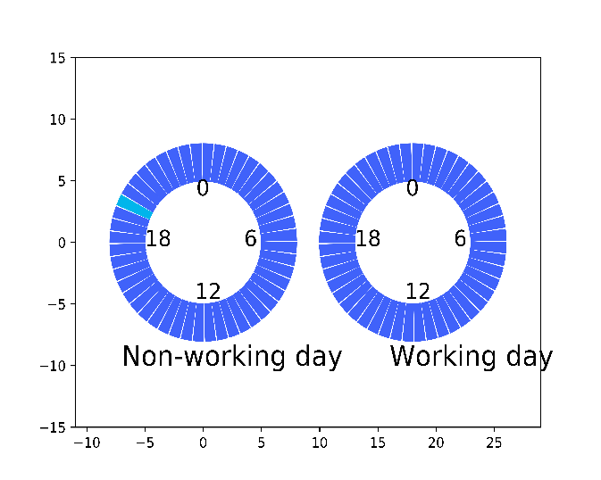
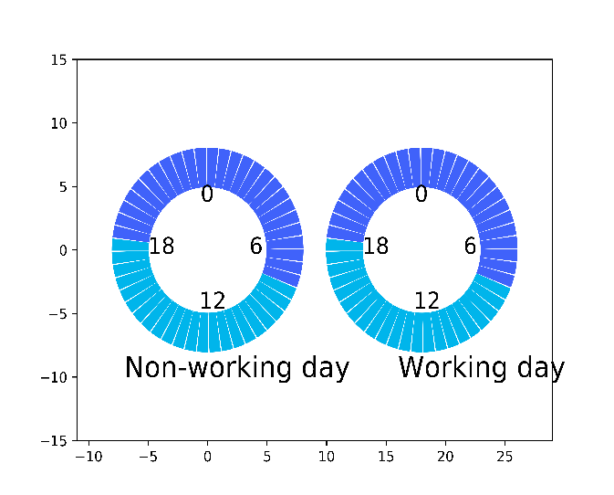
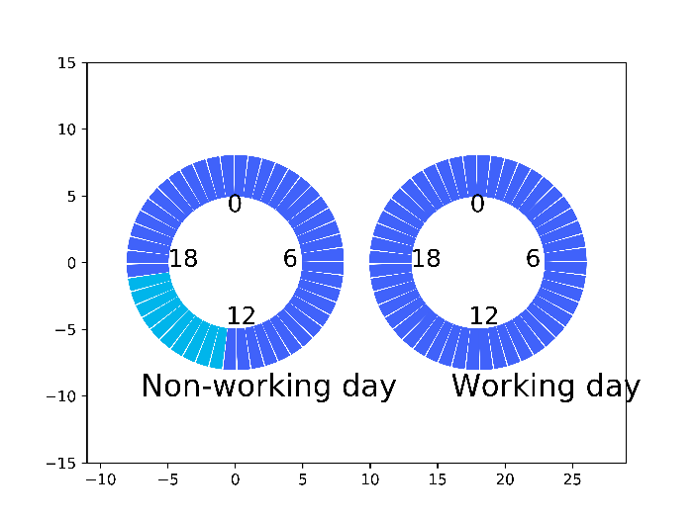
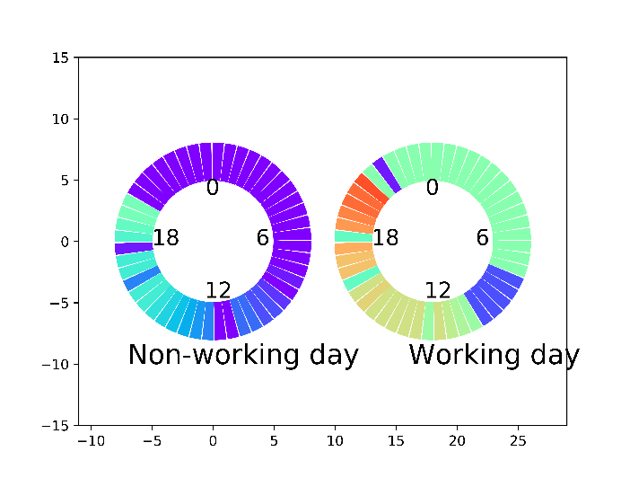
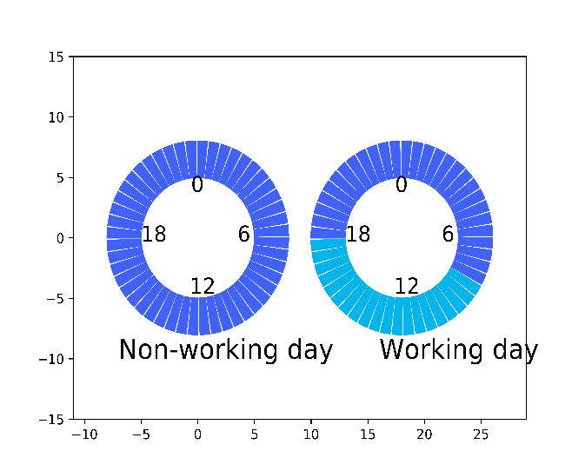
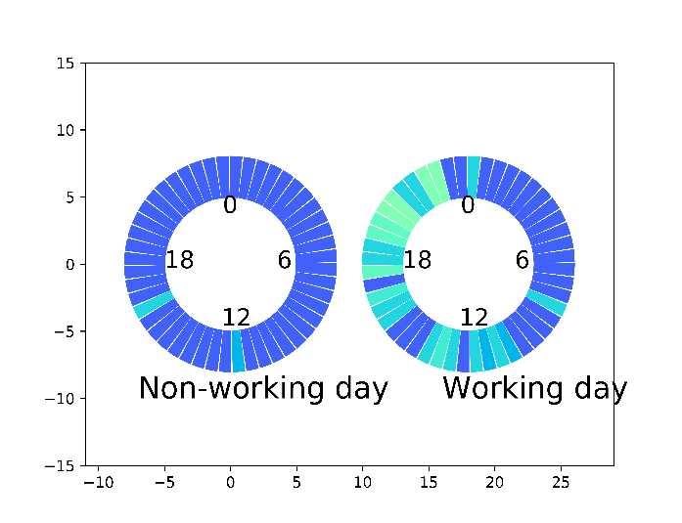
Behavioral Analysis
Extract the key positions of users at each time and cluster

Slide 26
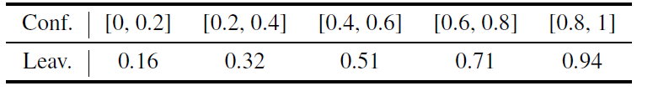
Hometown Returning Prediction
Leaving rate for different Sigmoid outputs
Application: recommend journey/hometown-returning related services to residents, such as ticket booking, express and remittance services

Slide 27
Conclusion
Among the earliest studies on identifying native/migrant profile from both online (communications) and offline (locations) human behaviors.
The proposed model uses CNN to extract resident features and using dimensionality balancing and co-training for training.
Comparative experiments on the city Wuxi demonstrate the high predictive power of CD-CNN.
My opinion:
An application; Lack of labels

Slide 28
Thanks
Q&A

