Slide 1
Detecting Popular Temporal Modes in Population-scale Unlabelled Trajectory Data
FENGLI XU, TONG XIA, HANCHENG CAO, and YONG LI∗, Tsinghua University, China FUNING SUN and FANCHAO MENG, Tencent Inc., China
Ubicomp 18
Temporal modes: regular patterns of individuals allocating their time on different contextual locations
Notes:
流行的时间模式:个体在不同含义的区域内分配时间的规律
人类生活方式的语义信息
揭示城市移动性与人类行为之间的相关性
流行的时间模式与个人社会经济状况之间的关系

Slide 2
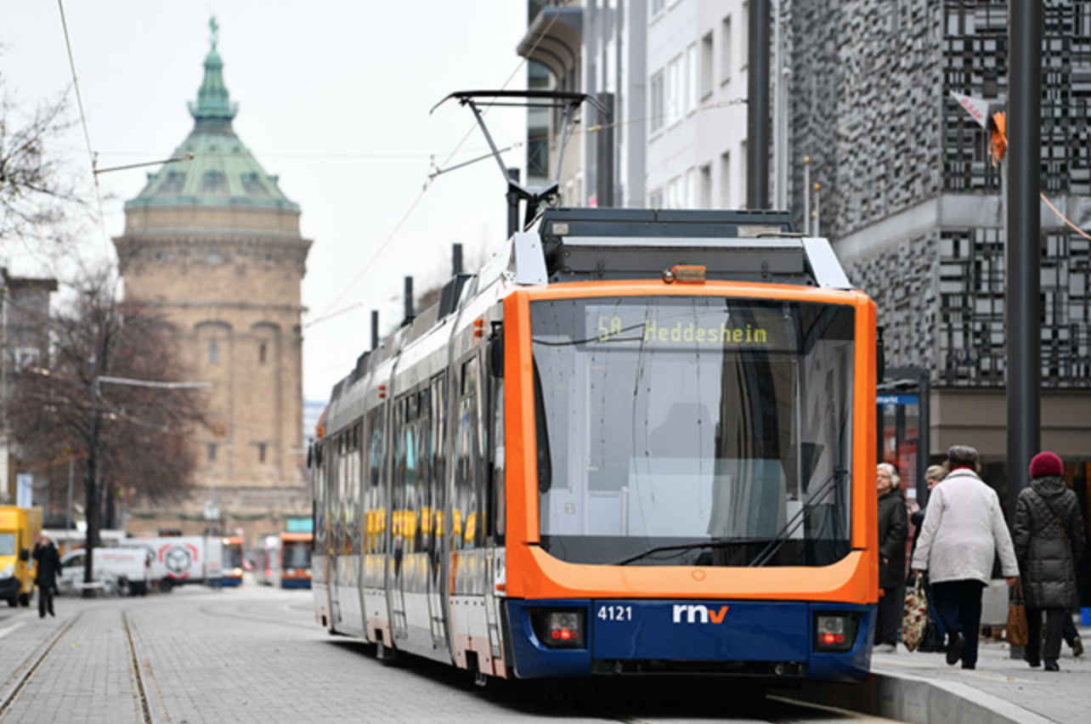
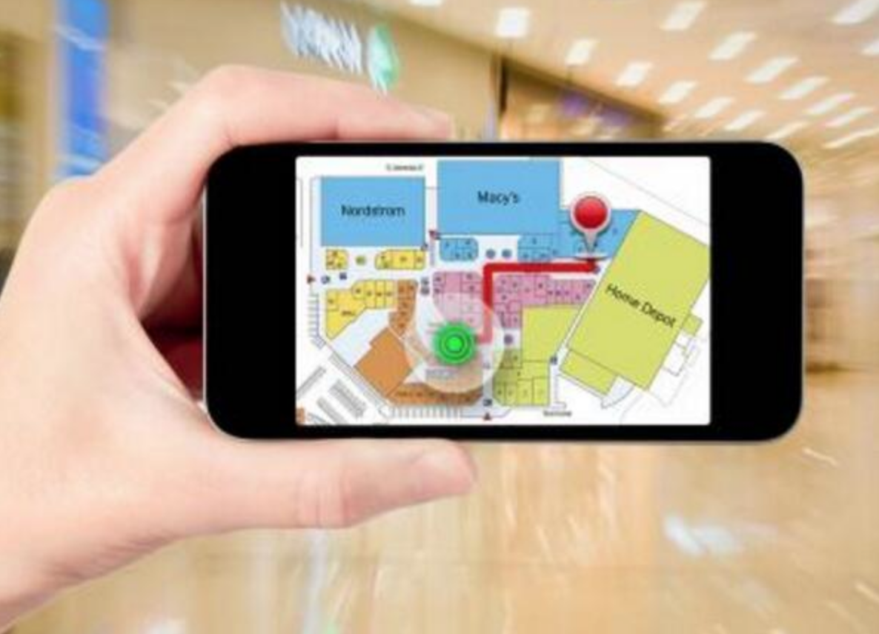
Motivation and Related Work
Trajectory clustering
Mobility patterns modeling
Urban activity recognition
Notes:
一般的直觉,经验和最近的一些研究都指出个体的移动性是非常有规律可循的
一方面寻找时间规律 有利于 公共行政 商业智能 和疾病控制
个体的时间模式和他的身份，经济状况有很大关系，user profiling

Slide 3
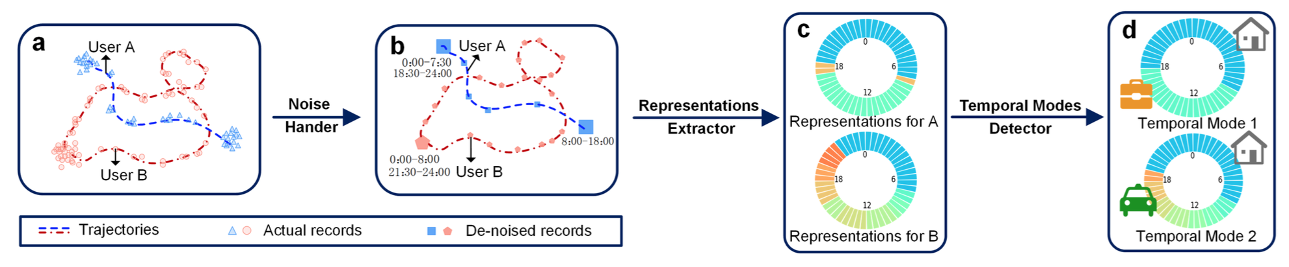
Method
Handling Noise
Representations for Temporal Modes
Detect Popular Temporal Modes

Slide 4
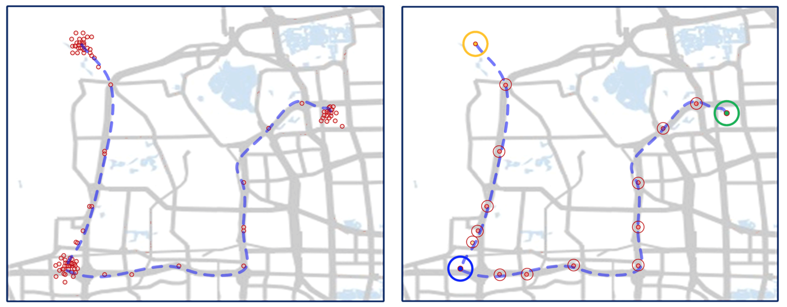
Handling Noise

Slide 5
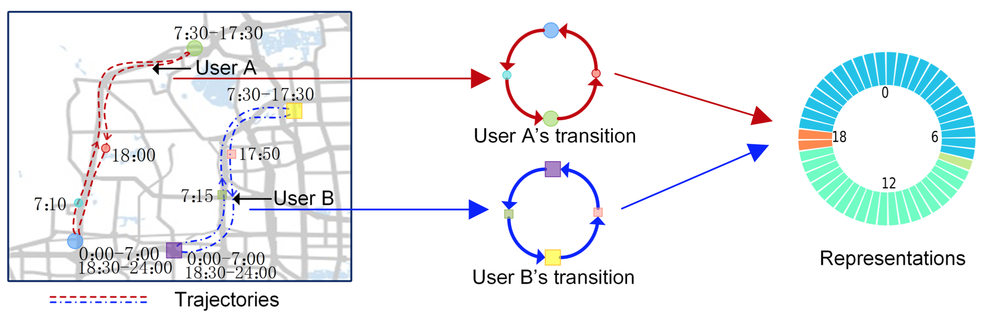
Representations for Temporal Modes
Notes:
1) the representations should be suitable for measuring the similarities in temporal mode, which indicates that the trajectories with similar temporal modes should have similar representation; 2) preserving the contextual information of temporal modes, which implies that the representation should have clear physical meaning and easy to interpreted.

Slide 6
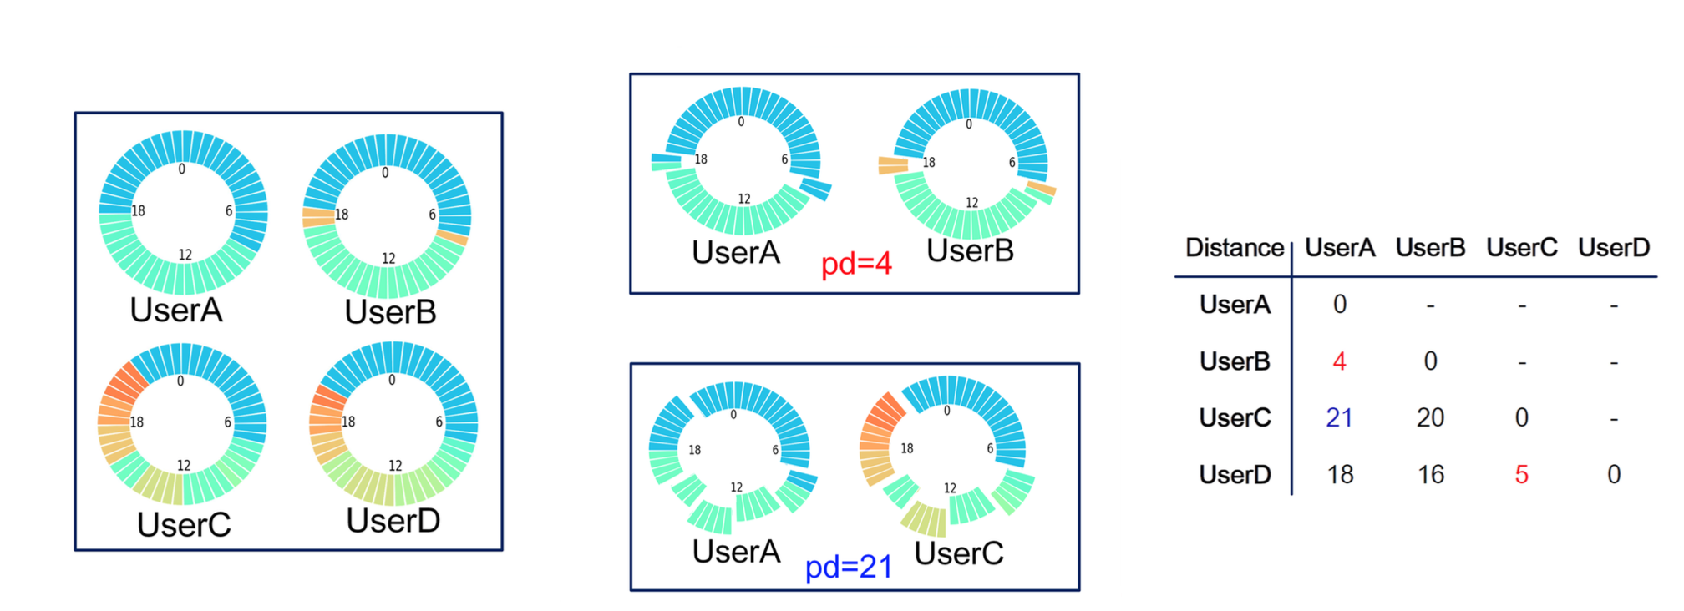
Detect Popular Temporal Modes
Define partition distance
Notes:
non-negativity, symmetry, identity of indiscernibles and triangle inequality

Slide 7
Detect Popular Temporal Modes
Identifying the popular temporal modes: k-medoids(k-中心点算法)
Initiate: randomly choose medoids
Iteration: update the medoids as the representations that have minimum sum of distance to other representations in the cluster, until the medoids are stable
Select K: the largest value that produce stable and distinctive popular temporal modes.
Notes:
non-negativity, symmetry, identity of indiscernibles and triangle inequality

Slide 8
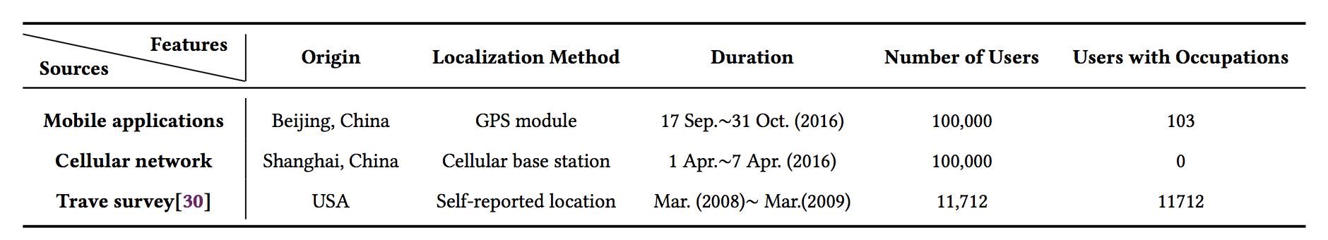
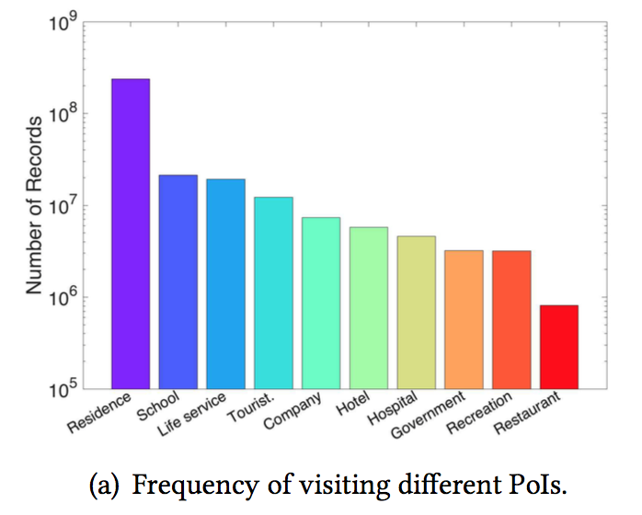
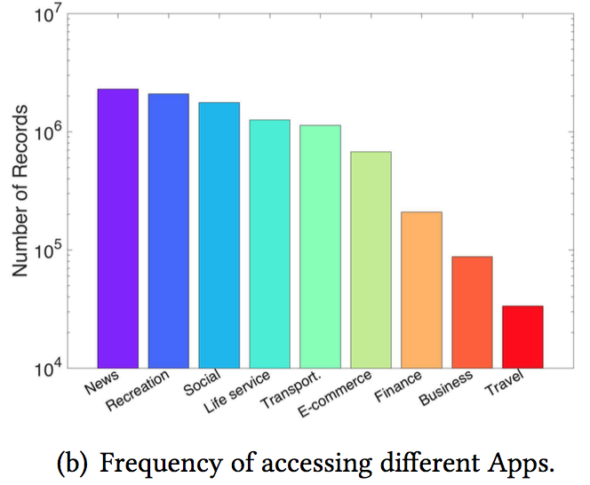
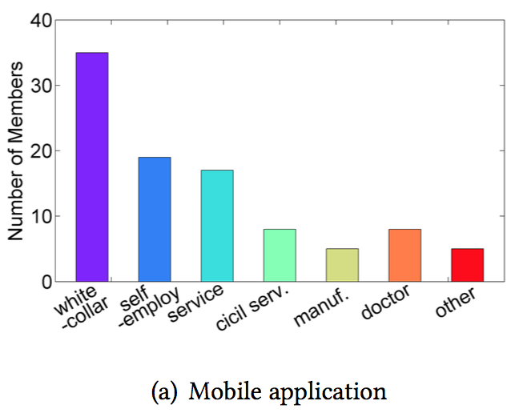
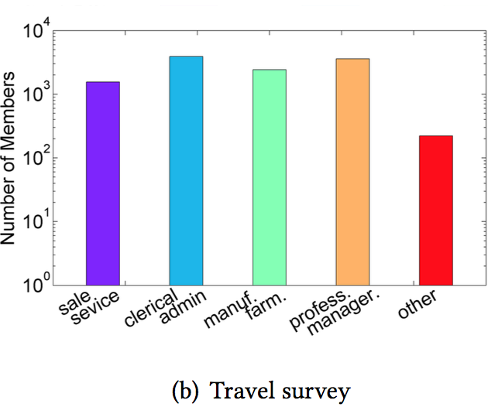
Analysis and Evaluation
Data set
Notes:
Vendor 包含poi
基站数据基本上和我们一样
National Household Travel Survey(NHTS)
第一个和第三个有职业信息

Slide 9
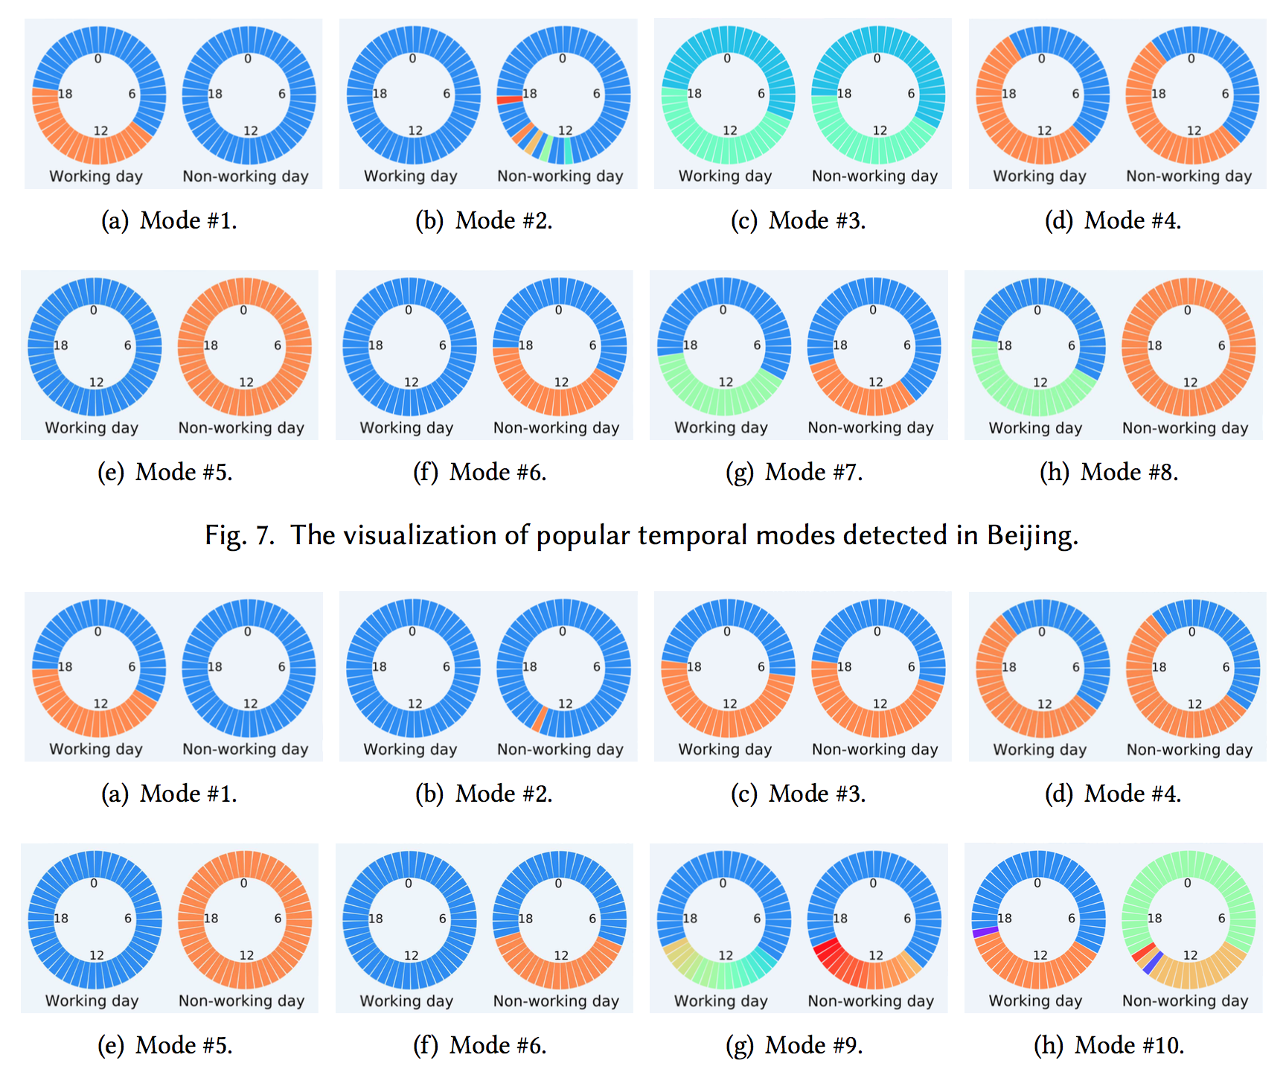
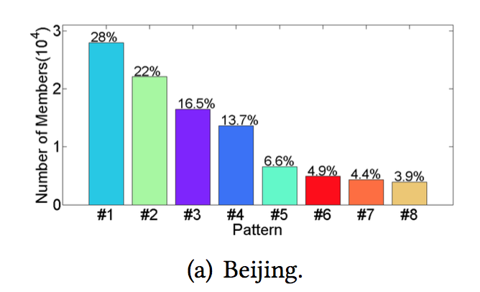
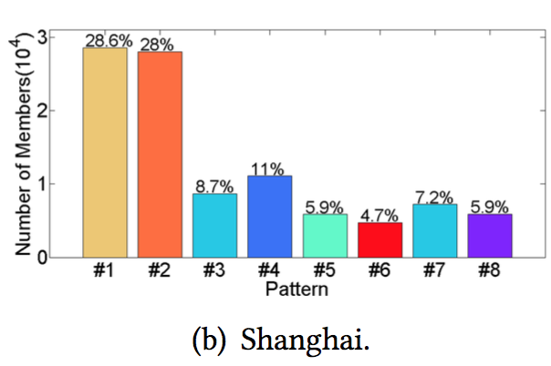
Notes:
#3是加班狗QAQ
#4是加班狗QAQ

Slide 10
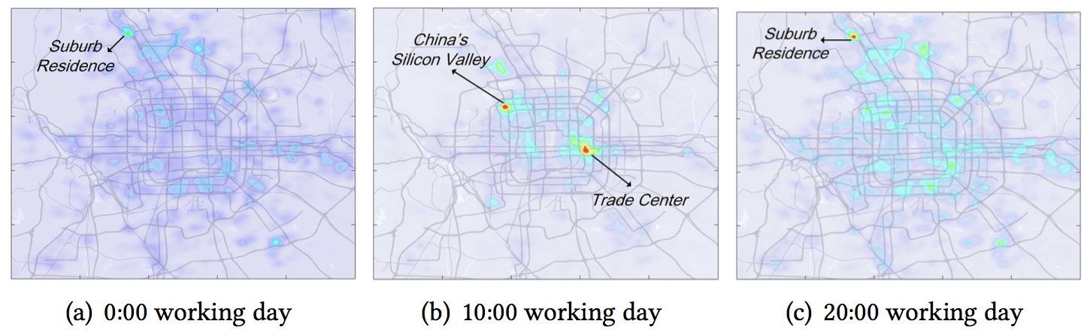
Spatial insight for mode#1
Notes:
早上来到市中心，晚上回到郊区住宅

Slide 11
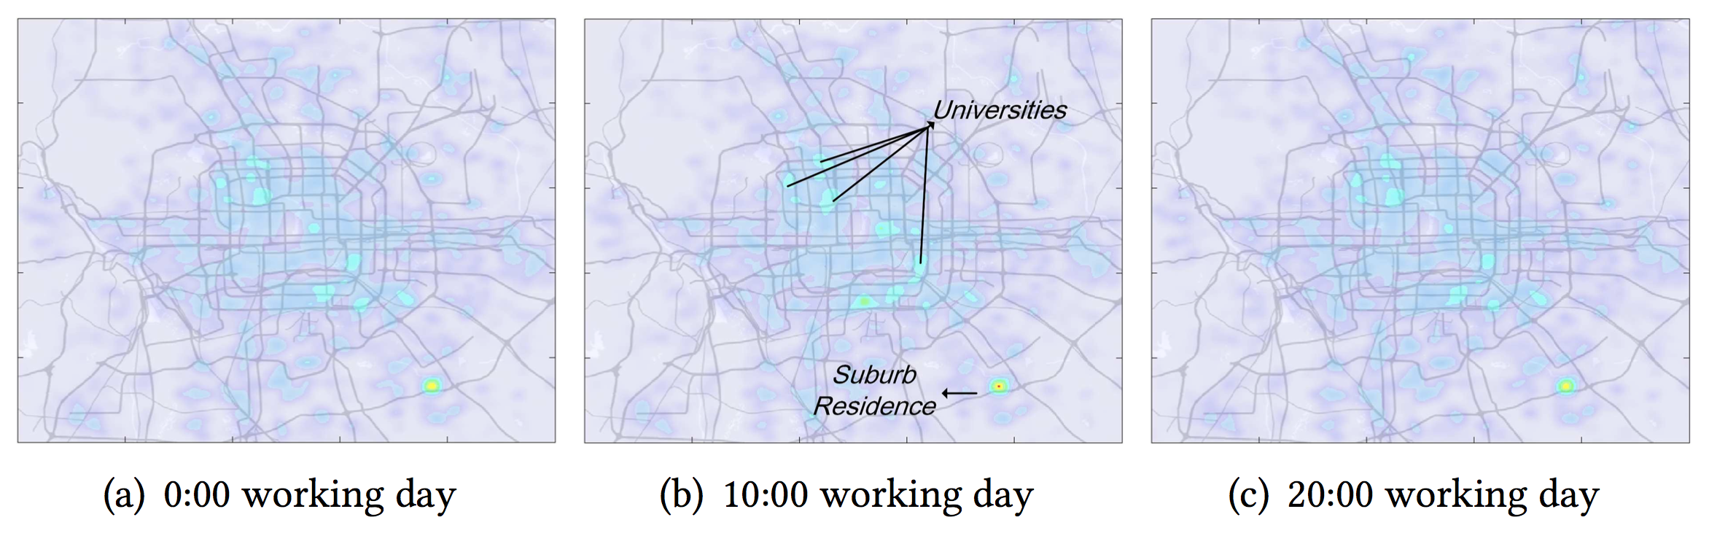
Spatial insight for mode#2
Notes:
学生和家庭主妇

Slide 12
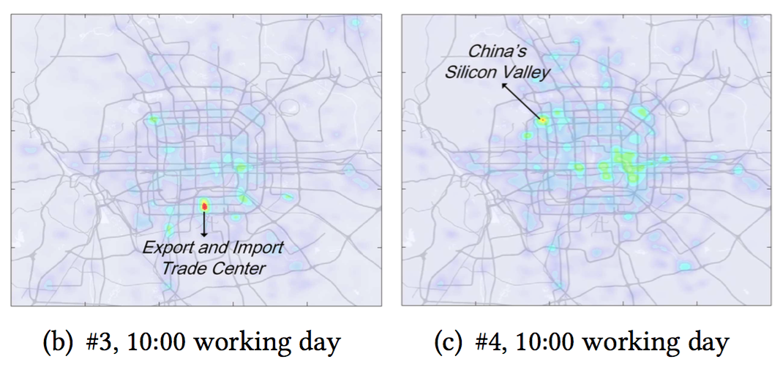
Spatial insight for mode#3#4
Notes:
易于解释、符合普遍直觉
不同时间模式的人的行为不同
不同时间模式和经济状况之间的关系

Slide 13
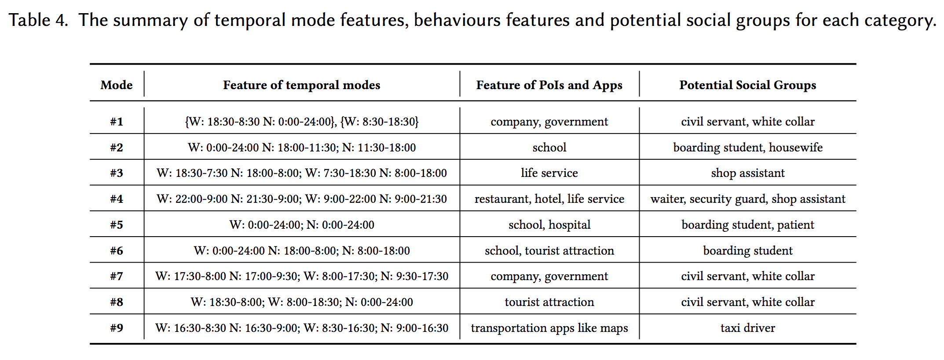
Correlations between temporal modes and users’ attributes

Slide 14
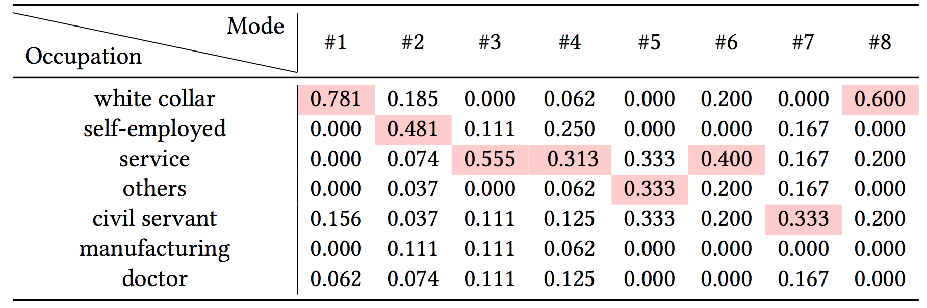
Correlation Between Temporal Modes and Social Economic Status

Slide 15
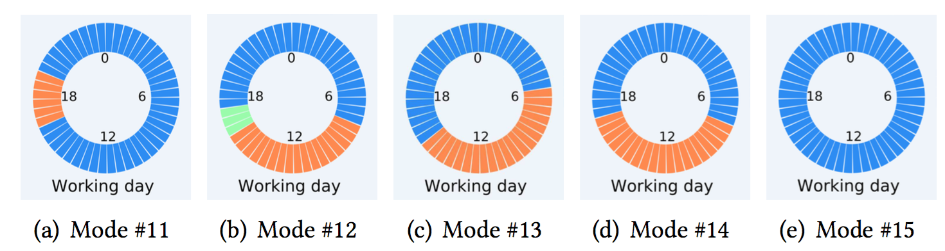
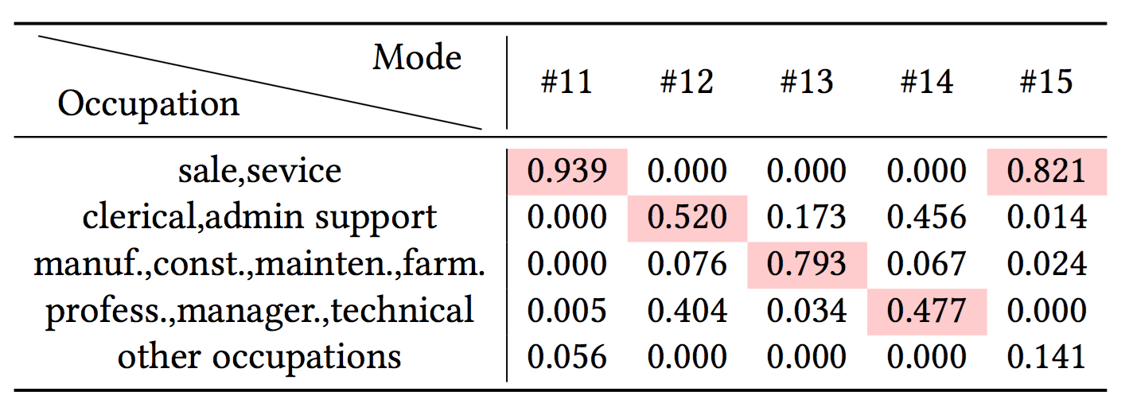

Slide 16
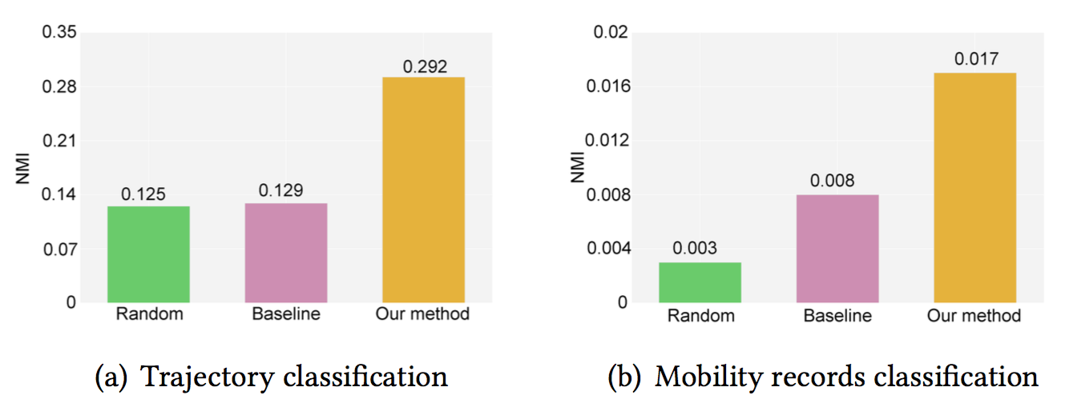
Performance Gain Comparing with Baseline
Comparing with LDA：The LDA algorithm is originally designed to extract latent sematic feature for words and documents based on their co-occurrences frequency.
Notes:
轨迹是记录的集合，把轨迹视为一个文档，把每次访问记录视为一个词，
归一化互信息
H(⋆) is the entropy of mobility records(trajectories), and I(Y,Z) quantifies the mutual information between the PoIs(occupations) categories and the identified mobility records(trajectories) clusters.

Slide 17
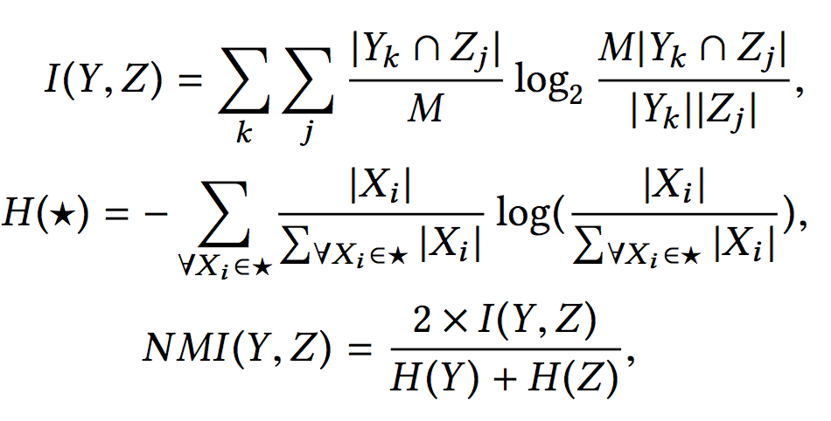
Normalized mutual information(NMI)
Notes:
归一化互信息
H(⋆) is the entropy of mobility records(trajectories), and I(Y,Z) quantifies the mutual information between the PoIs(occupations) categories and the identified mobility records(trajectories) clusters.
说“互信息”的时候，两个随机变量的地位是相同的；说“信息增益”的时候，是把一个变量看成减小另一个变量不确定度的手段。但其实二者的数值是相等的。
“互信息”或者“信息增益”经常作为决策树中选择特征的标准，两种称呼都很常见。

Slide 18
Conclusion
+design a pipeline system
+focus on how users allocate time slides
+explain temporal modes and evaluate properly
-problem in preprocess
-explanation not good enough

