Slide 1
Calibrating Time-variant, Device-specific
Phase Noise for COTS WiFi Devices
Jincao Zhu, Youngbin Im, Shivakant Mishra and Sangtae Ha
University of Colorado Boulder
SenSys 2017

Slide 2
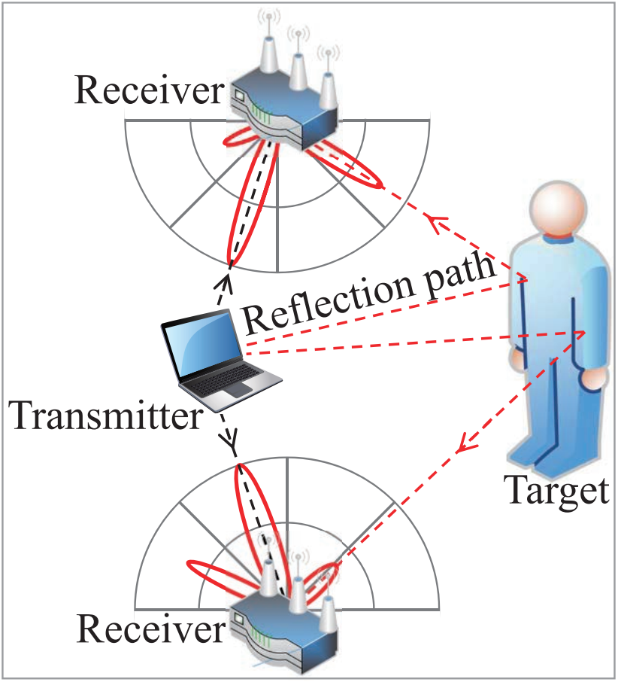
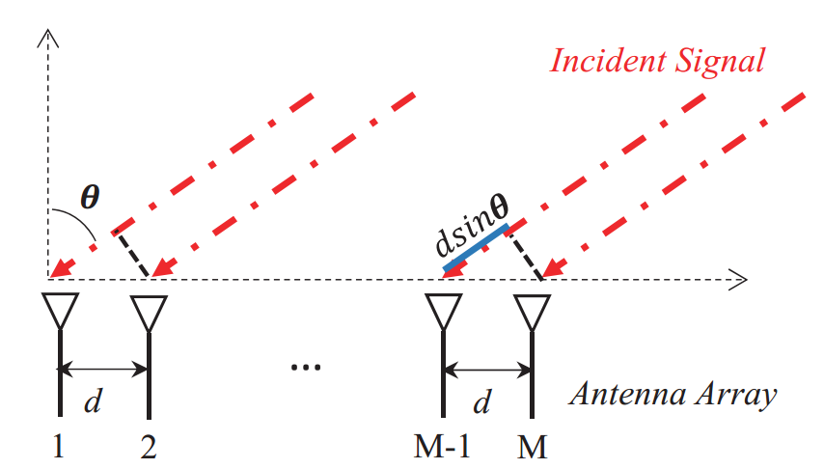
Preliminary on AoA Localization
phase difference of received signal contains Angle of Arrive information
moving human body cause phase and amplitude change in signal received by antenna array

Slide 3
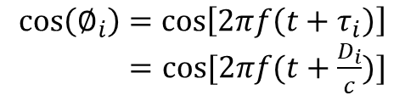
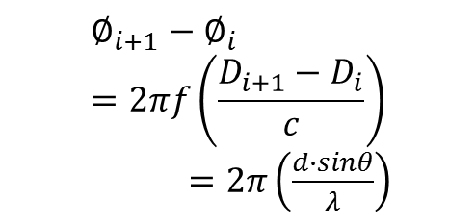
Preliminary on AoA Localization
$$\cos\left(∅_{i}\right)=\cos\left[2πf\left(t+τ_{i}\right)\right]$$
$=cos⁡[2πf(t+\frac{D_{i}}{c})]$
$$∅_{i+1}−∅_{i}=2πf\left(\frac{D_{i+1}−D_{i}}{c}\right)$$
$=2π\left(\frac{d∙sinθ}{λ}\right)$
phase difference of received signal contains Angle of Arrive information
AoA is correlated to phase difference

Slide 4
Preliminary on AoA Localization
Phase difference between antennas
MUSIC
AoA for all incident signal

Slide 5
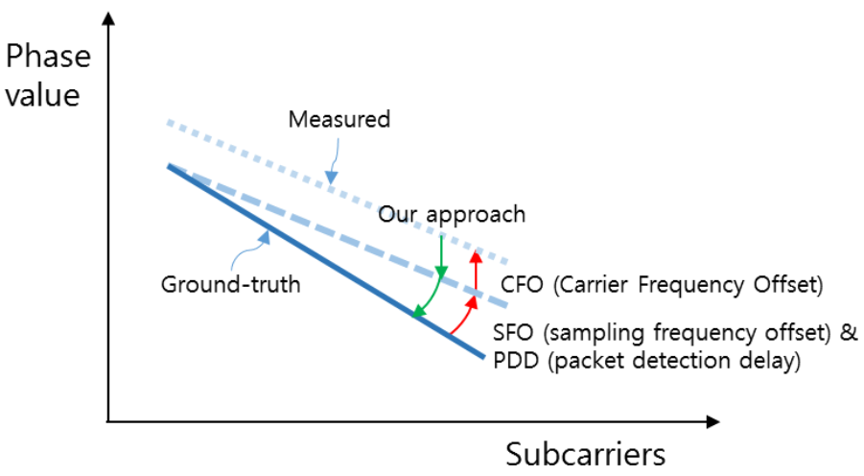


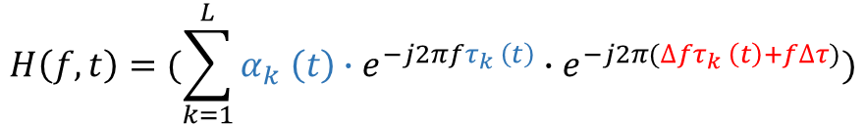
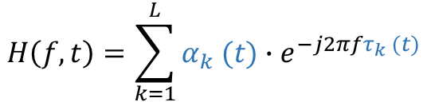
Phase noise in COTS Wi-Fi
$$H\left(f,t\right)=α∙e^{−j2πfτ}$$
object move
$${Phase}_{k}=2π\left(fτ_{k} \left(t\right)+∆fτ_{k} \left(t\right)+f∆τ\right)$$
$$H\left(f,t\right)=α(t)∙e^{−j2πfτ(t)}$$
multi-path
$$H\left(f,t\right)=\sum_{k=1}^{L}{α_{k} (t)∙e^{−j2πfτ_{k} (t)}}$$
phase noise
$$H\left(f,t\right)=(\sum_{k=1}^{L}{α_{k} \left(t\right)∙e^{−j2πfτ_{k} \left(t\right)}}∙e^{−j2π(∆fτ_{k} \left(t\right)+f∆τ)})$$

Slide 6
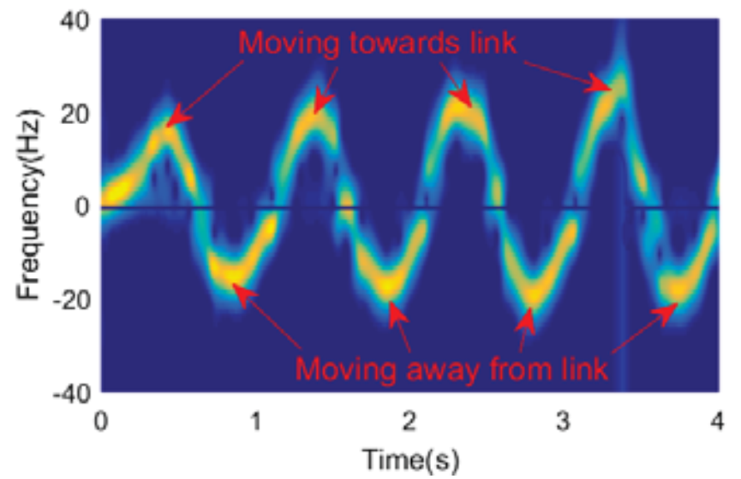
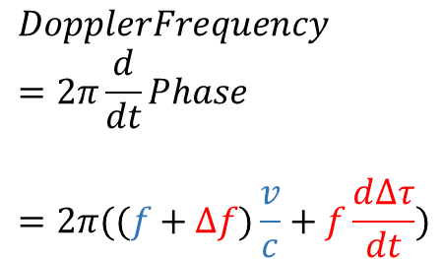

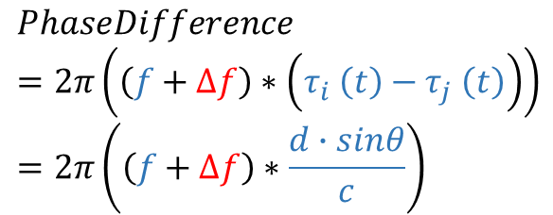
Phase noise impact
$$Phase=2π(fτ \left(t\right)+∆fτ\left(t\right)+f∆τ)$$
$$DopplerFrequency$$
$$=2π\frac{d}{dt}Phase$$
$$=2π((f+∆f)\frac{v}{c}+f\frac{d∆τ}{dt})$$
$$PhaseDifference$$
$$=2π\left(\left(f+∆f\right)∗\left(τ_{i} \left(t\right)−τ_{j} \left(t\right)\right)\right) \\ =2π\left(\left(f+∆f\right)∗\frac{d∙sinθ}{c}\right)$$

Slide 7
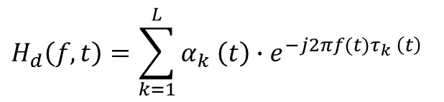

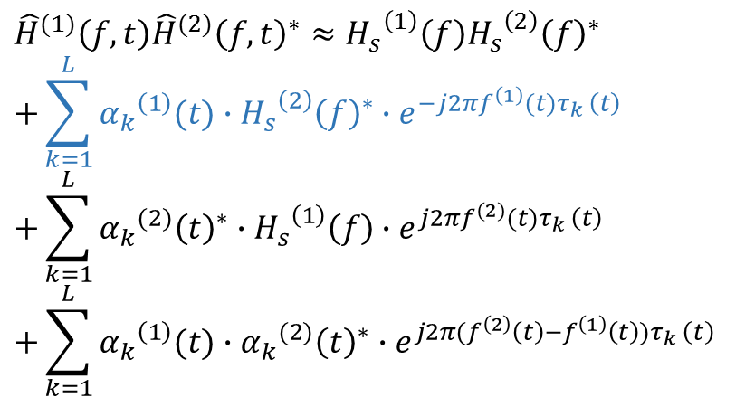
Phase noise mitigation
--WiDance
$$H_{d}\left(f,t\right)=\sum_{k=1}^{L}{α_{k} \left(t\right)∙e^{−j2πf(t)τ_{k} \left(t\right)}}$$
$\hat{H}\left(f,t\right)=(H_{s}\left(f\right)+H_{d}\left(f,t\right)$) $∙e^{−j2π(∆fτ_{k}\left(t\right)+f∆τ)}$
Discard dynamic phase difference between antennas,
only consider Doppler effect
$${\hat{H}}^{(1)}\left(f,t\right){{\hat{H}}^{(2)}\left(f,t\right)}^{∗}≈{H_{s}}^{\left(1\right)}\left(f\right){{H_{s}}^{\left(2\right)}\left(f\right)}^{∗} \\ +\sum_{k=1}^{L}{{α_{k}}^{\left(1\right)}(t)∙{{H_{s}}^{\left(2\right)}\left(f\right)}^{∗}∙e^{−j2πf^{\left(1\right)}(t)τ_{k} \left(t\right)}} \\ +\sum_{k=1}^{L}{{{α_{k}}^{(2)}\left(t\right)}^{∗}∙{H_{s}}^{\left(1\right)}\left(f\right)∙e^{j2πf^{(2)}(t)τ_{k} \left(t\right)}} \\ +\sum_{k=1}^{L}{{α_{k}}^{\left(1\right)}(t)∙{{α_{k}}^{(2)}\left(t\right)}^{∗}∙e^{j2π(f^{\left(2\right)}\left(t\right)−f^{\left(1\right)}\left(t\right))τ_{k} \left(t\right)}}$$

Slide 8

Phase noise mitigation
--CARM
$$H_{d}\left(f,t\right)=\sum_{k=1}^{L}{α_{k} \left(t\right)∙e^{−j2πf(t)τ_{k} \left(t\right)}}$$
$\hat{H}\left(f,t\right)=(H_{s}\left(f\right)+H_{d}\left(f,t\right)$) $∙e^{−j2π(∆fτ_{k}\left(t\right)+f∆τ)}$
Eliminate phase information;
machine learning method is necessary;
not applicable for AoA.
$$|\hat{H}\left(f,t\right)|^{2}=|H_{s}\left(f\right)+H_{d}\left(f,t\right)|^{2}$$

Slide 9
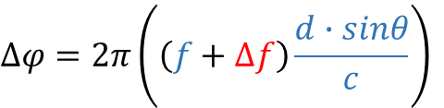
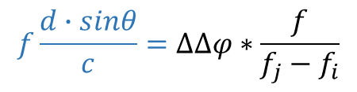
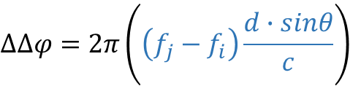
Key Insight
$${Phase}_{k}=2π\left(fτ_{k} \left(t\right)+∆fτ_{k} \left(t\right)+f∆τ\right)$$
difference between antenna
$$∆φ=2π\left(\left(f+∆f\right)\frac{d∙sinθ}{c}\right)$$
difference between subcarrier
$$∆∆φ=2π\left(\left(f_{j}−f_{i}\right)\frac{d∙sinθ}{c}\right)$$
$$f\frac{d∙sinθ}{c}=∆∆φ∗\frac{f}{f_{j}−f_{i}}$$

Slide 10
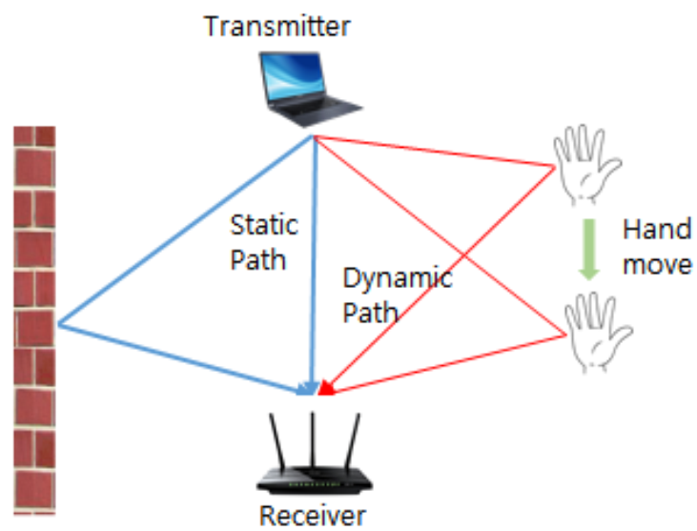
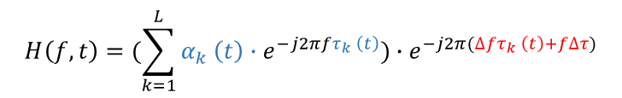
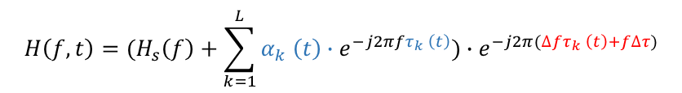
Challenge
How to separate dynamic response from static response?
$$H\left(f,t\right)=(\sum_{k=1}^{L}{α_{k} \left(t\right)∙e^{−j2πfτ_{k} \left(t\right)}})∙e^{−j2π(∆fτ_{k} \left(t\right)+f∆τ)}$$
Dynamic
$$H\left(f,t\right)=(H_{s}\left(f\right)+\sum_{k=1}^{L}{α_{k} \left(t\right)∙e^{−j2πfτ_{k} \left(t\right)}})∙e^{−j2π(∆fτ_{k} \left(t\right)+f∆τ)}$$
Observed

Slide 11
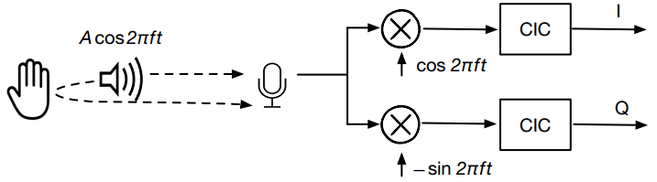
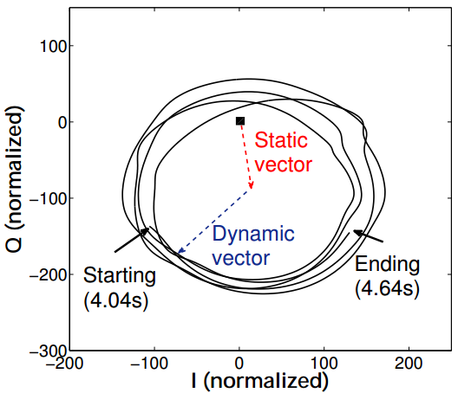
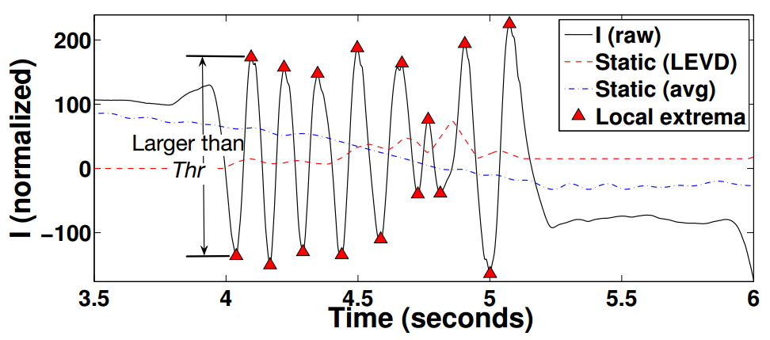
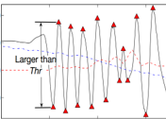
Inspiration
W.Wang, A.X.Liu, and K.Sun. Device-free gesture tracking using acoustic signals. In Proceedings of the 22Nd Annual International Conference on Mobile Computing and Networking, MobiCom‘16
NOT applicable in Wi-Fi due to CFO offset between oscillators

Slide 12
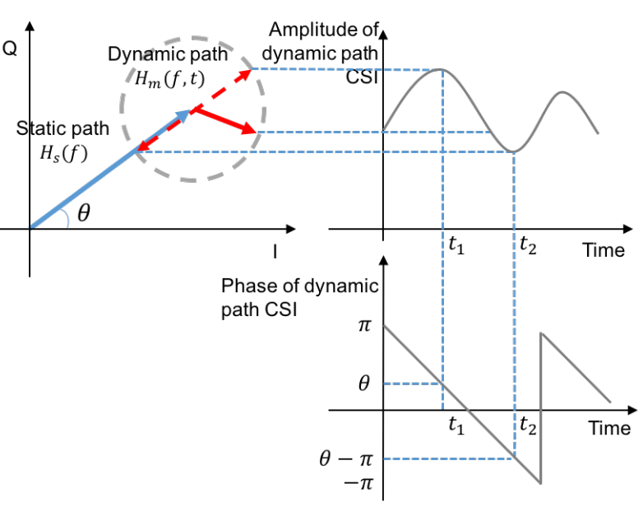
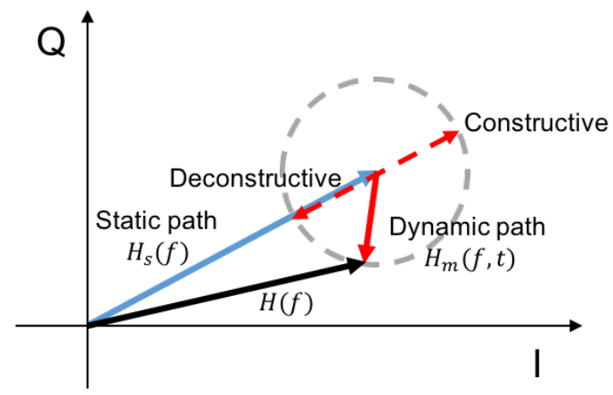
Inspiration
How to extract dynamic phase according to observed CSI amplitude?
The peak and valley of observed CSI amplitude have the same phase value with static/dynamic path phase.

Slide 13
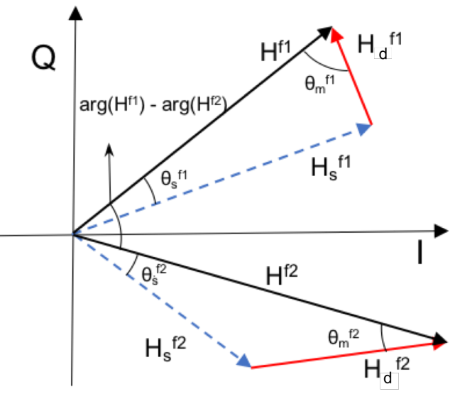
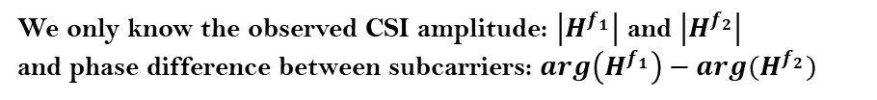

Problem Setup
We only know the observed CSI amplitude: $\left|H^{f_{1}}\right|$ and $\left|H^{f_{2}}\right|$
and phase difference between subcarriers: $arg\left(H^{f_{1}}\right)−arg(H^{f_{2}})$
We want to know the phase difference between dynamic vector:
$$arg\left({H_{d}}^{f_{1}}\right)−arg({H_{d}}^{f_{2}})$$

Slide 14
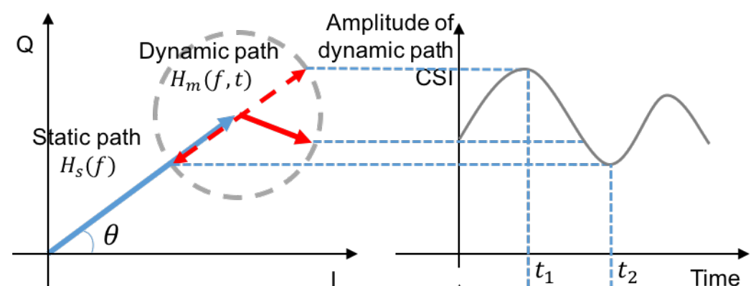
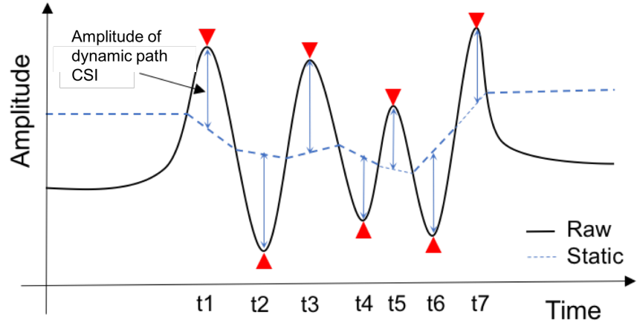
Methodology
Different from LLAP:
Extract static & dynamic amplitude from observed CSI amplitude rather than I/Q component
Phase of dynamic/static vector is invisible, but amplitude of them can be extracted from amplitude of CSI

Slide 15
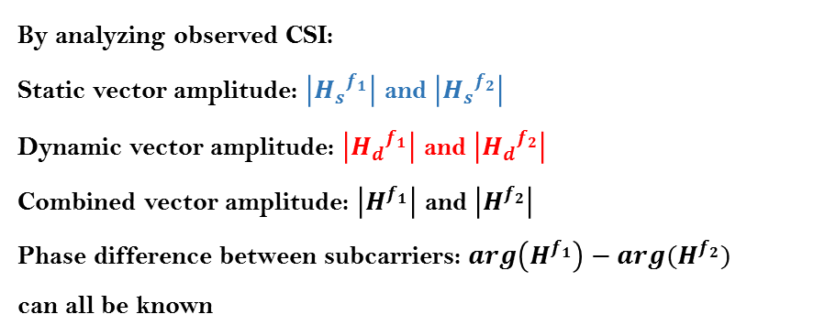


Methodology
By analyzing observed CSI:
Static vector amplitude: $\left|{H_{s}}^{f_{1}}\right|$ and $\left|{H_{s}}^{f_{2}}\right|$
Dynamic vector amplitude: $\left|{H_{d}}^{f_{1}}\right|$ and $\left|{H_{d}}^{f_{2}}\right|$
Combined vector amplitude: $\left|H^{f_{1}}\right|$ and $\left|H^{f_{2}}\right|$
Phase difference between subcarriers: $arg\left(H^{f_{1}}\right)−arg(H^{f_{2}})$
can all be known
$$arg\left({H_{d}}^{f_{1}}\right)−arg\left({H_{d}}^{f_{2}}\right) \\ =∠\left(H^{f_{1}},H^{f_{2}}\right)+{θ_{d}}^{f_{1}}−{θ_{d}}^{f_{2}}$$
$$s.t. {θ_{d}}^{f_{1}}=acos(A^{2}+{A_{d}}^{2}−{A_{s}}^{2})$$
Dynamic phase difference between antennas has successfully been extracted !

Slide 16
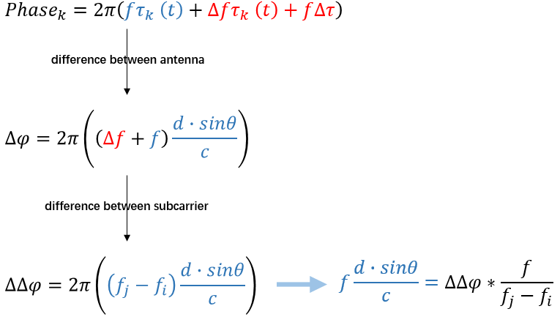
System Design
Phase difference between antenna
MUSIC
AoA for all incident signal

Slide 17
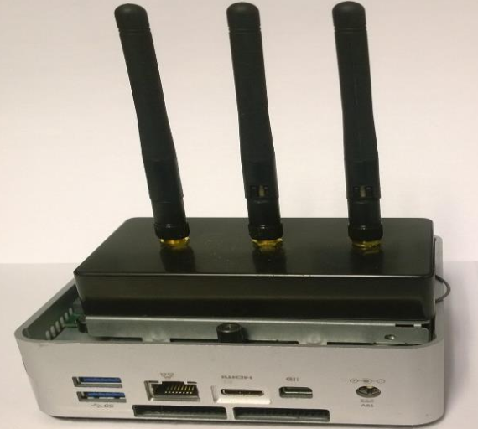
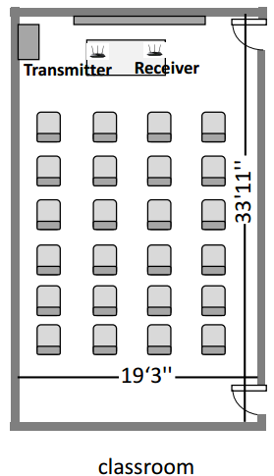
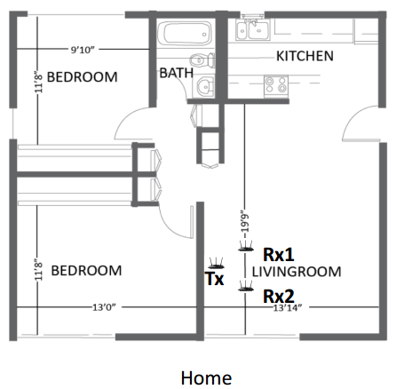
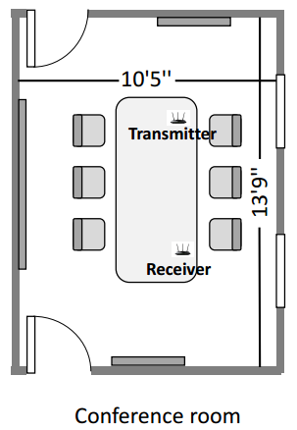
Evaluation Setup
Off-the-shelf Intel 5300 Wi-Fi NICs
One Tx with one antennas
Two Rx with two antennas
Three different locations

Slide 18
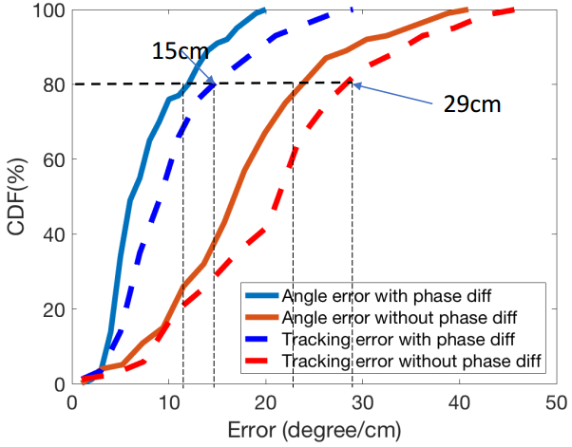
Evaluation
A 100% accuracy improved with phase difference

Slide 19
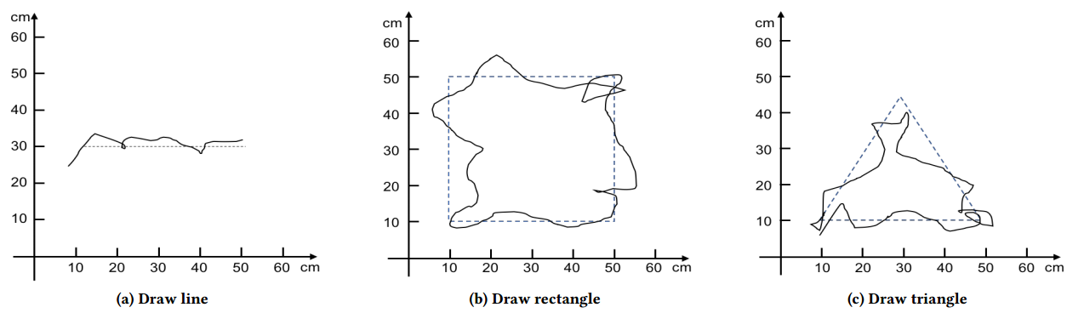
Evaluation

Slide 20
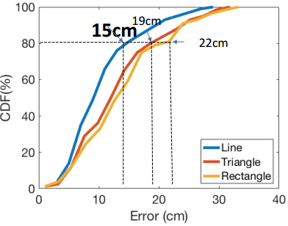
Evaluation
For line movement, achieves 80% tracking error up to 15cm
For triangle and rectangle movements, the average error is increased

Slide 21
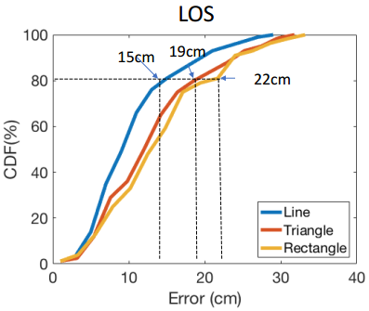
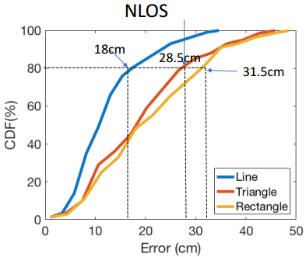
Evaluation
Evaluate both in LOS and NLOS scenarios
Wall block will reduce accuracy

Slide 22
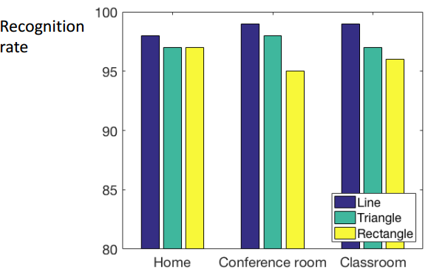
Evaluation
Robust to environment

Slide 23
Conclusion
calibrated the phase value of CSI of COTS Wi-Fi
    based on the amplitude and phase difference changes over time
developed a prototype system for tracking hand
    80th percentile tracking error up to 15 cm
the approach is attractive
    not training based
    not environment dependent

