Slide 1
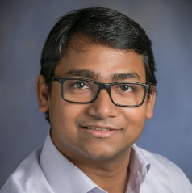
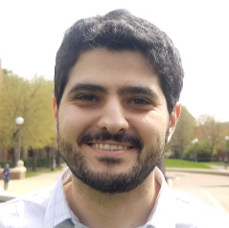
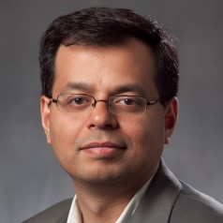
Inaudible Voice Commands: The Long-Range Attack and Defense
Nirupam Roy
Haitham Hassanieh
Romit Roy Choudhury
University of Illinois at Urbana-Champaign
Notes:
1. Good morning, I am Nirupam Roy and today I want to talk to you about our work … on how sounds can be designed such that … microphones hear what they are NOT supposed to hear.
This is a joint work with Haitham and Romit, and we are all from the University of Illinois at Urbana Champaign.

Slide 2
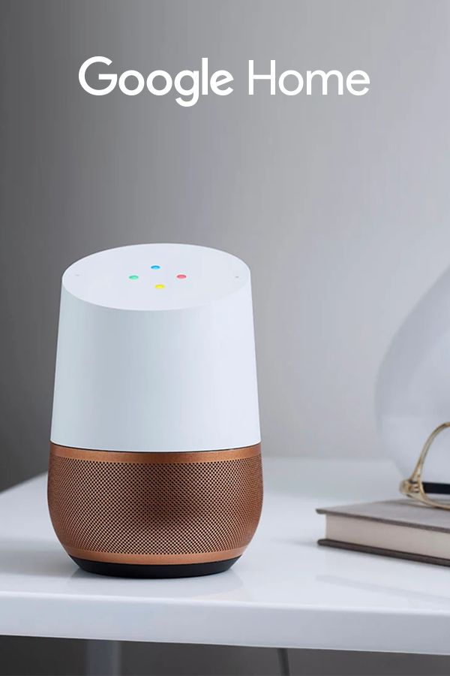
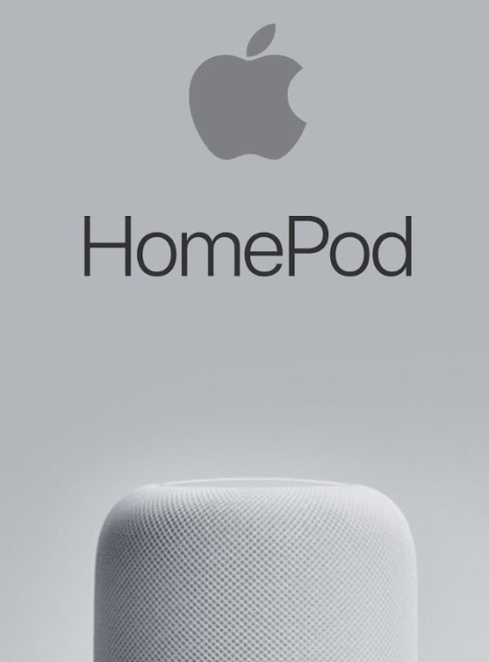
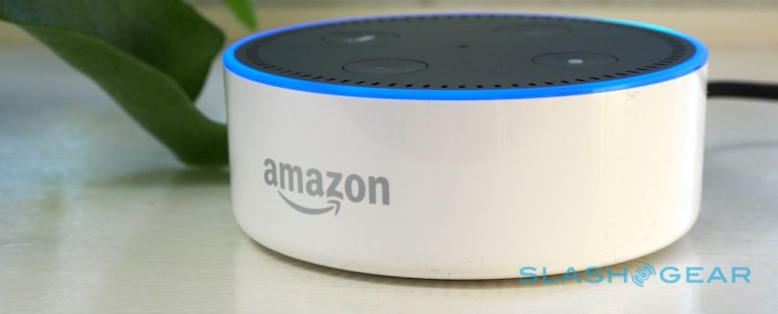
Inaudible voice commands
Backdoor
DolphinAttack
arXiv
Notes:
2. We all know that hundreds of devices and applications are designed to record and process audible sounds …

Slide 3
Two issues remain open
1
Attack range
2
Defense

Slide 4
Outline
1
Background
2
Long range attack
3
Defense
4
Evaluation

Slide 5
Outline
1
Background
2
Long range attack
3
Defense
4
Evaluation

Slide 6
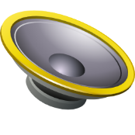
Backdoor
F₁= 50kHz
F₂= 40kHz
(F₁-F₂)
Microphone
filter
F₂
F₁
Amplitude
10k
20k
30k
40k
50k
60k
70k
80k
90k
100k
Frequency
Notes:
As a generalization … a whole set of frequencies can be TRANSLATED into the lower frequency band by using an appropriate frequency F2 … at a slightly lower value.

Slide 7
Outline
1
Background
2
Long range attack
2
Long range attack
3
Defense
4
Evaluation

Slide 8
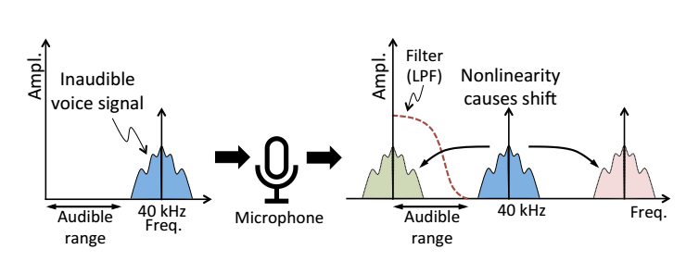


Short range attack
high power
Speaker’s non-linearity
audible
Range: 5ft
Notes:
As a generalization … a whole set of frequencies can be TRANSLATED into the lower frequency band by using an appropriate frequency F2 … at a slightly lower value.

Slide 9




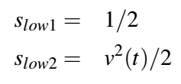

Long range attack
Core idea: using multiple speakers
×
Notes:
As a generalization … a whole set of frequencies can be TRANSLATED into the lower frequency band by using an appropriate frequency F2 … at a slightly lower value.

Slide 10
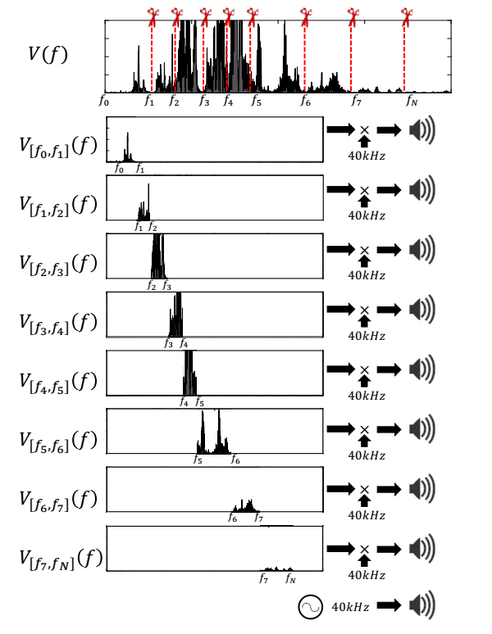
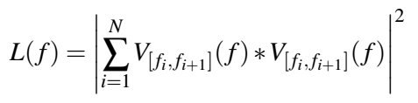
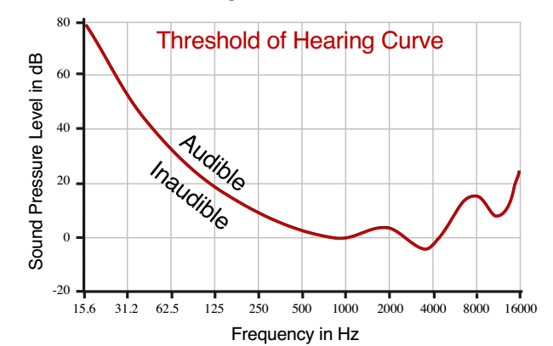

Long range attack
Suppressing $v^{2}(t)$ leakage:
Notes:
As a generalization … a whole set of frequencies can be TRANSLATED into the lower frequency band by using an appropriate frequency F2 … at a slightly lower value.

Slide 11
Outline
1
Background
2
Long range attack
3
Defense
3
Defense
4
Evaluation

Slide 12

Defending inaudible voice commands
1
Decompose incoming signals $s(t)$
2
Energy at low frequencies from $v^{2}(t)$
3
Amplitude degradation at higher frequencies
4
Phase based separation of speakers
Notes:
As a generalization … a whole set of frequencies can be TRANSLATED into the lower frequency band by using an appropriate frequency F2 … at a slightly lower value.

Slide 13
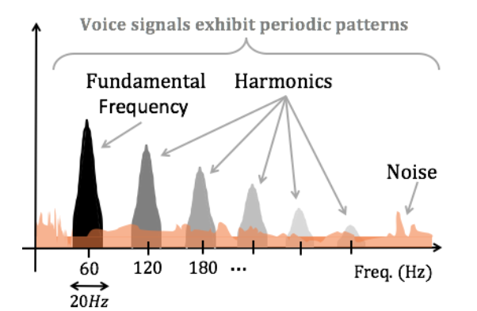
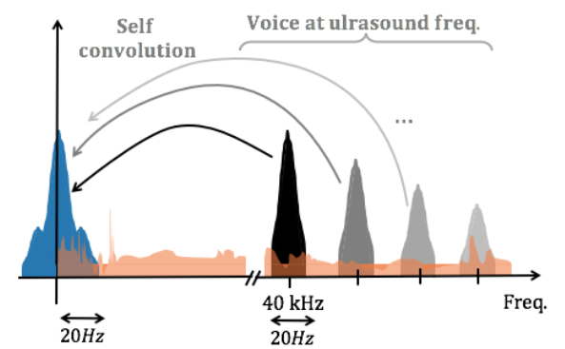
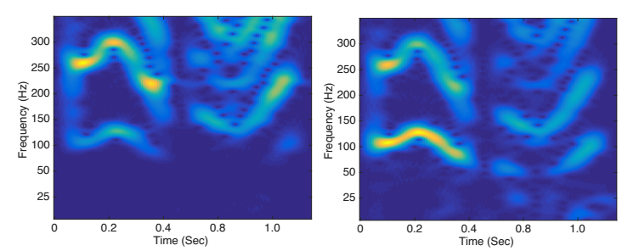
Defending inaudible voice commands
Power in sub-50Hz
Notes:
As a generalization … a whole set of frequencies can be TRANSLATED into the lower frequency band by using an appropriate frequency F2 … at a slightly lower value.

Slide 14
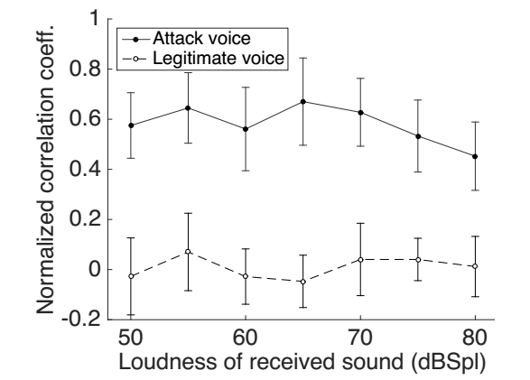
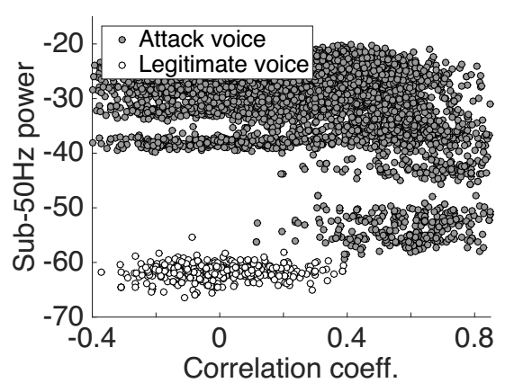
Defending inaudible voice commands
Correlation coefficient
Notes:
As a generalization … a whole set of frequencies can be TRANSLATED into the lower frequency band by using an appropriate frequency F2 … at a slightly lower value.

Slide 15
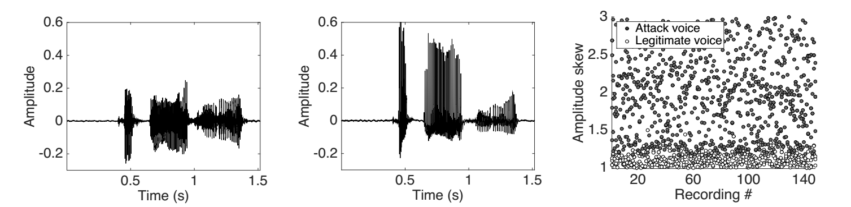
Defending inaudible voice commands
Amplitude skew
Notes:
As a generalization … a whole set of frequencies can be TRANSLATED into the lower frequency band by using an appropriate frequency F2 … at a slightly lower value.

Slide 16
Outline
1
Background
2
Long range attack
3
Defense
4
Evaluation
3
Evaluation
4
Defense

Slide 17
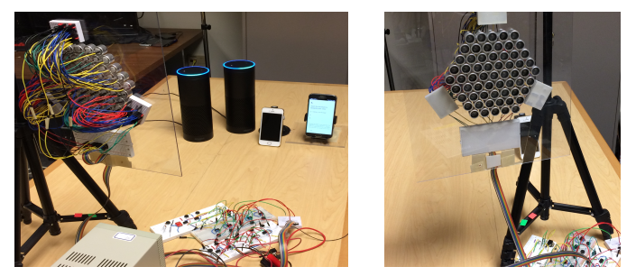
Implementation
Ultrasonic speaker and voice enabled devices
Attack speakers
Notes:
Now although we don’t need to change anything on the microphone devices., we need to build special speaker system for backdoor.
We implemented the BackDoor in two prototypes…the first one is the communication system that emulates acoustic beacon.
The other one is a jammer prototype with an array of speakers.

Slide 18
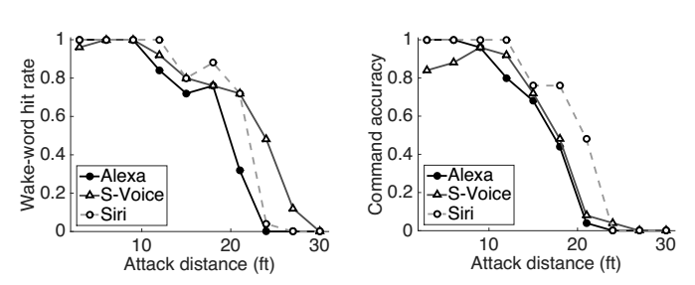
Attack performance
Activate distance
5ft
25ft
Notes:
we…evaluated the performance of our communication prototype by sending datapacket to a smartphone…the result shows that it can achieve 4kbps of datarate upto a distance of 1 meter. Of course we can vary the signal power to increase or decrease the distance of coverage

Slide 19
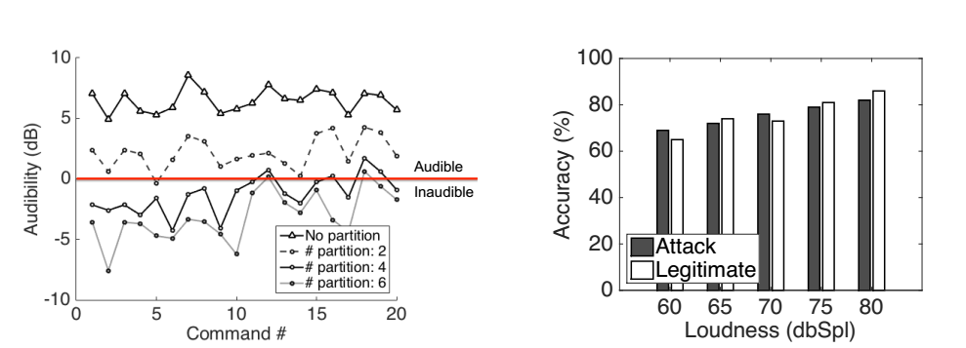
Attack performance
Leakage audibility
Notes:
we…evaluated the performance of our communication prototype by sending datapacket to a smartphone…the result shows that it can achieve 4kbps of datarate upto a distance of 1 meter. Of course we can vary the signal power to increase or decrease the distance of coverage

Slide 20
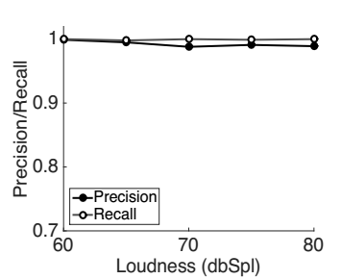
Defense performance
Notes:
we…evaluated the performance of our communication prototype by sending datapacket to a smartphone…the result shows that it can achieve 4kbps of datarate upto a distance of 1 meter. Of course we can vary the signal power to increase or decrease the distance of coverage

Slide 21
My opinion
技术上具有一定的创新性
工作量大、工作细致

