Slide 1
A Review of Blockchain
Presenter: Kai Zhang

Slide 2

What is Blockchain?
A continuously growing list of records, called blocks, which are linked and secured using cryptography.
Each block typically contains a hash pointer as a link to a previous block.
Feature: resistant to modification
When blockchain serves as a distributed ledger:
High Byzantine fault tolerance
Decentralized

Slide 3
Blockchain Development
First work on a cryptographically secured chain of blocks in 1991
First distributed blockchain in 2008
Blockchain 2.0 & Smart Contracts by 2014

Slide 4
First Work on Blockchain: How to Time-Stamp a Digital Document
To certify the time a document was created or last modified
While digital documents are so easy to tamper with, and the change need not leave any telltale sign
We need a method of time-stamping digital documents with the following two properties:
Impossible to change the document without being apparent
Impossible to stamp the document with a fake time

Slide 5
A Naïve Solution
A client transmits a to be time-stamped document to a time-stamping service (TSS)
TSS records the time the document was received and retains a copy of the document for safe-keeping
Several concerns:
Privacy
Bandwidth and storage
Incompetence
Trust

Slide 6
Suppose A Trusted Time-Stamping Service
Two improvements on the naïve solution:
Hash
Instead of transmitting document x to TSS, transmit h(x)=y
Solves bandwidth & storage and privacy problems
Digital signature
After TSS receives the hash value, it appends time, then signs this compound document and sends it to the client.
Solves incompetence problem

Slide 7
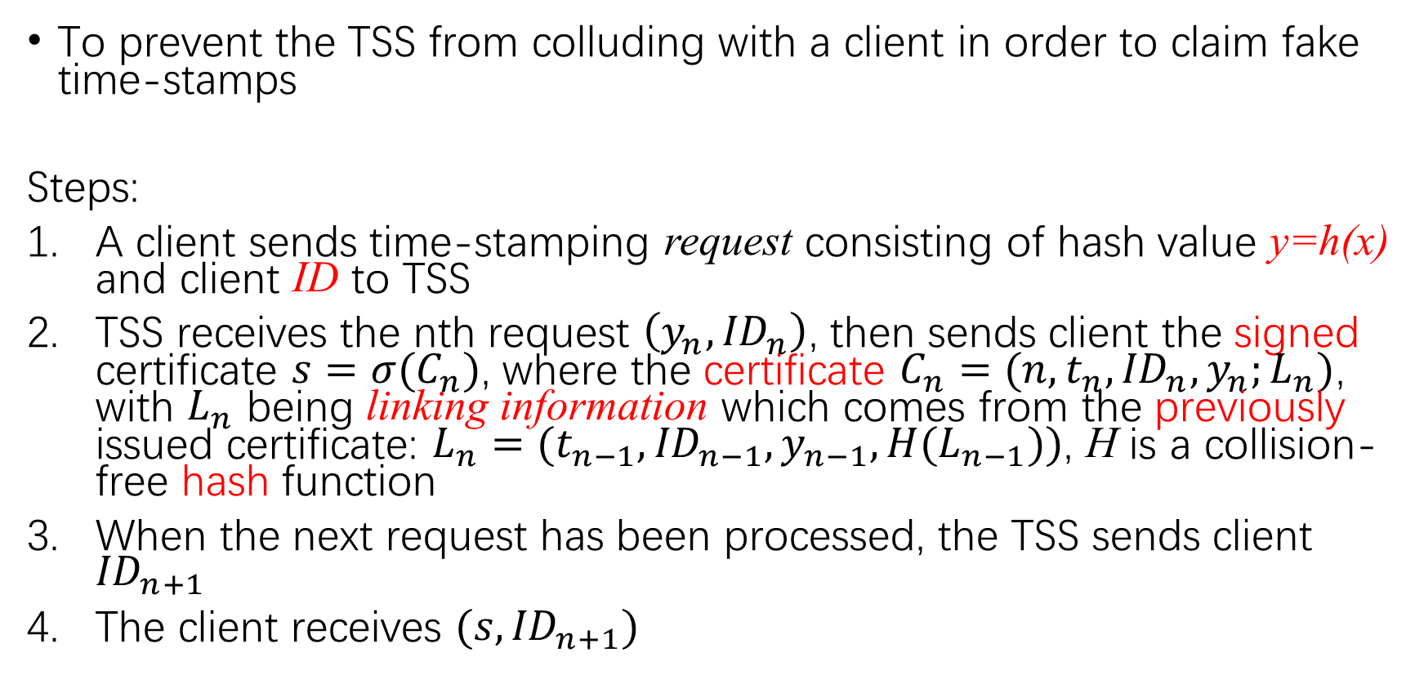
Linking Scheme for Time-Stamping
To prevent the TSS from colluding with a client in order to claim fake time-stamps
Steps:
A client sends time-stamping request consisting of hash value y=h(x) and client ID to TSS
TSS receives the nth request $\left(y_{n},{ID}_{n}\right)$, then sends client the signed certificate $s=σ(C_{n})$, where the certificate $C_{n}=(n,t_{n},{ID}_{n},y_{n};L_{n})$, with $L_{n}$ being linking information which comes from the previously issued certificate: $L_{n}=(t_{n−1},{ID}_{n−1},y_{n−1},H(L_{n−1}))$, H is a collision-free hash function
When the next request has been processed, the TSS sends client ${ID}_{n+1}$
The client receives $(s,{ID}_{n+1})$

Slide 8
First Distributed Blockchain: Bitcoin: A Peer-to-Peer Electronic Cash System
A solution to the double-spending problem using a peer-to-peer network.
The network timestamps transactions by hashing them into an ongoing chain of hash-based proof-of-work, forming a record that cannot be changed without redoing the proof-of-work.

Slide 9
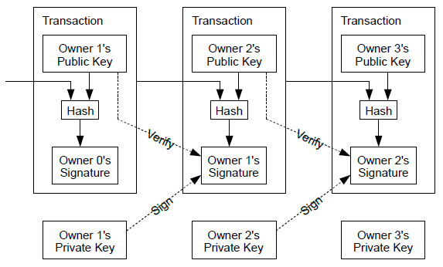
Transactions
Define an electronic coin as a chain of digital signatures.
Each owner transfers the coin to the next by digitally signing a hash of the previous transaction and the public key of the next owner and adding these to the end of the coin. A payee can verify the signatures to verify the chain of ownership.
Double spending problem!

Slide 10
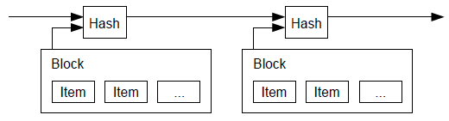
Solution: Timestamp Server
A timestamp server works by taking a hash of a block of items to be timestamped and widely publishing the hash. Each timestamp includes the previous timestamp in its hash, forming a chain, with each additional timestamp reinforcing the ones before it.

Slide 11
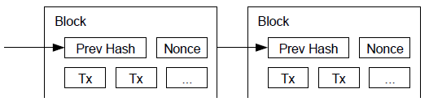
Proof-of-Work
We implement the proof-of-work by incrementing a nonce in the block until a value is found that makes the block's hash begins with a number of zero bits.
The average work required is exponential in the number of zero bits required and can be verified by executing a single hash.

Slide 12
Proof-of-Work
Proof-of-work is essentially one-CPU-one-vote. The majority decision is represented by the longest chain, which has the greatest proof-of-work effort invested in it.
The proof-of-work difficulty is determined by a moving average targeting an average number of blocks per hour.

Slide 13
Network
The steps to run the network are as follows:
New transactions are broadcast to all nodes.
Each node collects new transactions into a block.
Each node works on finding a difficult proof-of-work for its block.
When a node finds a proof-of-work, it broadcasts the block to all nodes.
Nodes accept the block only if all transactions in it are valid and not already spent.
Nodes express their acceptance of the block by working on creating the next block in the chain, using the hash of the accepted block as the previous hash.

Slide 14
Network: Branch
Nodes always consider the longest chain to be the correct one and will keep working on extending it.
If two nodes broadcast different versions of the next block simultaneously, some nodes may receive one or the other first. In that case, they work on the first one they received, but save the other branch in case it becomes longer. The tie will be broken when the next proof-of-work is found and one branch becomes longer; the nodes that were working on the other branch will then switch to the longer one.
New transaction broadcasts do not necessarily need to reach all nodes. As long as they reach many nodes, they will get into a block before long.
If a node does not receive a block, it will request it when it receives the next block and realizes it missed one.

Slide 15
Incentive
The first transaction in a block is a special transaction that starts a new coin owned by the creator of the block.
This adds an incentive for nodes to support the network, and provides a way to initially distribute coins into circulation.
The incentive can also be funded with transaction fees.
The incentive may help encourage nodes to stay honest.

Slide 16
Blockchain 2.0 & Smart Contract
Blockchain 2.0
Blockchain 2.0 go beyond transactions and enable "exchange of value without powerful intermediaries acting as arbiters of money and information
Smart Property
Using blockchain technology to represent ownership of custom currencies and financial instruments, stocks, domain names, etc.
Smart Contract
Programs that encode certain conditions and outcomes serving as contracts and are automatically executed.

Slide 17
Ethereum: A Next-Generation Smart Contract and Decentralized Application Platform
Ethereum is a decentralized platform that runs smart contracts
Apps run on a custom built blockchain, an enormously powerful shared global infrastructure that can move value around and represent the ownership of property
Ethereum intends to provide is a blockchain with a built-in fully fledged Turing-complete programming language that can be used to create "contracts"

Slide 18
我的评价
不要神化区块链
分布式区块链的价值
区块链与供应链：让供应链更透明，更安全，更可信

Slide 19
References
Stuart Haber and W. Scott Stornetta. (1991). How To Time-Stamp a Digital Document. Journal of Cryptology. p99-111.
Satoshi Nakamoto. (2008). Bitcoin: A Peer-to-Peer Electronic Cash System.
https://www.ethereum.org. (2014). A Next-Generation Smart Contract and Decentralized Application Platform. Available: https://github.com/ethereum/wiki/wiki/White-Paper. Last accessed 16th Oct 2017.
https://techcrunch.com/2016/11/24/blockchain-has-the-potential-to-revolutionize-the-supply-chain/

Slide 20
Thank you!

