Slide 1
An introduction to LPWAN and related work

Slide 2
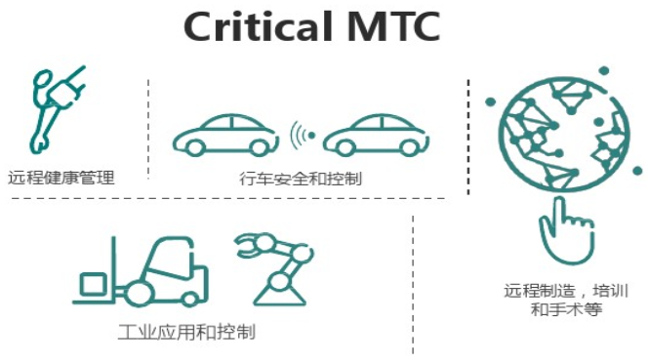
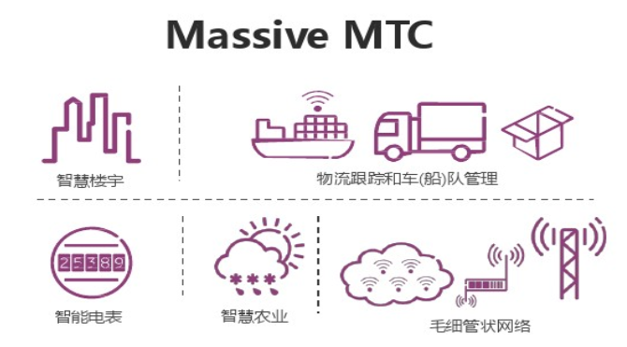
LPWAN
-- Overview
Low-Power Wide-Area Network
Cost Power Connection Coverage

Slide 3
LPWAN
-- Overview
LPWAN
Spread Spectrum (扩频技术)
Narrowband (窄带技术)
Ultra Narrowband (超窄带技术)
NB-IoT
Sigfox
eMTC
LoRa

Slide 4
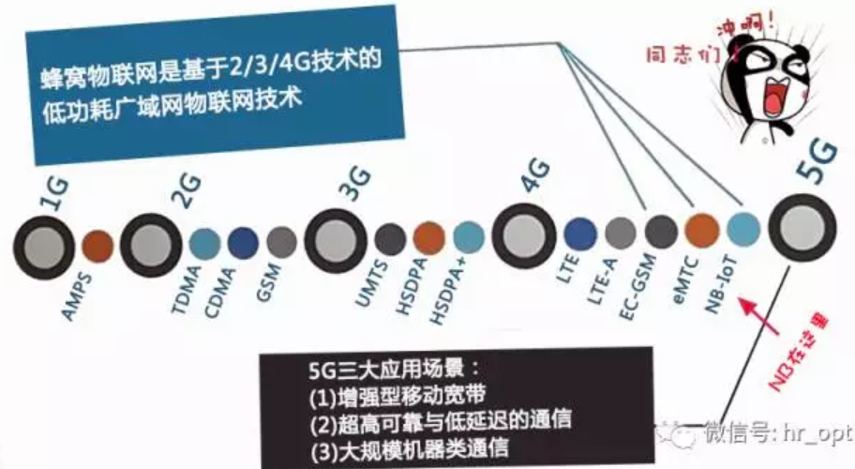
LPWAN
-- NB-IoT

Slide 5
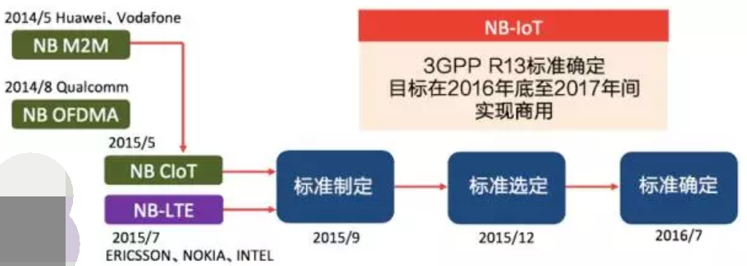
LPWAN
-- NB-IoT
3GPP R13
2015.9 Project initialize;
2016.6 Project finalize;

Slide 6
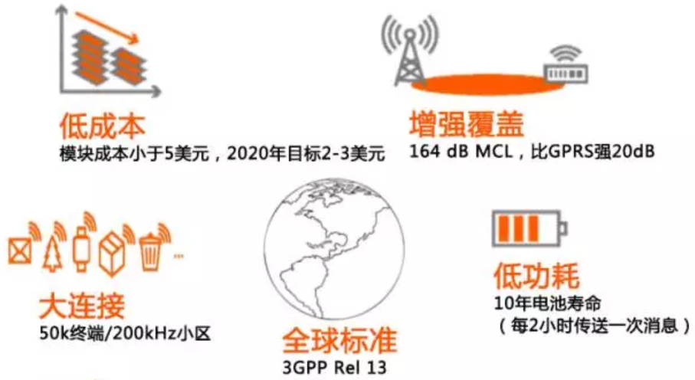
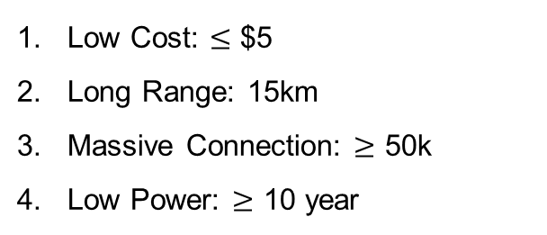
LPWAN
-- NB-IoT
Low Cost: $≤$ $5
Long Range: 15km
Massive Connection: $≥$ 50k
Low Power: $≥$ 10 year

Slide 7
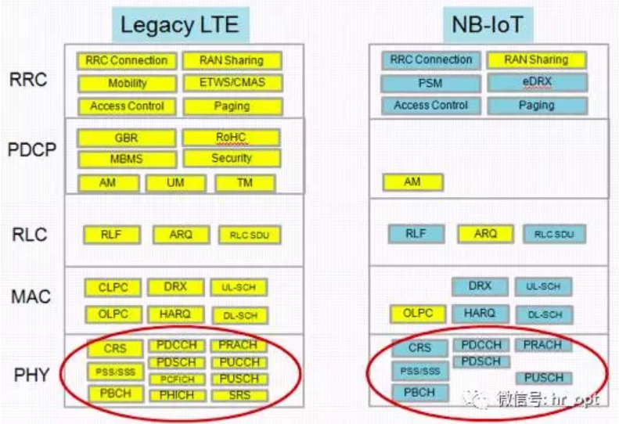
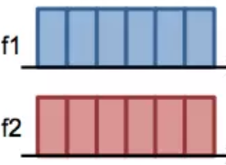
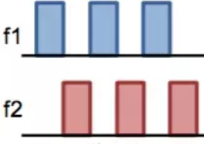
LPWAN
-- NB-IoT
1. Low Cost
Reduced Protocol
Half Duplex

Slide 8
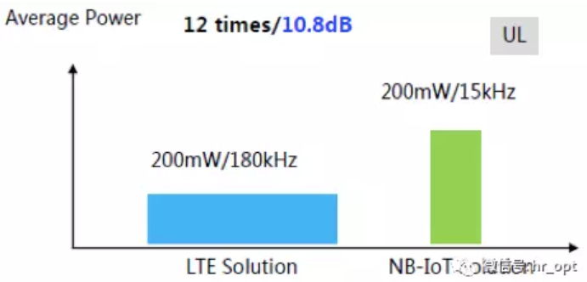
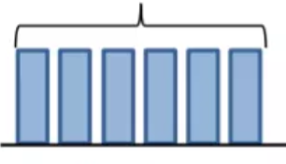
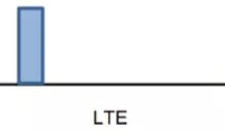

LPWAN
-- NB-IoT
2. Long Range
Repeat times $≤$ 128
LTE
NB-IoT
High PSD
Repeat transmission

Slide 9
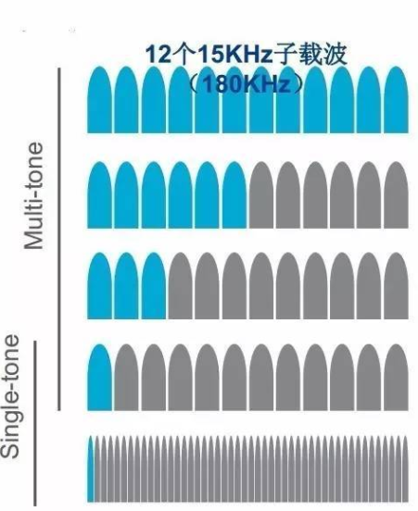
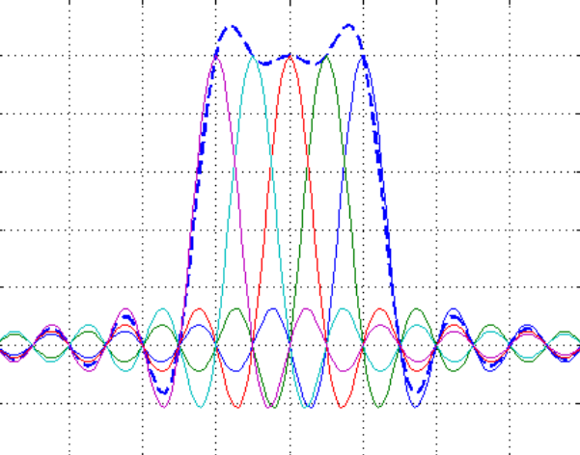
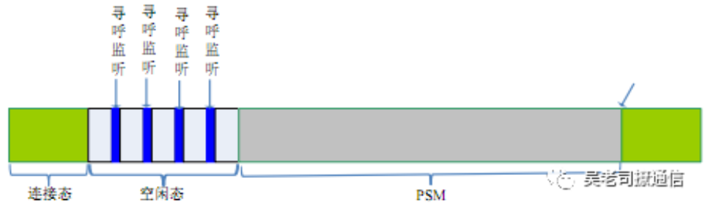
LPWAN
-- NB-IoT
3. Massive Connection
Mostly at PSM model
Fine-grained scheduling

Slide 10

LPWAN
-- NB-IoT
4. Low Power
DRX
eDRX
LTE
NB-IoT
Mostly at PSM model
Enhanced discontinues reception

Slide 11
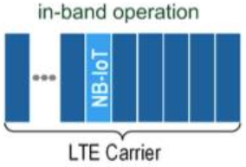
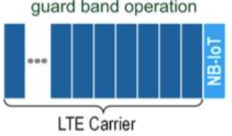
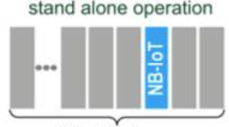
LPWAN
-- NB-IoT
Operation Modes
LTE Carrier
LTE Carrier
GSM Carrier
Frequency re-farming

Slide 12
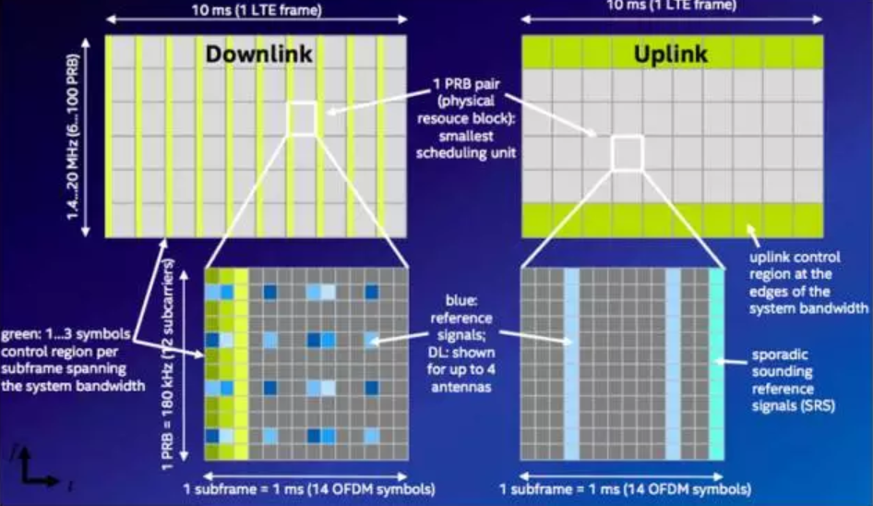
LPWAN
-- NB-IoT
Frame Structure

Slide 13
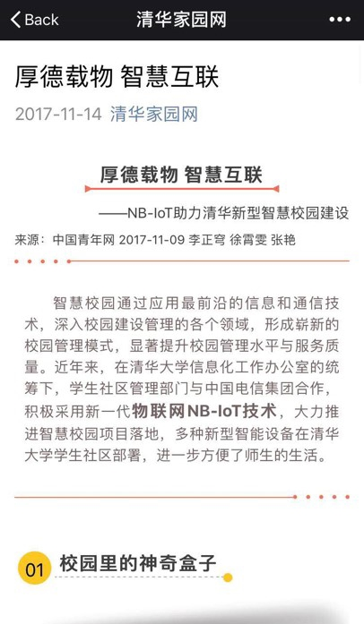
LPWAN
-- NB-IoT
Application Scenario
Smart meter reading
Smart agricultural
Smart industry
Smart community
Smart vehicle
…

Slide 14

Related Work
--Resource Scheduling
#AN AUTOMATIC TBS INDEX SELECTION SCHEME FOR VIDEO TRANSMISSION OVER NARROW BAND CELLULAR IOT (ICMLC 2016)
Deploying NB-IoT in LTE could lead to an issue of “Low Spectrum Utilization”

Slide 15
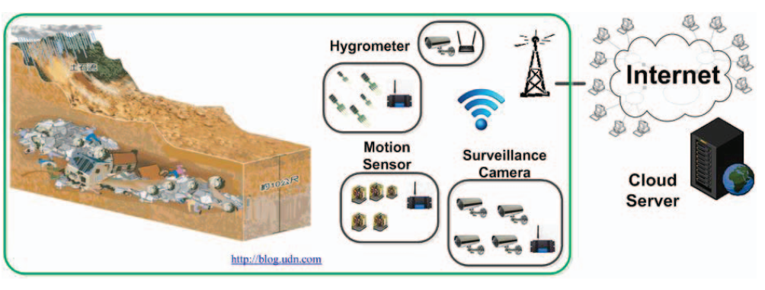
Related Work
--Resource Scheduling
#AN AUTOMATIC TBS INDEX SELECTION SCHEME FOR VIDEO TRANSMISSION OVER NARROW BAND CELLULAR IOT (ICMLC 2016)
1. Images recorded by surveillance cameras are transferred as video-streams by the identical wireless network;
2. Communication requirements of datagram and video-stream are different.

Slide 16
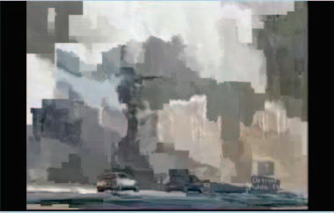
Related Work
--Resource Scheduling
#AN AUTOMATIC TBS INDEX SELECTION SCHEME FOR VIDEO TRANSMISSION OVER NARROW BAND CELLULAR IOT (ICMLC 2016)
1. Allocate PRB according to request from node;
2. HARQ reduced from the original allocated bandwidth resource for transmission;
3. The maximal loop number for the scheduling retry is set to a default value of 10 times.

Slide 17
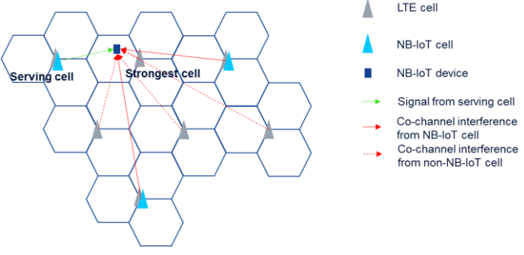
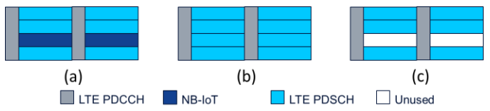
Related Work
--Resource Scheduling
#NB-IoT Deployment Study for Low Power Wide Area Cellular IoT (PIMRC workshop 2016)
Only a fraction of the LTE cell support NB-IoT
“near-far” effect

Slide 18
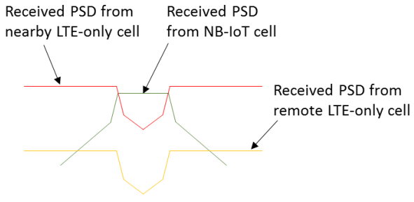
Related Work
--Resource Scheduling
#NB-IoT Deployment Study for Low Power Wide Area Cellular IoT (PIMRC workshop 2016)
Power boost: stealing power from the other PRB;
Blanking approach: leaving corresponding PRB blank used by NB-IoT;

Slide 19
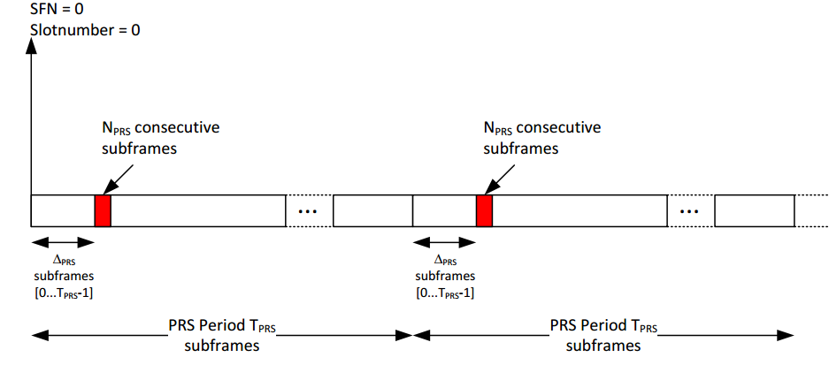
Related Work
--Positioning
E-CID Positioning method; (>50m)
OTDOA positioning method (3GPP R-14);

Slide 20
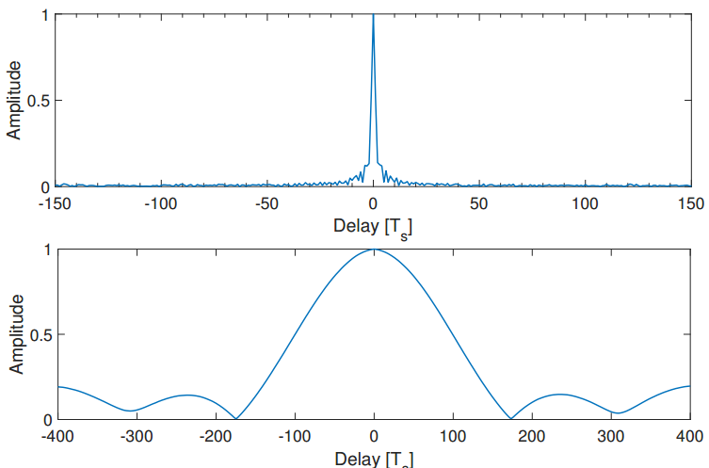
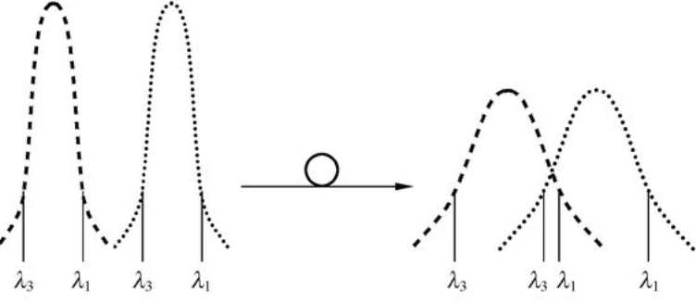
Related Work
--Positioning
Narrow-band frequency domain → Wide-band time domain;
Inter-symbol-interference (ISI);
Guard interval (Cyclic prefix)
Spread Spectrum

Slide 21
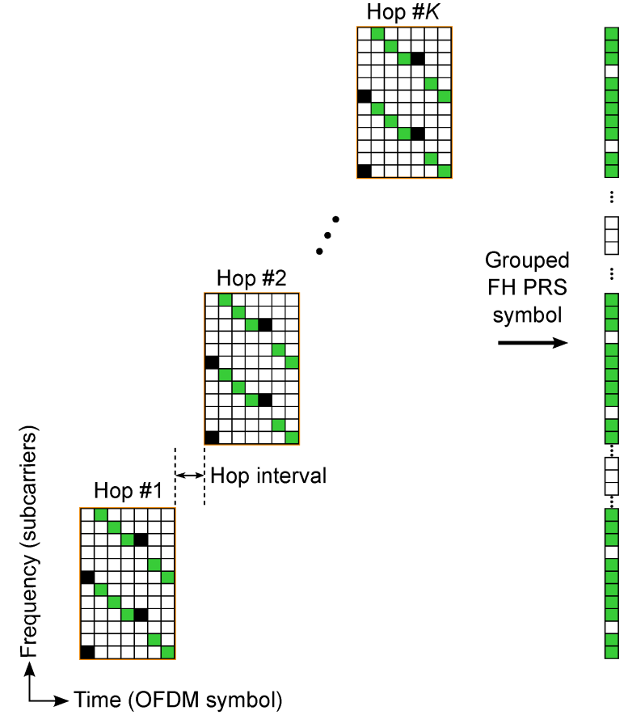
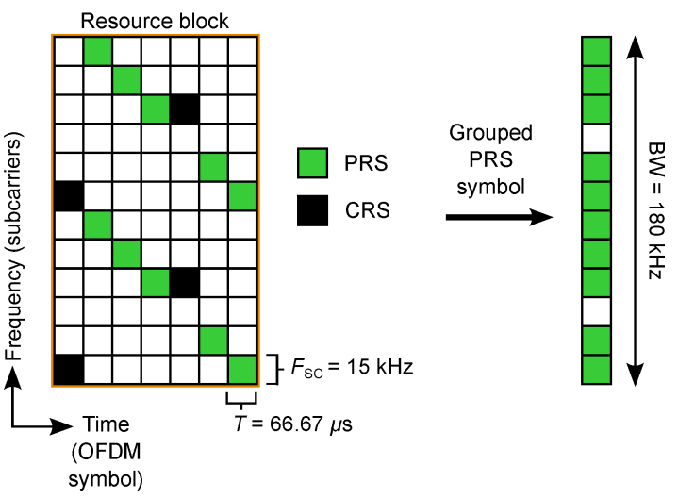
Related Work
--Positioning
#Impact of Frequency-Hopping NB-IoT Positioning in 4G and Future 5G Networks (ICC workshop 2017)
Frequency-Hopping technology to virtually increase signal bandwidth

Slide 22
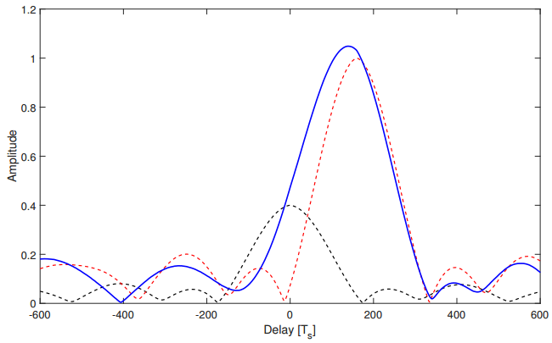
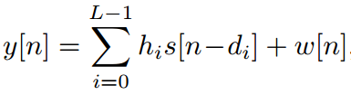
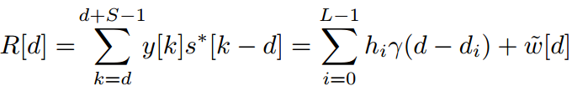
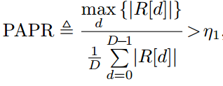
Related Work
--Positioning
#On Time-of-Arrival Estimation in NB-IoT Systems (arXiv 2017)
peak-to-average power-ratio (PAPR) used for detecting LOS is inaccurate without considering the wide lobe of the ACF

Slide 23
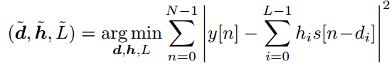
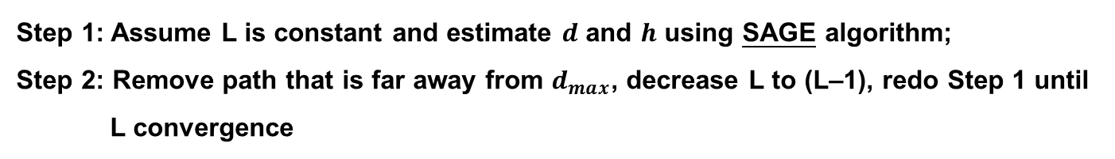
Related Work
--Positioning
#On Time-of-Arrival Estimation in NB-IoT Systems (arXiv 2017)
Step 1: Assume L is constant and estimate $d$ and $h$ using SAGE algorithm;
Step 2: Remove path that is far away from $d_{max}$, decrease L to (L–1), redo Step 1 until L convergence

Slide 24
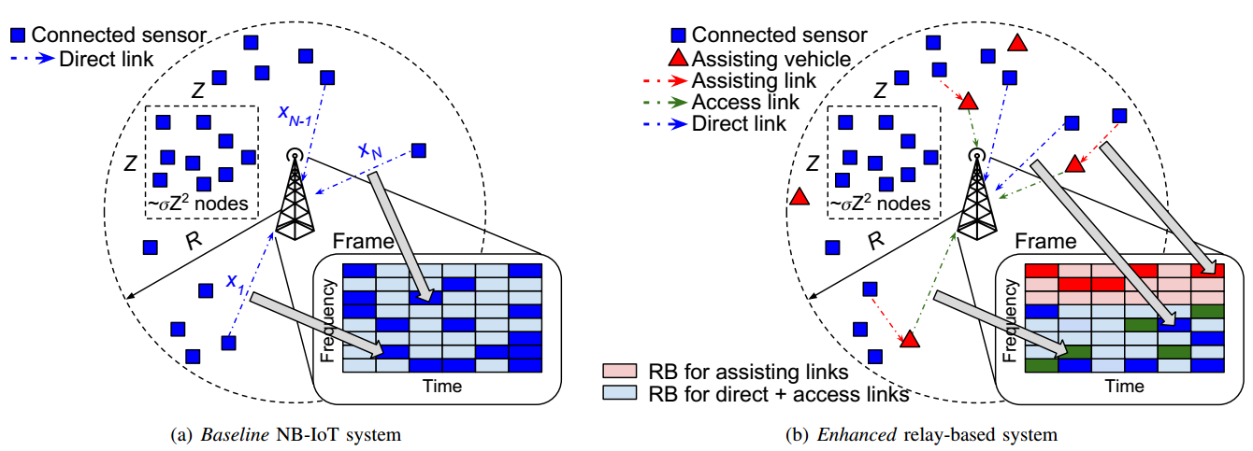
Related Work
--Network Modeling
#Vehicle-Based Relay Assistance for Opportunistic Crowdsensing over Narrowband IoT (IOT Journal)
Radius can be as high as 30km according to NB-IoT protocol;
Opportunistic crowd sensing technology widely used in IoT;
Vehicles closer to sensor and reduce transmit power;

Slide 25
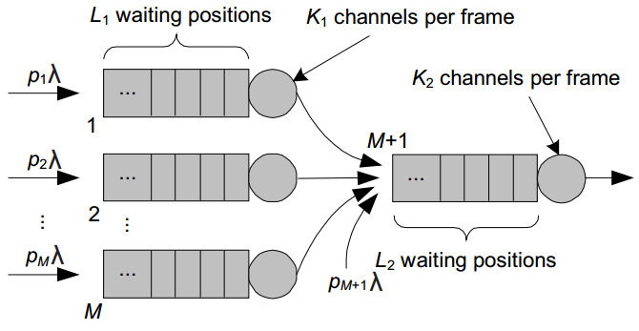
Related Work
--Network Modeling
#Vehicle-Based Relay Assistance for Opportunistic Crowdsensing over Narrowband IoT (IOT Journal)
Model:
1. Arrival process of message is Poisson
2. M queuing systems representing the service process of the relay-BSs
3. M/M/s(n) queuing system

Slide 26
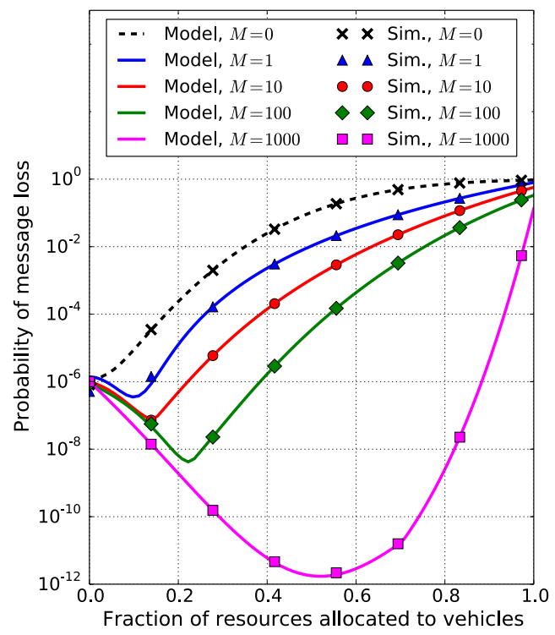
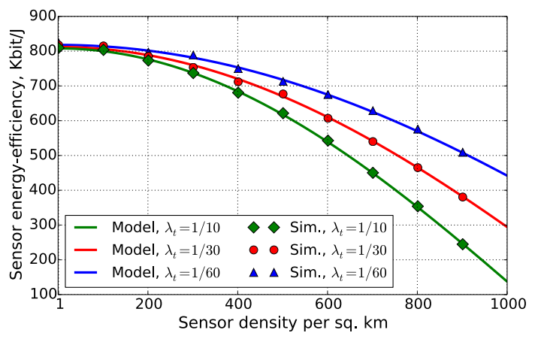
Related Work
--Network Modeling
#Vehicle-Based Relay Assistance for Opportunistic Crowdsensing over Narrowband IoT (IOT Journal)
Simulation result:
Improvement in energy-efficiency;
Improvement in reliability;

Slide 27
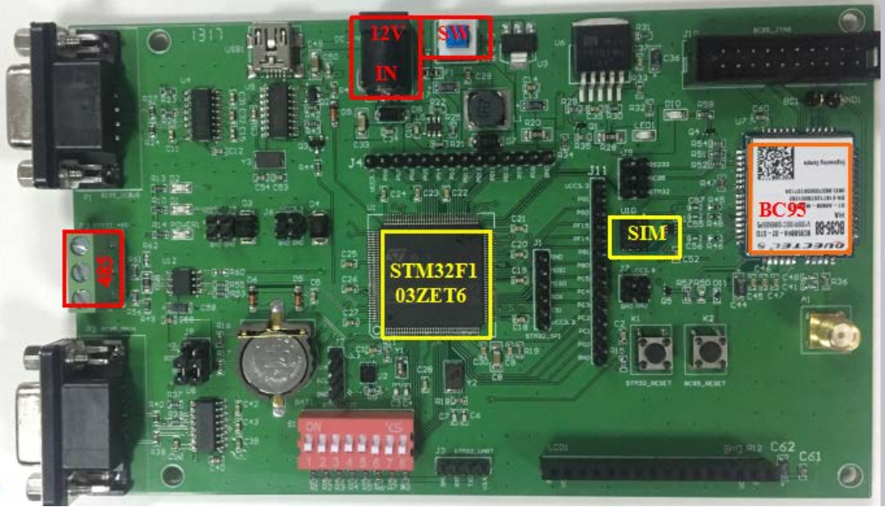
Related Work
--Others
#Narrow-Band Internet of Things: Implementations and Applications (IOT Journal)
#Dynamic Inter-Channel Resource Allocation for Massive M2M Control Signaling Storm Mitigation (VTC 2016)
#Random Access Preamble Design and Detection for 3GPP Narrowband IoT Systems (WCL 2016)
#Uplink Resource Scheduling for Power Wireless Private Network based on NB-IoT and LTE Hybrid Transmission (CSE 2017)

Slide 28
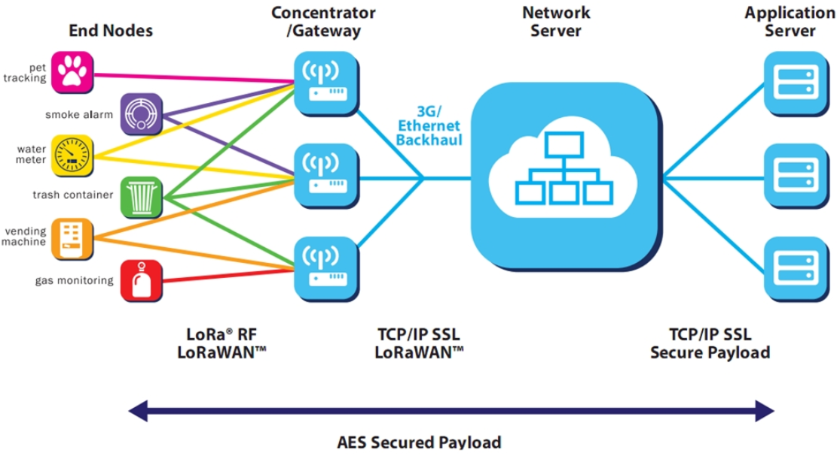
LPWAN
-- LoRa
Star topology
Uplink broadcast
3G/Ethernet/Satellite access network
Network server reduce duplication

Slide 29

LPWAN
-- LoRa
Long Range: 15km
Low Power: 10years
Low Cost: 1$
Massive Connection: 20k/gateway
ISM band: 470~510Mhz
Bit rate: 0.3~50kbps
ADR: adaptive data rate
ALOHA: data link protocol

Slide 30
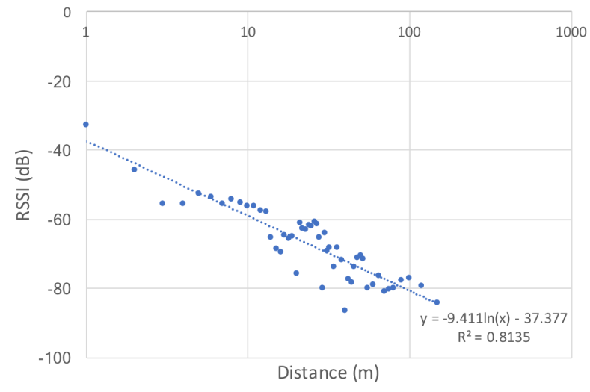
Related Work
--Positioning
#LoRa-based Localization Systems for Noisy Outdoor Environment (SEUN workshop 2017)
LoRa-based system make use of RSSI to locate a node;
Expand spectrum lead to low SPD and low SNR

Slide 31
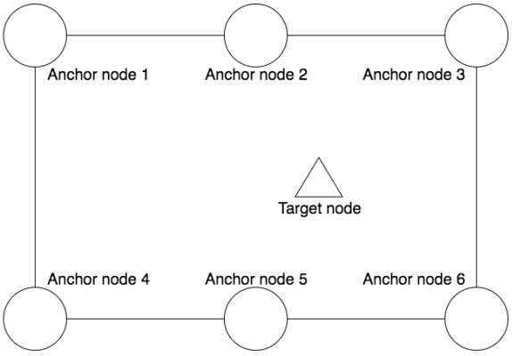
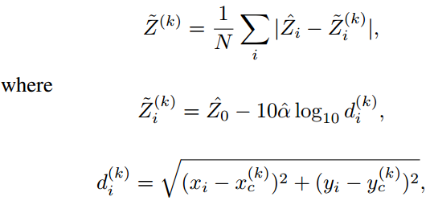
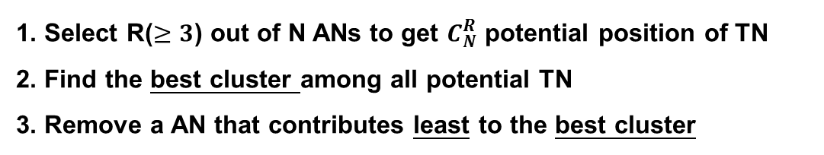
Related Work
--Positioning
#LoRa-based Localization Systems for Noisy Outdoor Environment (SEUN workshop 2017)
1. Select R($≥3$) out of N ANs to get $C_{N}^{R}$ potential position of TN
2. Find the best cluster among all potential TN
3. Remove a AN that contributes least to the best cluster

Slide 32
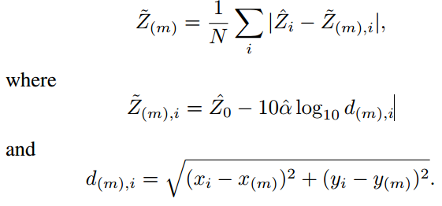
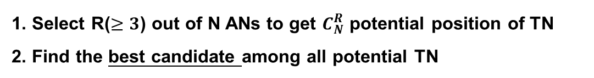
Related Work
--Positioning
#LoRa-based Localization Systems for Noisy Outdoor Environment (SEUN workshop 2017)
1. Select R($≥3$) out of N ANs to get $C_{N}^{R}$ potential position of TN
2. Find the best candidate among all potential TN

Slide 33
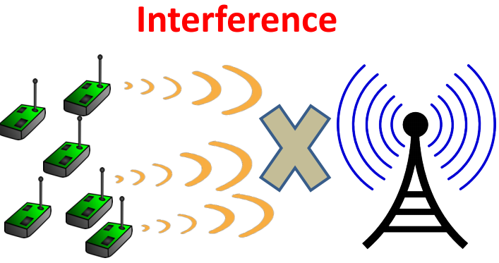
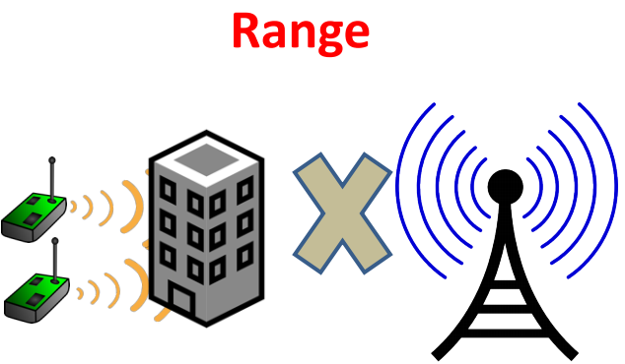
Related Work
--Interference
#Empowering Low-Power Wide Area Networks in Urban Settings (Sigcomm 2017)
Collisions emerge from the sheer density of nodes and the simplicity of the current MAC protocols (ALOHA);
LPWAN ranges drop by 10x in urban areas due to excessive multipath, shadowing.

Slide 34

Related Work
--Interference
#Empowering Low-Power Wide Area Networks in Urban Settings (Sigcomm 2017)
1-bit encoding

Slide 35

Related Work
--Interference
#Empowering Low-Power Wide Area Networks in Urban Settings (Sigcomm 2017)
2-bit encoding

Slide 36


Related Work
--Interference
#Empowering Low-Power Wide Area Networks in Urban Settings (Sigcomm 2017)
Collision happens when two nodes transmit the same symbol

Slide 37


Related Work
--Interference
#Empowering Low-Power Wide Area Networks in Urban Settings (Sigcomm 2017)
Received signal consist of same chirp with different offset;
Offset $f_{1} and f_{2}$ are unlikely to be at integer boundaries of the FFT bin;
Fractional part consist of abundant hardware information.

Slide 38

Related Work
--Interference
#Empowering Low-Power Wide Area Networks in Urban Settings (Sigcomm 2017)
Estimate the approximate wireless channels $\tilde{h_{1}}$ and $\tilde{h_{2}}$ with observed $\tilde{f_{1}}$ and $\tilde{f_{2}}$ with least-squares algorithm;
Get the fractional part of $f_{1} and f_{2}$ with searching method.

Slide 39


Related Work
--Interference
#Empowering Low-Power Wide Area Networks in Urban Settings (Sigcomm 2017)
The integer part depends on both data and hardware offsets and fractional part depends only on hardware offsets;
Hardware offset remain constant during a frame.

Slide 40

Related Work
--Interference
#Empowering Low-Power Wide Area Networks in Urban Settings (Sigcomm 2017)
Fractional part as fingerprint of hardware to identify the collided nodes

Slide 41



Related Work
--Interference
#Empowering Low-Power Wide Area Networks in Urban Settings (Sigcomm 2017)
An offset in time absorbed into offset in frequency

Slide 42


Related Work
--Interference
#Empowering Low-Power Wide Area Networks in Urban Settings (Sigcomm 2017)
Noise Floor
Noise Floor
Data signal deeply buried in noise when sensors individually beyond range;
Groups of sensors transmit identical data package lead to received power to add up.

Slide 43


Related Work
--Others
#Physical-Layer Fingerprinting of LoRa devices using Supervised and Zero-Shot Learning (WiSec 2017)
#Performance Evaluation of LoRa Networks in a Smart City Scenario (ICC 2017)

Slide 44
Backup slides

Slide 45



