Slide 1
SmartLight: Light-Weight 3D Indoor Localization Using a Single LED Lamp
Song Liu and Tian He
Computer Science and Engineering
University of Minnesota
Sensys 2017
Notes:
The first digital localization approach in 3D

Slide 2
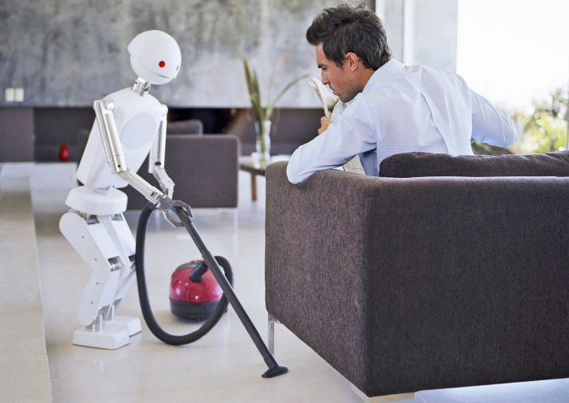

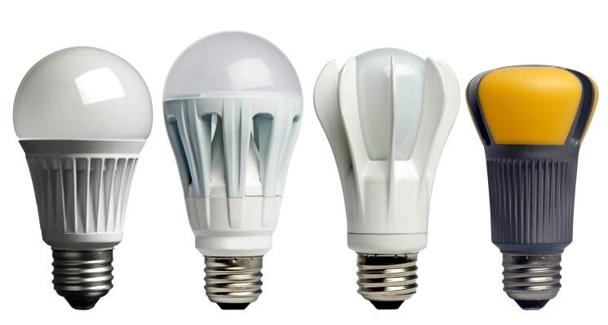
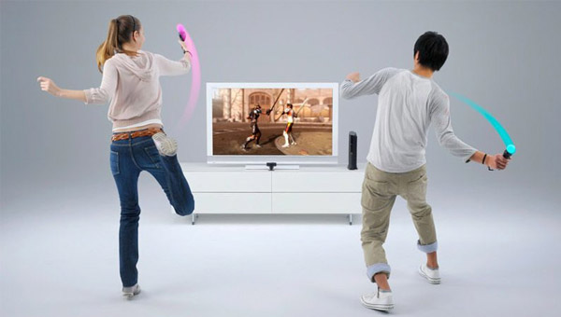
Importance of 3D Indoor Localization
Robot navigation
Social interaction
LED Lights
LED revenue reaching 10B in 2019
3D Localization and Lighting?
Motion-based gaming
Notes:
Reliable indoor 3D localization enables many exciting applications such as understanding social interactions in a conference setting, navigating robots in a room, and also many motion-based entertainment. At the same time, LED lights are gradually dominating the lighting market nowadays due to many of superiority over fluorescent lighting in terms of energy efficiency and life span etc. We naturally ask ourselves the question of can we utilize LED lights to localize in 3D while lighting up a room efficiently? The answer is yes. As a solid state device, LED lights also has the inherent property of switching on/off very quickly, thus being able to carry location information by flashing at a rate as fast as to be unnoticeable by the human eyes. Here I present Smartlight, our digital solution to indoor 3D localization.

Slide 3
Outline
The State of the Art
The Design
Implementation & Evaluation
Conclusion and Q&A

Slide 4
The State of the Art

Slide 5
A Brief History of 3D Indoor Localization
SmartLight
Digital 3D
Song Liu, Tian He
Magnetic
Joerg Blankenbach
IPIN 2012
SpinLoc
Ho-lin Chang
Sensys 2008
Beep
Atri Mandal
CCNC 2005
TSLRL
Swati Rallapalli
MobiCom 2010
SPOTON
Analog RSS
Jeffrey Hightower
Integrated
Guoliang Chen
Sensors 2015
3Dindoor
Omar Cruz
CONIELECOMP 2011
RFScatter
Yunfei Ma
MobiCom 2016
HLPP
Analog TOA
Jian Qiu
Epsilon
Analog RSS
Liqun Li
Luxapose
Analog AoA
Y.S Kuo
RIPS
Analog: RF phase
Miklos Maroti
HLPP
Analog TOA
Jian Qiu
Luxapose
Analog AoA
Y.S Kuo
Tagoram
Analog RF Phase
L Yang
MobiCom
2014
MobiCom
2014
Sensys
2017
Sensys
2005
Sensys
2011
NSDI
2014

Slide 6
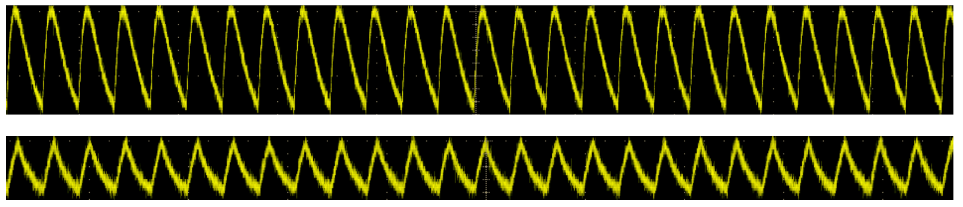
Analog VS. Digital
Analog
Accurate analog model and measurements.
Digital
Make binary decisions on signal reception.
RSSI
Amplitude
Distance
Time
RSS propagation model
Frequency received or NOT?

Slide 7
SmartLight Design

Slide 8
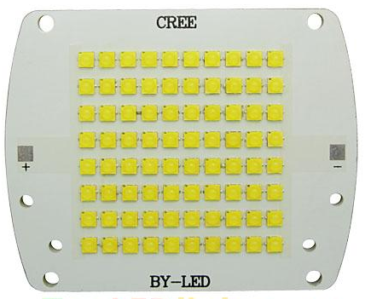
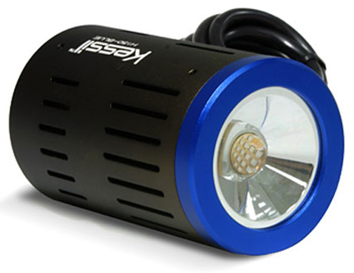
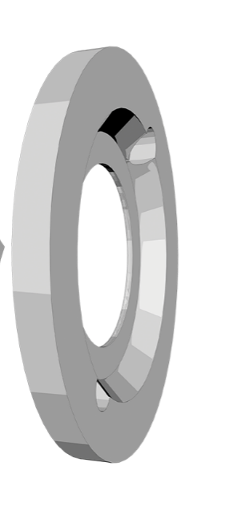
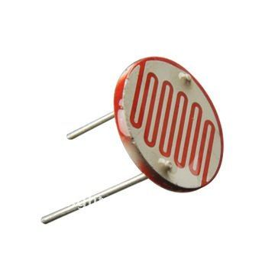
SmartLight: Three System Components
Blinking
LEDs array
Y
Light sensor
Z
Binary Decision
X
Lens
Notes:
The sensor localized in 3D space as its relative position to the lens. The 3D cartesian coordinates is centered at the center of the lens. Up and down direction is the Y-axis direction, left and right direction is the X-axis direction, away and closer to the lens is the Z-axis direction.

Slide 9
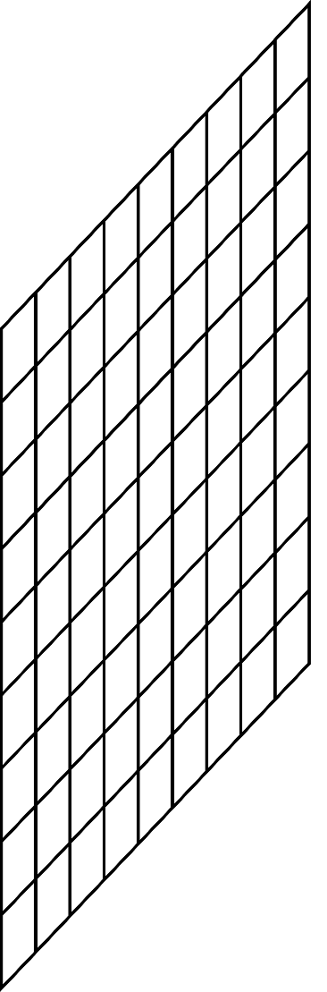


The Key Idea of SmartLight
Y
LEDs Array
Z
Sensor
X
Not Detected!
Light Detected!
Convex Lens
Light refract through the lens and form a lighting region
Sensor receives light from different set of LEDs different location
Sees Light from a continuous circle of LEDs

Slide 10
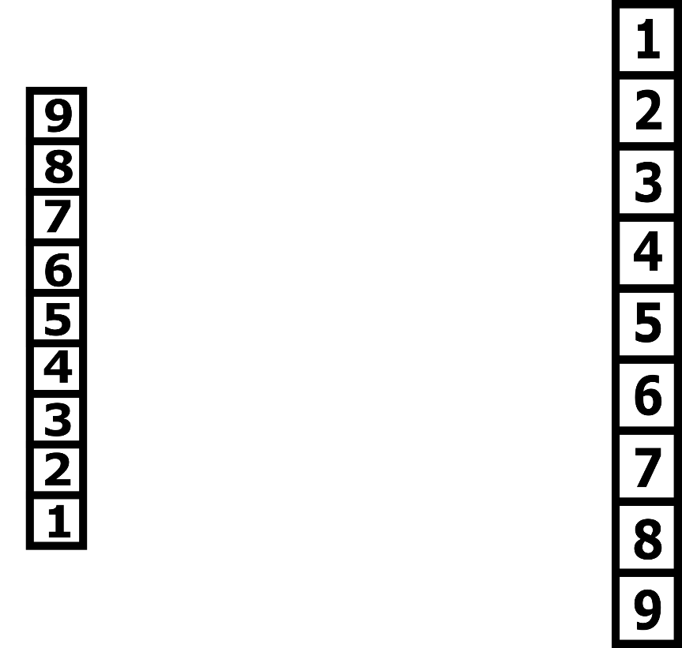


2D View - Localization in the Y axis
Y
Sensor
Sensor
Z
5, 6, 7
X
3, 4, 5
Shift sensor down
Sensor receives light arrays from different LEDs at different locations

Slide 11
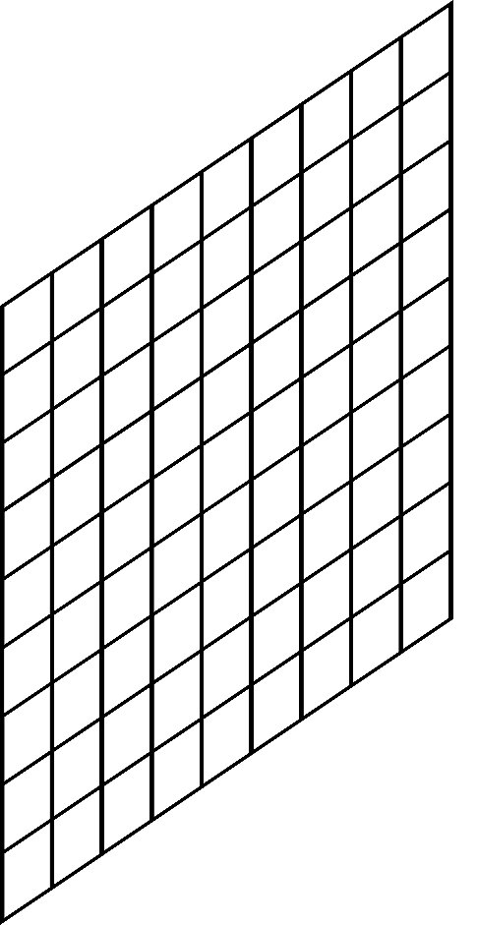
3D View: Localization in the X, Y axis
In 3D, the sensor sees light from a continuous circle of LEDs
As the sensor moves down, the circle moves up
Y
LEDs Array
Sensor
Z
X

Slide 12
2D View - Localization in the Z-axis
Y
Sensor
Sensor
Z
X
3, 4, 5
6, 7
4, 5
Shift sensor closer to lens
Sensors receives light from more LED pixels when closer to lens.

Slide 13
3D View: Continuous Circle of LEDs Pixels
In 3D, the sensor sees light from a continuous circle of LEDs
The closer the sensor, the bigger the circle.
Y
LEDs Array
Sensor
Z
X

Slide 14
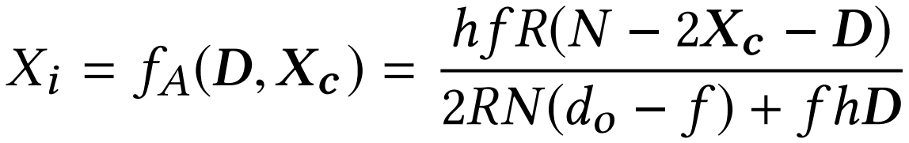
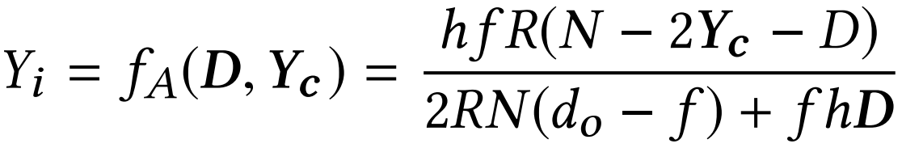
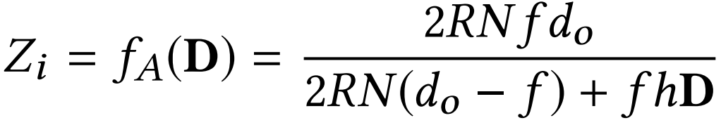
Localization from Light Geometry
Using light geometry, the sensor sees a unique set of frequencies at different locations. Localize sensor from the circle location and size.
Calculate the X, Y, Z axis location:
LEDs Array
D
Refer to paper for detailed derivation!

Slide 15
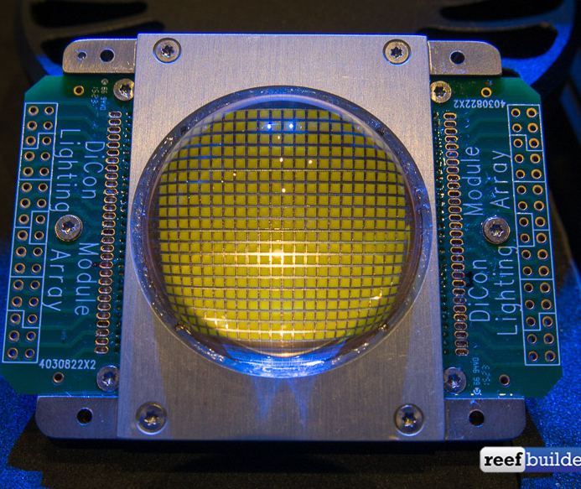
Too Many Unique Frequencies …
Commercial LED arrays may have up 400 LEDs.
Burden on the receiver to differentiate a large number of frequencies.
Reduce number of unique frequencies?
While maintaining same accuracy?

Slide 16
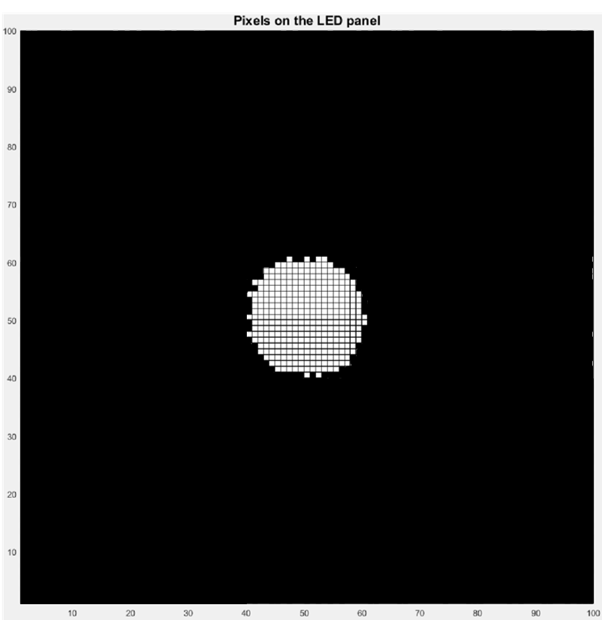
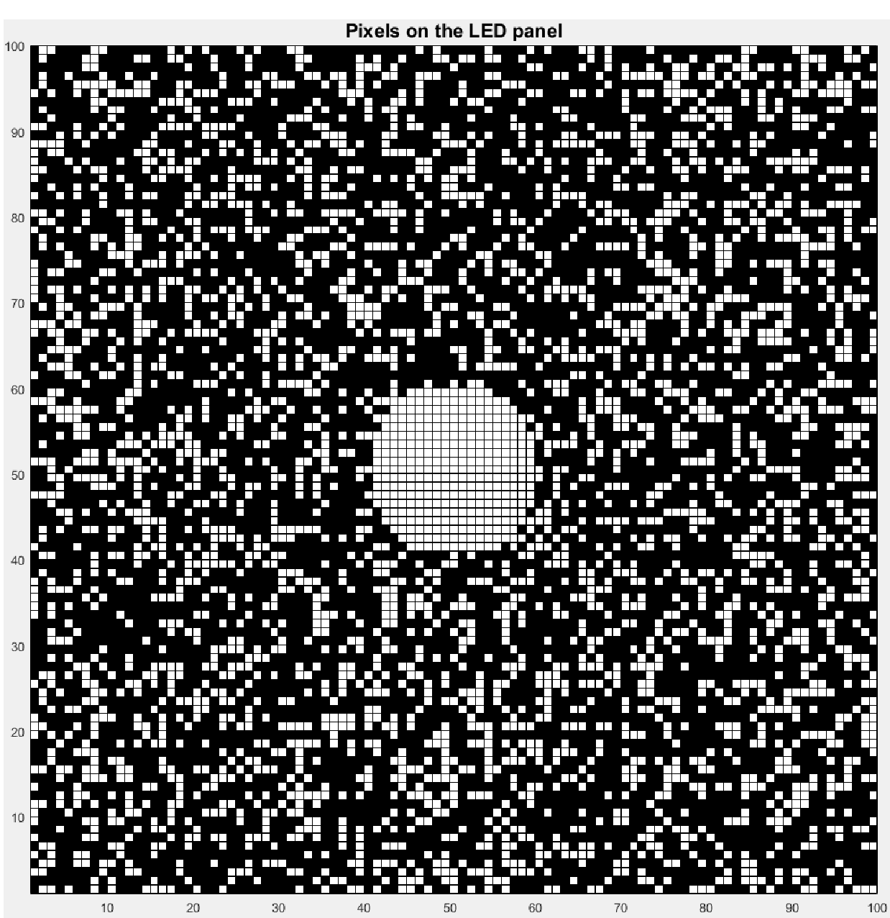
Advanced design: Random Frequency Reuse
To reduce unique frequencies, random reuse each frequency.
Paint LEDs that blinks at one of received frequencies white, obtain bitmap:
Rediscover the circle
among false positive noises?
Without reuse
With reuse

Slide 17
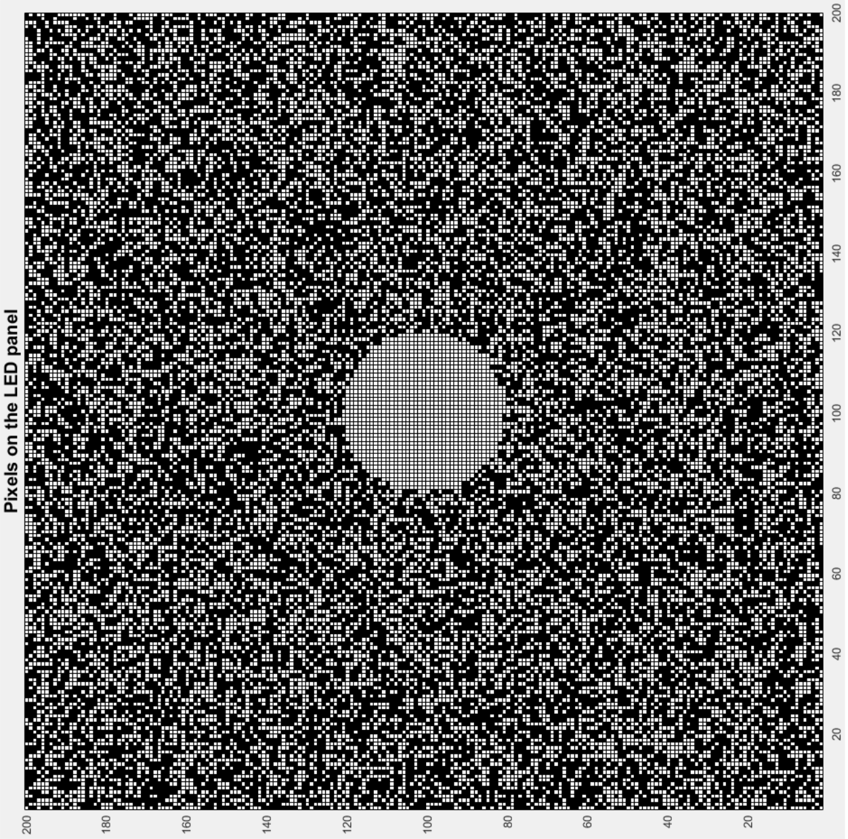
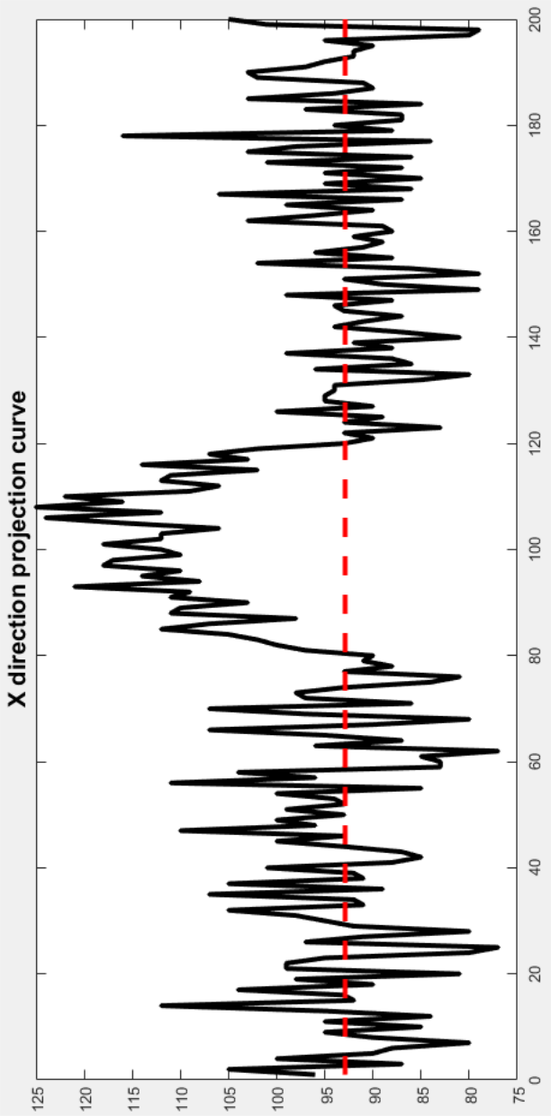
Solution: Single Directional Projection
Step 1: Count the number of white pixels in each row
Step 2: Form a curve from step1
Step 3: Use mean value to intercept the curve.
Step 4: The largest intercept interval is the location of the circle

Slide 18
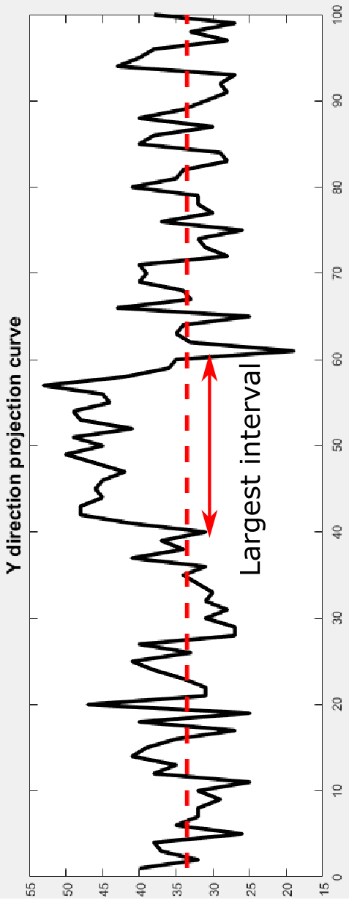
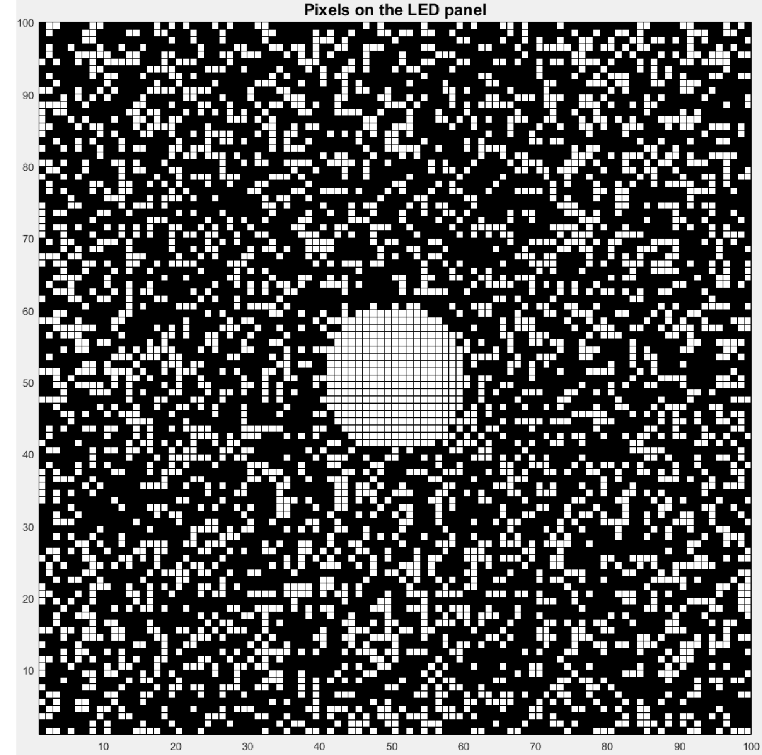
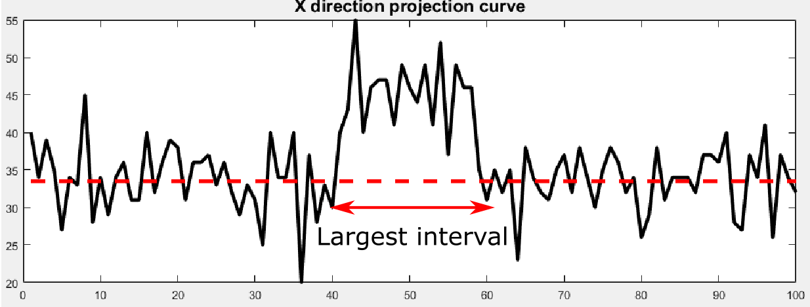
Solution: Multi-directional Projection
Project the bitmap in multiple directions to further increase accuracy.
Need to project to a minimum
of 2 directions

Slide 19
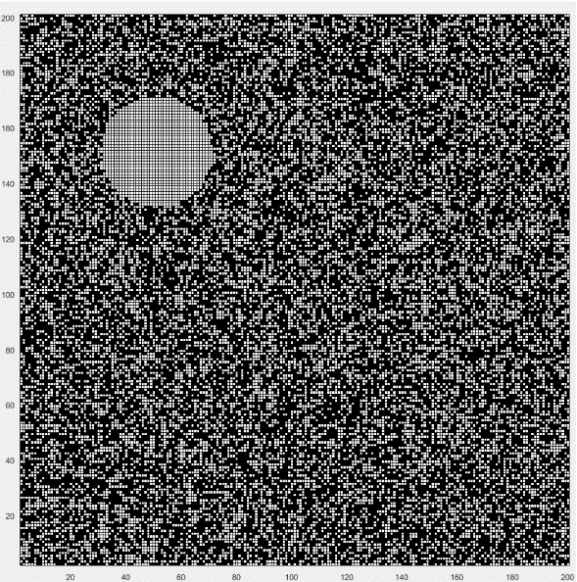
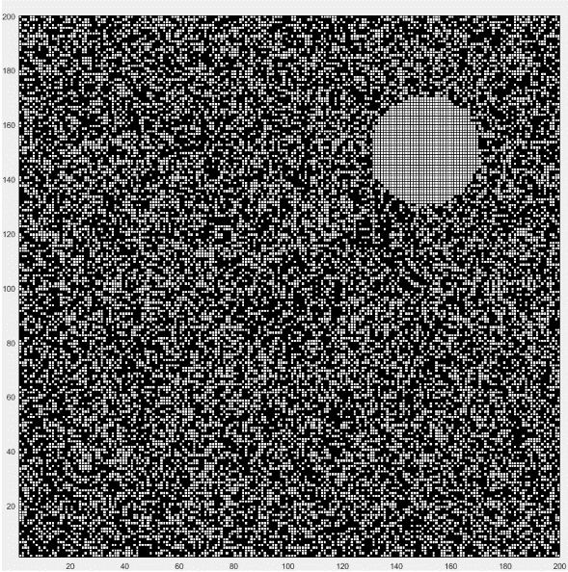
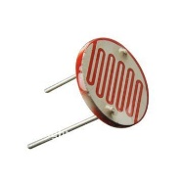

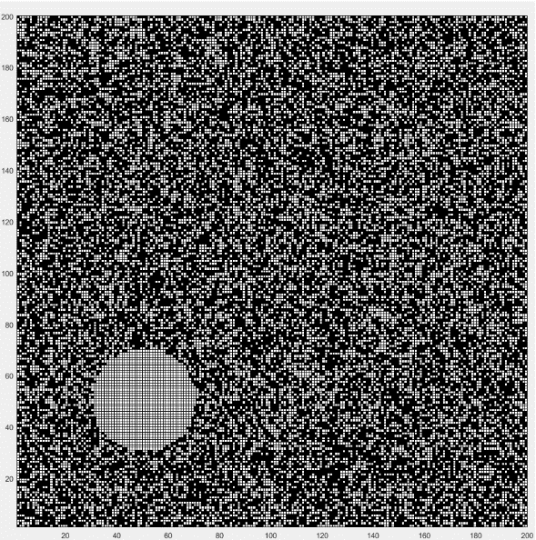
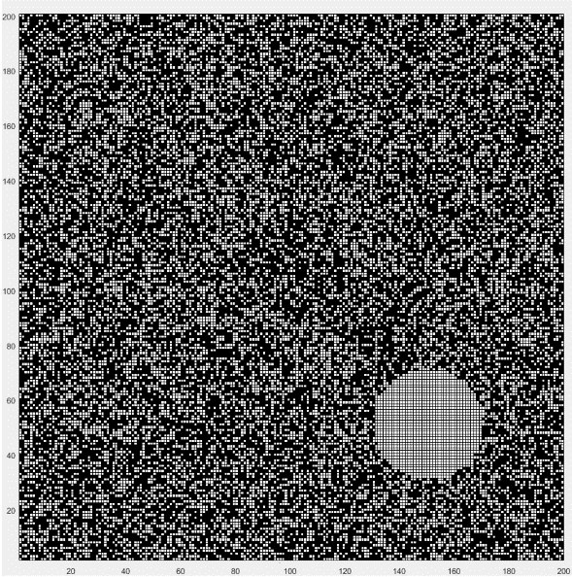
Concurrent Localization of Multiple Sensors
Concurrently localize multiple sensors.
Sensors form individual bitmaps

Slide 20
Implementation & Evaluation

Slide 21
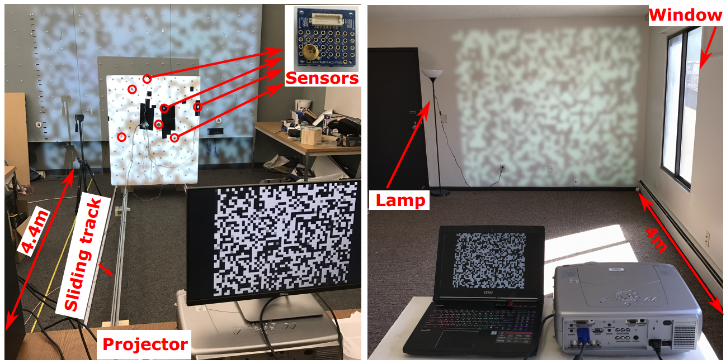
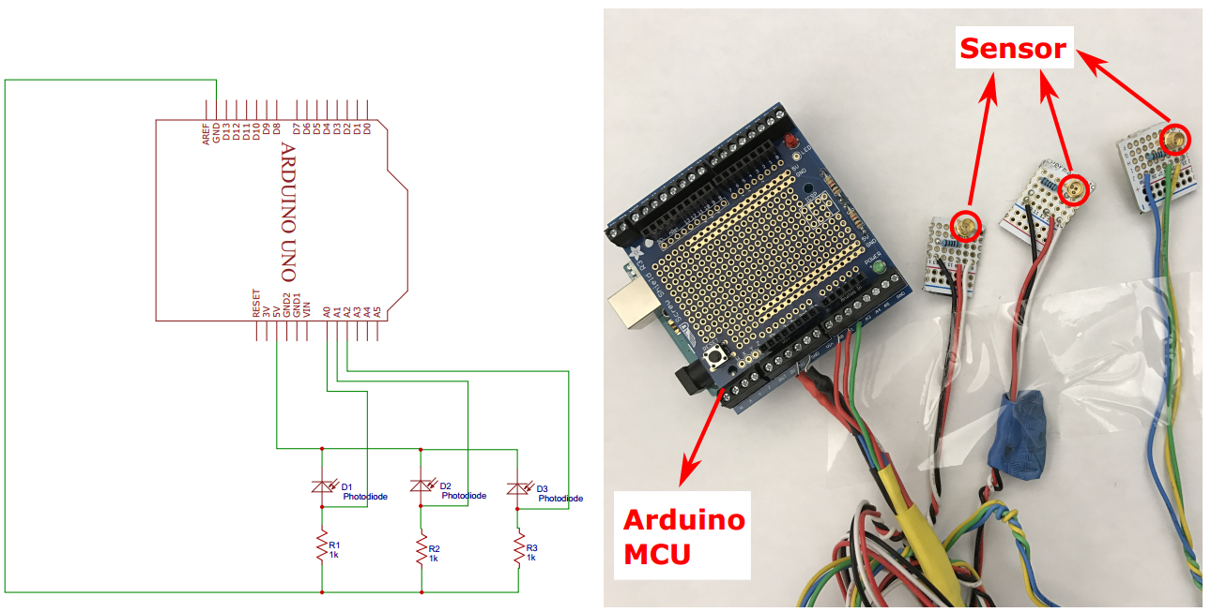
System Implementation
MCU, 60Hz Projector
Light sensors
10feet Sliding track
76*76 LEDs array
33 Times reuse
172 different frequencies
Lab without windows and a living room with windows

Slide 22
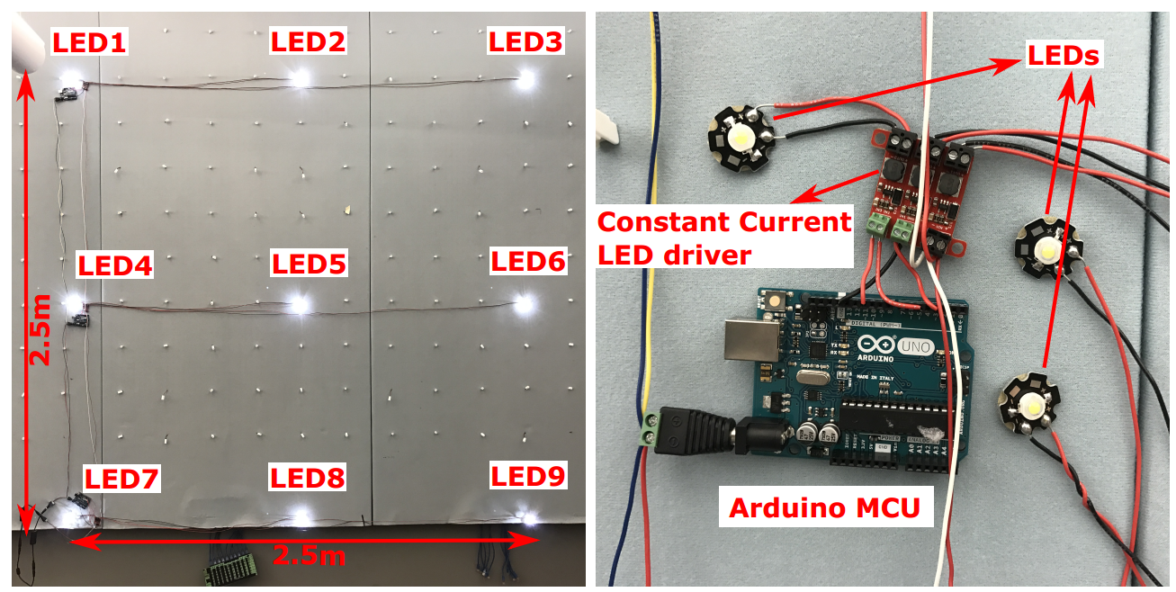
Comparison Testbed with State-of-the-Art
Epsilon (NSDI’14), Weighted Average, Coverage Method
3*3 Ultrabright LEDs testbed

Slide 23
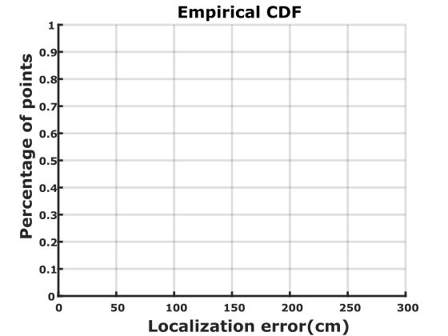

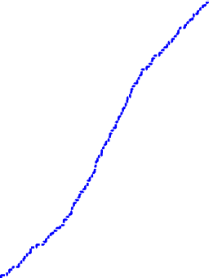
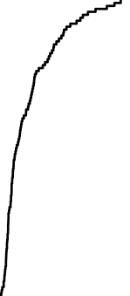
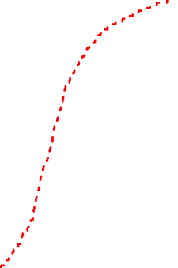
Performance Comparison
SmartLight
SmartLight best
Minimum device calibration and system deployment cost
Epsilon
Weighted
Coverage

Slide 24
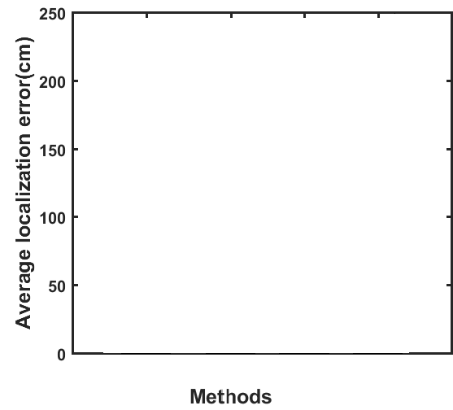
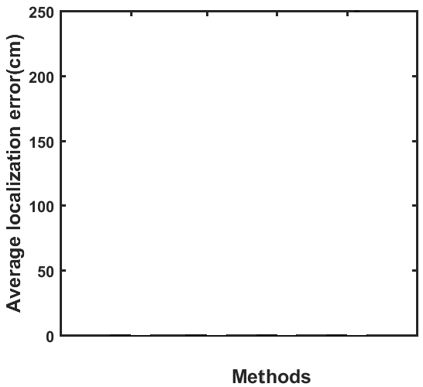

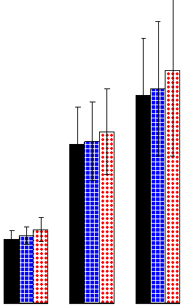
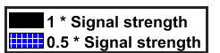
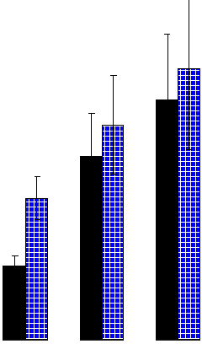

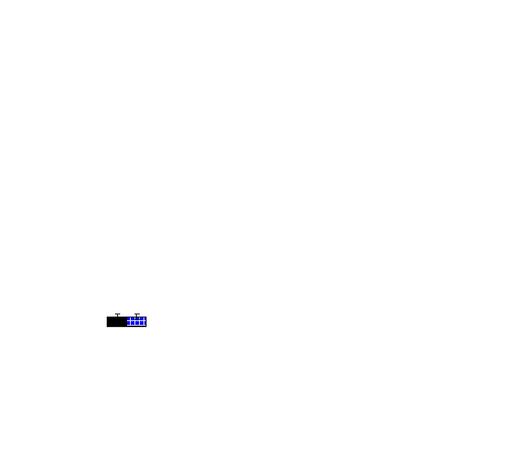
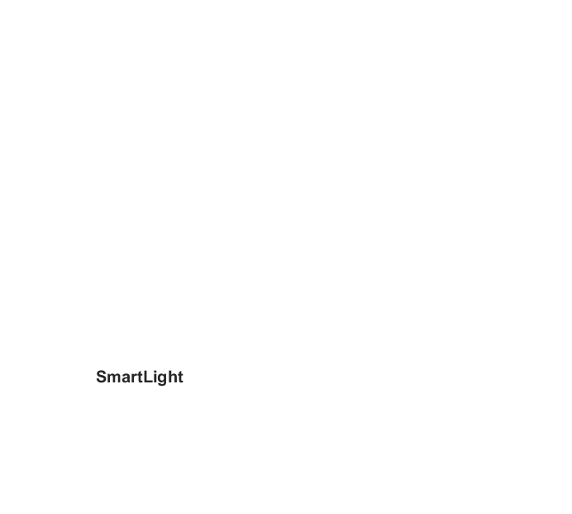
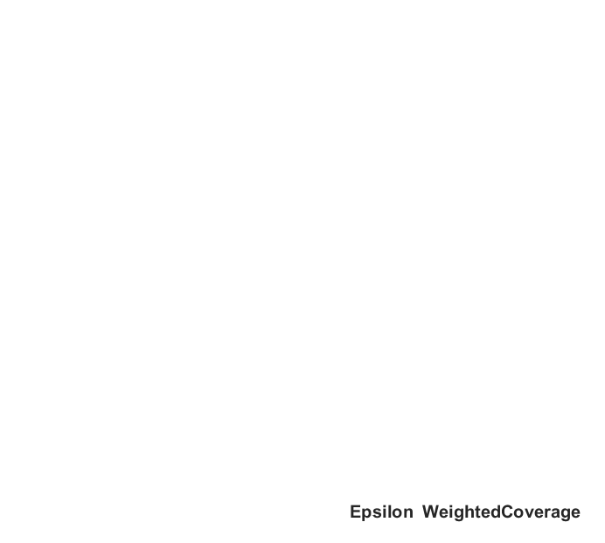
Robustness: Frequency-based Digital Approach
As a frequency-based digital approach, system is robust against many noises
Robust against common reflectors, and uncalibrated signal disturbance.
Impact of common diffuse reflectors
Impact of uncalibrated signal strength change

Slide 25
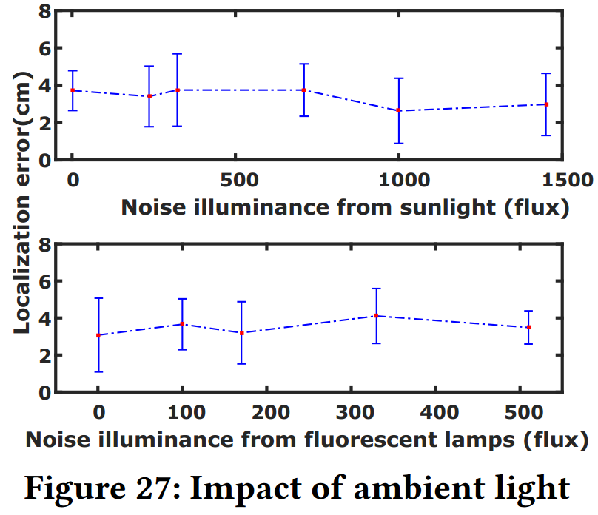
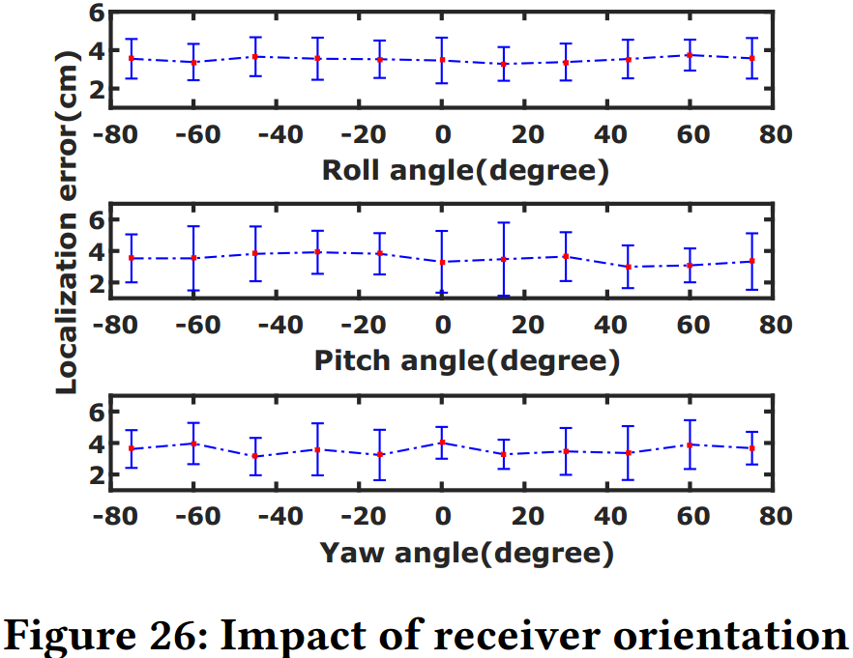
Robustness: Ambient Light and Receiver Orientation
Robust against ambient light and receiver orientation.

Slide 26
Summary
SmartLight is the only digital 3D indoor localization system. Robust against various noises. Average accuracy of 10cm.
Adopts the novel design philosophy of shifting all hardware complexity into a single light lamp
Receiver complexity is kept to the minimum to encourage mass deployment
Minimum system deployment and device calibration overhead

Slide 27
Question and Answer?

Slide 28
Q&A Digital v.s. Analog
RF RSSI vary significantly over time and are susceptible to human presence, multipath, and fading, and antenna’s orientation.
RF phase measurements would be significantly distorted by multipath propagation.
Acoustic time-of-flight: devices introduce a significant delay caused by the soundcard.
Admittedly, analog-based approaches can achieve high accuracy with careful calibration in a static environment. However, they suﬀer performance degradation in dynamic environments where the cost of calibration is prohibitive.
Analog approaches rely heavily on 1) the accuracy of model parameters, 2) the measurements of analog metrics, and 3) careful system calibration in a controlled environment.

