Slide 1
MagneComm: Magnetometer-based Near-Field Communication
Hao Pan#, Yi-Chao Chen#, Guangtao Xue#, Xiaoyu Ji *
Shanghai Jiao Tong University#, Zhejiang University*
panh09@sjtu.edu.cn, yichao@utexas.edu, gt_xue@sjtu.edu.cn, xji@zju.edu.cn

Slide 2





1 Near-Field Communication Applications
my phone doesn’t have NFC chip on it..
Notes:
Near-field communication has been widely used in our daily life. For example, we can use NFC chip on phones to make payment, access NFC-based door lock, and control IoT devices and smart appliance.
Moreover, various transport IC cards are also used RFID to enable quick and easy payment.
The advantage of these near-field communication technologies is that they don’t need complicated match and association process; it consumes less power, and is more secure due to its nature property.
NFC is convenient and featured with lots of applications.
However, what if my phone does not have NFC chip on it? Does that mean I cannot enjoy these applications?

Slide 3
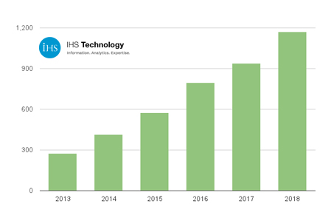



1 NFC Availability
NFC will be included in 64% of the mobile phones in 2018.
Still 675 million phones have no NFC.
Notes:
If you are like me, still using a phone without NFC, we are not lonely.
According to the latest forecast from IHS Technology, NFC will be included in 64% of the mobile phones shipped in 2018.
That is to say, there will be still 675 million people using phones without NFC.
Can we do something for them? Can we enable NFC functions on these phones without adding new hardware?
Motivated by the above, we present the MagneComm, a novel near-filed communication solution based on the magnetometers without additional hardware.

Slide 4
1
Motivation
2
Key Idea and Applications
OUTLINE
3
Challenges and Design
4
Prototypes
5
Evaluation
6
Conclusion
Notes:
This is the outline of this talk. Followed by Motivation, I will present the key idea behind MagneComm, challenges and design, two MagneComm prototypes, evaluation, and conclude the work.

Slide 5
2
Key Idea and Applications
PART
Notes:
Let‘s talk about the key ideas and applications

Slide 6
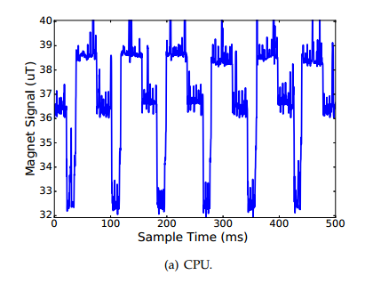
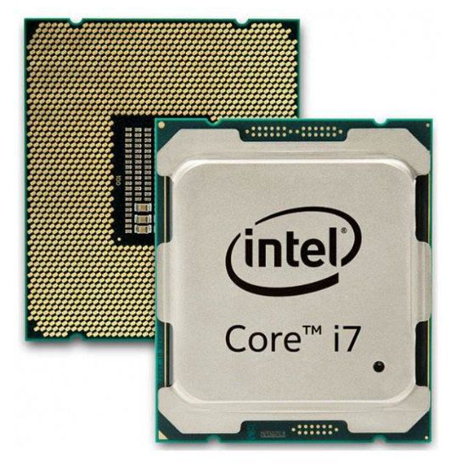


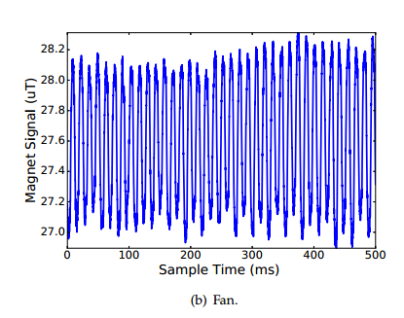
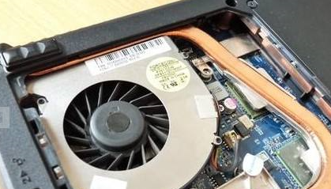
Magnetic Induction (MI) Signals 2
CPU
fans
Notes:
As we all know, the changing current produces a changing magnetic field, so working appliances emit the magnetic induction signals.
Take a laptop as an example, a laptop has many electronic components and many of these components generate strong magnetic field signals, like CPU, fan, GPU, and etc. As we can see, a CPU generates different magnetic signals depending on its working states while magnetic signals from a fan is of the form of sine waves.
These MI signals are strong enough to be captured by a magnetometer on a phone.

Slide 7



Use MI signals to Transmit Data? 2
Notes:
This intuitively lead to a question, can we utilize the magnetic induction signals to enable the side channel communication between laptop and phone by manipulating the working state of the laptop?

Slide 8
3
Challenges and Design
PART

Slide 9
3 Challenges
How to modulate
CPU MI signals?
How to handle the user’s interference?
1
2
How to enhance the transmission speed?
3
4
How to implement the full-duplex communication?
Notes:
There are some challenges to enable the side-channel communication using MI signals from CPU.
First, how to encode MI signals.
Second, how to handle the interference generated when users are using the laptop.
Third, how to enhance the transmission speed.
And last, how to implement the full-duplex communication.
So, first, let’s start with encoding and decoding.

Slide 10
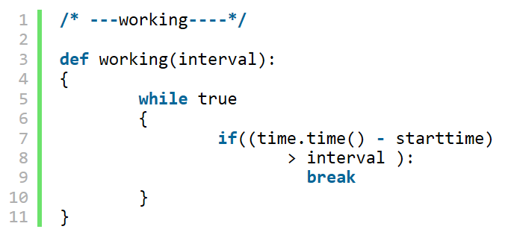
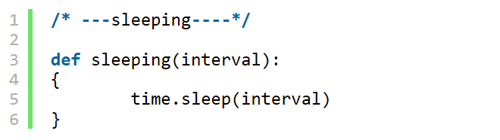
3-1 Generating Desired MI Signals
Magnet Value(unit)
1
baseline
0
working
sleeping
time(ms)
Notes:
We first shows how to control CPU to generate the desired magnetic signals.
Since the operating system may assign processes to different CPU cores to maximize CPU utilization, we bind our process to specific CPU cores by enforcing the CPU affinity.
Then we see that when the CPU core is busy, the magnetic magnitude becomes higher. The magnitude is propotional to the number of CPU cores are working at the same time.
While the CPU core is sleeping, the magnitude of the magnetic signals becomes lower.

Slide 11
3-1 Modulation
PWM: Changing Width, M = 2
PWAM: Changing Width & Amplitude
“01”
“00”
“11”
Level1
Level1
Level1
“0001”
“1000”
“1110”
“0111”
40% duty
11->Level4
20% duty
80% duty
10->Level3
PAM: Changing Amplitude, N = 2
01->Level2
“00”
“01”
“10”
00->Level1
Level3
Level2
40%
|
01
60%
|
10
20%
|
00
80%
|
11
Level1
40% duty
40% duty
40% duty
Notes:
Based on the above observation, we combine the PWM and PAM to encode data.
PWM stands for Pulse Width Modulation. It uses the width of a symbol signal to represent the data bits. For example, when each symbol stands for two data bits, we need four width values. We can use 40%, 20%, 80% of CPU core usage duty cycle to represent 01, 00, and 11, respectively.
Similarly, PAM, stands for Pulse Amplitude Modulation, uses amplitude of a symbol signal to represent data bits. For example, we can use a qual-core CPU to modulate 2-bit data symbols.
PWAM, which combines PWM and PAM, is used in our work to modulate data by manipulating the CPU duty cycle and the number of CPU cores.

Slide 12
3 Challenges
How to modulate
CPU MI signals?
How to handle the user’s interference?
1
2
How to enhance the transmission speed?
3
4
How to implement the full-duplex communication?
Notes:
The second challenge is how to handle the user’s interference.

Slide 13
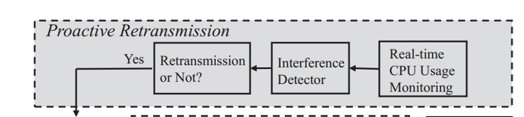
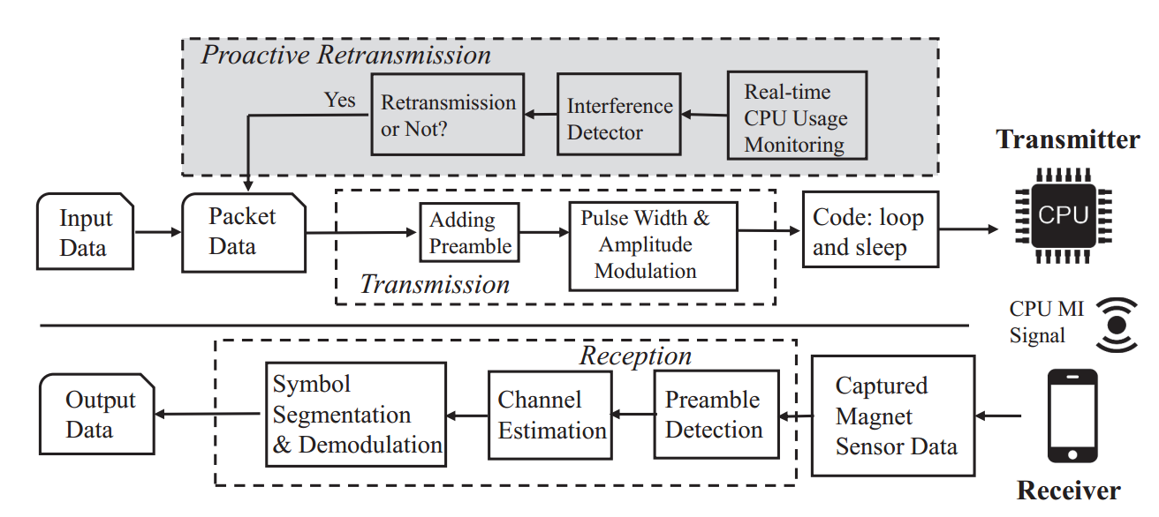

3-2 Work Flow
Notes:
This is the workflow of the MagneComm.
At the transmitter side, Once it gets input data, the transmitter segment data into packets and modulate them using PWAM. Then the transmission by controlling CPU usage to generate MI signals.
At the receiver side, the magnetometer embedded in the phones are used to capture the magnetic field value. It first detects preamble pattern to identify packets. The preamble is also used to estimate channel state. Then the receiver demodulate the packet and decode the packet.
In the scenario where only the phone has magnet sensor, there is no way for the receiver to provide feedback to the sender. In other words, the receiver is not able to ask sender to retransmit a corrupted packet. Therefore, we need a mechanism for the sender to know if the transmission is successful.
Fortunately, MagneComm serves as a near-field communication method, and our experiments show the interference majorly comes from either the sender or receiver when they are running some other tasks on other CPU cores. Therefore, the sender can monitor its own CPU usage to know if there is interference and if it needs retransmission.

Slide 14

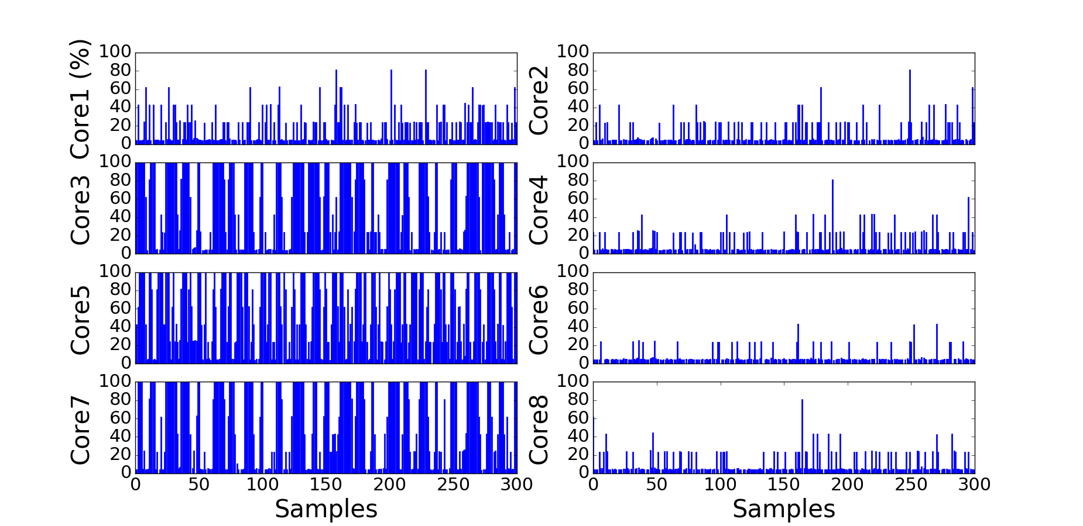
3-2 Retransmission Mechanism
packet k
packet k+1
retransmission
packet k+1
…
packet k+n
Notes:
For example, we use the core 3, 5, and 7 as to transmit data. During the transmission, the sender also monitors the CPU usage in real-time. If the other CPU cores have low usage value, it means there is no interference and the packet is transmitted correctly. During the transmission of packet k+1, it finds that other CPU cores have high usage, we retransmit packet k+1 data because it’s very likely that packet k+1 is corrupted.

Slide 15
3 Challenges
How to modulate
CPU MI signals?
How to handle the user’s interference?
1
2
How to enhance the transmission speed?
3
4
How to implement the full-duplex communication?
Notes:
The third challenge is how to enhance the transmission rate

Slide 16

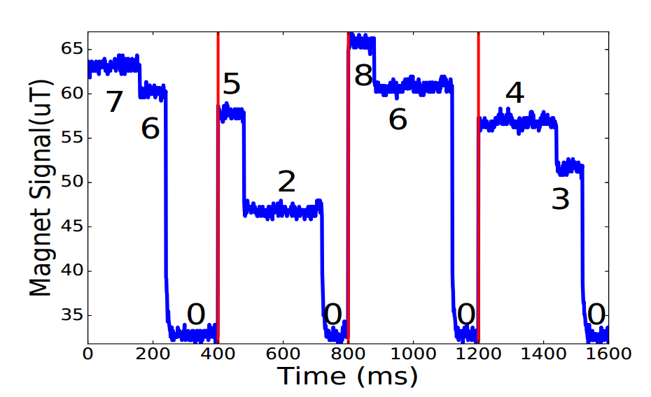
Transmitter I
Multiple Transmitters 3-3
“001”
“111”
“100”
“010”
Level2
Level1
Baseline
MI Signals with Multiple TXs
40%
80%
20%
60%
T
Transmitter II
“110”
“111”
Level6
“000”
“011”
Level3
Baseline
60%
20%
80%
80%
Notes:
As described above, the transmission rate is limited by the symbol window size as well as CPU core number. Reducing the window size relies on the precise control over CPU usage which is difficult due to the scheduling algorithm of modern operating system.
With the limited resource, we design to allow multiple concurrent transmitters to improve the total data rate.
Take a laptop with eight cores as an example. Transmitter One is composed of two CPU cores, and each symbol embed 3 data bits. Transmitter Two is composed of six CPU cores, and each symbol also embed 3 data bits. Two transmitters send data concurrently and the resulted MI signals are the superposition of that from the individual transmitter.

Slide 17
Separating Signals From Transmitters 3-3
“111”
“100”
Level2
“001”
“010”
Level1
Baseline
40%
80%
20%
60%
“110”
“111”
Level6
“000”
“011”
Rules Table:
Level3
0 = 0+0 | 3 = 3+0 | 6 = 6+0
1 = 0+1 | 4 = 3+1 | 7 = 6+1
2 = 0+2 | 5 = 3+2 | 8 = 6+2
Baseline
60%
20%
80%
80%
Notes:
Since two transmitters use different number of CPU cores which generates different magnitude of signals, we can use a look-up table to separate signals from different transmitters.

Slide 18
3 Challenges
How to modulate
CPU MI signals?
How to handle the user’s interference?
1
2
How to enhance the transmission speed?
3
4
How to implement the full-duplex communication?
Notes:
The fourth challenge is, when both nodes have magnet sensor, for example, two mobile phones are communicating with each other. Can we enable the full-duplex communication?

Slide 19
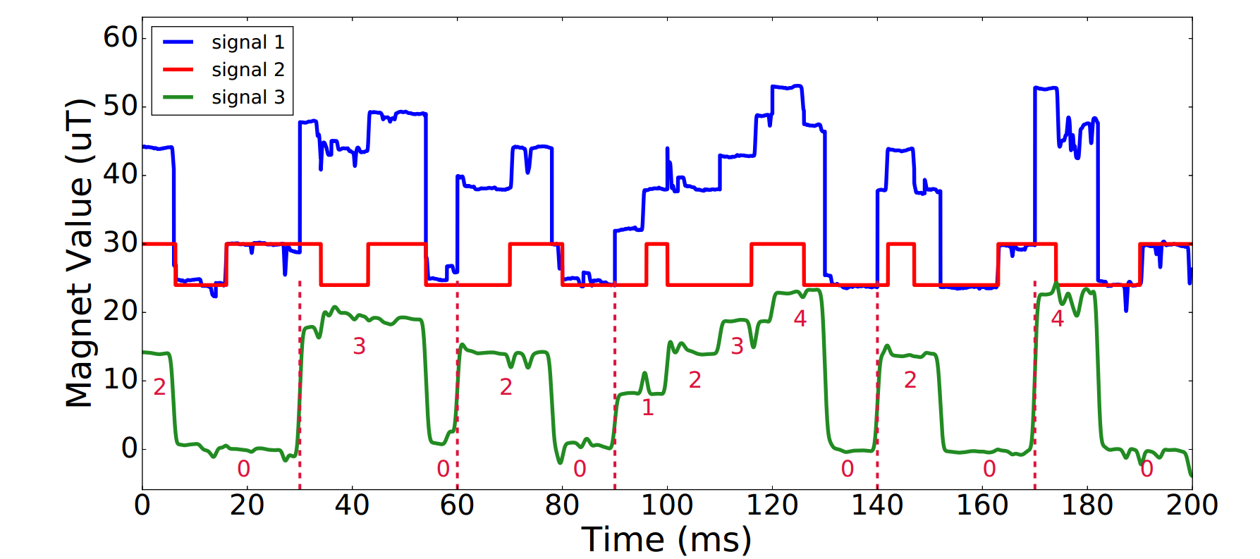

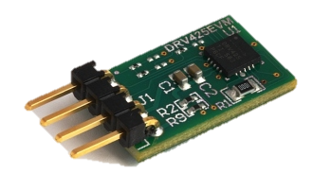
Full-Duplex Communication 3-4
laptop A
laptop B
sensor B
sensor A
Notes:
The key feature to enable full-duplex communication is the the observed MI signals is the superposition of signals from two nodes.
Since the receiver knows what signals it sent, the receiver can cancel out its own MI signals from the received one.
Take this figure as an example, the blue curve represents MI signals received by the receiver, and the red curve is the modulated MI signals it sent. By subtracting the red curve from the blue curve, we get the green curve which can then demodulated as described above to get data from the sender.

Slide 20
4
MagneComm Prototypes
PART

Slide 21
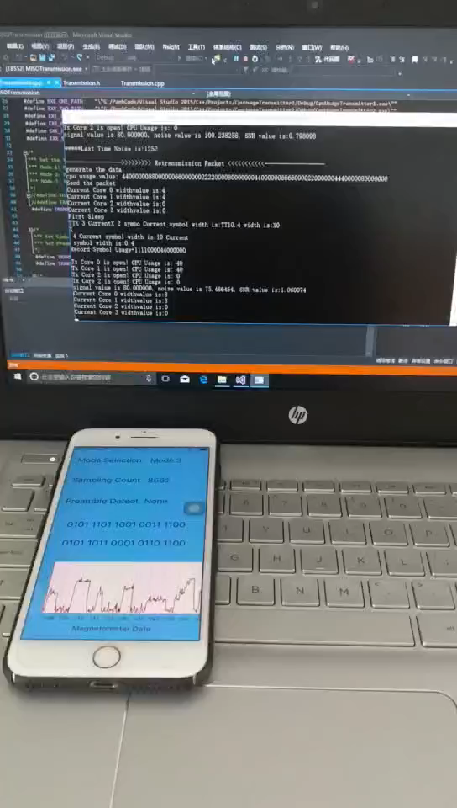
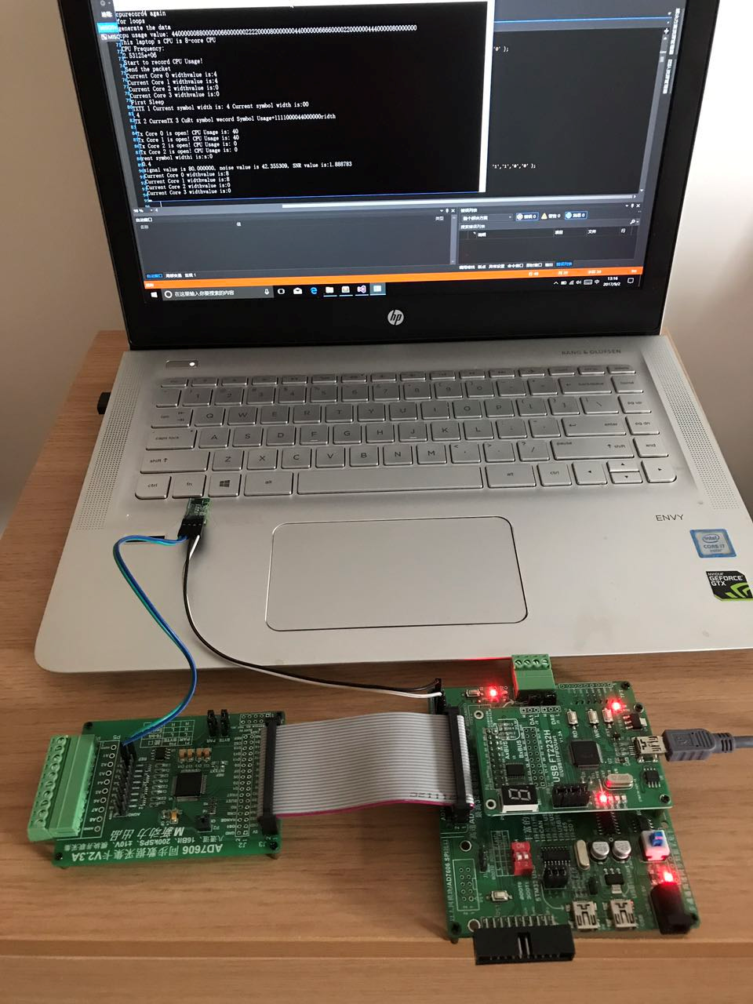
4 Two Prototypes
Transmitter:
CPU cores
Receiver:
Magnet sensor
Receiver:
iPhone
AD sampling board
Notes:
We implemented MagneComm to enable communication between laptop and phone as well as between two laptops attached with external magnet sensor.

Slide 22
5
Performance
PART
Notes:
Next we evaluate MagneComm using the two prototypes

Slide 23
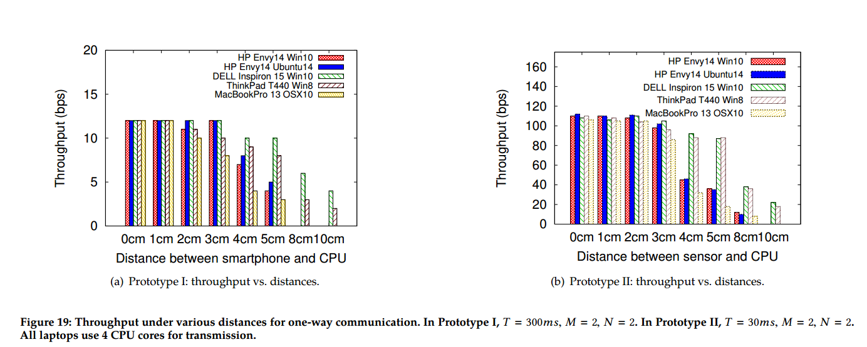
One-Way Communication 5
T = 300ms, M=2, N=2
T = 30ms, M=2, N=2
Notes:
We first vary the communication distance to see how throughput changes when there is no background application running. Two figures represent the performance of two prototypes respectively. In Prototype I where a laptop acts as the sender while a phone acts as the receiver, it achieves 12bps when they are within 3cm. Some laptops generate stronger signals can still be heard when the distance is 10cm.
In Prototype II where a laptop acts as the sender while the other laptop with external magnet sensor as the receiver, it achieve 110bps due to higher sampling rate.

Slide 24
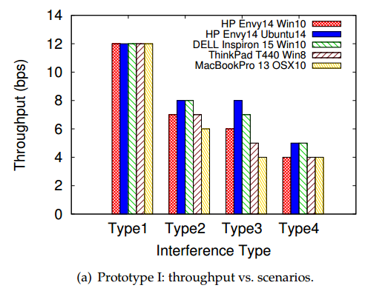
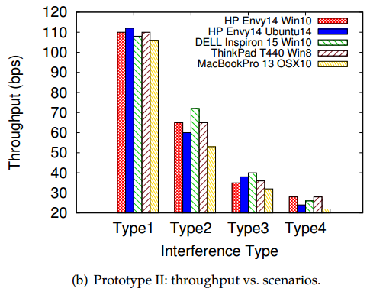
Impact of Interference 5
Type1 = doing nothing, Type2 = watching live video,
Type3 = surfing websites, Type4 = playing games
Notes:
When the interference is present, the throughput decreases. For example, while the user is watching live video, also corresponding to the interference type2, the throughputs drop to 7 bps and 60 bps, respectively.

Slide 25
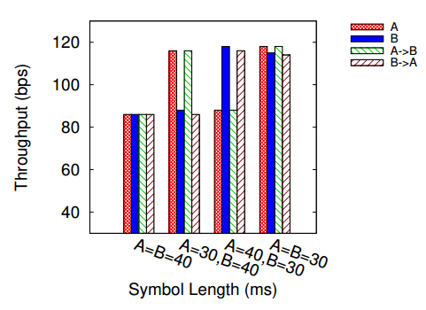
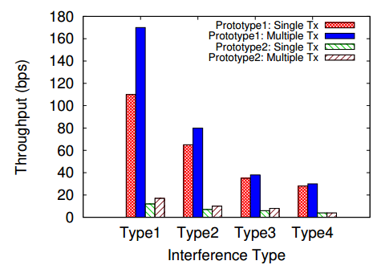
Full Duplex & Multiple Transmitters 5
Increased by 154.5%
Increased by 195%
Type1 = doing nothing, Type2 = watching live video,
Type3 = surfing websites, Type4 = playing games
M_{A}=M_{B}=2, N_{A}= N_{B} =2
Notes:
We evaluate the full-duplex communication performance using Prototype II. We can see that the total throughput in full-duplex communication is 195.5% of that in one-way communication.
While using multiple transmitters: by increasing the number of transmitter antennas from 1 to 2, the throughput is increased by 141.6% and 154.5% in Prototype I and II under the clean background, respectively. However, in noisy environment, the improvement of using Multiple Transmitters is less significant because using multiple cores increases the risk of being interfered by the background applications.

Slide 26
6
Conclusion
PART
Notes:
Finally, we conclude our work.

Slide 27
Conclusion 6
MagneComm
Explore the possibility of a novel near-field communication using Magnetic Induction signals.
Use CPU and magnetometer as sender and receiver
No additional hardware is required.
Compensate existing NFC technologies with additional bandwidth
Notes:
In this work, we explore the possibility of a novel near-field communication by using Magnetic Induction signals generated from mobile devices.
We control CPU to generate the modulated MI signals and use magnetometer on a phone to receive and decode the data.
The advantage of MagneComm is that, since CPU is essential on laptops while magnetometers are widely available in most phones, we can enable the near-field communication without additional hardware.
Even NFC chips is becoming popular, MagneComm can still compensate it by providing additional bandwidth.

Slide 28
THANKS
Any question, please contact me!
panh09@sjtu.edu.cn
Notes:
This concludes my talk. Thank you!

