Slide 1
Improved Wi-Fi RSSI Measurement for Indoor Localization
IEEE SENSORS JOURNAL， APRIL 2017

Slide 2

Wi-Fi Based localization
Wide deployment of Wi-Fi
Wide coverage
Work in dark
Low cost
Without the need of any hardware addition or modification

Slide 3
Two categories
Trilateration algorithm
  Based on the principle of distance intersection
Fingerprint positioning method
  Based on the use of a database
  specific geometric or probabilistic algorithm
The extraction of RSSI is vital to both of them

Slide 4
The extraction of RSSI
The mean value of RSSI
  Multipath
  non-line-of-sight
Kalman filter and particle filter
  May not be effective to deal with the ever-changing dynamics of indoor environment

Slide 5
Kalman filter
Example:
  假设我们要研究的对象是一个房间的温度。
  根据你的经验判断，这个房间的温度是恒定的，也就是下一分钟的温度等于现在这一分钟的温度.
  假设你对你的经验不是100%的相信，可能会有偏差。我们把这些偏差看成是高斯白噪声也就是这些偏差跟前后时间是没有关系的而且符合高斯分布。
  我们在房间里放一个温度计，但是这个温度计也不准确的，测量值会比实际值偏差。我们也把这些偏差看成是高斯白噪声。
  你根据经验的预测值（系统的预测值）和温度计的值（测量值）,结合他们各自的噪声来估算出房间的实际温度值。
  如果k-1时刻估算出的最优温度值的偏差是3，你对自己预测的不确定度是4度，他们平方相加再开方，就是5.
  然后，你从温度计那里得到了k时刻的温度值，假设是25度，同时该值的偏差是4度。
  因为Kg=5^2/(5^2+4^2)，所以Kg=0.61，我们可以估算出k时刻的实际温度值是：23+0.61*(25-23)=24.22度。
  k时刻最优值（24.22度）的偏差：((1-Kg)*5^2)^0.5=3.12。

Slide 6
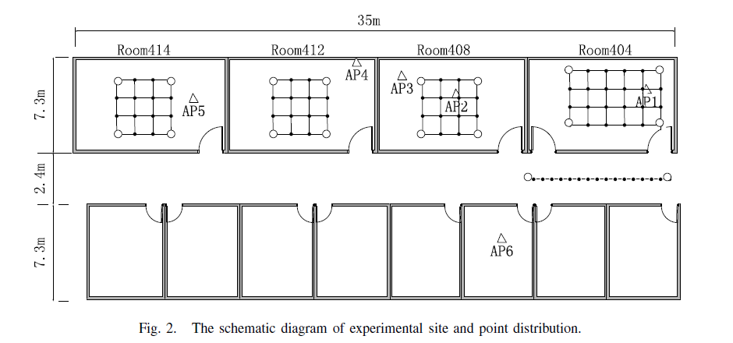
Experiment environment
Four rooms and one corridor

Slide 7


Algorithm of RSSI integration based on the maximum
  The Wireless signal intensity attenuation model
  The unknown distance d can be calculated by
  η is the pathloss exponent
Notes:
ETA η

Slide 8
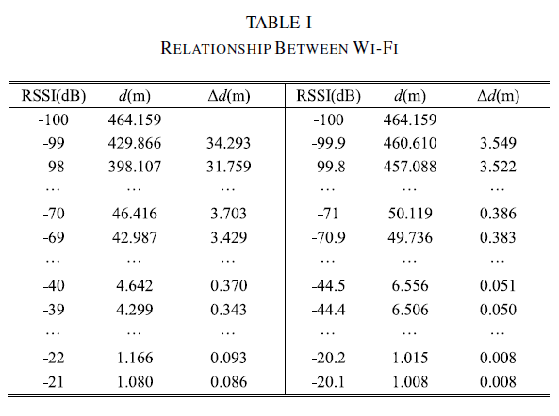
Algorithm of RSSI integration based on the maximum
Table 1 displays a range of RSSI values and the corresponding propagation distances
Larger RSSI produces smaller differential distance, providing better spatial resolution.
Differential RSSI of 0.1 dB produces much smaller differential distance than differential RSSI of 1dB.

Slide 9
Algorithm of RSSI integration based on the maximum
The Kalman Filter algorithm and the particle filter algorithm may not be able to effectively handle complex RSSI measurement noise in ever-changing dynamic indoor environment.
RSSI is significantly affected by fading, shadowing and interference.
  The strong RSSI be mainly affected by fading
  The weak RSSI can be affected by one or more of the 3 factors
Notes:
Fading 信号衰减 由于墙壁或其它物体的遮挡，多径效应，移动设备在收集RSSI信号时产生的误差
Shadowing 发射机和接收机之间的行人
Interference 相同频段的信号产生干扰

Slide 10
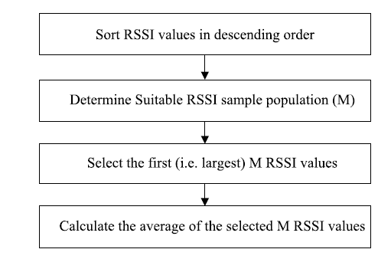
RSSI extraction algorithm
Larger RSSI values
The mean of some RSSI values

Slide 11

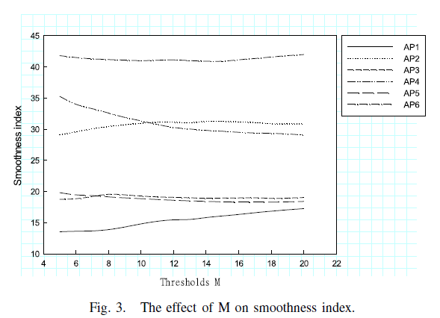
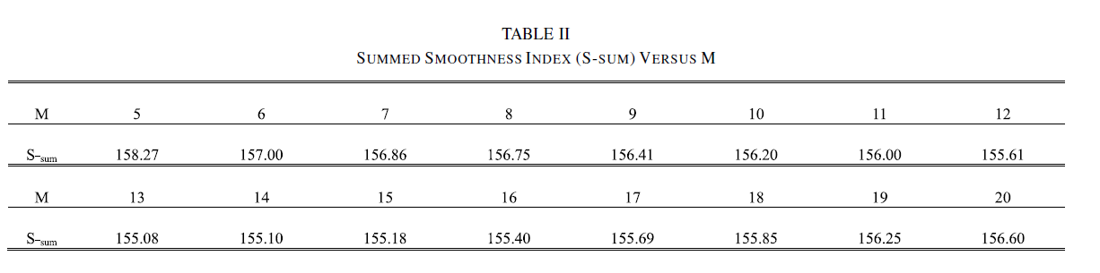
Determination of the Number M
Smoothness index denoted by S as a measure.
The smaller S is, the smoother the signal curve is, the better quality of RSSI is.

Slide 12
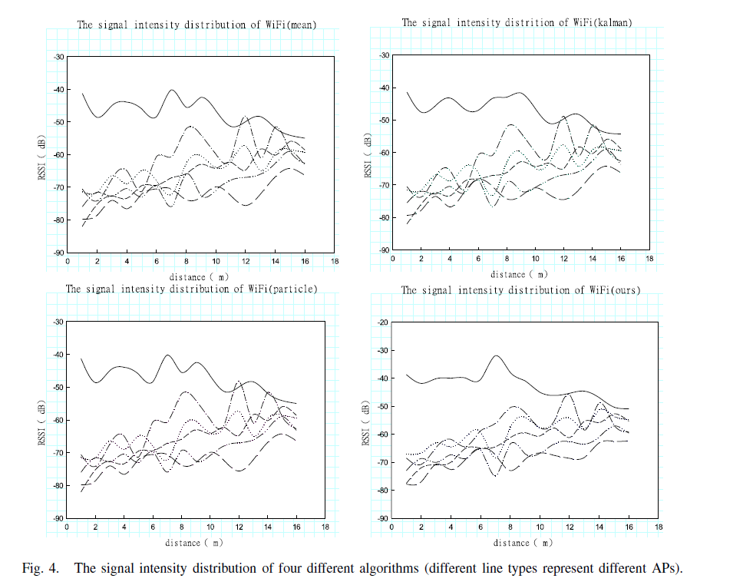
One-Dimensional RSSI spatial Distribution
The smoothness of the RSSI curve of the proposed algorithm is better than those of other three algorithms.

Slide 13
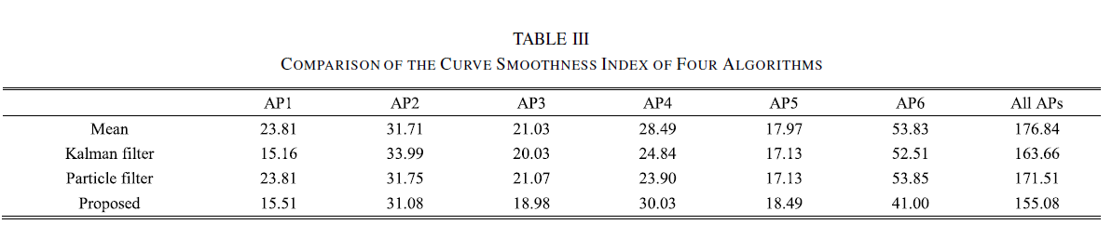
One-Dimensional RSSI spatial Distribution
The smoothness of the RSSI curve of the proposed algorithm is better than those of other three algorithms.

Slide 14
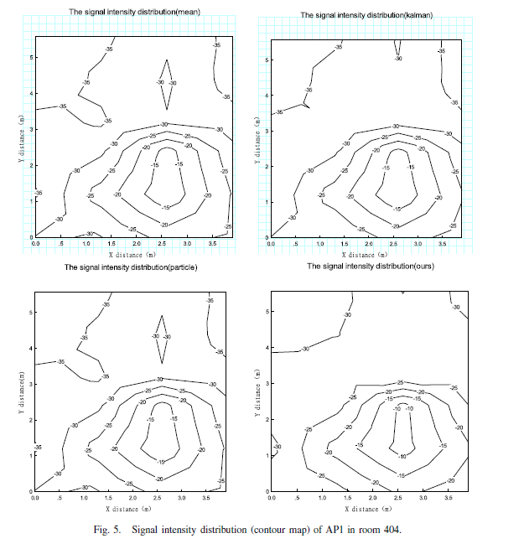
Two-Dimensional RSSI spatial Distribution
The number of saltation point is an important index to describe the RSSI distribution pattern.
Notes:
A saltation point in the contour map refers to a point where the RSSI is very different from those of the surrounding points.

Slide 15
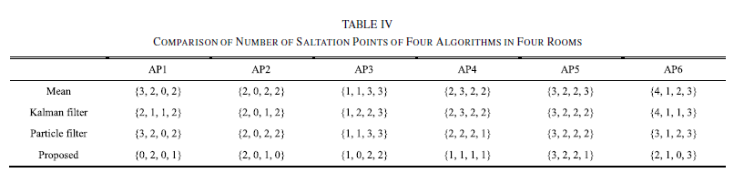
Two-Dimensional RSSI spatial Distribution
The number of saltation point is an important index to describe the RSSI distribution pattern.
Notes:
A saltation point in the contour map refers to a point where the RSSI is very different from those of the surrounding points.

Slide 16
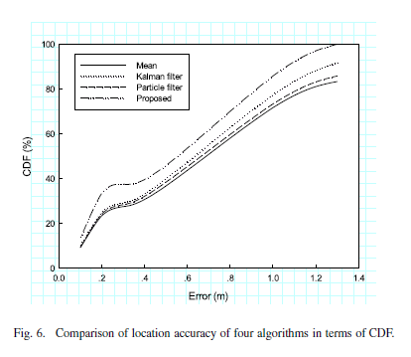
Location Accuracy Comparison
kNN algorithm is used to obtain position estimates

Slide 17
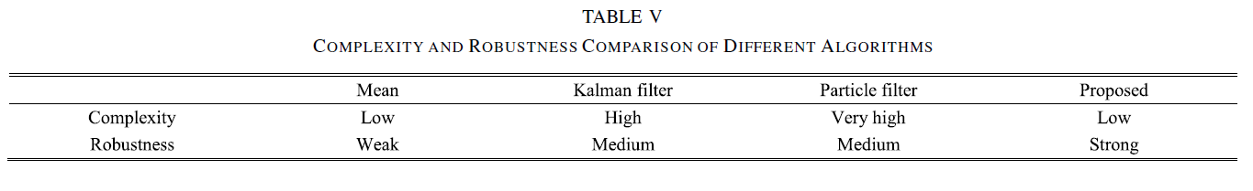
Complexity and Robustness

Slide 18
Conclusion
New idea to measure fingerprint
Feasible?
Spatial pattern: improve the quality of RSSI

