Slide 1
NICScatter: Backscatter as a Covert Channel in Mobile Devices
Zhice Yang^{1,2}, Qianyi Huang², Qian Zhang²
^{MobiCom 2017}
Notes:
今天给大家介绍的文章来自MobiCom 2017，介绍了如何利用backscatter技术窃取移动设备信息。
Good morning, everyone. My name is Qianyi Huang from Hong Kong University of Science and Technology. [Pause]
Today, I will be talking about “NICScatter: Backscatter as a covert channel in Mobile Devices”.
This is a joint work with Dr. Zhice Yang, advised by Prof. Qian Zhang.

Slide 2

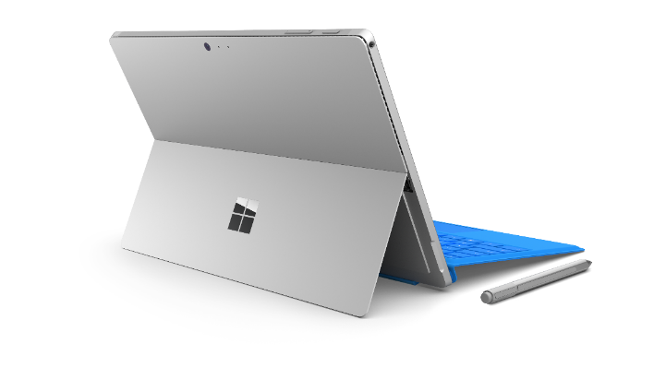


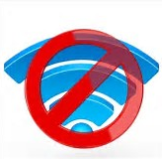


Is Our Data Safe Enough ?
Notes:
当今，移动设备存储了很多包括指纹、银行卡、密码等的敏感信息。为了防止这些信息被泄露，传统的保护方式是使用网络防火墙技术或者网络监控技术，来监测该设备的网络流量，
因为普遍的观点认为黑客窃取信息的主要渠道是通过网络传输，而事实情况确实如此。
一种保护信息的极端方式是把设备与因特网隔离起来，军队和银行大多采用这种方式来保护数据。
普通用户在感觉自己的电脑中病毒了之后的第一反应也往往是切断网络连接。
那么在没有网络的情况下是否能百分之百保证数据不会泄露呢？
-------------------------------------------------------------------------
Nowadays, our mobile devices collect very sensitive data about us, such as credit card information when making online payment, fingerprint information and passwords to various accounts. We want to guarantee that this information is safe with our device. [Pause]
[amination]
To achieve this purpose, we use firewalls, or network monitors to monitor the traffic going out of the deivces.
[amination]
For the extreme case, we may isolate the devices from the public Internet. The devices may be kept in a safe region without public Internet connection, which is a common practice in military or banking system.
We want to know that, are these methods secure enough to protect our data from malicious agencies ?
---------------------------------------------------------------------------------------------------------------------------------------------------------------------------------------------------------------------------
Today’s Mobile devices contains very sensitive data, we want to keep them safe enough
e.g. credit card, password, hearth data,…
[amination]
So we use firewalls, or information control systems to guard them.
[amination]
Or people as me,
[amination]
I only trust applications work locally. I disconnect the wifi, data network. I’m clever enough, speaker is also close.
[amination]
However, are these means enough to safely isolate the our data from malicious agencies ?

Slide 3
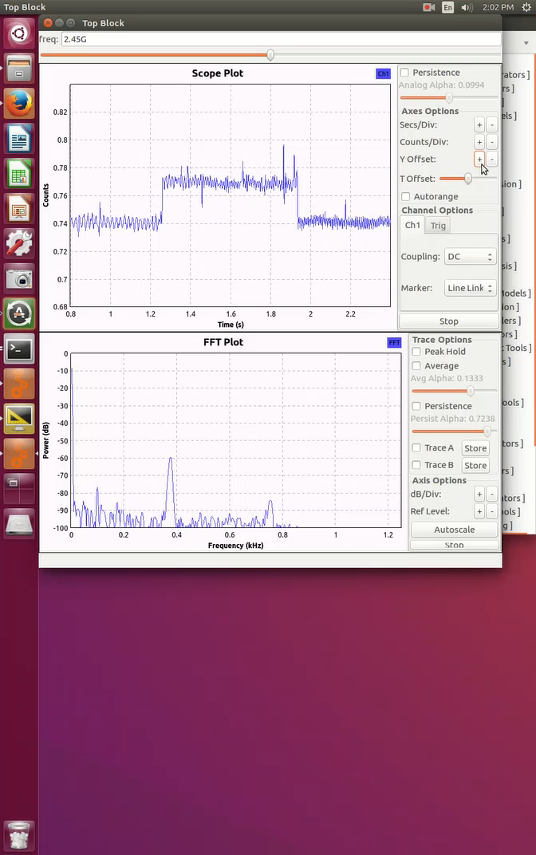

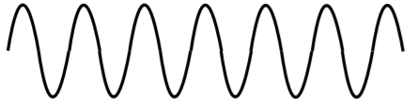
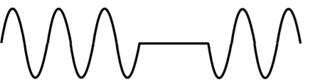

Information Leakage under Isolation
Incident Signal
Reflected Signal
Victim
Attacker
Notes:
答案是否定的。本论文发现移动设备的一个漏洞，在没有网络连接的情况下，仍然会泄漏数据。
作者提出了一个黑客攻击的场景，当移动设备被安装了某种后门程序（病毒/木马等），在不使用网络连接的情况下，该后门程序仍然可以将数据发送给附近黑客的设备。
这页ppt显示，利用电磁波反射的技术，在入射的电磁波信号被移动设备反射后，被黑客的电脑接收到，就可以提取出后门程序泄漏出的0101比特数据流。
下面详细介绍技术细节。
----------------------------------------------------------------------
Unfortunately, the answer is NO. Our data can still be under risk.
In our scenario, the victim can be a phone or a laptop.
[Animation]
Assume that the malware has been installed in the victim, [Pause]
[Animation]
a nearby attacker can receive the leaked information from the malware, regardless of the existing protection mechanism. [Pause]
From this slide, we can see that the attacker can receive the 0101 sequence transmitted by the malware.
[Long pause]
[Animation]
So, how are the bits transmitted? [Pause]
The fact is that the malware simply force the victim to reflect surrounding RF signals to convey information, just like a passive backscatter tag.
[Pause]
In this talk, we talk about this covert channel.
---------------------------------------------------------------------------------------------------------------------------------------------------------------------------------------------------------------------------
The answer is NO.
Even under the strong protection, our data is still under risk.
Here we have a demo show how our data is leaked out under strong isolation. We should have brought the demo to the demo section, but the Mobicom demo deadline is before the main paper notification…
The victim can be a phone or a laptop. The victim has no wireless or wire connections. Given the malware has been installed in the victim,
[Animation]
a nearby attacker can receive the leaked information from the malware without causing attentions to existing protecting mechanism.
[Video]
The received wave, a simple 0101 trace is shown in the animation.
So, how are the bits transmitted?
Like a passive backscatter tag, the malware simply force the victim to reflected surrounding RF signals to convey information.
In this talk, we talk about this covert channel.

Slide 4
Covert Communication through Backscatter
NICScatter: backscatter through commercial NICs
System vulnerabilities in smartphone and Linux notebook
Notes:
论文首先提出了利用backscatter技术在无线网卡上建立隐秘信道来传递数据，该系统称作NICScatter
其次，论文分析了智能手机和Linux系统上系统漏洞，正是这样的漏洞才使得该系统有可行性。
[Animation]
The basic communication method of the covert channel is a new form of backscatter communication, we call it NICScatter.
Specifically, it enable backscatter communication using commercial NICs.
[Animation]
[Pause]
Further, we identify vulnerabilities in current mobile systems that can stealthily enable NICScatter communication.

Slide 5
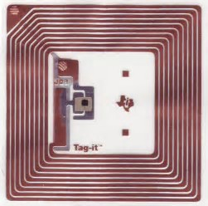
Backscatter Basics
Impedance Switching Circuits
Backscatter Transmitter
Incident Signals
Za
Zc1
Zc2
Reflected Signals
Notes:
首先来看Backscatter的技术背景
标签内有发射天线和简单的开关电路，开关通过切换来改变天线的负载阻抗，当阻抗不匹配时，入射信号会被反射，反之，信号会被天线吸收。
通过切换开关的状态，可以对反射信号的幅度进行调制，从而达到发射0101序列的目的。
技术原理很简单
Let us first review how backscatter tags work.
[Pause]
[Animation]
The tag will switch its antenna load in two states. In one state, the incident signals will be reflected due to the impedance mismatch. In the other state, the incident signals are absorbed.
[Animation]
By switching between the two states, the tag can transmit ‘0,1’ sequence.

Slide 6


Backscatter through Commercial NICs
Incident Signal
Za
Zc1
Zc2
Reflected Signal
Notes:
因此，如果为了调制反射信号的幅度，就需要切换反射电路的负载阻抗，也就是需要开关电路。
但是在普通的移动设备上，没有这样的开关电路，那么怎么来模拟出这样的功能呢？
However, on commercial devices, we do not have these circuits for backscatter communication.
How can the commercial device emulate a tag?

Slide 7
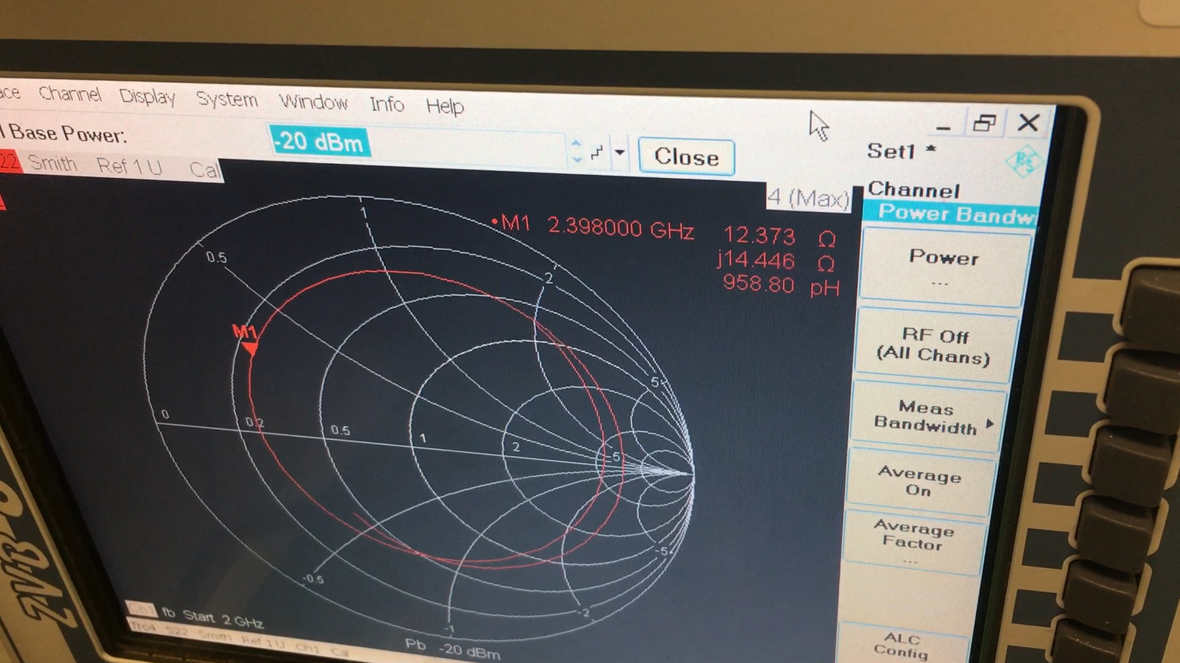
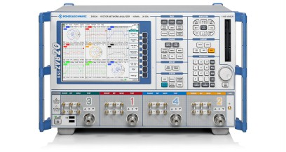
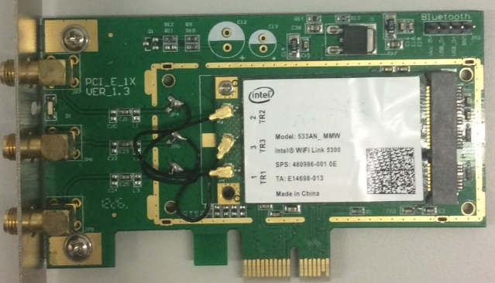
Vector Network Analyzer
WiFi NIC OFF
WiFi NIC ON
BCM1045 Wi-Fi NIC
Notes:
作者发现网卡的阻抗在ON/OFF状态下是不一样的。
作者通过将wifi网卡接入向量网络分析仪，来分析其阻抗特性，发现在改变网卡开关状态时，阻抗特性从史密斯圆的一个区域跳变到另外一个区域。
也就是说，可以通过对网卡发出ON/OFF指令来模拟开关的效果。
这是NICScatter系统的工作原理。
We observe that, NIC impedance are different in ON/OFF states.
[Pause]
We connect an Broadcom Wi-Fi NIC to a vector network analyzer and observe that when we switch the NIC from OFF to ON, the impedance switch from one region on the Smith chart to another region.
[Pause]
So, we can use the ON/OFF to emulate the two states on a backscatter tag. This is the working principle of NICScatter.
---------------------------------------------------------------------------------------------------------------------------------------------------------------------------------------------------------------------------
The key observation of NICScatter is that,
NIC impedance changes with different working states

Slide 8
NICScatter Efficiency
Model | Off State | On State
BCM1045, ant1 | 12.4+j14.4 | 106.9-j9.8
Intel5300, ant1 | 119.0+j137.0 | 80.3+j66.8
Intel5300, ant2 | 54.3+j122.7 | 57.7+j78.4
Incident Signal
-6 dB
Reflected Signal
Notes:
列表是一些网卡的阻抗特性，
首先对于BCM1045网卡，在OFF状态下阻抗实部是12.4，在ON状态下阻抗实部是106.9，
信号通过网卡反射会有6db的衰减
Here we give several examples.
First, let’s look at BCM1045 model. When we switch the NIC from OFF to ON, the real part of the impedance changes from 12 to above 100.
By calculation, this will case 6 dB loss during reflection. This efficiency is close to many dedicated tags. [????????????????]
---------------------------------------------------------------------------------------------------------------------------------------------------------------------------------------------------------------------------
Backscatter Efficiency (defined by energy loss in the reflection)
Values measured for different NICs
For some, already Close to many dedicated tags.

Slide 9
NICScatter Efficiency
Model | Off State | On State
BCM1045, ant1 | 12.4+j14.4 | 106.9-j9.8
Intel5300, ant1 | 119.0+j137.0 | 80.3+j66.8
Intel5300, ant2 | 54.3+j122.7 | 57.7+j78.4
Incident Signal
-18 dB
Reflected Signal
Notes:
其次对于Intel 5300网卡，在OFF状态下阻抗实部是119.0，在ON状态下阻抗实部是80.3，
信号通过网卡反射会有18db的衰减
The second example is the Intel 5300 model. The impedance change is smaller compared to the Broadcom model. The reflection loss is about 18 dB. It has a larger reflection loss than the previous model and is also the largest among all the model we tested.
[Pause]
In evaluation, we show that with this NIC, the communication distance is about 2 meters.
---------------------------------------------------------------------------------------------------------------------------------------------------------------------------------------------------------------------------
Backscatter Efficiency, Communication distance is about 2meters. Talk later in the evaluation

Slide 10
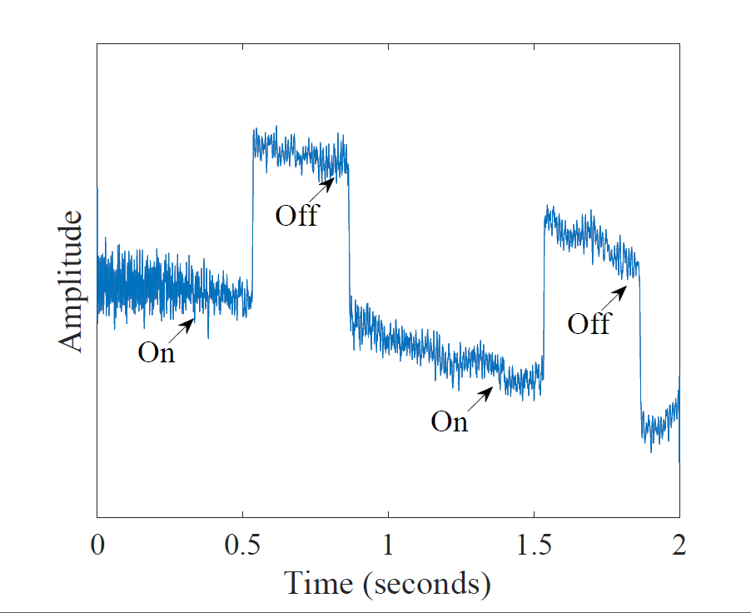
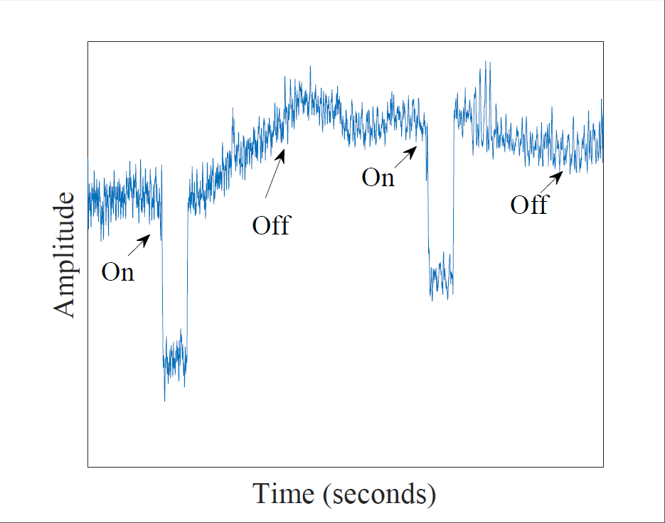
Reflection Diversities
Intel 5300
Atheros AR9285
Notes:
那么这种阻抗变化会对反射信号造成的幅度调制会有多明显呢？
下面是不同网卡在ON/OFF切换时的反射信号的波形。
对于Intel 5300芯片，当从ON切换到OFF时，信号幅度会有明显的下降，反之会有明显的上升；
对于Atheros AR9285芯片，当从OFF切换到ON时，反射信号会有明显的下降，随后会自动回归高电平，反向切换并不会导致信号幅度有明显的变化。
作者测试的网卡大多可以归为这两类。
可以发现，这两类网卡芯片可以有效地在可控范围内调制反射信号的幅度。
Here is the detailed waveform from different WiFi NICs when we turn them ON and OFF.
[Pause]
We can see that, in addition to the differences in reflection efficiency, different models have different wave forms.
[Pause]
For the Intel model, when in ON states, it will stay in one level. When switched to the off state, it will change to another level and remain there.
[Pause]
However, for the Atheros model, when we turn it on, it shows a rapid change in the waveform but no obvious change when we turn it off.
There are the two main types of waveforms we have encountered with.
---------------------------------------------------------------------------------------------------------------------------------------------------------------------------------------------------------------------------
Todo, replace these figure to better ones. Here is the detailed waveform of the reflection from different WiFi NICs. On off switching freq 1s.
Observation:
In addition to different intensity. Different NICs has different wave forms.
->Two categories: pulse type and static type.
-> OOPM (next slide)

Slide 11
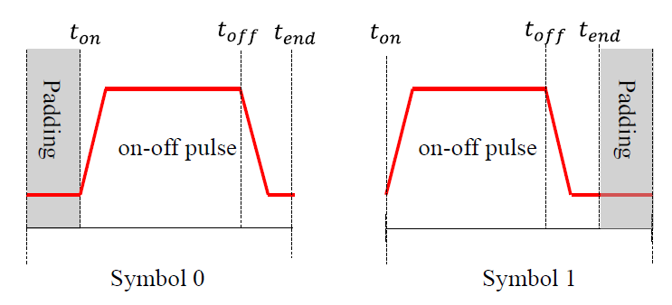
On-o Position Modulation (OOPM)
Notes:
基于这种开关效应，作者设计了一种基带的调制方式，称作OOPM，
将时间划分为一个个slot，每个slot中有一个脉冲，根据脉冲出现在slot前后位置代表不同的symbol。
Based on this characteristic, we use ON-OFF position modulation.
We divide time into slots. We use the position of the ON-OFF pulse to modulate information. When the pulse appears at the front part of the time slot, we encode it as ‘1’; when the pulse appears at the back part of the time slot, we encode the bit as ‘0’.
This is how we encode data in NICScatter.
---------------------------------------------------------------------------------------------------------------------------------------------------------------------------------------------------------------------------
Positive and Negative (location) diversity(Decoding)
-> not a problem, flip it.

Slide 12

Encoding Schemes
On Off Position Modulation (OOPM)
0
1
1
0
1
1
0
Notes:
作者也设计了一个package的构成方式，11110构成preamble用于同步，负载部分是20个bit。
下图就是在时域上整个package的波形。
Based on this characteristic, we use ON-OFF position modulation.
We divide time into slots. We use the position of the ON-OFF pulse to modulate information. When the pulse appears at the front part of the time slot, we encode it as ‘1’; when the pulse appears at the back part of the time slot, we encode the bit as ‘0’.
This is how we encode data in NICScatter.
---------------------------------------------------------------------------------------------------------------------------------------------------------------------------------------------------------------------------
Positive and Negative (location) diversity(Decoding)
-> not a problem, flip it.

Slide 13
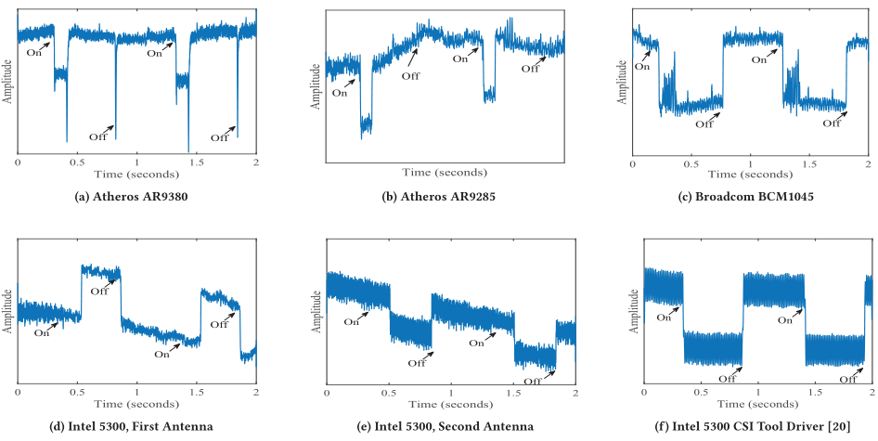
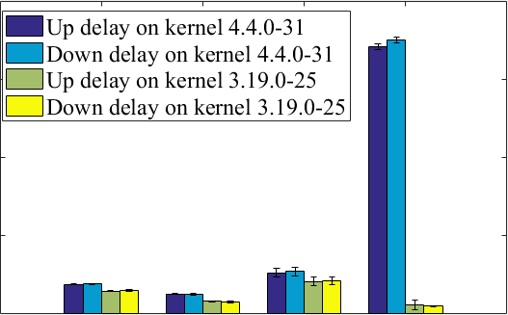
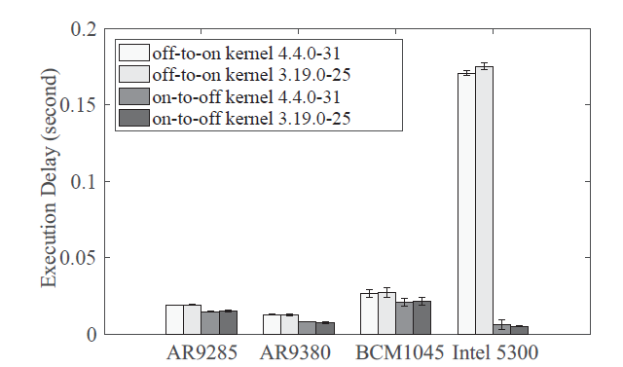
Latency Diversities
Notes:
作者通过实验来分析对不同网卡发送ON/OFF指令后反射信号作出反馈的时延
从右图可以看出来，当发出ON指令后，有些网卡会立马做出反馈，而5300网卡会有较大的时延。
左图是通过一百次实验统计的不同网卡的Execution delay，可以看出on-to-off以及off-to-on的时间大多是0.025s左右，
但是Intel5300网卡例外，他的off-to-on时延大约是其他的十多倍。作者通过更换该网卡的驱动程序发现时延下降到了平均水平，
因此网卡的时延与驱动程序有很大的关系。
Another diversity is the execution delay.
Here we show the execution delay for four models.
The execution delay for each NIC is measured 100 times. Results in Figure 4 show that the on-to-off or off-to-on delay is normally around 0.025s. One
exception is Intel 5300. Its off-to-on delay is about 10 times higher than that of other NICs.
In order to incorporate the Intel Model, we set the duration of the time slot on the previous slide to be 0.5 seconds, which means that the maximum throughput we can achieve is 2bps. The throughput can be significantly improved if we exclude the Intel Model.
For a quick summary, the reflection property is consistent among the same NIC model. For different models, the property is different, even though they may come from the same manufacturer.

Slide 14
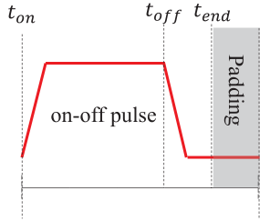
Latency Diversities
0.3s
0.1s
0.1s
On Off Position Modulation (OOPM)
0.5s
0
1
1
0
1
1
0
Notes:
Execution delay对吞吐量有很大的影响，比如两个连续的符号1，后一个符号的上升沿需要提前一个时延量来发送指令，
这个提前量不能大于前一个符号的拖尾部分。
所以作者设计一个symble的pulse持续时间是0.3s，低电平部分是0.2s，总共时间是0.5s，
从而吞吐量是2bps
作者指出，如果不考虑前面所说的5300网卡，那么一个symble的持续时间可以大大缩减，从而吞吐量可以大大提高。
Another diversity is the execution delay.
Here we show the execution delay for four models.
The execution delay for each NIC is measured 100 times. Results in Figure 4 show that the on-to-off or off-to-on delay is normally around 0.025s. One
exception is Intel 5300. Its off-to-on delay is about 10 times higher than that of other NICs.
In order to incorporate the Intel Model, we set the duration of the time slot on the previous slide to be 0.5 seconds, which means that the maximum throughput we can achieve is 2bps. The throughput can be significantly improved if we exclude the Intel Model.
For a quick summary, the reflection property is consistent among the same NIC model. For different models, the property is different, even though they may come from the same manufacturer.

Slide 15
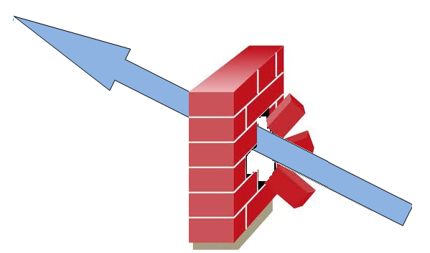


How to Hide the Communication ?
Notes:
以上介绍了通过改变网卡的ON/OFF状态，调制反射信号的波形，从而传输信息的方案。
那么问题是这种方法是否会绕过移动设备的安全监测？
The problem is how can a malware stealthily enable NICScatter.
As we mentioned in the beginning of the talk, how can NICScatter bypass the security protection system on mobile devices?
[Pause]
We observe that there are vulnerabilities in current operating system.
---------------------------------------------------------------------------------------------------------------------------------------------------------------------------------------------------------------------------
Turning on or off of the WiFi NIC sounds quit sensitive.
So how does the malware finish the operation without too much requirement like rooting the device, acquiring superuser permissions ?
[animation]
The covert transmission through NICScatter is possible once we consider the following vulnerabilities in current operating systems.

Slide 16
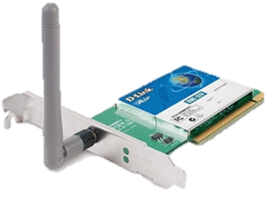
RFKILL Subsystem
# file: rfkill
# owner: root
# group: netdev
user::rw-
user:testu:rw-
group::rw-
mask::rw-
other::r--
Network Manager
rfkill unblock
rfkill block
netlink socket
/dev/rfkill
USERSPACE
uevent
KERNEL
rtnetlink
rfkill core
cfg80211_rfkill_set_block
cfg80211
IEEE80211_open
IEEE80211_stop
mac80211
*driver*_start
*driver*_stop
WNIC driver
on
off
HARDWARE
Notes:
对于Linux系统，作者发现Rfkill命令有安全隐患。
Rfkill是用来操作Rf io设备的命令，常见的飞行模式就是使用的Rfkill接口。
Linux中调用这个接口是通过向一个叫做Rfkill的文件中写入block/unblock指令。
问题在于这个文件的权限是对所有用户开放，也就是说NICScatter所需要的操作不需要root权限，即使是在网络防火墙阻塞进程通信时，也可以通过本文提出的方案进行短距离通信。
作者认为系统中这个权限隐患很大，在一些涉及敏感信息的移动设备上会有安全威胁。
For linux systems. The vulnerability lies in RF-kill subsystem. RF-kill is originally designed to manage all the RF io devices. The airplane mode that we are familiar with is implemented with the RF-kill interface.
[Animation]
The control interface of RF kill system is a device file called rfkill, writing block command to this file can close certain RF device like the WiFi NIC.
[Animation]
Similarly, writing unblock command can bring up the WiFi NIC.
[Animation]
But, the problem is the writing permission of this file is open to all the users.
[Animation]
In other words, the operation of NICscatter requires no special permissions if it switches NICs through the RF Kill interface.
Certainly, the write permission of a device file like this is quite weird (possible the only one) and contains potential risks. We found the permission is granted in order to incorporate a special case of the Bluetooth manager application, which is included in the Gnome desktop environment. We report this because we thought the risks should be known to the public.

Slide 17
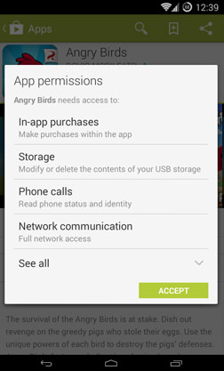
Android App Permissions
Dangerous Permissions
READ_CALENDAR, CAMERA, READ_SMS,
READ_CALL_LOG …
Normal Permissions
SET_ALARM, SET_TIME_ZONE, …
CHANGE_WIFI_STATE
Notes:
对于Android系统，根据对数据的威胁程度，权限被分为两种类别，敏感的权限会在用户安装app时候询问用户是否开启，非敏感的权限会自动被允许。
Android API中改变网卡工作状态的接口是WIFImanager，对应的权限叫做：CHANGE_WIFI_STATE，这个权限被归类为普通权限，在安装app时并不会通知用户，也就是说app获取这个权限的过程对用户完全是隐蔽的。那么本文提出的backscatter系统对用户完全是隐蔽的。
隐私泄漏的过程也就不会被用户觉察到。
For android systems, operation permissions are classified into two categories according to their risks to user data and the system .
Dangerous permissions require explicit grant from the user during the installation.
[Animation]
In some sense, the popup informs the user about potential risks.
However, normally permissions are automatically granted during the installation without notifications.
We note that NIC working states of android phones are controlled by the a system services called WiFiManager. Operating the WiFiManager requires an android permission called change wifi state.
[animation]
This permission is classified into Normal permissions. Which means users are totaled blind on whether an app would possibly use NICScatter as a communication way, and to leak their private information.

Slide 18
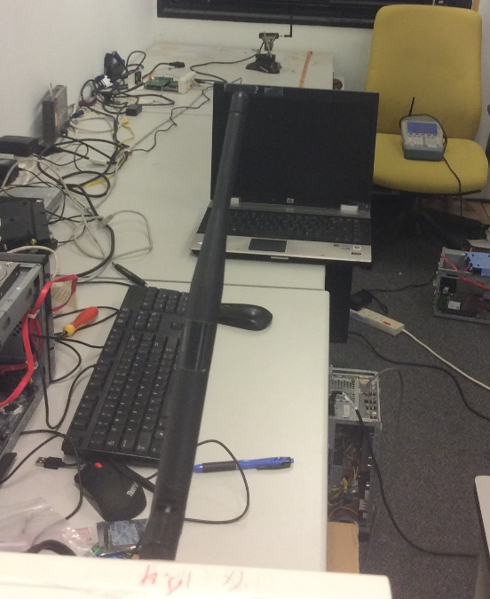
Attack Scenario
Receiver
Helper
Victim
d1
d3
65cm
150cm
d2
Helper
Victim
Receiver
Notes:
下面是系统评估的场景。
目标主机和接收器都在桌子上，signal helper采用特殊的信号发生器或者普通的WIFI AP，放在另外一侧的桌子上，距离桌子有一定的高度。
实验过程中，通过改变三个设备的相对位置来评估该系统的通信距离和效果。
So far, we’ve talked about ….
Now let me show you how we do the evaluation.
The victim and the receiver is placed on a table. The signal helper, which could be a dedicated signal generator or an AP, is placed above the table. During the experiment, we change the distance between the victim and the receiver, which is d two in the figure.

Slide 19
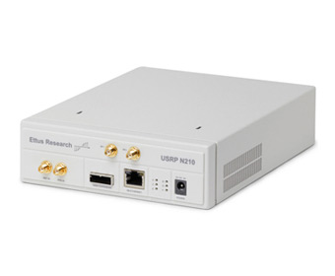
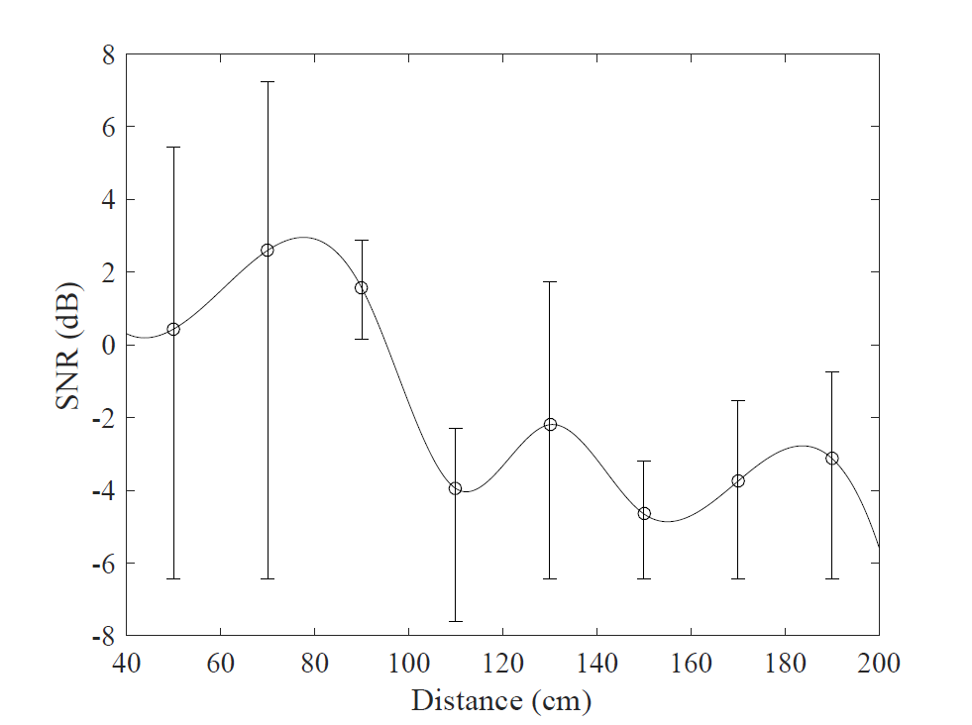
Attack Scenario
N210
Incident Signal
Reflected Signal
N210
HP Elitebook 8530P
Notes:
第一个场景使用USRP作为信号发射端和接收端，笔记本作为目标主机反射信号
入射信号强度是-40dB
下图是接收到的信号强度与距离的关系，发现表现最差的网卡的通信距离也能达到2m
所以。大多数的网卡通信距离都能达到2m以上
Evaluation
In the first scenario, we use a USRP as the signal helper, a laptop as the victim and another USRP as the attacker.
[Pause]
The strength of the incident signal is about -40 dBm.
Here we show the relationship between SNR and distance. The SNR is generally decreasing with increasing distance with some fluctuations.
The effective receiving distance of this setting is about 2 meters. This test is done with the Intel 5300 model. Compared to the other two models, its impedance change is the smallest. Thus, the communication distance can be larger than 2 meters with the victim has other WiFi NICs.

Slide 20
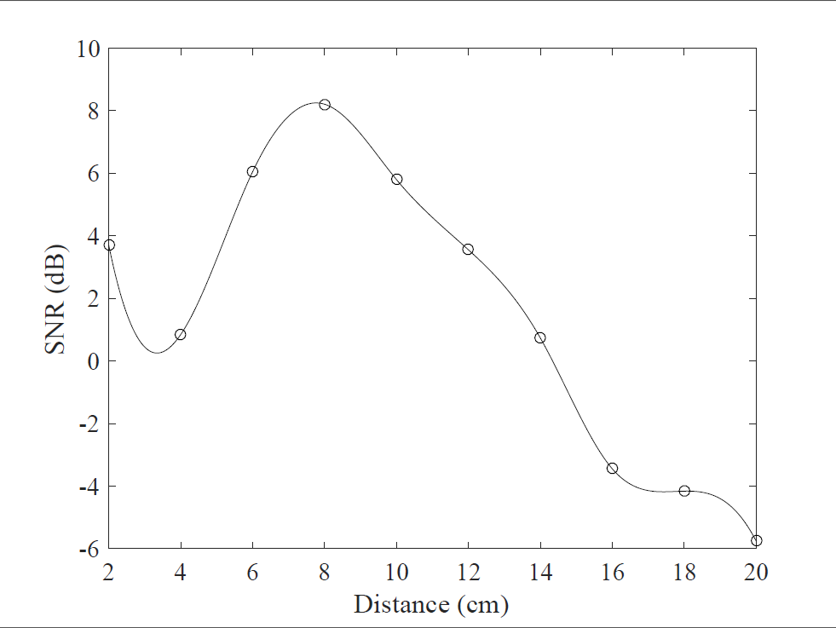

Attack Scenario
N210
Incident Signal
Reflected Signal
N210
Galaxy S2
Notes:
第二个场景是USRP作为发射和接受端，手机作为目标设备，
通信距离大约是20cm，远远小于笔记本的通信距离，原因是手机的网卡比笔记本的小，而且增益也小很多。
尽管通信距离最大20cm，但是仍然有很多应用场景，比如手机支付的时候，用户会将手机贴近NFC设备或者扫码支付，这个距离足够利用本文提出的系统进行信息传递，造成信息泄漏。
Evaluation
On this slide, we show the scenario that the smartphone is the victim. The communication distance is about 20 cm.
The communication distance is less than that of the laptop. One possible reason is the antenna of the mobile phone is more compact and has less gain than that of the laptop.
Although the communication distance is limited, the smartphone is still under risks. There are many possible ways for the covert channel to leak information. For example, when making mobile
payments, we need to put the smartphone close to a reader, which could be malicious. In another case, a QR code can pretend to be a coupon which in fact just intends to attract people to be close to the receiver.

Slide 21
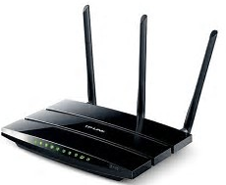
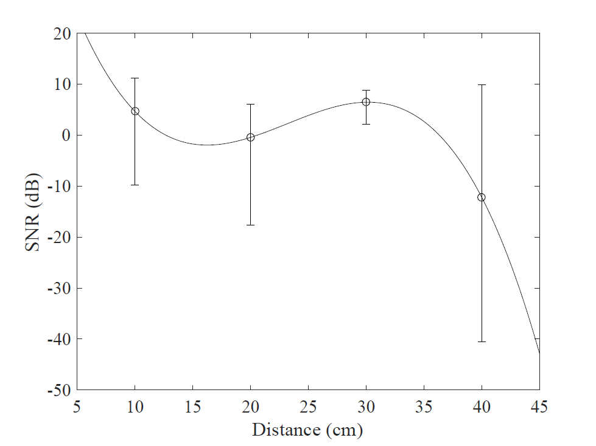
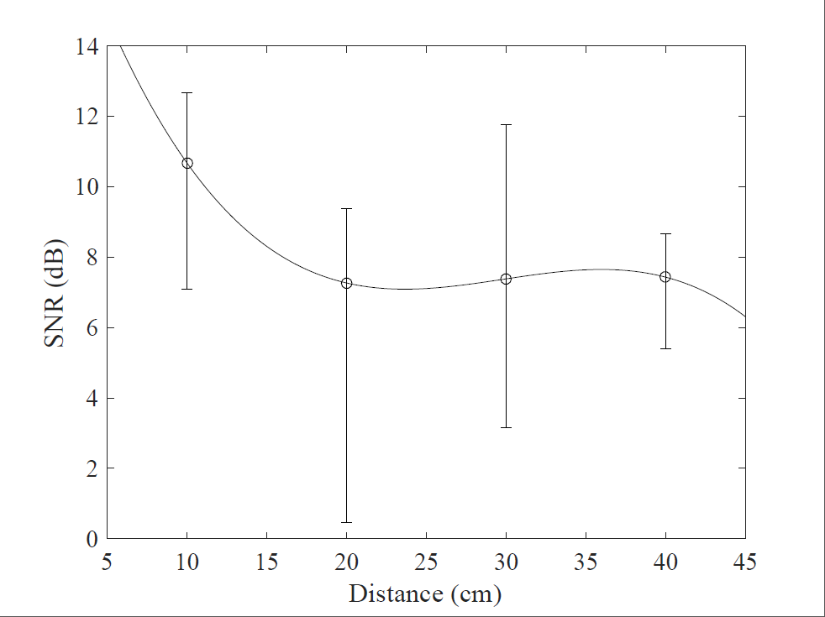
Attack Scenario
TPLink 4300
Incident Signal
RSSI
CSI
Reflected Signal
HP Elitebook 8530P
HP Elitebook 8530P
Notes:
第三个场景是使用普通的wifi ap作为信号发射器，笔记本作为目标主机，另外一个笔记本作为信号接收器。
利用网卡提供的接口提取出RSSI和CSI值，发现通信距离大约是35-40cm，
比使用USRP作为信号发射端小了很多，原因是USRP的频率分辨率和性能比普通AP和笔记本的网卡大很多。
Evaluation
In the third scenario, we use a commercial AP as the signal generator and another laptop as the receiver.
We extract the RSSI and CSI values from the CSI tool. The communication is about 35 cm for RSSI and 40 cm for CSI. The RSSI follow below decodable range beyond this distance. The distance is shorter than using USRP because they have lower resolution and smaller dynamic range than USRP samples.

Slide 22
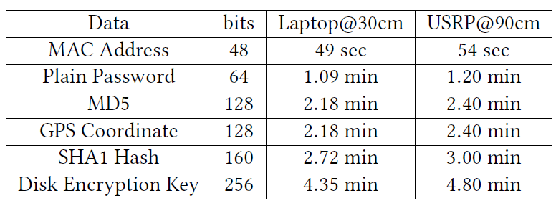
Transmission Time of Sensitive Information
Notes:
下面作者对几种敏感信息做了实验，测试本系统传输这几种敏感信息所需要的时间。
基本都是在两三分钟都能传输完毕。
前面提到本文为了兼容所有型号的网卡，比特符号设计得很大，造成吞吐量为2bps左右，实际上大部分的网卡都能做到十几bps，表中这些时间都能缩小十倍左右

Slide 23
Contributions and Limitations
Enable backscatter communication on commercial mobile devices
System vulnerabilities in smartphone and Linux notebook
New way to enable low-power communication in IoT
Communication Distance
Throughput
Can not work without malware
Notes:
贡献：
将RFID上的backscatter技术迁移到移动设备的无线网卡上，使得网卡不经过网络也能够传送数据；
发现Linux和Android系统上的用户权限的隐患；
Backscattrer技术可以迁移到其他领域，比如：ZigBee、蓝牙，是否也能够产生类似的通信模式？
甚至在物联网领域，无线节点是否也能够利用backscatter技术进行低功耗通信？

