Slide 1


Strata: Fine-Grained Acoustic-based Device-Free Tracking
Sangki Yun, Yi-Chao Chen, Huihuang Zheng, Lili Qiu, and Wenguang Mao
The University of Texas at Austin
Notes:
In this talk, I will introduce acoustic signal based device-free object tracking mechanism, which is very useful to design user interface for smart watch and VR devices.

Slide 2
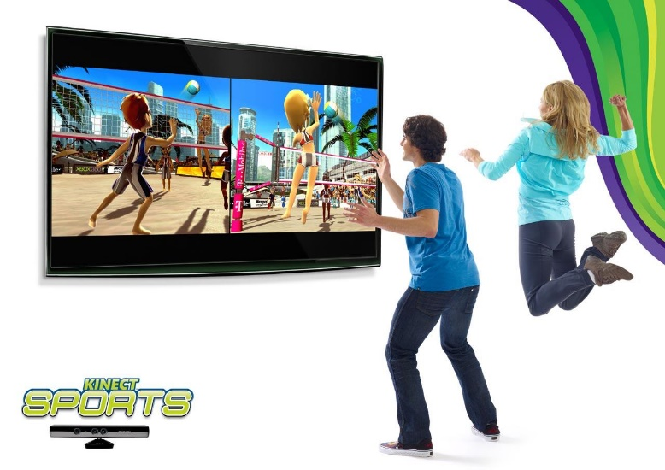
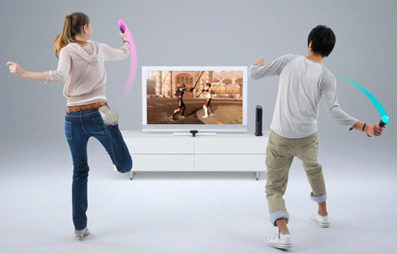


Applications of Object tracking
Motion-based Gaming
Gesture-based Remote Controller
Notes:
These days, object tracking has huge amount of applications. It can introduce gesture based interactive game, and can intuitively control the smart appliances and VR headset.

Slide 3
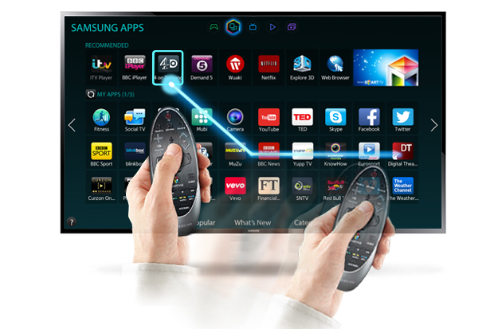
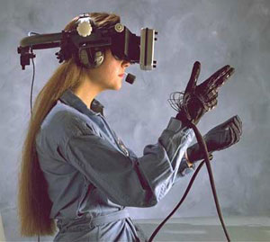
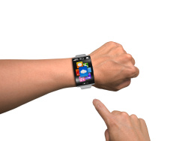
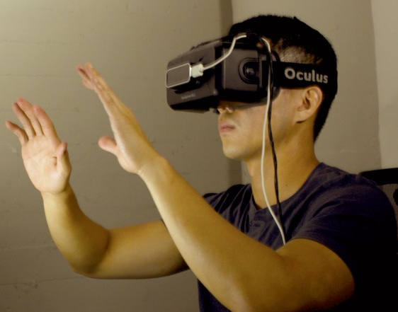
Device-Free tracking
With Device
Device-Free
Notes:
For emerging techniques such as smart watch and VR device, device free object tracking is particularly useful. For example, AR and VR users wears the headset, so tracking controller position and controlling the device based on it can uncomfortable to user, because it is difficult to grab the device. In such environment, it is more desirable if we can find the finger or hand location, and track the device based on it.

Slide 4
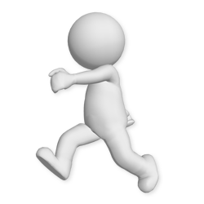

Device-Free tracking: challenge
Both transmitter and receiver are static
Should rely on the reflected signal
Notes:
Unfortunately, enabling device free tracking is very challenging. For the device tracking, we mostly rely on the directly received wireless signal. But in case of device-free tracking, we should use the signal reflected from the target object, which is weak, and overlapped with many other reflections.

Slide 5
Compared Schemes
FingerIO [1] – Compares the cross-correlation of two frames and find the position of the moving target
LLAP [2] – continuously sends sine wave, tracks the phase of the received signal, and finds the position
[1] Nandakumar Rajalakshmi, Shyam Gollakota, et al. "FingerIO: Using Active Sonar for Fine-Grained Finger Tracking." ACM CHI, 2016
[2] Wei Wang, Alex Liu, et al. "Device-Free Gesture Tracking Using Acoustic Signals." ACM MobiCom, 2016

Slide 6
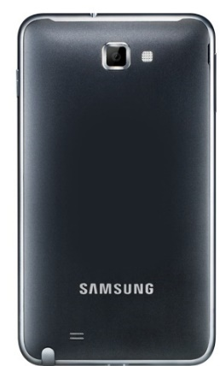


Strata: Acoustic based Fined grained tracking
Device-free passive tracking only relying on mobile device
high accuracy: 0.3cm distance tracking error; 1.0cm 2D tracking error
low latency: update the position every 12.5ms
easy to deploy: a software app installation
Notes:
In this talk, we introduce strata that enables device-free finger tracking only using the commercial smartphone. Using the speaker and microphones of the smartphone, we send and receive audio signal in inaudible frequency band, and track the movement of small object such as finger. The tracking algorithm is all implemented in software.

Slide 7
Approach
Distance change
using the phase change of the acoustic channel derived from the CIR estimation
Absolute distance
using a novel optimization framework base on the change in CIR

Slide 8
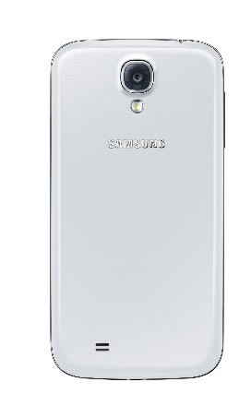
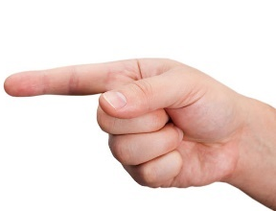

Acoustic based object tracking
Phase change proportional to the distance change $×$ wavelength (1.7 cm in 20 KHz)
Tracking phase enables very fine-grained positioning
Finger movement of 1mm changes the phase 0.2$π$!
Notes:
Basically, tracking object with acoustic signal have several advantages. One of the important advantages is that it have small wavelength, so small travel distance change causes significant phase change. For example, when we use 20 KHz band, the wavelength is 1.7 cm, so changing the distance of the object only by 1 mm causes the phase change of 0.2pi, which is large enough to detect and monitor. By observing the phase change, we can track the movement of the target in fine resolution.

Slide 9

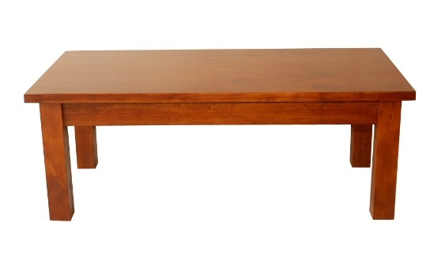
Challenges
Reflections from multiple objects
Notes:
Moreover, what makes it more difficult is when there are multiple moving objects. If multiple objects cause different phase change, it becomes really challenging to separately observe them. Considering that this tracking technique will be used for smart watch and VR devices that are exposed to the movement of the surrounding objects, this is very serious problem that we have to address in practice.

Slide 10

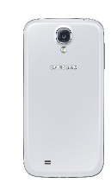






Our solution
Tracking from the channel impulse response (CIR)
Can distinguish multiple reflections in different ranges
Represented as a vector $H=\left\{h\left[0\right], h\left[1\right], …,h\left[n\right]\right\}$
$h\left[n\right]=\sum_{i=1}^{K}{a_{i}e^{−j2πf_{c}τ_{i}}sinc(n−τ_{i}W)≈}\sum_{k}{a_{k}e^{−j2πf_{c}τ_{k}}}$
Each $h[n]$ captures reflections with different delay
0.6 ms
Mag.
0.3 ms
0.3 ms
0.8 ms
0.6 ms
Time
0.8 ms
$$h[0]$$
$$h[1]$$
$$h[2]$$
$$h[3]$$
Notes:
In Strata, we address these challenges by tracking the object using the channel impulse response. CIR is characterization of all of the reflected paths between transmitter and the receiver. It is represented as the complex vector h[n], where each element includes the signal path information in different delays. Let’s say there are three different reflecting objects in the channel. Depending on the delay of them, they are represented in different elements in the channel impulse response vector. This is a general mathematical representation of the channel. It is represented as a complex number where the magnitude is determined by the strength of the reflected signal, and the phase is determined by the delay. Here I presented only 3 reflector, but in practice, there are much more reflectors, and the profile of the multiple reflectors in a single element are linearly added.
In the remainder the talk, I will explain how to get the CIR from the acoustic channel, and how to track the finger movement using it.

Slide 11
Strata architecture
Estimate CIR from audio signal
Find channel tap that includes the finger movement
Track distance change from phase change
Absolute distance estimation from CIR difference
Tracking finger position in 2D space
Notes:
Here I introduce system design of Strata. It first estimates channel impulse response from the audio signal, and find the channel taps that includes the reflected signal from finger. Then it tracks the distance change of the finger from the phase and the absolute distance from CIR difference, and finally find the position of the finger in 2D space.

Slide 12
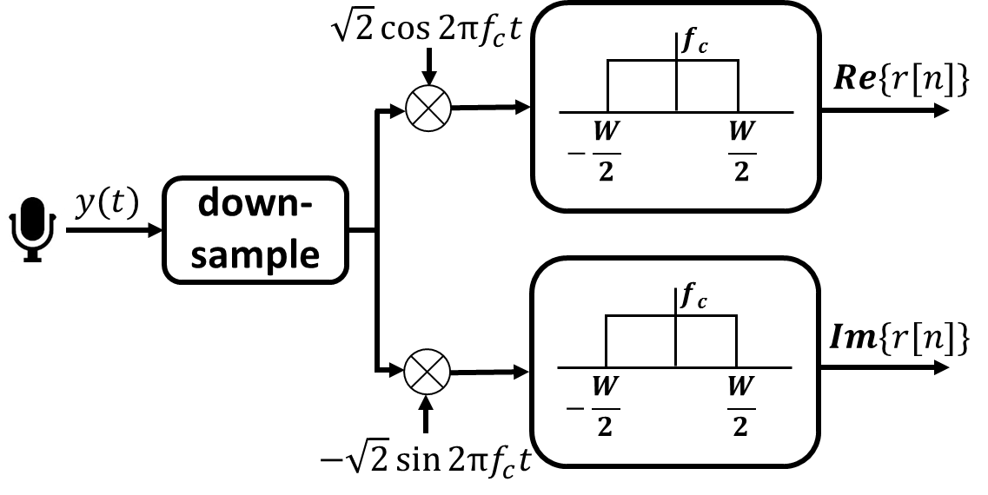
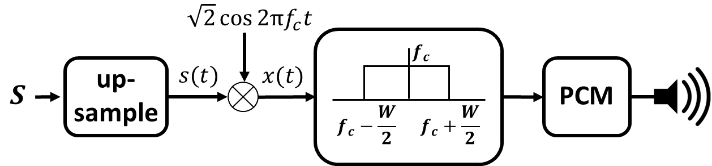
CIR estimation
Send and received data frames in inaudible band with 12.5ms interval
Estimate CIR with Least Squared channel estimation
Transmitter design
Receiver design
Notes:
To estimate the channel impulse response, we send and receive data frame in inaudible frequency band. Using the speaker, we transmit 26-bit BPSK modulated symbols every 12.5 ms. The transmitted signal is recorded as PCM format wave file so any smarphone app can easily play it. The received audio signal from the microphone is converted from passband to baseband by downcoverting and lower-pass filtering, which are all implemented in smartphone app as software. This takes around 1ms in Galaxy S4 mobile phone. Using the processed baseband symbols, we estimate the CIR with least squared channel estimation technique.

Slide 13
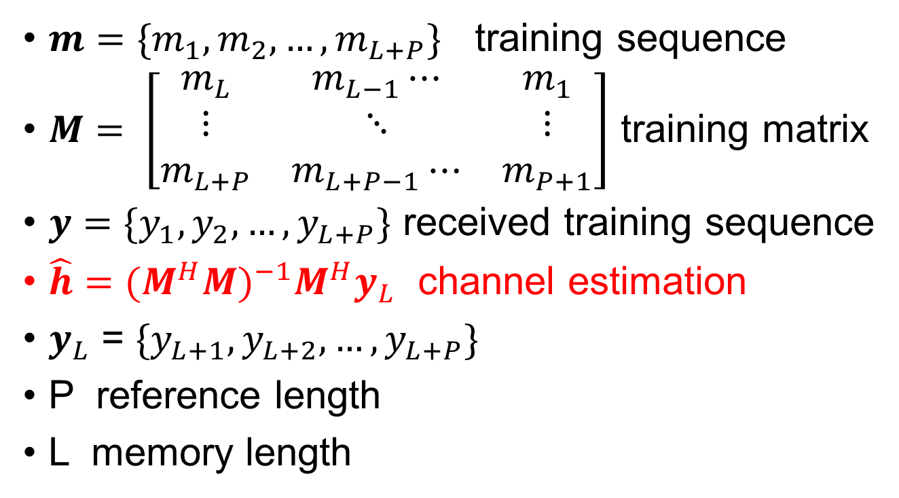
Least-Square(LS) channel estimation
$m=\{m_{1},m_{2},…,m_{L+P}\}$ training sequence
$M= \left[\begin{matrix}m_{L} & m_{L−1}⋯ & m_{1} \\ ⋮ & ⋱ & ⋮ \\ m_{L+P} & m_{L+P−1}⋯ & m_{P+1}\end{matrix}\right]$ training matrix
$y=\{y_{1},y_{2},…,y_{L+P}\}$ received training sequence
$\hat{h}={(M^{H}M)}^{−1}M^{H}y_{L}$ channel estimation
$y_{L}$ = $\{y_{L+1},y_{L+2},…,y_{L+P}\}$
P reference length
L memory length
Notes:
L determines the number of channel taps we can estimate and the reliability of estimation.

Slide 14
Tracking phase change
If we know which channel tap is affected by the moving target, how to extract the phase change caused by the target’s movement.
How to determine which channel tap is affected by the target.

Slide 15


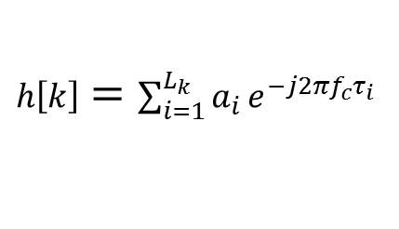

Tracking phase
$h[k]$ – the channel tap that includes finger reflected path
Superposed with the other signals with similar delays
Difficult to observe the phase change by finger movement
$h\left[k\right]=\sum_{i=1}^{L_{k}}{a_{i}}e^{−j2πf_{c}τ_{i}}$
$=\sum_{i=1}^{L_{k}−1}{a_{i}}e^{−j2πf_{c}τ_{i}}+a_{L_{k}}e^{−j2πf_{c}τ_{L_{k}}}$
Static paths
Finger path
$\text{∠}\left(h\left[k\right]\right)$ while moving a finger
Notes:
Once we estimate the channel coefficients, the first thing to do is finding the right tap that includes the finger movement, which is h[k] here. We skip the detail on how to find it but you can find it in the paper. Then given this h[k], the next question is how to track the finger movement from the phase of it. h[k] is the summation of the other reflection paths with similar delay. Because this signal from these static paths are much stronger than the finger related path, from the h[k] itself, it’s difficult to observe the phase change incurred by the movement of the finger. This is the phase change of h[k] while we are moving a finger for 10 cm. Theoretically, the phase should rotate from –pi to pi whenever the finger moves by 0.9cm. But in this observation, the phase is almost constant throughout this measurement.

Slide 16

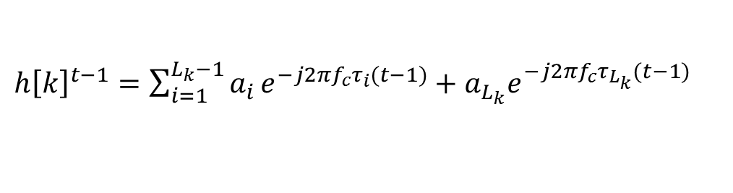
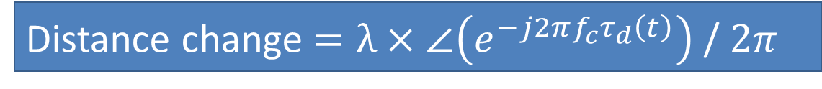
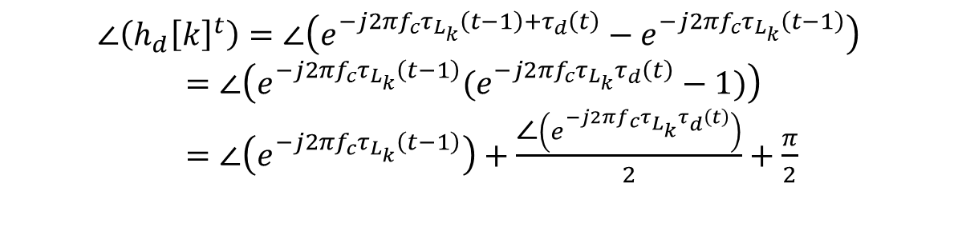
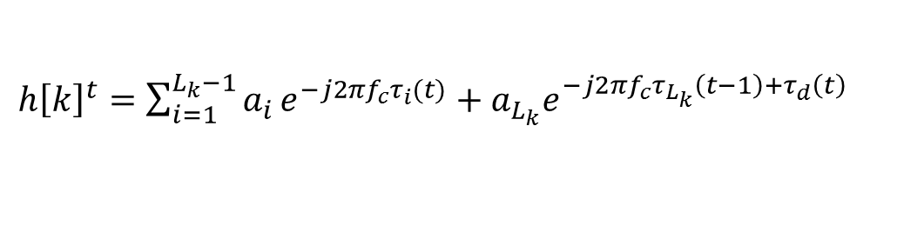

Tracking phase
Cancelling out the static reflections
Observing the phase of the finger path
${h\left[k\right]}^{t−1}=\sum_{i=1}^{L_{k}−1}{a_{i}}e^{−j2πf_{c}τ_{i}(t−1)}+a_{L_{k}}e^{−j2πf_{c}τ_{L_{k}}(t−1)}$
${h\left[k\right]}^{t}=\sum_{i=1}^{L_{k}−1}{a_{i}}e^{−j2πf_{c}τ_{i}(t)}+a_{L_{k}}e^{−j2πf_{c}τ_{L_{k}}\left(t−1\right)+τ_{d}\left(t\right)}$
$${h_{d}\left[k\right]}^{t}={h\left[k\right]}^{t}−{h\left[k\right]}^{t−1}=a_{L_{k}}(e^{−j2πf_{c}τ_{L_{k}}\left(t−1\right)+τ_{d}\left(t\right)}−e^{−j2πf_{c}τ_{L_{k}}\left(t−1\right)})$$
Phase of $\left({h\left[k\right]}^{t}\right)$
$$\text{∠}\left({h_{d}\left[k\right]}^{t}\right)=\text{∠}\left(e^{−j2πf_{c}τ_{L_{k}}\left(t−1\right)+τ_{d}\left(t\right)}−e^{−j2πf_{c}τ_{L_{k}}\left(t−1\right)}\right)$$
$=\text{∠}\left(e^{−j2πf_{c}τ_{L_{k}}\left(t−1\right)}(e^{−j2πf_{c}τ_{L_{k}}τ_{d}\left(t\right)}−1)\right)$
$=\text{∠}\left(e^{−j2πf_{c}τ_{L_{k}}\left(t−1\right)}\right)+\frac{\text{∠}\left(e^{−j2πf_{c}τ_{L_{k}}τ_{d}\left(t\right)}\right)}{2}+\frac{π}{2}$
Phase of $\left({h_{d}\left[k\right]}^{t}\right)$
Distance change $=λ×\text{∠}\left(e^{−j2πf_{c}τ_{d}\left(t\right)}\right)$ / $2π$
Notes:
To observe the phase change by the finger movement, we first need to filter out static reflections. The idea of cancelling the static reflection is observing the difference between two consecutive channel samples. Assuming that only the finger related path is changing while all other paths are static, if we subtract the current channel from the previous channel, we can remove all static paths and the remaining one is from the finger related path. If we observe the phase of it, we can eventually observe the phase rotation caused by the delay change of the finger path. We denote the difference of the channel as h_d[k], and here, I compare the phase of h[k] and h_d[k]. If you see the red line here, you can see very clear phase rotation between –pi to pi as we move the finger and the delay of the finger-reflected signal changes. From this channel difference h_d[k], we can eventually get the phase change of the finger path by solving this equation. Once we get it, we can calculate the distance change by multiplying the phase change with lambda, which is the wavelength of the audio signal.

Slide 17
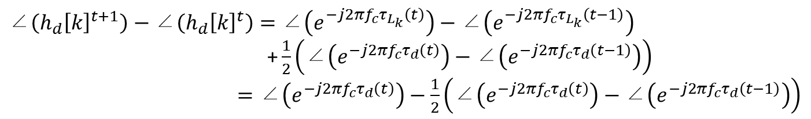

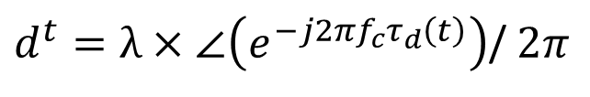
Tracking the distance change
Tracking the phase change
Tracking the distance change
$$\text{∠}\left({h_{d}\left[k\right]}^{t+1}\right)−\text{∠}\left({h_{d}\left[k\right]}^{t}\right)=\text{∠}\left(e^{−j2πf_{c}τ_{L_{k}}\left(t\right)}\right)−\text{∠}\left(e^{−j2πf_{c}τ_{L_{k}}\left(t−1\right)}\right)$$
$\text{+}\frac{1}{2}\left(\text{∠}\left(e^{−j2πf_{c}τ_{d}\left(t\right)}\right)−\text{∠}\left(e^{−j2πf_{c}τ_{d}\left(t−1\right)}\right)\right)$
$=\text{∠}\left(e^{−j2πf_{c}τ_{d}\left(t\right)}\right)−\frac{1}{2}\left(\text{∠}\left(e^{−j2πf_{c}τ_{d}\left(t\right)}\right)−\text{∠}\left(e^{−j2πf_{c}τ_{d}\left(t−1\right)}\right)\right)$
$d^{t}=λ×\text{∠}\left(e^{−j2πf_{c}τ_{d}\left(t\right)}\right)$/ $2π$
$λ$: wavelength
Notes:
From this h_d[k], we can find the phase change every phase sampling interval. From the difference of two hd[k] in different time, we can calculate the phase change. And once we find the phase change, we can also calculate the distance change by multiplying it with the wavelength.

Slide 18
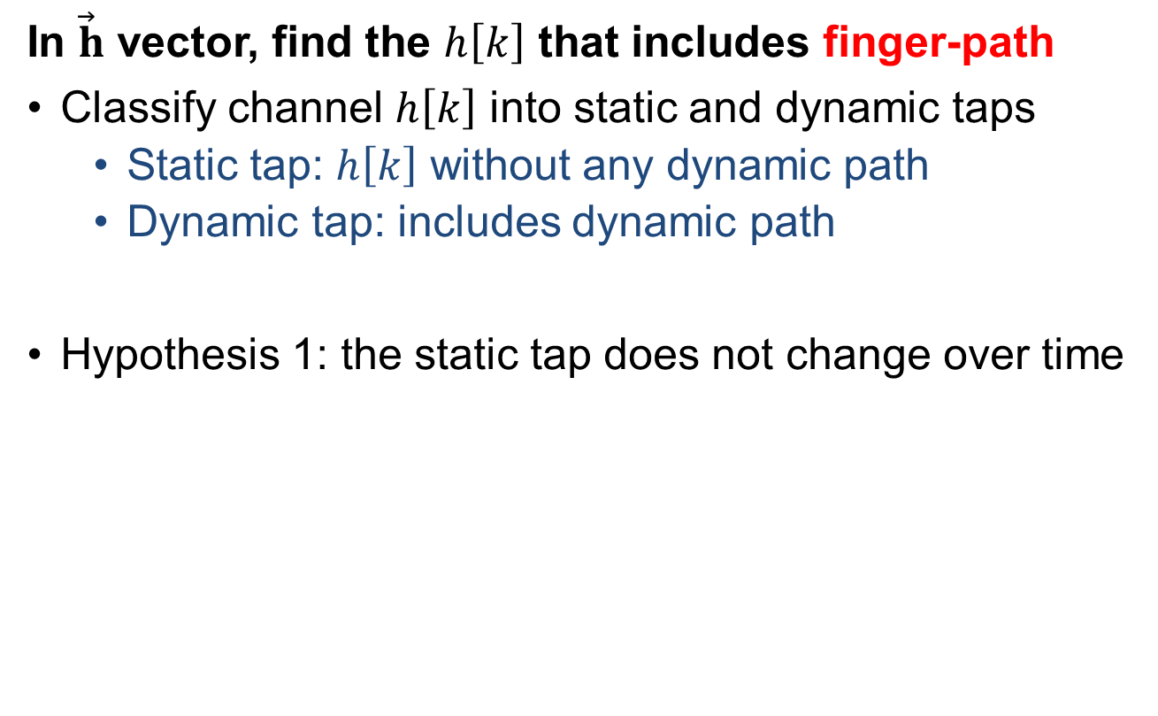
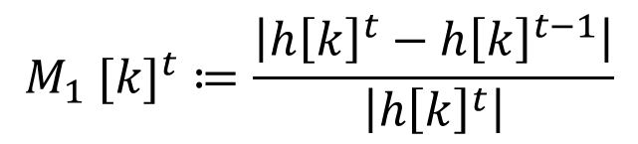
Finding the correct channel tap
In $\vec{h}$ vector, find the $h\left[k\right]$ that includes finger-path
Classify channel $h\left[k\right]$ into static and dynamic taps
Static tap: $h\left[k\right]$ without any dynamic path
Dynamic tap: includes dynamic path
Hypothesis 1: the static tap does not change over time
$${M_{1} [k]}^{t}≔\frac{\left|{h\left[k\right]}^{t}−{h\left[k\right]}^{t−1}\right|}{\left|{h\left[k\right]}^{t}\right|}$$
Notes:
So far, I have assumed that we already know which h[k] to observe to track the finger movement. But in practice, depending on the absolute distance of the finger, some channels may or may not include the path reflected by the finger, and we have to select the right channel tap that included the finger path to track the movement of the finger. Conventionally, we denote each individual h[k] in h-vector as channel tap. To find the tap that includes the finger path, we can first classify the tap into static and dynamic taps, where the reflected path of the static tap does not include dynamic path that the path distance changes over time, and dynamic tap includes at least one dynamic path. Of course the correct tap should be one of the dynamic taps. One simple hypothesis to classify the taps is that the static taps does not change over time. Therefore, if we measure the difference of the channels over two samples, we can determine whether a tap is dynamic or static. Using this metric, we detect the dynamic taps that M1 are higher than threshold. We set the threshold 0.05.

Slide 19

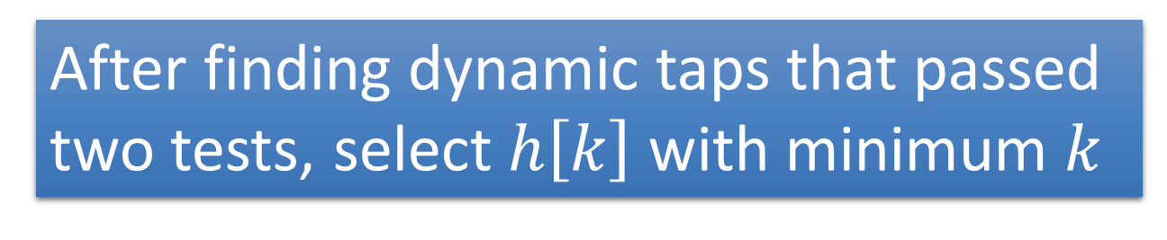
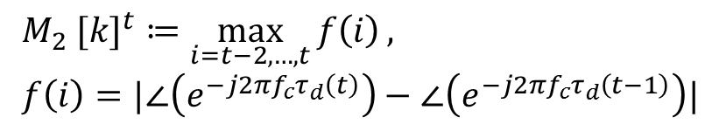
Finding the correct channel tap
In $\vec{h}$ vector, find the $h\left[k\right]$ that includes finger-path
Hypothesis 2: the phase change of ${h_{d}\left[k\right]}^{t}$ in the static tap is unstable
$${M_{2} [k]}^{t}≔\max_{i=t−2,…,t}{f\left(i\right)}, \\ f\left(i\right)=|\text{∠}\left(e^{−j2πf_{c}τ_{d}\left(t\right)}\right)−\text{∠}\left(e^{−j2πf_{c}τ_{d}\left(t−1\right)}\right)|$$
After finding dynamic taps that passed
two tests, select $h\left[k\right]$ with minimum $k$
Notes:
Using the first test, we can detect dynamic taps, but it’s unlikely it perfectly classify static and dynamic taps. Especially, when there is random noise in the estimated channel, it will misdetect a static tap as a dynamic tap. To improve the accuracy of finding the right tap, we devise a second metric to classify the dynamic tap. Here, our baseline observation is that the phase change of the static tap is pretty unstable. As I explained, we observe the phase change of the dynamic path by comparing two consecutive measurements of the channel. If there is no dynamic tap, then the difference will be purely noise, which cause random phase rotation. On the other hand, in the dynamic tap, the phase change of the dynamic tap is determined by the path length change of the dynamic path, which shows stable phase change. Here, I show an example of phase change in multiple taps while I’m moving my finger. Here, some taps that are suspected to be static, phase is randomly changing, but for the dynamic tap, phase change is stable. Therefore, I devise a metric that determines the stability of the phase change and determine the dynamic tap. After finding the dynamic taps that passes two tests, I select the tap with smallest k that is supposed to the closest to the mobile device. This is based on the assumption that the finger is the closest moving object from the mobile device when we use this technique as a gesture recognition.

Slide 20
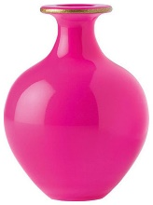
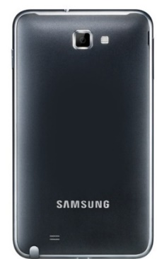

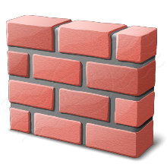


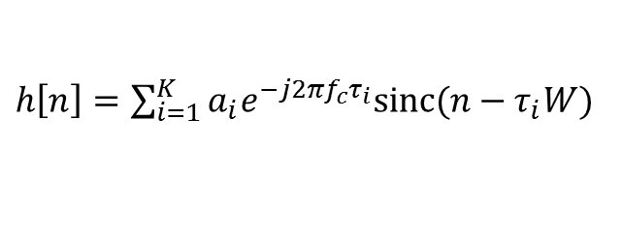
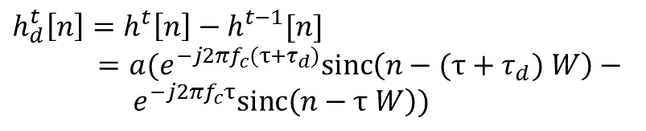

Absolute distance estimation
CIR based absolute distance estimation
2K unknowns
Bandwidth
$$α_{1}, τ_{1}$$
$h\left[n\right]=\sum_{i=1}^{K}{a_{i}e^{−j2πf_{c}τ_{i}}sinc(n−τ_{i}W)}$
$$α_{2}, τ_{2}$$
Cancelling out the static reflections
$$h_{d}^{t}\left[n\right]=h^{t}\left[n\right]−h^{t−1}[n]$$
$$=a(e^{−j2πf_{c}(τ+τ_{d})}sinc\left(n−(τ+τ_{d}) W\right)−$$ $e^{−j2πf_{c}τ}sinc\left(n−τ W\right))$
…
$$α_{K}, τ_{K}$$
2 unknowns
Known from phase tracking
Notes:
In addition to the phase based distance change tracking, I introduce another tracking idea using channel impulse response, which can provide absolute distance of the target rather than the distance change. Basically, the channel impulse response is the summation of the all of the reflected signals, where each reflection has two unknowns, one magnitude and another is delay. Let’s say the number of reflection is very small number while we have L elements in our CIR measurement. If K << L, then we would be able to we would reconstructs all reflections using sparse recovery techniques such as compressive sensing. But in the audio signal, in includes many reflections and such a technique hardly works. In Strata, we observe the difference of the two consecutive CIRs. Again, we subtract the current channel from the previous channel. By doing this, we can effectively nullify all of the other reflections except the reflected signal from the moving finger. Here, tau_delta is the change of the delay during the measurement, which can be provided by the phase tracking. As a result, these equations have only two unknowns.

Slide 21
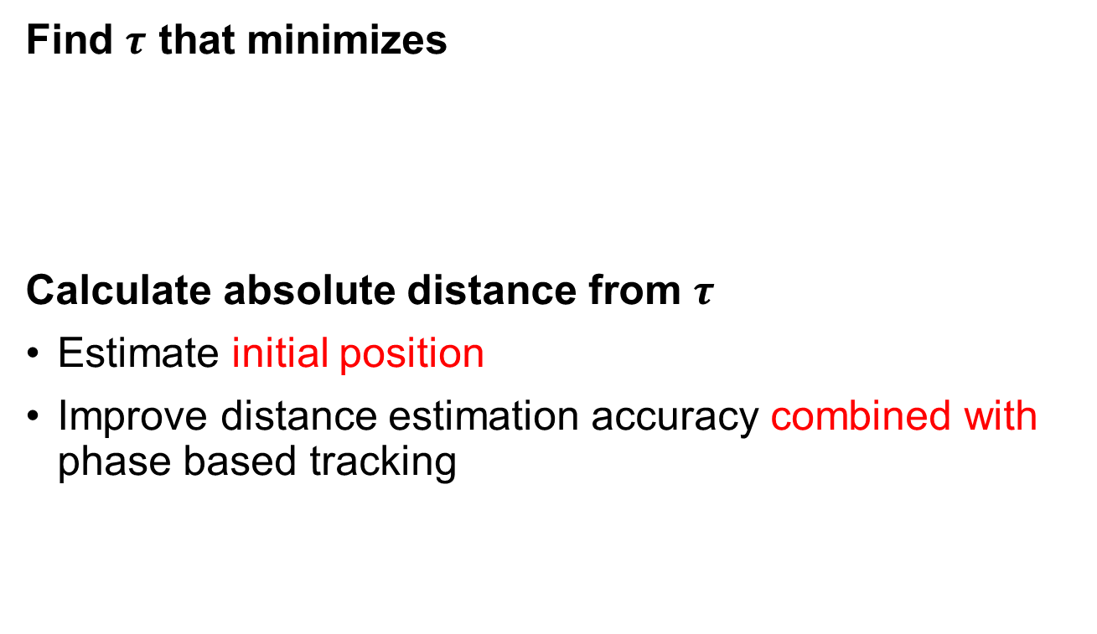
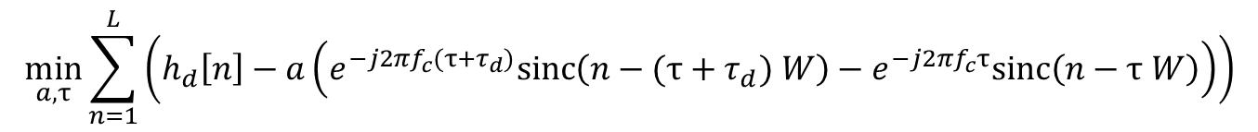
Absolute distance estimation
Find $τ$ that minimizes
Calculate absolute distance from $τ$
Estimate initial position
Improve distance estimation accuracy combined with phase based tracking
$$\min_{a, τ}{\sum_{n=1}^{L}{\left(h_{d}\left[n\right]−a\left(e^{−j2πf_{c}(τ+τ_{d})}sinc\left(n−(τ+τ_{d}) W\right)−e^{−j2πf_{c}τ}sinc\left(n−τ W\right)\right)\right)}}$$
Notes:
Given this CIR difference h_d, we estimate the delay tau from the channel difference h_d by solving such an optimization problem. Since the number of constraints is only while we have L known values, this is much more feasible problem to solve. From the estimated tau, we can find the absolute distance of the moving finger. It can be useful to find the initial position when we first start the finger tracking, because phase based finger tracking only works when we know the previous position of the finger. Also, it can be used to improve the tracking accuracy combined with the phase based finger tracking. How to combine these two information is explained in detail in the paper.

Slide 22
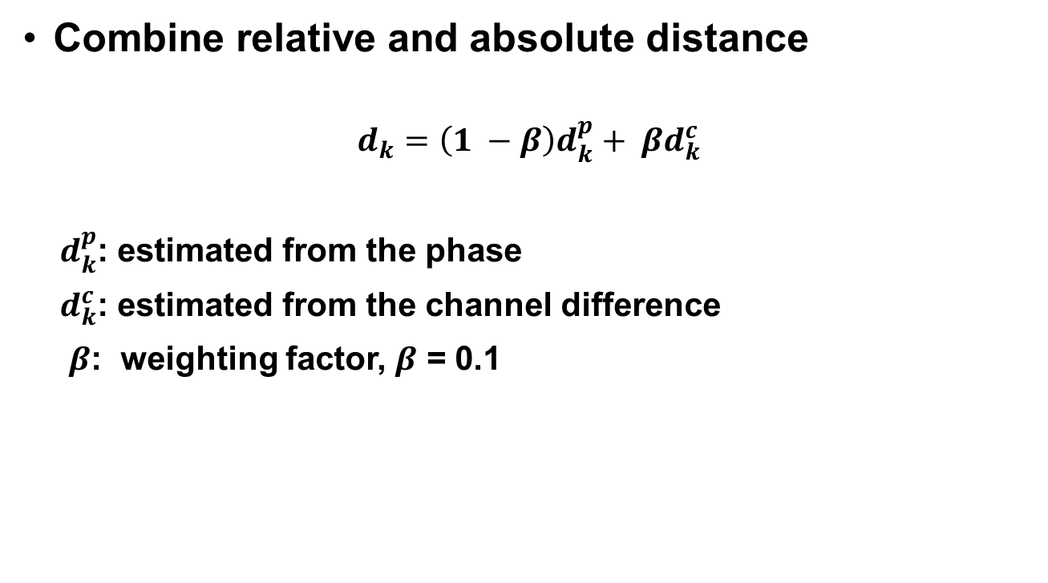
Tracking the position
Combine relative and absolute distance
$$d_{k}=\left(1 −β\right)d_{k}^{p}+ βd_{k}^{c}$$
$d_{k}^{p}$: estimated from the phase
$d_{k}^{c}$: estimated from the channel difference
$β$: weighting factor, $β$ = 0.1
Notes:
Given the travel distance of the signal from the speaker to the two microphones, we can eventually find the location of the finger and track it. Here, we find the position by solving the minimization problem that minimizes the difference between the current position and the travel distance from the speaker to the microphones.

Slide 23
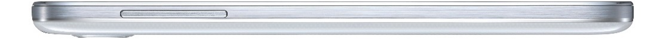






Tracking the position
Estimate coordinate
$$\left(x_{1},y_{1}\right)$$
$$\left(0,0\right)$$
$$\left(x_{2},y_{2}\right)$$
SPEAKER
MIC 1
MIC 2
$$d_{1}$$
$$d_{2}$$
Notes:
Given the travel distance of the signal from the speaker to the two microphones, we can eventually find the location of the finger and track it. Here, we find the position by solving the minimization problem that minimizes the difference between the current position and the travel distance from the speaker to the microphones.

Slide 24
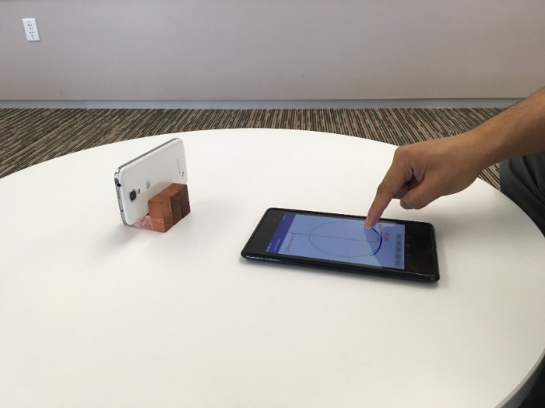
Experimental Setup
Galaxy S4 as testbed device
Collect the ground-truth finger movement with tablet
Evaluate the trajectory error while users are drawing simple shapes
Compared with FingerIO and LLAP
Notes:
Now I will show the performance evaluation result. Basically, setting up the testbed is pretty simple because it only requires a mobile phone without any extra hardware. But to collect the ground-truth, we use a tablet in addition. While the mobile phone is tracking the location of the finger, ground-truth finger trajectory is collected by tracking the finger position on the screen of the tablet. We basically evaluate the 2D trajectory error while users are drawing simple shapes such as circle, diamond and triangle. We compare the accuracy of Strata with FingerIO and LLAP, which is the other acoustic device-free tracking schemes presented in CHI and MobiCom last year.

Slide 25
1D distance tracking error
Distance tracking error while moving the finger 10 cm
0.3
0.8
1.97
3.24
0.89
1.5
Achieves mm-level 1D tracking accuracy
Notes:
I first show the tracking accuracy in 1D space. Here, the user is 20 cm away from the mobile device, moves the finger 10cm towards the mobile device, and we measure the distance estimation error. In terms of median error, Strata achieves 3 mm, which is lower than half of LLAP. Likewise, the 90th percentile error of Strata is less than half of LLAP and FingerIO.

Slide 26
1D distance tracking error with interference
Distance error while nearby person is moving
0.45
1.12
1.5
Robust to movement of surrounding objects
Notes:
Here, we repeated the same experiment while there is another moving person nearby the user. In this experiment, we let one person in 50 cm distant from the mobile phone moves his body. In this result, Strata is not significantly affected with 1mm increased error, because it can effectively nullify the interference of the surrounding object by CIR based tracking. On the other hand, LLAP does not have particular solution on the multi-path reflection, so its error grows much larger than Strata. This result shows that Strata is robust to the movement of the surrounding objects.

Slide 27
2D Trajectory Error
Trajectory error while user is drawing simple shapes
1.09
1.9
3.2
4.2
2.05
3.4
Achieves 1-cm error in 2D tracking accuracy
Notes:
This is the tracking error experiment in 2D space. Here, we asked the user to follow some simple shapes on the tablet screen such as circle, triangle and diamonds, and measured the trajectory error in 2D space. With strata, we can achieve the tracking error of 1 cm, while the compared schemes have much higher errors.

Slide 28
Drawing samples
USER 1
USER 2

Slide 29
Conclusion
Strata - an audio based device-free object tracking
Based on COTS devices and software processing
Achieve 2D finger tracking with median tracking error of 1 cm
Notes:
In this talk, In introduced Strata, an audio based device-free object tracking mechanism. It uses commercial mobile phone without any extra hardware, and all tracking algorithms are implemented in software. In 2D space, Strata can track the finger movement with the median error of 1 cm.

Slide 30
Conclusion
Principal strengths
It employs the channel impulse response (CIR) to handle multipath.
It estimates the distance change and absolute distance to locate the finger.
Principal weaknesses
unclear whether the target path finding algorithm is robust against multi-path caused by the arm and hand
The small working range of the system is an issue for real-life applications.

Slide 31

Thank you!

