Slide 1
Battery-Free Cellphone
Vamsi Talla, Bryce Kellogg, Shyam Gollakota, Joshua Smith
IMWUT 2017

Slide 2
Motivation
Put the backscatter techniques into practical application
Batteries add weight, bulk, cost and require recharging and replacement.
  Is it possible to eliminate battery from cellphone?
But How？
Power by harvesting μW-level
Reduce power consumption lower than harvested energy

Slide 3
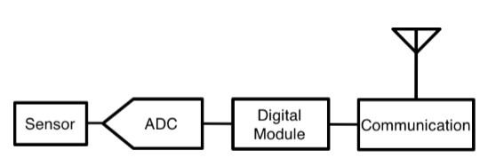
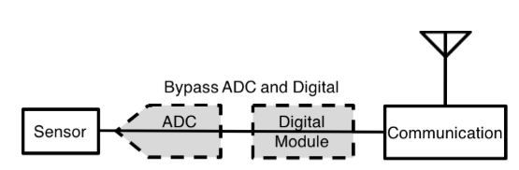
Background
Basic operations of a cellphone
Structure of current digital system
1. Sense speech at device
2. Transmit it to base station
3. Receive speech from base station
4. Actuate the speaker/earphones
Sensor->ADC->Digital computing->Communication
μW-level
mW-level
μW-level， using backscatter

Slide 4
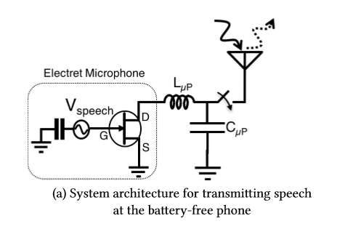
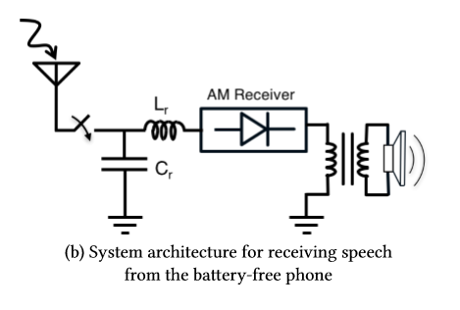
Design Overview
Base Station
Transmitter
Receiver
Dedicated designed, cover all the power-hungry components and operations
Uses Skype API to communicate with cellular networks
Use analog backscatter directly transmit speech from phone to base station
Passive Wi-Fi NSDI 2016
Base station uses AM to modulate data, phone uses envelope detector based receiver to decode digital bits
Ambient Backscatter SIGCOMM 2013

Slide 5


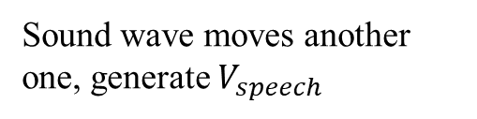
Transmitter
Sound wave moves another one, generate $V_{speech}$
Two electret material mental plate, one fixed
The impedance seen by the antenna is
Change the reflection coefficient
JFET, changing $V_{speech}$ will change the impedance

Slide 6
Receiver
Envelope Detector

Slide 7
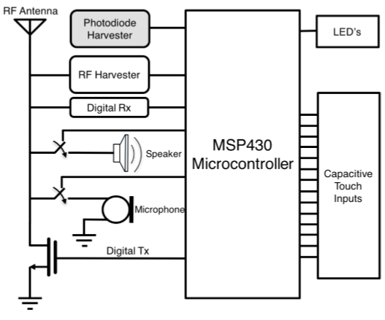
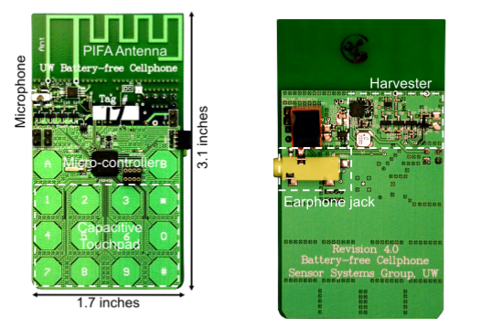
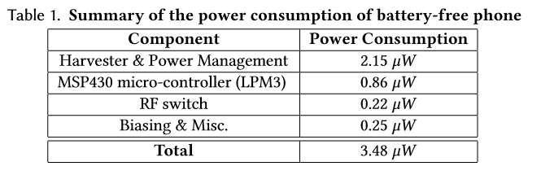
Implementation
Architecture
Notes:
能耗更多是用在了用户界面 包括键盘和LED 几十uW

Slide 8

Example

Slide 9
Evaluation
Energy harvesting capabilities
  while transmitting/receiving speech
Quantify the quality of speech
  Transmitted and received at the battery-free phone

Slide 10
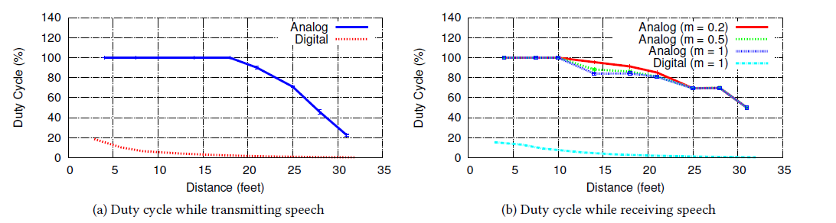
Energy Harvesting
Amplitude Modulation Index
RF Harvesting
Antenna simultaneously used for both RF energy harvesting and other functionalities
Whenever the phone has sufficient energy on the storage capacitor, it connects the backscatter microphone to the antenna and transmits speech back to the basestation
Whenever the voltage on the storage capacitor drops below the threshold, the phone disconnects the backscatter microphone from the antenna and goes into sleep mode to efficiently harves RF power
Notes:
即使天线有负载，即microphone正在被使用的时候，虽然没有达到最佳匹配效果，harvester依然是能够获得能量的，当距离小于18feet时，可以满足持续通信

Slide 11
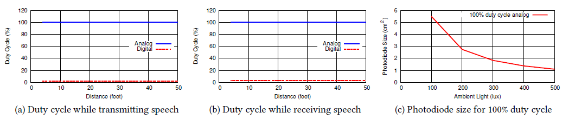
Energy Harvesting
Photodiode Harvesting
Photodiode harvesting can be decoupled from communication
Can operate continuously as long as there is enough ambient light(500 lux)
Analog design consumes way less than digital design
4. 100 lux require 5.5 cm^2 to guarantee 100% duty cycle

Slide 12
Quality of Speech
How to evaluate?
  For transmitter
  For receiver
Speaker transmits 1.75 kHz single tone signal at 80 decibels (equivalent to human). Base station measures the signal strength of this signal tone speech to indicate SNR
Speaker transmit a two second speech at 80 decibels and measure the PESQ of the received speech at the base station
Same metrics as above
Notes:
感知语音质量评价 1 sufficient 5 highest quality

Slide 13
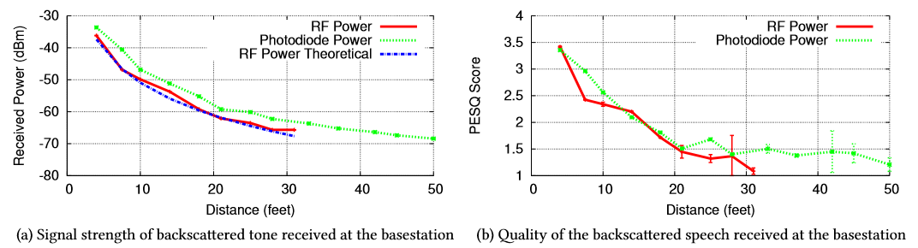
Quality of Speech
Speech transmission

Slide 14
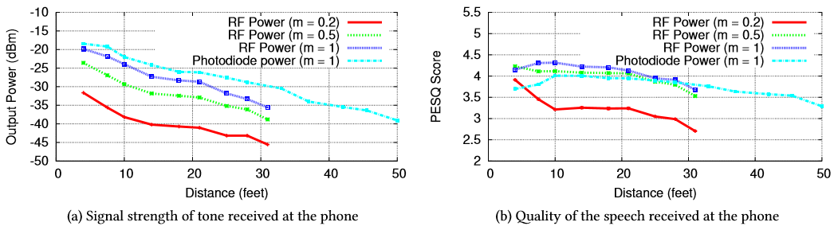
Quality of Speech
Speech transmission

Slide 15
Limitations
Limited range
  Build the protocol circuit into a Wi-Fi router or phone tower
Support for multiple devices
  TDM, FDM
Other functionalities
  Cannot hold touchscreen, awkward voice, switch between listening and talking…
  E-ink display for text message, maybe a RF-powered camera
  Raise power consumption, is it achievable?
Notes:
1 km

