Slide 1


Planning Bike Paths based on
Sharing-Bikes’ Trajectories
Jie Bao, Tianfu He, Sijie Ruan, Yanhua Li, Yingcai Wu, Yu Zheng

Slide 2
Outline
Introduction
Methodology
  Pre-processing
  Greedy Network Expansion
Experiments
  Effectiveness and Case Studies
  System Deployment
Conclusion

Slide 3
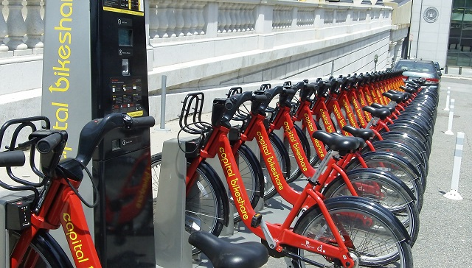

Introduction
Cycling – Green transportation mode
Benefits
Constraints:
  Budget Limitation
  Construction Convenience
  Bike Path Utilization
Notes:
好处：1. 环保 2. 缓解路面交通压力 3. 有益于身体健康

Slide 4
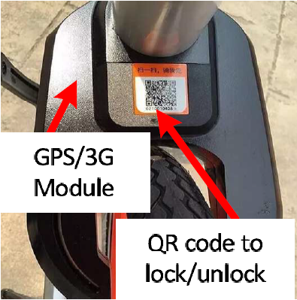
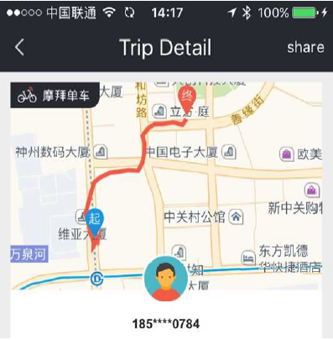
Motivation
Introduction
Earlier data mining methods drawbacks
Incorporate real world constraints using Mobike user trajectories
Benefits of Mobike trajectories data:
  Realistic Travel Demands
  Rich Travel Information
Notes:
原来的工作主要考虑了第三个因素，没有考虑前两个显示得因素

Slide 5


Problem Definition
Introduction
Road network graph G = (V , E)
  V -> Intersections and E -> Road segments
  Goal: To discover a subset of edges E′ ⊆ E, that follows three criterion:
    construction budget constraint
    connectivity constraint
    maximal usage benefit

Slide 6
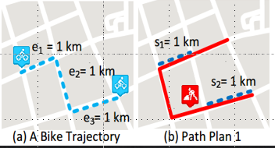
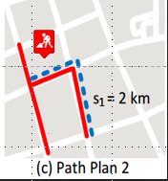
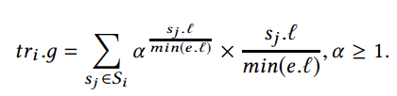
Maximal Usage Benefits
Introduction
Goal: Maximize usage of deployed bike paths which includes:
  Facilitate as many users as possible
  Cover more continuous route segments
Example:
  Bike travels e1 → e2 → e3
  2 planned paths cover same distance
  Plan 2 is preferred due to longer continuous path
  Serving more users vs longer continuous trips conflicts
  Flexible Score function
Set of Continuous Road Segments
Beneficial Score
Normalize Si
Tuning Parameter
Notes:
收益的定义是一个凸函数，凸函数他的最大值就是在他的边缘，就是只有一条s_j

Slide 7
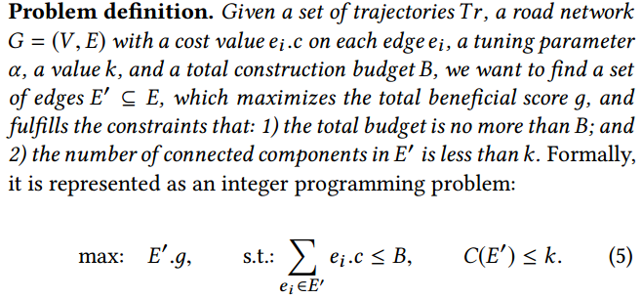
Problem Statement

Slide 8
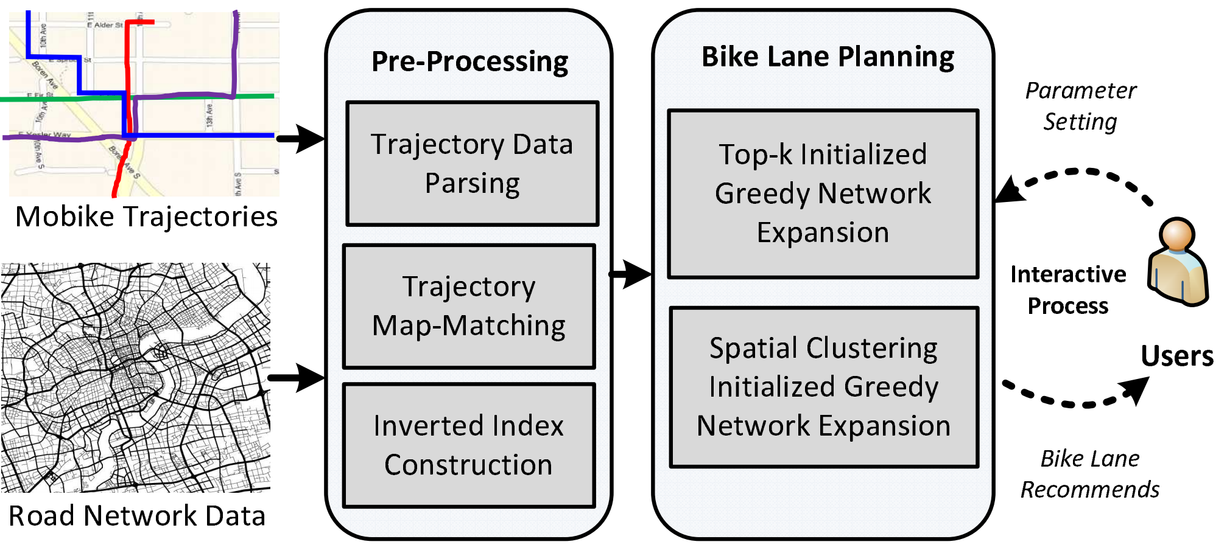
System Overview
Introduction
Explain an overview of the system

Slide 9
Methodology

Slide 10
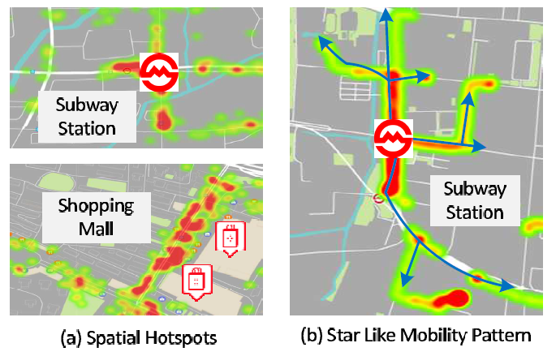
Idea
Methodology
Two interesting spatial patterns from visualization
  Spatial hotspots
  Star like trajectories
Idea of a greedy algorithm
  Start from hotspots
  Expand out
  Until reach the budget
Questions
  What road segments do we START from?
  What road segments do we EXPAND to?

Slide 11

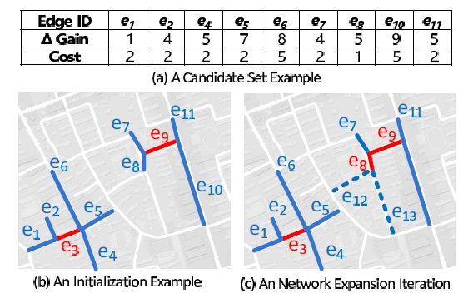
Greedy Network Expansion
Methodology
Maintain a list of candidate segments
  Start from the initial segments
  Add their neighbor segments to the list
  Pick one with the highest beneficial score per cost
  Add its neighbor segments, and update budget
  Repeat pick… until reach budget

Slide 12
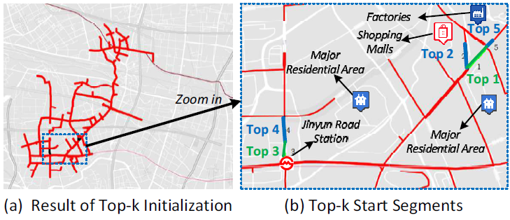
Where do we START?
Methodology
Top-K Initialization
  Pick K segments with the highest beneficial score per cost
Analysis
  High rank segments tend to be close to each other
  End up covering less areas (especially when budget B is large)

Slide 13
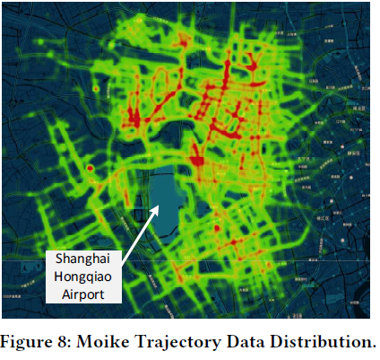
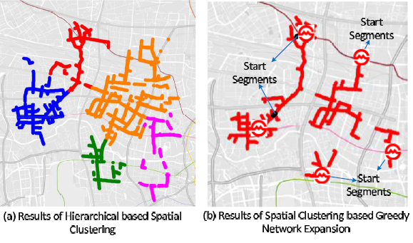
Where do we START? (cont.)
Methodology
Spatial Clustering Initialization
  Pick K clusters from the highest ranked segments
Analysis
  Covers more areas when budget is large
  May not expand important areas enough when budget is small

Slide 14
Experiments

Slide 15
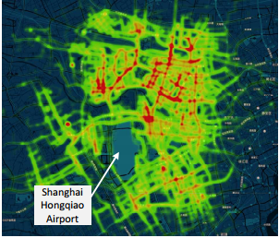
Dataset Statistics
Experiments
Road Network:
  Shanghai (Source- Bing Map)
  Intersections: 333,766
  Road Segments: 440,922
  Mobike Dataset:
    One month dataset (September 2016)
    13,063 unique users
    3791 Bikes
    230,303 trajectories

Slide 16
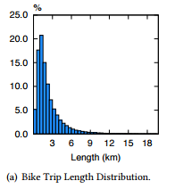
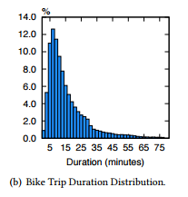
Dataset Statistic
Bike Trip Length Distribution
Bike Trip Duration Distribution

Slide 17
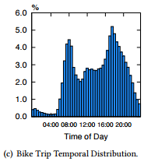
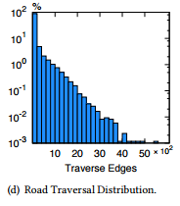
Dataset Statistics
Bike Trip Temporal Distribution
Traversed Edges

Slide 18
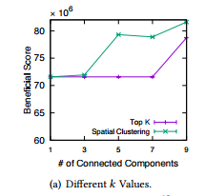
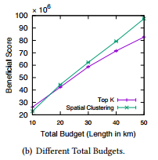
Effectiveness Study
Experiments
Different k-values
Different Total Budgets

Slide 19
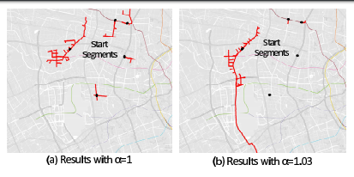
Effectiveness Study

Slide 20
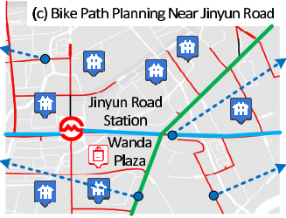
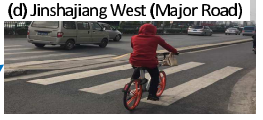
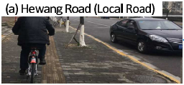
Case Study
Experiments

Slide 21
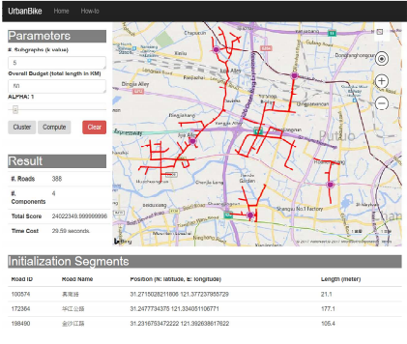
System Deployment
Experiments

Slide 22
Conclusion
Conclusion
Data Driven approach to plan bike paths
A realistic problem with a new trend in sharing economy
The solution is simple and not robust.

