Slide 1
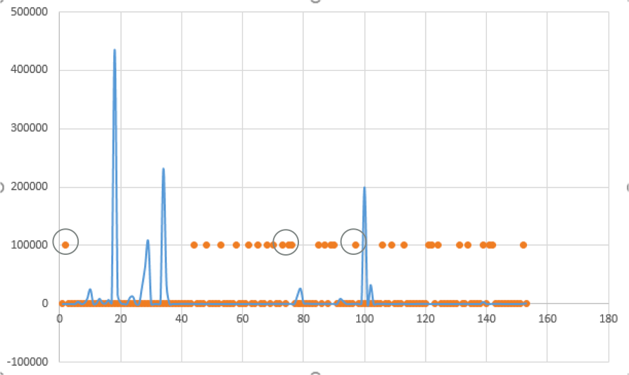
Interruptibility --- Engagement
Notes:
上学期末讲过一篇CHI17的文章“Interruptibility的文章，How Busy are you? Predicting the interruptibility Intensity of Mobile Users.不知道大家还记不记得。Interruptibility直接翻译过来是“可中断性”用来描述用能够容忍被打扰的程度。从我了解来看，这类文章的出发点通常是为了让用户获得更好的使用体验，避免被不合时宜的消息打扰。旨在确保用户不被打扰。
但是从另一个角度来想，在在线产品和服务越来越多的今天，用户关注的资源有限的情况下，如何吸引用户的关注其实是服务提供者，应用开发者们更加关注的问题。旨在吸引用户注意。

Slide 2

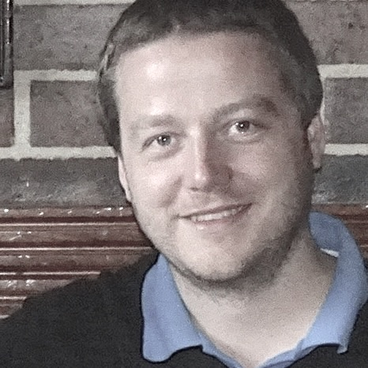

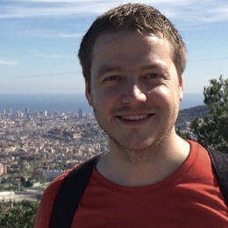
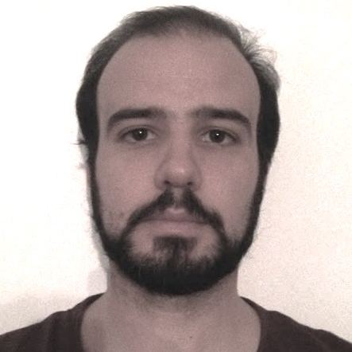
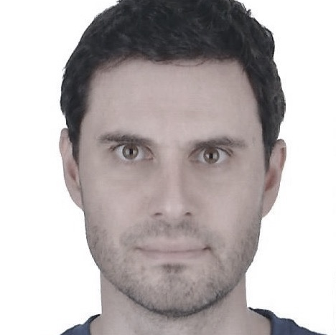
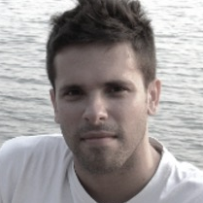

Beyond Interruptibility: Predicting Opportune Moments to Engage Mobile Phone Users
Martin
Pielot
Telefonica
Research
Bruno
Cardoso
Universidade Nova de Lisboa
Kleomenis
Katevas
Queen Mary University of London
Joan
Serra
Telefonica
Research
Aleksandar
Matic
Telefonica
Alpha
Nuria
Oliver
Vodafone &
DataPop Alliance
S11: Cognitive Load & Interruptions - UbiComp ‘17, Maui, Hawaii

Slide 3
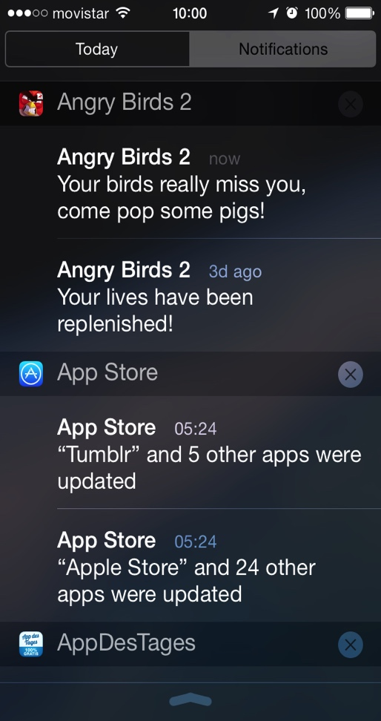
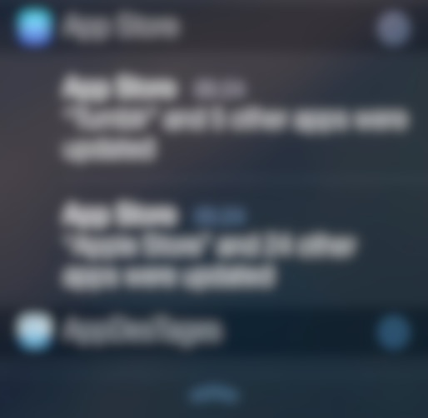
User Engagement via Push Notifications

Slide 4
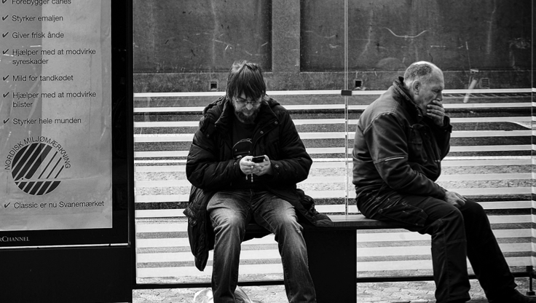



When to engage with a person is crucial

Slide 5
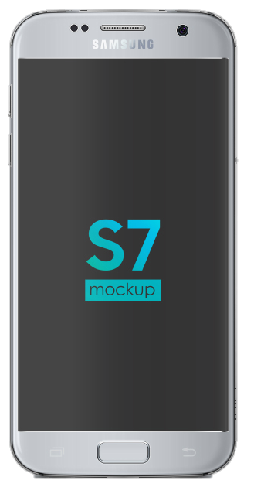
Opportune Moment Prediction
`
INFO ABOUT USER
INTELLIGENCE
MOBILE PHONE
Device Activity
Contextual Info
Phone State
Personality
Data Stream
Feature extraction
Prediction (AI Model)
Posting Notifs
Notification
Affect
1
2
3
Sender
Notif. Content
(…)

Slide 6
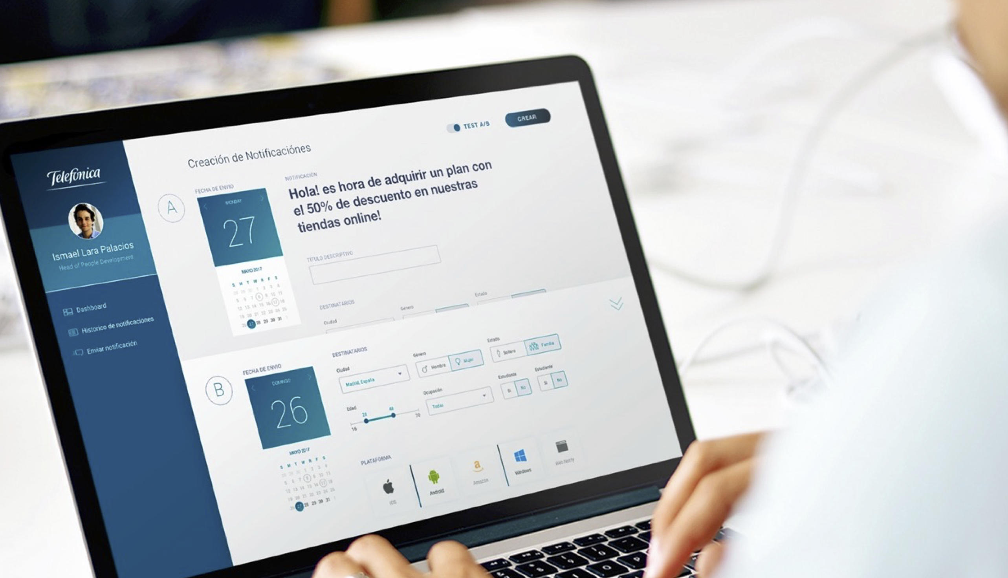
SMART NOTIFICATION STUDY Inform development of an intelligent system to detect opportune moments to engage mobile phone users
Notes:
为了应对这一挑战，作者致力于开发智能移动系统，自动推出用户可以使用建议内容的时间。为此作者进行了为期四周的用户调查。

Slide 7
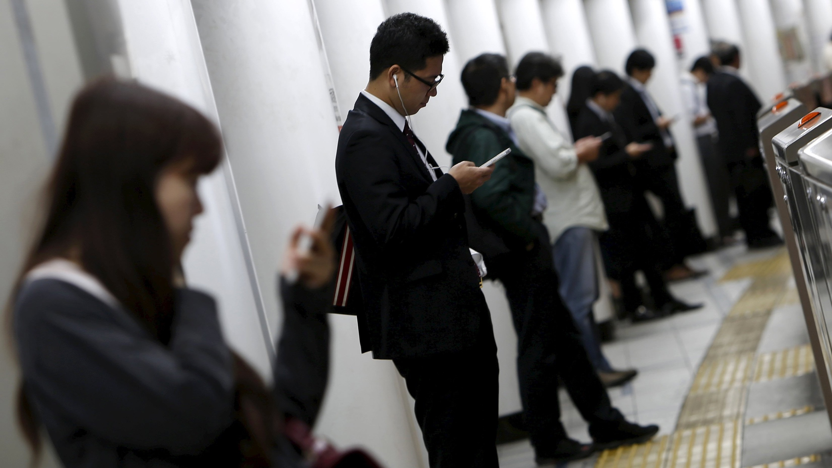
Engagement ≉ Interruptibility
Read a text message?
Sign-up for a new service?
Turner et al. (2017) Reachable but not receptive
Notes:
“可达但是不可接受”

Slide 8
Data Collection
337 people installed study app
Age 18 – 66 (M = 37.85, SD = 11.01) years
178 female, 159 male
Summer 2016
M =27.43 (Mdn = 27, SD = 11.49) of participation

Slide 9
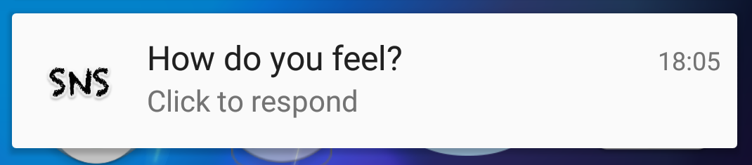
Data Collection
337 people installed study app
Age 18 – 66 (M = 37.85, SD = 11.01) years
178 female, 159 male
Summer 2016
M =27.43 (Mdn = 27, SD = 11.49) of participation

Slide 10
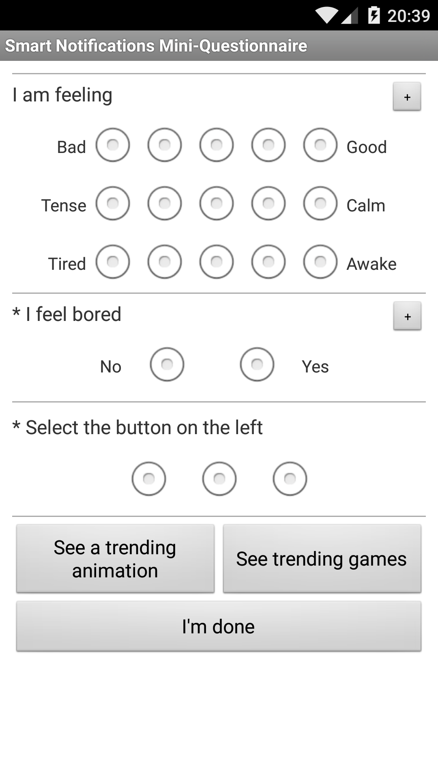
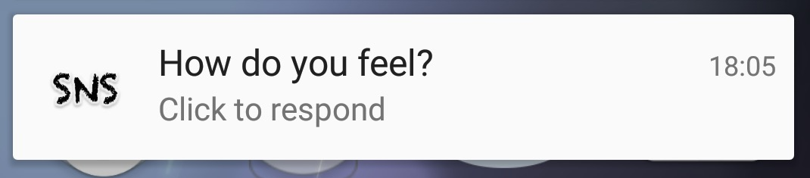
Decoupling Content via Intermediate
Informed Consent: “Content for your enjoyment, optional”

Slide 11
Buttons populated randomly out of 8 different content types
Participants had little info about the content they were about to consume
strong indicator for opportune moment for suggesting content
Notes:
Main difference to previous work

Slide 12
MAIN RESULTS

Slide 13
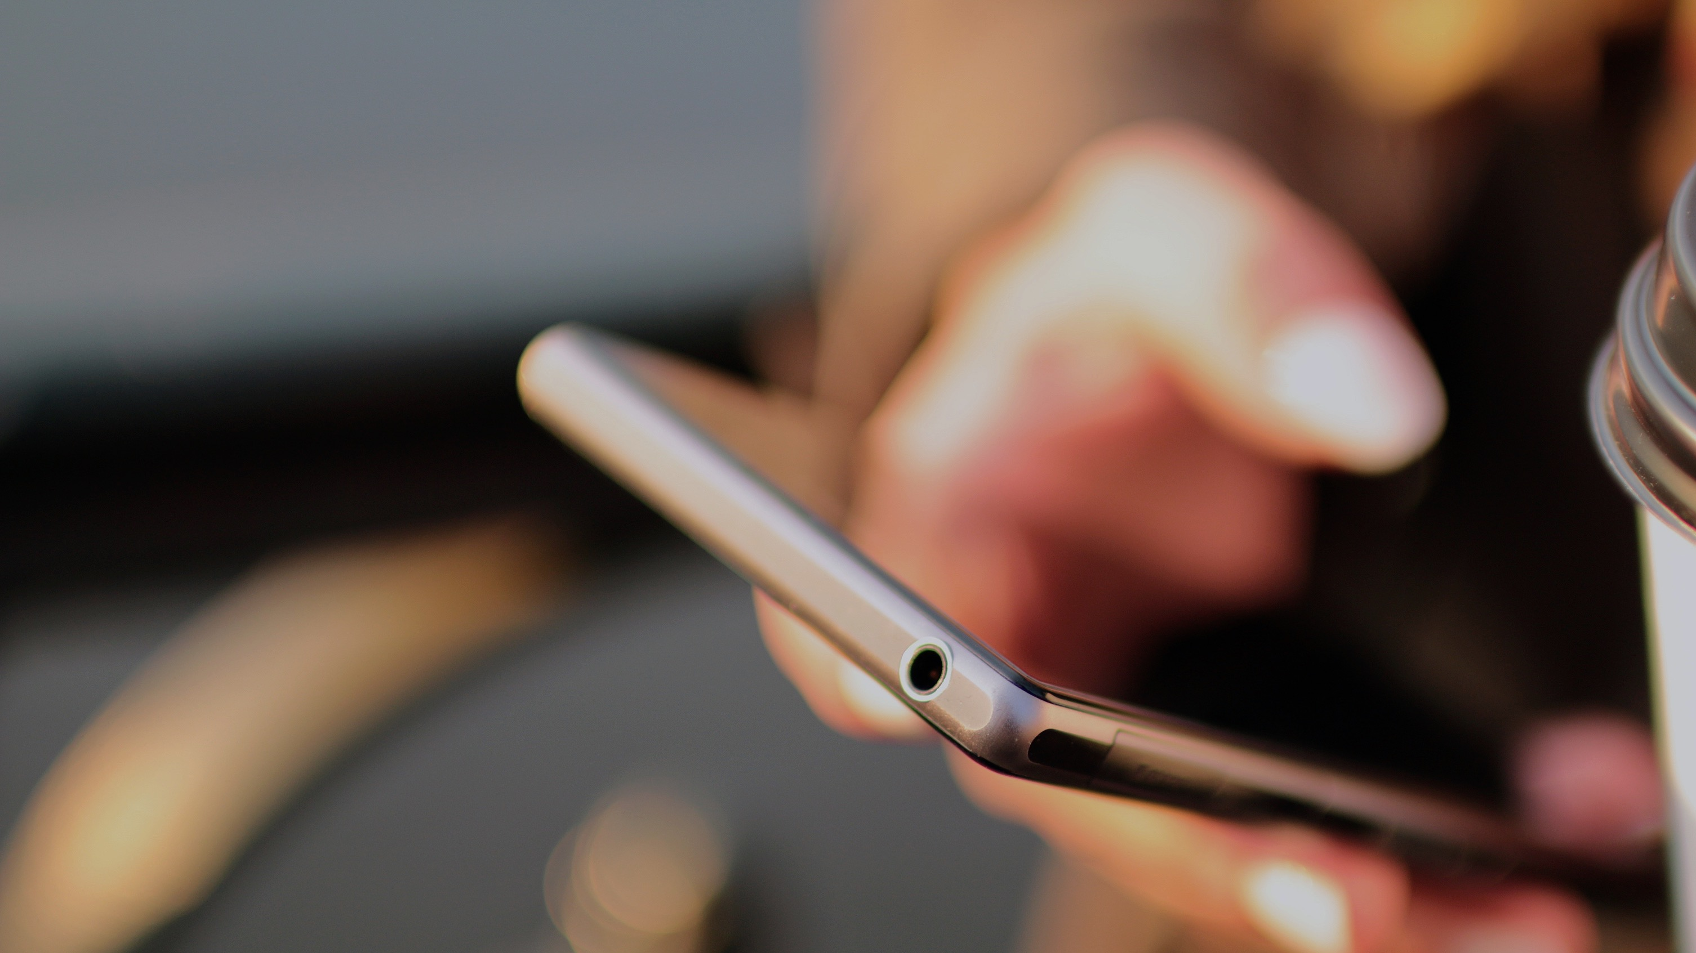
Engagement : Open Suggested Content
78,930 notifications
3,367 times (4.3%) engaged with suggested content
Built model to predict – at moment of posting notification -- whether user would engage, on the basis of 197 features derived from device usage
Notes:
* Size of the experiment very important, because positive examples occurred rarely

Slide 14
Selected Prior Work
Silence Ringer during Inopportune Moments
Horvitz (2005) BayesPhone -- Pre-computed call-handling policies
Rosenthal & Dey et al. (2011) Personalized Mobile Phone Interruption Models
Time EMA / Health-Intervention Notifications
Poppinga et al. (2014) Opportune Moments for Experience (Mood) Sampling
Pejovic et al. (2014) Intelligent Prompting Mechanism
Sarker et al. (2014) Availability of Users to Engage in Just-in-Time Intervention
Predict whether notifications / messages will be handled within time limit
Pielot et al. (2014) Predicting Attentiveness to Mobile Instant Messages
Mehrotra et al. (2015) Content-driven intelligence
Mehrotra et al. (2016) Sender-receiver relationship
Time Push Notifications
Pielot et al. (2015) Detecting Boredom as Trigger for Proactive Recommendations
Kushlev et al. (2017) Effect of Affect on Openness to Suggested Content
Okoshi et al. (2017) Delivering notifications at breakpoints – in-the-wild test with Yahoo!
Notes:
那些feature有可能会影响engagement呢。刚才说到研究Interruptibility的文章并不少，作者列举了这些并从中获取经验。

Slide 15
197 Features – Derived from Phone Use Logs
Category | # | Example Features
Communication Activity | 37 | # of SMS received during past hour Time since last incoming phone call Category of app that posted last notification
Context | 73 | Time of the day Recent levels of motion activity Average ambient noise levels during last hour
Demographics | 2 | Age Gender
Phone Status | 13 | Current ringer mode Connected to charger? Screen status (on, off, unlocked)
Usage Patterns | 72 | Average data usage during day so far Battery level drain during recent hour # of device unlocks during last 5 minutes

Slide 16
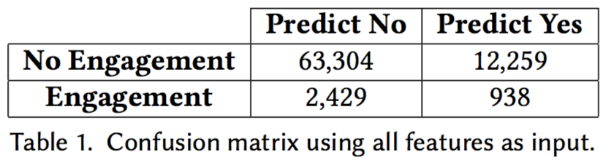
Model Choice & Evaluation Procedure
XGBoost: state-of-the-art gradient boosting regression tree algorithm
Evaluation: 10-fold cross-validation schema (data from user always in same fold = do not learn to recognize users)

Slide 17
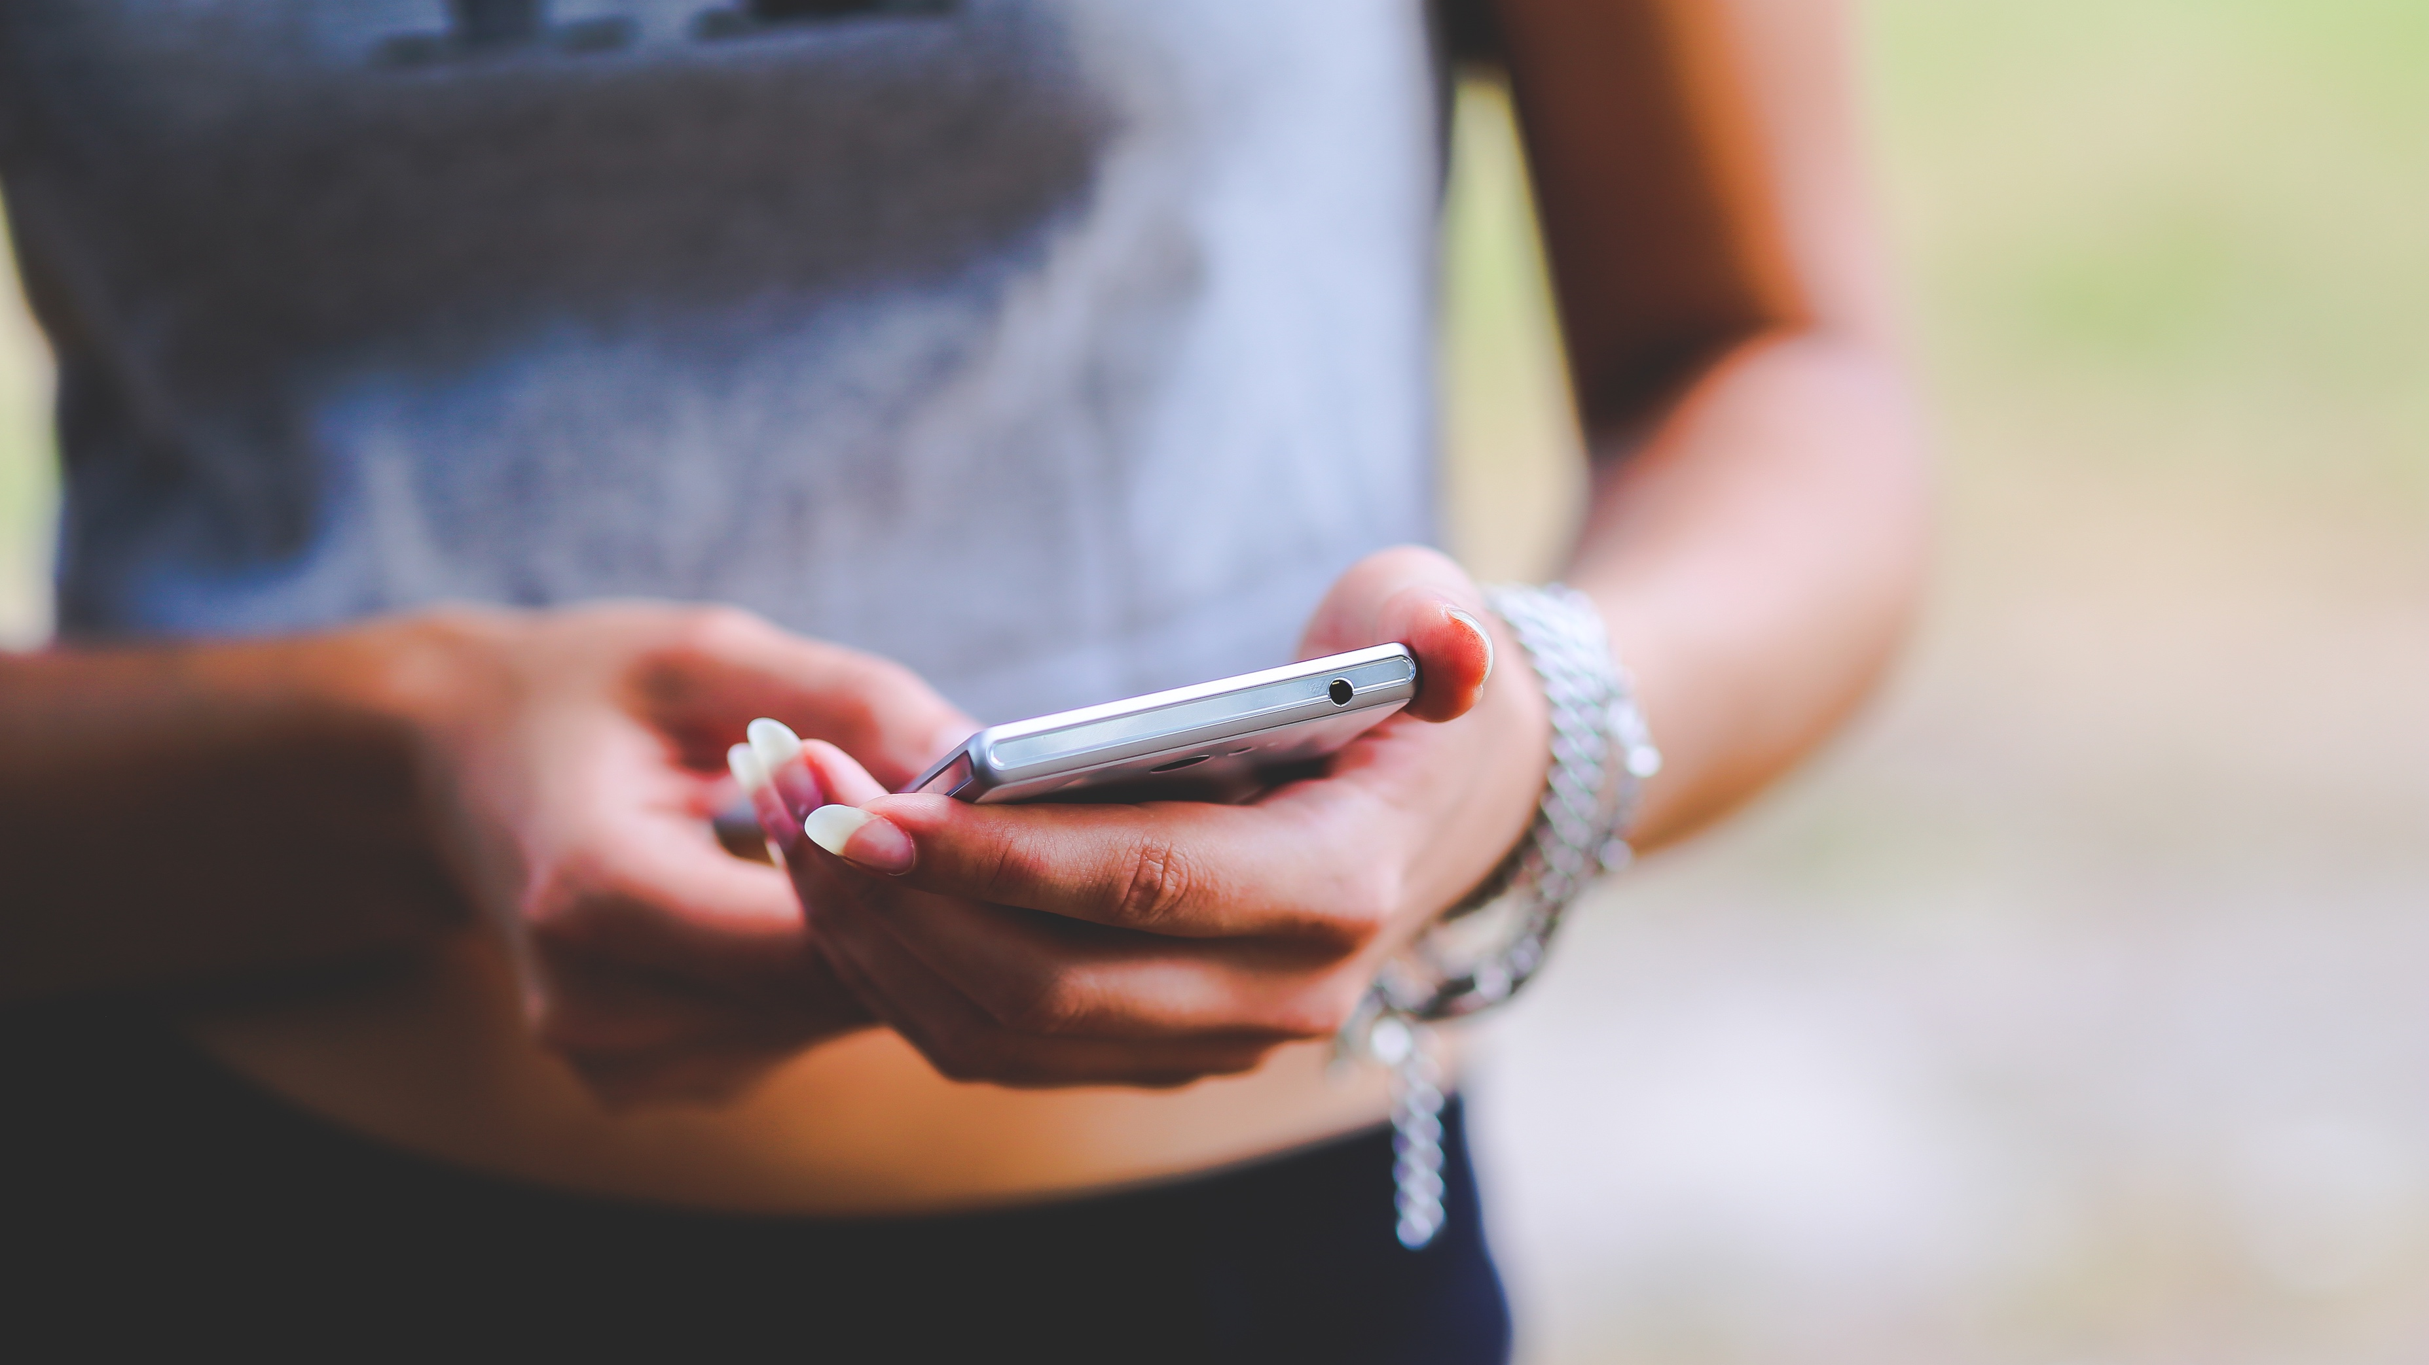
Prediction Performance
Precision: 0.071
(in 7.1% of the positive predictions, user would have clicked)
 | Baseline | XGBoost
Precision | 0.043 | 0.076515213
Recall | 1 | 0.19365285
F1 | 0.082454458 | 0.109690161
Baseline: 0.043
66.6% uplift of conversion rate!

Slide 19
Modeling Past Behavior
Last notification successful?
Mean conversion rate
Running means

Slide 20
Modeling Past Behavior
Precision: 0.218
(in 21.8% of the positive predictions, user would have clicked)
 | Baseline | XGBoost
Precision | 0.043 | 0.218
Recall | 1 | 0.504
F1 | 0.082454458 | 0.304354571
507% uplift of conversion rate!
Reduced exposure to notifications
(15% of participants would almost never be notified)

Slide 21
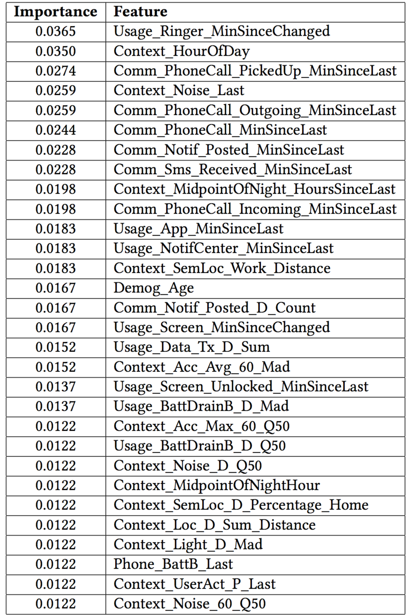
Feature Ranking
All the 5 groups of variables are useful
1.Predictive
2.Feasible

Slide 22
Limitation
Data feasibility. Android->Root / IOS->╮(╯_╰)╭
Energy Cost

Slide 23
Beyond Interruptibility: Predicting Opportune Moments to Engage Mobile Phone Users
Motivation
User Engagement via Push Notifications becoming increasingly popular
Risks of notifying at inopportune moment: loss of conversion, churn
Engagement ≉ Interruptibility
Engagement requires more time and cognitive resources
Participants decided to engage with content before knowing exact content
Results
General ML model provides 66.6% increase in conversion rate
Including past behavior : 507% increase while sig. reducing notification volume
Application
Increase conversion rates = revenue of push notification campaigns
Decrease churn by reducing notification exposure to users with little interest
Martin
Pielot
Bruno
Cardoso
Kleomenis
Katevas
Joan
Serra
Aleksandar
Matic
Nuria
Oliver
Contact: martin.pielot@telefonica.com | @martinpielot | UbiComp ‘17, Maui, Hawaii
Notes:
4 min

