Slide 1
Human Mobility Synchronization and Trip Purpose Detection with Mixture of Hawkes Processes
Yanjie Fu
Notes:
这篇文章研究的是城市中人群移动的规律，人群的移动是带有目的性的，比如……这篇文章首先提出了一个观察：不同区域统一目的的人流之间在时间上有同步现象，它把它称作……然后，他利用混合霍克斯点过程来对人群的移动及移动的目的进行建模，从而分析出实际数据中轨迹背后的目的是什么。

Slide 2
Outline
Background and Motivation
Problem Statement
Methodology
Evaluation
Conclusion and Future Work

Slide 3
The Importance of Modeling Human Mobility
Understand human movements
Profiling local residents and out-of-town travelers
Public transportation optimization
Smart and connected communities
Urban economics
City governance
…
Notes:
理解人群的移动规律在很多方面都有重要意义，比如优化公共交通系统，进行城市区域的规划等。

Slide 4





Pervasive Sensing for Human Movements
Notes:
同时，现在关于人移动轨迹的数据越来越丰富，比如出租车、各种基于位置的服务，社交网络等等。

Slide 5
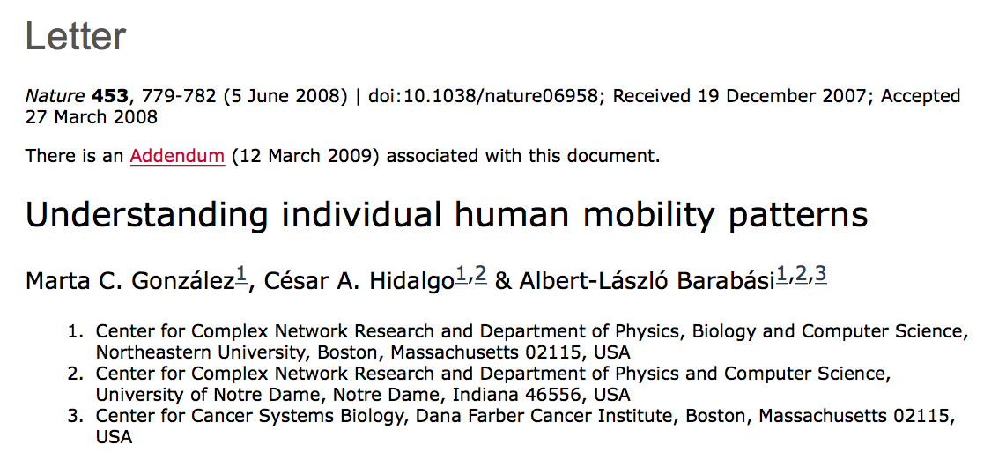
Mobility Research in Nature (1)
Understanding individual human mobility patterns, by Barabasi 2009
Human trajectories show a high degree of temporal and spatial regularity
Each individual being characterized by a time-independent characteristic travel distance and a significant probability to return to a few highly frequented locations
Most individuals travel only over short distances, but a few regularly move over hundreds of kilometres
Notes:
这里作者列举了两篇发表在natrue上的研究人群移动规律的文章，第一篇提出了一些人群移动的一般规律，

Slide 6
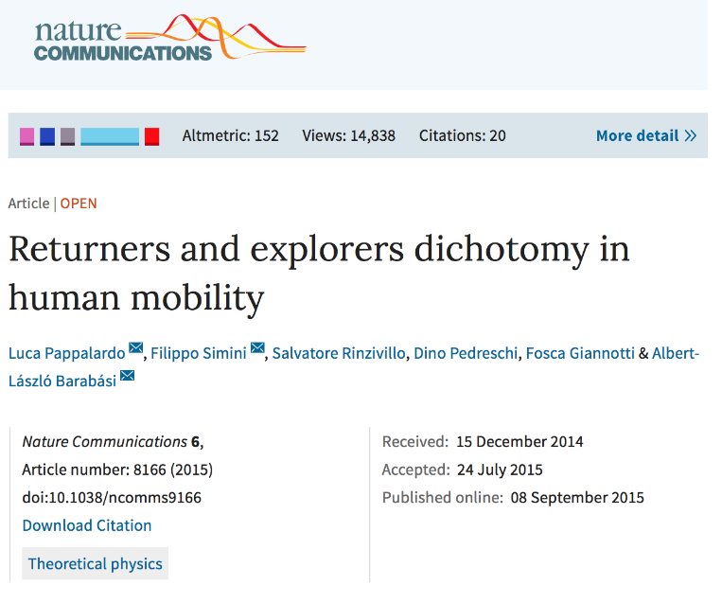
Mobility Research in Nature (2)
Returners and explorers dichotomy in human mobility, by Barabasi 2015
Discover the existence of two distinct classes of individuals: returners and explorers
Returners and explorers play a distinct quantifiable role in spreading phenomena and that a correlation exists between their mobility patterns and social interactions
Notes:
第二篇将人群分为两类，一类倾向于不断探索新的区域，一类倾向于回到自己之前去过的地方。

Slide 7
Research Questions in The Paper
Understanding
What is the nature of the spatial diffusion of human mobility across regions of different urban functions?
Modeling
How to spot and trace the trip purposes of human mobility trajectories?
Notes:
而这篇文章则将终点放在了探究人群移动背后的目的上，研究的问题主要有两个，一是通过他提出的模型来说明人群在不同的城市功能区之间移动的本质是什么；二是我们如何判断人群移动的目的是什么。

Slide 8
Human Mobility Synchronization (1)
Synchronization in our daily lives
Feeling synchronization between twins
Love synchronization between a man and a women
Work style synchronization between two professors
Life style synchronization between two house wives
Outdoor activities synchronization between two business managers
…
Notes:
首先作者提出了人群移动的同步现象，同步现象在生活中很常见，比如双胞胎之间，恋人时间，从事相同职业的人之间。他们往往会不约而同的表现出一些相似之处。

Slide 9
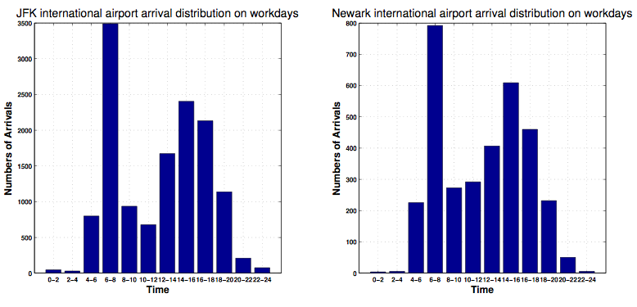
Human Mobility Synchronization (2)
Taxi arrival distributions of JFK Airport and Newark Airport
Notes:
在城市中，各个区域的人流情况之间也会有这种同步的现象，比如，这两张图分别来自纽约市的两大飞机场，横轴代表时间段，纵轴代表各个时间段进入两个区域的人流量。

Slide 10
Human Mobility Synchronization (3)
Two regions show similar arrival patterns in particular time periods if they share similar urban functions
Notes:
我们可以看到，这两个区域人流的变化趋势非常类似。有相似功能的城市区域特定时间段的人流变化区域也相似，这就是人群移动的同步现象。

Slide 11
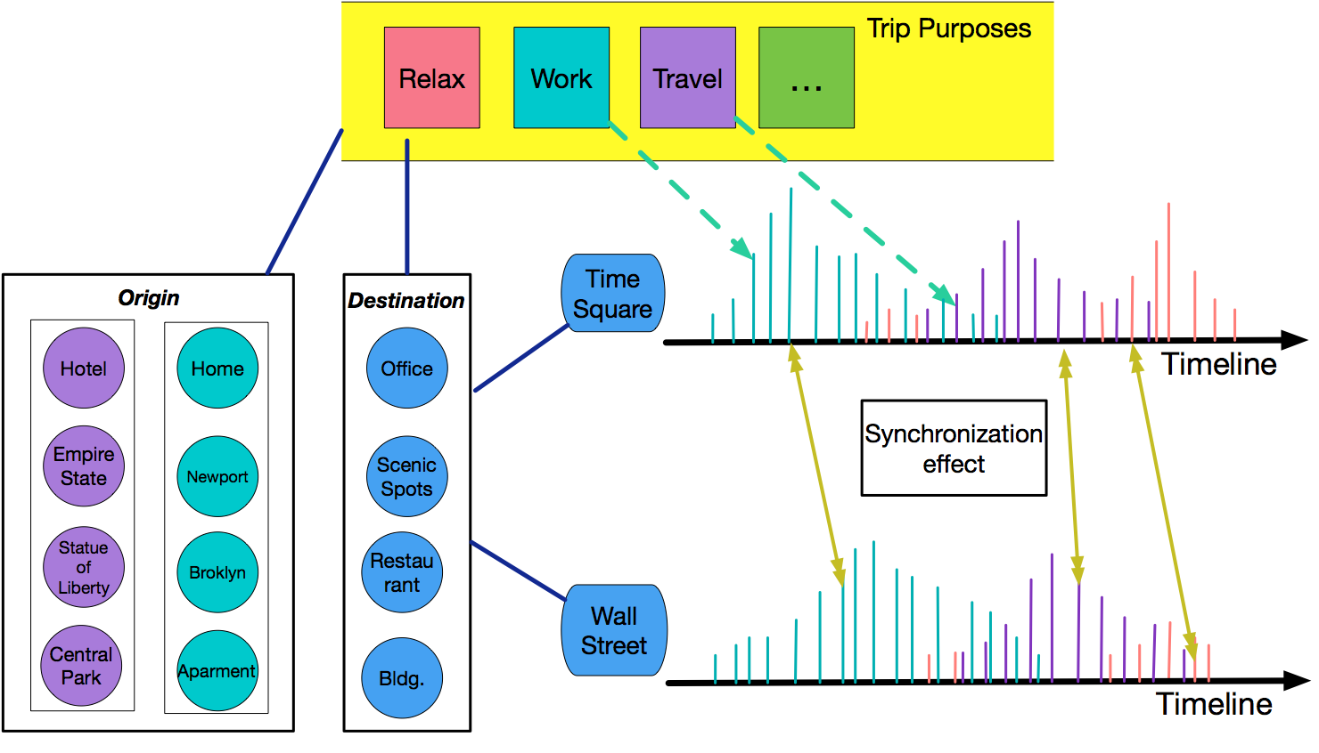
Linking Arrivals, Regions and Purposes
Notes:
下面介绍这篇文章所采用的模型，这张图大致表示了建模的思路，首先，轨迹的目的和轨迹起点终点区域的POI是有关的，然后，轨迹的目的，以及不同区域之间的同步效应又决定了实际人流表现出的变化趋势，比如，……。在这幅图里，最上面代表不同的目的，左边举了几个区域POI分布的例子，起点和终点的POI可以在很大程度上推断出轨迹的目的，比如……，右边画出了两个区域（时代广场和华尔街）的人流情况，横轴是时间，纵轴的高度代表人群的规模，颜色代表人群的目的。（两个高峰对应的目的，对应的POI）。同步现象 原因。
已知的数据就是POI和人流的变化情况，然后通过建立的概率模型来反推出轨迹背后的目的。

Slide 12
Framework Overview
Modeling the arrivals of a single region for a single trip purpose
Modeling the arrivals of a single region for multiple trip purposes
Modeling the arrivals of multiple regions for multiple trip purposes
Incorporating human mobility synchronization effects
Adding interpretation and explanations via modeling POIs of origin and destination regions
Notes:
下面就来具体介绍这篇文章用来具体刻画这种关系的数学模型。首先介绍右边的这部分，具体分这样4步……从第一步到第二步……，然后介绍左边的部分

Slide 13
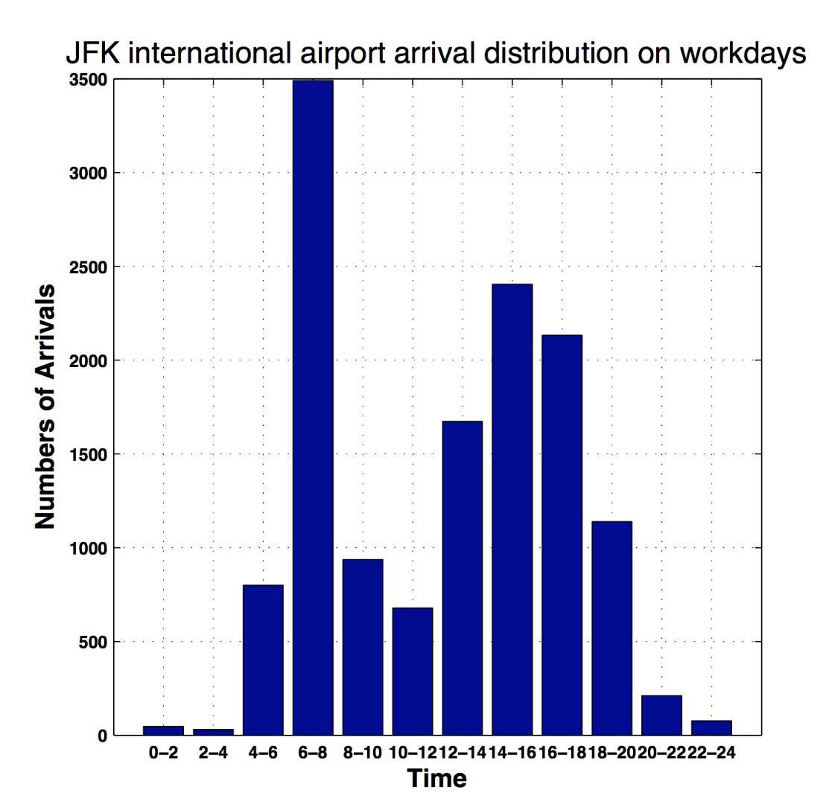
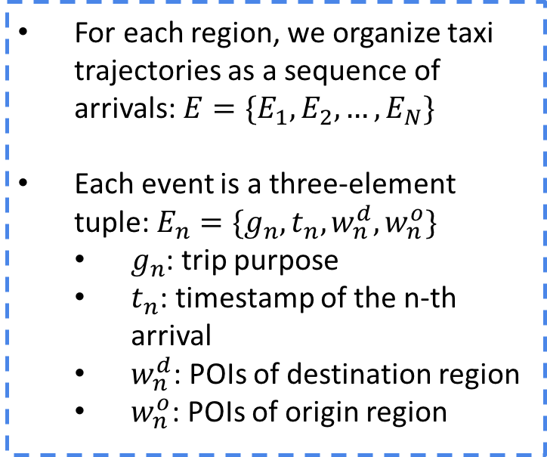
Modeling Arrivals of Single Region for A Particular Trip Purpose (1)
For each region, we organize taxi trajectories as a sequence of arrivals: $E=\{E_{1},E_{2},…,E_{N}\}$
Each event is a three-element tuple: $E_{n}=\{g_{n},t_{n}, w_{n}^{d},w_{n}^{o}\}$
$g_{n}$: trip purpose
$t_{n}$: timestamp of the n-th arrival
$w_{n}^{d}$: POIs of destination region
$w_{n}^{o}$: POIs of origin region
Notes:
首先是输入数据，每一条轨迹可以按照到达时间排序，形成一个序列，E1,E2,E3……每一条轨迹可以看做是一个三元组，gn是这条轨迹的目的，tn是它发生的时间，w是起点和终点的POI。我们考虑某个区域某种目的的人流序列，它们的tn就组成了一个时间的序列，然后用霍克斯随机点过程来对这个序列进行建模。

Slide 14
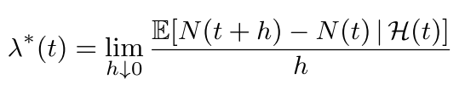
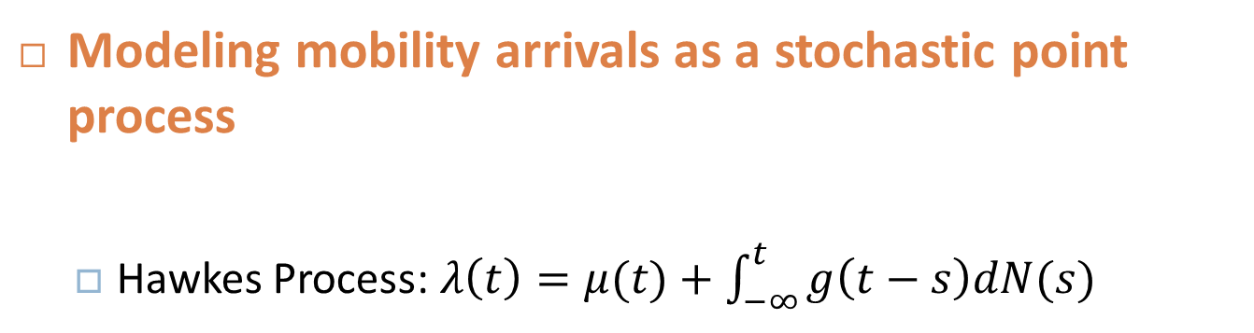
Modeling Arrivals of Single Region for A Particular Trip Purpose (2)
Modeling mobility arrivals as a stochastic point process
Hawkes Process: $λ\left(t\right)=μ(t)+\int_{−∞}^{t}{g\left(t−s\right)dN(s)}$
Notes:
N(t) …… H(t) …… \lamda (t) ……
霍克斯过程就是
确定了区域和目的之后，得到的tn序列，作者假设是符合这样一个模型的。

Slide 15
Modeling Arrivals of Single Region for Multiple Trip Purposes (1)
Notes:
同一区域，不同目的的轨迹序列都分别符合一个霍克斯过程

Slide 16
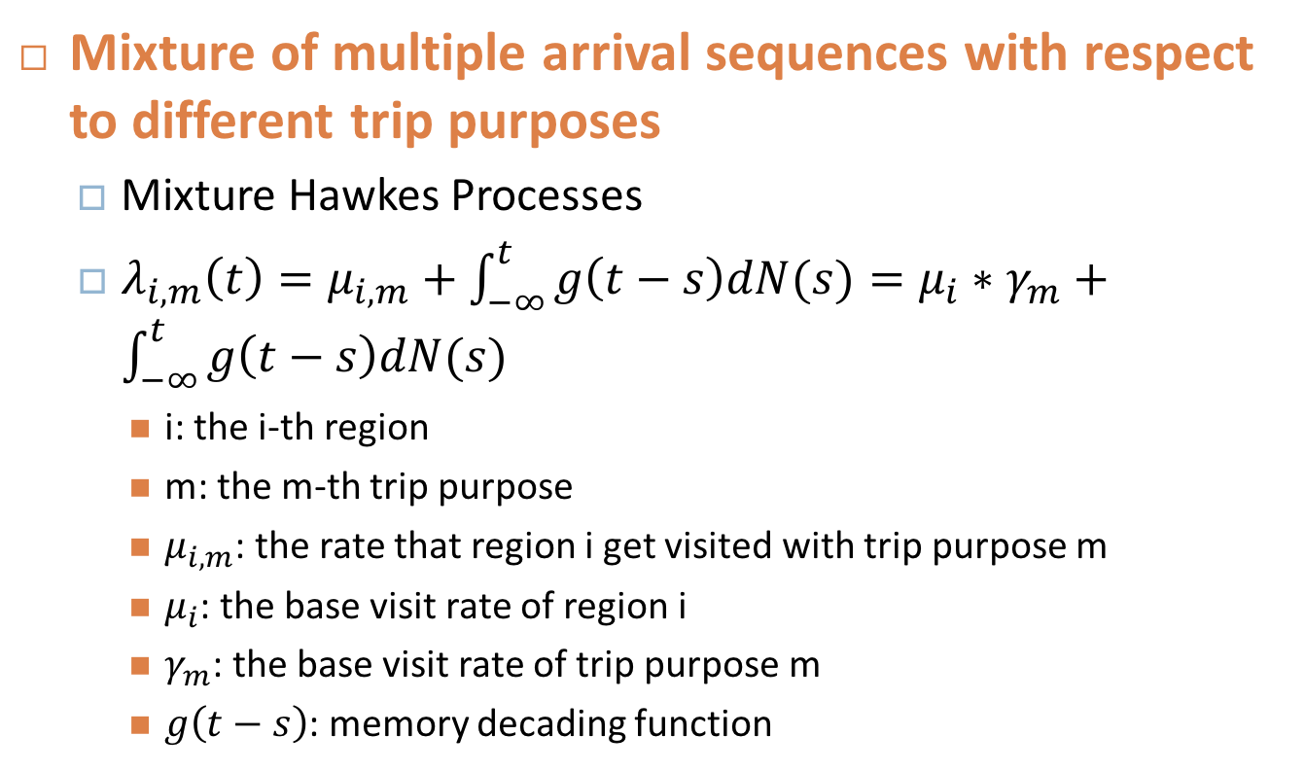
Modeling Arrivals of Single Region for Multiple Trip Purposes (2)
Mixture of multiple arrival sequences with respect to different trip purposes
Mixture Hawkes Processes
$λ_{i,m}\left(t\right)=μ_{i,m}+\int_{−∞}^{t}{g\left(t−s\right)dN(s)}=μ_{i}∗γ_{m}+\int_{−∞}^{t}{g\left(t−s\right)dN(s)}$
i: the i-th region
m: the m-th trip purpose
$μ_{i,m}$: the rate that region i get visited with trip purpose m
$μ_{i}$: the base visit rate of region i
$γ_{m}$: the base visit rate of trip purpose m
$g\left(t−s\right)$: memory decading function
Notes:
i代表区域 m代表目的 确定了区域和目的之后 得到的到达事件的子序列 就符合一个霍克斯过程

Slide 17

Modeling Arrivals of Single Region for Multiple Trip Purposes (3)
Mobility arrivals observed in the i-th region :
$${λ_{i}=λ}_{i,eat}\left(t\right)+λ_{i,work}\left(t\right)+λ_{i,relax}\left(t\right)+…$$
Notes:
再回到这张图，一个区域总的点密度的函数 \lamda i就等于各个目的各自的密度函数加起来。

Slide 18
Synchronization Effect Across Regions (1)
Road networks: graph
Region: nodes in the graph
Synchronization rate between two regions: similarity (edge connectivity) between two nodes
Region i
Synchronization rate (i, j)
αij
Region j
Notes:
点代表区域 线代表同步效应的强弱，用alpha i j来表示

Slide 19
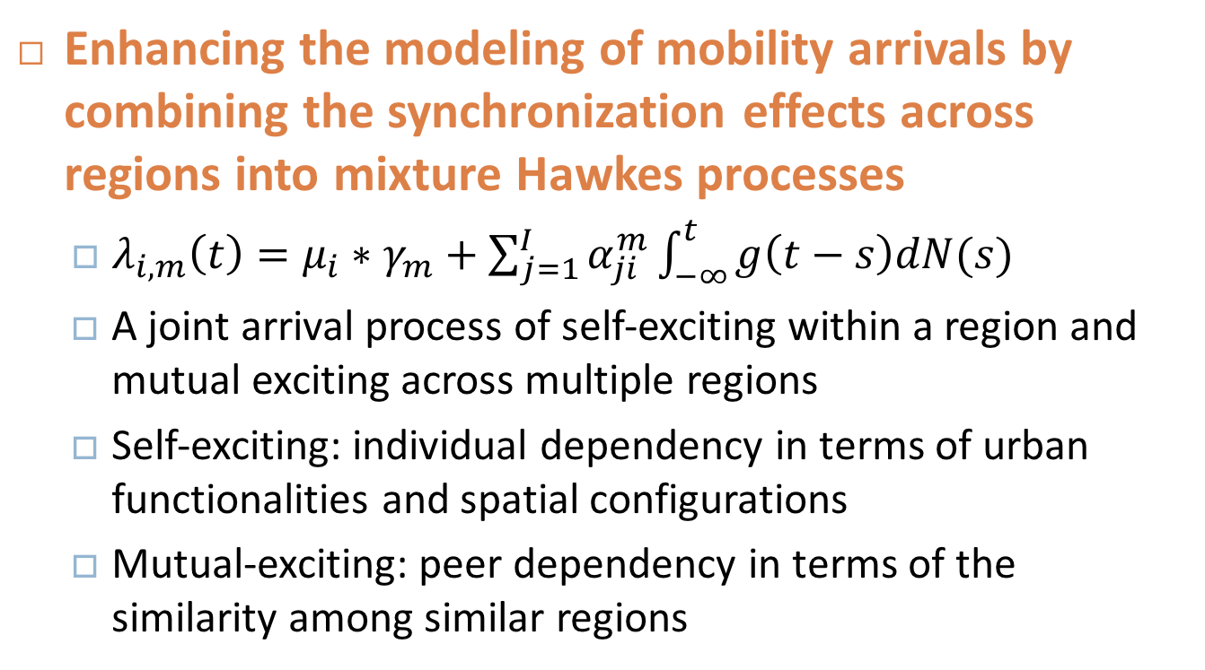
Synchronization Effect Across Regions (2)
Enhancing the modeling of mobility arrivals by combining the synchronization effects across regions into mixture Hawkes processes
$λ_{i,m}\left(t\right)=μ_{i}∗γ_{m}+\sum_{j=1}^{I}{α_{ji}^{m}}\int_{−∞}^{t}{g\left(t−s\right)dN(s)}$
A joint arrival process of self-exciting within a region and mutual exciting across multiple regions
Self-exciting: individual dependency in terms of urban functionalities and spatial configurations
Mutual-exciting: peer dependency in terms of the similarity among similar regions
Notes:
这个式子就是考虑了区域之间的同步效应之后点密度的表达式，……，这样得到的lamda就是一个既有self exciting又有mutual exciting的随机过程，……

Slide 20
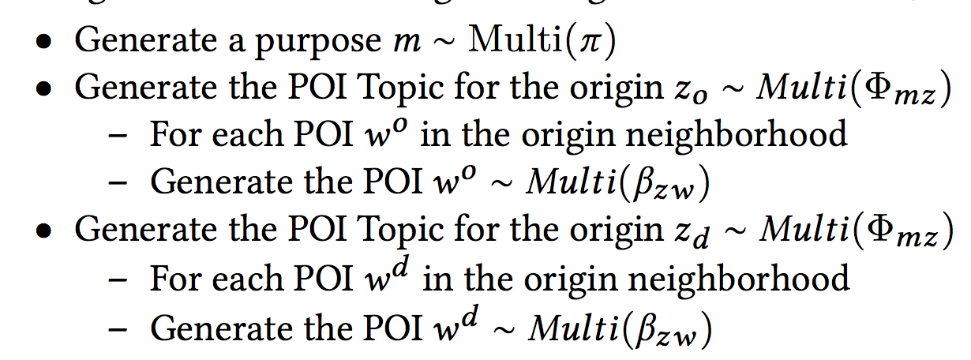
Incorporating the Functionalities of Origin and Destination Regions
The weakness of Mixture Hawkes Processes with Synchronization
As a clustering/signal filtering method, Identify K latent trip purposes indexed from 1 to K without explanations and interpretations
To provide explanations, we connect trip purposes with the POIs of origin and destination regions
Notes:
接下来再将起点和终点的POI信息结合到模型当中。结合POI信息一方面可以让得到的结果更准确，另一方面也可以让结果变得可解释。下面叙述的这个过程是从轨迹的目的到轨迹起点终点的POI的概率模型，举例介绍m z w之间的关系。

Slide 21


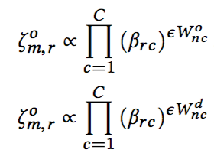
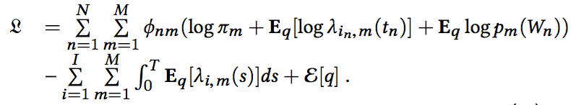
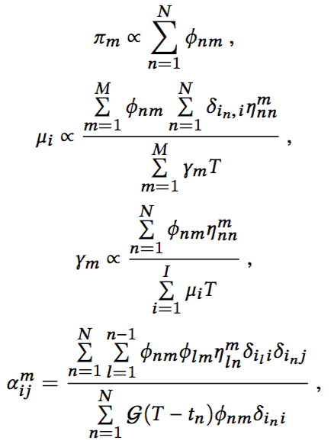
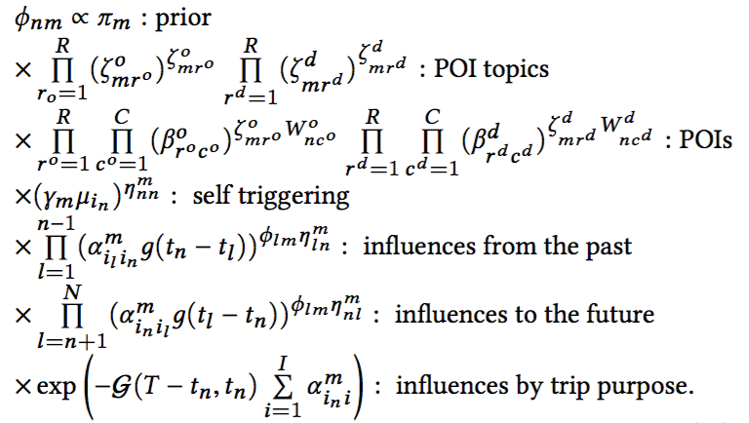

Solving the Optimization Problem
21
Notes:
接下来是模型参数的推导，第一个函数L是模型的似然概率，N是轨迹的个数，连乘，每一项就是每一条轨迹产生的概率，Gn就是第n条轨迹的目的，首先是产生这个目的的概率，然后是在这个目的的条件下，产生这样的POI和tn的概率。接下来就是寻找参数最大化这个似然概率的问题，但由于这个函数没办法直接求解，所以推导出了它的一个下界，就是这个式子，我们可以大致看一下里面参数的意义，……，下面是推导出的各个参数的表达式，结合这些表达式寻找最优解。其中最重要的几个参数是……
其中我们最关心的是fa n m

Slide 22
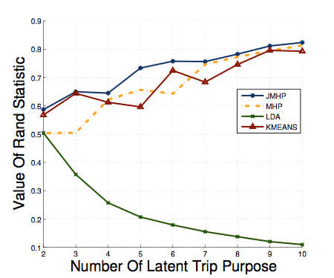
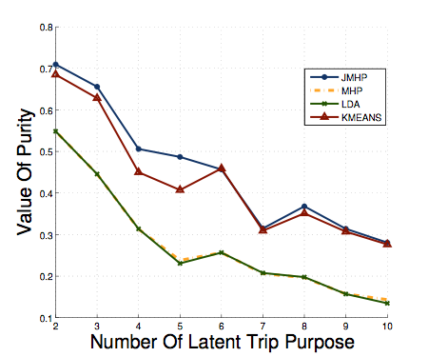
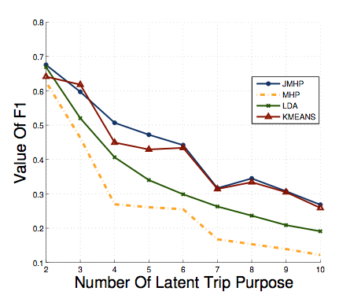
Experiment on Synthetic Data
Experiments on synthetic data
Other methods: MHP, LDA, K-means
Indicators: purity, F1-Measure, Rand Statistics
Notes:
第一个实验是在模拟数据上进行的，他先用自己的模型生成一些移动数据，然后使用不同的方法对轨迹进行聚类，每个轨迹的目的，也就是ground truth是已知的。然后这就是一个聚类问题了，所以这里采用了聚类的评价指标。使用的方法有…… 无奈之举

Slide 23
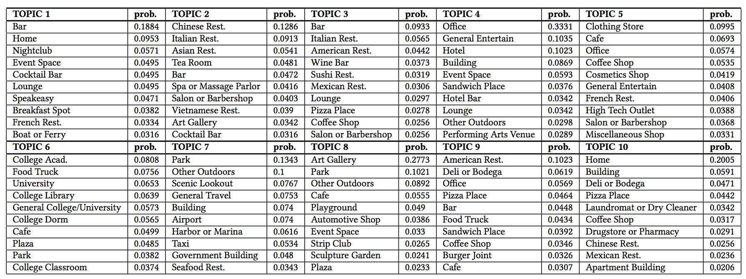
Experiments on Real World Data
Notes:
Specifically, we see representative POIs such as bar, nightclub and restaurant in Topic 1, which refers to a nightlife related POI Topic. Both Topic 2 and Topic 3 can be inferred as dining related topics, but there still exist some differences regard- ing the types of restaurants. Topic 4 is mixed with office, hotel and entertainment places, which corresponds to the fact that some regions in the city play the role of both working areas and scenic spots, e.g., Time Square. Topic 5 indicates shopping related urban functions and Topic 6 is regarded as school oriented because it mostly consists of POIs concerning schools. Obviously, Topic 7 should be identified as a mixture of travelers’ visited places includ- ing scenic spots, traffic centers, etc. Topic 8 can be viewed as a general entertainment function while Topic 9 consists of fast food related POIs, as well as offices; since a working place is usually blended with many fast food restaurants. Topic 10 refers to the residential areas with apartment buildings and dining restaurants.
成分复杂：城市区域本身就是很复杂，不纯粹 分区方法有问题
deli or bodega
熟食店或酒窖

Slide 24
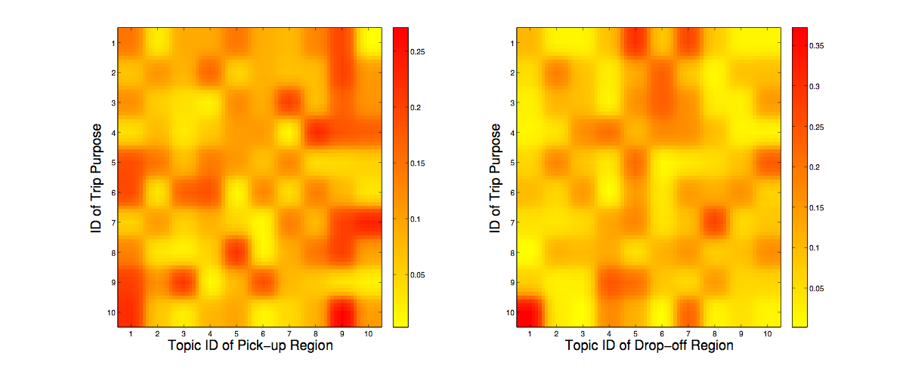
Experiments on Real World Data
POI Topic distribution over latent trip purposes for origin and destination
Notes:
Shopping purpose. In purpose 1, we see topics of the origins concentrate on Topic 1 and 9, while the destinations are mainly composed of Topic 5 and 7. Considering the urban functionality of both ends, such trips can be inferred as shopping and outdoors activities.
Dining purpose. Purpose 2 consists of office related topics (Topic
4 and 9) as the origins and the restaurant related topics (Topic 6) as destinations, thus such trips can be inferred as for dining purpose.
Figure
55,000,000 31630

Slide 25
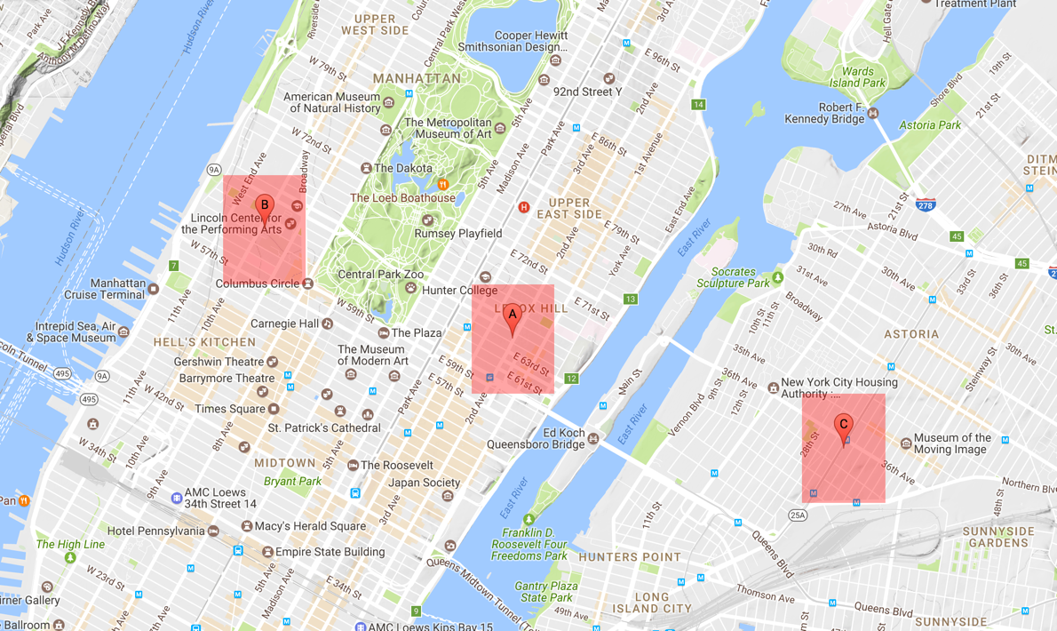
Synchronization Effect
αAB = 8.27066832
αAC = 0.00711464
A and B have a higher synchronization rate
A and C have a lower synchronization rate

Slide 26
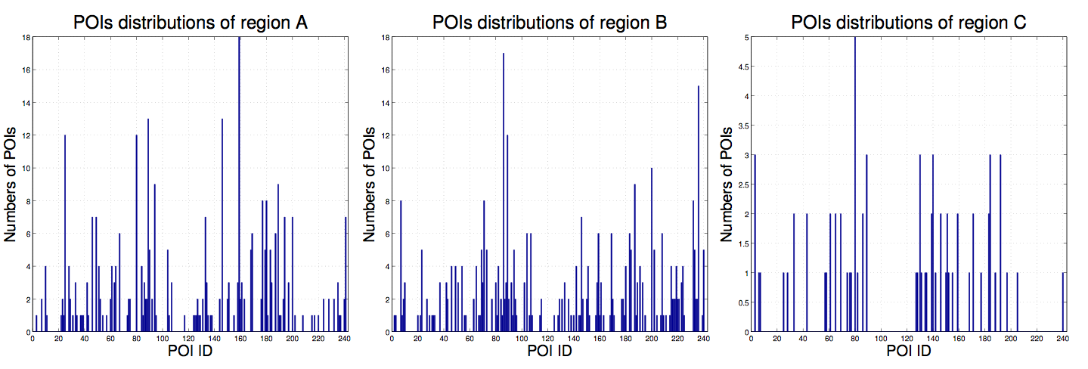
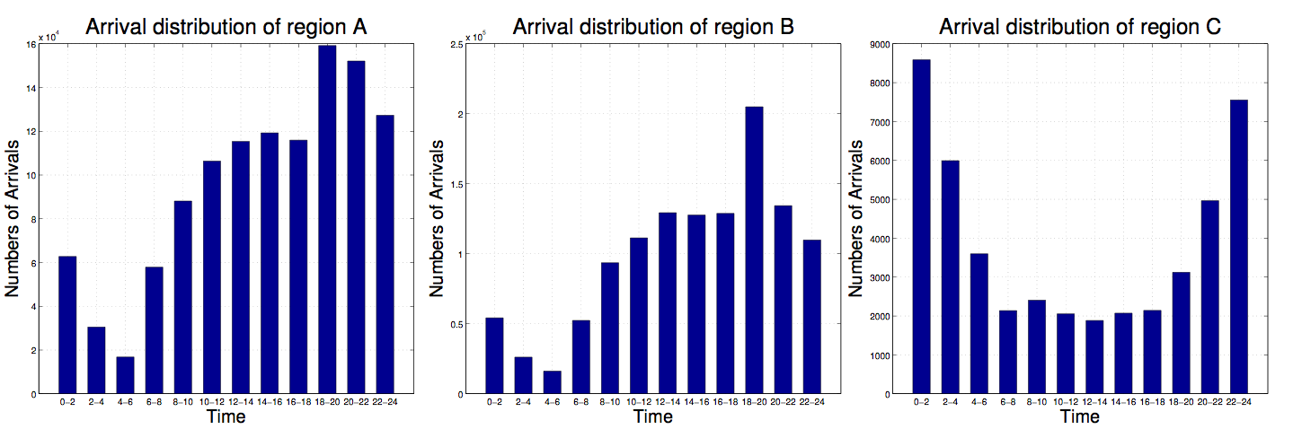
Synchronization Effect

Slide 27
Conclusion Remarks
Problem
Human mobility modeling
Two research questions
What is the nature of the spatial diffusion of human mobility across functional regions?
How to spot and trace the trip purposes of trajectories?
Property (provide in-depth understanding)
Identify the synchronization property of human mobility
Modeling (make it predictable and traceable)
Provide a unique perspective of modeling human mobility as stochastic point processes
Use human mobility synchronization property to link mobility arrivals, functional regions, and trip purposes
Notes:
优点：
和我们的工作相关，模型合理。
局限性：
区域划分
实验设计

Slide 28
Questions?
Looking Forward to Future Collaboration
THANK YOU
Homepage: www. yanjiefu.com
Notes:
28

