Slide 1
User Interactions and Permission Use on Android
Kristopher Micinski, Daniel Votipka, Rock Stevens, Nikolaos Kofinas, Michelle L. Mazurek, and Jeffrey S. Foster
University of Maryland, College Park
Presented by Kai Zhang

Slide 2
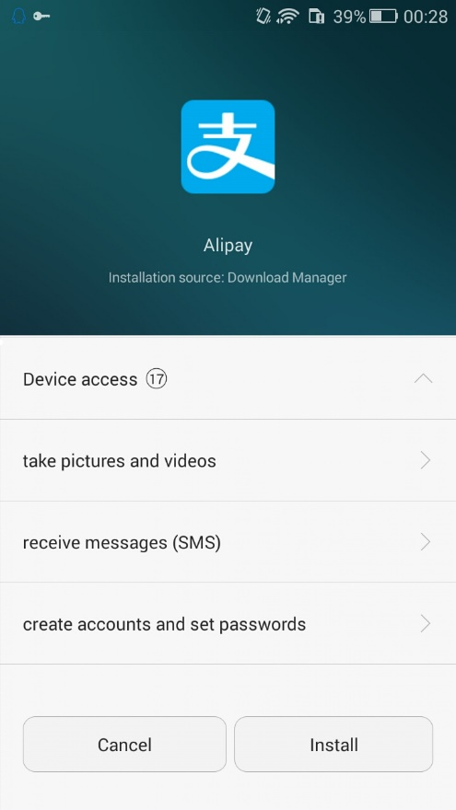
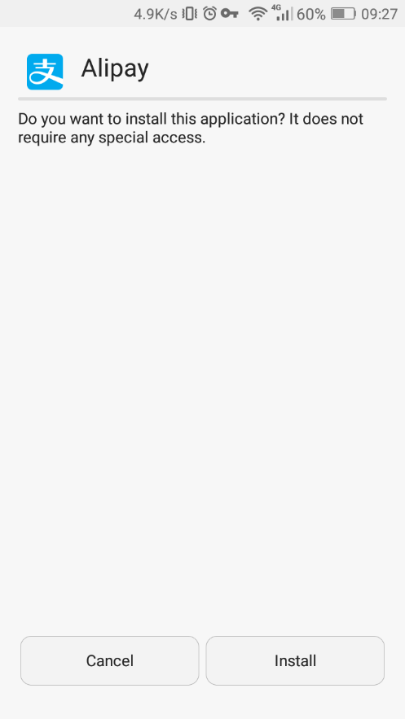
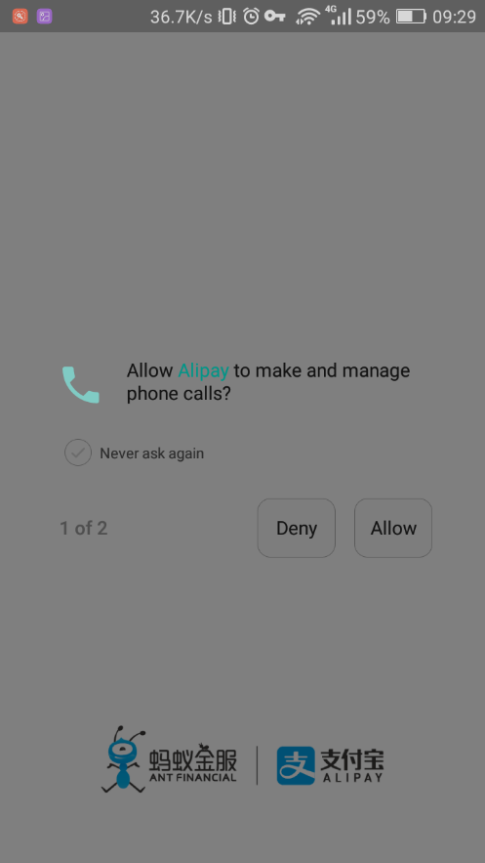
INTRODUCTION
Android has a permission system that asks users for authorization before an app uses sensitive resources such as contacts or GPS location.

Slide 3
INTRODUCTION
We hypothesize that such authorization systems could be improved by becoming more integrated with the app’s user interface.
In particular, in this paper we ask whether user interactions— button clicks, page changes, dialog boxes, etc.—can be taken as evidence of authorization to use certain sensitive resources.
Conversely, we ask whether sensitive resource use without an associated interaction suggests a need for additional authorization requests.
To answer these questions, we conducted two related studies.

Slide 4
RELATED WORK
Contextual Security on Mobile Devices
Almuhimedi et. al [3] showed users historical data about how apps accessed their locations. They found 95% of users reassessed the apps’ need for location, with 58% of those users further restricting location access.
Several researchers found users are surprised by some sensitive resource accesses that occur when apps are in the background.
Most closely related to this paper, in a field study Wijesekera et al. found that context is an important factor in determining expectation of resource use.

Slide 5
RELATED WORK
Enforcing Contextual Security
Chen et. al [8] present Pegasus, a static analysis system for analyzing apps and enforcing policies based on permission event graphs (PEGs).
Roesner et. al [27] expand user-driven access control with Access Control Gadgets (ACGs), which tie resource accesses to certain UI elements.
The original ACG paper includes a user study measuring expectations related to interactive permission uses; our work expands on this idea to study a broader variety of factors and use cases.

Slide 6
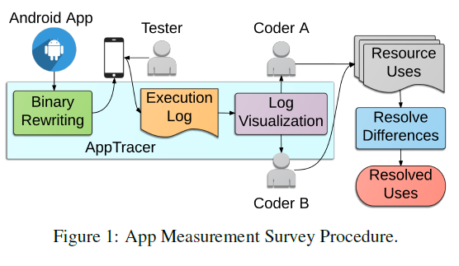
APP MEASUREMENT SURVEY METHODOLOGY
First, we reviewed 150 popular Android apps to determine whether sensitive resource uses are related to user interactions in existing apps.
To carry out this study, we developed AppTracer, a dynamic analysis tool that instruments Android apps to log UI actions and resource uses, and then visualizes the logs as graphs that show temporal ordering of logged events.

Slide 7
APP MEASUREMENT SURVEY METHODOLOGY
Binary Rewriting and Execution Logging
AppTracer adds instrumentation using Redexer, a rewriting tool for Dalvik bytecode (the language to which Android apps are compiled).
AppTracer instruments code by appending a log method to the bytecode and inserting calls to log at the beginning of UI-related callbacks (e.g., onClick handlers for button events) and just before calls to permission-protected methods (e.g., getLastLocation).

Slide 8
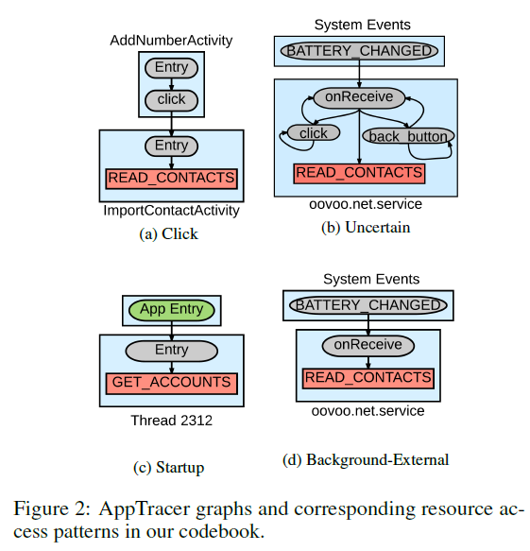
APP MEASUREMENT SURVEY METHODOLOGY
Log Visualization

Slide 9
APP MEASUREMENT SURVEY METHODOLOGY
Resource Uses
The next step is to examine the AppTracer graph and record a set of codes that accurately categorize various resource accesses.
More precisely, for each red node in the graph, the coder assigns a pair of the form (resource; pattern), where resource indicates what is protected by the permission and pattern is one of six different UI patterns:
interactive patterns: Click and Page
background patterns Startup, Bg-App, and Bg-Ext
uncertain pattern

Slide 10
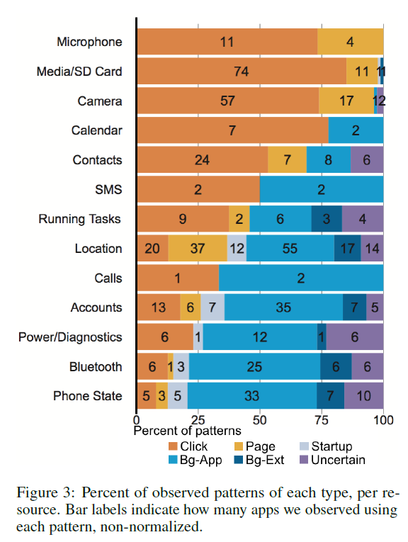
APP MEASUREMENT SURVEY RESULTS
Given the large amount of interactive resource use overall, there seems to be a clear opportunity for better integrating authorization into the UI.
Moreover, apps sometimes use the same resource both in the foreground and in the background, to different purposes.
This suggests interactive and background uses should be authorized separately.

Slide 11
USER EXPECTATIONS STUDY METHODOLOGY
These results informed the design of our second study, a 961-participant online survey investigating participants’ expectations about interactive and background permission uses.
Concretely, our user study examined the following three hypotheses:
H1. Users are more likely to expect resource accesses with an interactive use pattern than without.
H2. The more apps that use a resource (as measured in our app survey), the more likely users are to expect less-interactive uses of that resource.
H3. Users are more likely to expect resource accesses they have seen before.

Slide 12
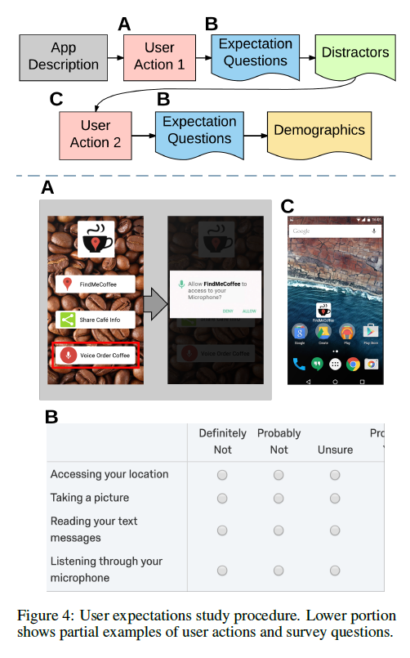
USER EXPECTATIONS STUDY METHODOLOGY
Each participant viewed a slideshow of two usage scenarios for a mock mobile app, where each scenario shows a short interaction (e.g., launching the app, clicking a button, etc.) and then asks if the participant expects microphone, location, and/or contacts to be used after the interaction.

Slide 13
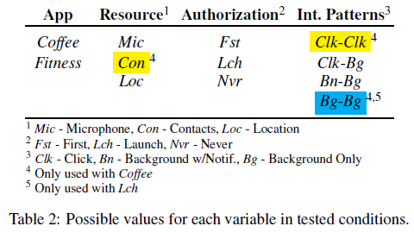
USER EXPECTATIONS STUDY METHODOLOGY
Participants were assigned round-robin to one of 42 conditions, which varied across four variables: the app, the resource being accessed, the authorization pattern, and the pair of interaction patterns.

Slide 14
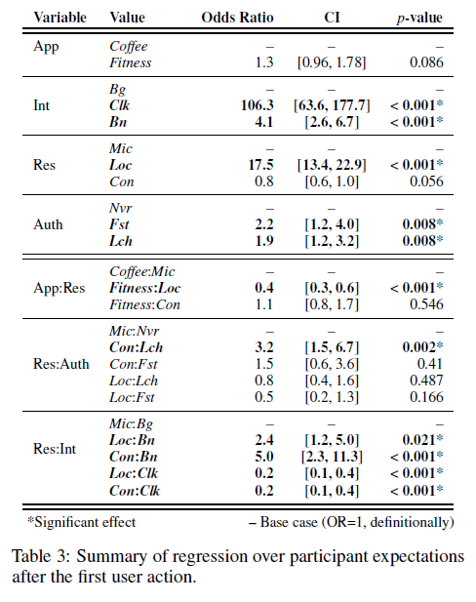
USER EXPECTATIONS STUDY RESULTS
Each table shows the included input variables and their values. Each variable includes a base case value (identified by dashes in the remaining columns). The odds ratio (OR) shows the observed effect of each value relative to the base case, measured as odds of expectation increasing one unit on our Likert scale. We also provide the 95% confidence interval (CI) and p-value for each measurement.
The second half of each table shows interactions between value pairs, given as the two values separated by a colon. These odds ratio indicate the change in likelihood when the two variables co-occur, relative to considering them independently.

Slide 15
USER EXPECTATIONS STUDY RESULTS
We found that H1 holds: users were the most likely to expect a resource use when shown a more interactive int. pattern. In contrast, we observed that while resource type does affect user expectation, H2 was not strongly supported. Finally, we found that H3 does not hold.
H1. Users are more likely to expect resource accesses with an interactive use pattern than without.
H2. The more apps that use a resource (as measured in our app survey), the more likely users are to expect less-interactive uses of that resource.
H3. Users are more likely to expect resource accesses they have seen before.

Slide 16
USER EXPECTATIONS STUDY RESULTS
We found that users are much more likely to expect resources to be accessed after a related interaction than in the background.
We also found that seeing one interactive use does not prime the user to expect a future background use, indicating a potential weakness in the Android M request-on-first-use authorization model.
In contrast, our findings show that an authorization request at launch does increase expectations for both interactive and background accesses, perhaps because it better conveys the idea that the resource could be accessed at any time.

Slide 17
CONCLUSIONS AND DESIGN RECOMMENDATIONS
First, resource uses should be made after associated interactions as much as possible. Given the current makeup of apps, this should be achievable for many commonly used resources without extensive effort.
Second, if a resource use is interactive, then a separate authorization dialog can be eliminated.
Finally, authorization for background resource uses should be distinct from authorization for interactive uses, and these background authorizations may be most effective when the app is launched.

Slide 18
我的看法
论文整体思路：motivation，两个study，三个conclusion
User study手法细腻：
在两个user action的问卷之间添加无关问题让participant平滑过渡
对user的问卷打分使用了logistic regression
结论只是提出了设计建议而没有实现
后台资源使用每次打开应用都要授权，是否过于繁琐，造成重复性的劳动？

Slide 19
Thank you!

