Slide 1

Convolutional Neural Networks on Graphs
with Fast Localized Spectral Filtering
Michaël Defferrard
Swiss Federal Institute of Technology (EPFL)

Slide 2
Structured data
Majority of data is naturally unstructured, but can be structured.
Why structure data ?
To incorporate additional information.
To regularize the learning process.
To decrease learning complexity by making geometric assumptions.
Data structured by Euclidean grids.
1D: sound, time-series.
2D: images.
3D: video, hyper-spectral images.
1

Slide 3

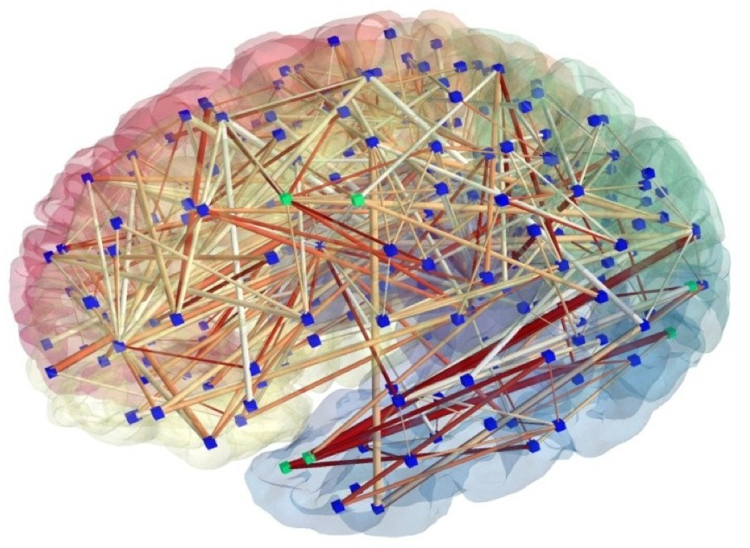
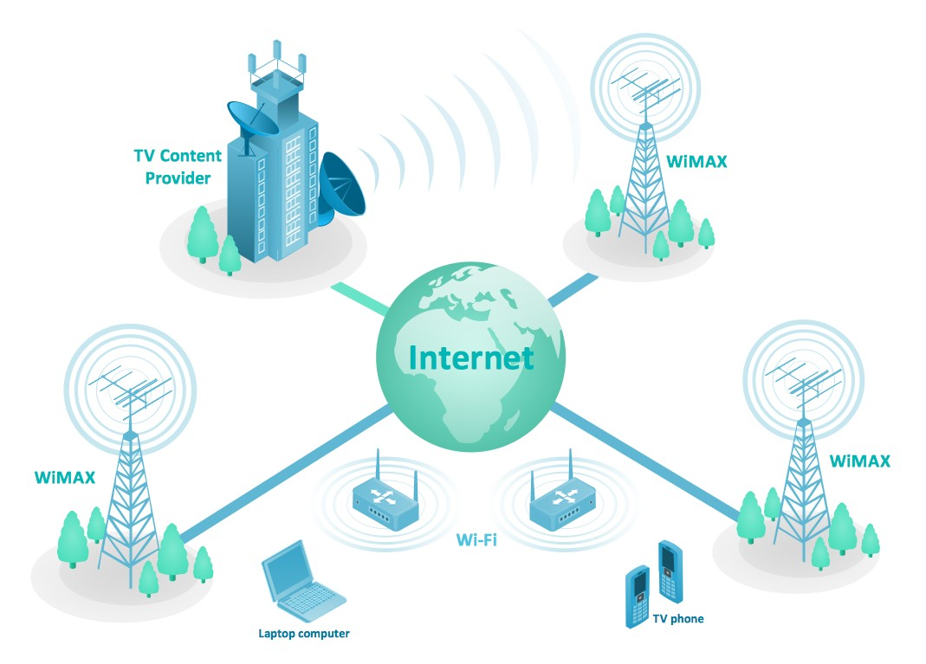
Graph Data
Modeling versatility: graphs model heterogeneous pairwise relationships
Examples of irregular / graph-structured data:
Social networks: Facebook, Twitter.
Biological networks: genes, molecules, brain connectivity.
Infrastructure networks: energy, transportation, Internet, telephony.
Social network
Brain structure
Telecommunication
2
Notes:
Non-Euclidean data 的好处，Model 的多样性

Slide 4
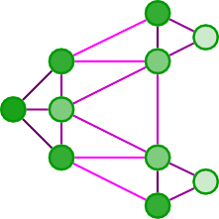
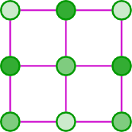
Graph Data
Euclidean Graph
Non-Euclidean Graph
3
Notes:
Non-Euclidean data 的好处，Model 的多样性

Slide 5
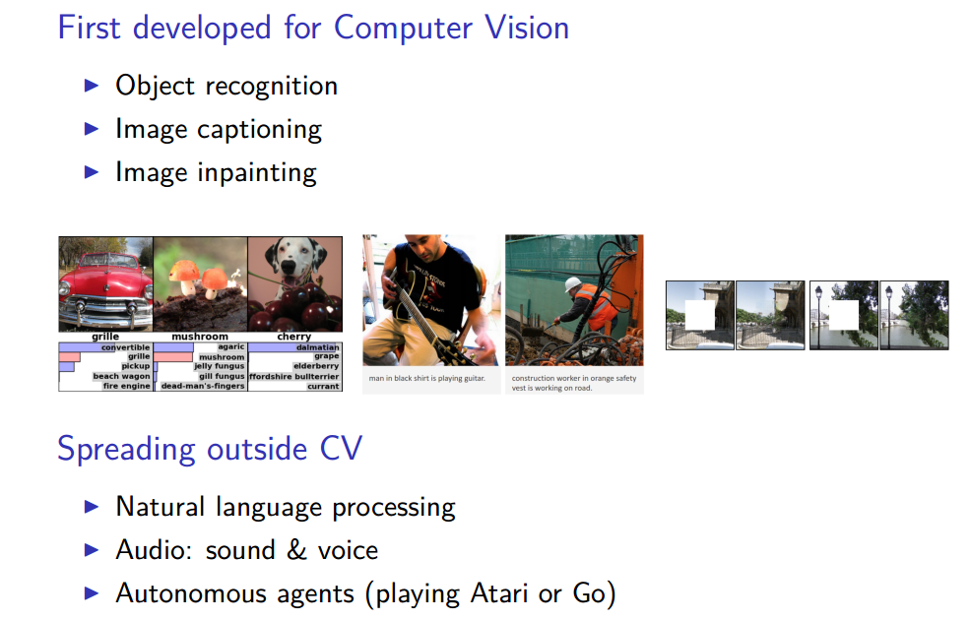
ConvNets are ubiquitous
LeCun, Bengio, and Hinton 2015
4

Slide 6
Why are ConvNets good ?
ConvNets are extremely efficient at extracting meaningful statistical patterns in large-scale and high-dimensional datasets.
Because they make use of the underlying structure in the data.
Statistical assumptions
Localization: compact filters for low complexity
Stationarity: translation invariance
Compositionality: analysis with a filterbank
5
Notes:
局部性
平稳性
复合型

Slide 7
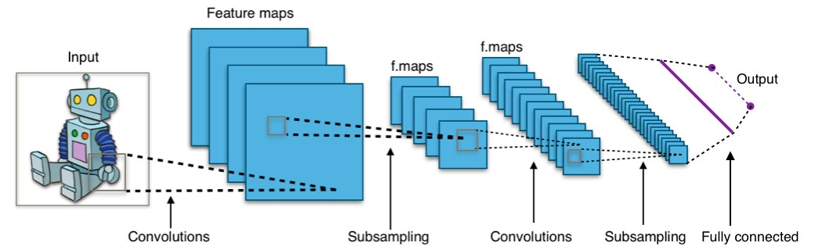
ConvNets: architecture
Ingredients
Convolution
Non-linearity (ReLU) 3.Down-sampling 4.Pooling
6
Notes:
1. 卷积 2. 激活函数 3. 向下采样 4. 池化

Slide 8
ConvNets on graphs
Graphs vs Euclidean grids
Irregular sampling.
Weighted edges.
No orientation (in general).
Challenges
Formulate convolution and down-sampling on graphs.
Make them efficient!
7

Slide 9
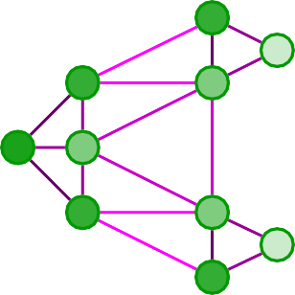
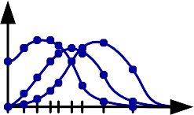
ConvNets on graphs: spectral approach
Bruna, Zaremba, Szlam, and LeCun 2014; Henaff, Bruna, and LeCun 2015
Spectral graph theory for convolution on graphs.
Balanced cut model for graph coarsening (sub-sampling).
8

Slide 10
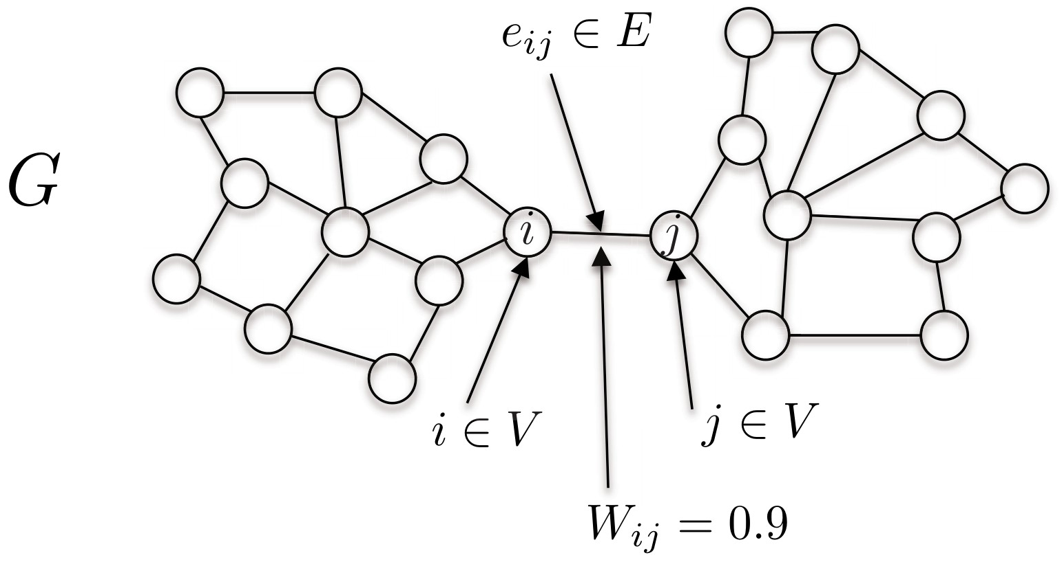
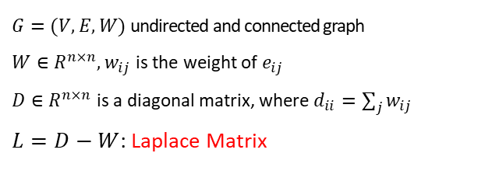
Definitions: graph
Chung 1997
$G=(V,E,W)$ undirected and connected graph
$W∈R^{n×n}, w_{ij}$ is the weight of $e_{ij}$
$D∈R^{n×n}$ is a diagonal matrix, where $d_{ii}=\sum_{j}{w_{ij}}$
$L=D−W$: Laplace Matrix
9

Slide 11
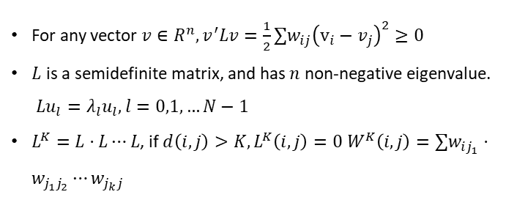
Laplace Matrix
Property
For any vector $v∈R^{n},v^{′}Lv=\frac{1}{2}∑w_{ij}{\left(v_{i}−v_{j}\right)}^{2}≥0$
$L$ is a semidefinite matrix, and has $n$ non-negative eigenvalue. $Lu_{l}=λ_{l}u_{l},l=0,1,…N−1$
$L^{K}=L⋅L⋯L$, if $d\left(i,j\right)>K,L^{K}\left(i,j\right)=0 W^{K}\left(i,j\right)={∑w}_{ij_{1}}⋅w_{j_{1}j_{2}}⋯w_{j_{k}j}$
10

Slide 12
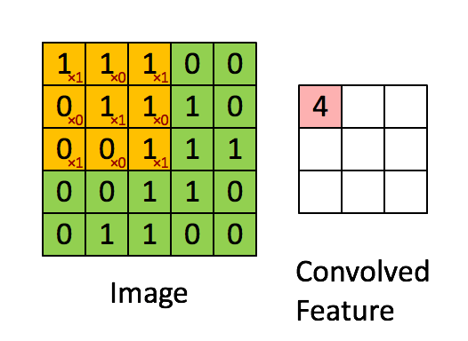

Convolution
Convolution theorem
11

Slide 13


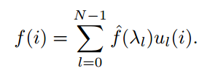


Convolution
Fourier
graph Fourier
$$\hat{x}=U^{∗}x$$
inverse graph Fourier
$$x=U\hat{x}=UU^{∗}x=x$$
12
Notes:
ul* (i) 转置

Slide 14
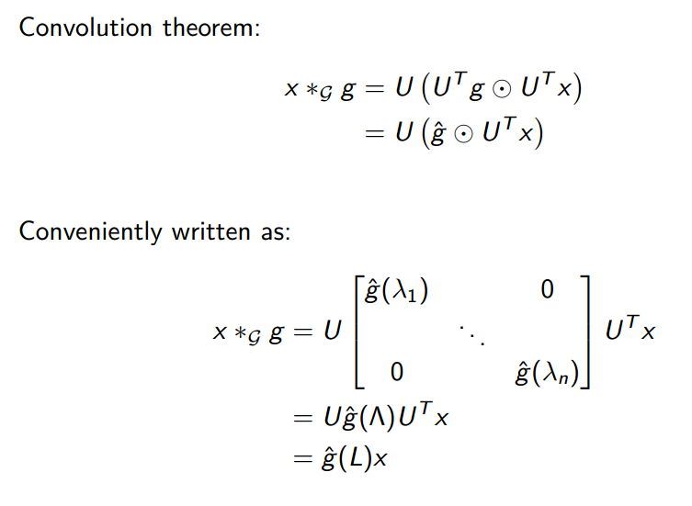
Definitions: convolution on graphs
Shuman, Narang, Frossard, Ortega, and Vandergheynst 2013
13

Slide 15
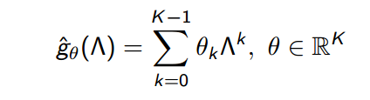

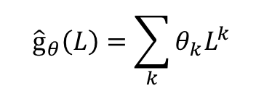
Polynomial parametrization for localized filters
Shuman, Ricaud, and Vandergheynst 2016
$${\hat{g}}_{θ}\left(L\right)=\sum_{k}{θ_{k}L^{k}}$$
$$L^{k}\left(i,j\right)=0,if d\left(i,j\right)>k$$
We only consider k-order neighbors.
14

Slide 16
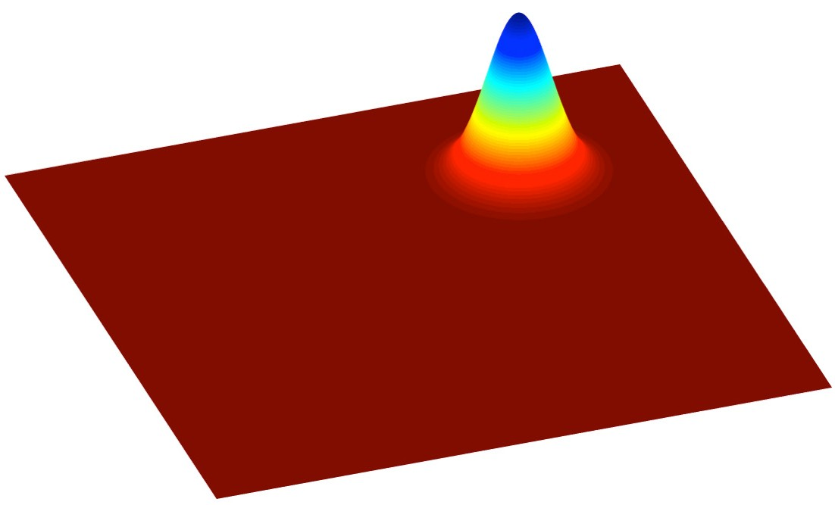
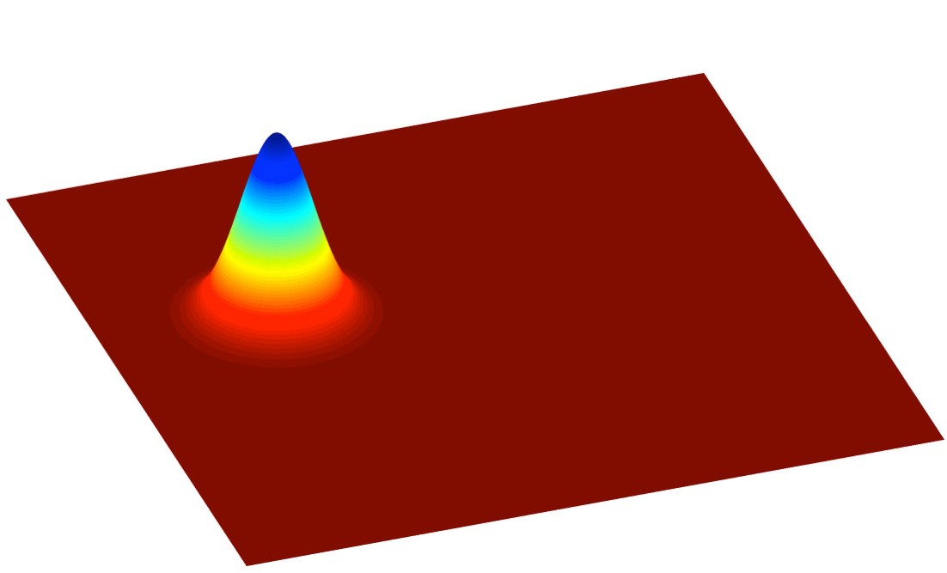
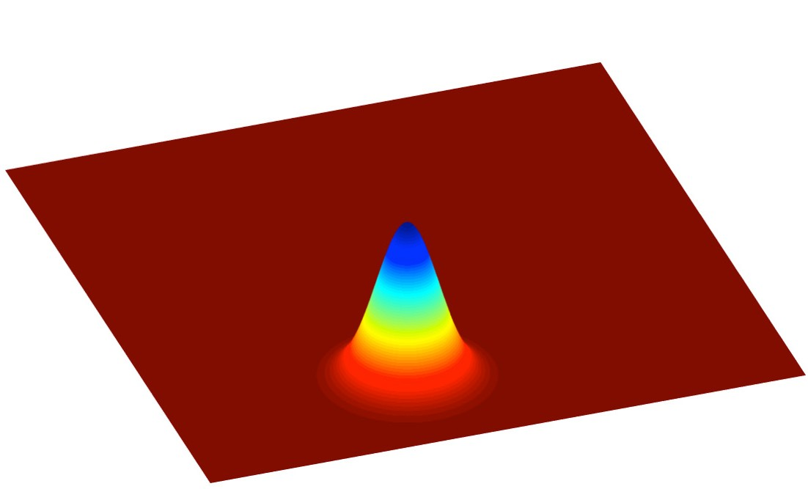
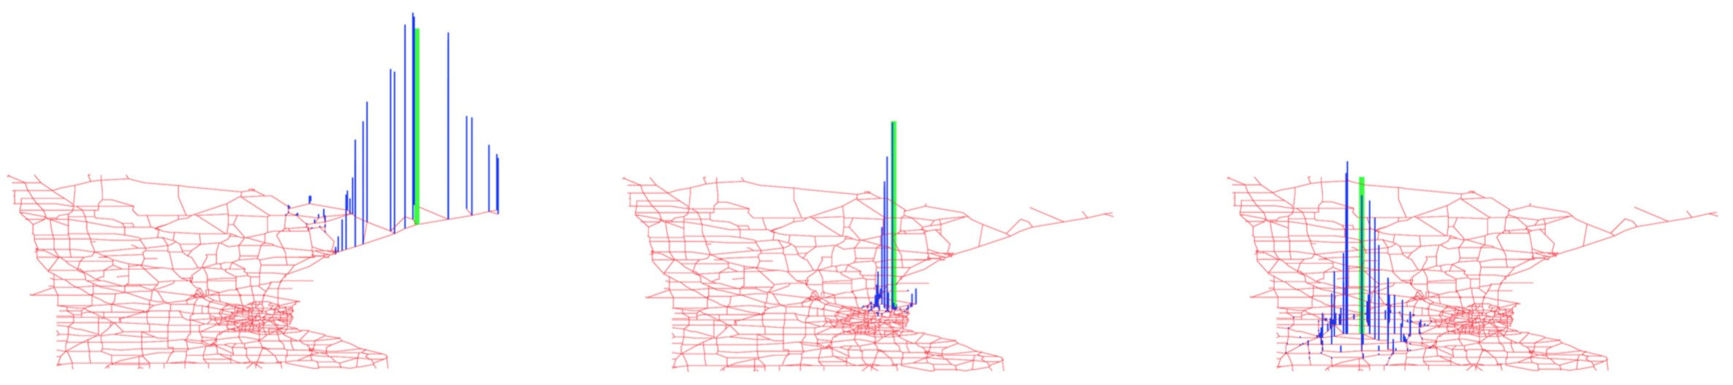
Filter localization
Shuman, Ricaud, and Vandergheynst 2016
Figure:Localization on regular Euclidean grid.
Figure:Localization on graph
15

Slide 17
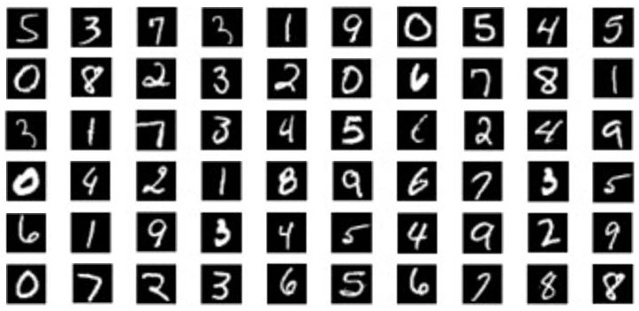
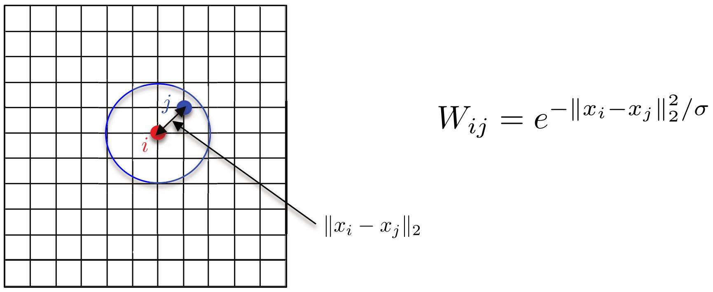
MNIST: revisiting Euclidean ConvNets
16

Slide 18
MNIST: classification accuracy
Model | Architecture | Accuracy
Classical CNN | C32-P4-C64-P4-FC512 | 99.33
Proposed graph CNN | GC32-P4-GC64-P4-FC512 | 99.14
Comparison to classical CNNs.
Comparable to classical ConvNets!
17

Slide 19
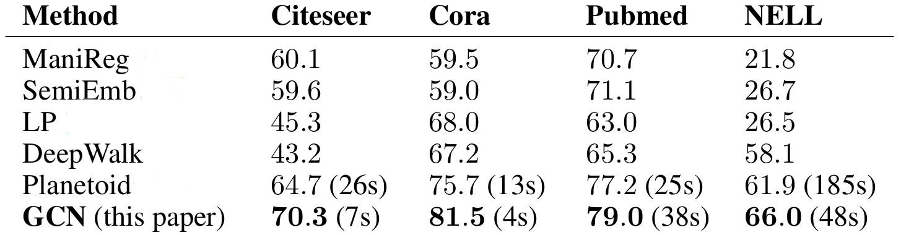
Application: semi-supervised learning
Kipf and Welling 2016
Problem: Semi-supervised classification.
Architecture: two graph convolutional layers.
Filters: first-order approximation, i.e. K = 1.
18

Slide 20






























Application: time-varying graph signals
Seo, Defferrard, Bresson, and Vandergheynst 2016
Stack a RNN on top of a graph ConvNet.
Encoder input Sequence
Input
Decoder output Sequence
Prediction gt
6000
LSTM+CNN, 5x5 filters LSTM+GCNN, K=3 LSTM+GCNN, K=5 LSTM+GCNN, K=7
validation cross-entropy
5500
5000
4500
4000
3500
0
2 4 6 8 10 12 14
19
#epoch

Slide 21
Conclusion
相对完备的Graph Convolutional 理论,并且具有较高的计算效率
论文在传统的CNN领域取得了近似CNN的效果
没有考虑有向图
20

