Slide 1


Enabling High-Quality Untethered Virtual Reality
Omid Abari
Dinesh Bharadia, Austin Duffield, Dina Katabi

Slide 2
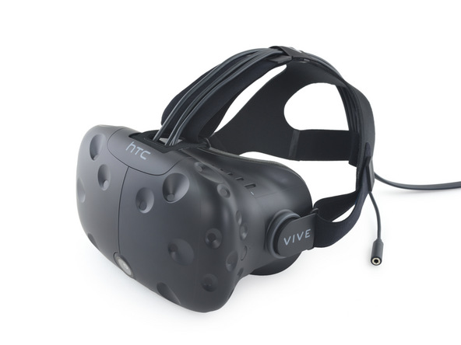
Virtual Reality
Bloomberg forecasts VR headset sales to hit 42 million units by 2020

Slide 3
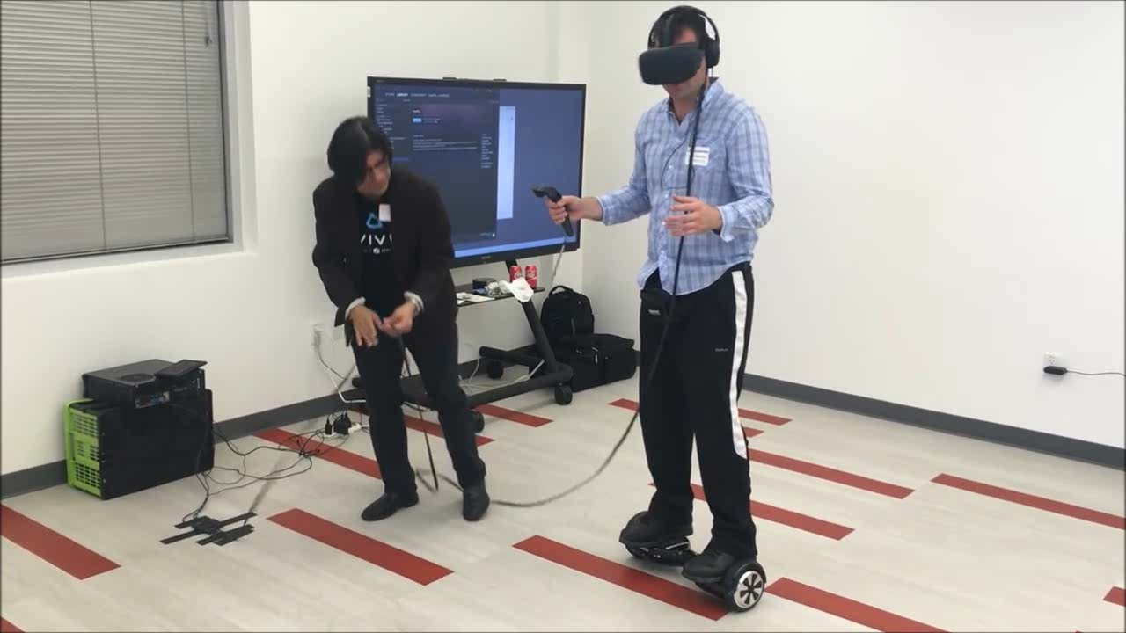
VR headsets require a cable connection to a PC
The cable significantly limits the player’s mobility

Slide 4

Why does VR headset need a cable?
HDMI Cable
Powerful PC
Stream 6.4 Gbps of data from PC to headset

Slide 5
Untethered Virtual Reality
Typical wireless systems: WiFi, cellular, etc.
mmWave Technology

Slide 6
mmWave Technology
Today’s WiFi
mmWave
0
10GHz
20GHz
30GHz
40GHz
50GHz
60GHz
70GHz
80GHZ
90GHz
100GHz
Frequency Spectrum
Enable multi-Gbps wireless links

Slide 7

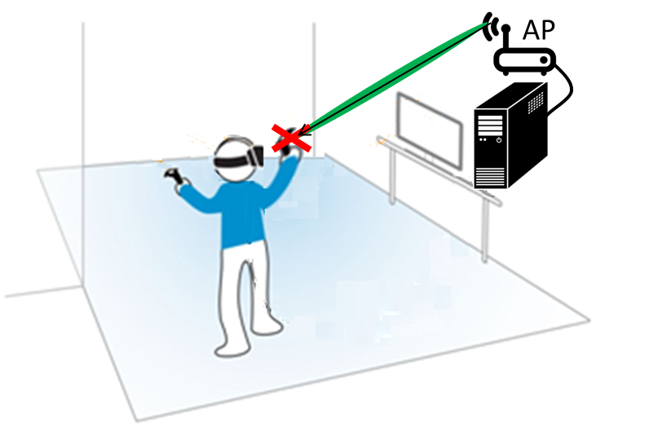
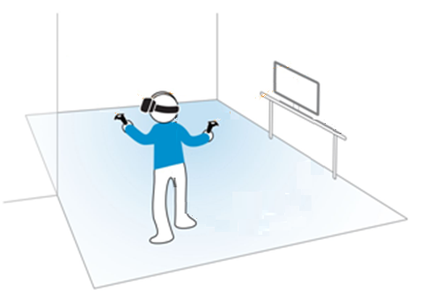



Problem: Signal Blockage
AP
RX
RX
mmWave Signal can be easily blocked by even a small obstacle like the player’s hand

Slide 8
Impact of Blockage
Required data rate
Blocking mmWave signals results in a significant drop in data rate

Slide 9
How can we solve the blockage problem?

Slide 10

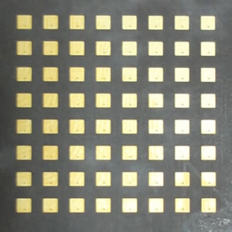
mmWave Mirror
Idea
AP

Slide 11
MoVR
A system that enables high-quality untethered virtual reality
A configurable mmWave mirror
Does not require the angle of reflection to be equal to the angle of incidence
Amplifies and reflects the signal
Built and evaluated in a representative VR gaming setup

Slide 12
MoVR Architecture
G
amplifier

Slide 13
MoVR Architecture
MoVR architecture is simple:
No transmitter chain
No receiver chain
No baseband processor
No coding/decoding
G
amplifier

Slide 14
Challenge 1: Beam Alignment
AP
Existing schemes require the node to have a transmitter or receiver chain
How can the mirror find the direction of AP and headset given no transmitter and receiver?

Slide 15
Solution: Delegate the task of transmitting and receiving to the AP

Slide 16
Solution: Delegate the task of transmitting and receiving to the AP
AP
MoVR mirror
Exploit the inherent VR headset tracking system to track the beam alignment in real-time
MoVR finds and tracks the beam alignment, despite lacking transmit and receive chains

Slide 17
Challenge 2: Amplify and reflect at the same time
Leakage
G
From control theory:
If gain larger than leakage,
amplifier saturates
+
-L dB
G dB
How can we avoid saturation?

Slide 18
Solution: Exploit amplifier’s characteristic
Amplifiers draw significantly higher current from the power supply as they get close to saturation
Current
Optimal point
Saturation
Amplifier’s Output
The mirror amplifies and reflects the signal at the same time

Slide 19
Experimental Results

Slide 20
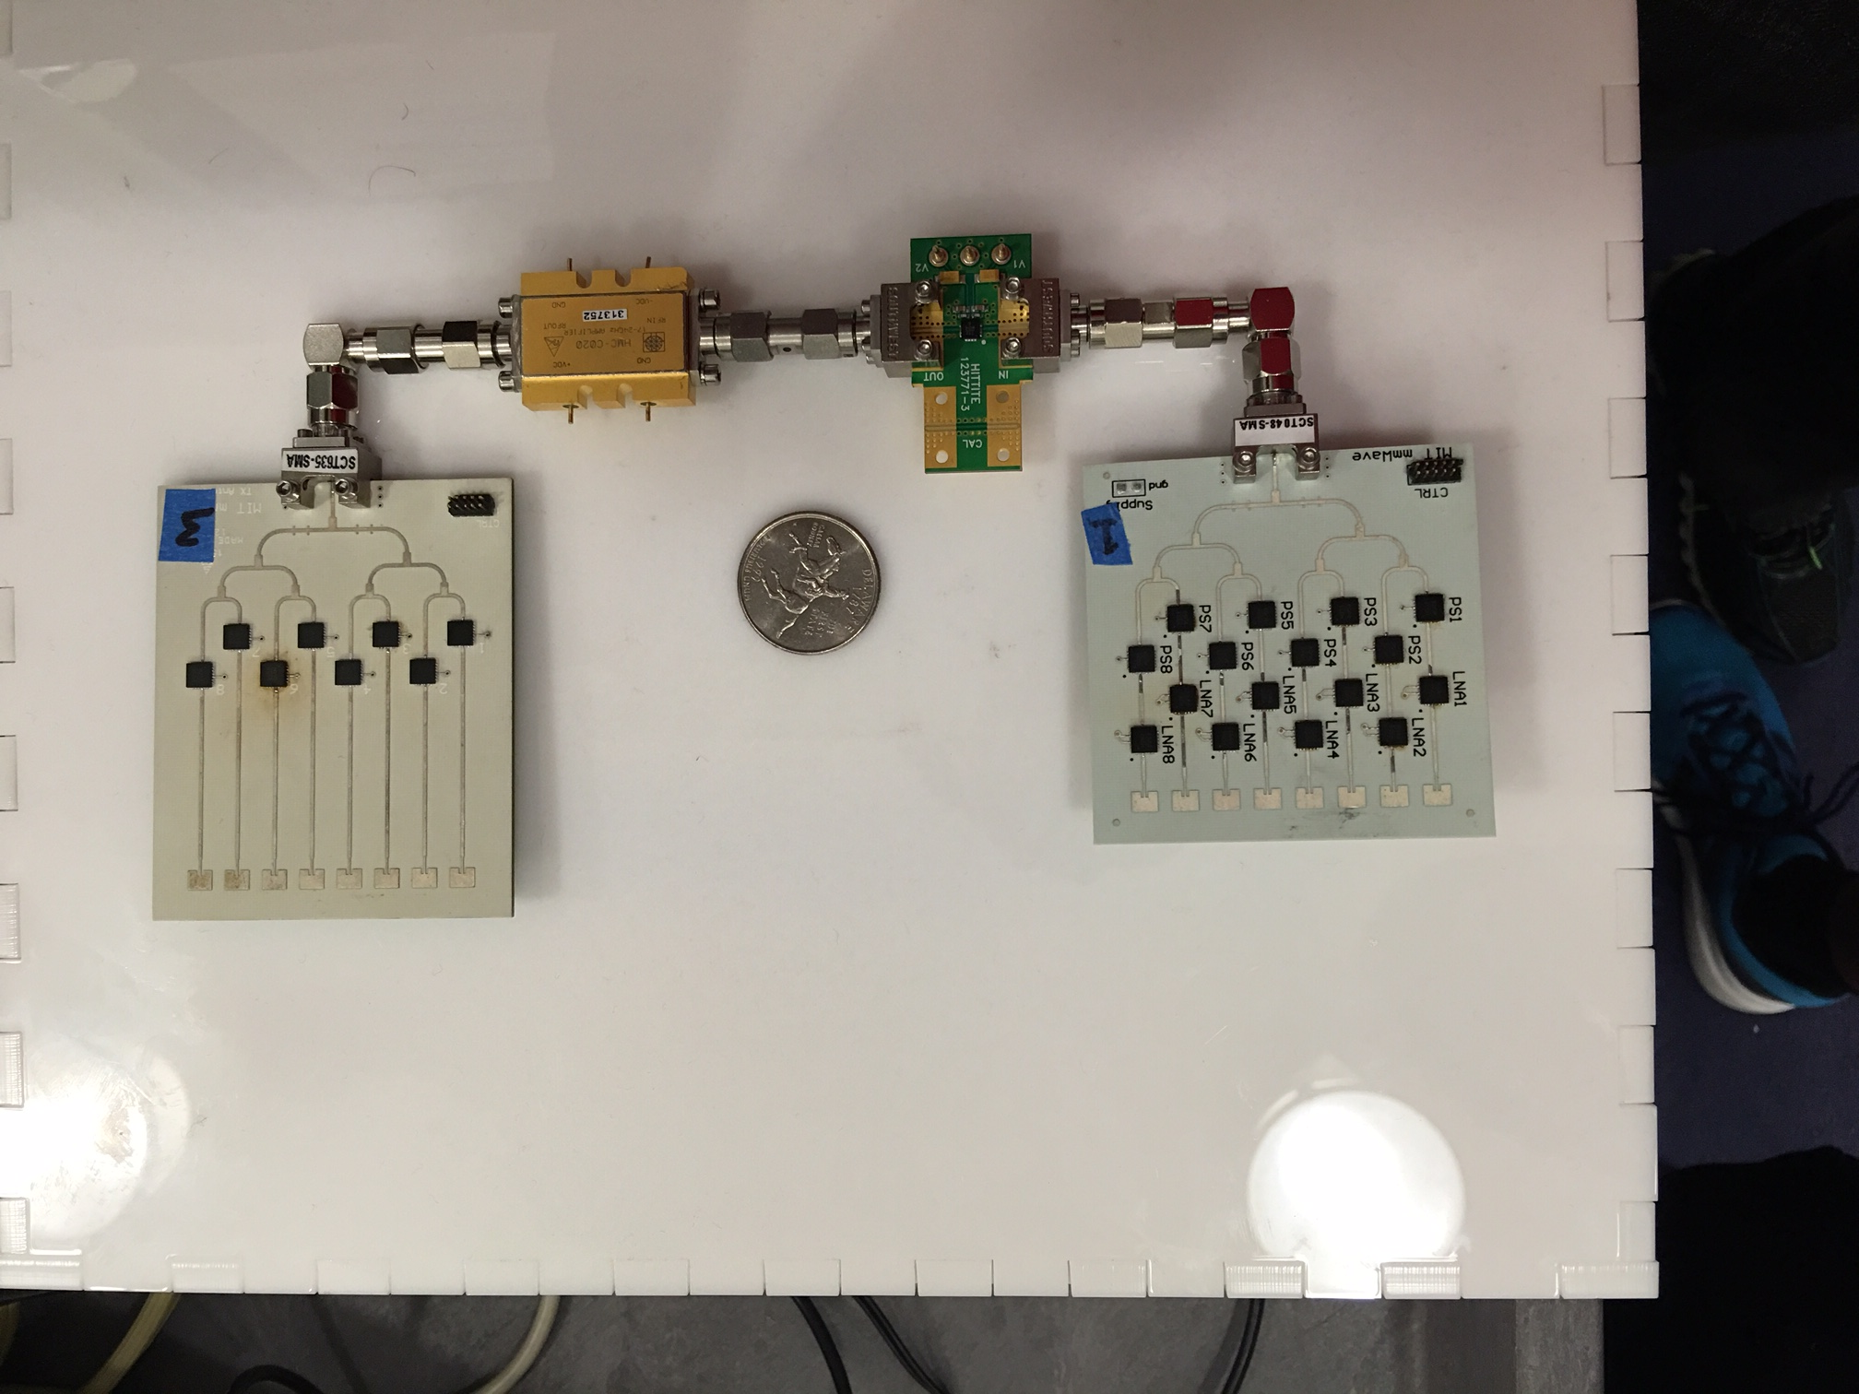
Evaluation
Built a prototype of MoVR
Used an HTC VIVE VR headset
Evaluated in a 5mx5m room

Slide 21
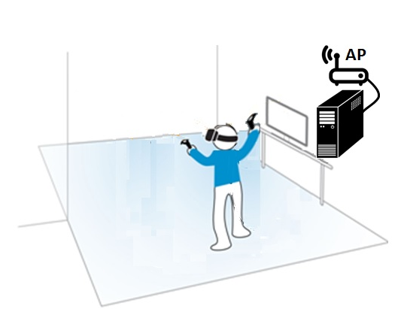
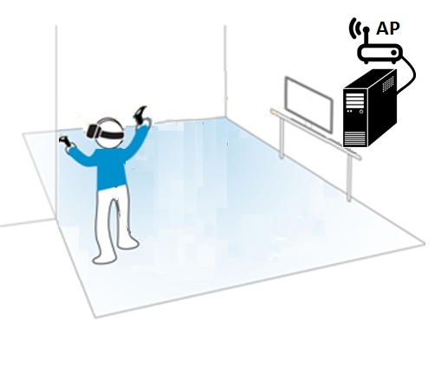
Evaluation
mmWave Mirror
mmWave Mirror
mmWave Mirror
AP

Slide 22
Beam Alignment Accuracy
MoVR estimates the angle of best beam alignment to within 2 degrees

Slide 23
Data Rate Performance
Required data rate
MoVR enables a high-data-rate link even in
the presence of blockage

Slide 24
Related Work
mmWave communications
They address static links where there is always a line-of-sight path such as data centers[D.H. SIGCOMM’11, B.Z. D.H. SIGCOMM’12, etc ].
or They target applications which can tolerate data rate drop due to blockage [S.S. NSDI’16, Y.Z. MobiCom’14, K.H. MobiHoc’16, S. S. IT’16, X. Z. SIGCOMM’12 etc].

Slide 25
Conclusion
Blockage is a key problem in using mmWave technology in VR applications.
MoVR: A mmWave system that enables a high-data-rate wireless link even in the presence of blockage.
MoVR enables high-quality untethered virtual reality.

Slide 26
Enabling High-Quality Untethered Virtual Reality

