Slide 1


UBICOMP 2016
Tell Me What I See:
Recognize RFID Tagged Objects
in Augmented Reality Systems
Lei Xie¹, Jianqiang Sun¹, Qingliang Cai¹, Chuyu Wang¹, Jie Wu², and Sanglu Lu¹
¹State Key Laboratory for Novel Software Technology, Nanjing University, China
²Department of Computer Information and Sciences, Temple University, USA
Presenter: Dr. Lei Xie
Associate Professor from Nanjing University

Slide 2
Outline
1
Motivation and Problem
2
System Overview
3
Feature Sampling and Extraction
4
Matching with Continuous Scanning
5
Performance Evaluation and Case Study
6
Conclusion

Slide 3
Outline
1
Motivation and Problem
2
System Overview
3
Feature Sampling and Extraction
4
Matching with Continuous Scanning
5
Performance Evaluation and Case Study
6
Conclusion

Slide 4

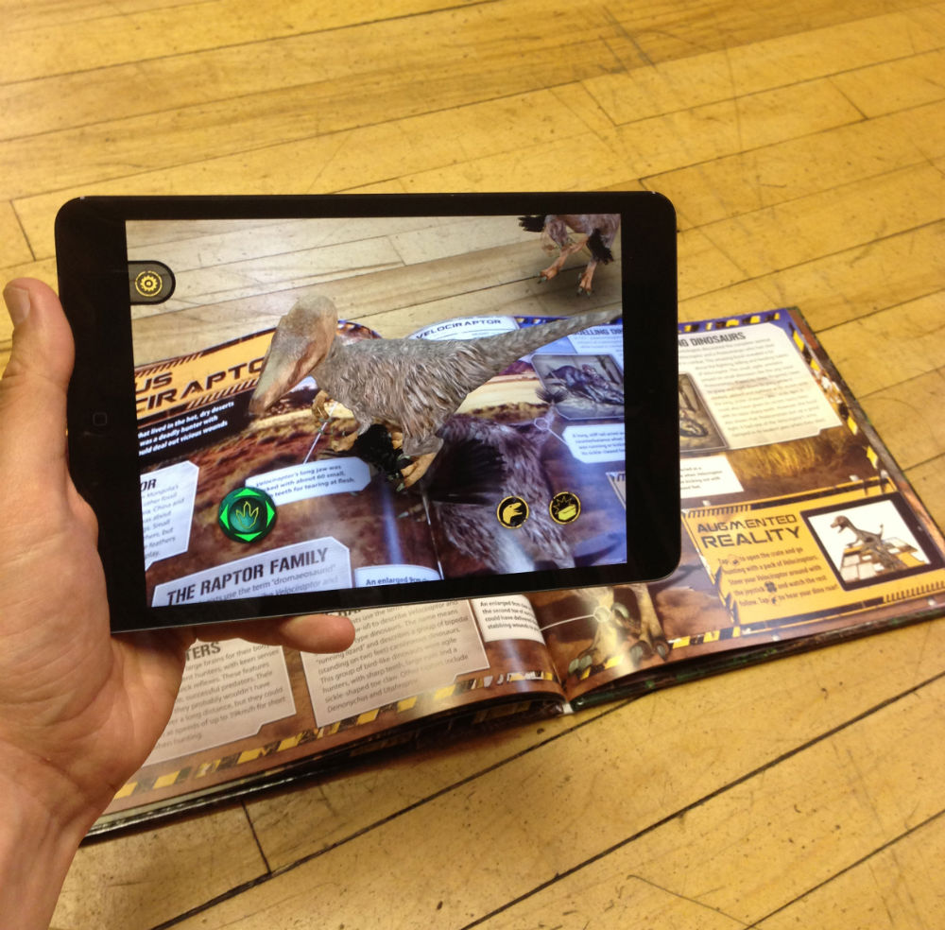
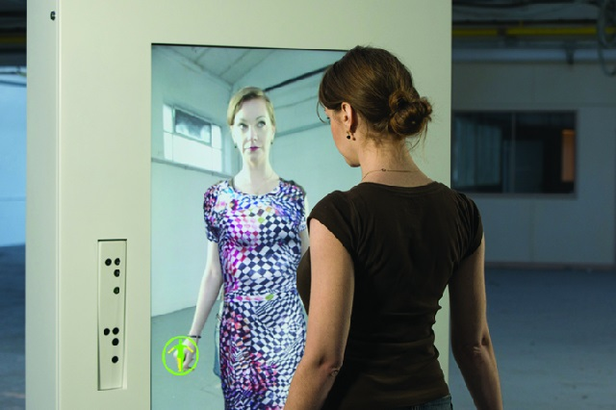
Motivation：Augmented Reality Systems
Augmented Reality technologies promise to enhance our perception and interaction with the real world.
Smart Glass
Smartphone or Tablet
Microsoft Kinect
Notes:
随着AR技术的普及，人们希望能在现实视角中看到更多信息
我们能通过智能手机，平板进行摄像的同时，看到添加了额外信息的图像
Goole Glass：在眼镜镜片上添加虚拟图像，增加交互渠道
Kinect：Kinect是微软在2010年对XBOX360体感周边外设正式发布的名字，增强游戏体验感。包括景深摄像机。

Slide 5

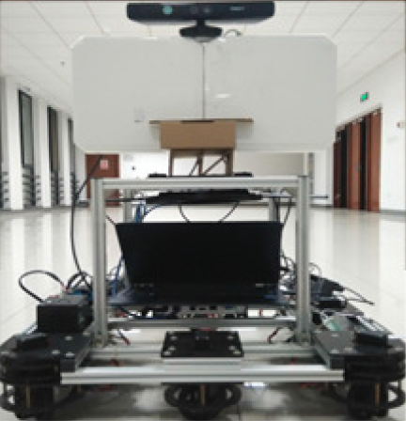
Motivation：Tell Me What I See (1)
Usage: Drinking Cup
Material: Pottery
Decade: 860s
More…
Usage: Bowl
Material: Wood
Decade: 700s
More…
Usage: Teapot
Material: Pottery
Decade: 800s
More…
Notes:
人们和系统都不擅长相似物体的区分。
结合AR系统， 加信息

Slide 6
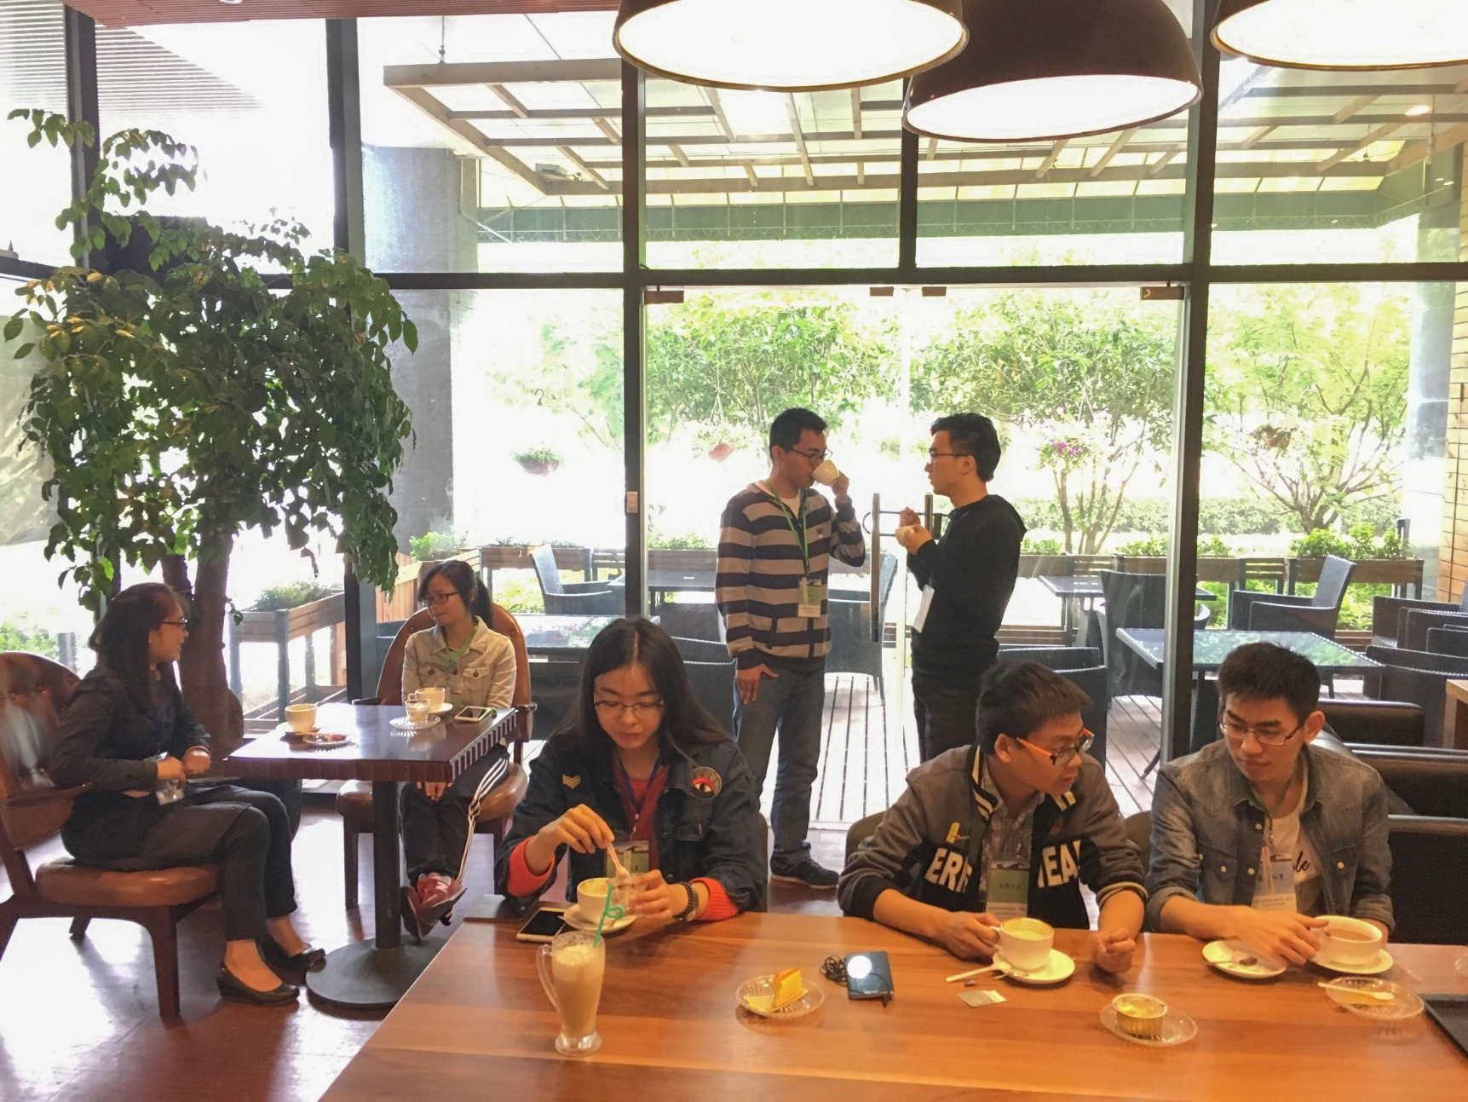
Motivation：Tell Me What I See (2)
Name: Edison
Job: Engineer
Interests: Films
More…
Name: David
Job: Designer
Interests: Photography
More…
Name: Carrot
Job: Doctor
Interests: Cooking
More…
Name: Savannah
Job: Teacher
Interests: Running
More…
Notes:
我们再也不用为想要与陌生人交流却不知如何开口感到烦恼

Slide 7
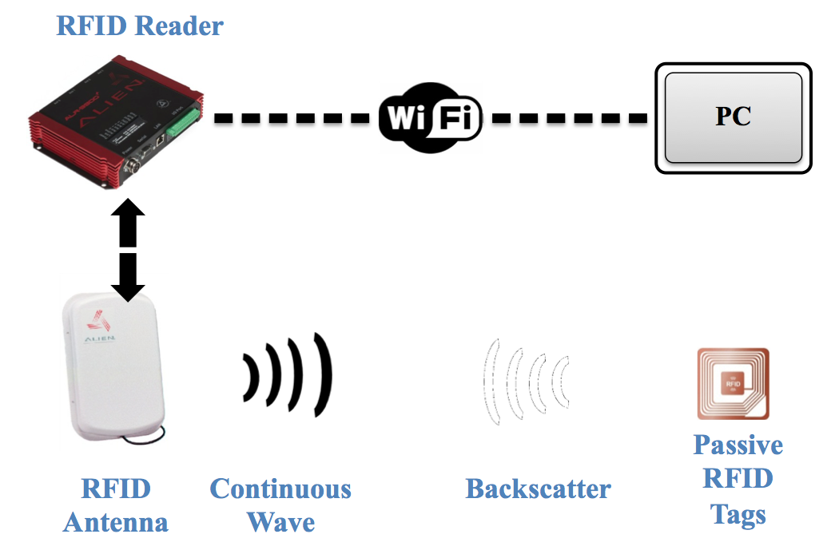
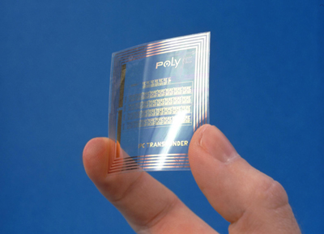


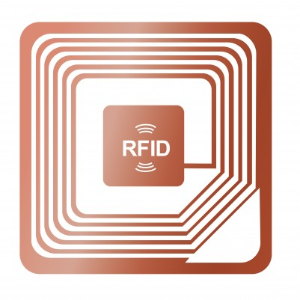
Approach：Recognize RFID Tagged Objects in Augmented Reality Systems
RFID Tags
The RFID tags can be used to label different objects, and store inherent information of these objects in their onboard memory

Slide 8

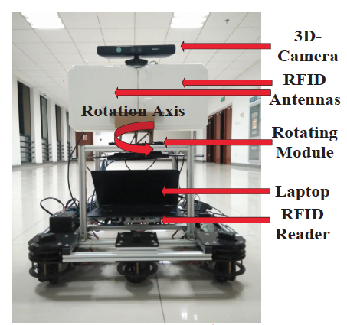
Approach：Recognize RFID Tagged Objects in Augmented Reality Systems
Depth of Field
RF Signal
Accurately identify and distinguish multiple tagged objects, by sufficiently exploring the inherent correlations between the depth of field and the received RF-signal.
Continuous Scanning
Prototype System
Notes:
我们的方法是设计一个系统并且通过摄像头和RFID天线同时持续转动就可以测量出景深和RF信号等信息，并且精确识别和区分出多个带标签的物体

Slide 9
Challenges
Challenge 1
How to conduct accurate paring between the objects and the tags?
Challenge 2
How to mitigate the interference from the multi-path effect and object occlusion in real settings?
Challenge 3
How to devise an efficient solution without any additional assistance like the anchor nodes?
Notes:
如何精确匹配物体以及标签
如何在实际环境中减轻多径效应和目标遮挡的干扰？
如何在不添加附件的情况下设计一个有效的方法

Slide 10
Outline
1
Motivation and Problem
2
System Overview
3
Feature Sampling and Extraction
4
Matching with Continuous Scanning
5
Performance Evaluation and Case Study
6
Conclusion

Slide 11
Design Goals & System Framework
Design Goals:
We aim to implement a supporting technology for the AR systems to realize the vision of “tell me what I see from the augmented system”, by leveraging RFID tags to label different objects.
Prototype System
Notes:
目标 为AR系统实现一项黑科技，通过识别RFID标签来为物体添加相应信息。
系统包括一个3D摄像头，RFID天线以及reader；计算需要用到的电脑。这些都放置在一个可移动且360度旋转的机器人上。

Slide 12
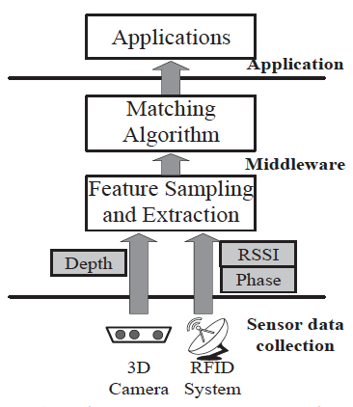
Design Goals & System Framework
Performance Metrics
Time-efficiency
Robustness
Accuracy
System Framework
Notes:
常常 需要区分的物体很接近->准确度
常常 实时运行->效率
常常 多径效应以及物体遮挡 ->鲁棒性

Slide 13
Outline
1
Motivation and Problem
2
System Overview
3
Feature Sampling and Extraction
4
Matching with Continuous Scanning
5
Performance Evaluation and Case Study
6
Conclusion

Slide 14
Feature Sampling and Extraction
Extract the Depth of Field from Depth-Camera
The depth value of object is directly related to the vertical distance instead of the absolute distance between the object and the 3D camera.
Fig. 3 (a) The depth histogram of multiple objects.

Slide 15
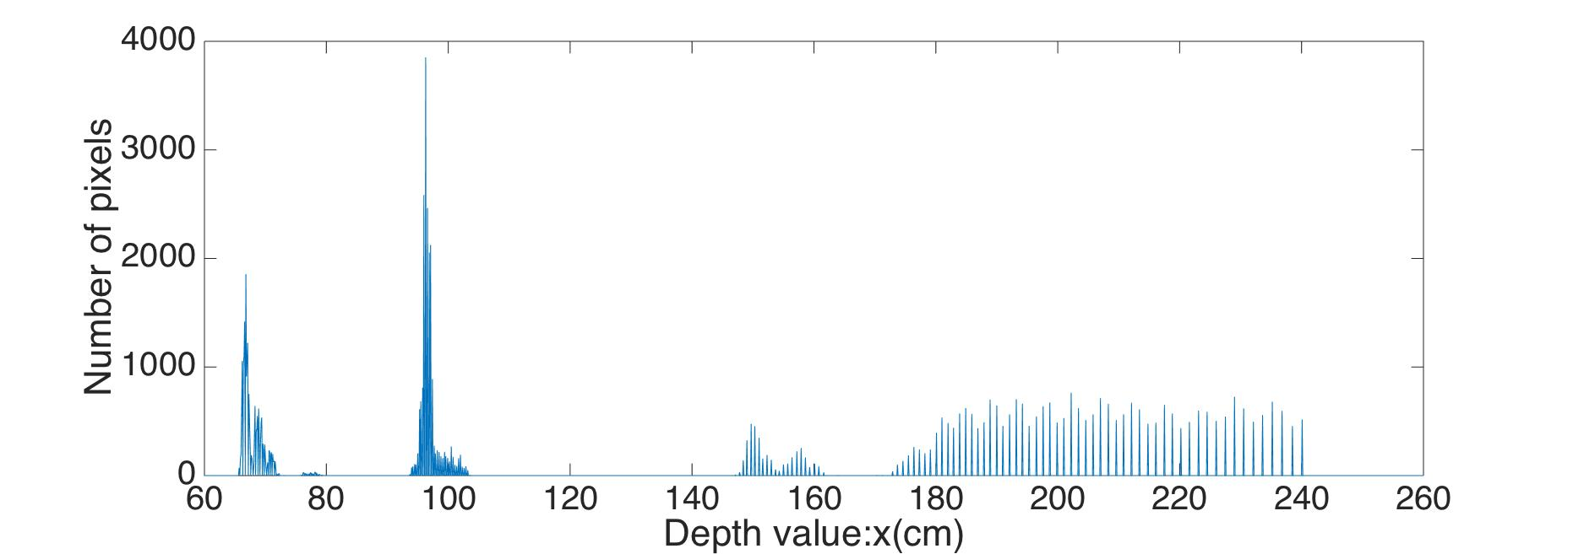

Feature Sampling and Extraction
Extract the depth of objects from the depth histogram of multiple objects.
Detect the peaks from the histograms
1: Set a threshold t to detect the peaks in regard to the number of pixels.
2: for each depth from the minimum depth to the maximum depth in the histogram.
3: if the number of pixels for a certain depth is larger than t , we identify it as a peak p(di,ni) with the depth di and the number of pixels ni .
Address the multiple-peaks problem
4: Set another threshold d. If the differences of these peaks’ depth values are smaller than d, then combine them as one peak.
multiple-peaks

Slide 16
Feature Sampling and Extraction
Extract the Received Signal Strength from RF-signals
perpendicular point
With different offset degrees from the tag to the center of antenna beam, the RSSI changes in a convex curve with the peak value at the perpendicular point .
Fig. 4. The variation of RSSI via rotating the RFID antenna

Slide 17
Feature Sampling and Extraction
Extract the Phase Value from RF-Signals
An example
Fig. 6. Estimate the distance from phase value of RF signals

Slide 18
Outline
1
Motivation and Problem
2
System Overview
3
Feature Sampling and Extraction
4
Matching with Continuous Scanning
5
Performance Evaluation and Case Study
6
Conclusion

Slide 19





Matching with Continuous Scanning
An Example Deployment of Multiple Tagged Objects
The objective:
Pair the Tags with Objects according to Depth and RF-signals

Slide 20
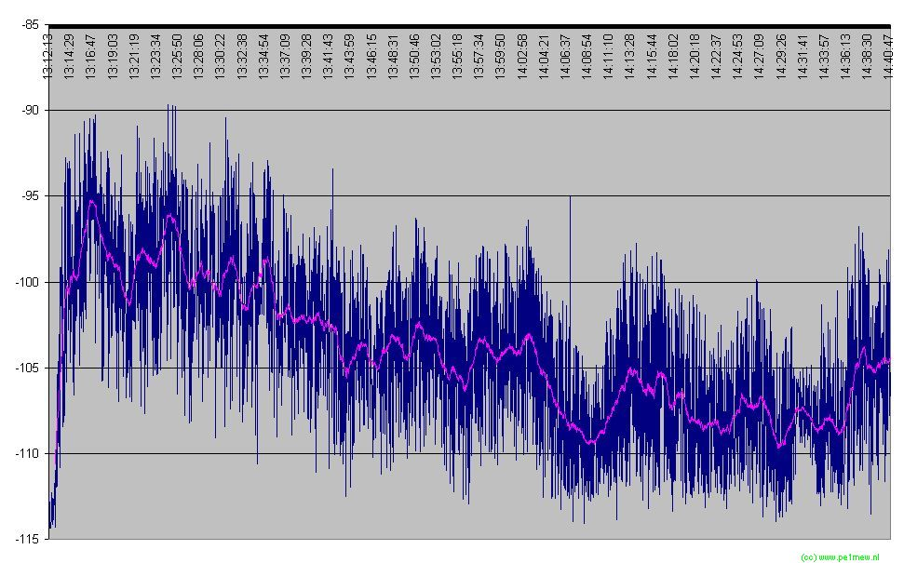
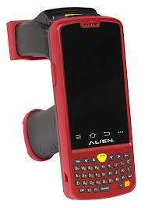
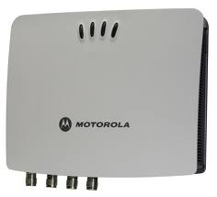
Matching with Continuous Scanning
Pair the Tags with Objects according to Depth and RSSI
Motivation
RSSI is not a very reliable metric to accurately measure the distance.
Easy to be impacted by the environmental factors.
However, most mid-and low-end COTS RFID systems can only extract the RSSI from RF-signals.
We need to figure out a solution based on RSSI.

Slide 21
Matching with Continuous Scanning
Extract Depth via Continuous Scanning
The rotation angle and the depth/RSSI of the peak values respectively denotes the differences in horizontal distances and vertical distances.
perpendicular
point
Extract RSSI via Continuous Scanning
We label each object/tag with the coordinate of its peak value, i.e., (θ,d) /(θ,r) , where θ represents the rotation angle and d/r represents the depth value/RSSI.
perpendicular
point

Slide 22
Matching with Continuous Scanning
Pair the Tags with Objects according to Depth and RSSI
While O≠null and T≠null do
Match the objects and tags: For any object Oi, select the candidate pairing tags according to the angle θi. Set all tags as pairing candidates with their angles in the range [θi-δ, θi+δ].
Match each object to a candidate tag based on their relative rank in RSSI and depth.
Calibrate the matching results: For the tag matched to multiple objects, make the tag select the object with the closest rank as the final pair.
End while
Rank in depth: 1st
θ4
Pair O4 with T4
θ1
θ2
θ4
Rank in RSSI: 1st

Slide 23
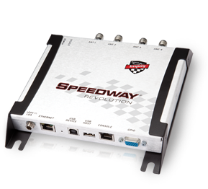
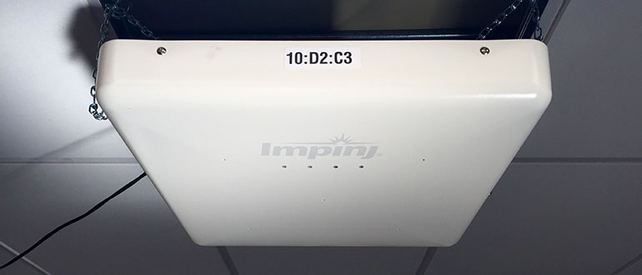
Matching with Continuous Scanning
Pair the Tags with Objects according to Depth and Phase
Motivation
A new brand of COTS RFID systems, like the ImpinJ, are able to extract the phase value from the RF-signals.
A new opportunity to differentiate the positions of the tagged objects with a more accurate approach.
Pair the tags with objects according to the correlations between the depth and phase in continuous scanning.

Slide 24

Matching with Continuous Scanning
Pair the Tags with Objects according to Depth and Phase
Derive the candidate position of the specified tag T according to the phase values
1: for each snapshot of the continuous scanning.
2: Extract the phase values (θ1, θ2) of tag T from the two antennas.
3: Compute the set of feasible positions in a global coordinate system as Si .
4: end for
5: Compute the intersection of different sets Si for all snapshots, and figure out a unique solution for the tag’s position as follows:
Fig. 8. Multiple solutions of the tag’s position
S1: candidate solution derived from the antenna pair
(A1, A2)
S2: candidate solution derived from the antenna pair
(A1, A’1)
S3: candidate solution derived from the antenna pair
(A2, A’2)
S=S1 Π S2 Π S3

Slide 25



Matching with Continuous Scanning
Pair the Tags with Objects according to Depth and Phase
Tag T’s
position
(x,y)
We can directly pair the objects Oi with the tags Tj according to the distance between the vector (θi,di) and the vector (θj,deltaj), since they can accurately estimate the positions of the objects/tags.

Slide 26
Outline
1
Motivation and Problem
2
System Overview
3
Feature Sampling and Extraction
4
Matching with Continuous Scanning
5
Performance Evaluation and Case Study
6
Conclusion

Slide 27
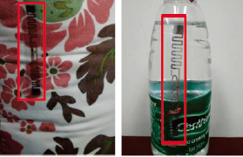
Performance Evaluation and Case Study
Experiment Settings
Four schemes for
performance comparison
Microsoft Kinect for windows
Laird S9028 RFID antennas
1) Static Scanning via Depth-RSSI Pairing (SS-RSSI)
2) Hybrid Scanning via Depth-Phase Pairing (HS-Phase)
3) Continuous Scanning via Depth-RSSI Pairing (CS-RSSI)
4) Continuous Scanning via Depth-Phase Pairing (CS-Phase)
ImpinJ R420
reader
Multiple ImpinJ E41-B
general purpose tags
Notes:
方法1：只在固定位置扫描一次，通过采集到的景深信息和RSSI的相对排名来匹配物体和标签
方法2：旋转摄像头，不断扫面；但是RFIDreader只在固定位置扫描一次，通过相位以及景深进行匹配
方法3：同时旋转，通过景深序列和信号强度进行匹配
方法4：同时旋转，通过景深序列和信号相位进行匹配

Slide 28
Evaluate the Accuracy in Pairing Tags with Objects
Accuracy for different cardinalities of tagged objects
Our solution achieves good performance in accuracy when the cardinalities of tagged objects are varied from 3 to 15.
Fig. 9(b) The match ratio for pairing different numbers of tagged objects

Slide 29
Evaluate the Accuracy in Pairing Tags with Objects
Accuracy for different vertical/horizontal distances
Our solution achieves good performance in accuracy when
the vertical/horizontal distances are varied from 10 cm to 50 cm.
Fig. 9(c) The match ratio with different
vertical distances
Fig. 9(d) The match ratio with different
horizontal distances

Slide 30
Evaluate the Robustness in Pairing Tags with Objects
Robustness to missing tags/objects
Our solution achieves good performance in robustness with
different ratios of missing objects/tags ranging from 10% to 50%.
Fig. 9(e) The match ratio with different
ratios of missing objects
Fig. 9(f) The match ratio with different
ratios of missing tags
Notes:
故意放入了无法识别的物体，当丢失率为…的时候，匹配率为

Slide 31
Evaluate the Robustness in Pairing Tags with Objects
Robustness to different numbers of samplings
Our solution achieves good performance in accuracy when the cardinalities of tagged objects are varied from 3 to 15.
Our solution achieves good performance in robustness with different numbers of samplings ranging from 3 to 15 during
continuous scanning.
Fig. 9(g) The match ratio with different numbers of samplings

Slide 32
Evaluate the Time Efficiency
SS-RSSI achieves the least time delay, as it only requires to scan once, whereas CS-RSSI achieves the most time delay.
Fig. 9(h) The time delay for different schemes

Slide 33
Case Study: RECOGNIZE MULTIPLE TAGGED HUMAN SUBJECTS IN THE CAFE
Example deployment of multiple human subjects wearing RFID badges in the cafe
Notes:
案例：

Slide 34
Case Study: RECOGNIZE MULTIPLE TAGGED HUMAN SUBJECTS IN THE CAFE
Example application interface
Notes:
我们可以在kinect中看到如下界面：包括对象的图片，详细信息，可以自行选择匹配算法，实验结果，扫描按键

Slide 35
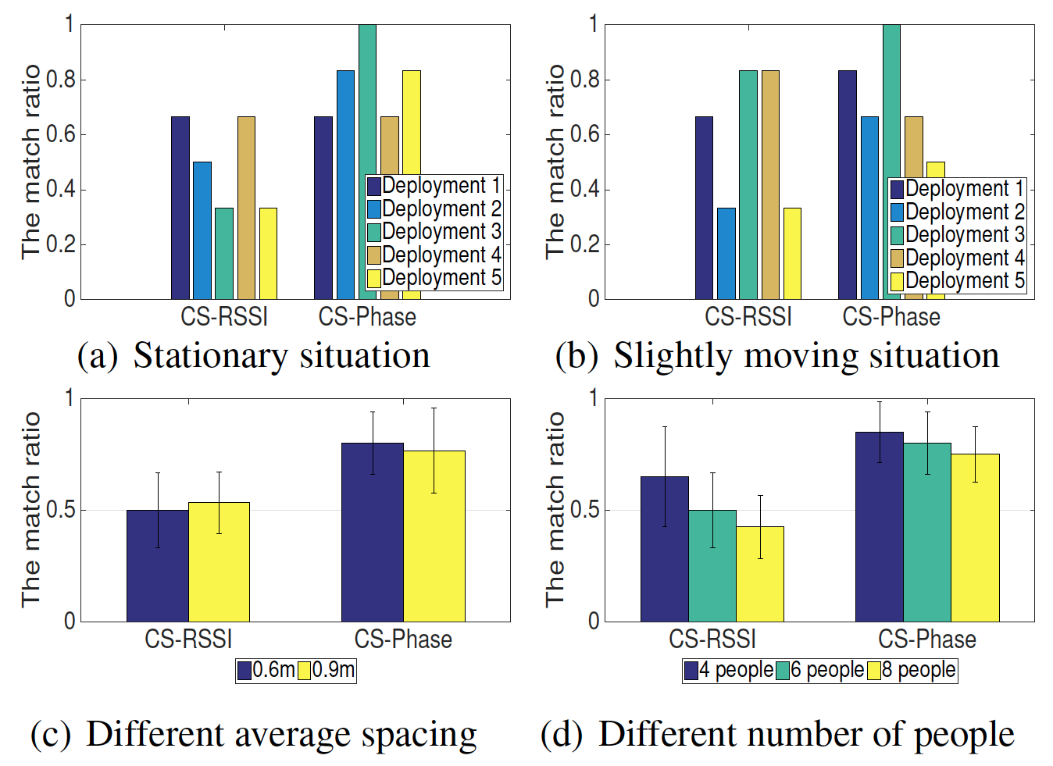
Performance Evaluation
Our solution can achieve fairly good matching accuracy to recognize multiple tagged human subjects of different factors like the height, spacing, moving state, etc.
Notes:
无论实在静止下，轻微移动下，不同大小的空间内，不同数量的人数下，我们的系统都可以实现很好的精度

Slide 36
Performance Evaluation
Our solution achieves very positive user experience in regard to 1) application meaning, 2) technical complexity, 3) accuracy, 4) friendliness of user interface.
Fig. 13. Evaluation of the user experience:
1) application meaning, 2) technical complexity, 3) accuracy, 4) friendliness of user interface.
Notes:
好评：这是一个很好的AR项目，给予用户很大的帮助。
差评：系统太大，不实用。不太直观。

Slide 37
Outline
1
Motivation and Problem
2
System Overview
3
Feature Sampling and Extraction
4
Matching with Continuous Scanning
5
Performance Evaluation and Case Study
6
Conclusion
1

Slide 38
Conclusion
Contributions
—We provides a key RFID-based technology for the augmented reality systems to realize the vision “tell me what I see from the AR system”.
—We conduct experimental studies to explore the inherent correlations between the depth of field and RF-signals from the tagged objects. We propose continuous scanning-based solutions to accurately distinguish the multiple tagged objects.
—We implemented a prototype system and evaluated the actual performance with case studies. Our solution achieves an
average match ratio of 91% in distinguishing up to dozens of
RFID tagged objects.
Notes:
进行了实验研究，探索了带标签物体的景深及其RF信号的相关性。因此提出了一个连续扫描的方法进行多标签物体场景下的物体区分以及匹配
实现了一个平均匹配度高达91%的基于RFID的AR系统。

Slide 39
—为多种需求提出相应的解决办法。
—实验认真，数据罗列清晰，场景全面
—Shown on the screen of glasses?

Slide 40
UBICOMP 2016
Questions ?
Thank you !

