Slide 1
I am a Smartwatch and I can Track my User’s Arm
MobiSys’16
Sheng Shen, He Wang, Romit Roy Choudhury
University of Illinois at Urbana-Champaign(UIUC)

Slide 2
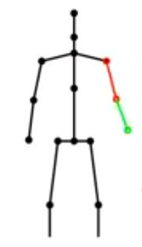
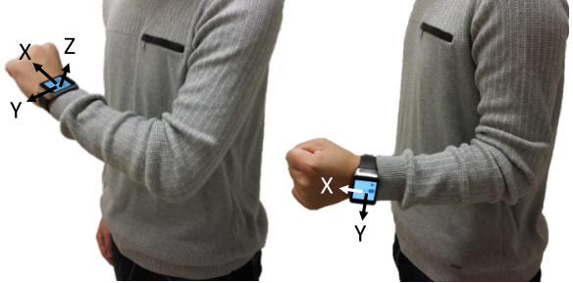
Background
For a fixed shoulder location, arm posture is uniquely defined by 3 parameters – elbow location, wrist location and wrist rotation.
A typical smart watch is equipped with gyroscope and accelerometer which gives orientation and location information.
The orientation of watch is aligned with the pointing direction of the forearm in 3D space.

Slide 3
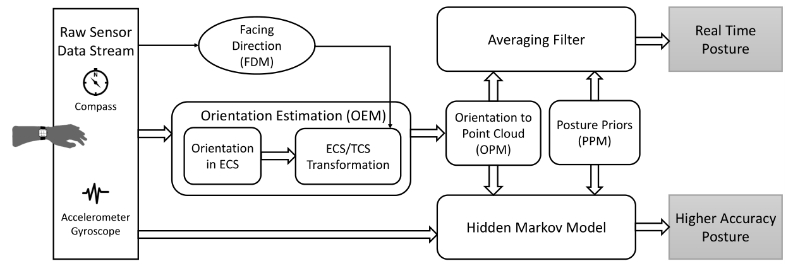
Architecture
Gyroscope
Accelerometer
Forearm orientation
Elbow location
Wrist location
Arm posture

Slide 4
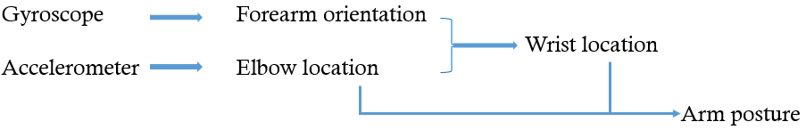
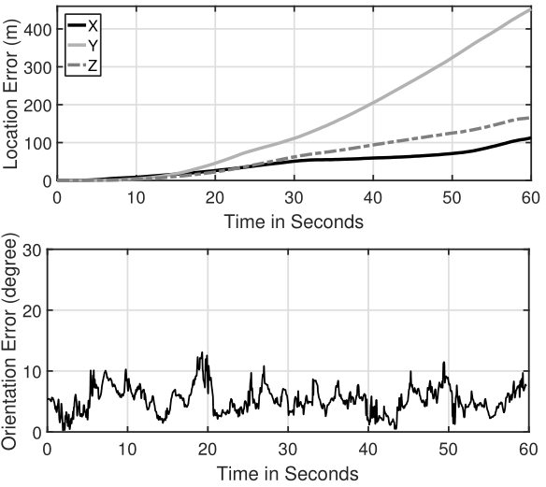
Problems
With noisy sensors, it is hard to calculate location from acceleration by double integration.
How to obtain elbow acceleration from accelerometer data extracted from smart watch.
How to calculate elbow location using noisy elbow acceleration.

Slide 5
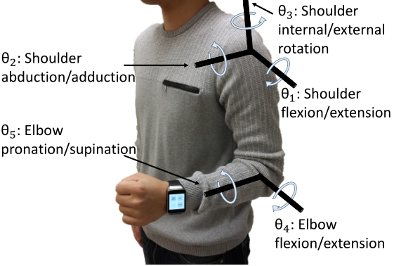
System design
– Estimate Elbow Acceleration
Torso Coordinate System(TCS):
Left shoulder serve as origin;
Plane of torso serve as XY plane;
Z axis emanating from the left shoulder in the frontward direction;
Global Coordinate System(GCS):
North-East coordinate system
Notes:
背景知识1:
人体坐标系和地理坐标系

Slide 6


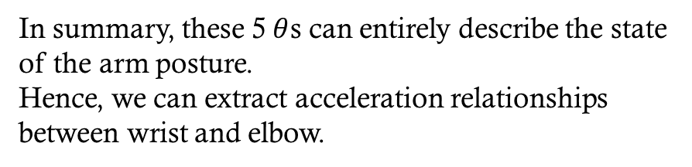
System design
– Estimate Elbow Acceleration
Elbow location and wrist location are functions of $θ_{1}$ to $θ_{5}$:
In summary, these 5$θ$s can entirely describe the state of the arm posture.
Hence, we can extract acceleration relationships between wrist and elbow.
Notes:
背景知识2：
作者对人体手臂的构造进行思考，参考了人体工程学，手臂的姿态可以通过七个旋转的自由度进行描述，忽略手掌的动作，剩下五个自由度，分别是。。。

Slide 7

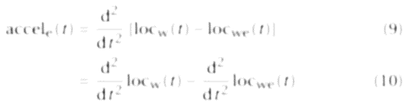


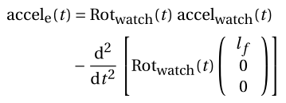
System design
– Estimate Elbow Acceleration
As a physical object, the acceleration of elbow is:
Applying equation 5:
Notes:
作者对人体手臂的构造进行思考，参考了人体工程学，手臂的姿态可以通过七个旋转的自由度进行描述，忽略手掌的动作，剩下五个自由度，分别是。。。
这两页的这么多公式最终得到方框里的这个公式，用手表的陀螺仪和加速度传感器的数据表示出胳臂肘的加速度

Slide 8
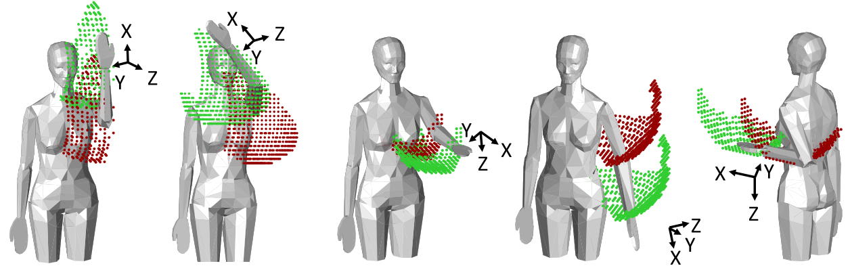
System design
– Estimate Elbow Location
With noisy sensors, it is hard to calculate location from acceleration by double integration.
For a given wrist orientation, the possible space of elbow locations can be reasonably restricted.
Notes:
前面得到胳臂肘的加速度，由于加速度传感器的数据噪声很大，不能简单的用二重积分来计算胳臂肘的位置，这里作者又对人体构造进行了思考，作者发现
1、整个手臂在自由运动的过程中，肘关节所能到达的位置是一个球面的一部分，范围大大缩小。比方说第四幅图；
2、如果保持小臂方向固定，那么肘关节和腕关节的运动曲面是平移关系，这就类比于铅锤+筷子。比方说第四幅图；
3、不同的小臂方向，对应的可达曲面是不一样的，比如说保持小臂侧平举方向的时候，胳臂肘就不可能到达身体前侧。
那么，告诉我一个小臂的方向，我可以得到两个关节能够到达的区域，继而在这个区域内搜索来得到肘关节的位置，搜索的依据就是elbow的加速度。

Slide 9
System design
– Estimate Elbow Location
Problems:
How to estimate the Range Of Motion(ROM) space for elbow?
How to search for elbow locations according to acceleration data?
Notes:
面对两个问题：
1、怎么由关节之间的约束得到关节的可达曲面？
2、怎么在可达曲面内搜索关节位置？

Slide 10
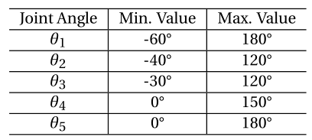
System design
– Estimate Elbow Location
– Estimate ROM
According to some medical papers, ROM for each DOF (Degrees Of Freedom) angle can be listed as:

Slide 11
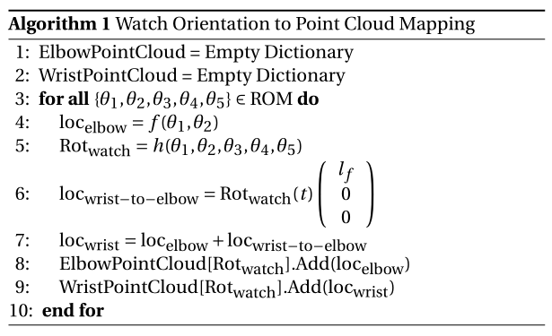
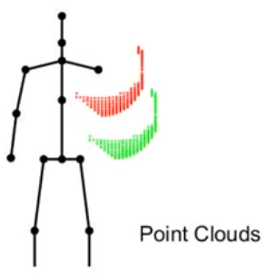
System design
– Estimate Elbow Location
– Estimate ROM

Slide 12

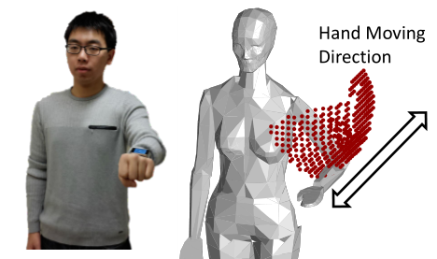
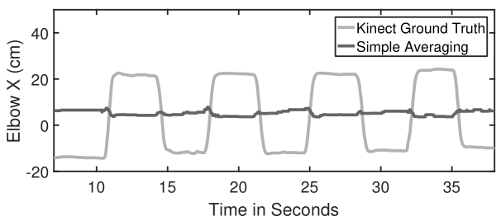
System design
– Estimate Elbow Location
– Search in ROM
Tentative solution: simple averaging
For punching posture, point cloud remains almost the same due to same forearm orientation.

Slide 13



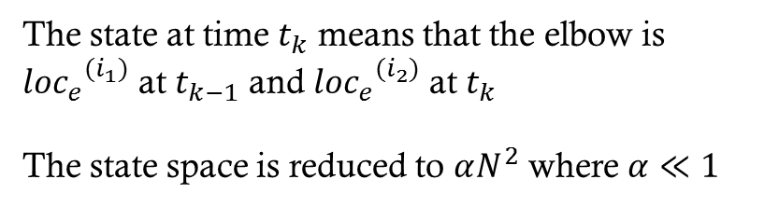
System design
– Estimate Elbow Location
– Search in ROM
Modified HMM for Elbow Tracking
State Definition:
Prior Probability:
$${state}_{i}=<{{loc}_{e}}^{(i_{1})},{{loc}_{e}}^{(i_{2})}>$$
$$π\left({state}_{i}\right)=\frac{1}{αN^{2}}$$
For any $i$
The state at time $t_{k}$ means that the elbow is ${{loc}_{e}}^{(i_{1})}$ at $t_{k−1}$ and ${{loc}_{e}}^{(i_{2})}$ at $t_{k}$
The state space is reduced to $αN^{2}$ where $α≪1$

Slide 14







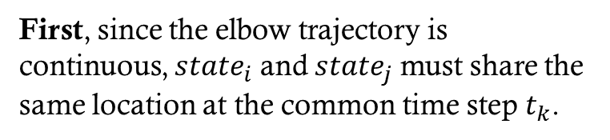

System design
– Estimate Elbow Location
– Search in ROM
Modified HMM for Elbow Tracking
Transition Probability:
First, since the elbow trajectory is continuous, ${state}_{i}$ and ${state}_{j}$ must share the same location at the common time step $t_{k}$.
Second, mode acceleration into two continuous tuples which is close to observation(Gaussian distribution).
$${velocity}_{j}={({{loc}_{e}}^{\left(j_{1}\right)}−{{loc}_{e}}^{(j_{2})})}/{∆T}$$
$${state}_{i}=<{{loc}_{e}}^{(i_{1})},{{loc}_{e}}^{(i_{2})}>$$
$${velocity}_{i}={({{loc}_{e}}^{\left(i_{1}\right)}−{{loc}_{e}}^{(i_{2})})}/{∆T}$$
$${state}_{j}=<{{loc}_{e}}^{(j_{1})},{{loc}_{e}}^{(j_{2})}>$$
$${accel}_{i,j}={({velocity}_{j}−{velocity}_{i})}/{∆T}$$
$${{loc}_{e}}^{(i_{2})}={{loc}_{e}}^{(j_{1})}$$
$${Pr}_{1}=I_{{{loc}_{e}}^{(i_{2})}={{loc}_{e}}^{(j_{1})}}$$

Slide 15


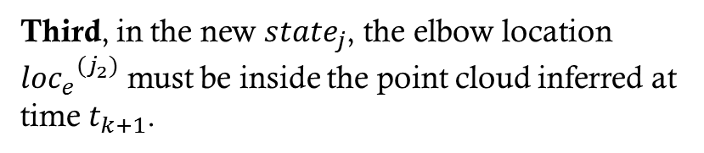
System design
– Estimate Elbow Location
– Search in ROM
Modified HMM for Elbow Tracking
Transition Probability:
Third, in the new ${state}_{j}$, the elbow location ${{loc}_{e}}^{(j_{2})}$ must be inside the point cloud inferred at time $t_{k+1}$.
In sum, the transition probability is:

Slide 16
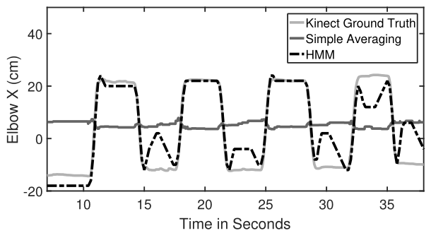
System design
– Estimate Elbow Location
– Search in ROM
Modified HMM for Elbow Tracking
Emission Probability:
Since we have already integrated the observed acceleration into transition probability, emission probability is simply set as 1.

Slide 17
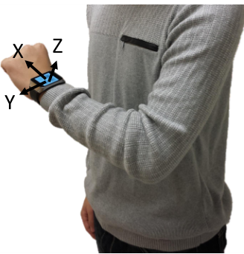
System design
– Others
Facing Direction:
Real Time Posture:
Opportunistically sense the facing direction when the user’s hand is in the vertical free-fall posture.
Use a simple weighted averaging filter.

Slide 18
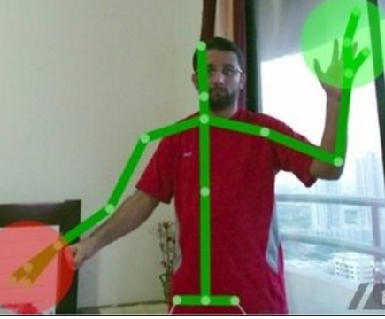
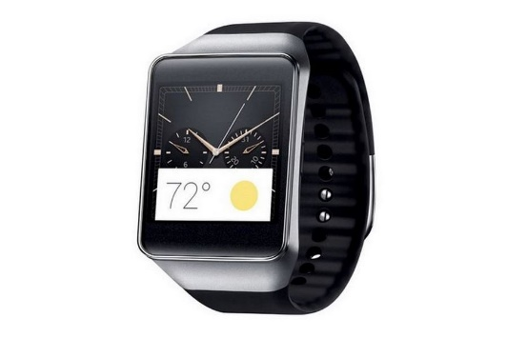
Evaluation
– Implementation
Kinect as ground truth
Samsung Gear Live

Slide 19
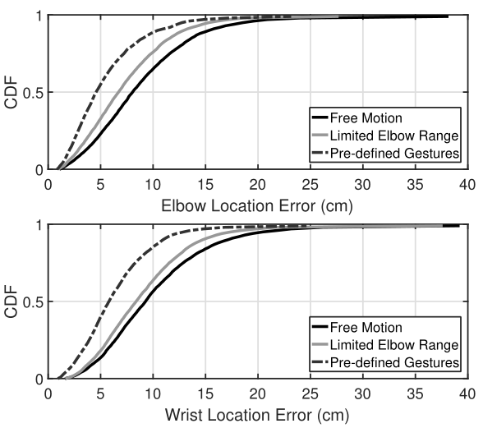
Evaluation
– Performance
Performance for different motions

Slide 20
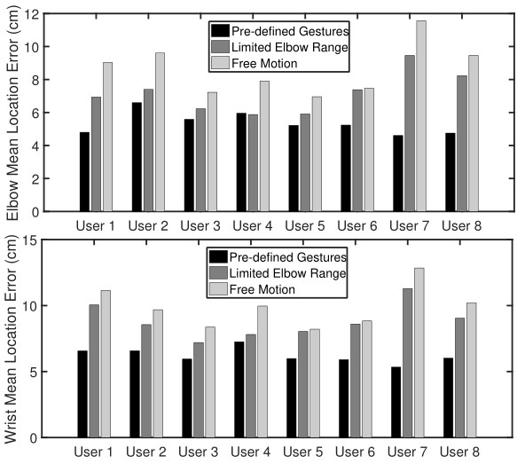
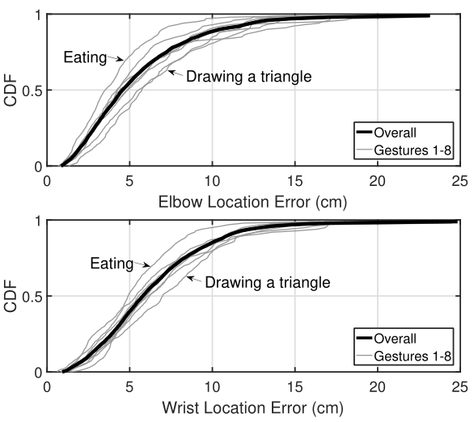
Evaluation
– Performance
Performance for different users & postures

Slide 21
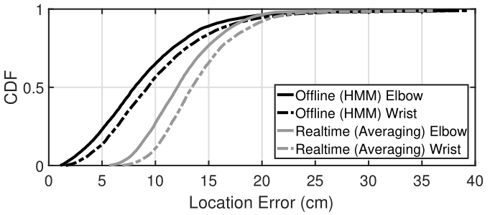
Evaluation
– Performance
Performance for two models

Slide 22
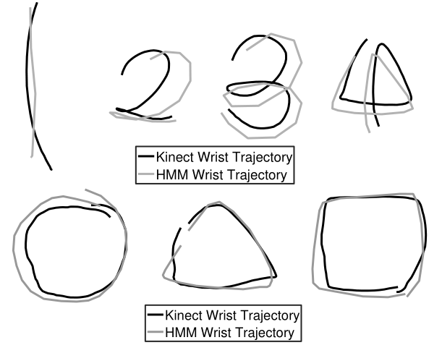
Evaluation
– Performance
Performance for drawing shapes

Slide 23
Conclusion
Contributions:
Utilizing the sensors on off-the-shelf smart watches to track arm postures.
Deep insight into anatomical models and combining robotics technology with posture recognition.
Modified HMM to reduce time complexity.
Parameterizing the system to achieve different tradeoffs between accuracy and latency, and offering them as a single knob to application developers.
Shortcomings:
Vulnerable to ferromagnetic materials in indoor environment.
Performance degrade while user move around.
Gyroscopes are energy-consuming.

Slide 24
Thanks

