Slide 1
UniPass: Design and Evaluation of a Smart Device-Based Password Manager for Visually Impaired Users
Natã M. Barbosa, Jordan Hayes, Yang Wang
SALT Lab, School of Information Studies, Syracuse University
Presented by Kai Zhang

Slide 2
INTRODUCTION
Password schemes are the most common form of authentication such as logging into a website.
Some users adopt web browsers’ built-in password reminders or dedicated passwords managers for creating, maintaining, and remembering strong passwords.
Users with visual impairments face various issues when dealing with password-based authentication on the web using such password managers.

Slide 3
OUR CONTRIBUTION
We designed UniPass, an accessible password manager for visually impaired users based on a smart device.
To evaluate UniPass, we recruited ten visually impaired users to test and compare UniPass with two commercial password managers: LastPass and StrongPass.
We seek to understand this population’s mental models, perceived security, perceived necessity and acceptance, perceived ease of use, comfort level, and perceived accessibility when using password managers.

Slide 4
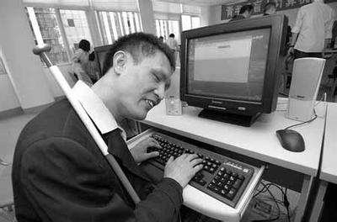
RELATED WORK
How visually impaired users surf the Internet?
No monitor.
No mouse.
Use speaker for screen reader.
Use keyboard for cursor control.

Slide 5
RELATED WORK
Some hints from existing usability evaluation of password managers
Users’ incorrect mental models may cause leakage of sensitive information and render password management systems vulnerable.
Users preferred portable password managers over online managers.
Users found the dual-possession (e.g., using a computer and a smartphone) to offer similar conveniences to that of Firefox’s built-in password manager protected by a master password.

Slide 6
RELATED WORK
We made specific design decisions based on these recommendations when designing UniPass:
Provide clear feedback when saving and protecting a password.
Provide clear feedback when accessing a password.
Make the current state of the system easily determinable at all times.
Store credentials on a device controlled by users in order to increase acceptance, perceived security, and perceived necessity.
Avoid the use of a master password to simplify the workflow.

Slide 7
UNIPASS
Three main components:
Password manager application (installed on a smart phone)
Browser client (a browser extension or JavaScript code)
Proxy server (a web socket server to mediate the connection between the password manager and the browser client)

Slide 8
UNIPASS WORKFLOW
Prompt asks if a user wants to log in with her smart phone to the website.

Slide 9
UNIPASS WORKFLOW
Browser broadcasts representations of paring code via multiple QR codes and high-frequency audio tones for pairing with phone.

Slide 10
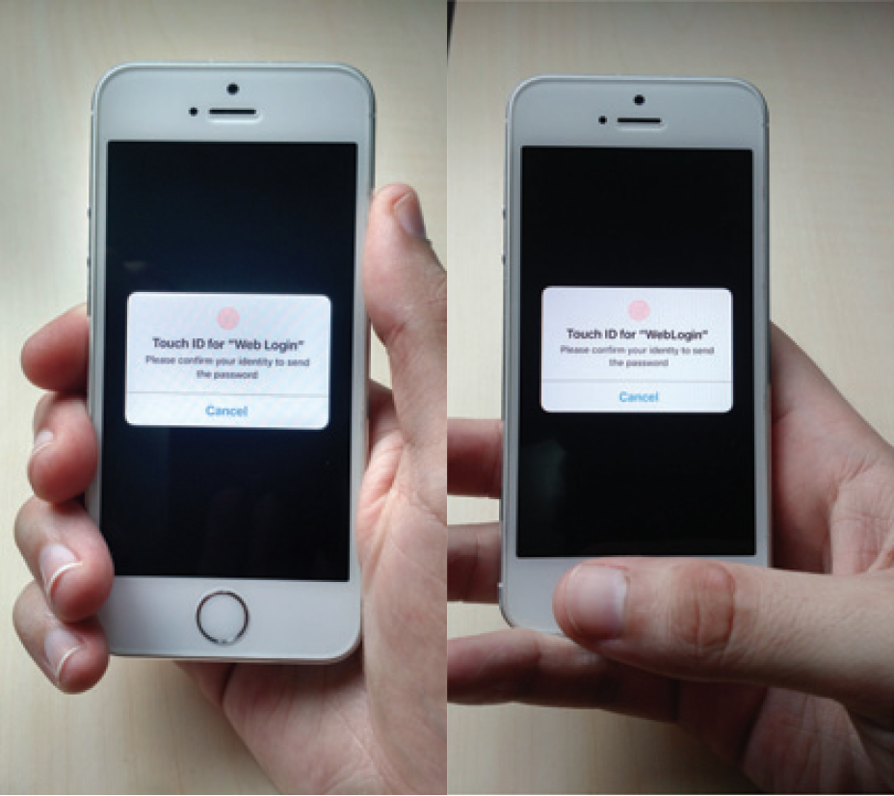
UNIPASS WORKFLOW
Phone recognizes audio tones, then completes a pairing process, and asks the user for fingerprint for authentication.

Slide 11
UNIPASS WORKFLOW
The login information is transferred, the login form on the computer is filled and submitted automatically.

Slide 12
FEATURES
Accessibility
Minimalistic design approach.
Only the minimum necessary steps and graphical elements are included.
Notes:
No user interface to see and change passwords stored on the smart device.
Users enter their credentials into the password manager on the computer instead of the phone.

Slide 13
FEATURES
Deployability
UniPass makes relatively minor software/hardware assumptions such as a public (desktop) computer having a speaker.
Any custom sensor (e.g., fingerprint sensor) used for authentication to the smart device could be replaced by other, more accessible sensors (e.g., gyroscope, accelerometer, camera, microphone) as long as they provide a reliable method (e.g., face/voice recognition, behavioral biometrics) to authenticate to the phone.
UniPass runs through a browser extension or JavaScript library.

Slide 14
ABANDONED FORMER PROTOTYPE
Pairing by scanning a QR code on the computer screen.
Authenticated to the smartphone by performing a secret movement with the phone (e.g., shaking the phone).
Users have difficulty scanning the QR code on the computer screen even though the QR code was optimized to randomly change its position and size.
“Shake the phone” device authentication strategy was perceived as unreliable in the preliminary user study.

Slide 15
USER STUDY
Compared with LastPass and StrongPass
We recruited 10 visually impaired users for a study session.
We created four fictitious websites of four real websites: Amazon, Facebook, Gmail, and the Chase bank.
For every session, users tested two password managers with the fictitious websites, one password manager always being UniPass.
Name | Phone | Master Password | Paring Method
UniPass | Needed | Unneeded | Audio & QR code
LastPass | Unneeded | Needed | -
StrongPass | Needed | Needed | QR code
Notes:
In the end, 10 participants
(six blind users and four users with low vision) finished the
study and six of them (P2, P3, P5, P7, P9, and P10) had tested
Prototype 1 previously.

Slide 16
USER STUDY RESULTS
Overall Preference
Seven out of ten participants preferred UniPass for several reasons. Two participants preferred LastPass and one participant was not able to complete any of the tasks.
The two participants who did not prefer UniPass were in the group of six participants who had tested Prototype 1 of UniPass in the preliminary user study.

Slide 17
USER STUDY RESULTS
Success Rate
Name | Success Rate | Total Task Number | Success Task Number
UniPass | 97.3% | 37 | 36
LastPass | 83.3% | 18 | 15
StrongPass | 68.7% | 16 | 11

Slide 18
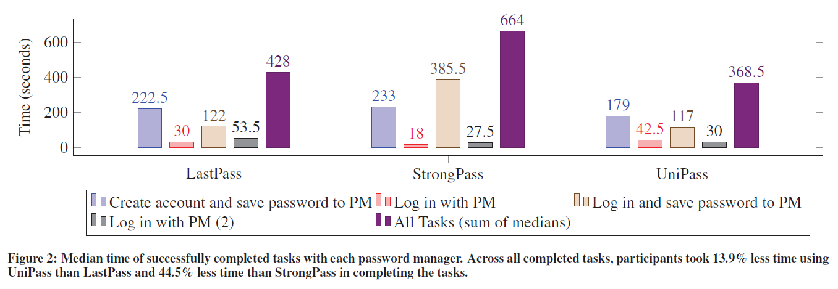
USER STUDY RESULTS
Task Completion Time

Slide 19
USER STUDY RESULTS
Ease of Use
Some participants liked having passwords on their phone for convenience (StrongPass and UniPass).
P1 preferred UniPass and mentioned the accessibility of device paring.
P10 liked UniPass because of the ease of fingerprint scanning. However, he was also concerned about switching to another device.

Slide 20
USER STUDY RESULTS
Perceived Security
Most uses agree UniPass is secure because the credentials are stored locally on the phone or because of the use of fingerprint.
However, P5 felt phones are not secure and thus preferred LastPass.

Slide 21
USER STUDY RESULTS
Suggestions for UniPass
A bigger scanner to read the fingerprint on the phone.
When screen readers were not used on the phone and on the computer?

Slide 22
USER STUDY RESULTS
Comparative Subjective Ratings of Password Managers
Name | Perceived Security | Comfort Level with Giving Control of Passwords | Perceived Ease of Use | Perceived Necessity and Acceptance | Perceived Accessibility
UniPass | Mean=3.72 SD=0.89 | Mean=2.63 SD=1.15 | Mean=3.95 SD=1.27 | Mean=4.08 SD=1.48 | Mean=4.22 SD=0.65
LastPass | Mean=3.70 SD=0.82 | Mean=2.0 SD=0.85 | Mean=3.38 SD=0.92 | Mean=3.57 SD=1.22 | Mean=4.40 SD=0.70
StrongPass | Mean=3.88 SD=1.46 | Mean=2.83 SD=1.27 | Mean=3.70 SD=0.82 | Mean=3.17 SD=1.17 | Mean=3.50 SD=1.07

Slide 23
USER STUDY RESULTS
Mental Models
For LastPass, participants could not describe how it works precisely or they did not have a good understanding about where their passwords were stored.
For StrongPass and UniPass, participants generally understood their passwords were stored locally in their devices.

Slide 24
我的想法
优点：
前期调研、User Study及分析充分
注重细节
对弱势群体的关怀
或许可以改进的地方：
全屏编码
去掉proxy server
指纹？

Slide 25
Thank you!

