Slide 1
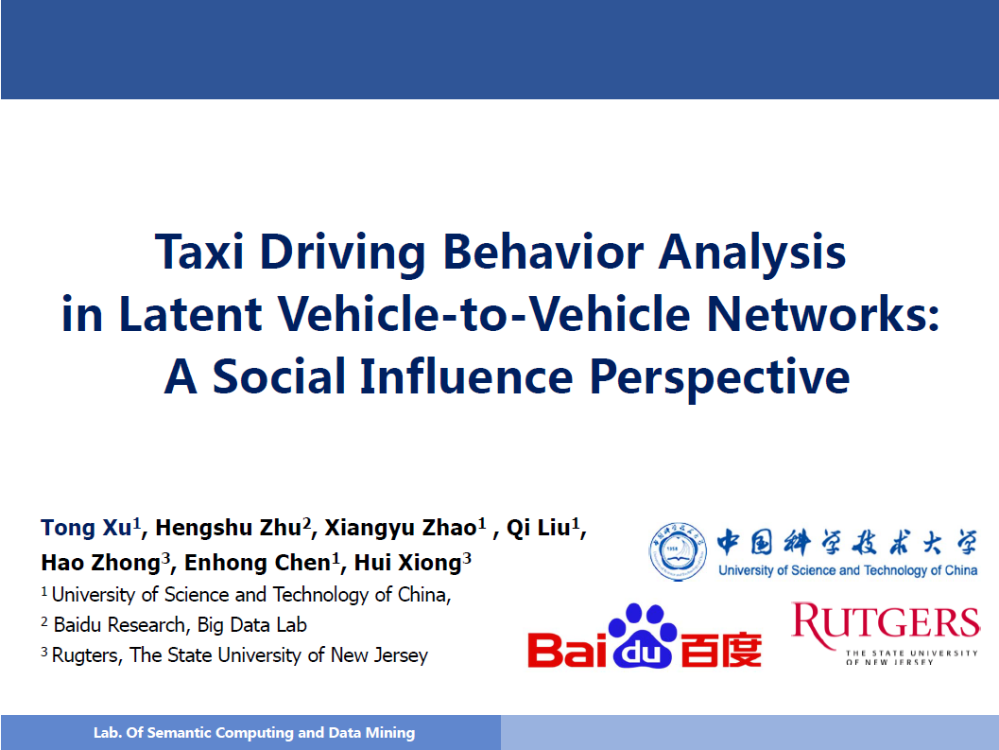

Slide 2
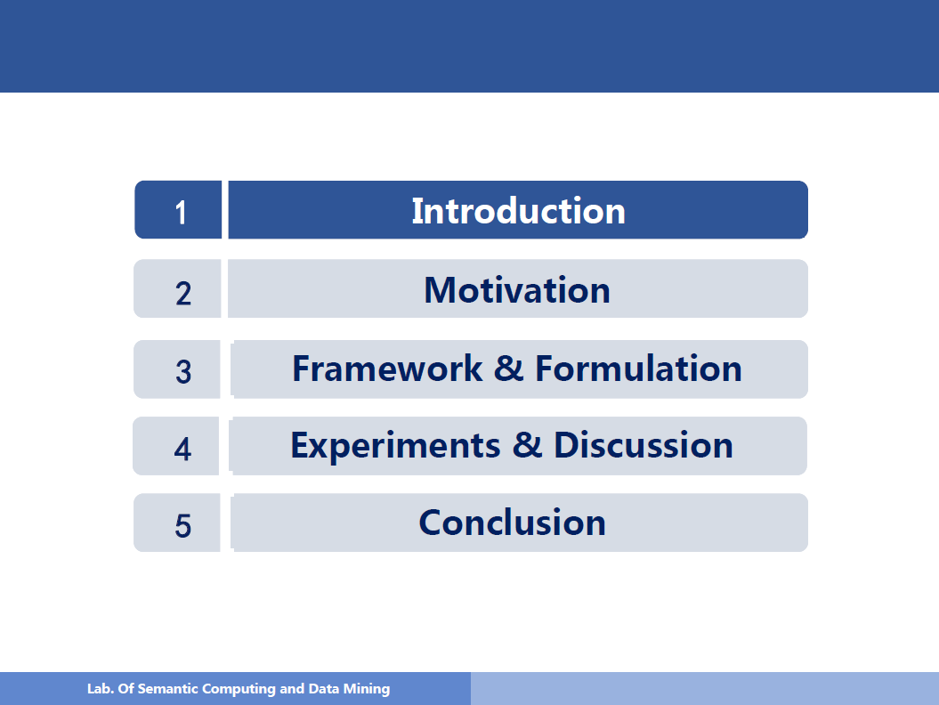

Slide 3
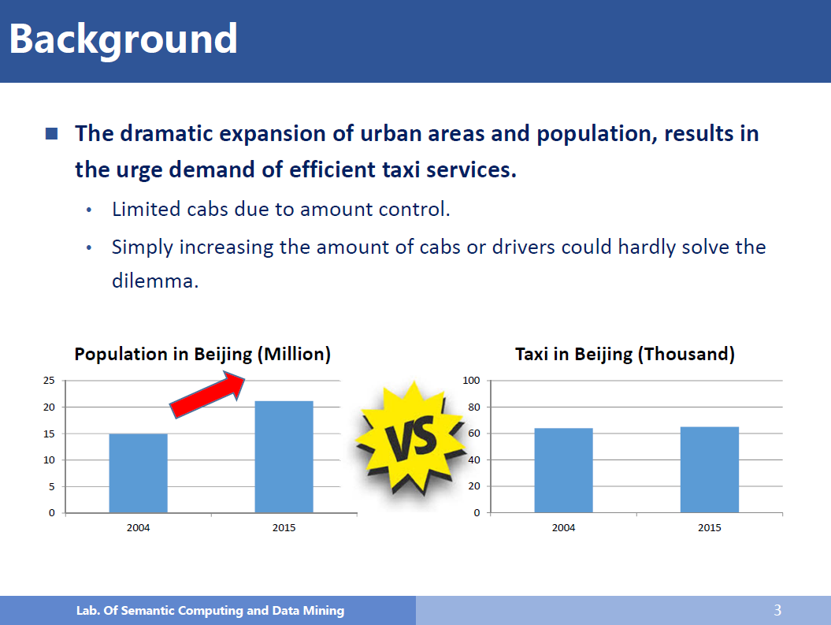

Slide 4
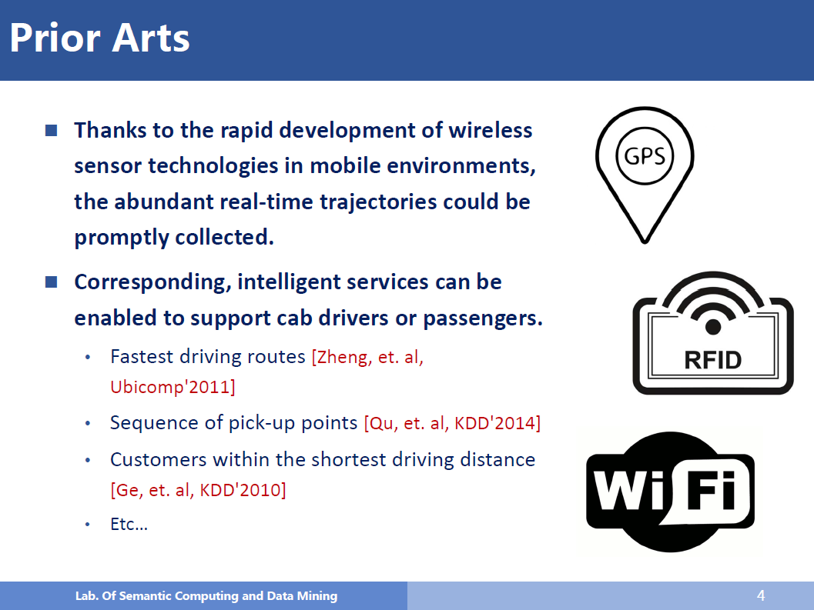

Slide 5
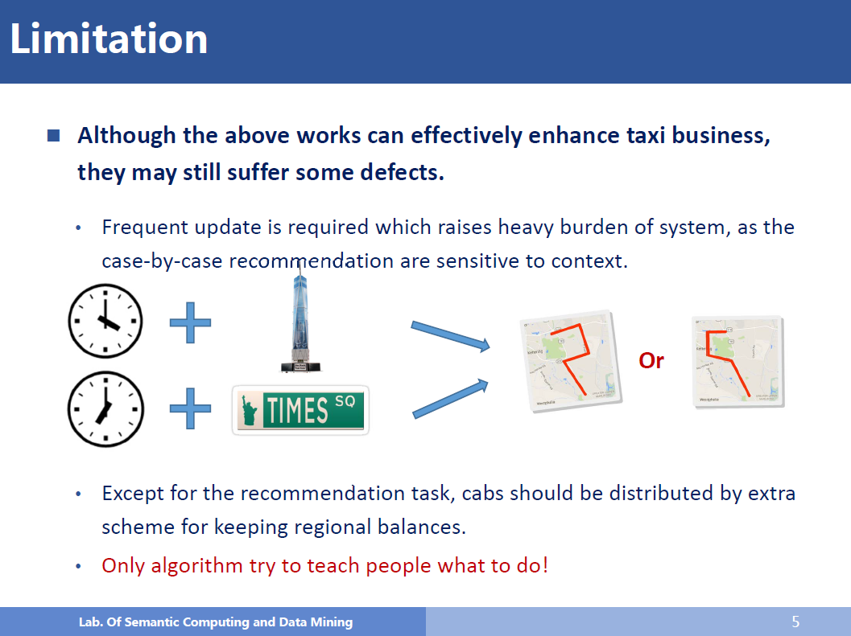

Slide 6
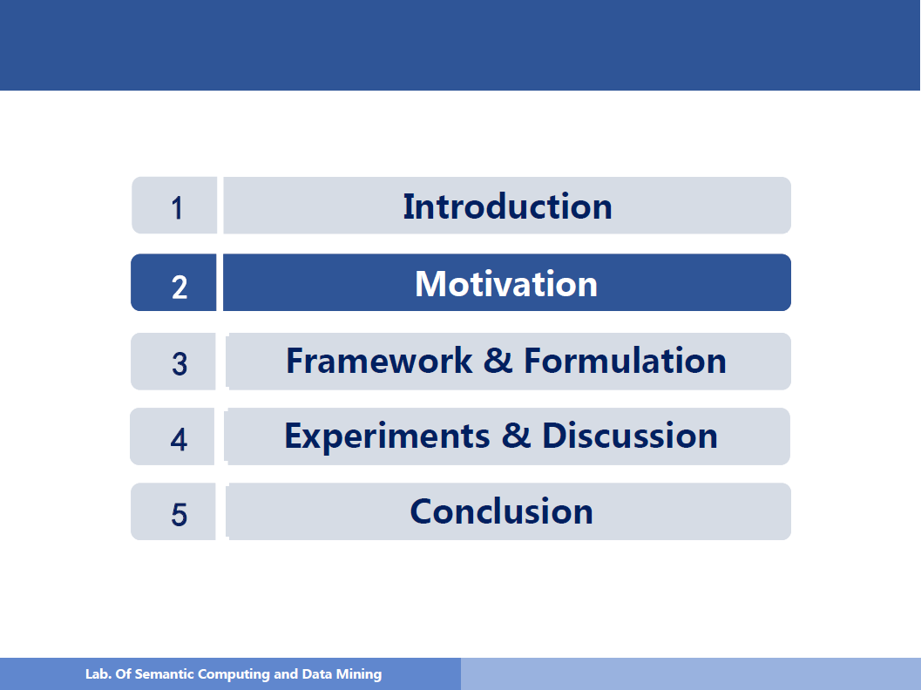

Slide 7
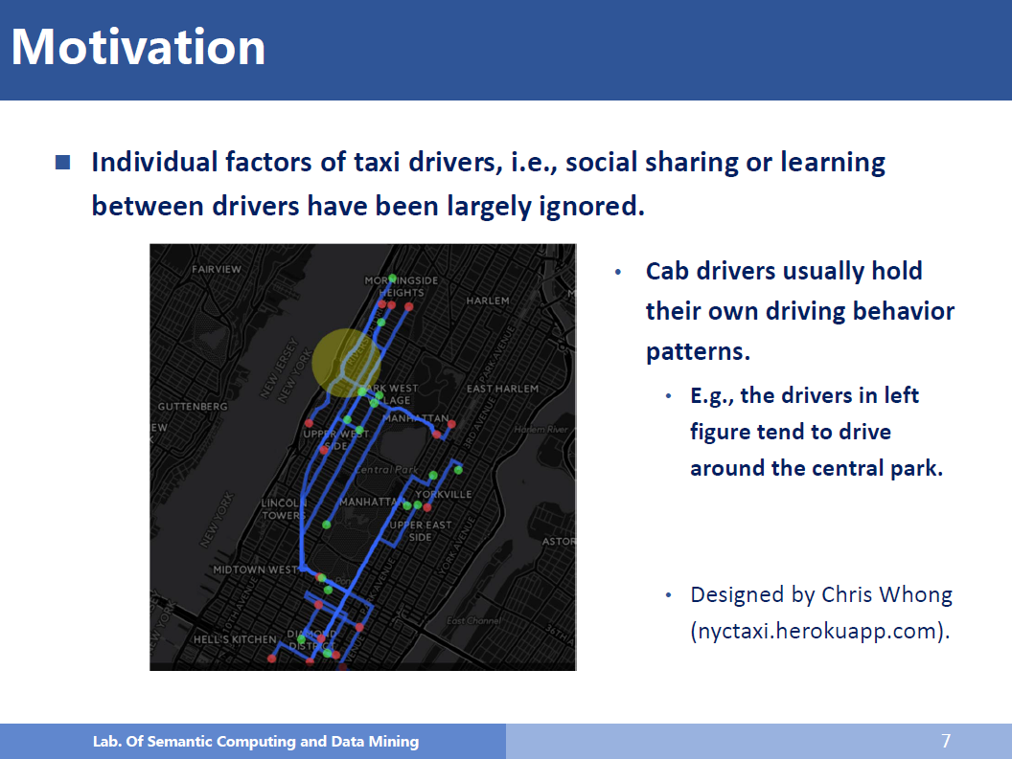

Slide 8
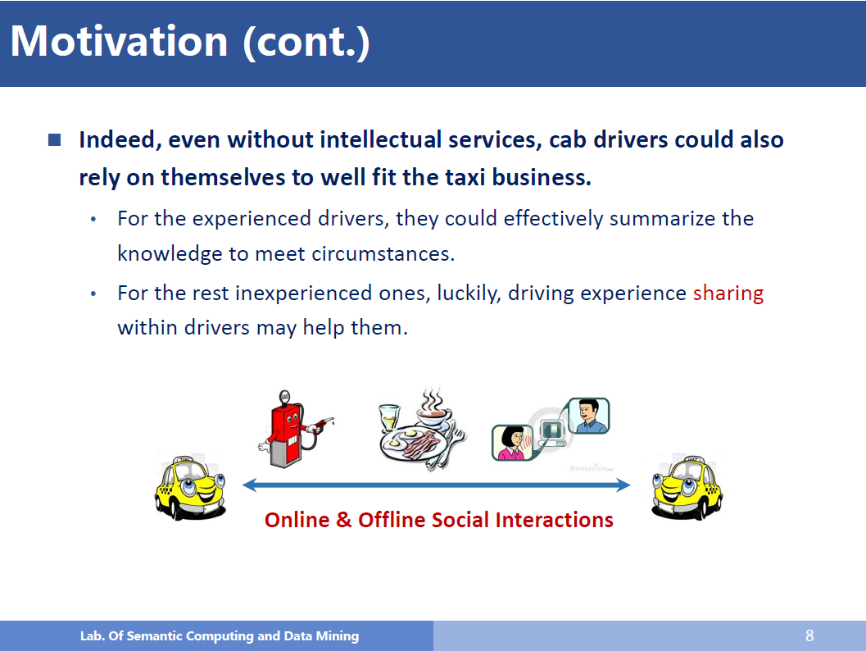

Slide 9
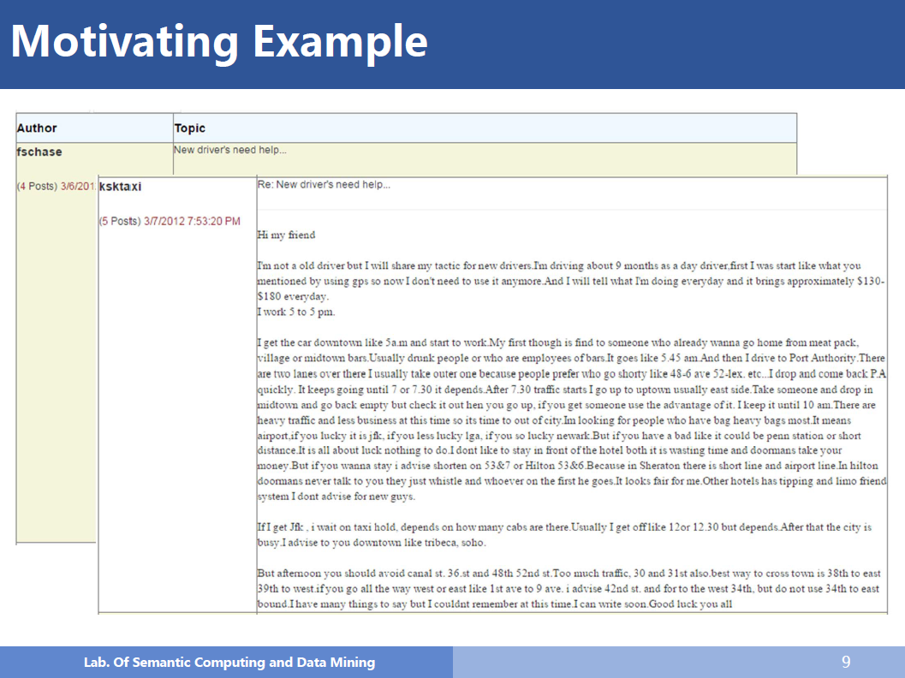

Slide 10
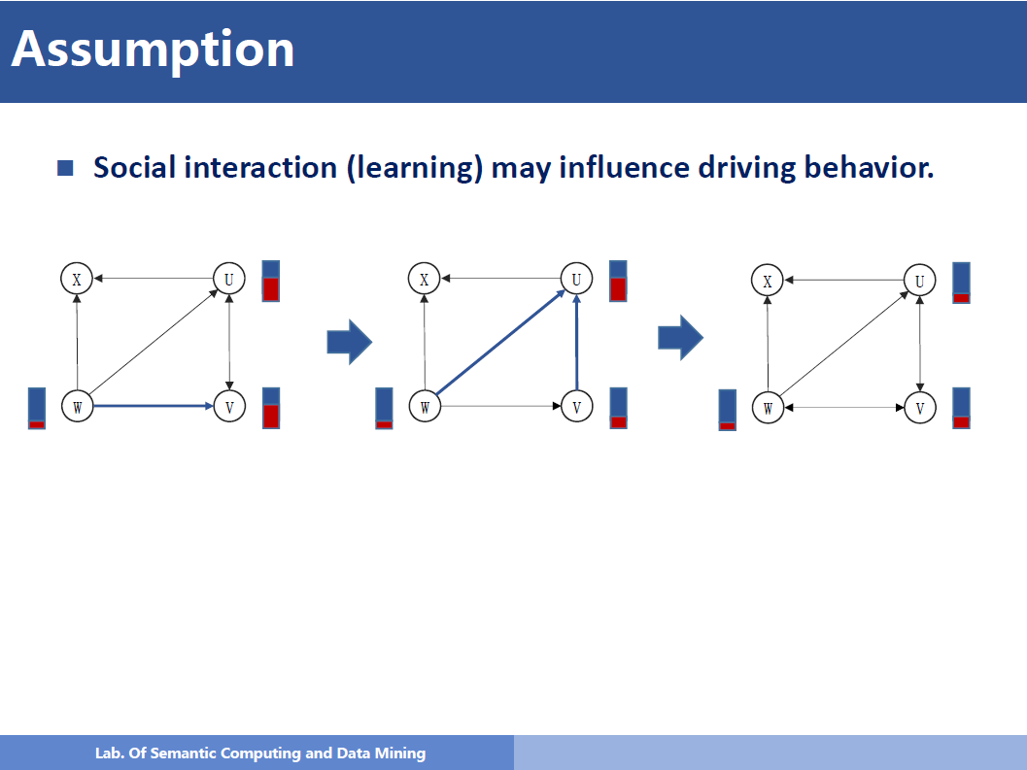

Slide 11
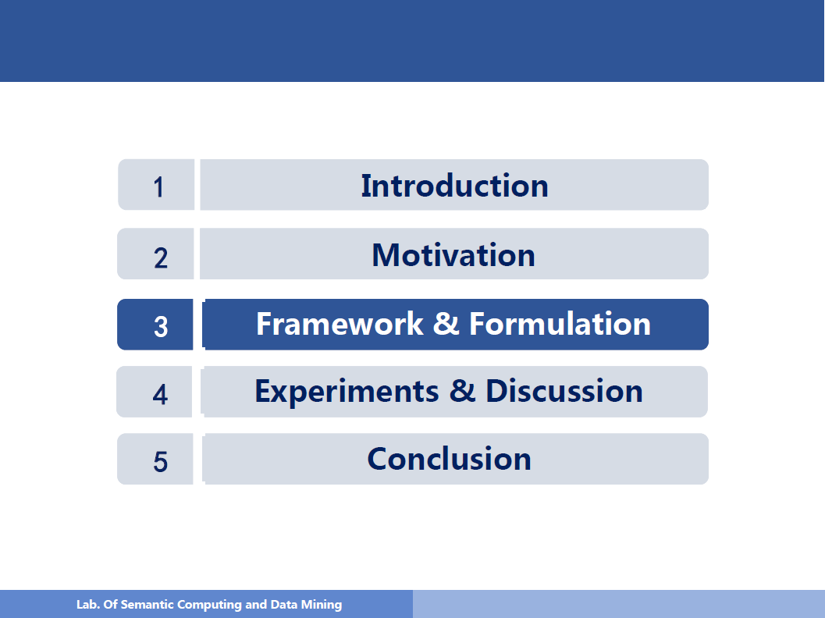

Slide 12
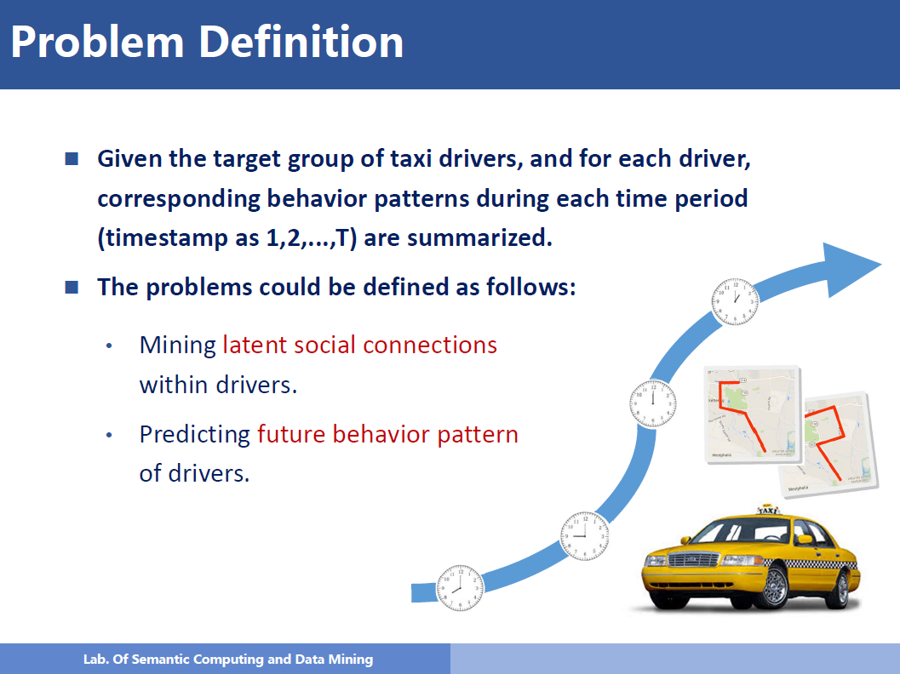

Slide 13
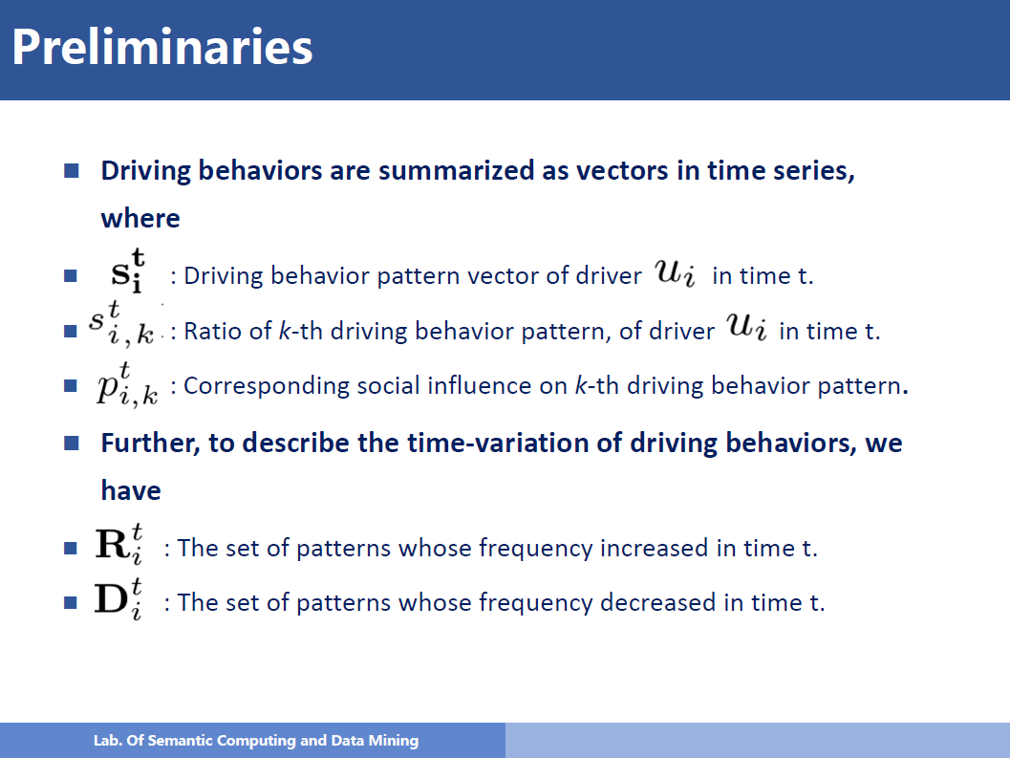

Slide 14
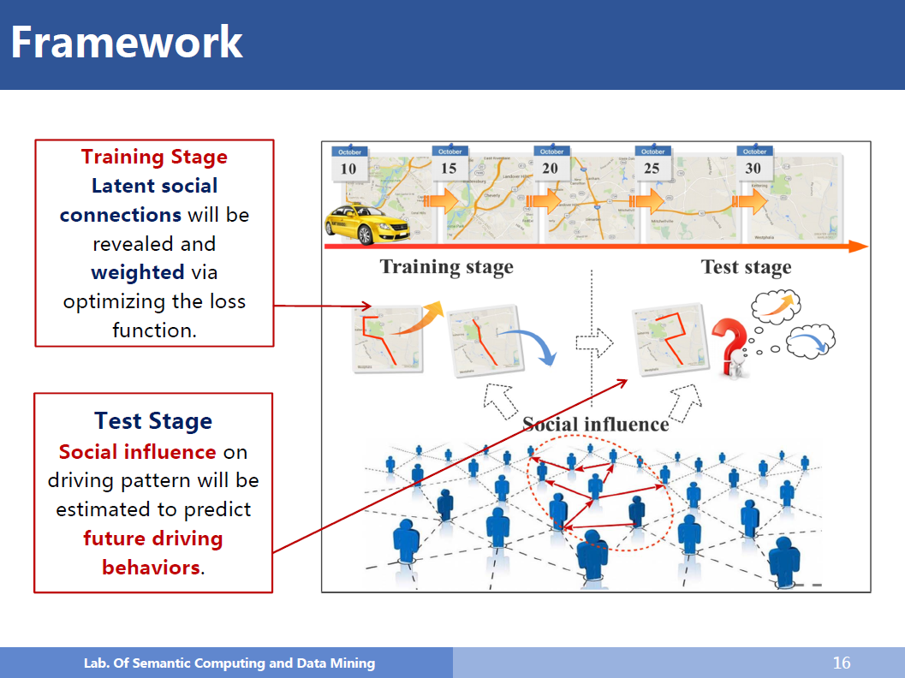

Slide 15

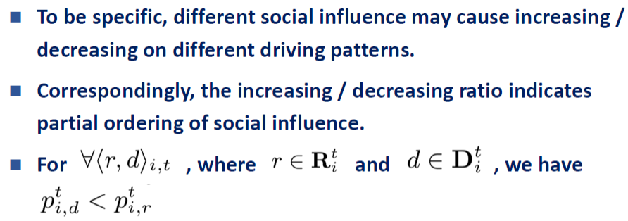
Two-stage Framework——Training Stage
Binary classfication
Binary classfication
Difficult to exactly estimate the value of
Ease the modeling: predicting whether will increase or decrease in the T + 1 round
Partial Ranking

Slide 16
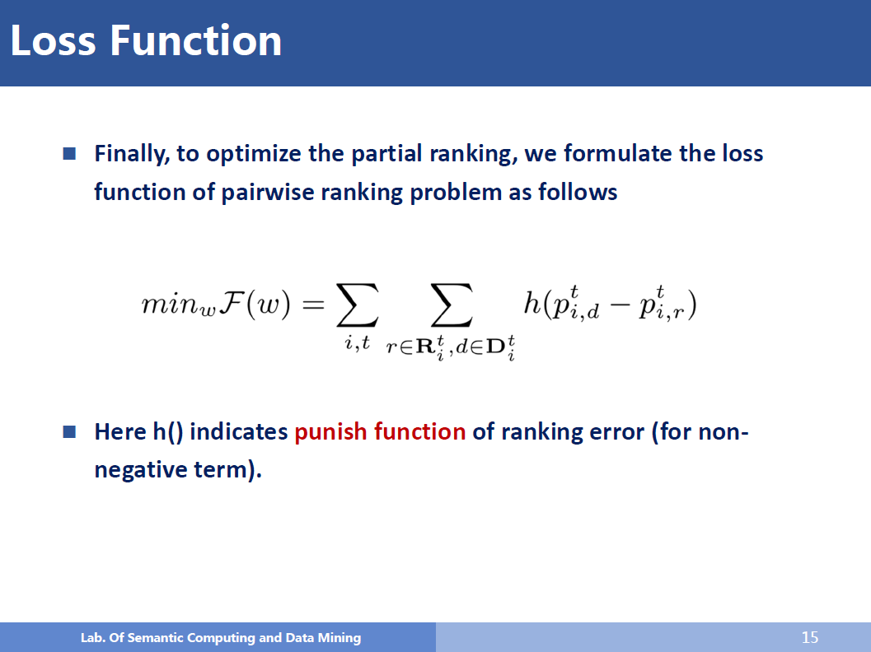

Slide 17
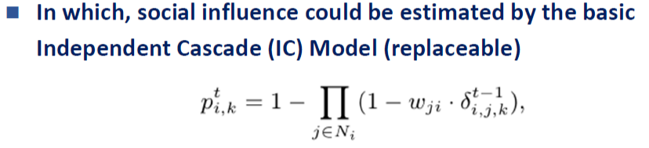


Two-stage Framework——Test Stage
In each round, all the nodes attempt influence their neighbors
The influence be measured by strength of social connections and their activating probabilities

Slide 18
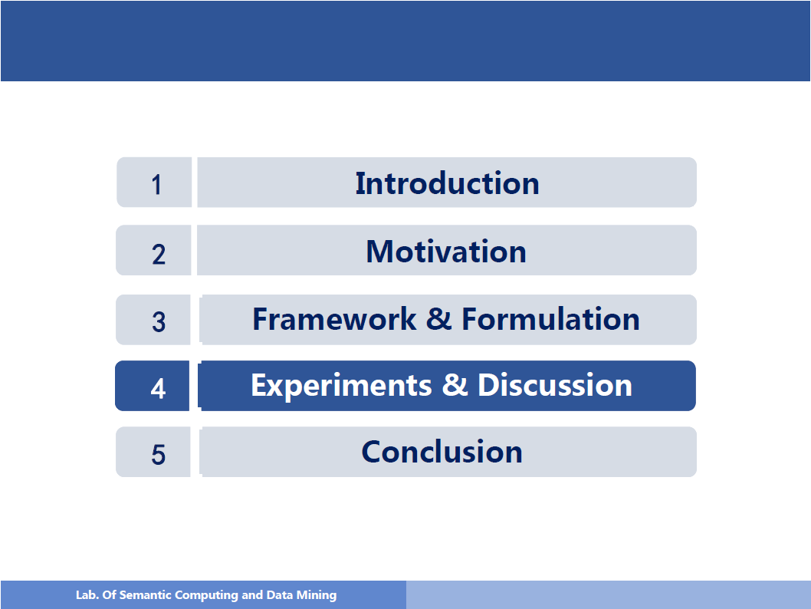

Slide 19
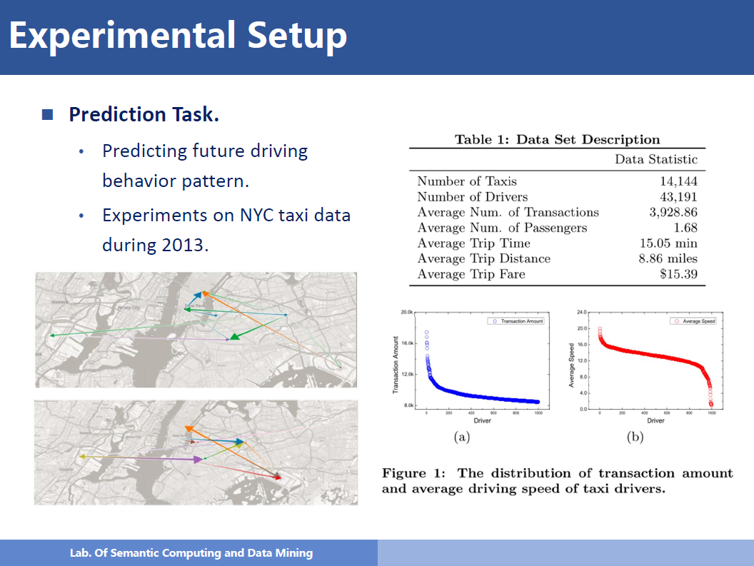

Slide 20
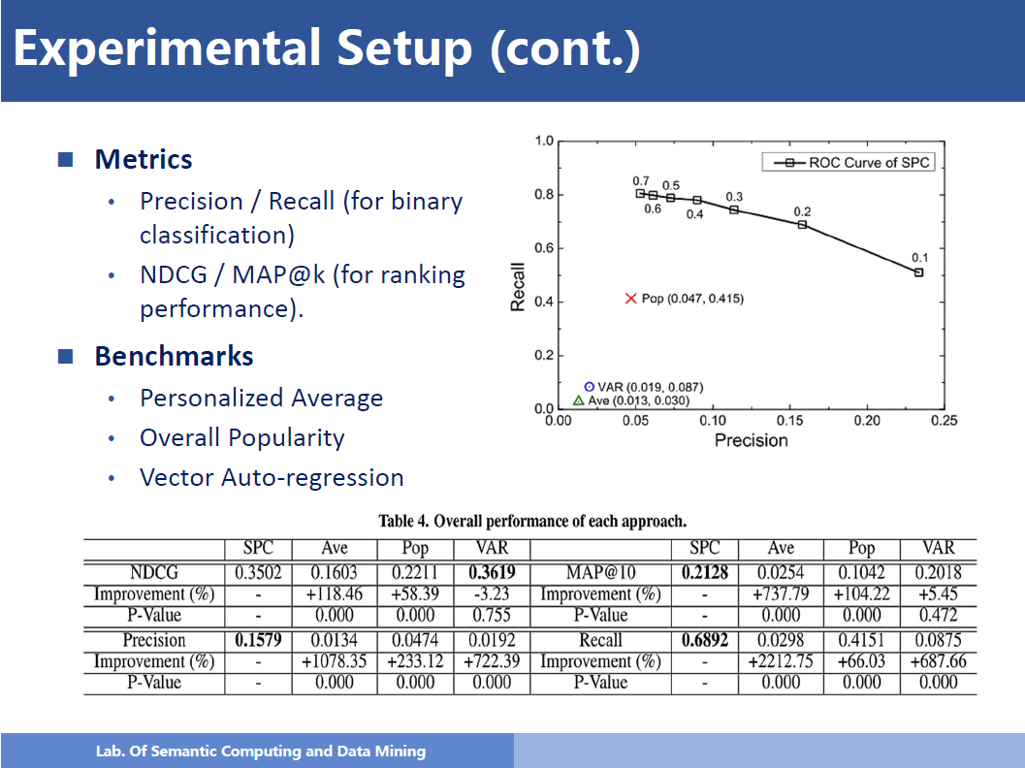

Slide 21
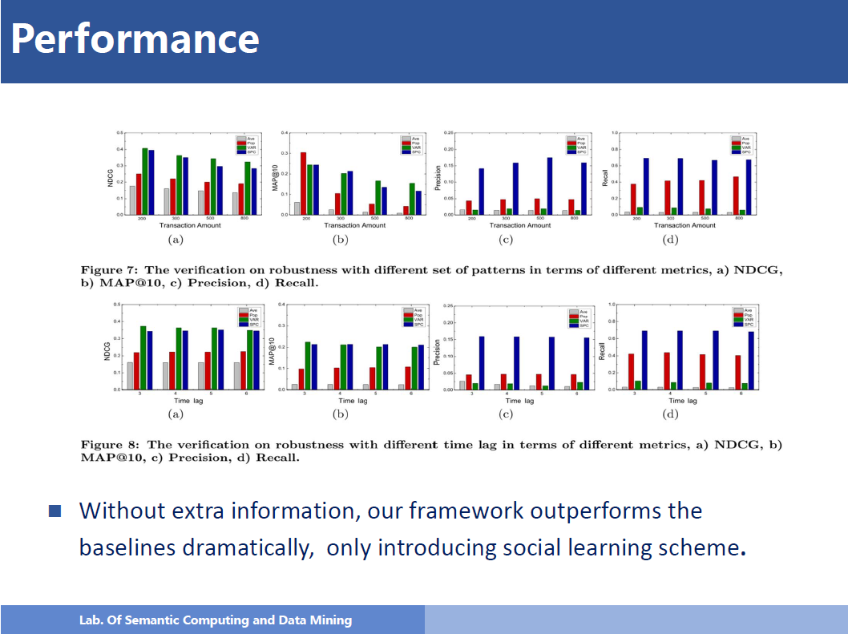

Slide 22
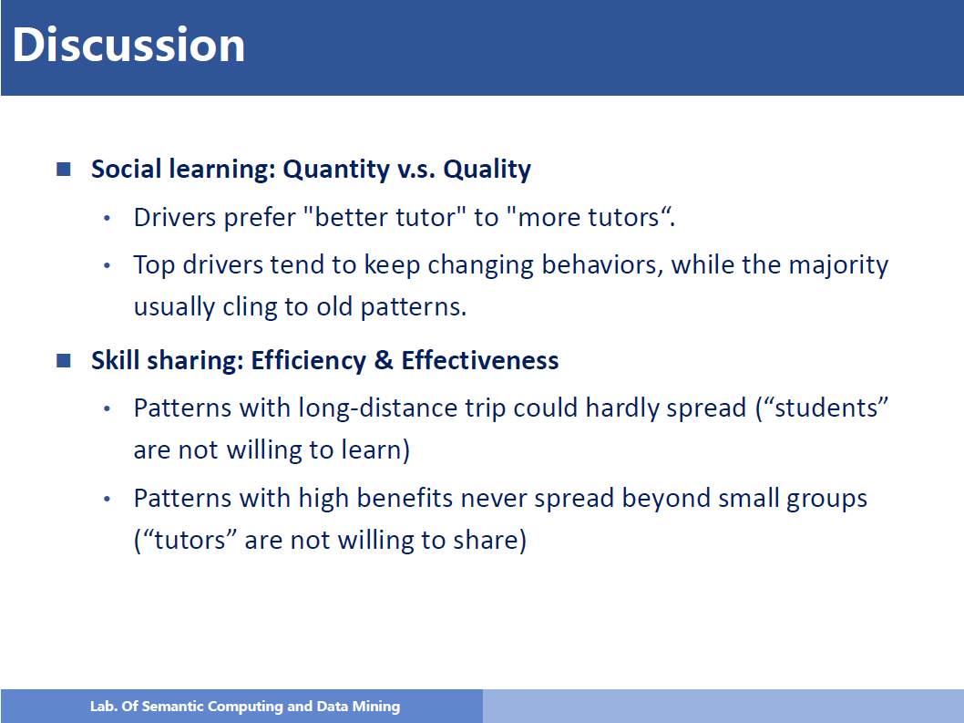

Slide 23
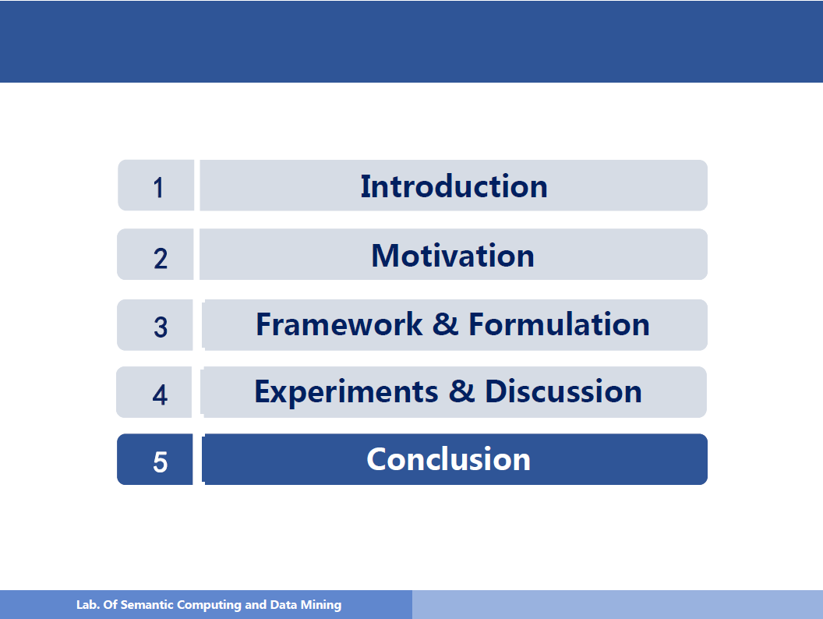

Slide 24
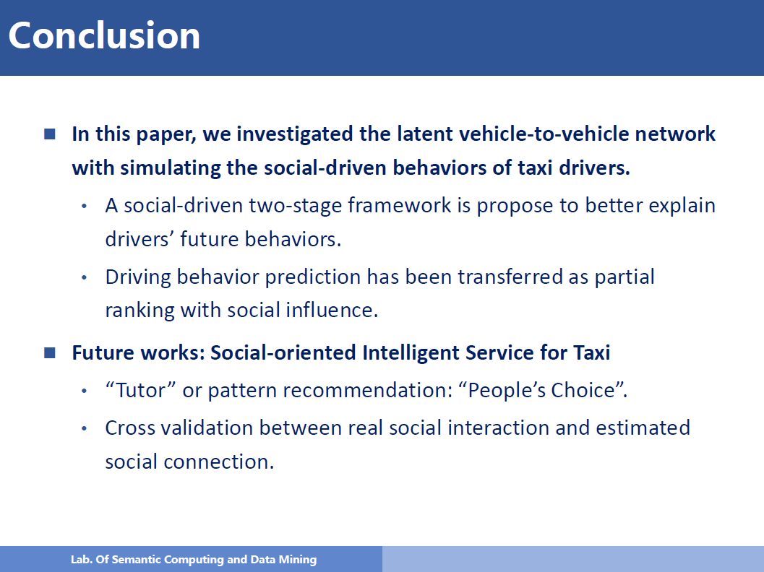

Slide 25
My Opinion
Problem
The assumption itself
Ignore other factors
No practice use
Reason
The first
Formulate the social inﬂuence from diﬀerence patterns
Two-stage framework

Slide 26


