Slide 1
Finexus
Tracking Precise Motions of Multiple Fingertips Using Magnetic Sensing
CHI’16

Slide 2
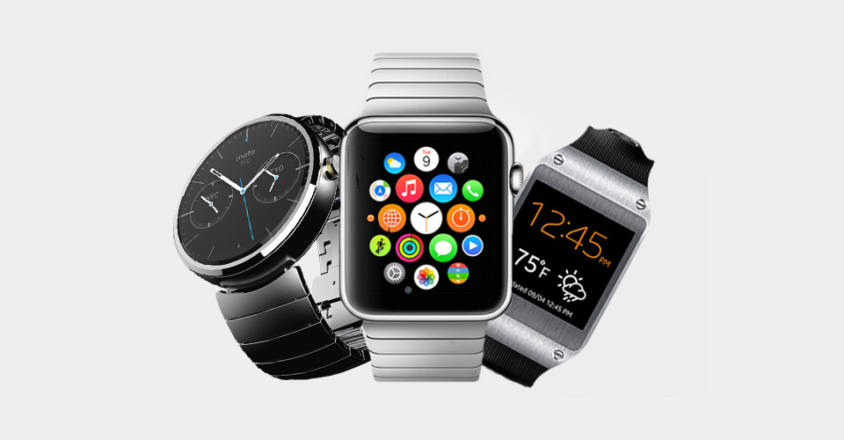
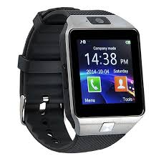
SmartWatch

Slide 3
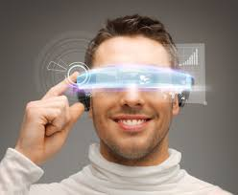
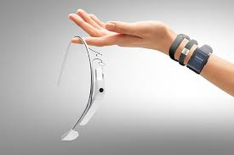
Wearables

Slide 4
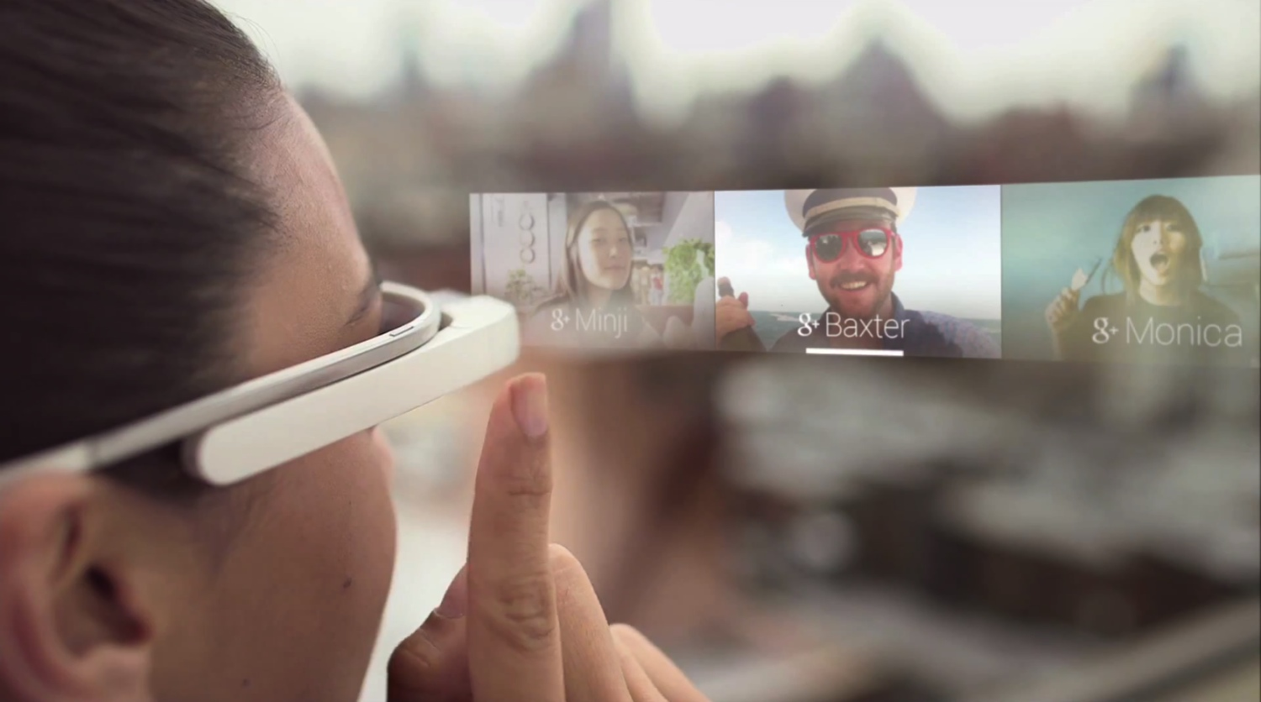
Limited Touch Area

Slide 5
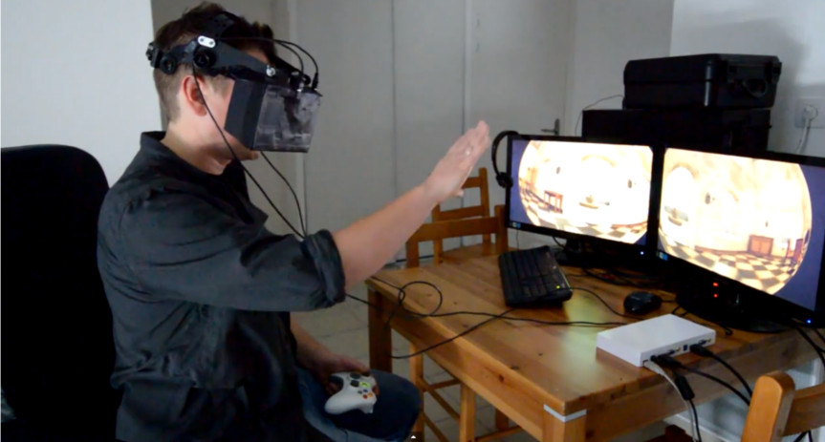
Head-mounted Display

Slide 6
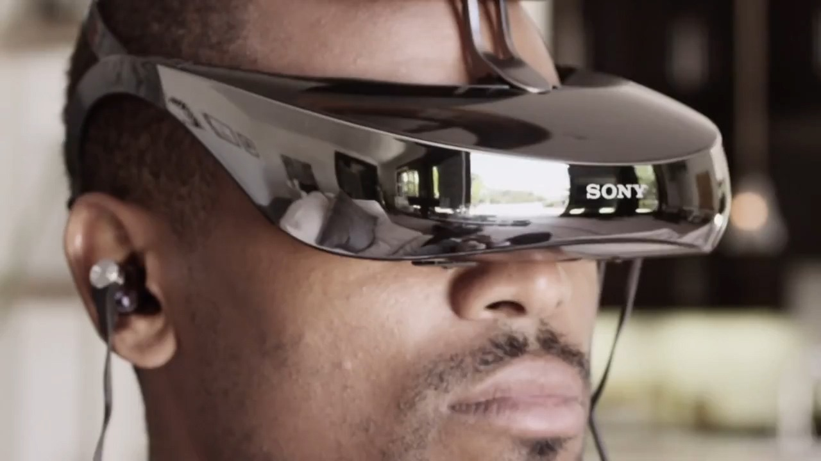
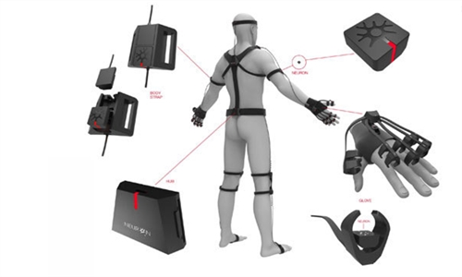
Existing Approach
Camera
Occlusion
IMU
Coarse hand motion

Slide 7
Magnetic-filed Sensing

Slide 8
Occlusion-free
Delicate Finger Motions in 3D

Slide 9
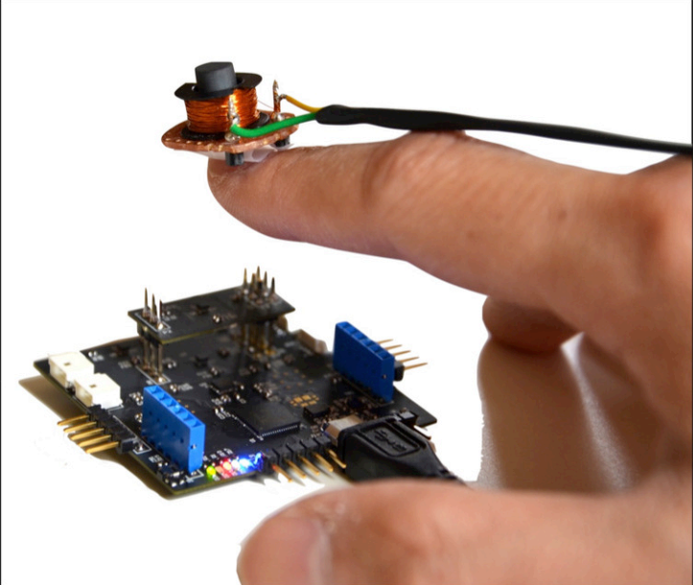
Tracking multiple fingertips
using magnetic-field sensing
3D-input

Slide 10
Electromagnet
Four Sensors
3D-input

Slide 11
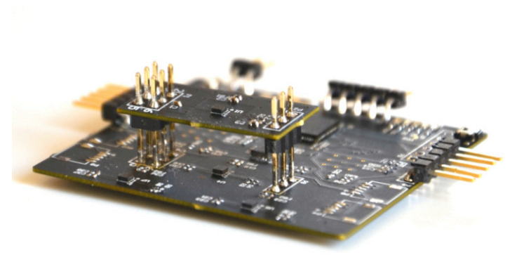
Localization Process
Similar to GPS
S4
S1
S2
S3

Slide 12
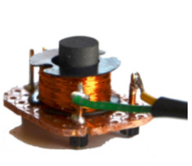
Localization Process
S4
S1
S2
S3

Slide 13
Localization Process
Step1: Magnetic Field -> Distance
S4
S1
S2
S3

Slide 14
Localization Process
Step2: Trilateration
S4
S1
S2
S3

Slide 15
How to get r from the magnetic field?

Slide 16
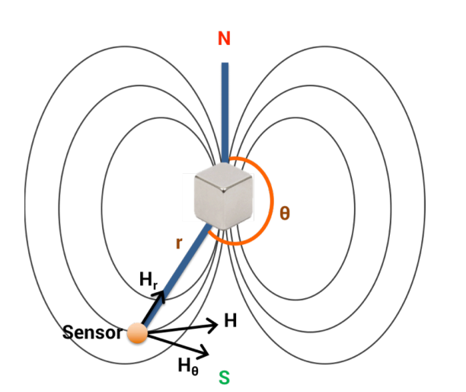
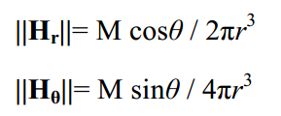
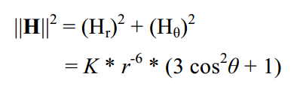

Slide 17

Beacon-based System
r
θ
S4
S1
S2
S3

Slide 18
Ambient Noise
The Earth Field
S4
S1
S2
S3
EMI

Slide 19
Ambient Noise
The Earth Field
S4
S1
S2
S3
EMI

Slide 20
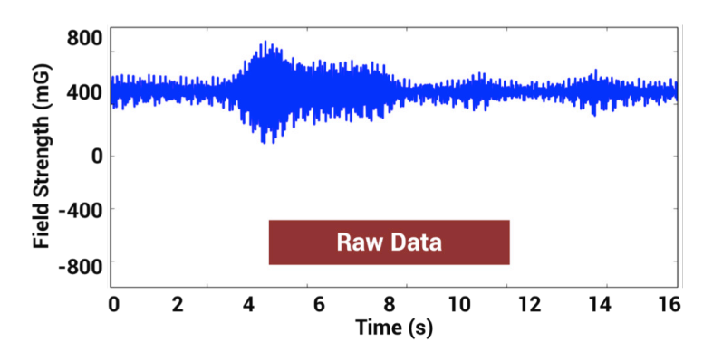
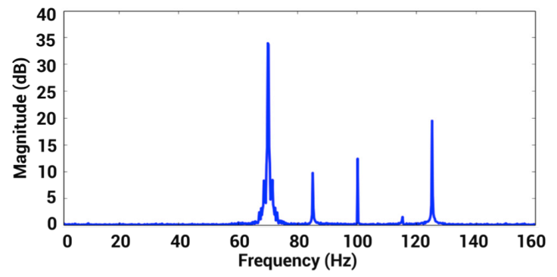
Tracking Multiple Fingertips
70Hz
85Hz
100Hz
115Hz
125Hz
useful
Earth Field(DC)

Slide 21
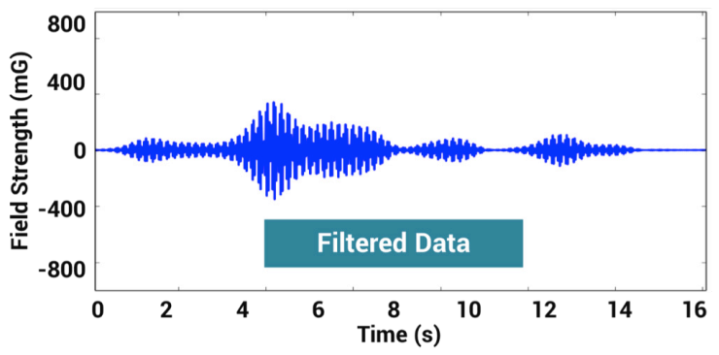
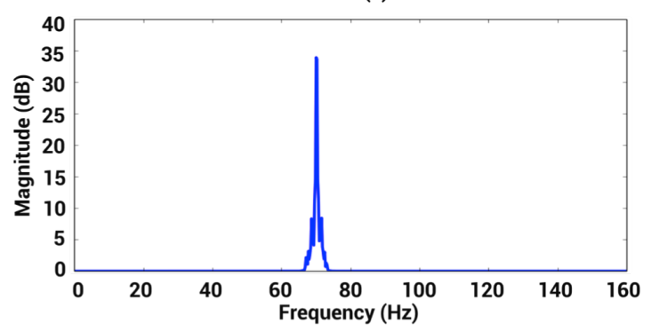
Tracking Multiple Fingertips
70Hz
85Hz
100Hz
115Hz
125Hz

Slide 22
Prototype

Slide 23
PCB Board
3 uC
(PSoC – CY8C5266LTI-LP150
4 Magnetometers
(450Hz, 14-bit)
S4
S1
S2
S3

Slide 24
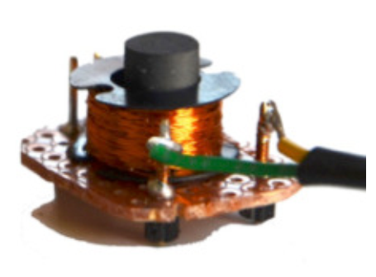
Electromagnets
Ferrite
0.25 cm²
300 turns

Slide 25
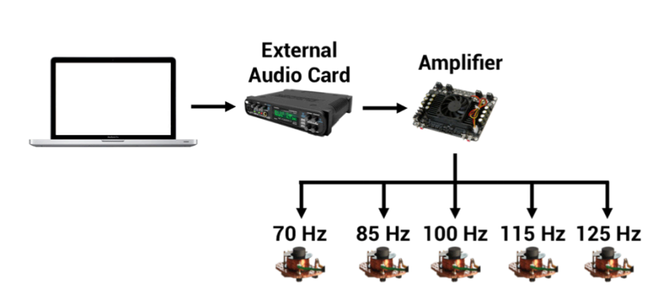
Driving Electromagnets
Avoid 60Hz & harmonics

Slide 26
Evaluation

Slide 27
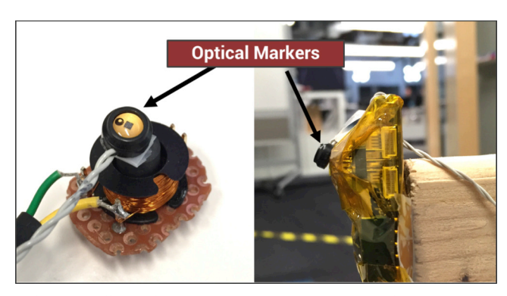
Ground Truth & Setup
Sensor

Slide 28
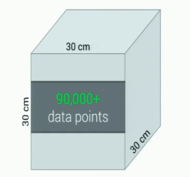
Data collection

Slide 29
Performance
Accuracy
1.33 mm (within 120 mm)
Computation Time

Slide 30
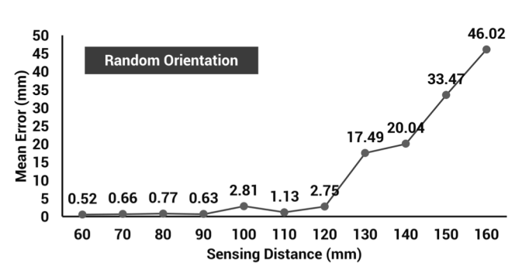
Performance

Slide 31
Performance
Accuracy
1.33 mm (within 120 mm)
Computation Time
2.07 ms (450Hz -> 2.22ms)

Slide 32
Future work

Slide 33
Future work
Smaller PCB
Smaller electromagnet
Better magnetometers (1kHz, 16bits)

Slide 34
Finexus is a 3D input device to track multiple fingertips using four sensors

