Slide 1

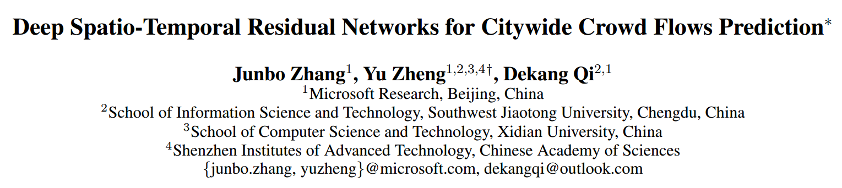
Presenter: Xu Wang

Slide 2
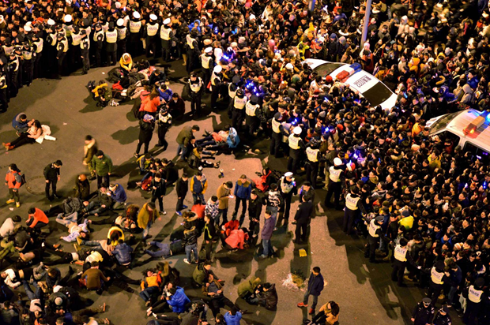
Background
Shanghai Stampede New Year Celebration 2015
Occupy Wall Street, Sep, 2014

Slide 3
Background
Important for:
  Traffic management
  Risk assessment
  Public safety

Slide 4
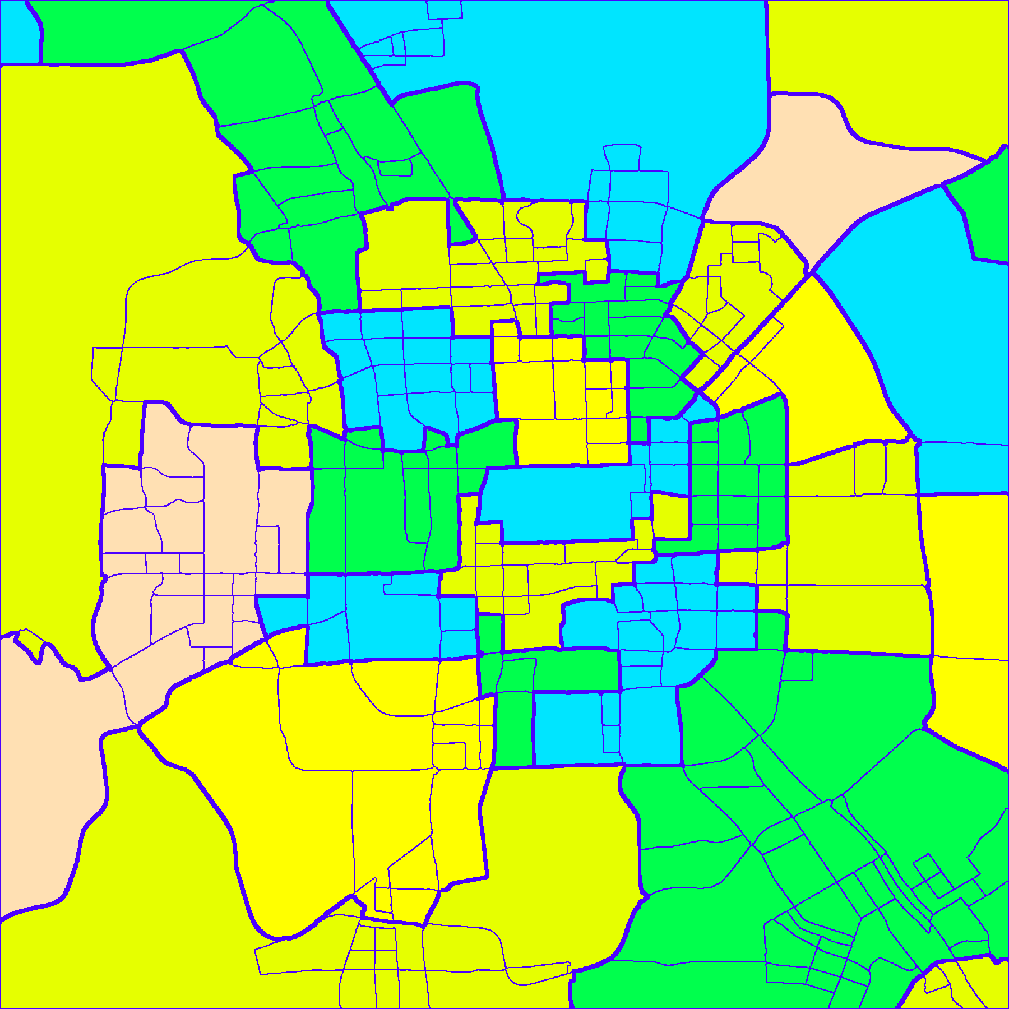
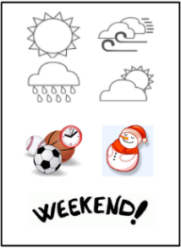
Challenges
Urban crowd flow depends on many factors
  Flows of previous time interval
  Flows of nearby regions and distant regions
  Weather, traffic control and events
Capturing spatial properties
  Spatial distance and hierarchy
Capturing temporal properties
  Temporal closeness
  Period and trend

Slide 5
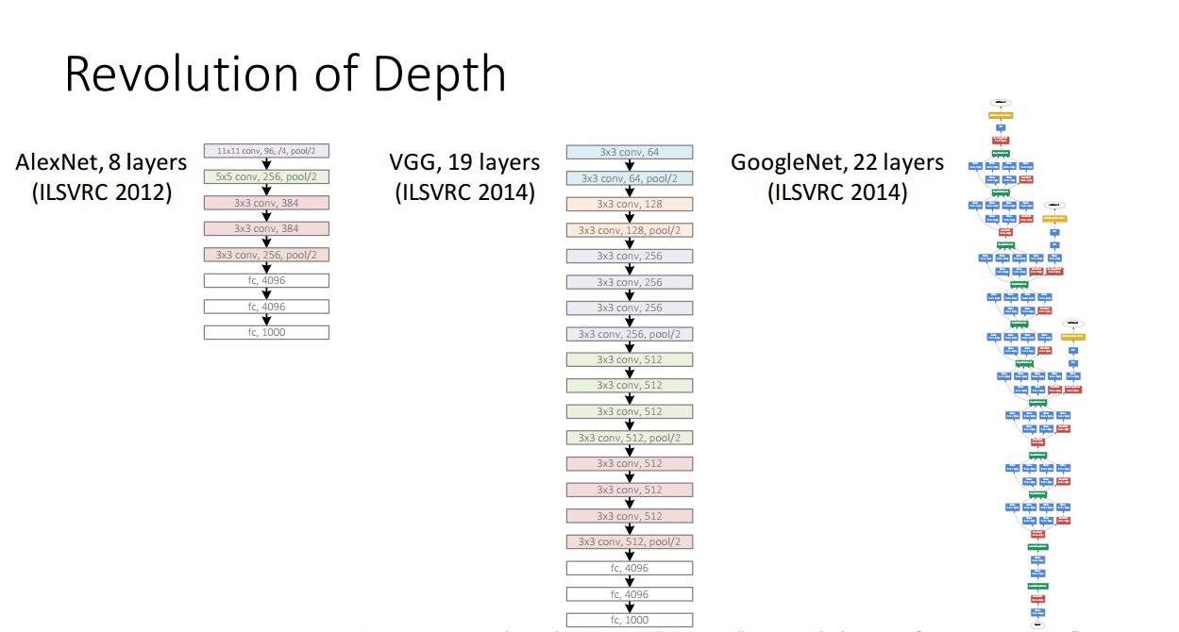

Slide 6
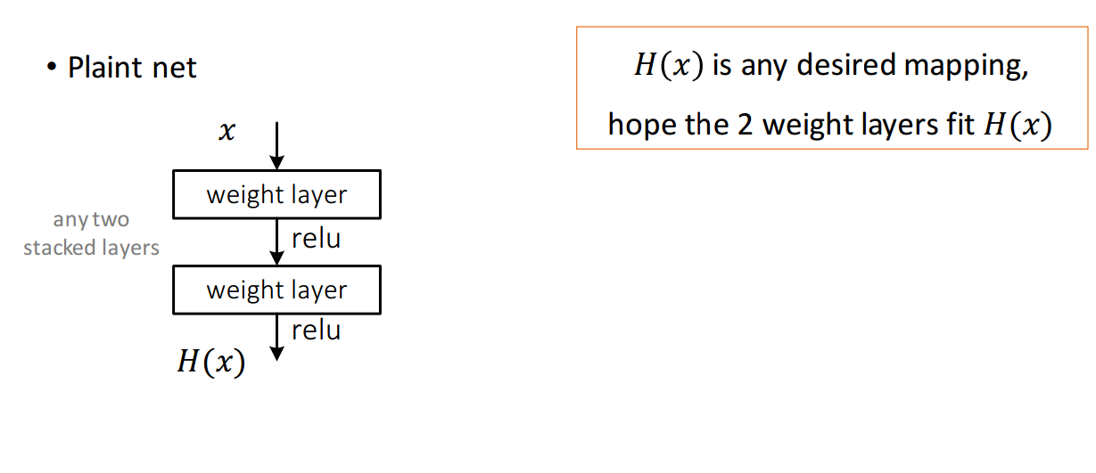

Slide 7
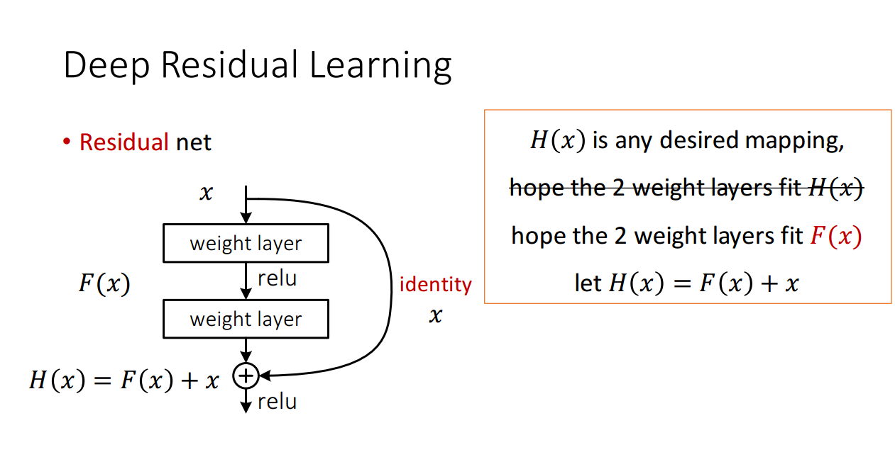

Slide 8
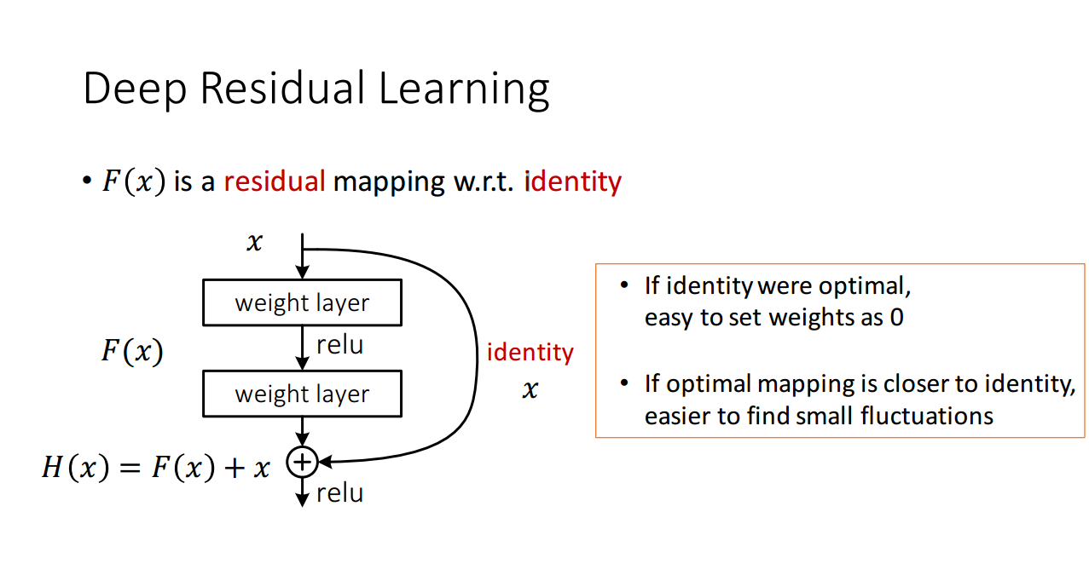

Why called residual neural network
$$F\left(x\right)=H\left(x\right)−x$$

Slide 9
Data Preprocessing
A region
Other regions
End-flow
End
Start
New-flow
Other regions

Slide 10
Crowd flow = closeness + period + trend
hour
day
week
No exactly decomposing but learning!

Slide 11
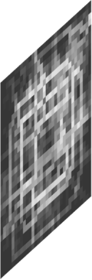
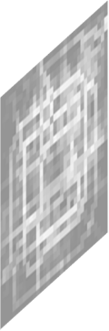

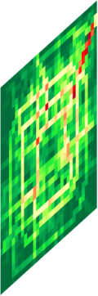
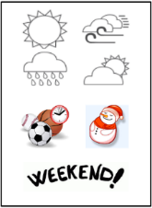
Converting Trajectories into Video-like Data
Trajectories

Slide 12
Why Deep Residual Learning
To capture the long spatial dependency, we need more deeper conv layers!

Slide 13
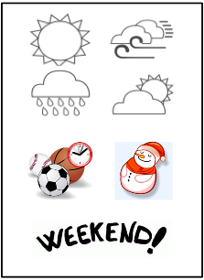
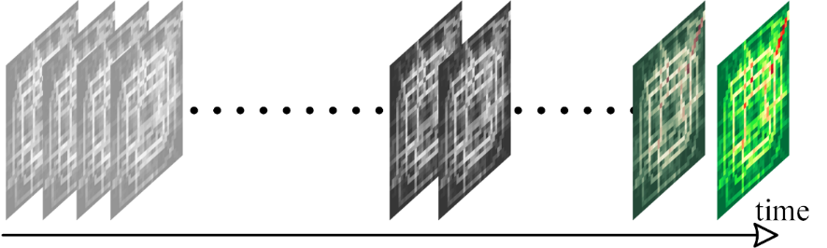
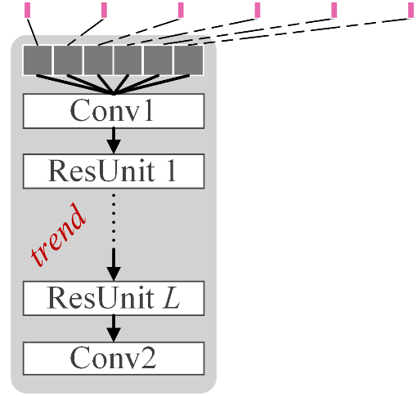
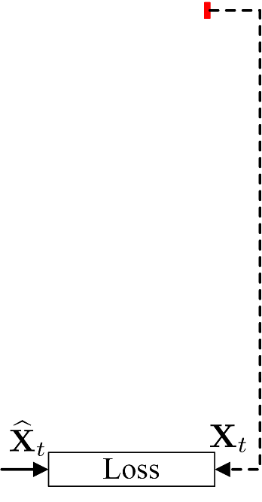
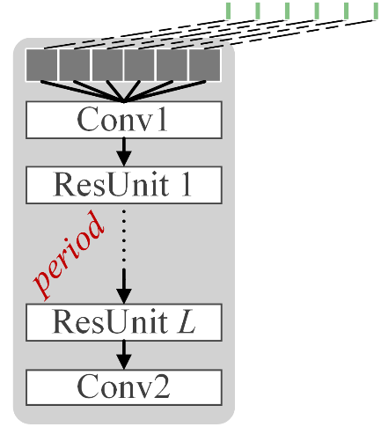
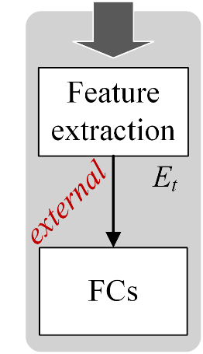
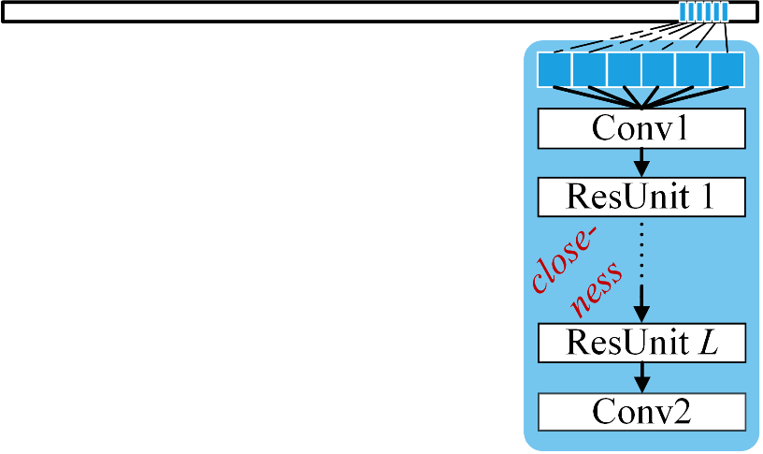
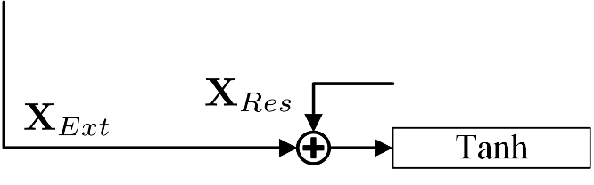
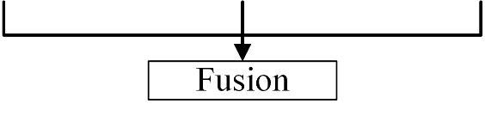
ST-ResNet Architecture: A Collective Prediction
distant
near
recent
Feature Extraction
Batch Normalization

Slide 14
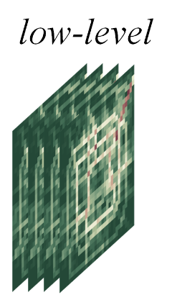
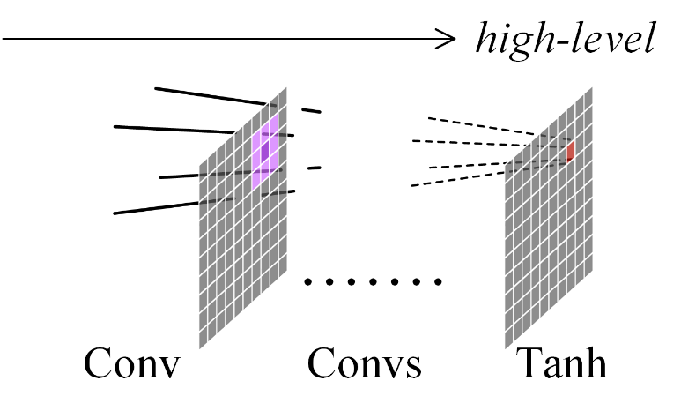
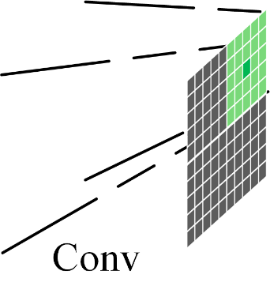
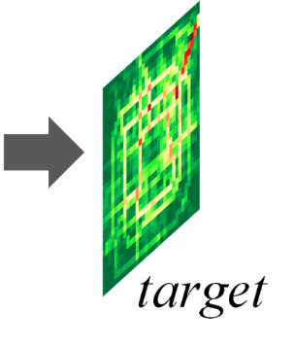
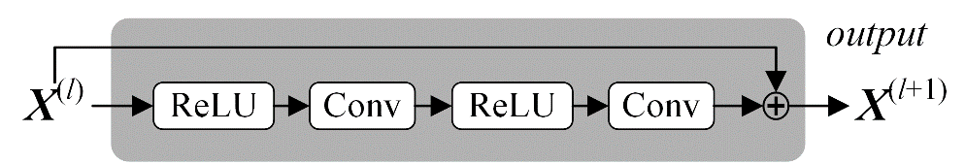
Residual Deep Convolutional Neural Network
Capturing spatial correlation of both near and far
Using residual network framework to help training

Slide 15
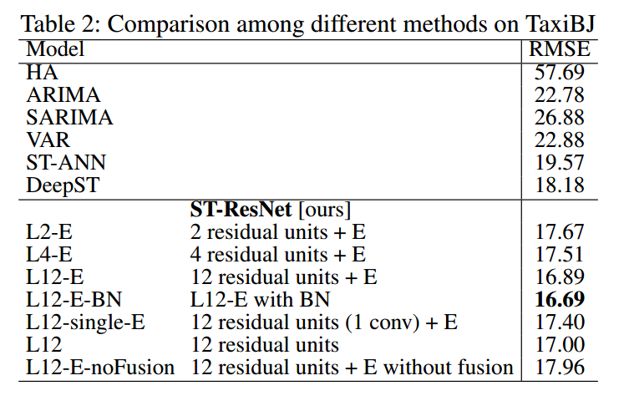
Evaluation
Conclusion:
more deeper, more better
Fusion is important
Batch normalization is effectiveness
External factors influence the result

Slide 16
Thanks!

